Slide 1
2.3 InterProcess Communication (IPC)
Part B

Slide 2
IPC methods
Signals
Mutex (MUTual EXclusion)
Semaphores
Shared memory
Memory mapped files
Pipes & named pipes
Sockets
Message queues
MPI (Message Passing Interface)
Barriers

Slide 3
Semaphores

Slide 4
(Bounded) Producer-Consumer
A producer produces some item and stores it in a warehouse.
A consumer consumes an item by removing an item from the warehouse.
Notes (rules):
  The producer must pause production if the warehouse fills up (bounded).
  If the warehouse is empty, the consumer must wait for something to be produced.

Slide 5
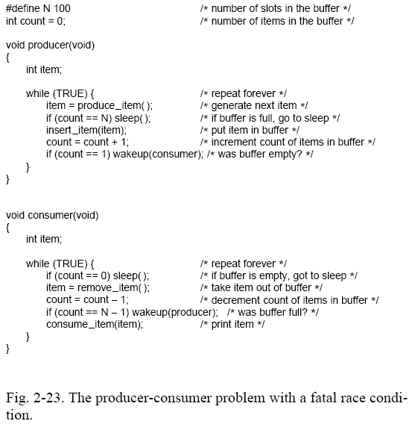
(Bounded) producer-consumer problem
Danger, Will Robinson (a shared variable)!

Slide 6
(Bounded) Producer-consumer problem
Buffer is initially empty.
Consumer checks count. It’s 0.
Scheduler interrupts consumer (puts consumer on ready queue).
Producer runs.
  Insert data into buffer.
  Count is 1 so producer wakes up consumer.
  But consumer is not asleep just yet! (The scheduler interrupted it right before the call to sleep().)
  Producer keeps inserting data into buffer until it’s full. Then producer goes to sleep!
Scheduler runs consumer. Consumer thinks count=0 so it goes to sleep!
Both sleep forever!

Slide 7
Semaphores
Invented by Dutch computer scientist Edsger Dijkstra.
Two basic operations:
  Up
    increments the value of the semaphore
    historically denoted as V (also known as signal)
  Down
    decrements the value of the semaphore
    P (also known as wait)

Slide 8
Semaphores
Types:
  POSIX
    Shared only among threads.
  Windows
    Can be system-wide.
  System V
    Can be shared according to user-group-other (can be system-wide).

Slide 9
Binary semaphores = mutex
Create semaphore and initialize it to 1.
  1 = unlocked
  0 = locked
Then to use this as a mutex:
  down
    c.s.
  up

Slide 10
POSIX SEMAPHORES

Slide 11
POSIX Semaphores (shared among threads only)
#include <semaphore.h>
int sem_init ( sem_t* sem, int pshared, unsigned int value );
int sem_wait ( sem_t* sem );
int sem_trywait ( sem_t* sem );
int sem_post ( sem_t* sem );
int sem_getvalue ( sem_t* sem, int* sval );
int sem_destroy ( sem_t* sem );

Slide 12
POSIX Semaphores
int sem_init ( sem_t* sem, int pshared, unsigned int value );
  initialize
  pshared must be 0 on (some versions of) Linux
    semaphore is not shared by processes
  Value is initial value for semaphore.

Slide 13
POSIX Semaphores
int sem_wait ( sem_t* sem );
  down (if possible/blocking)
int sem_trywait ( sem_t* sem );
  nonblocking down
Blocking?

Slide 14
POSIX Semaphores
int sem_post ( sem_t* sem );
  up (nonblocking)
int sem_getvalue ( sem_t* sem, int* sval );
  get the current semaphore value
int sem_destroy ( sem_t* sem );
  finish using the semaphore

Slide 15
WINDOWS SEMAPHORES

Slide 16
Windows Semaphores
HANDLE WINAPI CreateSemaphore (
__in_opt LPSECURITY_ATTRIBUTES lpSemaphoreAttributes,
__in LONG lInitialCount,
__in LONG lMaximumCount,
__in_opt LPCTSTR lpName
);
DWORD WINAPI WaitForSingleObject (
__in HANDLE hHandle,
__in DWORD dwMilliseconds
); //decrements count by 1
BOOL WINAPI ReleaseSemaphore (
__in HANDLE hSemaphore,
__in LONG lReleaseCount,
__out_opt LPLONG lpPreviousCount
); //increments count by lReleaseCount
BOOL WINAPI CloseHandle (
__in HANDLE hObject
);

Slide 17
SYSTEM V SEMAPHORES

Slide 18
System V Semaphores (system-wide)
#include <sys/types.h>
#include <sys/ipc.h>
#include <sys/sem.h>
int semget ( key_t key, int nsems, int semflg );
  create/access existing
int semctl ( int semid, int semnum, int cmd, ... );
  delete from system
int semop ( int semid, struct sembuf* sops, unsigned nsops );
  used for up and down

Slide 19
Create/access existing
//using the key, get the semaphore id
const int sid = semget( mySemKey, 1, IPC_CREAT | 0700 );
if (sid==-1) {
perror( "semget " );
exit( -1 );
}
printf( "sem id=%d \n", sid );
create if necessary
system-wide unique number
system-wide permissions
(In C/C++, octal values start with 0.)

Slide 20
Create/access existing
//using the key, get the semaphore id
const int sid = semget( mySemKey, 1, IPC_CREAT | 0700 );
alternative (#include <sys/stat.h>):
const int sid = semget( mySemKey, 1, IPC_CREAT | S_IRUSR | S_IWUSR | S_IRGRP | S_IWGRP | S_IROTH | S_IWOTH );
create if necessary
system-wide permissions
(In C/C++, octal values start with 0.)

Slide 21
Access and delete
//using the key, get the semaphore id
const int sid = semget( mySemKey, 1, 0700 );
if (sid==-1) {
perror( "semget " );
exit( -1 );
}
printf( "sem id=%d \n", sid );
//delete the semaphore
semctl( sid, 0, IPC_RMID, 0 );

Slide 22
Down function
static void down ( const int whichSid ) {
struct sembuf sem_lock;
sem_lock.sem_num = 0; //semaphore number: 0 = first
sem_lock.sem_op = -1; //semaphore operation
sem_lock.sem_flg = 0; //operation flags
if (semop(whichSid, &sem_lock, 1) == -1) {
perror("semop ");
exit(-1);
}
}

Slide 23
Up function
static void up ( const int whichSid ) {
struct sembuf sem_unlock;
sem_unlock.sem_num = 0; //semaphore number: 0 = first
sem_unlock.sem_op = 1; //semaphore operation
sem_unlock.sem_flg = 0; //operation flags
if (semop(whichSid, &sem_unlock, 1) == -1) {
perror("semop");
exit(-1);
}
}

Slide 24
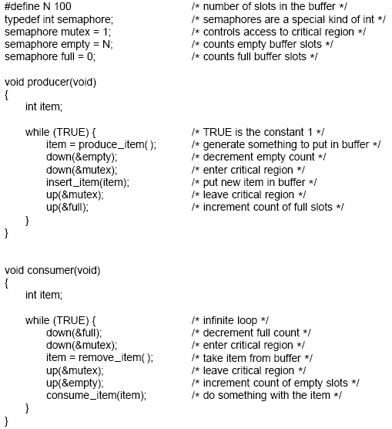
Note: 3 semaphores (one used as mutex)!
Solution to (bounded) producer-consumer problem using semaphores (via up() and down()).

Slide 25
(BOUNDED) PRODUCER-CONSUMER DEMO
bounded.h,
boundedProducer.cpp,
boundedConsumer.cpp

Slide 26
UNBOUNDED PRODUCER-CONSUMER

Slide 27
(Unbounded) producer-consumer
Every time the producer process runs, it produces one item.
Every time the consumer runs, it consumes one item (or waits until one is available, and then consumes it).

Slide 28
//unbounded producer
int main ( int argc, char* argv[] ) {
//using the key, get the semaphore id
const int sid = semget( mySemKey, 1, IPC_CREAT | 0700 );
if (sid==-1) {
perror( "semget " );
exit( -1 );
}
printf( "sem id=%d \n", sid );
puts( "producing" );
struct sembuf sem_unlock;
sem_unlock.sem_num = 0; //semaphore number: 0 = first
sem_unlock.sem_op = 1; //semaphore operation
sem_unlock.sem_flg = 0; //operation flags
if (semop(sid, &sem_unlock, 1) == -1) {
perror("semop ");
exit(-1);
}
puts( "produced" );
return 0;
}
Unbounded producer basically does an up() to indicate production.

Slide 29
//consumer
int main ( int argc, char* argv[] ) {
//using the key, get the semaphore id
const int sid = semget( mySemKey, 1, IPC_CREAT | 0700 );
if (sid==-1) {
perror( "semget " );
exit( -1 );
}
printf( "sem id=%d \n", sid );
puts( "consuming" );
struct sembuf sem_lock;
sem_lock.sem_num = 0; //semaphore number: 0 = first
sem_lock.sem_op = -1; //semaphore operation
sem_lock.sem_flg = 0; //operation flags
if (semop(sid, &sem_lock, 1) == -1) {
perror("semop ");
exit(-1);
}
puts( "consumed" );
return 0;
}
Consumer basically does a down() to indicate consumption.

Slide 30
(UNBOUNDED) PRODUCER-CONSUMER DEMO
mySemKey.h,
producer.cpp, consumerWait.cpp, consumerNoWait.cpp, bigProducer.cpp,
delete.cpp

Slide 31
Shared Memory

Slide 32
Shared memory (Linux/Unix)
Shared memory operations
  shmget
    allocates a shared memory segment
  shmctl
    allows the user to receive information on a shared memory segment, set the owner, group, and permissions of a shared memory segment, or destroy a segment

Slide 33
Shared memory
Shared memory operations
  shmat
    attaches the shared memory segment (identified by shmid) to the address space of the calling process
  shmdt
    detaches the shared memory segment (located at the address specified by shmaddr) from the address space of the calling process

Slide 34
Shared memory
From the Linux sem_init man page:
  The pshared argument indicates whether this semaphore is to be shared between the threads of a process, or between processes.
    If pshared has the value 0, then the semaphore is shared between the threads of a process, and should be located at some address that is visible to all threads (e.g., a global variable, or a variable allocated dynamically on the heap).
    If pshared is nonzero, then the semaphore is shared between processes, and should be located in a region of shared memory.

Slide 35
Memory mapped files

Slide 36
Memory mapped files
“There comes a time when you want to read and write to and from files so that the information is shared between processes. Think of it this way: two processes both open the same file and both read and write from it, thus sharing the information. The problem is, sometimes it's a pain to do all those fseek()s and stuff to get around. Wouldn't it be easier if you could just map a section of the file to memory, and get a pointer to it? Then you could simply use pointer arithmetic to get (and set) data in the file.
Well, this is exactly what a memory mapped file is. And it's really easy to use, too. A few simple calls, mixed with a few simple rules, and you're mapping like a mad-person.”
http://beej.us/guide/ipc/mmap.html

Slide 37
Memory mapped files (Unix/Linux)
mmap
  void* mmap ( void* start, size_t length, int prot, int flags, int fd, off_t offset );
  map length bytes starting at offset offset from the file specified by the file descriptor fd into memory, preferably at address start

Slide 38
Memory mapped files (Unix/Linux)
munmap
  int munmap ( void* start, size_t length );
  The munmap system call deletes the mappings for the specified address range, and causes further references to addresses within the range to generate invalid memory references.
  The region is also automatically unmapped when the process is terminated.
  On the other hand, closing the file descriptor does not unmap the region.

Slide 39
Shared memory and memory mapped files (Windows)
Windows combines both mechanisms into one set of function calls.
  If the file actually exists, then it will be memory-mapped (via call to CreateFileMapping).
  But if the hFile arg (to CreateFileMapping) is INVALID_HANDLE_VALUE, then the memory will be backed by an entry in the system paging file. (Windows refers to this are named shared memory.)

Slide 40
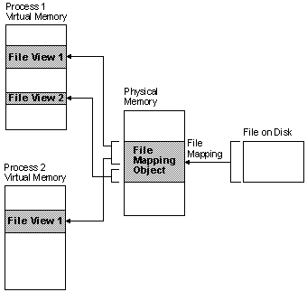
Memory mapped files (Windows)
HANDLE WINAPI CreateFileMapping (
__in HANDLE hFile,
__in_opt LPSECURITY_ATTRIBUTES lpAttributes,
__in DWORD flProtect,
__in DWORD dwMaximumSizeHigh,
__in DWORD dwMaximumSizeLow,
__in_opt LPCTSTR lpName
);
LPVOID WINAPI MapViewOfFile (
__in HANDLE hFileMappingObject,
__in DWORD dwDesiredAccess,
__in DWORD dwFileOffsetHigh,
__in DWORD dwFileOffsetLow,
__in SIZE_T dwNumberOfBytesToMap
);

Slide 41
Creating shared memory via Windows*
*http://msdn.microsoft.com/en-us/library/windows/desktop/aa366551%28v=vs.85%29.aspx
First process (creator):
  The first process creates the file mapping object by calling the CreateFileMapping function with INVALID_HANDLE_VALUE and a name for the object.
  Then the process uses the file mapping object handle (that CreateFileMapping returns) in a call to MapViewOfFile to create a view of the file in the process address space. The MapViewOfFile function returns a pointer to the file view, pBuf.
  The process then uses the CopyMemory function to write a string to the view that can be accessed by other processes.
  When the process no longer needs access to the file mapping object, it should call UnmapViewOfFile(pBuf) and then CloseHandle.
When all handles are closed, the system can free the section of the paging file that the object uses.

Slide 42
Creating shared memory via Windows
Second/other processes:
  A second process can access the string written to the shared memory by the first process by calling the OpenFileMapping function specifying the same name for the mapping object as the first process.
  Then it can use the MapViewOfFile function to obtain a pointer to the file view, pBuf.

Slide 43
Example: creating shared memory via Windows – first process (creator)
#include <windows.h>
#include <stdio.h>
#include <conio.h>
#include <tchar.h>
#define BUF_SIZE 256
TCHAR szName[]=TEXT("Global\\MyFileMappingObject");
TCHAR szMsg[]=TEXT("Message from first process.");
int _tmain ( ) { //sloppy/nonstandard main!
HANDLE hMapFile;
LPCTSTR pBuf;
hMapFile = CreateFileMapping(
INVALID_HANDLE_VALUE, // use paging file
NULL, // default security
PAGE_READWRITE, // read/write access
0, // maximum object size (high-order DWORD)
BUF_SIZE, // maximum object size (low-order DWORD)
szName); // name of mapping object
if (hMapFile == NULL) {
_tprintf(TEXT("Could not create file mapping object (%d).\n"),
GetLastError());
return 1;
}
pBuf = (LPTSTR) MapViewOfFile(hMapFile, // handle to map object
FILE_MAP_ALL_ACCESS, // read/write permission
0,
0,
BUF_SIZE);
if (pBuf == NULL) {
_tprintf(TEXT("Could not map view of file (%d).\n"),
GetLastError());
CloseHandle(hMapFile);
return 1;
}
CopyMemory((PVOID)pBuf, szMsg, (_tcslen(szMsg) * sizeof(TCHAR)));
_getch();
UnmapViewOfFile(pBuf);
CloseHandle(hMapFile);
return 0;
}

Slide 44
Example: creating shared memory via Windows – second/other processes
#include <windows.h>
#include <stdio.h>
#include <conio.h>
#include <tchar.h>
#pragma comment(lib, "user32.lib")
#define BUF_SIZE 256
TCHAR szName[]=TEXT("Global\\MyFileMappingObject");
int _tmain ( ) {
HANDLE hMapFile;
LPCTSTR pBuf;
hMapFile = OpenFileMapping(
FILE_MAP_ALL_ACCESS, // read/write access
FALSE, // do not inherit the name
szName); // name of mapping object
if (hMapFile == NULL) {
_tprintf(TEXT("Could not open file mapping object (%d).\n"),
GetLastError());
return 1;
}
pBuf = (LPTSTR) MapViewOfFile(hMapFile, // handle to map object
FILE_MAP_ALL_ACCESS, // read/write permission
0,
0,
BUF_SIZE);
if (pBuf == NULL)
{
_tprintf(TEXT("Could not map view of file (%d).\n"),
GetLastError());
CloseHandle(hMapFile);
return 1;
}
MessageBox(NULL, pBuf, TEXT("Process2"), MB_OK);
UnmapViewOfFile(pBuf);
CloseHandle(hMapFile);
return 0;
}

