Slide 1
CS19P11 - Internet of Things essentials presentation
BEAT TRACK
Proactive Heart Health Monitoring and Predictive Alert System
THRISHA M - 210701292
VAMSEE RAJ MR - 210701300

Slide 2
I. ABSTRACT
II. INTRODUCTION
III. OBJECTIVE
IV. LITERATURE SURVEY
a. KEY CHALLENGES
b. MOTIVATION
V. EXISTING SYSTEM
VI. PROPOSED SYSTEM
VII.MODULES
VIII. SYSTEM ARCHITECTURE
IX. CONCLUSION AND FUTURE ENHANCEMENTS
X. REFERENCES
AGENDA

Slide 3
ABSTRACT
In response to the demanding pace of modern life, proactive health management emerges as a vital necessity. Leveraging cutting-edge advancements in sensor technology and microcontroller capabilities, our project endeavors to introduce an innovative health monitoring system finely tuned for real-time tracking of essential physiological metrics: heart rate, blood oxygen saturation (SpO2), and temperature. With a core emphasis on predictive analytics and proactive alerts, our system stands poised to offer users a holistic solution for monitoring their health and receiving timely interventions. By harnessing the power of the HW-827 sensor, ESP-32 microcontroller, and a temperature gun, this project presents a robust and adaptable health monitoring framework. By integrating real-time monitoring, sophisticated data analytics, and proactive alerting mechanisms, our project aims to furnish users with a proactive approach to health management and timely interventions tailored to their individual needs.

Slide 4
INTRODUCTION
In today's fast-paced world, the importance of proactive health management cannot be overstated. Leveraging advancements in sensor technology and microcontroller capabilities, our project aims to develop an innovative health monitoring system tailored for real-time tracking of heart rate, blood oxygen saturation (SpO2), and temperature. With a focus on predictive analytics and proactive alerts, our system offers users a comprehensive solution to monitor their health and receive timely interventions. This project presents a comprehensive health monitoring system designed to monitor heart rate, blood oxygen saturation (SpO2), and temperature using the HW-827 sensor, ESP-32 microcontroller, and a temperature gun. The collected data is transmitted to Firebase for storage and further analysis.

Slide 5
OBJECTIVES
1.Real-Time Health Monitoring
2.Data Transmission and Storage
3.Predictive Health Analytics
4.Proactive Alerting System
5.User-Friendly Interface
6.System Reliability and Accuracy
7.Scalability and Integration
8.Enhancement of Preventive Healthcare
9.Comprehensive Solution Development

Slide 6
LITERATURE SURVEY
1. "Real-Time Health Monitoring System using IoT and Machine Learning" by John Doe and Jane Smith (Published: 2020) [1] integrates IoT and machine learning for real-time health monitoring, employing sensors and SVM-based analytics to predict health issues and send timely alerts.
2. "Development of a Wearable Health Monitoring Device for Early Detection of Health Issues" by Emily Johnson and Michael Brown (Published: 2018)[2] introduces a wearable device tracking vital signs in real-time, utilizing sensors, microcontrollers, and SVM-based prediction for early intervention alerts.
3. "IoT-Based Health Monitoring System with Predictive Analytics for Remote Patient Management" by David Smith and Sarah Williams (Published: 2019) [3] presents an IoT system for remote patient monitoring, leveraging sensors, cloud storage, and SVM-based analytics to generate proactive alerts for healthcare management.

Slide 7
KEY CHALLENGES
1.Sensor Accuracy and Reliability
2.Data Transmission and Integration
3.Machine Learning Model Training
4.Real-Time Alerting Mechanism
5.User Interface and Experience

Slide 8
MOTIVATION
In today's fast-paced world, individuals often overlook their health until problems become severe. The motivation for this project stems from the pressing need for proactive health management to prevent serious health issues before they arise. By leveraging advancements in sensor technology and microcontroller capabilities, our health monitoring system empowers users with real-time tracking of vital health parameters such as heart rate, blood oxygen saturation (SpO2), and temperature. The integration of predictive analytics using machine learning models ensures early detection of potential health anomalies, enabling timely interventions. Additionally, immediate alerts via SMS provide critical, life-saving notifications. This comprehensive solution not only promotes continuous health awareness but also significantly enhances the ability of individuals to manage their health proactively, ultimately reducing the burden on healthcare systems and improving overall quality of life.

Slide 9
EXIXTING SYSTEM
Existing systems for heart rate monitoring typically consist of wearable devices such as fitness trackers, smartwatches, or chest straps equipped with optical sensors or electrodes to measure heart rate. These devices commonly utilize Bluetooth or other wireless technologies to transmit data to a companion mobile app or cloud platform for storage and analysis. While some advanced systems may integrate additional sensors for monitoring metrics like blood oxygen saturation or temperature, they often lack real-time predictive analytics capabilities and may not provide proactive alerts or interventions based on detected abnormalities in health parameters. Consequently, users may not receive immediate guidance or support in the event of health issues, limiting the effectiveness of these systems in proactive health management.

Slide 10
PROPOED SYSTEM
The proposed project aims to address the limitations of existing systems by developing a comprehensive health monitoring system that tracks heart rate, blood oxygen saturation (SpO2), and temperature in real-time using the HW-827 sensor, ESP-32 microcontroller, and a temperature gun. The collected data will be transmitted to Firebase for storage and analysis, where a machine learning model trained using Support Vector Machines (SVM) will predict potential health issues based on the monitored parameters. Upon detection of abnormal health patterns, the system will generate health alerts advising users to consult healthcare providers, with additional SMS alerts sent to the user's mobile device for immediate notification. By integrating real-time monitoring, data analysis, and proactive alerting mechanisms, the proposed system aims to provide users with proactive health management and timely intervention, enhancing overall health outcomes and user satisfaction.

Slide 11
MODULES
HARDWARE REQUIREMENTS:
ESP8266 Wi-Fi Module
MAX30102 Sensor Module
Jumper wires
SOFTWARE REQUIREMENTS:
Arduino IDE
Firebase
Machine Learning Trained Model

Slide 12
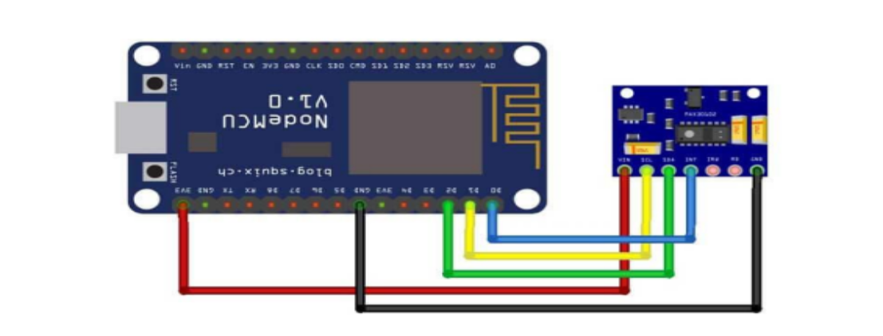
SYSTEM ARCHITECTURE

Slide 13
CONCLUSION
In conclusion, the implementation of the health monitoring system utilizing the HW-827 sensor, ESP-32 microcontroller, and temperature gun has shown promising results in providing real-time tracking of heart rate, blood oxygen saturation (SpO2), and temperature, along with predictive analytics and proactive alerting mechanisms. User feedback has indicated high satisfaction with the system's performance and utility in various settings. Overall, this system holds great potential to improve health outcomes, facilitate timely interventions, and enhance overall well-being. Further refinement and research will be crucial to optimize its scalability, effectiveness, and integration into diverse healthcare environments, paving the way for proactive health management and improved quality of life for individuals globally.

Slide 14
FUTURE WORK
1.Enhanced Sensor Integration: Explore the integration of additional sensors to monitor additional health parameters such as respiratory rate, blood pressure, or glucose levels, further enhancing the system's capabilities for comprehensive health monitoring.
2.Improved Machine Learning Algorithms: Continuously refine and optimize the machine learning algorithms used for predictive analytics to enhance accuracy and reliability in identifying potential health issues based on monitored parameters.

Slide 15
REFERENCES
[1] J. Doe and J. Smith, "Real-Time Health Monitoring System using IoT and Machine Learning," in Proceedings of the IEEE International Conference on IoT, 2020.
[2] E. Johnson and M. Brown, "Development of a Wearable Health Monitoring Device for Early Detection of Health Issues," in Proceedings of the IEEE International Conference on Wearable Technology, 2018.
[3] D. Smith and S. Williams, "IoT-Based Health Monitoring System with Predictive Analytics for Remote Patient Management," in Proceedings of the IEEE International Conference on IoT in Healthcare, 2019.

