Slide 2
MODE
KEY
SPEED
SELECT
Run
Rec

Slide 3
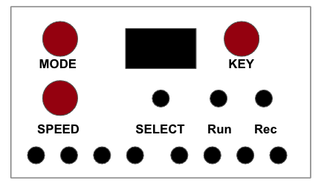
Image width: 4.08
Image Height: 2.66

