Slide 1
Data wrangling & manipulation in R
Dept. Biological Sciences Postgraduate Workshop Ruan van Mazijk, MSc candidate

Slide 2
Motivation

Slide 3
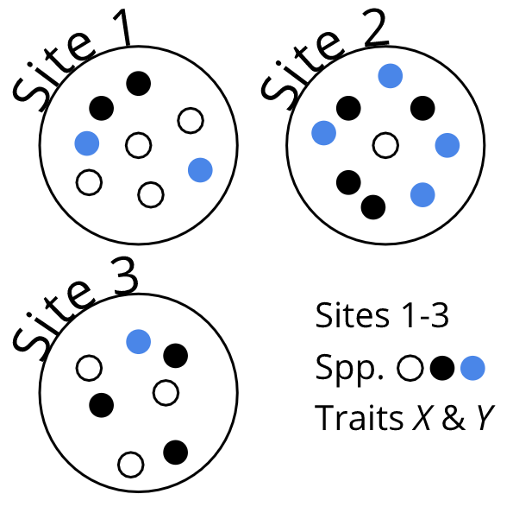
An example data-collection scenario in biology

Slide 4
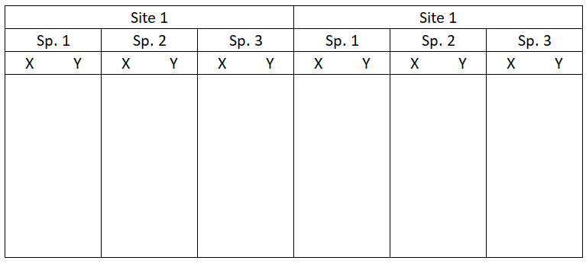
One way to lay out your collected data…

Slide 5
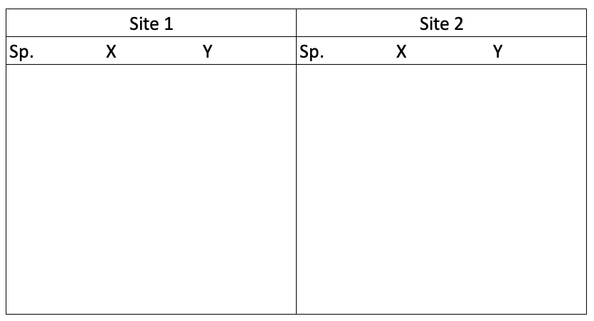
Another way…

Slide 6
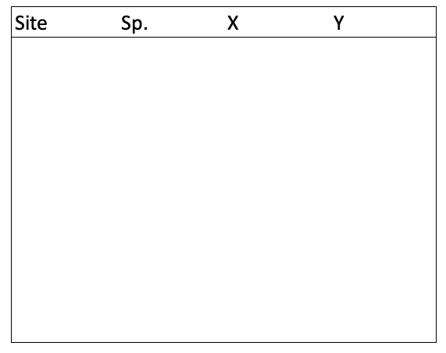
The “best” way. Will make your life easiest in the long-term.

Slide 7
Workshop outline
Embracing the rectangle
Making your data rectangular
Things to see & do in rectangle land
mutate() & friends—How to extend your raw dataset
Complicated Exotic problems

Slide 8
Embracing the rectangle
Long vs wide data
Remember this?

Slide 10
This is wide-form data. Let’s move away from that…
Using the iris dataset built into R!

Slide 11
Wide-form data
## $setosa ## Sepal.Length Sepal.Width Petal.Length Petal.Width ## 1 5.1 3.5 1.4 0.2 ## 2 4.9 3.0 1.4 0.2 ## ## $versicolor ## Sepal.Length Sepal.Width Petal.Length Petal.Width ## 1 7.0 3.2 4.7 1.4 ## 2 6.4 3.2 4.5 1.5 ## ## $virginica ## Sepal.Length Sepal.Width Petal.Length Petal.Width ## 1 6.3 3.3 6.0 2.5 ## 2 5.8 2.7 5.1 1.9

Slide 12
Classic long-form data
## Species Sepal.Length Sepal.Width Petal.Length Petal.Width ## 1 setosa 5.1 3.5 1.4 0.2 ## 2 setosa 4.9 3.0 1.4 0.2 ## 3 setosa 4.7 3.2 1.3 0.2 ## 4 versicolor 7.0 3.2 4.7 1.4 ## 5 versicolor 6.4 3.2 4.5 1.5 ## 6 versicolor 6.9 3.1 4.9 1.5 ## 7 virginica 6.3 3.3 6.0 2.5 ## 8 virginica 5.8 2.7 5.1 1.9 ## 9 virginica 7.1 3.0 5.9 2.1

Slide 13
We can get longer…
## Species trait trait_value ## 1 setosa Sepal.Length 5.1 ## 2 versicolor Sepal.Length 7.0 ## 3 virginica Sepal.Length 6.3 ## 4 setosa Sepal.Width 3.5 ## 5 versicolor Sepal.Width 3.2 ## 6 virginica Sepal.Width 3.3 ## 7 setosa Petal.Length 1.4 ## 8 versicolor Petal.Length 4.7 ## 9 virginica Petal.Length 6.0 ## 10 setosa Petal.Width 0.2 ## 11 versicolor Petal.Width 1.4 ## 12 virginica Petal.Width 2.5

Slide 14
The advantages of long data
Machine-readable
The standard for most software/R-functions (e.g. lm(), plot(), ggplot())
How most statistical methods treat data mathematically
Easier to subset & wrangle further!

Slide 15
Making your data rectangular
What are your options?
(Easiest to lay it out like that from the start…)
(Many tools (to follow) assume your data is nice & tidy)
Careful Excel work
Risky…
Use R!
Many tools also help in tidying data
Namely, the package tidyr

Slide 16
tidyr::
An R-package all about getting to this:

Slide 17
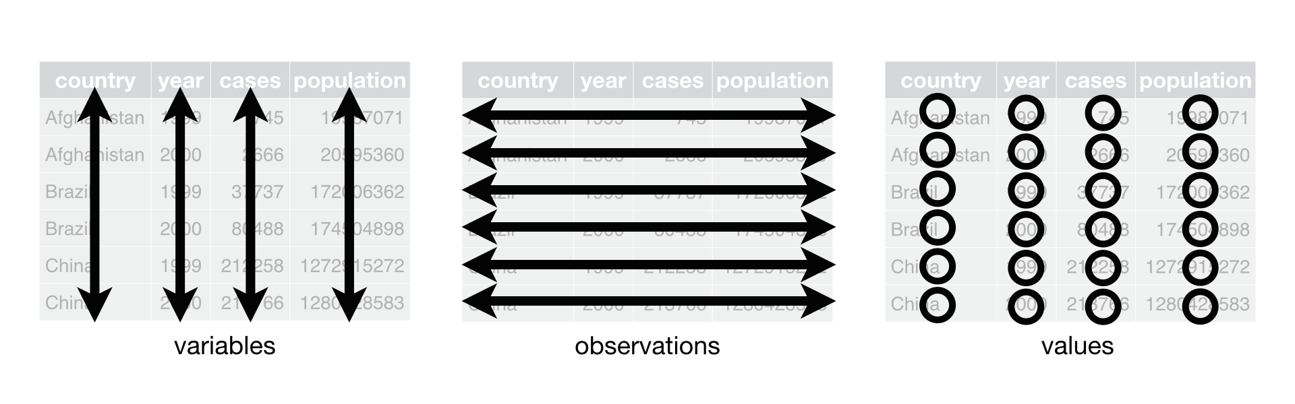

Slide 18
Each variable must have its own column.
Each observation must have its own row.
Each value must have its own cell.

Slide 19
tidyr:: cont.
Verbs to tidy your data
Untidy observations?
gather() # if > 1 observation per row spread() # if observations live in > 1 row
Untidy variables?
separate() # if > 1 variable per column unite() # if variables live in > 1 column

Slide 20
Note the following when choosing tidyr:: verbs
Be clear on what your observations are
Like, what unit of your study counts as an observation
E.g. : plant leaf vs plant individual
E.g. : egg size vs clutch size
This will depend on your study &/or data!
Variables are discrete, seperate ideas

Slide 21
Things to see & do in rectangle land
Using dplyr:: to work with data
Subsetting etc.
Extending your dataset

Slide 22
dplyr::
Verbs to touch, slice-up, subset & look inside data
select() # !!! filter() # !!! group_by() summarise() arrange() join() mutate()

Slide 23
1. Subsetting etc.
select() # !!! filter() # !!!

Slide 24
iris
## Sepal.Length Sepal.Width Petal.Length Petal.Width Species ## 1 5.1 3.5 1.4 0.2 setosa ## 2 4.9 3.0 1.4 0.2 setosa ## 3 4.7 3.2 1.3 0.2 setosa ## 4 4.6 3.1 1.5 0.2 setosa ## 5 5.0 3.6 1.4 0.2 setosa ## 6 5.4 3.9 1.7 0.4 setosa ## 7 4.6 3.4 1.4 0.3 setosa ## 8 5.0 3.4 1.5 0.2 setosa ## 9 4.4 2.9 1.4 0.2 setosa ## 10 4.9 3.1 1.5 0.1 setosa ## 11 5.4 3.7 1.5 0.2 setosa ## 12 4.8 3.4 1.6 0.2 setosa ## 13 4.8 3.0 1.4 0.1 setosa ## 14 4.3 3.0 1.1 0.1 setosa ## 15 5.8 4.0 1.2 0.2 setosa ## 16 5.7 4.4 1.5 0.4 setosa ## 17 5.4 3.9 1.3 0.4 setosa ## 18 5.1 3.5 1.4 0.3 setosa ## 19 5.7 3.8 1.7 0.3 setosa ## 20 5.1 3.8 1.5 0.3 setosa ## 21 5.4 3.4 1.7 0.2 setosa ## 22 5.1 3.7 1.5 0.4 setosa ## 23 4.6 3.6 1.0 0.2 setosa ## 24 5.1 3.3 1.7 0.5 setosa ## 25 4.8 3.4 1.9 0.2 setosa ## 26 5.0 3.0 1.6 0.2 setosa ## 27 5.0 3.4 1.6 0.4 setosa ## 28 5.2 3.5 1.5 0.2 setosa ## 29 5.2 3.4 1.4 0.2 setosa ## 30 4.7 3.2 1.6 0.2 setosa ## 31 4.8 3.1 1.6 0.2 setosa ## 32 5.4 3.4 1.5 0.4 setosa ## 33 5.2 4.1 1.5 0.1 setosa ## 34 5.5 4.2 1.4 0.2 setosa ## 35 4.9 3.1 1.5 0.2 setosa ## 36 5.0 3.2 1.2 0.2 setosa ## 37 5.5 3.5 1.3 0.2 setosa ## 38 4.9 3.6 1.4 0.1 setosa ## 39 4.4 3.0 1.3 0.2 setosa ## 40 5.1 3.4 1.5 0.2 setosa ## 41 5.0 3.5 1.3 0.3 setosa ## 42 4.5 2.3 1.3 0.3 setosa ## 43 4.4 3.2 1.3 0.2 setosa ## 44 5.0 3.5 1.6 0.6 setosa ## 45 5.1 3.8 1.9 0.4 setosa ## 46 4.8 3.0 1.4 0.3 setosa ## 47 5.1 3.8 1.6 0.2 setosa ## 48 4.6 3.2 1.4 0.2 setosa ## 49 5.3 3.7 1.5 0.2 setosa ## 50 5.0 3.3 1.4 0.2 setosa ## 51 7.0 3.2 4.7 1.4 versicolor ## 52 6.4 3.2 4.5 1.5 versicolor ## 53 6.9 3.1 4.9 1.5 versicolor ## 54 5.5 2.3 4.0 1.3 versicolor ## 55 6.5 2.8 4.6 1.5 versicolor ## 56 5.7 2.8 4.5 1.3 versicolor ## 57 6.3 3.3 4.7 1.6 versicolor ## 58 4.9 2.4 3.3 1.0 versicolor ## 59 6.6 2.9 4.6 1.3 versicolor ## 60 5.2 2.7 3.9 1.4 versicolor ## 61 5.0 2.0 3.5 1.0 versicolor ## 62 5.9 3.0 4.2 1.5 versicolor ## 63 6.0 2.2 4.0 1.0 versicolor ## 64 6.1 2.9 4.7 1.4 versicolor ## 65 5.6 2.9 3.6 1.3 versicolor ## 66 6.7 3.1 4.4 1.4 versicolor ## 67 5.6 3.0 4.5 1.5 versicolor ## 68 5.8 2.7 4.1 1.0 versicolor ## 69 6.2 2.2 4.5 1.5 versicolor ## 70 5.6 2.5 3.9 1.1 versicolor ## 71 5.9 3.2 4.8 1.8 versicolor ## 72 6.1 2.8 4.0 1.3 versicolor ## 73 6.3 2.5 4.9 1.5 versicolor ## 74 6.1 2.8 4.7 1.2 versicolor ## 75 6.4 2.9 4.3 1.3 versicolor ## 76 6.6 3.0 4.4 1.4 versicolor ## 77 6.8 2.8 4.8 1.4 versicolor ## 78 6.7 3.0 5.0 1.7 versicolor ## 79 6.0 2.9 4.5 1.5 versicolor ## 80 5.7 2.6 3.5 1.0 versicolor ## 81 5.5 2.4 3.8 1.1 versicolor ## 82 5.5 2.4 3.7 1.0 versicolor ## 83 5.8 2.7 3.9 1.2 versicolor ## 84 6.0 2.7 5.1 1.6 versicolor ## 85 5.4 3.0 4.5 1.5 versicolor ## 86 6.0 3.4 4.5 1.6 versicolor ## 87 6.7 3.1 4.7 1.5 versicolor ## 88 6.3 2.3 4.4 1.3 versicolor ## 89 5.6 3.0 4.1 1.3 versicolor ## 90 5.5 2.5 4.0 1.3 versicolor ## 91 5.5 2.6 4.4 1.2 versicolor ## 92 6.1 3.0 4.6 1.4 versicolor ## 93 5.8 2.6 4.0 1.2 versicolor ## 94 5.0 2.3 3.3 1.0 versicolor ## 95 5.6 2.7 4.2 1.3 versicolor ## 96 5.7 3.0 4.2 1.2 versicolor ## 97 5.7 2.9 4.2 1.3 versicolor ## 98 6.2 2.9 4.3 1.3 versicolor ## 99 5.1 2.5 3.0 1.1 versicolor ## 100 5.7 2.8 4.1 1.3 versicolor ## 101 6.3 3.3 6.0 2.5 virginica ## 102 5.8 2.7 5.1 1.9 virginica ## 103 7.1 3.0 5.9 2.1 virginica ## 104 6.3 2.9 5.6 1.8 virginica ## 105 6.5 3.0 5.8 2.2 virginica ## 106 7.6 3.0 6.6 2.1 virginica ## 107 4.9 2.5 4.5 1.7 virginica ## 108 7.3 2.9 6.3 1.8 virginica ## 109 6.7 2.5 5.8 1.8 virginica ## 110 7.2 3.6 6.1 2.5 virginica ## 111 6.5 3.2 5.1 2.0 virginica ## 112 6.4 2.7 5.3 1.9 virginica ## 113 6.8 3.0 5.5 2.1 virginica ## 114 5.7 2.5 5.0 2.0 virginica ## 115 5.8 2.8 5.1 2.4 virginica ## 116 6.4 3.2 5.3 2.3 virginica ## 117 6.5 3.0 5.5 1.8 virginica ## 118 7.7 3.8 6.7 2.2 virginica ## 119 7.7 2.6 6.9 2.3 virginica ## 120 6.0 2.2 5.0 1.5 virginica ## 121 6.9 3.2 5.7 2.3 virginica ## 122 5.6 2.8 4.9 2.0 virginica ## 123 7.7 2.8 6.7 2.0 virginica ## 124 6.3 2.7 4.9 1.8 virginica ## 125 6.7 3.3 5.7 2.1 virginica ## 126 7.2 3.2 6.0 1.8 virginica ## 127 6.2 2.8 4.8 1.8 virginica ## 128 6.1 3.0 4.9 1.8 virginica ## 129 6.4 2.8 5.6 2.1 virginica ## 130 7.2 3.0 5.8 1.6 virginica ## 131 7.4 2.8 6.1 1.9 virginica ## 132 7.9 3.8 6.4 2.0 virginica ## 133 6.4 2.8 5.6 2.2 virginica ## 134 6.3 2.8 5.1 1.5 virginica ## 135 6.1 2.6 5.6 1.4 virginica ## 136 7.7 3.0 6.1 2.3 virginica ## 137 6.3 3.4 5.6 2.4 virginica ## 138 6.4 3.1 5.5 1.8 virginica ## 139 6.0 3.0 4.8 1.8 virginica ## 140 6.9 3.1 5.4 2.1 virginica ## 141 6.7 3.1 5.6 2.4 virginica ## 142 6.9 3.1 5.1 2.3 virginica ## 143 5.8 2.7 5.1 1.9 virginica ## 144 6.8 3.2 5.9 2.3 virginica ## 145 6.7 3.3 5.7 2.5 virginica ## 146 6.7 3.0 5.2 2.3 virginica ## 147 6.3 2.5 5.0 1.9 virginica ## 148 6.5 3.0 5.2 2.0 virginica ## 149 6.2 3.4 5.4 2.3 virginica ## 150 5.9 3.0 5.1 1.8 virginica
select() vs $
iris <- as.data.frame(iris) # like this by default iris
## Sepal.Length Sepal.Width Petal.Length Petal.Width Species ## 1 5.1 3.5 1.4 0.2 setosa ## 2 4.9 3.0 1.4 0.2 setosa ## 3 4.7 3.2 1.3 0.2 setosa ## 4 4.6 3.1 1.5 0.2 setosa ## 5 5.0 3.6 1.4 0.2 setosa ## 6 5.4 3.9 1.7 0.4 setosa ## 7 4.6 3.4 1.4 0.3 setosa ## 8 5.0 3.4 1.5 0.2 setosa ## 9 4.4 2.9 1.4 0.2 setosa ## 10 4.9 3.1 1.5 0.1 setosa ## 11 5.4 3.7 1.5 0.2 setosa ## 12 4.8 3.4 1.6 0.2 setosa ## 13 4.8 3.0 1.4 0.1 setosa ## 14 4.3 3.0 1.1 0.1 setosa ## 15 5.8 4.0 1.2 0.2 setosa ## 16 5.7 4.4 1.5 0.4 setosa ## 17 5.4 3.9 1.3 0.4 setosa ## 18 5.1 3.5 1.4 0.3 setosa ## 19 5.7 3.8 1.7 0.3 setosa ## 20 5.1 3.8 1.5 0.3 setosa ## 21 5.4 3.4 1.7 0.2 setosa ## 22 5.1 3.7 1.5 0.4 setosa ## 23 4.6 3.6 1.0 0.2 setosa ## 24 5.1 3.3 1.7 0.5 setosa ## 25 4.8 3.4 1.9 0.2 setosa ## 26 5.0 3.0 1.6 0.2 setosa ## 27 5.0 3.4 1.6 0.4 setosa ## 28 5.2 3.5 1.5 0.2 setosa ## 29 5.2 3.4 1.4 0.2 setosa ## 30 4.7 3.2 1.6 0.2 setosa ## 31 4.8 3.1 1.6 0.2 setosa ## 32 5.4 3.4 1.5 0.4 setosa ## 33 5.2 4.1 1.5 0.1 setosa ## 34 5.5 4.2 1.4 0.2 setosa ## 35 4.9 3.1 1.5 0.2 setosa ## 36 5.0 3.2 1.2 0.2 setosa ## 37 5.5 3.5 1.3 0.2 setosa ## 38 4.9 3.6 1.4 0.1 setosa ## 39 4.4 3.0 1.3 0.2 setosa ## 40 5.1 3.4 1.5 0.2 setosa ## 41 5.0 3.5 1.3 0.3 setosa ## 42 4.5 2.3 1.3 0.3 setosa ## 43 4.4 3.2 1.3 0.2 setosa ## 44 5.0 3.5 1.6 0.6 setosa ## 45 5.1 3.8 1.9 0.4 setosa ## 46 4.8 3.0 1.4 0.3 setosa ## 47 5.1 3.8 1.6 0.2 setosa ## 48 4.6 3.2 1.4 0.2 setosa ## 49 5.3 3.7 1.5 0.2 setosa ## 50 5.0 3.3 1.4 0.2 setosa ## 51 7.0 3.2 4.7 1.4 versicolor ## 52 6.4 3.2 4.5 1.5 versicolor ## 53 6.9 3.1 4.9 1.5 versicolor ## 54 5.5 2.3 4.0 1.3 versicolor ## 55 6.5 2.8 4.6 1.5 versicolor ## 56 5.7 2.8 4.5 1.3 versicolor ## 57 6.3 3.3 4.7 1.6 versicolor ## 58 4.9 2.4 3.3 1.0 versicolor ## 59 6.6 2.9 4.6 1.3 versicolor ## 60 5.2 2.7 3.9 1.4 versicolor ## 61 5.0 2.0 3.5 1.0 versicolor ## 62 5.9 3.0 4.2 1.5 versicolor ## 63 6.0 2.2 4.0 1.0 versicolor ## 64 6.1 2.9 4.7 1.4 versicolor ## 65 5.6 2.9 3.6 1.3 versicolor ## 66 6.7 3.1 4.4 1.4 versicolor ## 67 5.6 3.0 4.5 1.5 versicolor ## 68 5.8 2.7 4.1 1.0 versicolor ## 69 6.2 2.2 4.5 1.5 versicolor ## 70 5.6 2.5 3.9 1.1 versicolor ## 71 5.9 3.2 4.8 1.8 versicolor ## 72 6.1 2.8 4.0 1.3 versicolor ## 73 6.3 2.5 4.9 1.5 versicolor ## 74 6.1 2.8 4.7 1.2 versicolor ## 75 6.4 2.9 4.3 1.3 versicolor ## 76 6.6 3.0 4.4 1.4 versicolor ## 77 6.8 2.8 4.8 1.4 versicolor ## 78 6.7 3.0 5.0 1.7 versicolor ## 79 6.0 2.9 4.5 1.5 versicolor ## 80 5.7 2.6 3.5 1.0 versicolor ## 81 5.5 2.4 3.8 1.1 versicolor ## 82 5.5 2.4 3.7 1.0 versicolor ## 83 5.8 2.7 3.9 1.2 versicolor ## 84 6.0 2.7 5.1 1.6 versicolor ## 85 5.4 3.0 4.5 1.5 versicolor ## 86 6.0 3.4 4.5 1.6 versicolor ## 87 6.7 3.1 4.7 1.5 versicolor ## 88 6.3 2.3 4.4 1.3 versicolor ## 89 5.6 3.0 4.1 1.3 versicolor ## 90 5.5 2.5 4.0 1.3 versicolor ## 91 5.5 2.6 4.4 1.2 versicolor ## 92 6.1 3.0 4.6 1.4 versicolor ## 93 5.8 2.6 4.0 1.2 versicolor ## 94 5.0 2.3 3.3 1.0 versicolor ## 95 5.6 2.7 4.2 1.3 versicolor ## 96 5.7 3.0 4.2 1.2 versicolor ## 97 5.7 2.9 4.2 1.3 versicolor ## 98 6.2 2.9 4.3 1.3 versicolor ## 99 5.1 2.5 3.0 1.1 versicolor ## 100 5.7 2.8 4.1 1.3 versicolor ## 101 6.3 3.3 6.0 2.5 virginica ## 102 5.8 2.7 5.1 1.9 virginica ## 103 7.1 3.0 5.9 2.1 virginica ## 104 6.3 2.9 5.6 1.8 virginica ## 105 6.5 3.0 5.8 2.2 virginica ## 106 7.6 3.0 6.6 2.1 virginica ## 107 4.9 2.5 4.5 1.7 virginica ## 108 7.3 2.9 6.3 1.8 virginica ## 109 6.7 2.5 5.8 1.8 virginica ## 110 7.2 3.6 6.1 2.5 virginica ## 111 6.5 3.2 5.1 2.0 virginica ## 112 6.4 2.7 5.3 1.9 virginica ## 113 6.8 3.0 5.5 2.1 virginica ## 114 5.7 2.5 5.0 2.0 virginica ## 115 5.8 2.8 5.1 2.4 virginica ## 116 6.4 3.2 5.3 2.3 virginica ## 117 6.5 3.0 5.5 1.8 virginica ## 118 7.7 3.8 6.7 2.2 virginica ## 119 7.7 2.6 6.9 2.3 virginica ## 120 6.0 2.2 5.0 1.5 virginica ## 121 6.9 3.2 5.7 2.3 virginica ## 122 5.6 2.8 4.9 2.0 virginica ## 123 7.7 2.8 6.7 2.0 virginica ## 124 6.3 2.7 4.9 1.8 virginica ## 125 6.7 3.3 5.7 2.1 virginica ## 126 7.2 3.2 6.0 1.8 virginica ## 127 6.2 2.8 4.8 1.8 virginica ## 128 6.1 3.0 4.9 1.8 virginica ## 129 6.4 2.8 5.6 2.1 virginica ## 130 7.2 3.0 5.8 1.6 virginica ## 131 7.4 2.8 6.1 1.9 virginica ## 132 7.9 3.8 6.4 2.0 virginica ## 133 6.4 2.8 5.6 2.2 virginica ## 134 6.3 2.8 5.1 1.5 virginica ## 135 6.1 2.6 5.6 1.4 virginica ## 136 7.7 3.0 6.1 2.3 virginica ## 137 6.3 3.4 5.6 2.4 virginica ## 138 6.4 3.1 5.5 1.8 virginica ## 139 6.0 3.0 4.8 1.8 virginica ## 140 6.9 3.1 5.4 2.1 virginica ## 141 6.7 3.1 5.6 2.4 virginica ## 142 6.9 3.1 5.1 2.3 virginica ## 143 5.8 2.7 5.1 1.9 virginica ## 144 6.8 3.2 5.9 2.3 virginica ## 145 6.7 3.3 5.7 2.5 virginica ## 146 6.7 3.0 5.2 2.3 virginica ## 147 6.3 2.5 5.0 1.9 virginica ## 148 6.5 3.0 5.2 2.0 virginica ## 149 6.2 3.4 5.4 2.3 virginica ## 150 5.9 3.0 5.1 1.8 virginica
iris[, 1]
## [1] 5.1 4.9 4.7 4.6 5.0 5.4 4.6 5.0 4.4 4.9 5.4 4.8 4.8 4.3 5.8 5.7 5.4 ## [18] 5.1 5.7 5.1 5.4 5.1 4.6 5.1 4.8 5.0 5.0 5.2 5.2 4.7 4.8 5.4 5.2 5.5 ## [35] 4.9 5.0 5.5 4.9 4.4 5.1 5.0 4.5 4.4 5.0 5.1 4.8 5.1 4.6 5.3 5.0 7.0 ## [52] 6.4 6.9 5.5 6.5 5.7 6.3 4.9 6.6 5.2 5.0 5.9 6.0 6.1 5.6 6.7 5.6 5.8 ## [69] 6.2 5.6 5.9 6.1 6.3 6.1 6.4 6.6 6.8 6.7 6.0 5.7 5.5 5.5 5.8 6.0 5.4 ## [86] 6.0 6.7 6.3 5.6 5.5 5.5 6.1 5.8 5.0 5.6 5.7 5.7 6.2 5.1 5.7 6.3 5.8 ## [103] 7.1 6.3 6.5 7.6 4.9 7.3 6.7 7.2 6.5 6.4 6.8 5.7 5.8 6.4 6.5 7.7 7.7 ## [120] 6.0 6.9 5.6 7.7 6.3 6.7 7.2 6.2 6.1 6.4 7.2 7.4 7.9 6.4 6.3 6.1 7.7 ## [137] 6.3 6.4 6.0 6.9 6.7 6.9 5.8 6.8 6.7 6.7 6.3 6.5 6.2 5.9
iris[[1]]
## [1] 5.1 4.9 4.7 4.6 5.0 5.4 4.6 5.0 4.4 4.9 5.4 4.8 4.8 4.3 5.8 5.7 5.4 ## [18] 5.1 5.7 5.1 5.4 5.1 4.6 5.1 4.8 5.0 5.0 5.2 5.2 4.7 4.8 5.4 5.2 5.5 ## [35] 4.9 5.0 5.5 4.9 4.4 5.1 5.0 4.5 4.4 5.0 5.1 4.8 5.1 4.6 5.3 5.0 7.0 ## [52] 6.4 6.9 5.5 6.5 5.7 6.3 4.9 6.6 5.2 5.0 5.9 6.0 6.1 5.6 6.7 5.6 5.8 ## [69] 6.2 5.6 5.9 6.1 6.3 6.1 6.4 6.6 6.8 6.7 6.0 5.7 5.5 5.5 5.8 6.0 5.4 ## [86] 6.0 6.7 6.3 5.6 5.5 5.5 6.1 5.8 5.0 5.6 5.7 5.7 6.2 5.1 5.7 6.3 5.8 ## [103] 7.1 6.3 6.5 7.6 4.9 7.3 6.7 7.2 6.5 6.4 6.8 5.7 5.8 6.4 6.5 7.7 7.7 ## [120] 6.0 6.9 5.6 7.7 6.3 6.7 7.2 6.2 6.1 6.4 7.2 7.4 7.9 6.4 6.3 6.1 7.7 ## [137] 6.3 6.4 6.0 6.9 6.7 6.9 5.8 6.8 6.7 6.7 6.3 6.5 6.2 5.9
iris[, "Sepal.Length"]
## [1] 5.1 4.9 4.7 4.6 5.0 5.4 4.6 5.0 4.4 4.9 5.4 4.8 4.8 4.3 5.8 5.7 5.4 ## [18] 5.1 5.7 5.1 5.4 5.1 4.6 5.1 4.8 5.0 5.0 5.2 5.2 4.7 4.8 5.4 5.2 5.5 ## [35] 4.9 5.0 5.5 4.9 4.4 5.1 5.0 4.5 4.4 5.0 5.1 4.8 5.1 4.6 5.3 5.0 7.0 ## [52] 6.4 6.9 5.5 6.5 5.7 6.3 4.9 6.6 5.2 5.0 5.9 6.0 6.1 5.6 6.7 5.6 5.8 ## [69] 6.2 5.6 5.9 6.1 6.3 6.1 6.4 6.6 6.8 6.7 6.0 5.7 5.5 5.5 5.8 6.0 5.4 ## [86] 6.0 6.7 6.3 5.6 5.5 5.5 6.1 5.8 5.0 5.6 5.7 5.7 6.2 5.1 5.7 6.3 5.8 ## [103] 7.1 6.3 6.5 7.6 4.9 7.3 6.7 7.2 6.5 6.4 6.8 5.7 5.8 6.4 6.5 7.7 7.7 ## [120] 6.0 6.9 5.6 7.7 6.3 6.7 7.2 6.2 6.1 6.4 7.2 7.4 7.9 6.4 6.3 6.1 7.7 ## [137] 6.3 6.4 6.0 6.9 6.7 6.9 5.8 6.8 6.7 6.7 6.3 6.5 6.2 5.9
iris[["Sepal.Length"]]
## [1] 5.1 4.9 4.7 4.6 5.0 5.4 4.6 5.0 4.4 4.9 5.4 4.8 4.8 4.3 5.8 5.7 5.4 ## [18] 5.1 5.7 5.1 5.4 5.1 4.6 5.1 4.8 5.0 5.0 5.2 5.2 4.7 4.8 5.4 5.2 5.5 ## [35] 4.9 5.0 5.5 4.9 4.4 5.1 5.0 4.5 4.4 5.0 5.1 4.8 5.1 4.6 5.3 5.0 7.0 ## [52] 6.4 6.9 5.5 6.5 5.7 6.3 4.9 6.6 5.2 5.0 5.9 6.0 6.1 5.6 6.7 5.6 5.8 ## [69] 6.2 5.6 5.9 6.1 6.3 6.1 6.4 6.6 6.8 6.7 6.0 5.7 5.5 5.5 5.8 6.0 5.4 ## [86] 6.0 6.7 6.3 5.6 5.5 5.5 6.1 5.8 5.0 5.6 5.7 5.7 6.2 5.1 5.7 6.3 5.8 ## [103] 7.1 6.3 6.5 7.6 4.9 7.3 6.7 7.2 6.5 6.4 6.8 5.7 5.8 6.4 6.5 7.7 7.7 ## [120] 6.0 6.9 5.6 7.7 6.3 6.7 7.2 6.2 6.1 6.4 7.2 7.4 7.9 6.4 6.3 6.1 7.7 ## [137] 6.3 6.4 6.0 6.9 6.7 6.9 5.8 6.8 6.7 6.7 6.3 6.5 6.2 5.9
iris$Sepal.Length
## [1] 5.1 4.9 4.7 4.6 5.0 5.4 4.6 5.0 4.4 4.9 5.4 4.8 4.8 4.3 5.8 5.7 5.4 ## [18] 5.1 5.7 5.1 5.4 5.1 4.6 5.1 4.8 5.0 5.0 5.2 5.2 4.7 4.8 5.4 5.2 5.5 ## [35] 4.9 5.0 5.5 4.9 4.4 5.1 5.0 4.5 4.4 5.0 5.1 4.8 5.1 4.6 5.3 5.0 7.0 ## [52] 6.4 6.9 5.5 6.5 5.7 6.3 4.9 6.6 5.2 5.0 5.9 6.0 6.1 5.6 6.7 5.6 5.8 ## [69] 6.2 5.6 5.9 6.1 6.3 6.1 6.4 6.6 6.8 6.7 6.0 5.7 5.5 5.5 5.8 6.0 5.4 ## [86] 6.0 6.7 6.3 5.6 5.5 5.5 6.1 5.8 5.0 5.6 5.7 5.7 6.2 5.1 5.7 6.3 5.8 ## [103] 7.1 6.3 6.5 7.6 4.9 7.3 6.7 7.2 6.5 6.4 6.8 5.7 5.8 6.4 6.5 7.7 7.7 ## [120] 6.0 6.9 5.6 7.7 6.3 6.7 7.2 6.2 6.1 6.4 7.2 7.4 7.9 6.4 6.3 6.1 7.7 ## [137] 6.3 6.4 6.0 6.9 6.7 6.9 5.8 6.8 6.7 6.7 6.3 6.5 6.2 5.9
iris["Sepal.Length"]
## Sepal.Length ## 1 5.1 ## 2 4.9 ## 3 4.7 ## 4 4.6 ## 5 5.0 ## 6 5.4 ## 7 4.6 ## 8 5.0 ## 9 4.4 ## 10 4.9 ## 11 5.4 ## 12 4.8 ## 13 4.8 ## 14 4.3 ## 15 5.8 ## 16 5.7 ## 17 5.4 ## 18 5.1 ## 19 5.7 ## 20 5.1 ## 21 5.4 ## 22 5.1 ## 23 4.6 ## 24 5.1 ## 25 4.8 ## 26 5.0 ## 27 5.0 ## 28 5.2 ## 29 5.2 ## 30 4.7 ## 31 4.8 ## 32 5.4 ## 33 5.2 ## 34 5.5 ## 35 4.9 ## 36 5.0 ## 37 5.5 ## 38 4.9 ## 39 4.4 ## 40 5.1 ## 41 5.0 ## 42 4.5 ## 43 4.4 ## 44 5.0 ## 45 5.1 ## 46 4.8 ## 47 5.1 ## 48 4.6 ## 49 5.3 ## 50 5.0 ## 51 7.0 ## 52 6.4 ## 53 6.9 ## 54 5.5 ## 55 6.5 ## 56 5.7 ## 57 6.3 ## 58 4.9 ## 59 6.6 ## 60 5.2 ## 61 5.0 ## 62 5.9 ## 63 6.0 ## 64 6.1 ## 65 5.6 ## 66 6.7 ## 67 5.6 ## 68 5.8 ## 69 6.2 ## 70 5.6 ## 71 5.9 ## 72 6.1 ## 73 6.3 ## 74 6.1 ## 75 6.4 ## 76 6.6 ## 77 6.8 ## 78 6.7 ## 79 6.0 ## 80 5.7 ## 81 5.5 ## 82 5.5 ## 83 5.8 ## 84 6.0 ## 85 5.4 ## 86 6.0 ## 87 6.7 ## 88 6.3 ## 89 5.6 ## 90 5.5 ## 91 5.5 ## 92 6.1 ## 93 5.8 ## 94 5.0 ## 95 5.6 ## 96 5.7 ## 97 5.7 ## 98 6.2 ## 99 5.1 ## 100 5.7 ## 101 6.3 ## 102 5.8 ## 103 7.1 ## 104 6.3 ## 105 6.5 ## 106 7.6 ## 107 4.9 ## 108 7.3 ## 109 6.7 ## 110 7.2 ## 111 6.5 ## 112 6.4 ## 113 6.8 ## 114 5.7 ## 115 5.8 ## 116 6.4 ## 117 6.5 ## 118 7.7 ## 119 7.7 ## 120 6.0 ## 121 6.9 ## 122 5.6 ## 123 7.7 ## 124 6.3 ## 125 6.7 ## 126 7.2 ## 127 6.2 ## 128 6.1 ## 129 6.4 ## 130 7.2 ## 131 7.4 ## 132 7.9 ## 133 6.4 ## 134 6.3 ## 135 6.1 ## 136 7.7 ## 137 6.3 ## 138 6.4 ## 139 6.0 ## 140 6.9 ## 141 6.7 ## 142 6.9 ## 143 5.8 ## 144 6.8 ## 145 6.7 ## 146 6.7 ## 147 6.3 ## 148 6.5 ## 149 6.2 ## 150 5.9
select(iris, Sepal.Length)
## Sepal.Length ## 1 5.1 ## 2 4.9 ## 3 4.7 ## 4 4.6 ## 5 5.0 ## 6 5.4 ## 7 4.6 ## 8 5.0 ## 9 4.4 ## 10 4.9 ## 11 5.4 ## 12 4.8 ## 13 4.8 ## 14 4.3 ## 15 5.8 ## 16 5.7 ## 17 5.4 ## 18 5.1 ## 19 5.7 ## 20 5.1 ## 21 5.4 ## 22 5.1 ## 23 4.6 ## 24 5.1 ## 25 4.8 ## 26 5.0 ## 27 5.0 ## 28 5.2 ## 29 5.2 ## 30 4.7 ## 31 4.8 ## 32 5.4 ## 33 5.2 ## 34 5.5 ## 35 4.9 ## 36 5.0 ## 37 5.5 ## 38 4.9 ## 39 4.4 ## 40 5.1 ## 41 5.0 ## 42 4.5 ## 43 4.4 ## 44 5.0 ## 45 5.1 ## 46 4.8 ## 47 5.1 ## 48 4.6 ## 49 5.3 ## 50 5.0 ## 51 7.0 ## 52 6.4 ## 53 6.9 ## 54 5.5 ## 55 6.5 ## 56 5.7 ## 57 6.3 ## 58 4.9 ## 59 6.6 ## 60 5.2 ## 61 5.0 ## 62 5.9 ## 63 6.0 ## 64 6.1 ## 65 5.6 ## 66 6.7 ## 67 5.6 ## 68 5.8 ## 69 6.2 ## 70 5.6 ## 71 5.9 ## 72 6.1 ## 73 6.3 ## 74 6.1 ## 75 6.4 ## 76 6.6 ## 77 6.8 ## 78 6.7 ## 79 6.0 ## 80 5.7 ## 81 5.5 ## 82 5.5 ## 83 5.8 ## 84 6.0 ## 85 5.4 ## 86 6.0 ## 87 6.7 ## 88 6.3 ## 89 5.6 ## 90 5.5 ## 91 5.5 ## 92 6.1 ## 93 5.8 ## 94 5.0 ## 95 5.6 ## 96 5.7 ## 97 5.7 ## 98 6.2 ## 99 5.1 ## 100 5.7 ## 101 6.3 ## 102 5.8 ## 103 7.1 ## 104 6.3 ## 105 6.5 ## 106 7.6 ## 107 4.9 ## 108 7.3 ## 109 6.7 ## 110 7.2 ## 111 6.5 ## 112 6.4 ## 113 6.8 ## 114 5.7 ## 115 5.8 ## 116 6.4 ## 117 6.5 ## 118 7.7 ## 119 7.7 ## 120 6.0 ## 121 6.9 ## 122 5.6 ## 123 7.7 ## 124 6.3 ## 125 6.7 ## 126 7.2 ## 127 6.2 ## 128 6.1 ## 129 6.4 ## 130 7.2 ## 131 7.4 ## 132 7.9 ## 133 6.4 ## 134 6.3 ## 135 6.1 ## 136 7.7 ## 137 6.3 ## 138 6.4 ## 139 6.0 ## 140 6.9 ## 141 6.7 ## 142 6.9 ## 143 5.8 ## 144 6.8 ## 145 6.7 ## 146 6.7 ## 147 6.3 ## 148 6.5 ## 149 6.2 ## 150 5.9

Slide 25
iris <- as_tibble(iris) iris
## # A tibble: 150 x 5 ## Sepal.Length Sepal.Width Petal.Length Petal.Width Species ## <dbl> <dbl> <dbl> <dbl> <fct> ## 1 5.1 3.5 1.4 0.2 setosa ## 2 4.9 3 1.4 0.2 setosa ## 3 4.7 3.2 1.3 0.2 setosa ## 4 4.6 3.1 1.5 0.2 setosa ## 5 5 3.6 1.4 0.2 setosa ## 6 5.4 3.9 1.7 0.4 setosa ## 7 4.6 3.4 1.4 0.3 setosa ## 8 5 3.4 1.5 0.2 setosa ## 9 4.4 2.9 1.4 0.2 setosa ## 10 4.9 3.1 1.5 0.1 setosa ## # … with 140 more rows
iris[[1]]
## [1] 5.1 4.9 4.7 4.6 5.0 5.4 4.6 5.0 4.4 4.9 5.4 4.8 4.8 4.3 5.8 5.7 5.4 ## [18] 5.1 5.7 5.1 5.4 5.1 4.6 5.1 4.8 5.0 5.0 5.2 5.2 4.7 4.8 5.4 5.2 5.5 ## [35] 4.9 5.0 5.5 4.9 4.4 5.1 5.0 4.5 4.4 5.0 5.1 4.8 5.1 4.6 5.3 5.0 7.0 ## [52] 6.4 6.9 5.5 6.5 5.7 6.3 4.9 6.6 5.2 5.0 5.9 6.0 6.1 5.6 6.7 5.6 5.8 ## [69] 6.2 5.6 5.9 6.1 6.3 6.1 6.4 6.6 6.8 6.7 6.0 5.7 5.5 5.5 5.8 6.0 5.4 ## [86] 6.0 6.7 6.3 5.6 5.5 5.5 6.1 5.8 5.0 5.6 5.7 5.7 6.2 5.1 5.7 6.3 5.8 ## [103] 7.1 6.3 6.5 7.6 4.9 7.3 6.7 7.2 6.5 6.4 6.8 5.7 5.8 6.4 6.5 7.7 7.7 ## [120] 6.0 6.9 5.6 7.7 6.3 6.7 7.2 6.2 6.1 6.4 7.2 7.4 7.9 6.4 6.3 6.1 7.7 ## [137] 6.3 6.4 6.0 6.9 6.7 6.9 5.8 6.8 6.7 6.7 6.3 6.5 6.2 5.9
iris[["Sepal.Length"]]
## [1] 5.1 4.9 4.7 4.6 5.0 5.4 4.6 5.0 4.4 4.9 5.4 4.8 4.8 4.3 5.8 5.7 5.4 ## [18] 5.1 5.7 5.1 5.4 5.1 4.6 5.1 4.8 5.0 5.0 5.2 5.2 4.7 4.8 5.4 5.2 5.5 ## [35] 4.9 5.0 5.5 4.9 4.4 5.1 5.0 4.5 4.4 5.0 5.1 4.8 5.1 4.6 5.3 5.0 7.0 ## [52] 6.4 6.9 5.5 6.5 5.7 6.3 4.9 6.6 5.2 5.0 5.9 6.0 6.1 5.6 6.7 5.6 5.8 ## [69] 6.2 5.6 5.9 6.1 6.3 6.1 6.4 6.6 6.8 6.7 6.0 5.7 5.5 5.5 5.8 6.0 5.4 ## [86] 6.0 6.7 6.3 5.6 5.5 5.5 6.1 5.8 5.0 5.6 5.7 5.7 6.2 5.1 5.7 6.3 5.8 ## [103] 7.1 6.3 6.5 7.6 4.9 7.3 6.7 7.2 6.5 6.4 6.8 5.7 5.8 6.4 6.5 7.7 7.7 ## [120] 6.0 6.9 5.6 7.7 6.3 6.7 7.2 6.2 6.1 6.4 7.2 7.4 7.9 6.4 6.3 6.1 7.7 ## [137] 6.3 6.4 6.0 6.9 6.7 6.9 5.8 6.8 6.7 6.7 6.3 6.5 6.2 5.9
iris$Sepal.Length
## [1] 5.1 4.9 4.7 4.6 5.0 5.4 4.6 5.0 4.4 4.9 5.4 4.8 4.8 4.3 5.8 5.7 5.4 ## [18] 5.1 5.7 5.1 5.4 5.1 4.6 5.1 4.8 5.0 5.0 5.2 5.2 4.7 4.8 5.4 5.2 5.5 ## [35] 4.9 5.0 5.5 4.9 4.4 5.1 5.0 4.5 4.4 5.0 5.1 4.8 5.1 4.6 5.3 5.0 7.0 ## [52] 6.4 6.9 5.5 6.5 5.7 6.3 4.9 6.6 5.2 5.0 5.9 6.0 6.1 5.6 6.7 5.6 5.8 ## [69] 6.2 5.6 5.9 6.1 6.3 6.1 6.4 6.6 6.8 6.7 6.0 5.7 5.5 5.5 5.8 6.0 5.4 ## [86] 6.0 6.7 6.3 5.6 5.5 5.5 6.1 5.8 5.0 5.6 5.7 5.7 6.2 5.1 5.7 6.3 5.8 ## [103] 7.1 6.3 6.5 7.6 4.9 7.3 6.7 7.2 6.5 6.4 6.8 5.7 5.8 6.4 6.5 7.7 7.7 ## [120] 6.0 6.9 5.6 7.7 6.3 6.7 7.2 6.2 6.1 6.4 7.2 7.4 7.9 6.4 6.3 6.1 7.7 ## [137] 6.3 6.4 6.0 6.9 6.7 6.9 5.8 6.8 6.7 6.7 6.3 6.5 6.2 5.9
iris[, 1]
## # A tibble: 150 x 1 ## Sepal.Length ## <dbl> ## 1 5.1 ## 2 4.9 ## 3 4.7 ## 4 4.6 ## 5 5 ## 6 5.4 ## 7 4.6 ## 8 5 ## 9 4.4 ## 10 4.9 ## # … with 140 more rows
iris[, "Sepal.Length"]
## # A tibble: 150 x 1 ## Sepal.Length ## <dbl> ## 1 5.1 ## 2 4.9 ## 3 4.7 ## 4 4.6 ## 5 5 ## 6 5.4 ## 7 4.6 ## 8 5 ## 9 4.4 ## 10 4.9 ## # … with 140 more rows
iris["Sepal.Length"]
## # A tibble: 150 x 1 ## Sepal.Length ## <dbl> ## 1 5.1 ## 2 4.9 ## 3 4.7 ## 4 4.6 ## 5 5 ## 6 5.4 ## 7 4.6 ## 8 5 ## 9 4.4 ## 10 4.9 ## # … with 140 more rows
select(iris, Sepal.Length)
## # A tibble: 150 x 1 ## Sepal.Length ## <dbl> ## 1 5.1 ## 2 4.9 ## 3 4.7 ## 4 4.6 ## 5 5 ## 6 5.4 ## 7 4.6 ## 8 5 ## 9 4.4 ## 10 4.9 ## # … with 140 more rows
2. Extending your dataset with mutate() & friends

Slide 26
Complicated Exotic problems

