Slide 1

data_wrangling() &&
("manipulation" %in% R)
🐨🐟🌿 %>% %>% %>% 🤓📊🥰
> day[3]
Ruan van Mazijk

Slide 2
Notes & slides will go up here:
tinyurl.com/r-with-ruan
(But I encourage you to make your own notes!)

Slide 3


> workshop$outline[1:3]
DAY 1
Tidy data principles
& tidyr
DAY 2
Manipulating data
& an intro to dplyr
DAY 3
Extending your data
with mutate(),
summarise()
& friends

Slide 4
> workshop$outline[2:3]
DAY 2
Manipulating data
& an intro to dplyr
DAY 3
Extending your data
with mutate(),
summarise()
& friends

Slide 5
dplyr::
# Verbs to manipulate your data
select() # operates on columns
filter() # operates on rows

Slide 6
data %>%

Slide 7
data %>%
gather(key = veg_type, value = fix) %>%

Slide 8
data %>%
gather(key = veg_type, value = fix) %>%
separate(fix, into = c("lon", "lat")) %>%

Slide 9
data %>%
gather(key = veg_type, value = fix) %>%
separate(fix, into = c("lon", "lat")) %>%
select(veg_type, lon, lat, soil, plant_height) %>%

Slide 10
data %>%
gather(key = veg_type, value = fix) %>%
separate(fix, into = c("lon", "lat")) %>%
select(veg_type, lon, lat, soil, plant_height) %>%
filter(plant_height %>% between(0.5, 10),

Slide 11
data %>%
gather(key = veg_type, value = fix) %>%
separate(fix, into = c("lon", "lat")) %>%
select(veg_type, lon, lat, soil, plant_height) %>%
filter(plant_height %>% between(0.5, 10),
veg_type %in% c("fynbos",
"strandveld",
"renosterveld"))

Slide 12
data %>%
gather(key = veg_type, value = fix) %>%
separate(fix, into = c("lon", "lat")) %>%
select(veg_type, lon, lat, soil, plant_height) %>%
filter(plant_height %>% between(0.5, 10),
veg_type %in% c("fynbos",
"strandveld",
"renosterveld"))
🤨🤔
Summary statistics for each vegetation type?

Slide 13
data %>%
gather(key = veg_type, value = fix) %>%
separate(fix, into = c("lon", "lat")) %>%
select(veg_type, lon, lat, soil, plant_height) %>%
filter(plant_height %>% between(0.5, 10),
veg_type %in% c("fynbos",
"strandveld",
"renosterveld")) %>%
???()
🤨🤔
Summary statistics for each vegetation type?

Slide 14
dplyr::
# Verbs to manipulate your data
select() # operates on columns
filter() # operates on rows

Slide 15
dplyr::
# Verbs to extend your data
mutate() # operates on columns
group_by() # operates on rows
summarise() # rows & columns

Slide 16
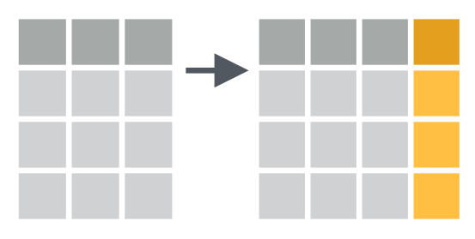
data %>%
mutate(...)
CC BY SA RStudio https://www.rstudio.com/resources/cheatsheets/

Slide 17
data %>%
mutate(...)

Slide 18
data %>%
mutate(...)
data %>%
mutate(BMI = height / weight)

Slide 19
data %>%
mutate(...)
data %>%
mutate(BMI = height / weight)
data %>%
mutate(BMI = height / weight,
BMI_std = scale(BMI))

Slide 20
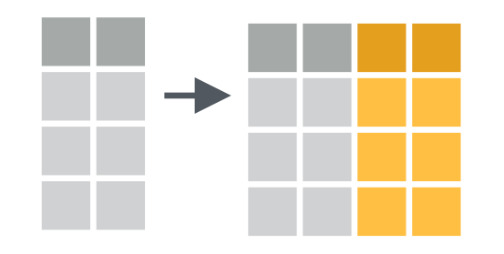
data %>%
mutate_all(...)
CC BY SA RStudio https://www.rstudio.com/resources/cheatsheets/

Slide 21
data %>%
mutate_all(.funs, ...)
data %>%
mutate_all(scale)
data %>%
mutate_all(list(log, log1p))

Slide 22
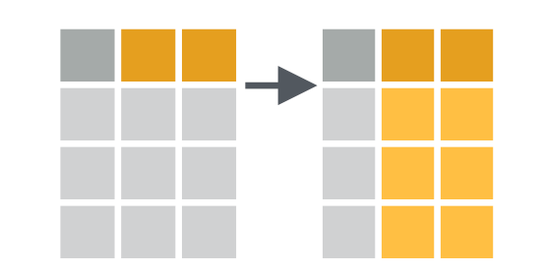
data %>%
mutate_if(.predicate, .funs)
CC BY SA RStudio https://www.rstudio.com/resources/cheatsheets/

Slide 23
data %>%
mutate_if(.predicate, .funs, ...)
data %>%
mutate_if(is.numeric, scale)
data %>%
mutate_if(is.numeric, list(log, log1p))

Slide 24
dplyr::
# Verbs to extent your data
mutate() # operates on columns
group_by() # operates on rows
summarise() # rows & columns

Slide 25
dplyr::
# Verbs to extent your data
mutate() # operates on columns
group_by() # operates on rows
summarise() # rows & columns

Slide 26

data
CC BY SA RStudio https://www.rstudio.com/resources/cheatsheets/

Slide 27
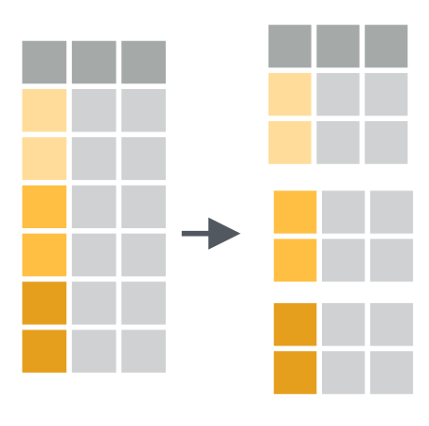
data %>% group_by(veg_type)
CC BY SA RStudio https://www.rstudio.com/resources/cheatsheets/

Slide 28
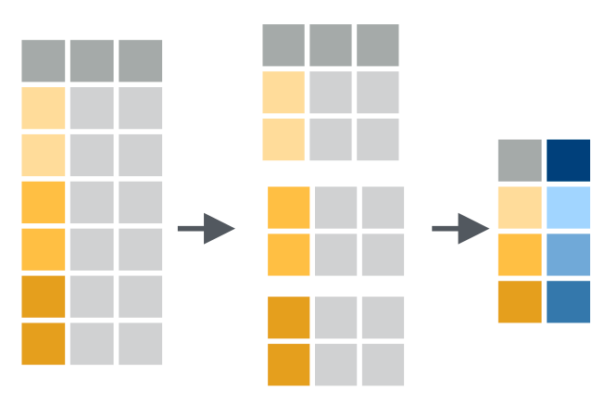
data %>% group_by(veg_type) %>% summarise(mean_plant_height =
mean(plant_height))
CC BY SA RStudio https://www.rstudio.com/resources/cheatsheets/

Slide 29
data %>%
group_by(veg_type) %>%
summarise(mean_plant_height = mean(plant_height),

Slide 30
data %>%
group_by(veg_type) %>%
summarise(mean_plant_height = mean(plant_height),
st_plant_height = sd(plant_height))

Slide 31
data %>%
group_by(veg_type) %>%
summarise(mean_plant_height = mean(plant_height),
st_plant_height = sd(plant_height))
data %>%
group_by(veg_type) %>%
summarise_if(is.numeric, mean)

Slide 32
data %>%
group_by(veg_type) %>%
summarise(mean_plant_height = mean(plant_height),
st_plant_height = sd(plant_height))
data %>%
group_by(veg_type) %>%
summarise_if(is.numeric, mean)
data %>%
group_by(veg_type) %>%
summarise_if(is.numeric, mean, na.rm = TRUE)

Slide 33
data %>%
group_by(veg_type) %>%
summarise(mean_plant_height = mean(plant_height),
st_plant_height = sd(plant_height))
data %>%
group_by(veg_type) %>%
summarise_if(is.numeric, mean)
data %>%
group_by(veg_type) %>%
summarise_if(is.numeric, mean, na.rm = TRUE)
data %>%
group_by(veg_type) %>%
summarise_if(is.numeric, list(mean, sd))

Slide 34
> demo()

