Slide 1

data_wrangling() &&
("manipulation" %in% R)
🐨🐟🌿 %>% %>% %>% 🤓📊🥰
> day[2]
Ruan van Mazijk

Slide 2
Notes & slides will go up here:
tinyurl.com/r-with-ruan
(But I encourage you to make your own notes!)

Slide 3


> workshop$outline[1:3]
DAY 1
Tidy data principles
& tidyr
DAY 2
Manipulating data
& an intro to dplyr
DAY 3
Extending your data
with mutate(),
summarise()
& friends

Slide 4
tidyr::
# Verbs to tidy your data
# Untidy observations?
gather() # if > 1 observation per row
spread() # if observations live in > 1 row
# Untidy variables?
separate() # if > 1 variable per column
unite() # if variables live in > 1 column

Slide 5
> workshop$outline[2:3]
DAY 2
Manipulating data
& an intro to dplyr
DAY 3
Extending your data
with mutate(),
summarise()
& friends

Slide 6
# base R
data[ , columns ]
data[ rows , ]

Slide 7
# base R
data[, 4]
data[, "plantheight"]
data[1:10, ]
data[data$soil == "a", ]

Slide 8
# base R
data[, "plantheight"]
data[data$soil == "a", ]

Slide 9
# tidyverse R
data %>%
select(plantheight)
data %>%
filter(soil == "a")

Slide 10
dplyr::
# Verbs to manipulate your data

Slide 11
dplyr::
# Verbs to manipulate your data
select() # operates on columns
filter() # operates on rows

Slide 12
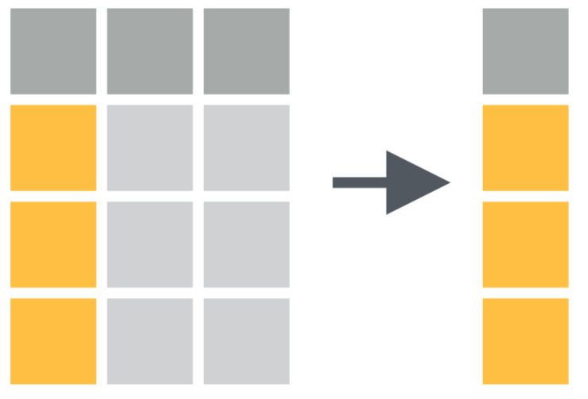
data %>%
select(...)
CC BY SA RStudio https://www.rstudio.com/resources/cheatsheets/

Slide 13
data %>%
select(plant_height, soil, lon, lat, veg_type)

Slide 14
data %>%
select(plant_height, soil, lon, lat, veg_type)
data %>%
select(plant_height:veg_type)
# Think 1:10 but with words!

Slide 15
data %>%
select(plant_height, soil, lon, lat, veg_type)
data %>%
select(plant_height:veg_type)
# Think 1:10 but with words!
data %>%
select(-mean_annual_temp)
# Think data[, -10],
# Or like gather(key, value, -foo)

Slide 16
data %>%
select(plant_height, plant_weight, plant_LAI)

Slide 17
data %>%
select(plant_height, plant_weight, plant_LAI)
data %>%
select(starts_with("plant"))
# Also:
# contains() ends_with() matches()
# num_range() one_of() starts_with()

Slide 18
data %>%
select(plant_height, plant_weight, plant_LAI)
data %>%
select(starts_with("plant"))
# Also:
# contains() ends_with() matches()
# num_range() one_of() starts_with()
data %>%
select_if(is.numeric)
# Accepts base R functions (sans "()"):
# is.logical is.character is.numeric
# is.factor is.datetime

Slide 19
> demo()

Slide 20
> demo()
DATASETS:
…

Slide 21
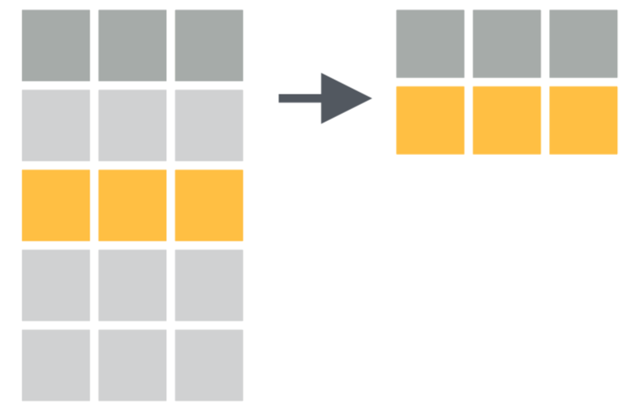
data %>%
filter(...)
CC BY SA RStudio https://www.rstudio.com/resources/cheatsheets/

Slide 22
data %>%
filter(plant_height <= 10)

Slide 23
data %>%
filter(plant_height <= 10)
data %>%
filter(plant_height <= 10, vegtype == "fynbos")

Slide 24
data %>%
filter(plant_height <= 10)
data %>%
filter(plant_height <= 10, vegtype == "fynbos")
# Multiple conditions must all be satisfied
# So it "&&"s them, so it would be the same as:
data %>%
filter(plant_height <= 10 && vegtype == "fynbos")

Slide 25
data %>%
filter(plant_height <= 10)
data %>%
filter(plant_height <= 10, vegtype == "fynbos")
# Multiple conditions must all be satisfied
# So it "&&"s them, so it would be the same as:
data %>%
filter(plant_height <= 10 && vegtype == "fynbos")
data %>%
filter(plant_height <= 10 || plant_weight >= 60)
# We can use "or": ||

Slide 26
# Intervals?
data %>%
filter(plant_height <= 10 && plant_height >= 0.5)
# There is also a tidy way!
data %>%
filter(plant_height %>% between(0.5, 10))

Slide 27
> demo()

Slide 28
> demo()
DATASETS:
…

