Slide 1
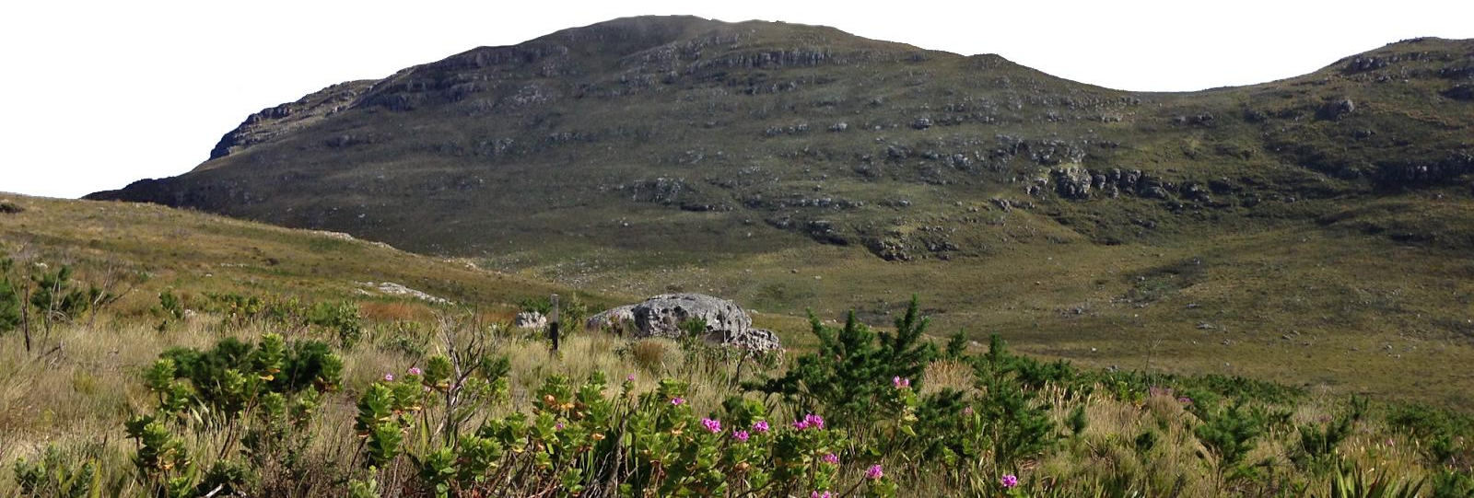
Similar axes of
environmental heterogeneity associate with
plant species richness in two MTEs
Ruan van Mazijk, Michael D. Cramer & G. Anthony Verboom
University of Cape Town
Comparing the Greater Cape Floristic Region &
the Southwest Australia Floristic Region
Silvermine, Table Mountain National Park, South Africa, 2017 © Ruan van Mazijk, Jonathan A. Drake

Slide 2
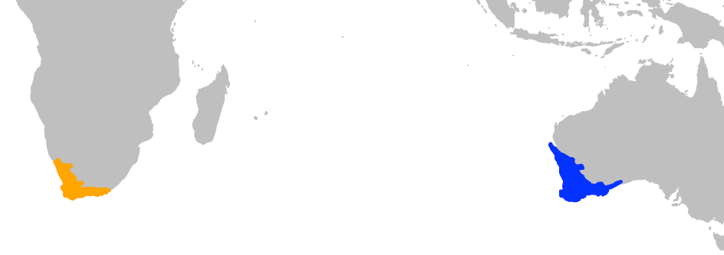
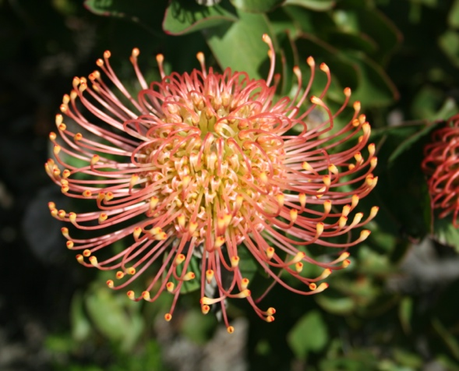
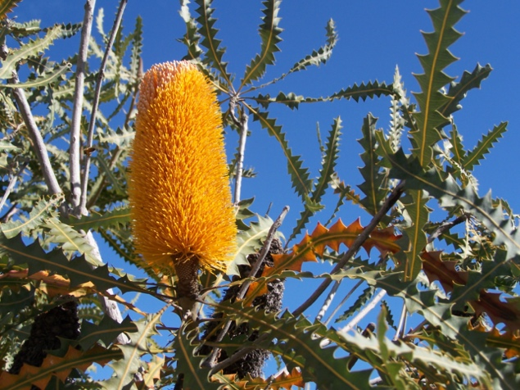
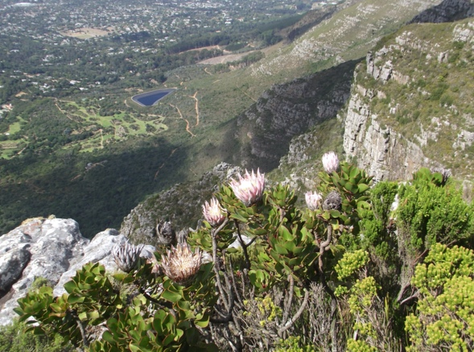
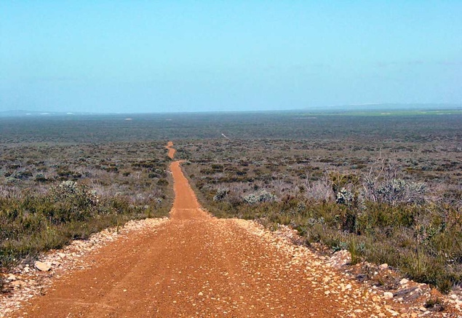
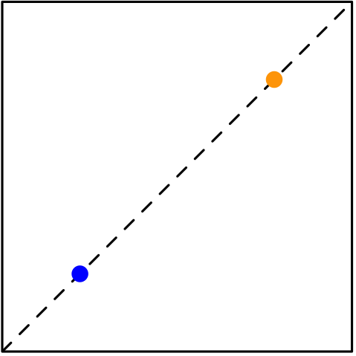
Cape Town
Perth
Hypothesis:
Species richness
The Greater Cape Floristic Region &
the Southwest Australian Floristic Region
Enviro. heterogeneity

Slide 3
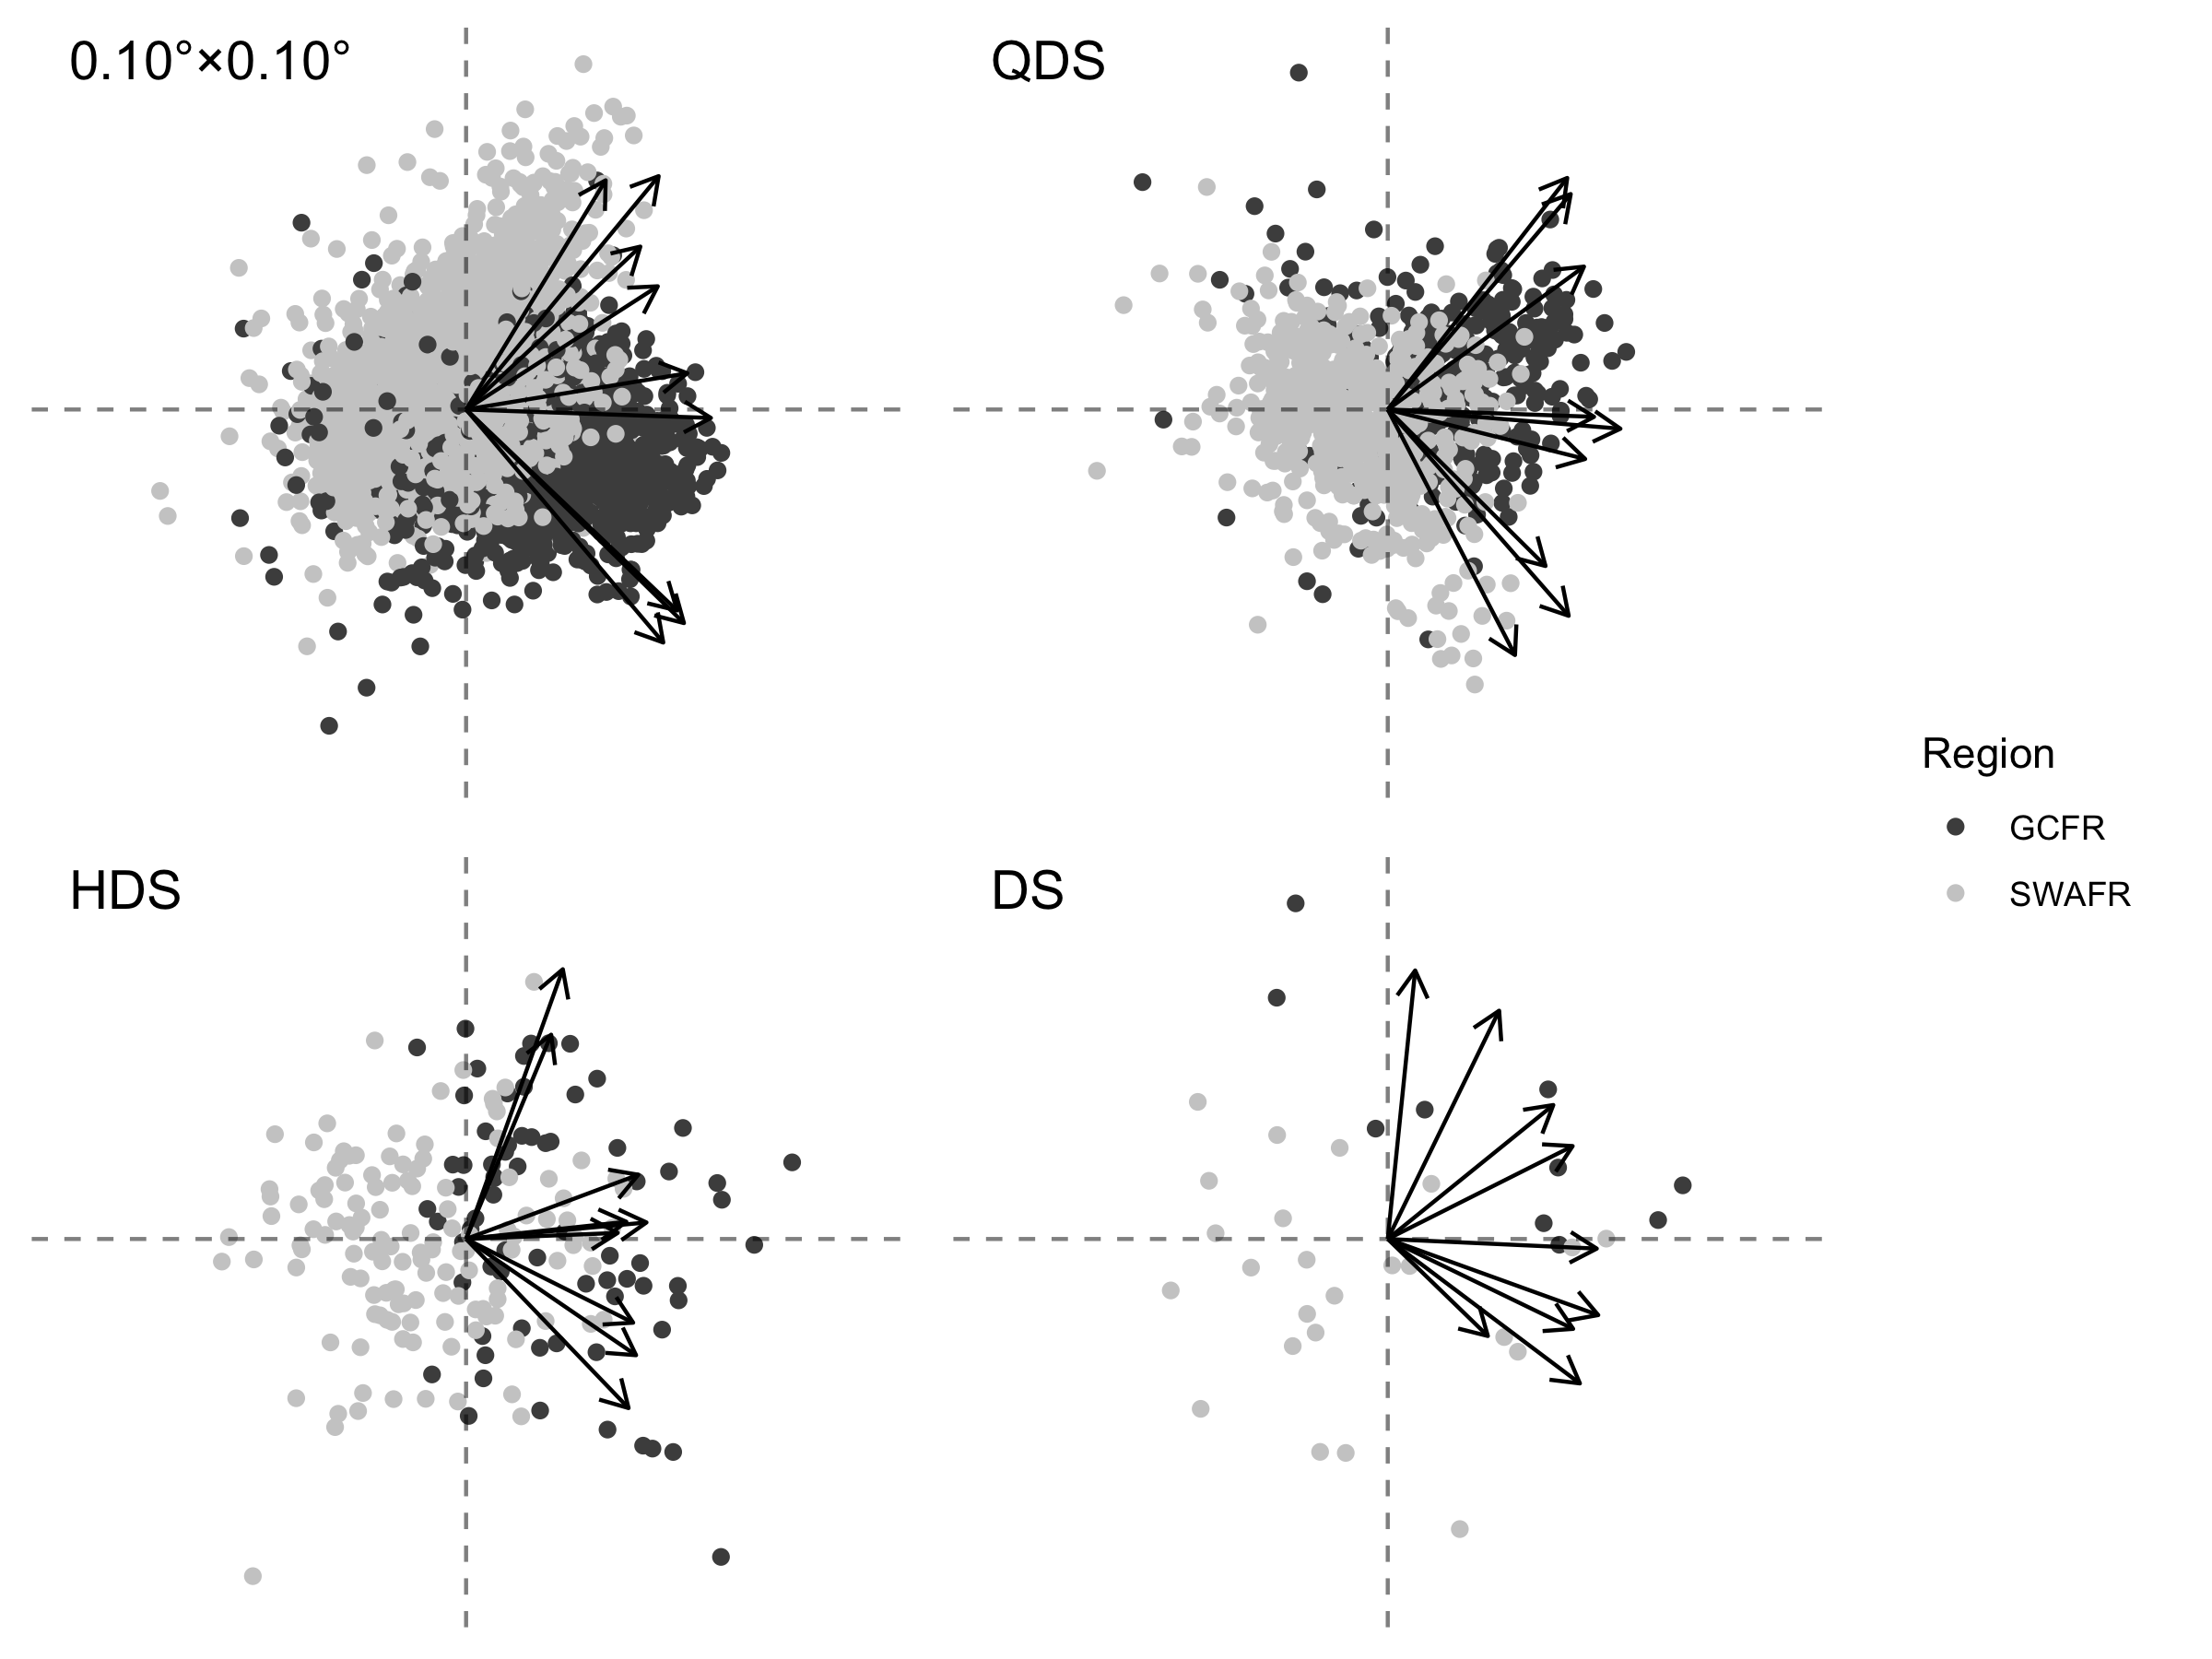
PC1 (38.1–49.9%)

Slide 4
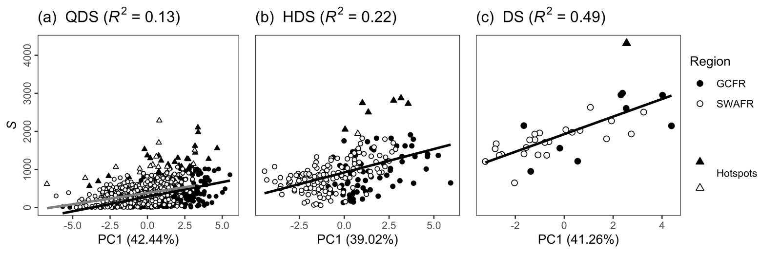
Species richness
Environmental heterogeneity

Slide 5
Species richness
Environmental heterogeneity

Slide 6






@rvanmazijk

