Slide 1





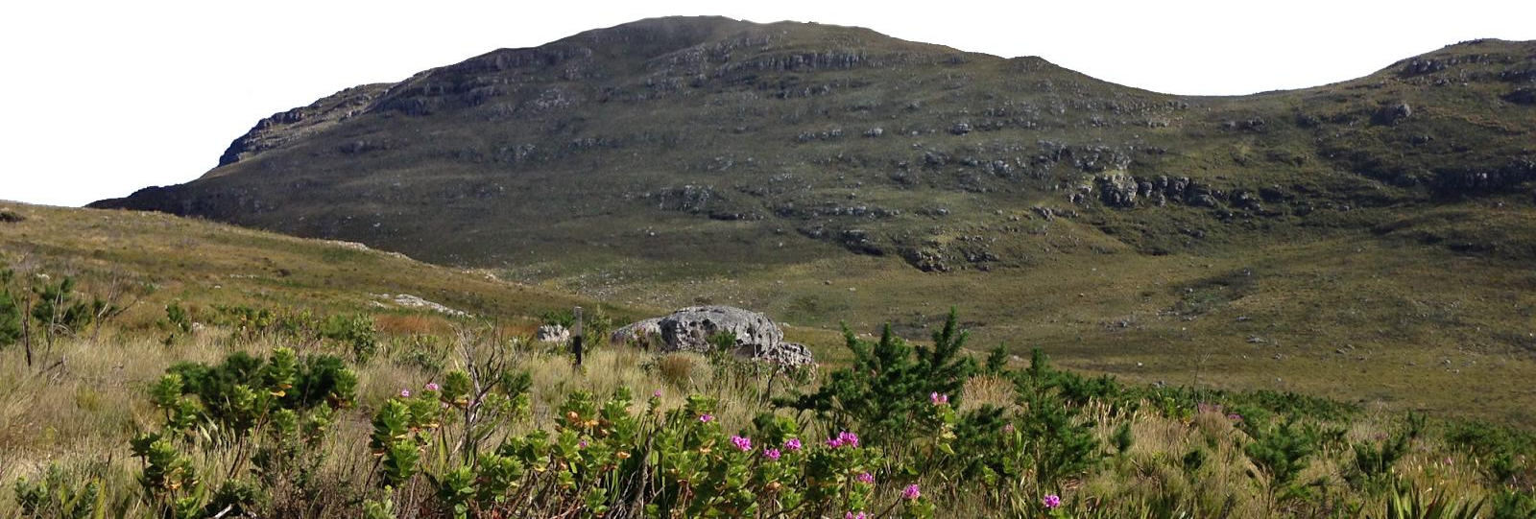
Environmental turnover predicts plant species richness & turnover
Supervised by
Prof M.D. Cramer &
A/Prof G.A. Verboom
Ruan van Mazijk
Comparing the Greater Cape Floristic Region &
the Southwest Australia Floristic Region
Silvermine, Table Mountain National Park, South Africa, 2017 © Ruan van Mazijk, Jonathan A. Drake

