Slide 1







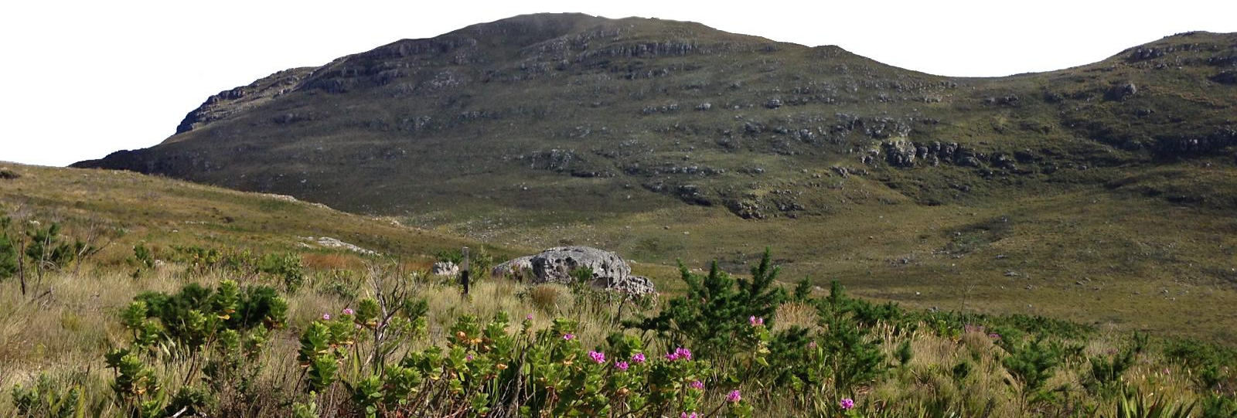
Supervised by
Prof M.D. Cramer &
A/Prof G.A. Verboom
Environmental turnover predicts plant species richness & turnover
Ruan van Mazijk
@rvanmazijk
Comparing the Greater Cape Floristic Region &
the Southwest Australia Floristic Region
Silvermine, Table Mountain National Park, South Africa, 2017 © Ruan van Mazijk, Jonathan A. Drake

