Slide 1
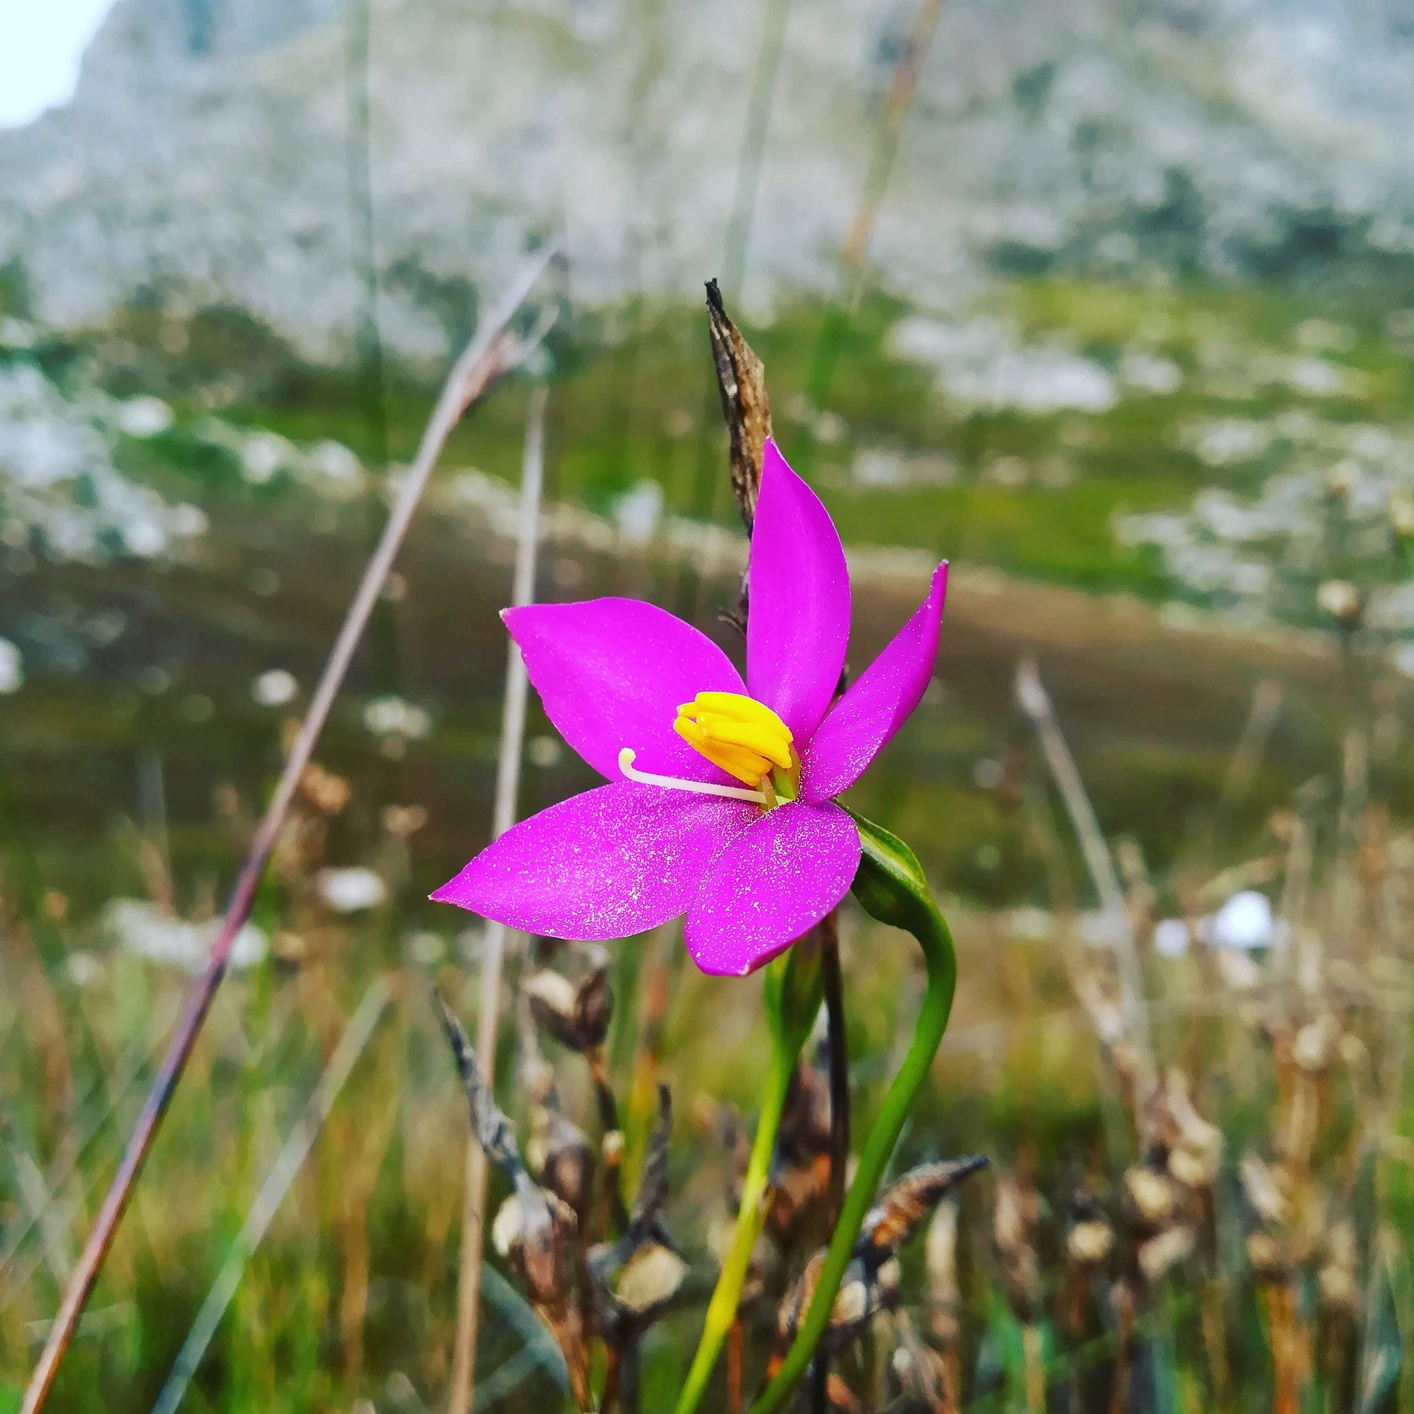


Biodiversity, evolution & taxonomy
Teaching Biodiversity for
FET Life Sciences
Chironia sp., Bobejaanskloof, 2018-05-24, CC BY 4.0 Ruan van Mazijk
Ruan van Mazijk
MSc candidate
Dept. Biological Sciences, UCT

