Slide 1
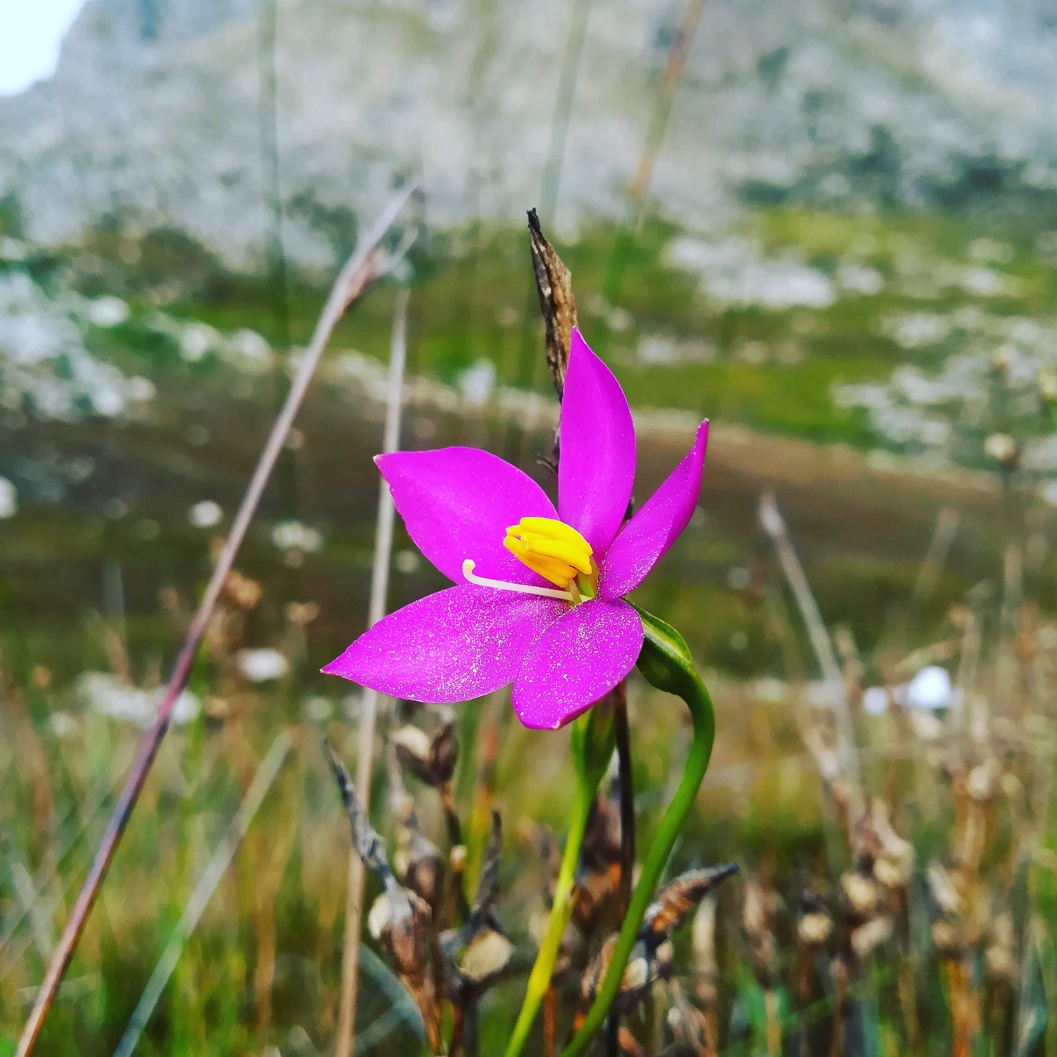


Biodiversity evolution & taxonomy
Teaching Biodiversity Short Course for FET Life Sciences Teachers
Chironia sp., Bobejaanskloof, 2018-05-24, CC BY 4.0 Ruan van Mazijk
MSc candidate
Dept. Biological Sciences, UCT
Ruan van Mazijk

