Slide 1
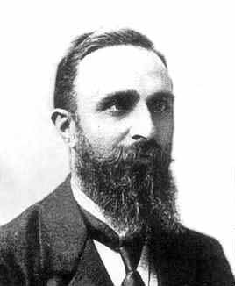
Henri Eugène Padé
Born: 17 Dec 1863 in Abbeville, Picardy, France,
Died: 9 July 1953 in Aix-en-Provence, France

Slide 2
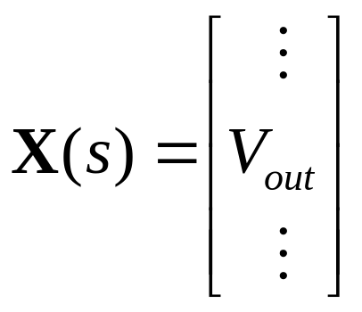
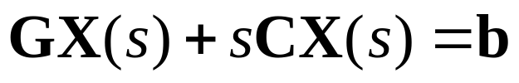
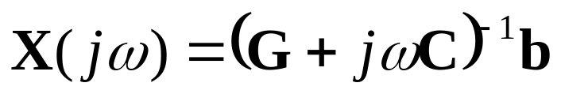
Frequency Response
At each frequency point:
100 frequency points → 100 LU decompositions

Slide 3
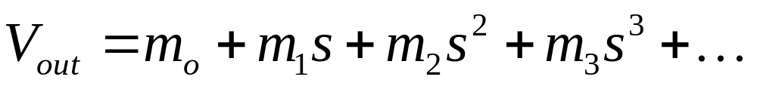
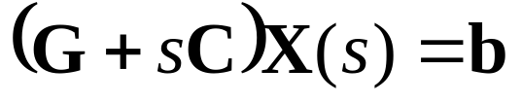
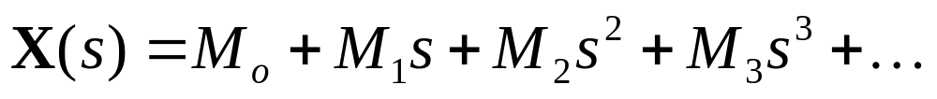
Asymptotic Waveform Evaluation
Moments

Slide 4
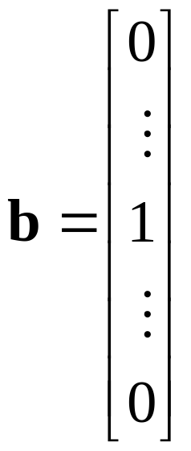
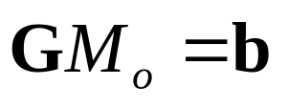
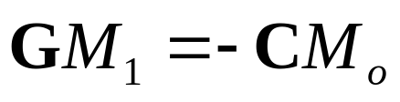
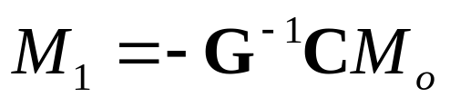
Moment Calculation
Impulse response →

Slide 5
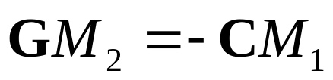
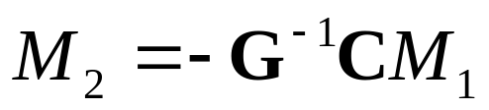
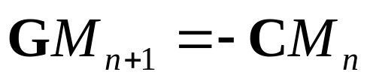
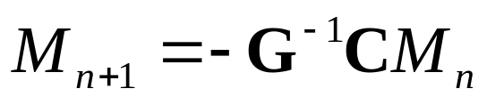
Moment Calculation
Cost of moments → 1 LU decomposition

Slide 6
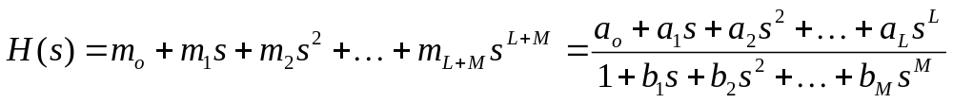
Padé Approximation
The Padé approximation matches the first L+M+1 moments
The Padé approximation is more accurate than the original Taylor expansion!
The “poles” are the roots of the denominator.

Slide 7
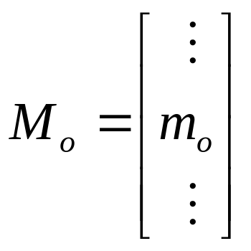
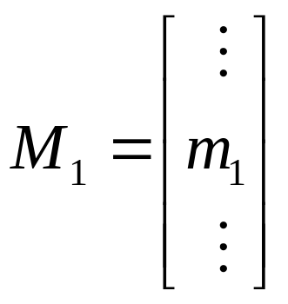

Moment Calculation

Slide 8
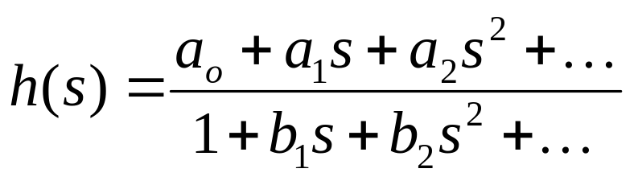
Padé Approximation
Taylor series is ill conditioned
Padé Approximation:

Slide 9
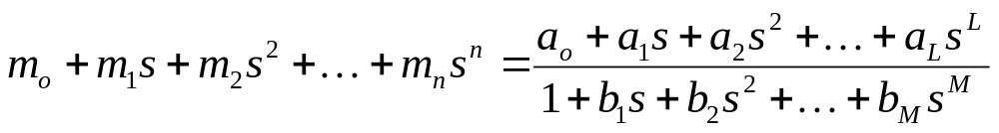
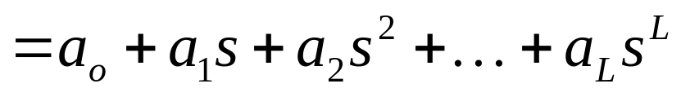
Padé Approximation

Slide 10
Padé Approximation
Equate powers of s for powers > L

Slide 11
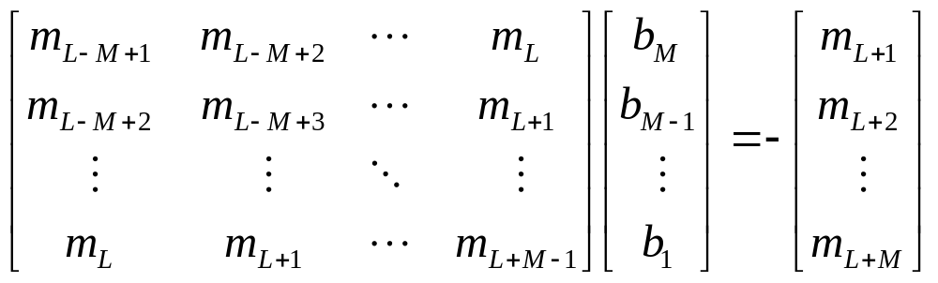
Padé Approximation
Eq(98)

Slide 12
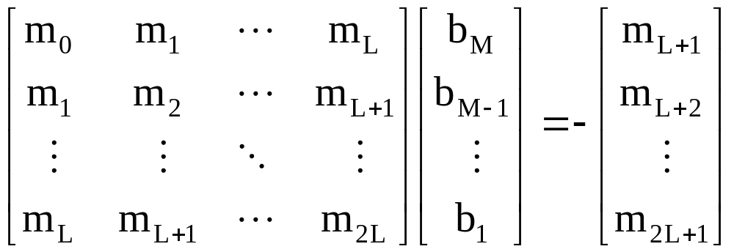
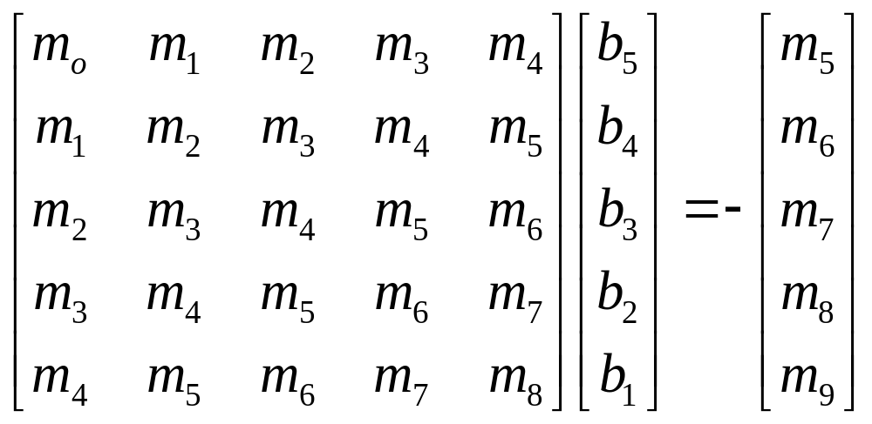
Padé Approximation
Special Case: L=M-1
L=4, M=5

Slide 13
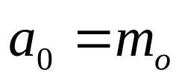
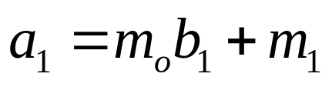
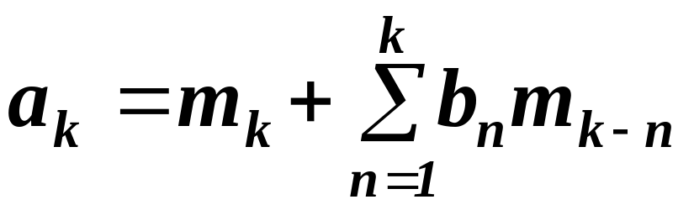
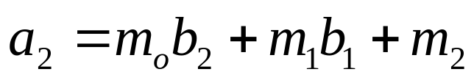
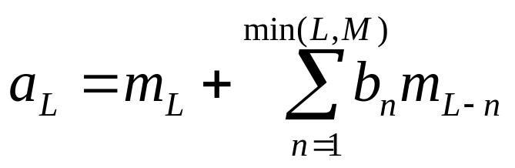
Padé Approximation
Equate powers of s for powers <= L
Eq.(99)

Slide 14
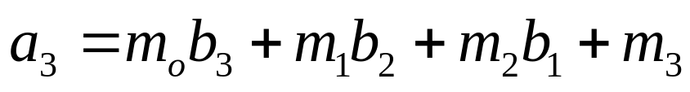
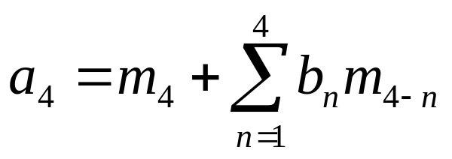
Example
L=4, M=5

Slide 15
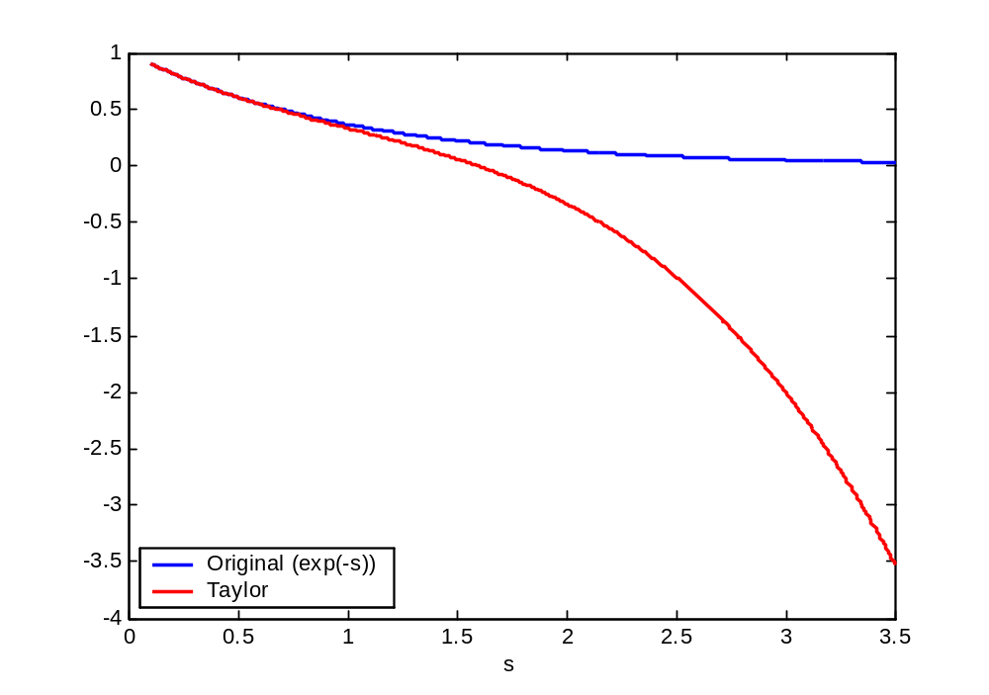

Slide 16
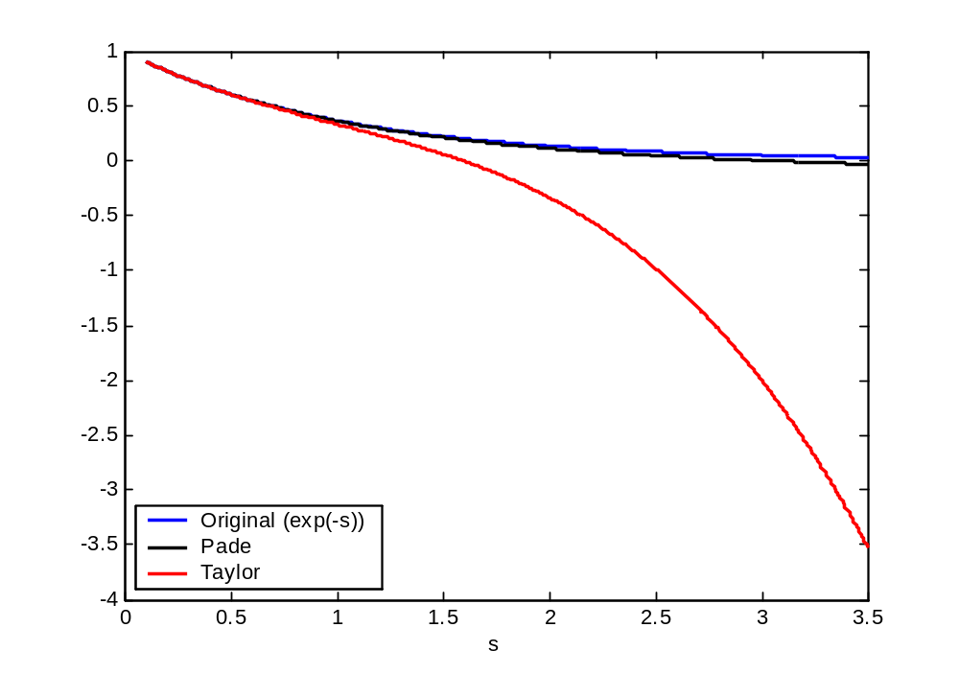
Pade

Slide 17
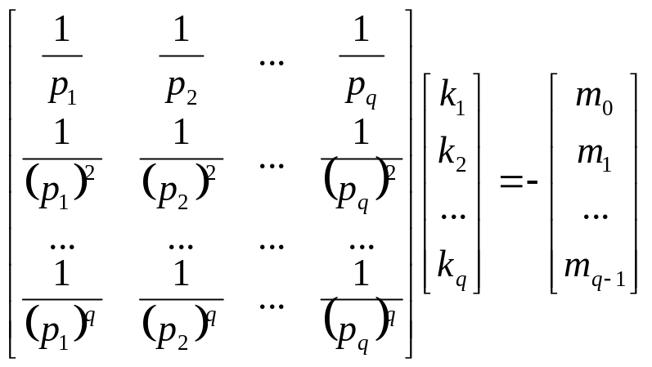
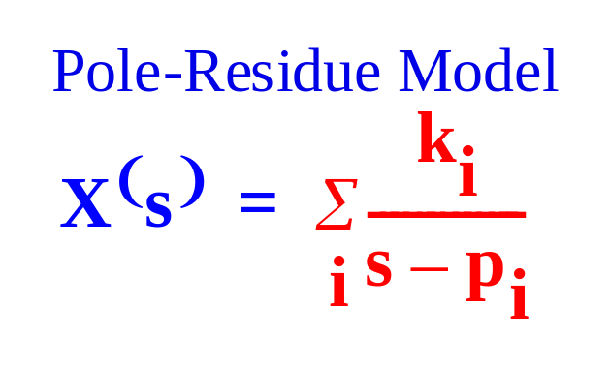
Poles/Residues
Eq(102)
EQ. (102)

Slide 18
Animated examples
http://math.fullerton.edu/mathews/numerical.html

Slide 19
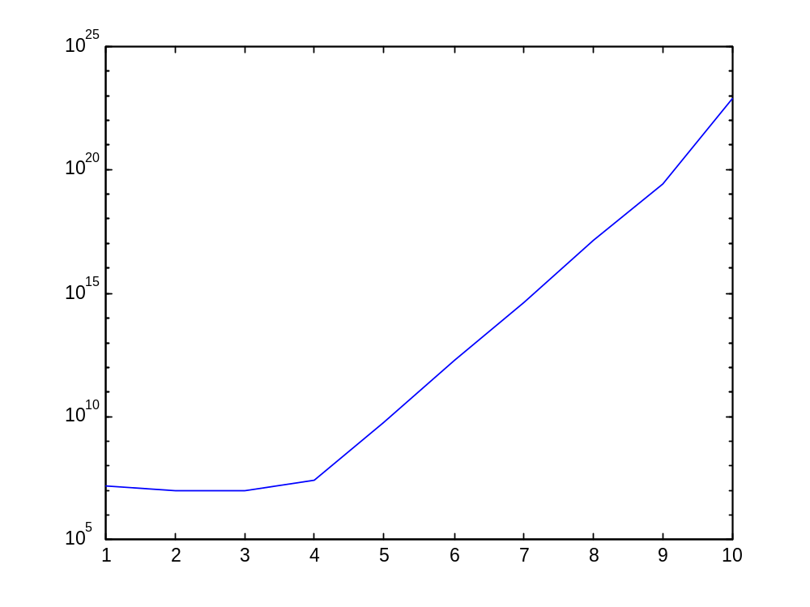
Condition Number
Dimension of the Pade Matrix

