Slide 1
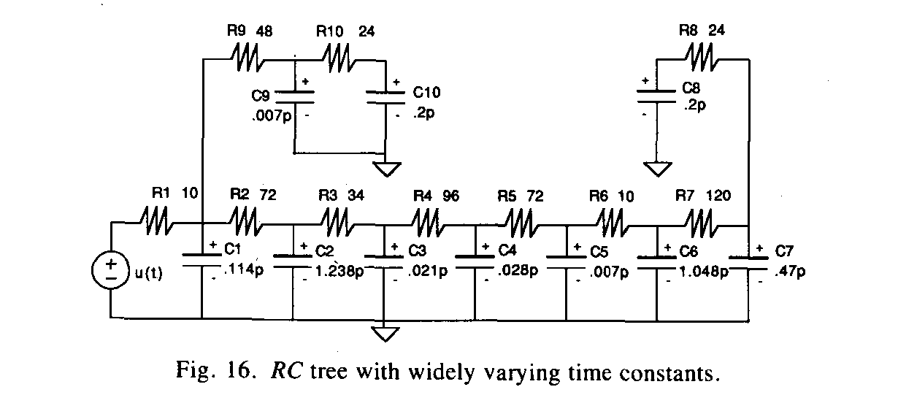
L. Pillage, R. Rohrer, “Asymptotic Waveform Evaluation for Timing Analysis”, IEEE Transactions on CAD, April 1990

Slide 2
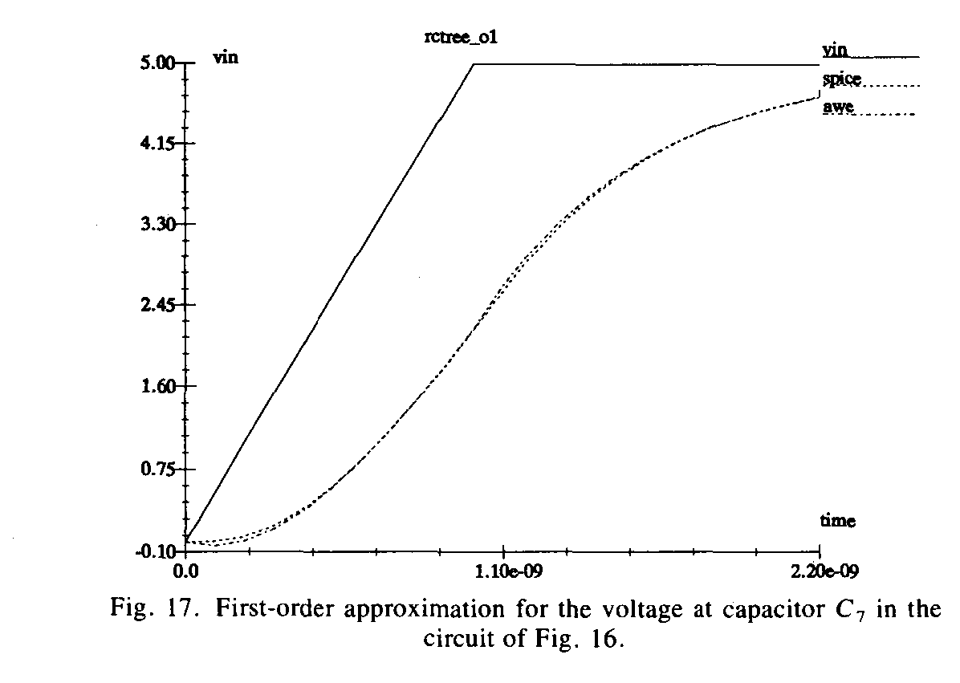
L. Pillage, R. Rohrer, “Asymptotic Waveform Evaluation for Timing Analysis”, IEEE Transactions on CAD, April 1990

Slide 3
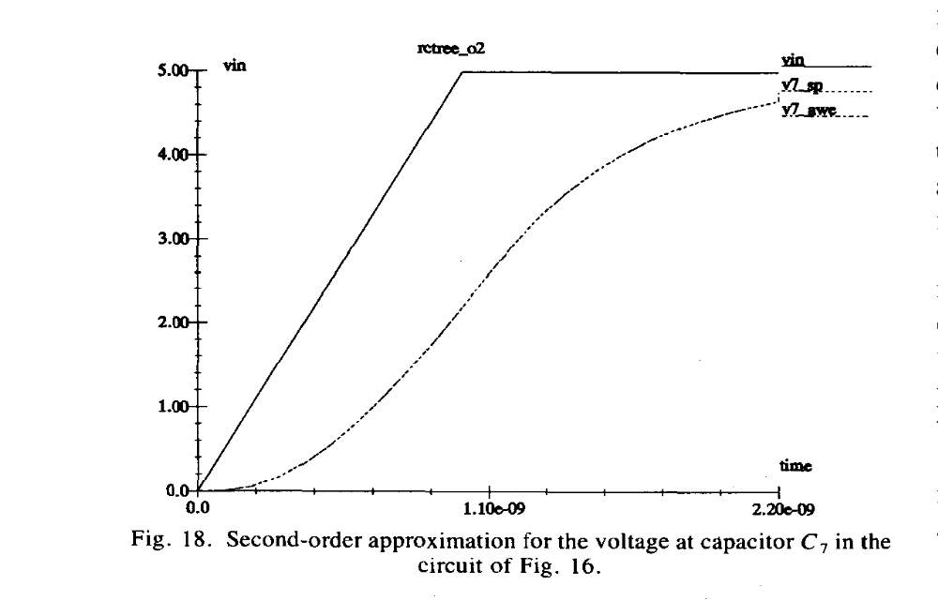
L. Pillage, R. Rohrer, “Asymptotic Waveform Evaluation for Timing Analysis”, IEEE Transactions on CAD, April 1990

Slide 4
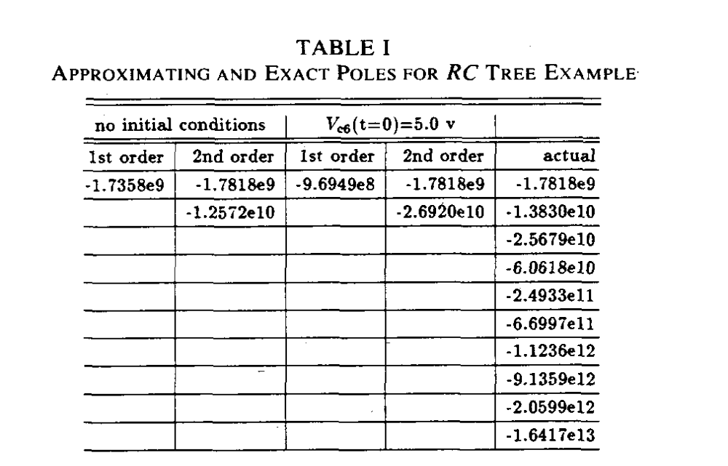
L. Pillage, R. Rohrer, “Asymptotic Waveform Evaluation for Timing Analysis”, IEEE Transactions on CAD, April 1990

Slide 5
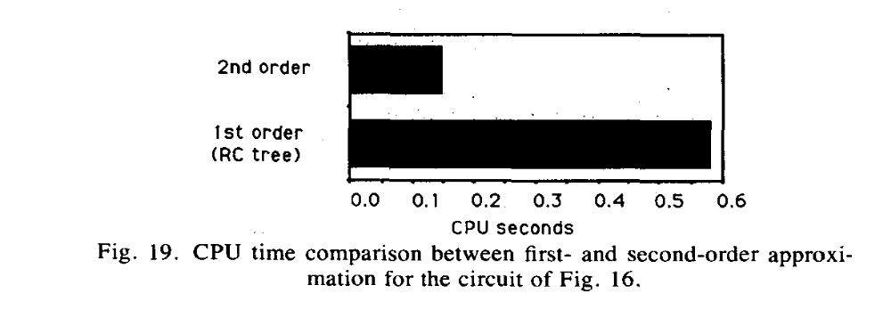
L. Pillage, R. Rohrer, “Asymptotic Waveform Evaluation for Timing Analysis”, IEEE Transactions on CAD, April 1990

Slide 6
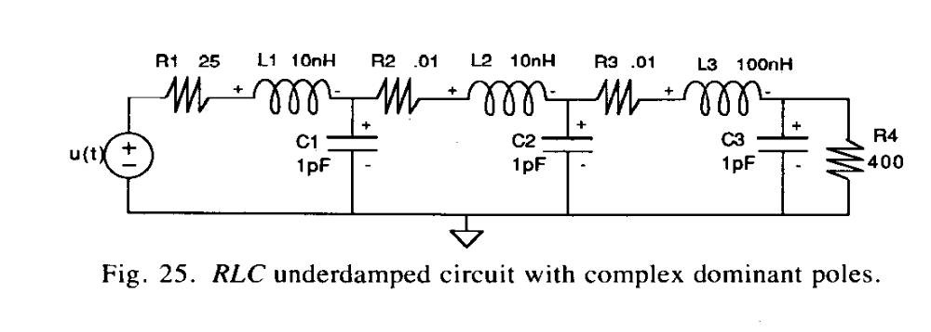
L. Pillage, R. Rohrer, “Asymptotic Waveform Evaluation for Timing Analysis”, IEEE Transactions on CAD, April 1990

Slide 7
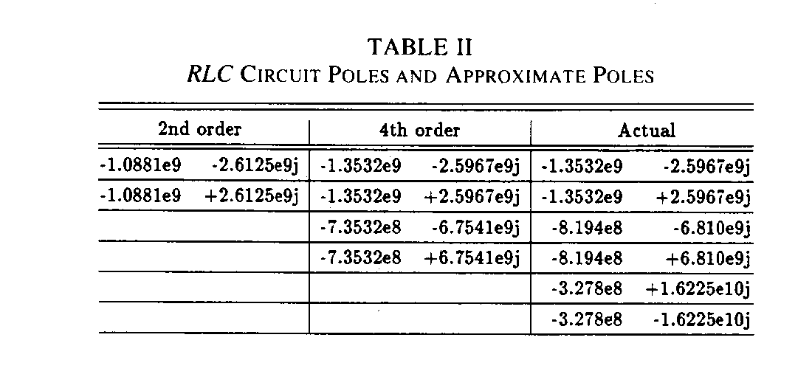
L. Pillage, R. Rohrer, “Asymptotic Waveform Evaluation for Timing Analysis”, IEEE Transactions on CAD, April 1990

Slide 8
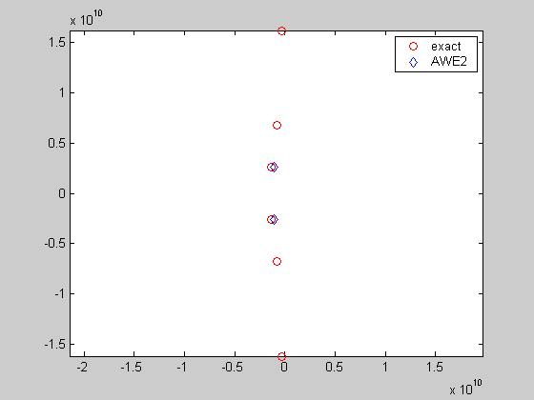

Slide 9
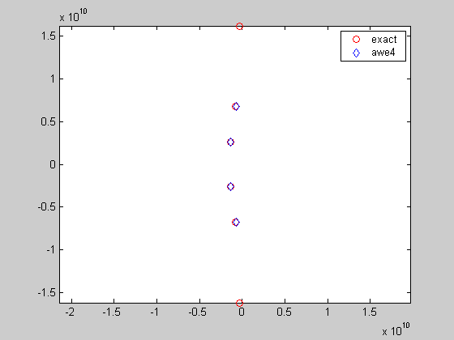

Slide 10
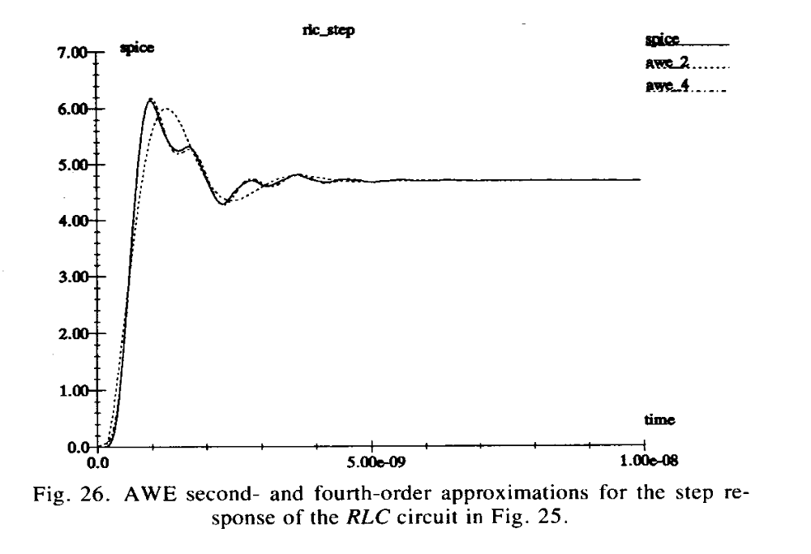
L. Pillage, R. Rohrer, “Asymptotic Waveform Evaluation for Timing Analysis”, IEEE Transactions on CAD, April 1990

