Slide 1
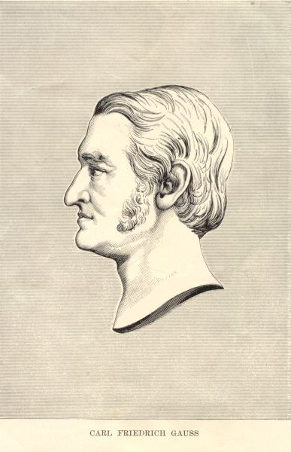
Born: 30 April 1777 in
Brunswick, Duchy of Brunswick (now Germany)
Died: 23 Feb 1855 in
Göttingen, Hanover (now Germany)
Johann Carl Friedrich Gauss

Slide 2
SIZE CPU TIME
10x10 1 second
100x100 1000 seconds (~ 17 minutes)
1000x1000 17,000 minutes (~ 12 days!)

Slide 3
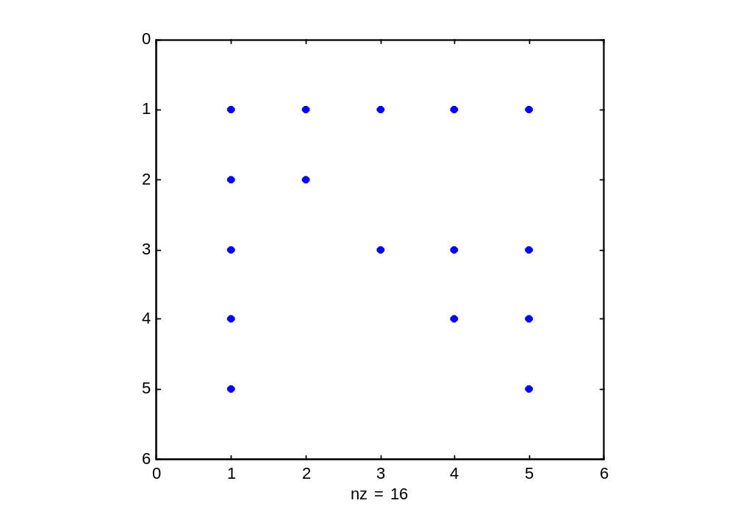
MATRIX A

Slide 4
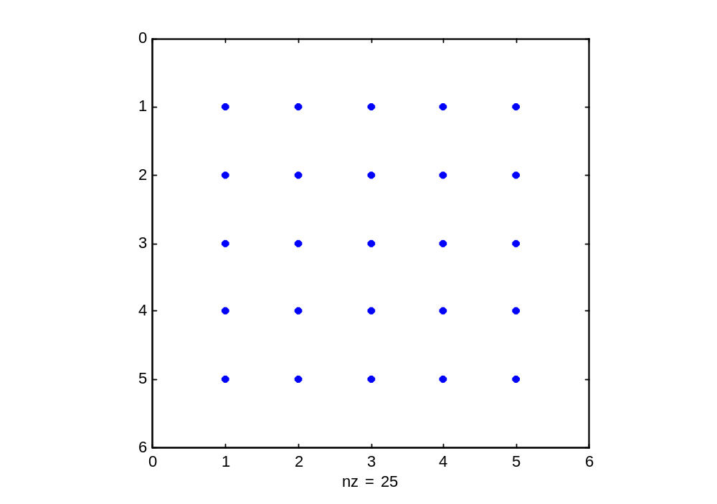
B=inv(A)

Slide 5







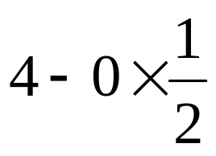
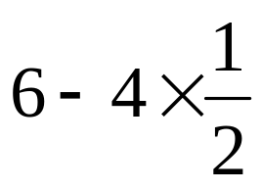





LU Algorithm: Example
Pivot
Pivot

Slide 6
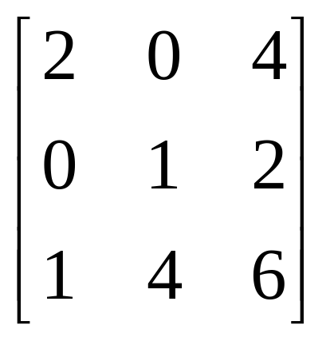
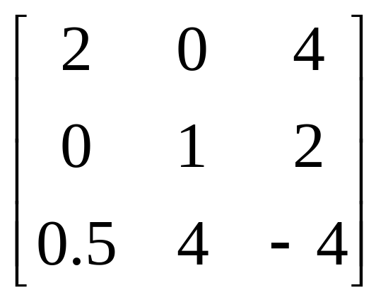
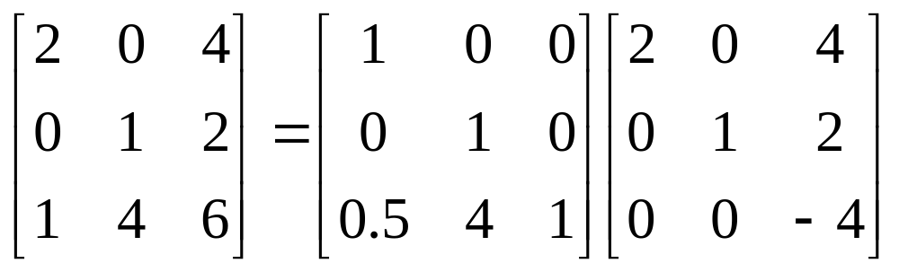
LU Algorithm: Example

Slide 7




LU Algorithm: Example

Slide 8
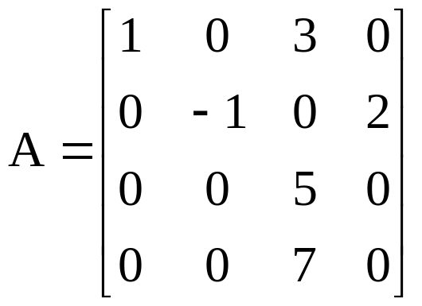
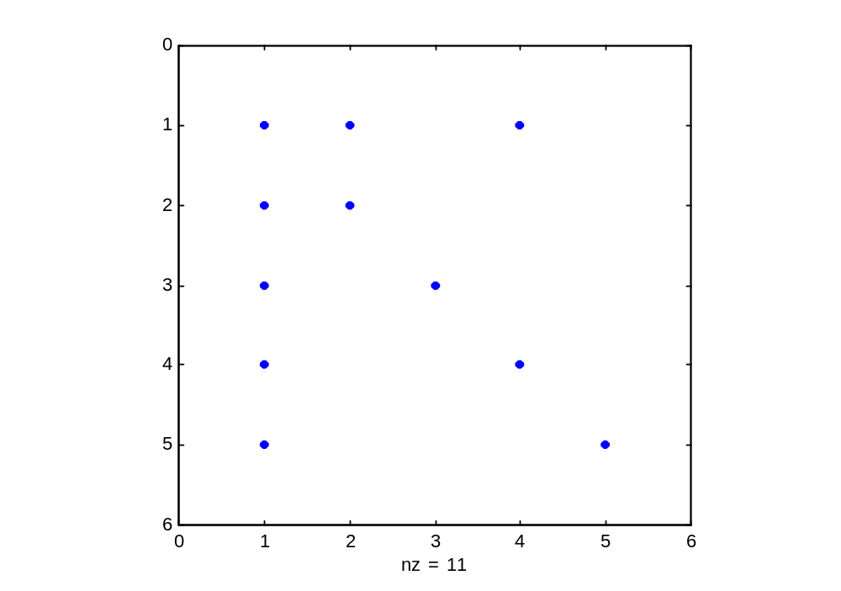
A(1,1) 1
A(1,3) 3
A(2,2) -1
A(2,4) 2
A(3,3) 5
A(4,3) 7

Slide 9
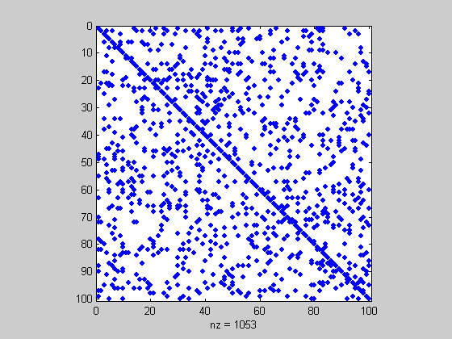
Matrix A
Sparsity=80%

Slide 10
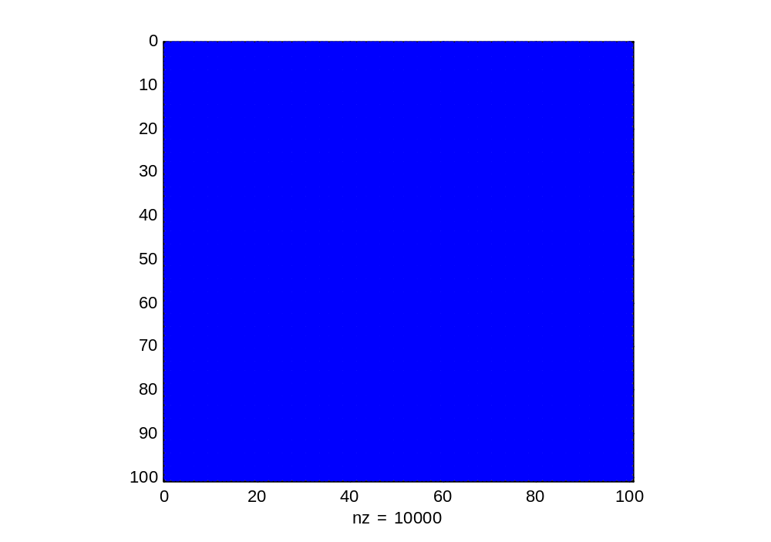
Inverse (A)
Sparsity=0%

Slide 11
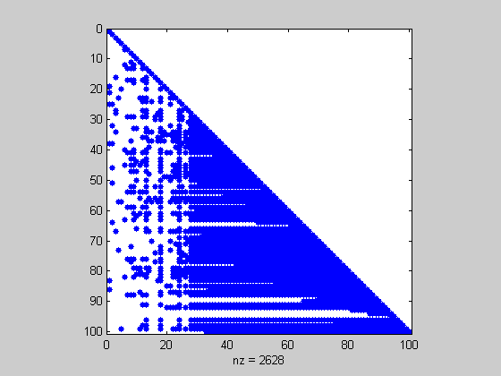
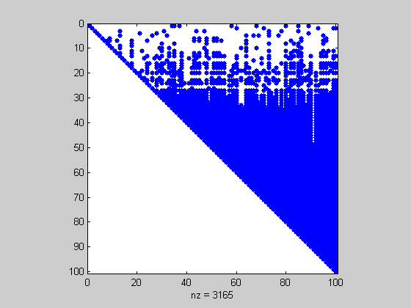
LU Factorization
Sparsity=43%

Slide 12

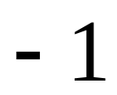
Example
1Ω
1
2
1Ω
3
1Ω
4
1A
1Ω
1Ω
1Ω
How many zeros remain after first step of LU
decomposition?

Slide 13
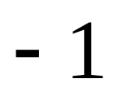
Example
1Ω
1
2
1Ω
3
1Ω
4
1A
1Ω
1Ω
1Ω
How many zeros doe we lose in the first step of LU decomposition?

Slide 14
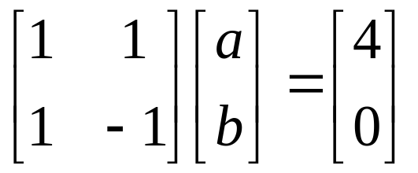
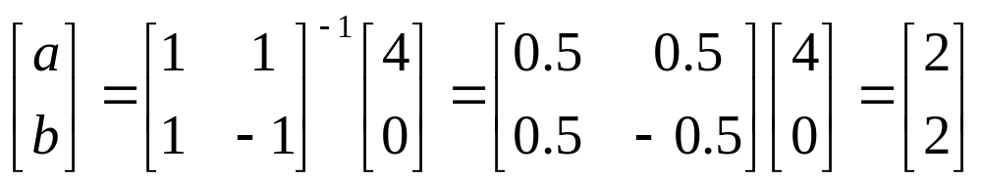
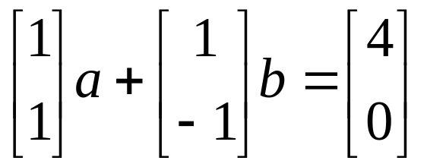
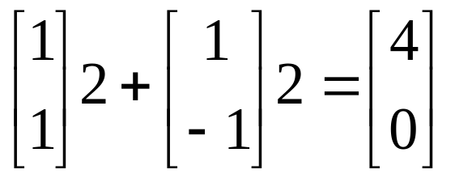
Solution of Linear Systems of Eqs
What is a solution of a linear system of equations?
The solution is:

Slide 15
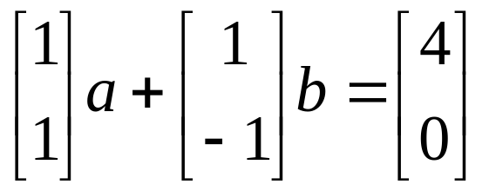
Solution of Linear Systems of Eqs
Geometric interpretation:

Slide 16
Solution of Linear Systems of Eqs
Geometric interpretation:
The solution is a set of scaling factors such that the right hand side vector is expressed as a linear combination of the linearly independent vectors forming the left hand side matrix. Solution is unique.

Slide 17
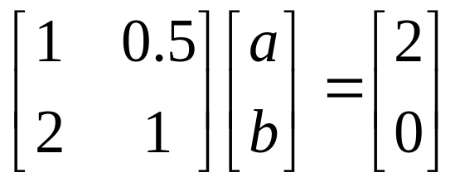
Solution of Linear Systems of Eqs
Consider the following case:
Solution does not exist.
Vectors are linearly dependent.
RHS vector is not in the space spanned by the LHS matrix.

Slide 18
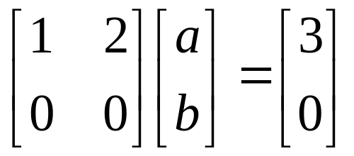
Solution of Linear Systems of Eqs
Consider the following case:
Vectors are linearly dependent.
RHS vector is in the space spanned by the LHS matrix.
Solution is not unique.

