Slide 1
MODIFIED NODAL AMITTANCE FORMULATION
Prepared by Dr. Roni Khazaka

Slide 2
Circuit Netlist
1
30Ω
50Ω
3
2
1A
20Ω
20Ω
R1 1 2 30
R2 2 0 20
R3 2 3 50
R4 3 0 20
Idc 0 1 1

Slide 3
Nodal Analysis by Inspection
g
col i
col j
Node i
Node j
row i
g
-g
row j
-g
g
col i
g
Node i
row i
g

Slide 4
Nodal Analysis by Inspection: Example
g₁
v₁
Ι_{a}
1
2
3
4
5
1
g₁
+ g₂
-g₁
0
0
0
v₁
g₂
Ι_{b}
2
-g₁
g₁
0
-g₄
0
v₂
v₃
+ g₄
v₂
g₃
3
0
0
g₃
+ g₆
0
-g₆
v₃
g₄
g₅
g₆
4
0
-g₄
0
g₄
+ g₅
0
v₄
Ι_{c}
v₅
v₄
v₅
5
0
0
-g₆
0
g₆
Ι_{a}
1
−Ι_{b}
2
→ Check to see that each row represents the KCL equation at the corresponding node.
=
−Ι_{a}
3
−Ι_{c}
4
Ι_{c}
5

Slide 5
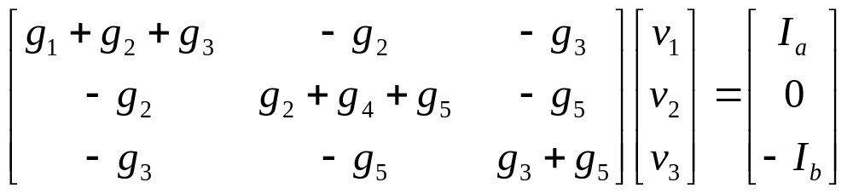
Nodal Analysis by Inspection
g₃
v₁
g₂
v₂
g₅
v₃
g₁
g₄
Ι_{a}
Ι_{b}

Slide 6
Nodal Analysis by Inspection
For circuits containing resistors and current sources only:
Designate a reference node.
Number the remaining nodes.
Size of the matrix (number of eqs) is equal to the number of nodes (not including the reference node).
Add the contribution of each element (or its “stamp”) to the matrix equations.
Resistors contribute to the LHS equations or to the matrix itself.
Current sources contribute to the right hand side (RHS) vector.

Slide 7
Nodal Analysis by Inspection
Node i
Right Hand Side vector
row i
Ι_{a}
Ι_{a}
row j
−Ι_{a}
Node j
Be careful about the signs.
If one of the terminals is connected to ground then there is no corresponding KCL equation and that node simply does not appear in the equations (we get only one entry in the RHS vector).

Slide 8
Capacitor Stamp
C
col i
col j
Node i
Node j
row i
sC
-sC
row j
-sC
sC
C
col i
Node i
row i
sC

Slide 9
Example: Using capacitor stamp
C₁
g₂
1
2
3
J
g₁
C₂
1
2
3
1
sC₁
-sC₁
0
v₁
J
2
-sC₁
g₁
+g₂
+sC₁
-g₂
v₂
=
0
3
0
-g₂
g₂
+sC₂
v₃
0

Slide 10
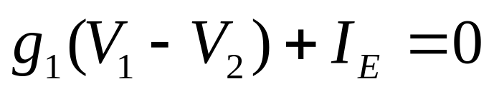
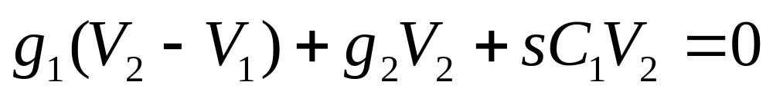
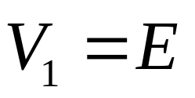
Example: Voltage source
1
g₁
2
I_{E}
g₂
C₁
E
2 equations,
3 unknowns

Slide 11
Voltage Source Stamp
E
Node i
Node j
RHS
vector
New col
col i
col j
row i
+1
row j
-1
New row
+1
-1
E

Slide 12
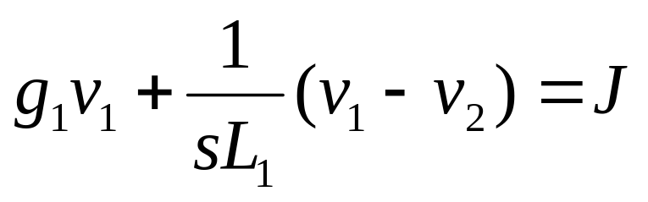
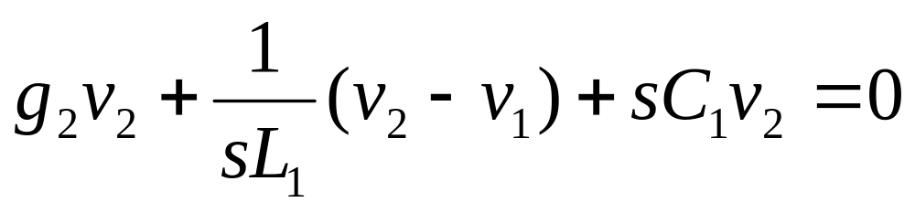
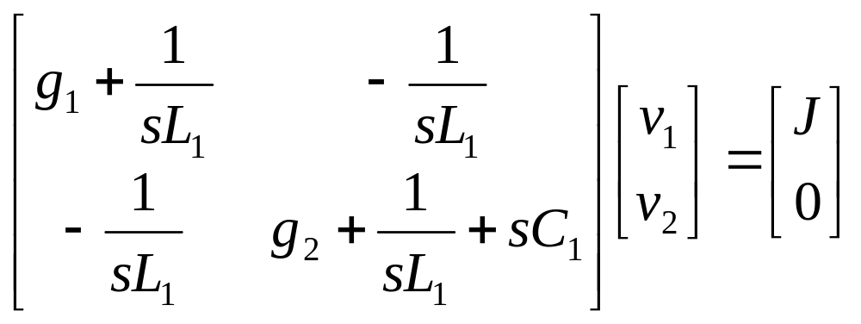
Example: Inductors

Slide 13
Example: Inductors
L₁
2
1
J
g₁
g₂
C₁

Slide 14
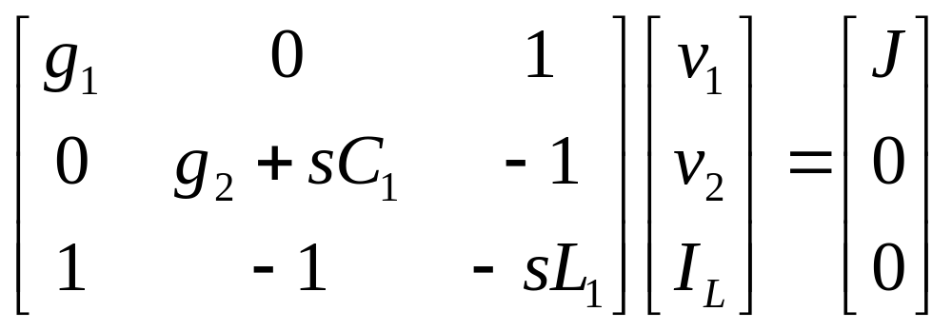
MNA Formulation
L₁
2
1
I_{L}
J
g₁
g₂
C₁

Slide 15
Inductor Stamp
L
Node i
Node j
New col
col i
col j
row i
+1
row j
-1
New row
+1
-1
-sL

Slide 16
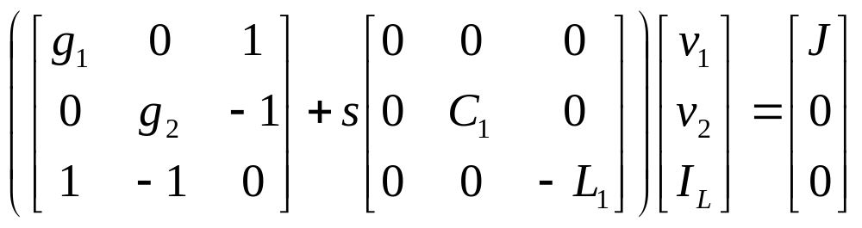
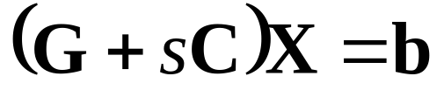
Inductor Example: Time domain

Slide 17
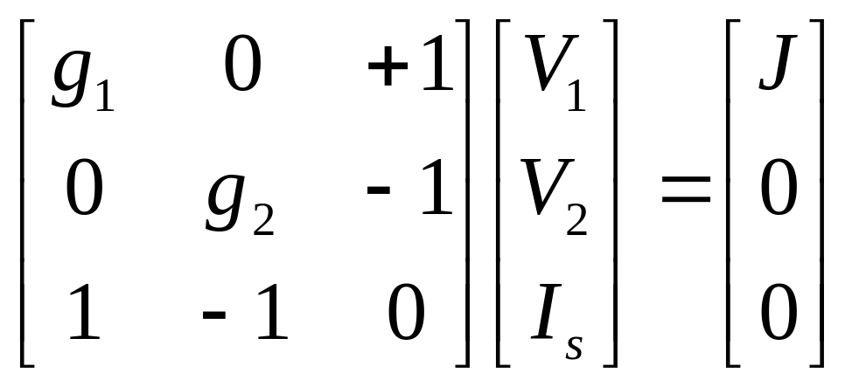
Short Circuit
1
2
I_{s}
J
g₁
g₂

Slide 18
Short circuit Stamp
Node i
Node j
New col
col i
col j
row i
+1
row j
-1
New row
+1
-1

Slide 19
Modified Nodal Analysis
New variables are added for inductor and voltage source stamps.
Vector of unknowns contains node voltages, and some currents (we will add more later).
MNA matrices are typically very sparse.
MNA matrices are symmetric (in the absence of controlled sources).

Slide 20
Voltage Controlled Current Source
VCCS
+
v_{o}
i=g_{m}v_{o}
-
A current source whose value is controlled by a voltage at another point in the circuit.
Example: Transistor small signal model.

Slide 21
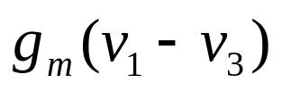
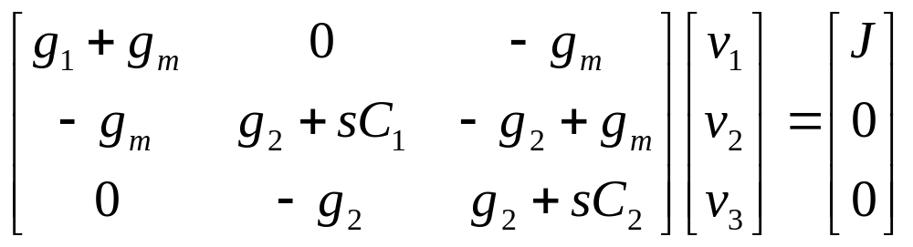
Example
g₂
1
2
3
J
g₁
C₁
C₂

Slide 22
VCCS Stamp
VCCS
j
k
+
v_{o}
i=g_{m}v_{o}
-
col j
col j’
j’
k’
row k
g_{m}
-g_{m}
row k’
-g_{m}
g_{m}
Note: No longer symetric!
What happens when one of the nodes is ground?

