Slide 1
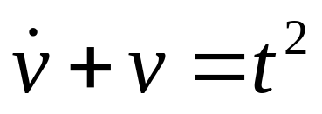
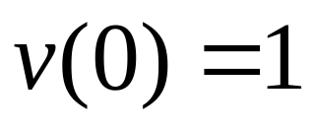
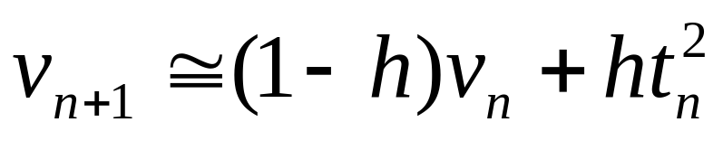
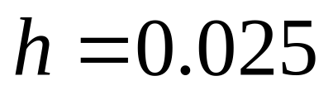
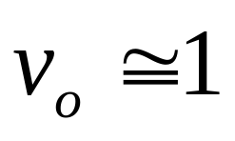
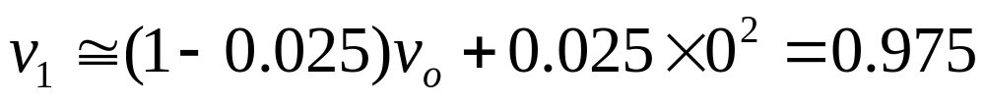
Forward Euler Example
0.9753
0.9513

Slide 2
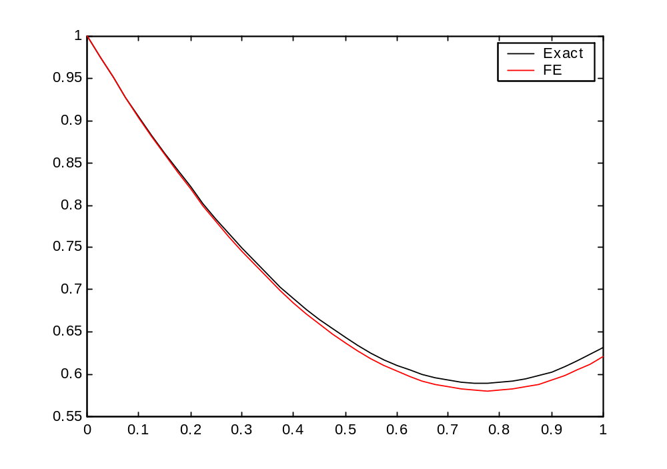

Slide 3
Time Vexact VFE |error|
0 1.0000 1.0000 0
2.5000e-002 9.7532e-001 9.7500e-001 3.1509e-004
5.0000e-002 9.5127e-001 9.5064e-001 6.2995e-004
7.5000e-002 9.2788e-001 9.2694e-001 9.4440e-004
1.0000e-001 9.0516e-001 9.0390e-001 1.2583e-003
1.2500e-001 8.8313e-001 8.8156e-001 1.5714e-003
1.5000e-001 8.6179e-001 8.5991e-001 1.8836e-003
1.7500e-001 8.4117e-001 8.3897e-001 2.1948e-003
2.0000e-001 8.2127e-001 8.1876e-001 2.5048e-003
2.2500e-001 8.0211e-001 7.9930e-001 2.8134e-003
2.5000e-001 7.8370e-001 7.8058e-001 3.1206e-003
2.7500e-001 7.6605e-001 7.6263e-001 3.4262e-003

Slide 4
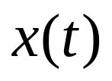




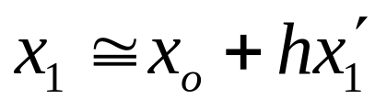
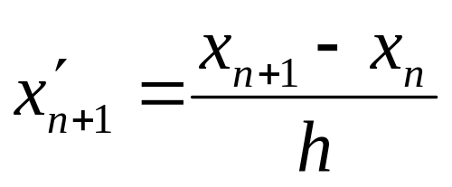
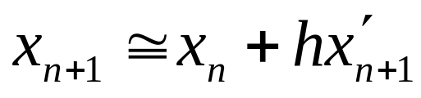
Bacward Euler

Slide 5
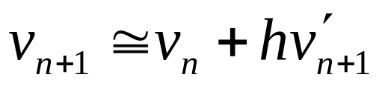
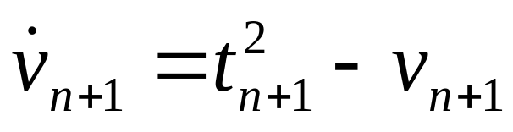
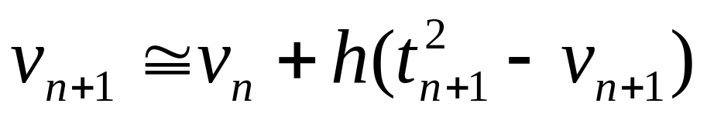
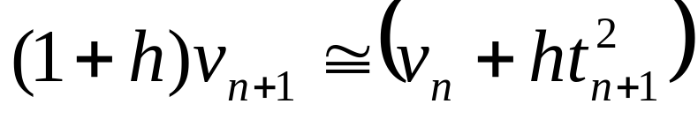
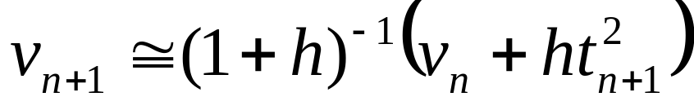
Backward Euler
Differential Equation
Integration formula
(Forward Euler)
Difference equation.
Use derivative at current point → implicit method

Slide 6
Backward Euler Example

Slide 7
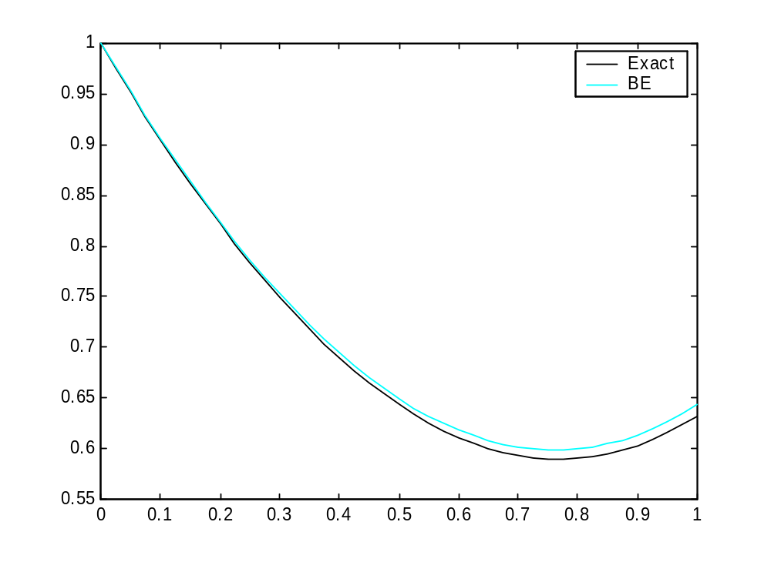

Slide 8
Time Vexact VBE |error|
0 1.0000 1.0000 0
2.5000e-002 9.7532e-001 9.7563e-001 3.0991e-004
5.0000e-002 9.5127e-001 9.5189e-001 6.1967e-004
7.5000e-002 9.2788e-001 9.2881e-001 9.2909e-004
1.0000e-001 9.0516e-001 9.0640e-001 1.2380e-003
1.2500e-001 8.8313e-001 8.8467e-001 1.5463e-003
1.5000e-001 8.6179e-001 8.6365e-001 1.8537e-003
1.7500e-001 8.4117e-001 8.4333e-001 2.1602e-003
2.0000e-001 8.2127e-001 8.2373e-001 2.4655e-003
2.2500e-001 8.0211e-001 8.0488e-001 2.7696e-003
2.5000e-001 7.8370e-001 7.8677e-001 3.0724e-003
2.7500e-001 7.6605e-001 7.6943e-001 3.3737e-003

Slide 9
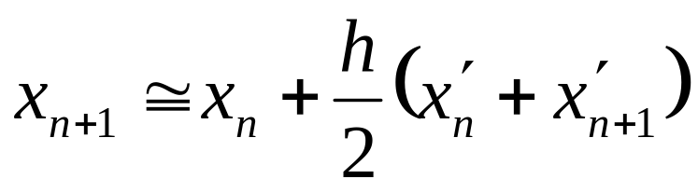
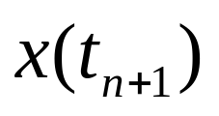
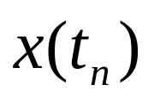
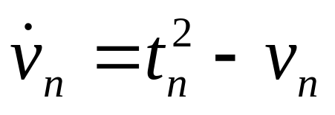
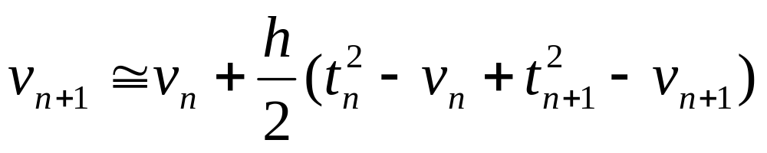
Trapezoidal Rule
→ Average of forward and backward Euler
Integration
formula
Example:

Slide 10
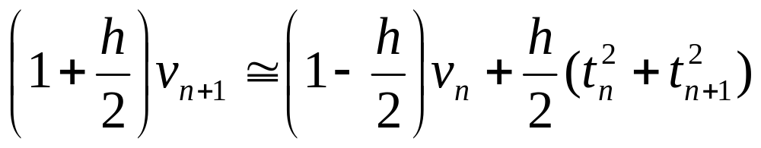
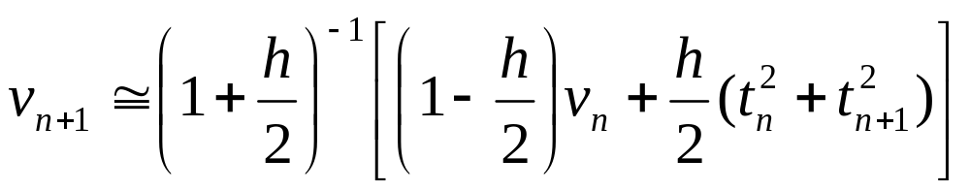
Trapezoidal Rule

Slide 11
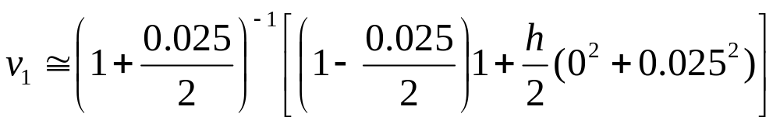
TR Example

Slide 12
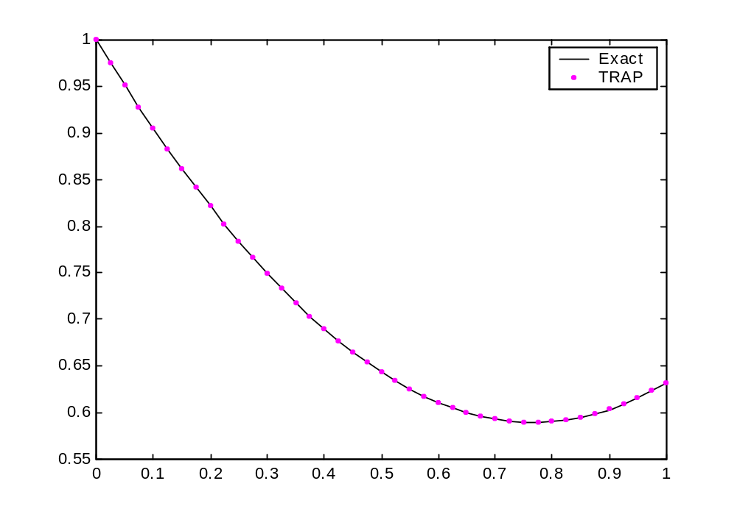

Slide 13
Time Vexact VTrap |error|
0 1.0000 1.0000 0
2.5000e-002 9.7532e-001 9.7532e-001 1.2701e-006
5.0000e-002 9.5127e-001 9.5127e-001 2.4774e-006
7.5000e-002 9.2788e-001 9.2789e-001 3.6243e-006
1.0000e-001 9.0516e-001 9.0517e-001 4.7131e-006
1.2500e-001 8.8313e-001 8.8313e-001 5.7459e-006
1.5000e-001 8.6179e-001 8.6180e-001 6.7249e-006
1.7500e-001 8.4117e-001 8.4118e-001 7.6520e-006
2.0000e-001 8.2127e-001 8.2128e-001 8.5292e-006
2.2500e-001 8.0211e-001 8.0212e-001 9.3584e-006
2.5000e-001 7.8370e-001 7.8371e-001 1.0142e-005
2.7500e-001 7.6605e-001 7.6606e-001 1.0880e-005

Slide 14
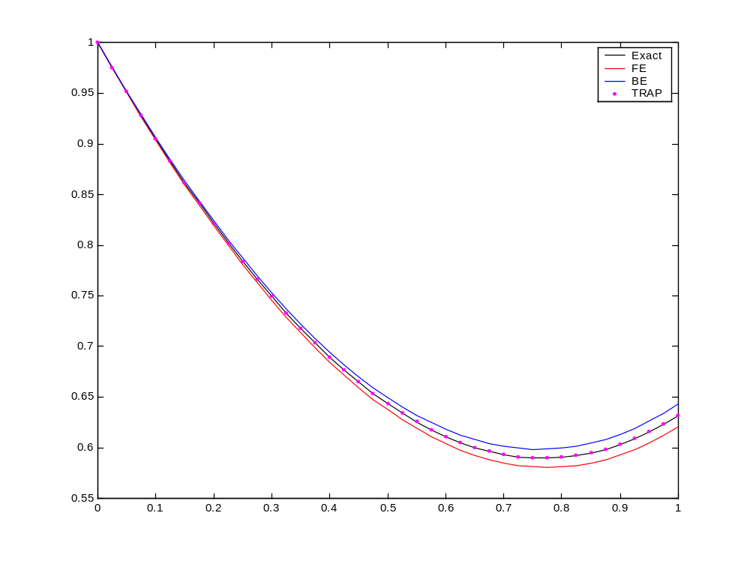

Slide 15
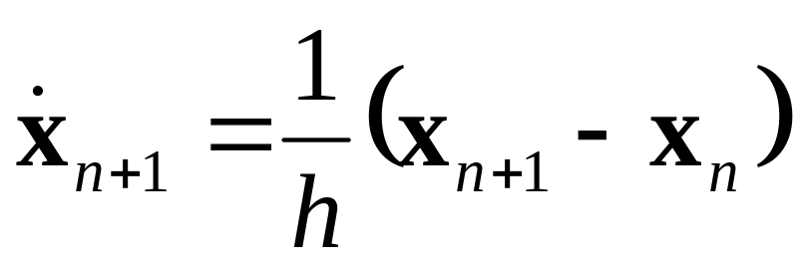
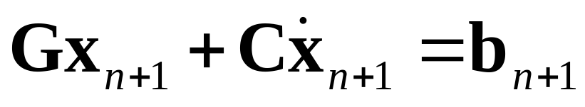
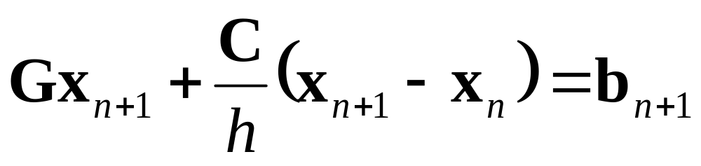
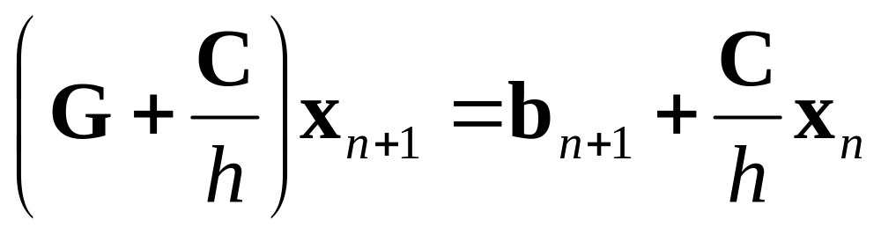
Circuit Equations: Backward Euler
BE
Difference
Equation

Slide 16
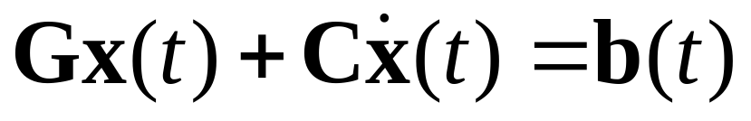
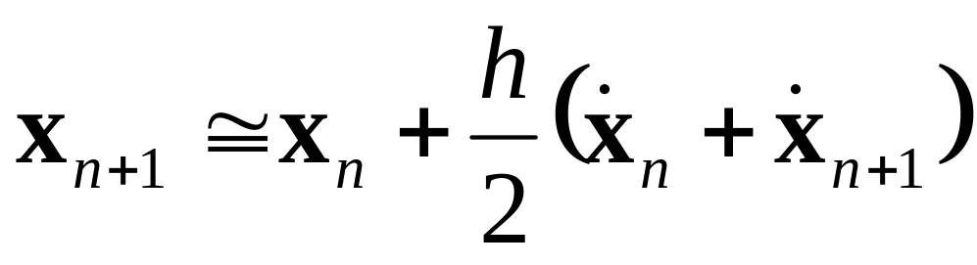
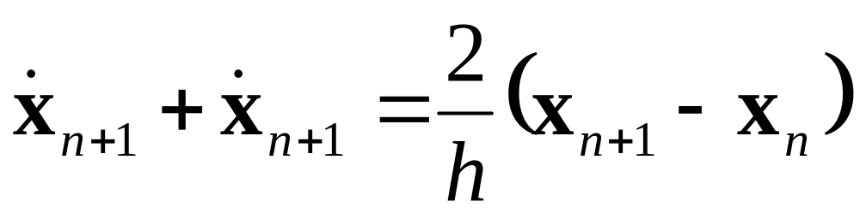
Circuit Equations: Trapezoidal Rule
MNA equations
TR formula

Slide 17
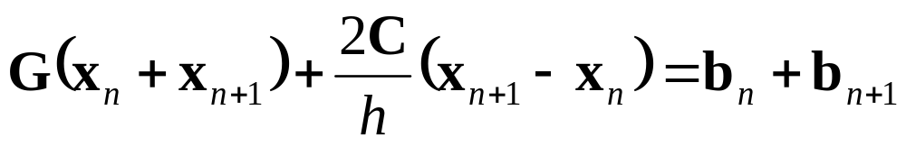
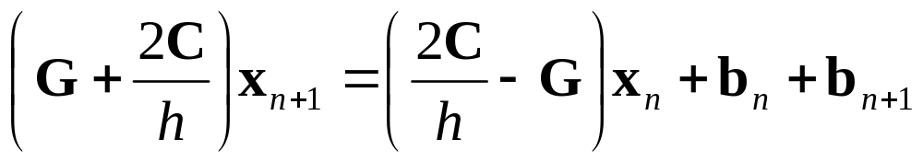
Circuit Equations: Trapezoidal Rule

Slide 18
Numerical Integration
Differential Equation
The solution of the differential equation is transformed into a solution of a system of linear equation at each time point.
Integration formula
(BE, TR,…)
Difference Equation

Slide 19
Numerical Stability of Forward-Euler (FE) is illustrated by the simple example ;
dx/dt=-x with x(0)=1
Exact solution x=exp(-t) is compared with FE for different values of the step size h.

Slide 20
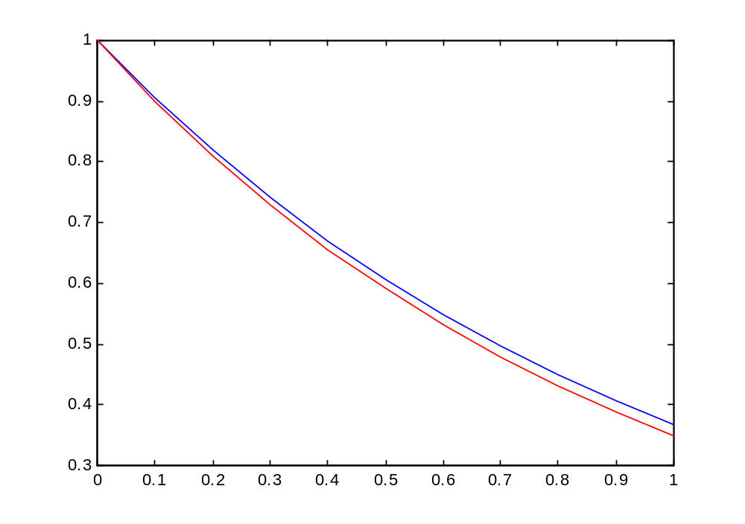
x
Exact
FE h=0.1
Time

Slide 21
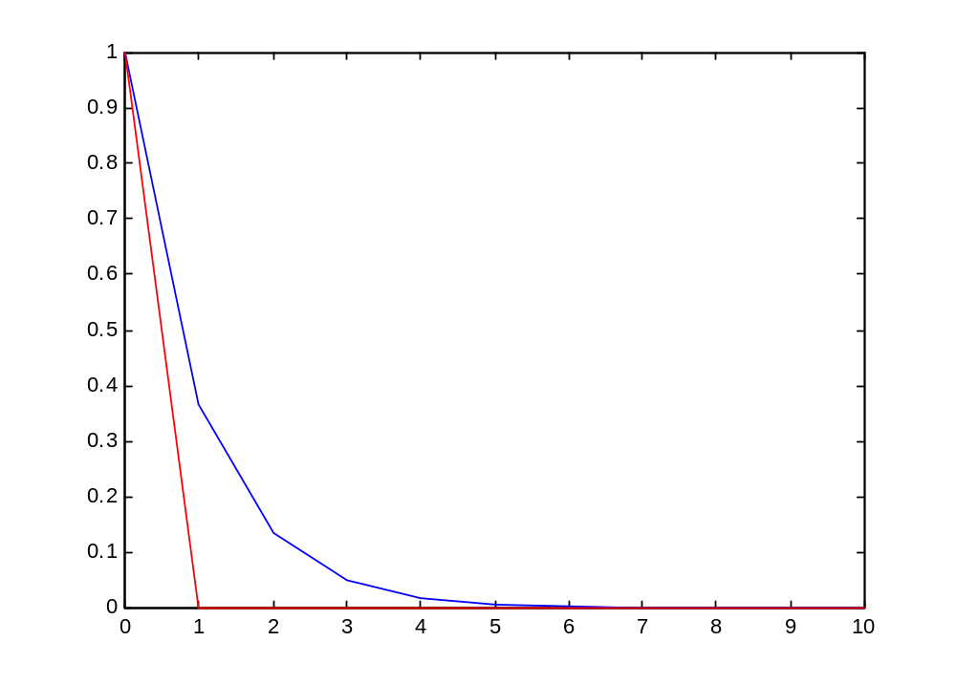
x
Exact
FE h=1
Time

Slide 22
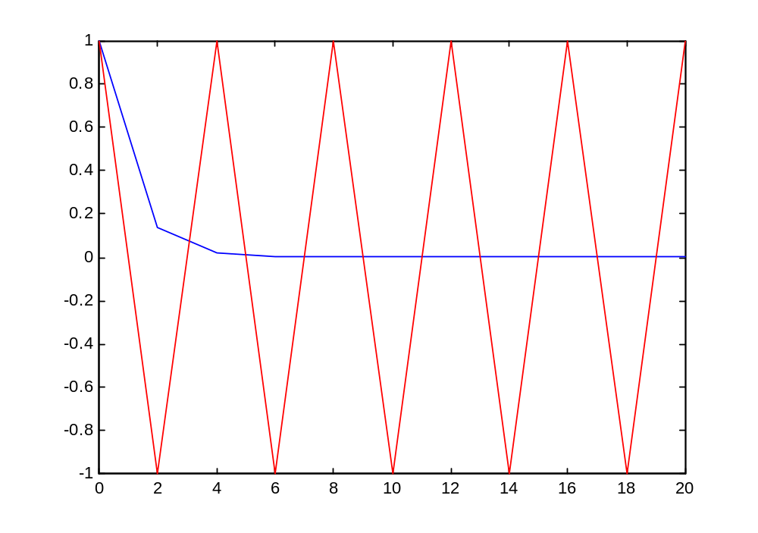
Exact
x
FE h=2
Time

Slide 23
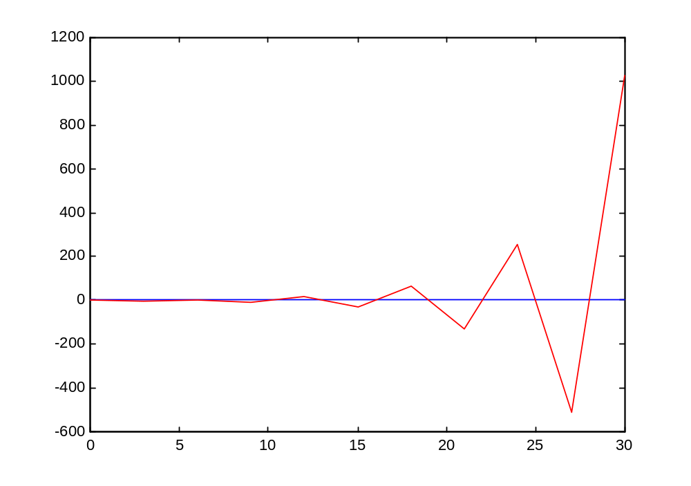
X
FE h=3
Exact
Time

Slide 24
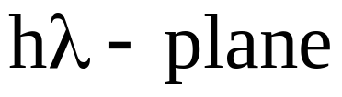
Numerical Stability-BE
Stable
Unstable
r=1

Slide 25
Numerical Stability-FE
Unstable
Stable
(-2,0)
r=1

Slide 26
Numerical Stability-TR
Stable
Unstable

Slide 27


Numerical Stability-FE
Example: h=1;
Unstable
Stable
(-2,0)
h=0.01
r=1

Slide 28
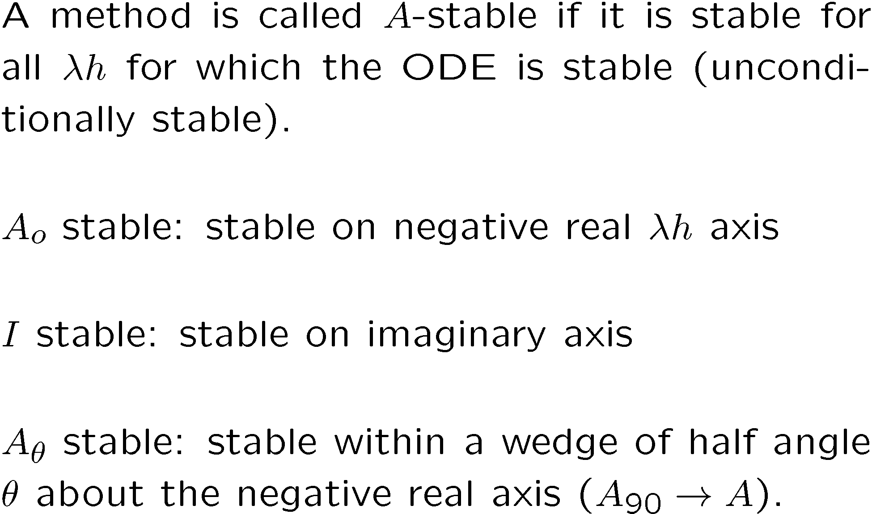
Some terminology

