Slide 1





Artificial Intelligence Methods for Assessing Medical Infrared Thermal Imaging in Early Identification of Thyroid Cancer
Authors names: Ricardo Vardasca, Rosa M. Cibrian-Ortiz de Anda, Valentina Vassilenko
Presenter name: Ricardo Vardasca

Slide 2
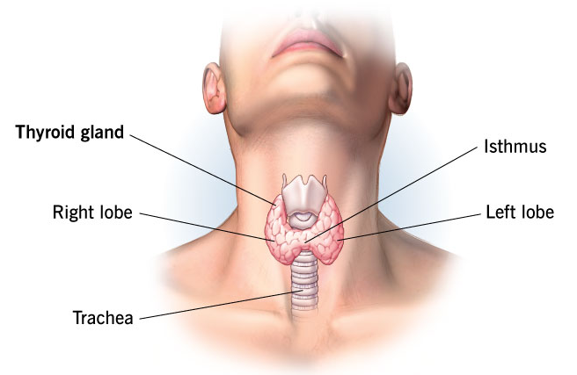
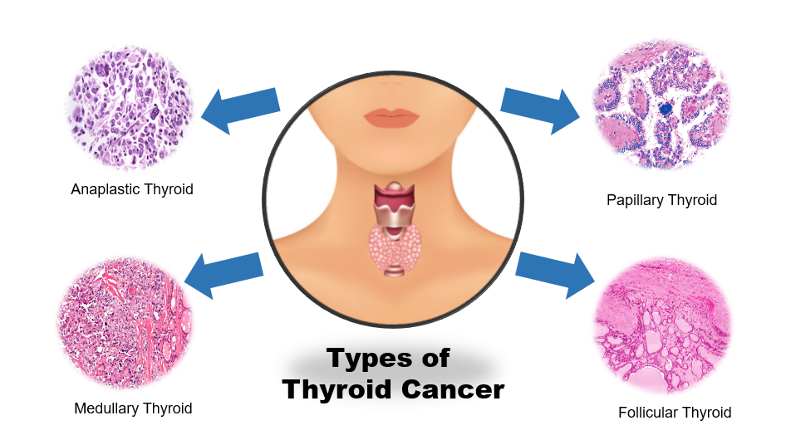
THYROID GLAND
Produces hormones that regulate metabolism and energy use in almost every cell in the body.
Cancer facts & figures:
  959,281 new cases (ranking 6th globally) and around 48,070 deaths annually, with the highest number of diagnoses occurring across Asia (77.4%) and Europe (8.1%) (GCO, 2026).
  Three times more common in women than in men (NIH, 2021).
  The 5-year relative survival rate is 98.3%, reflecting high rates of successful treatment for localized and regional stages (NCI, 2015).
  Papillary thyroid carcinoma is the most frequent form (accounting for roughly 70% to 84% of cases), followed by follicular, medullary, and anaplastic variants (ENCR, 2024).

Slide 3
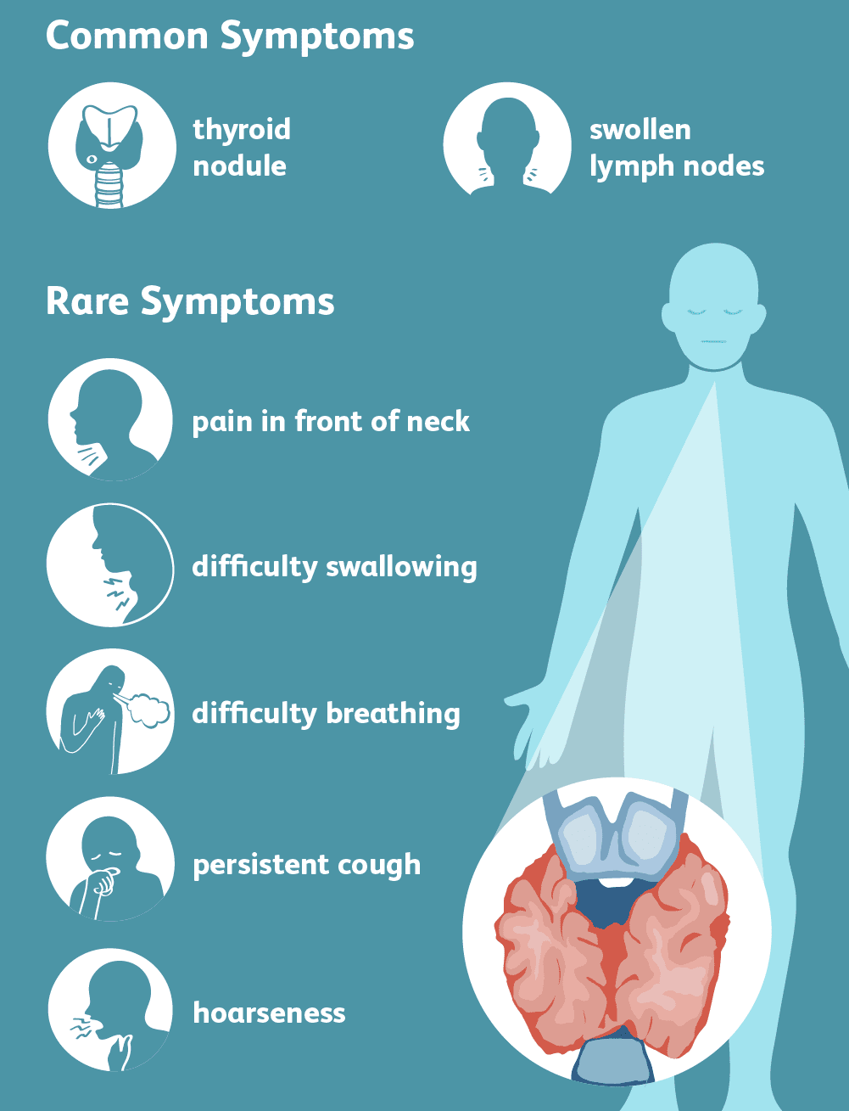
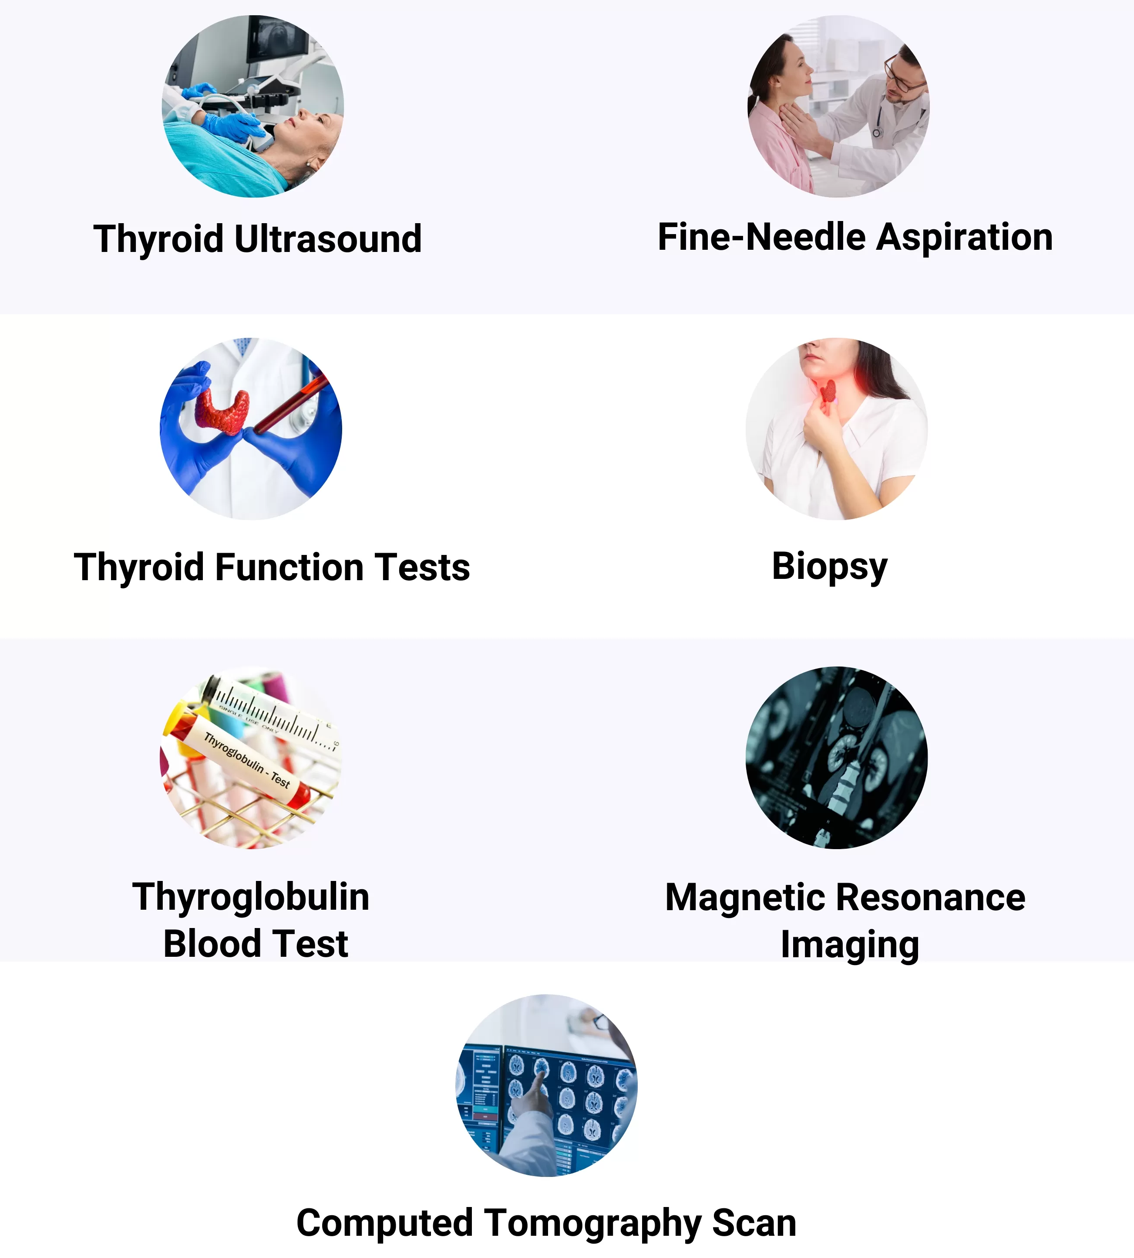
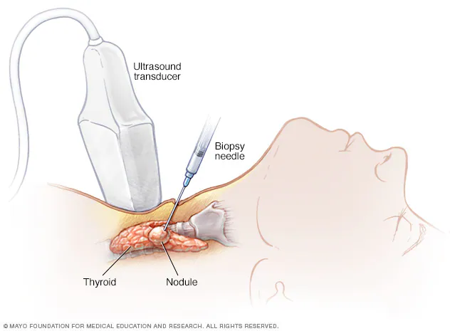
THYROID CANCER DIAGNOSIS

Slide 4
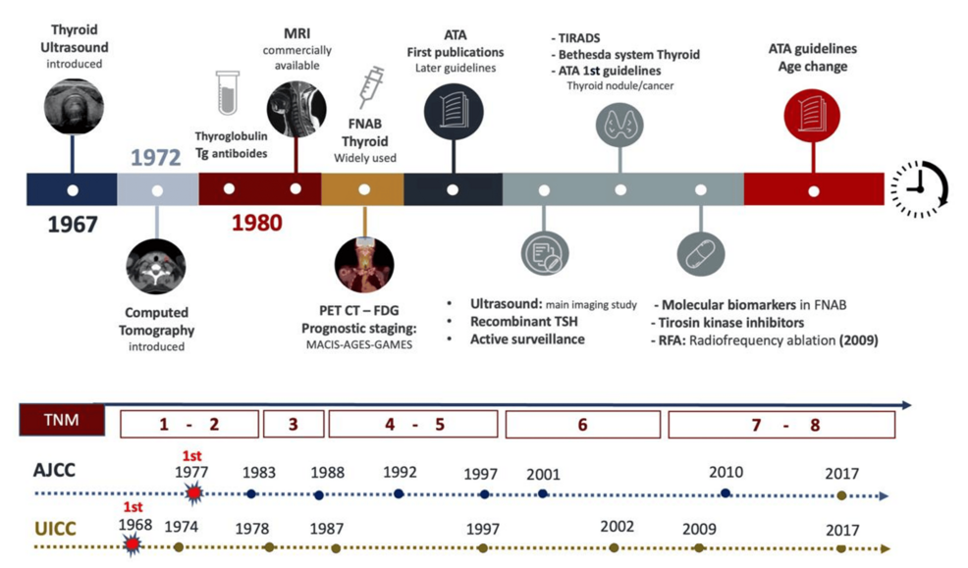
THYROID CANCER DIAGNOSIS

Slide 5
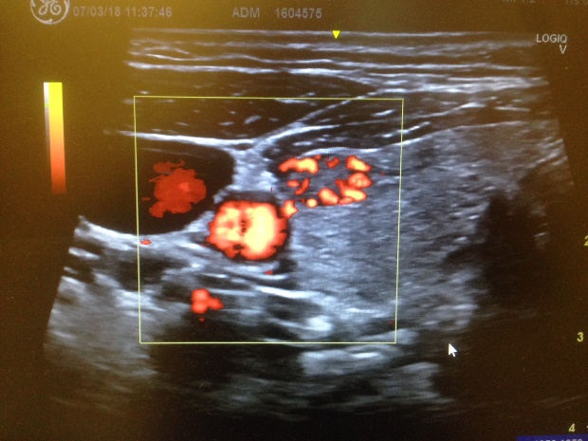
PERSONAL DISCLOSE

Slide 6



Diagnostic bottlenecks
586,000 Annual Cases
Aggressive Subtypes
Screening Latency
Fastest-rising endocrine malignancy globally with a pronounced 3:1 female predominance (GLOBOCAN 2020).
Anaplastic and poorly differentiated carcinomas carry substantial mortality, mandating early intervention.
Current pathways depend on palpation or incidental discovery, missing early metabolic shifts.

Slide 7
Diagnostic issues
Ultrasound (US) Operator Dependency
Subject to high inter-observer variability and limited functional insights into nodule behavior.
The Unmet Diagnostic Need
Invasive FNAC (15–30% Indeterminate)
Fine-needle aspiration cytology frequently requires diagnostic hemithyroidectomy for clear diagnoses.
A non-invasive, radiation-free, objective screening tool capable of pre-selecting high-risk nodules before invasive FNAC procedures are performed.
Scintigraphy & PET Limitations
Ionizing radiation exposure and high equipment costs preclude deployment in population-level screening.

Slide 8
Biological Mechanisms of Heat Emission
Hypermetabolism & Warburg Effect
Papillary & follicular carcinomas exhibit accelerated aerobic glycolysis, radiating excess metabolic heat.
Pathological Angiogenesis
Physiological Rationale
Disorganized, hyperpermeable tumor microvasculature alters regional skin surface thermal equilibrium.
Thermal alterations often precede structural anatomical changes visible on ultrasound. Automated AI interpretation is essential to detect these subtle physiological signatures against background thermal noise.
Benign Thermal Confounders
Hashimoto thyroiditis, goiter, and calcifications mimic or obscure malignant thermal signatures.

Slide 9
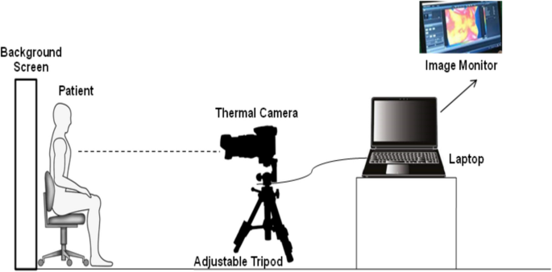
Thermographic Acquisition Requirements
LWIR Sensor Calibration
Climate Equilibrated Room
Multi-Angle Neck Views
8–14 µm long-wave infrared sensors with thermal sensitivity (NETD) < 50 mK.
Strict ambient control (18–22°C) with a mandatory 10–15 min patient acclimatization.
Anterior and bilateral oblique captures with standardized neck extension position.

Slide 10
Image Calibration & ROI Extraction
STEP ONE
STEP TWO
STEP THREE
Sensor Calibration
Anatomical ROI Segmentation
Bilateral Asymmetry Mapping
Non-uniformity correction (NUC), emissivity adjustment, and frame averaging.
U-Net & multi-atlas algorithms isolate anterior neck region, excluding carotid artifacts.
Mirror-contralateral subtraction generates temperature difference profiles.
Noise Reduction
Anatomical Delineation
Relative Thermal Index

Slide 11
Feature engineering in a thermal dataset
Texture & Frequency Descriptors
Thermal Symmetry Metrics
GLCM Statistics: Angular second moment, contrast, correlation, and entropy.
Thermal Difference Gradients: Peak-to-peak delta across left/right lobes.
Wavelet Transforms: Multi-resolution frequency band energy distribution maps.
Histogram Skewness & Kurtosis: Quantifying deviation from healthy symmetry.
Morphological Properties: Boundary irregularity and thermal hot-spot compactness.
Isothermal Boundary Index: Surface area ratio of hyperthermal regions.

Slide 12
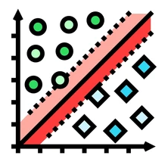
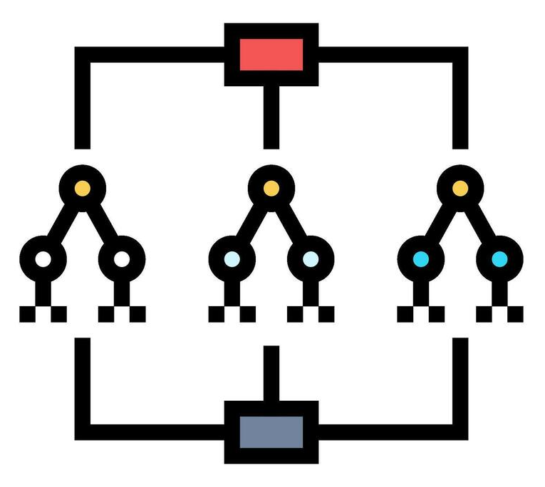


Classical ML classifiers performance benchmarks
Support Vector Machines
Random Forest Ensembles
k-NN & Gradient Boosting
RBF kernel SVM outperforms linear variants due to non-linear feature boundary separation.
Offers strong diagnostic performance alongside intrinsic feature-importance ranking.
Demonstrate lower sensitivity and higher susceptibility to image noise in comparative trials.
Top ML Classifier
High Interpretability
Baseline Comparison

Slide 13
Deep Learning: CNNs & Transfer Learning strategies
Pretrained Backbones
Staged Fine-Tuning
Multi-Source Pretraining
VGG-16, ResNet-50, DenseNet-121, and EfficientNet leverage ImageNet feature weights.
Freezing early layers, updating deeper representations specifically on thermal images.
Initializing weights on combined thyroid ultrasound datasets reduces domain gaps.
Mitigates Data Scarcity
Best Practice Strategy
Cross-Modal Transfer

Slide 14
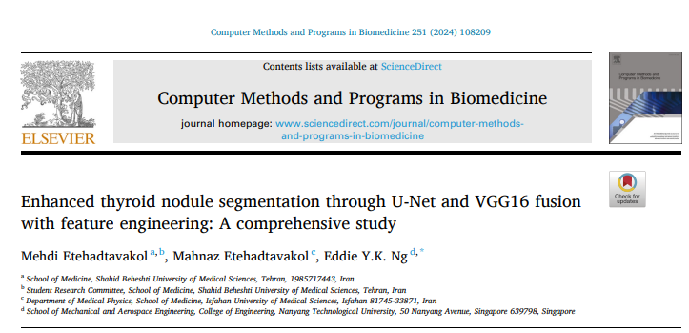
DL validation benchmark
Fused U-Net-VGG16 + Radiomics Landmark (Etehadtavakol 2024)
97.8%
Overall Classification Accuracy
Sub-image entropy feature engineering elevated segmentation Dice scores from 0.08–0.11 to 0.26–0.29 while maintaining ~95% specificity on small patient cohorts (N=46).

Slide 15
Interpretability: Explainable AI Frameworks (XAI)
Visual Saliency
Feature Attribution
Uncertainty Flags
Grad-CAM and LRP backpropagate activation maps to confirm AI focuses on true thermal anomalies rather than background noise.
SHAP values quantify Game-Theory contributions of temperature asymmetry and GLCM stats for case reporting.
Monte Carlo Dropout estimates prediction variance, automatically routing ambiguous thermograms to human specialists.
Spatial Verification
Quantitative Attribution
Human-in-the-Loop Safeguard

Slide 16
Critical Gaps & Dataset Bottlenecks
Domain Barrier | Current Research Reality | Required Infrastructure Remedy
Dataset Availability | Proprietary cohorts < 300 patients (unlike DMR-IR for breast). | Public repository (TCIA analogue).
Methodological Rigor | Optimistic bias from cross-validation without external test sets. | TRIPOD guideline adherence.
Class Imbalance | Benign nodules heavily skew training samples away from cancer. | SMOTE, focal loss & GAN augmentation.

Slide 17
Point-of-Care & Remote Screening Pathways
Portable Infrared Accessories
Compact thermal sensors coupled with smartphone interfaces for low-cost screening.
Cloud Inference Architecture
Triage Paradigm
Real-time automated image processing returning probabilistic risk scores in seconds.
Remote thermographic pre-screening enables priority referral to centralized ultrasound hubs, dramatically improving resource efficiency in overburdened health systems.
Demographic Accessibility
Bridges specialist shortages in LMIC environments and rural primary care clinics.

Slide 18

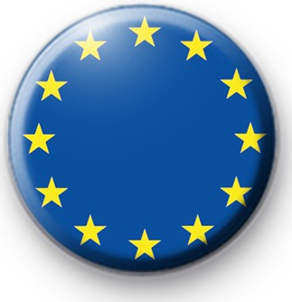
Governance: International Regulatory Frameworks
US FDA SaMD Pathway
European Union Dual Burden
Software as a Medical Device: Governed under FDA AI/ML Action Plan.
EU MDR 2017/745: Class IIa/IIb requiring prospective PMCF studies.
Predetermined Change Control: Protocol for algorithm updates.
EU AI Act (2024): Annex III "High-Risk" classification enforcement.
Clearance Class: 510(k) or De Novo depending on predicate devices.
Requirements: Cybersecurity, human oversight, and data governance.

Slide 19
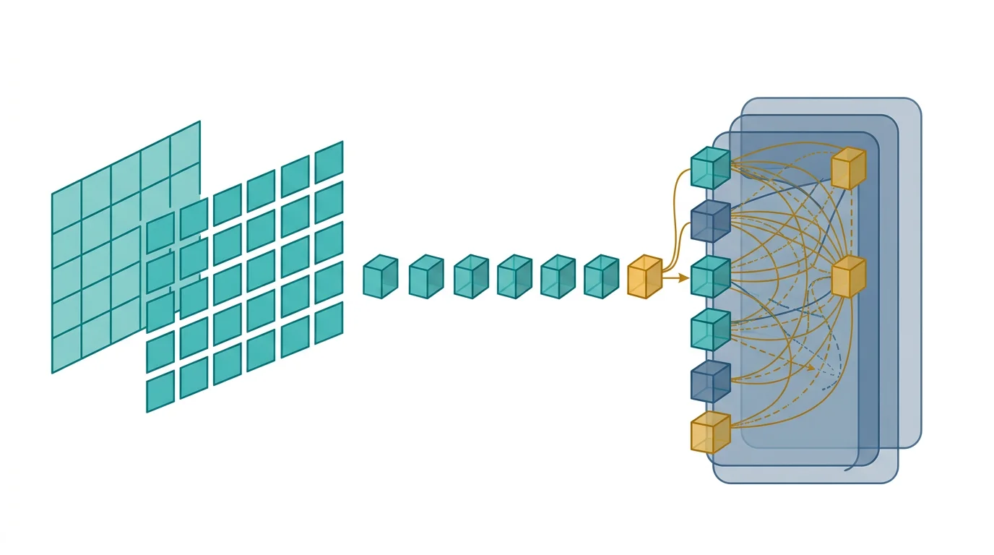
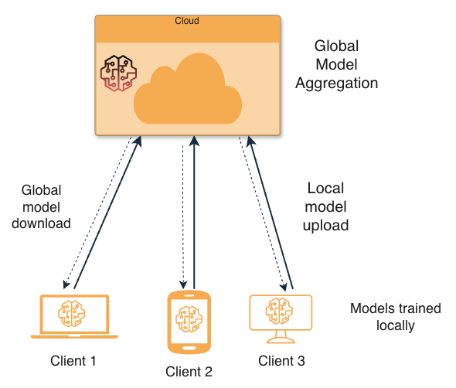
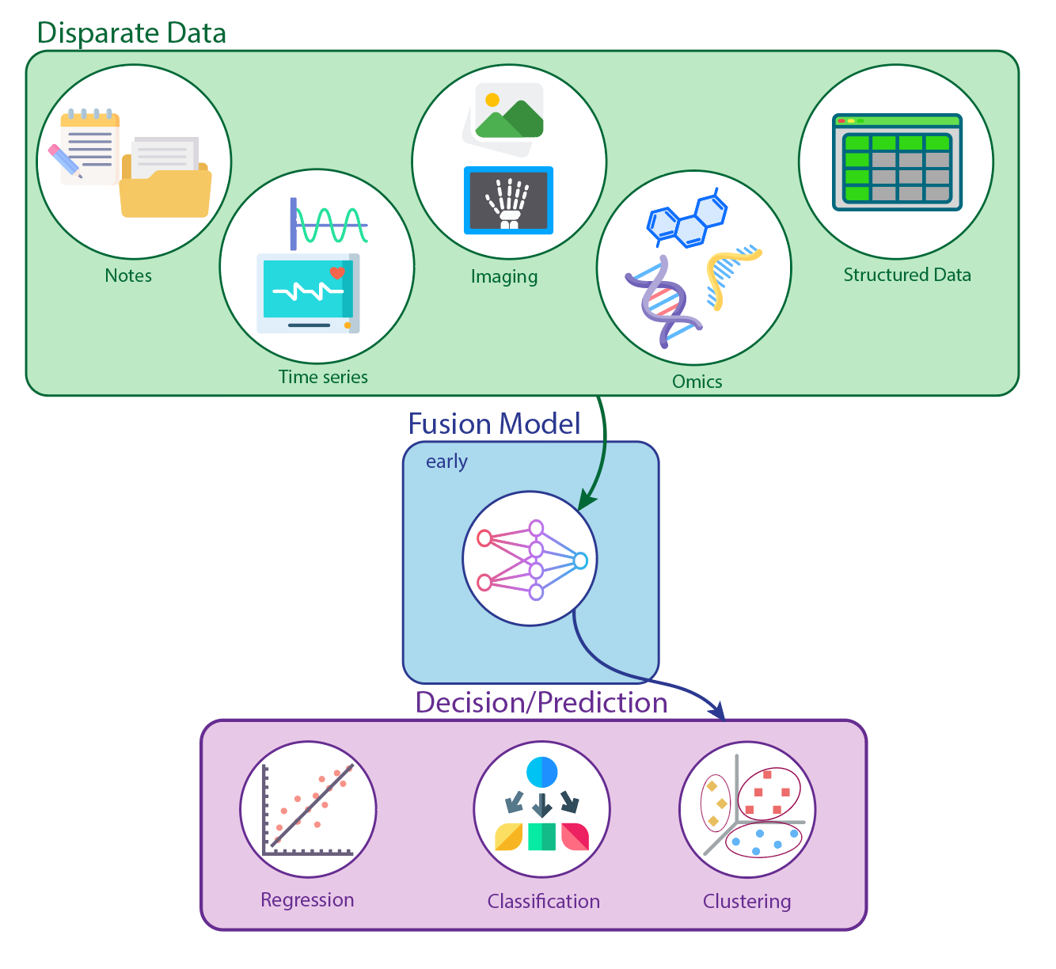
Future: Next-Generation Technical Directions
Vision Transformers
Federated Learning
Multimodal Fusion
Hybrid CNN-ViT models capture global long-range bilateral thermal asymmetries.
Multi-center model aggregation without centralizing sensitive patient thermal records.
Integrating thermal function + ultrasound structure + liquid biopsy markers.

Slide 20
Summary
The Path Toward Standardized, AI-Augmented Thyroid Thermography
AI-enhanced thermography offers a promising non-invasive, contact-free diagnostic window. However, large multi-center prospective validation and public benchmarking datasets are required before routine clinical translation.

Slide 21
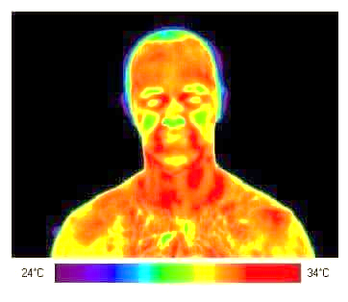
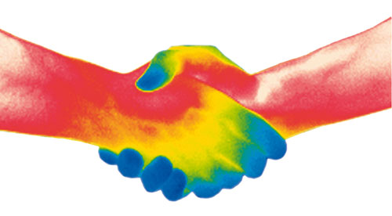
Thank you 4 your attention!
Ricardo Vardasca, PhD, ASIS, FRPS
ricardo.vardasca@islasantarem.pt

