Slide 1


CMMC Compliance Today
Audience Survey
Presented by
Ian MacRae
E-N Computers
MSP & MSSP

Slide 2
Audience Survey
https://forms.office.com/r/ScsgXC0PyC

Slide 3
NIST/CMMC compliance today
Why pay attention to NIST / CMMC compliance
Ian’s experience with NIST / CMMC
What is CMMC designed to protect?
What businesses are affected?
What is the DFARs rule?
Quick overview of the NIST 800-171 control families
What is your SPRS score?
What’s new with NIST 800-171 in 2023?
What’s new with CMMC in 2023?
Compliance Strategies
Tips and Tricks
Costly pitfalls
Customer experiences
Q&A

Slide 4

Ian MacRae
President and Founder
E-N Computers, Inc.
MSP / MSSP
CMMC Registered Provider
804-729-8835
www.encomputers.com

Slide 5


Slide 6
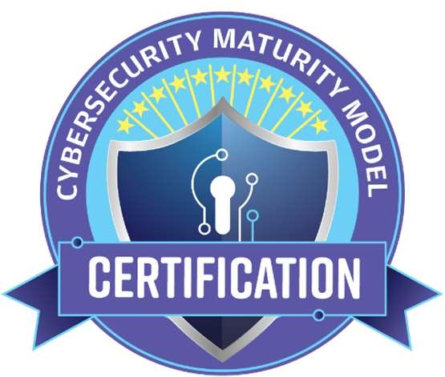

Slide 7


Slide 8
Why pay attention to NIST / CMMC compliance
The IT Security standard for doing business with the Federal Government

Slide 9
Federal Gov. Virginia’s Economic Engine
Defense Industrial Base 300,000 jobs and $36 billion
12% of all federal procurement spent in VA, 2nd only to CA
Gov contractors in VA hold more than 15,000 federal contracts
Overall DIB is 100,000 businesses

Slide 10
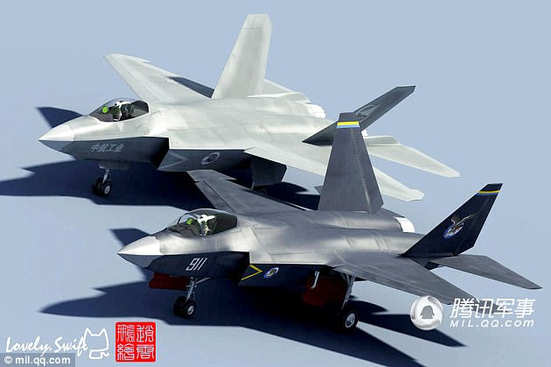
USA F-35
Chinese J-31
$600 billion lost in IP annually

Slide 11

2017 – Warren Called

Slide 12
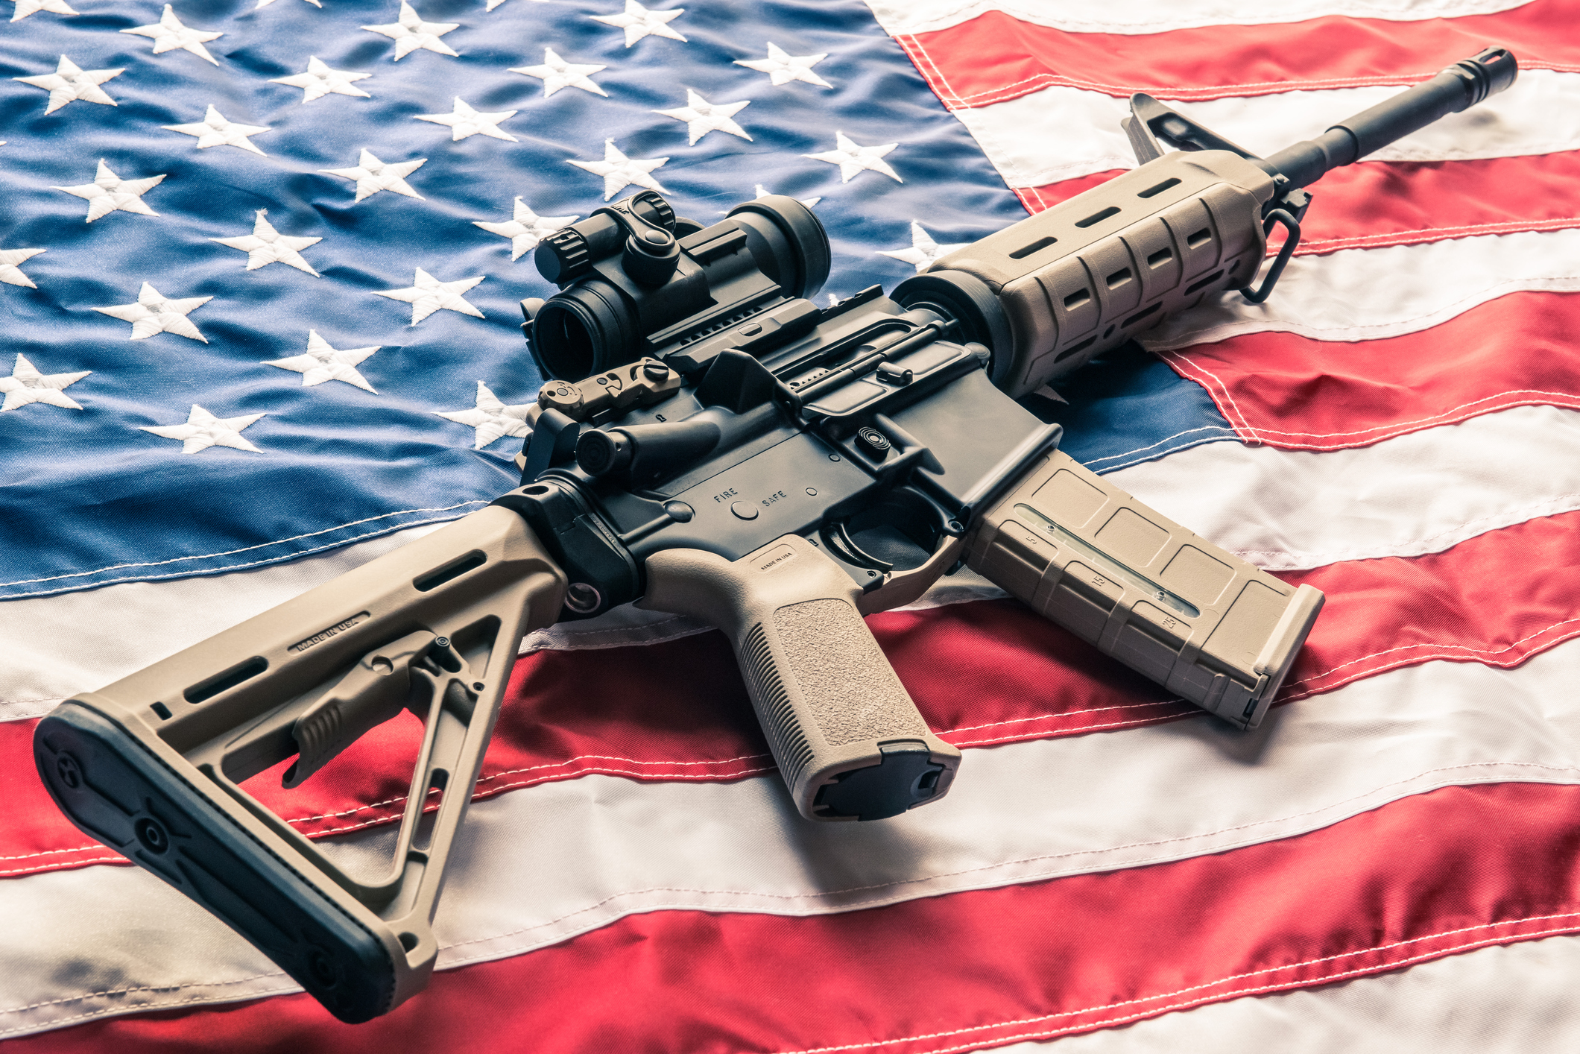
Can you secure my factory?

Slide 13


Slide 14
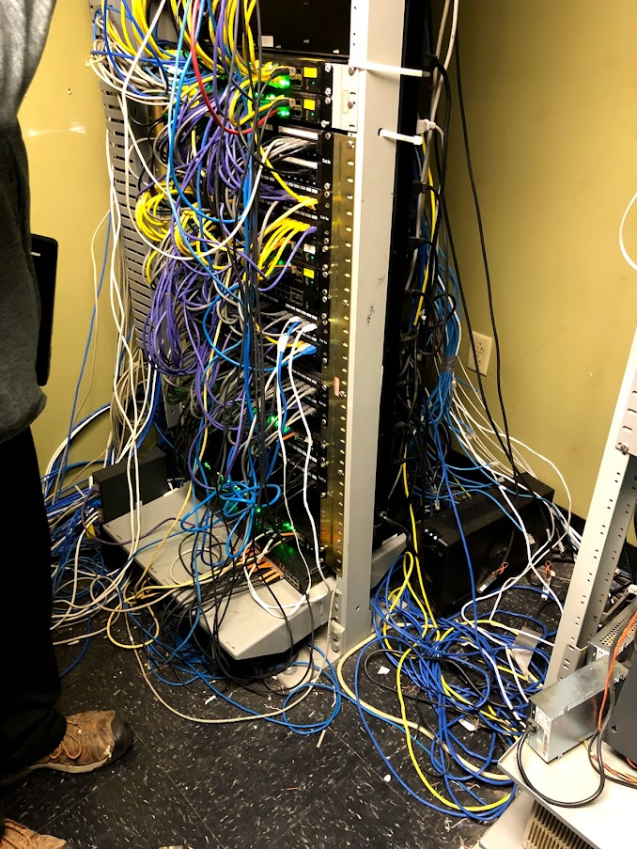
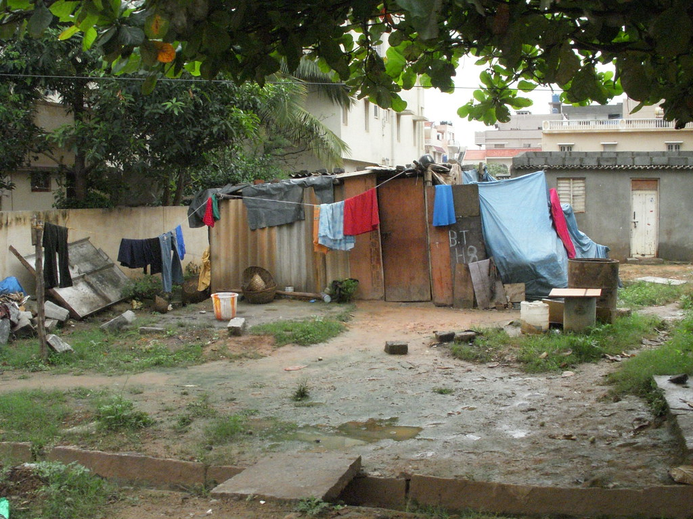
Please have some Standards!!!

Slide 15
What is CMMC designed to protect?
Scoping your CMMC Project

Slide 16

Federal Contract Information
Commercially Available Products & Services
Navy Uniform - 10,000 Socks for Guam
Examples: Quantities and Delivery Information under a Contract
https://dodcio.defense.gov/Portals/0/Documents/CMMC/AG_Level1_V2.0_FinalDraft_20211210_508.pdf

Slide 17
FAR Clause for FCI
(1) The Contractor shall apply the following basic safeguarding requirements and procedures to protect covered contractor information systems. Requirements and procedures for basic safeguarding of covered contractor information systems shall include, at a minimum, the following security controls:
(i) Limit information system access to authorized users, processes acting on behalf of authorized users, or devices (including other information systems).
(ii) Limit information system access to the types of transactions and functions that authorized users are permitted to execute.
(iii) Verify and control/limit connections to and use of external information systems.
(iv) Control information posted or processed on publicly accessible information systems.
(v) Identify information system users, processes acting on behalf of users, or devices.
(vi) Authenticate (or verify) the identities of those users, processes, or devices, as a prerequisite to allowing access to organizational information systems.
(vii) Sanitize or destroy information system media containing Federal Contract Information before disposal or release for reuse.
Notes:
Page 1

Slide 18
FAR Clause for FCI
(viii) Limit physical access to organizational information systems, equipment, and the respective operating environments to authorized individuals.
(ix) Escort visitors and monitor visitor activity; maintain audit logs of physical access; and control and manage physical access devices.
(x) Monitor, control, and protect organizational communications (i.e., information transmitted or received by organizational information systems) at the external boundaries and key internal boundaries of the information systems.
(xi) Implement subnetworks for publicly accessible system components that are physically or logically separated from internal networks.
(xii) Identify, report, and correct information and information system flaws in a timely manner.
(xiii) Provide protection from malicious code at appropriate locations within organizational information systems.
(xiv) Update malicious code protection mechanisms when new releases are available.
(xv) Perform periodic scans of the information system and real-time scans of files from external sources as files are downloaded, opened, or executed.
(c) Subcontracts. The Contractor shall include the substance of this clause, including this paragraph (c), in subcontracts under this contract (including subcontracts for the acquisition of commercial products or commercial services, other than commercially available off-the-shelf items), in which the subcontractor may have Federal contract information residing in or transiting through its information system.
Notes:
Page 2

Slide 19
Controlled Unclassified Information (CUI)
Critical Infrastructure | Ammonium Nitrate Chemical-terrorism Vulnerability Information Critical Energy Infrastructure Information Emergency Management General Critical Infrastructure Information Information Systems Vulnerability Information Physical Security Protected Critical Infrastructure Information SAFETY Act Information Toxic Substances Water Assessments
Defense | Controlled Technical Information DoD Critical Infrastructure Security Information Naval Nuclear Propulsion Information Unclassified Controlled Nuclear Information - Defense
https://www.archives.gov/cui

Slide 20
Export Control | Export Controlled Export Controlled Research
Financial | Bank Secrecy Budget Comptroller General Consumer Complaint Information Electronic Funds Transfer Federal Housing Finance Non-Public Information Financial Supervision Information General Financial Information International Financial Institutions Mergers Net Worth Retirement

Slide 21
Immigration | Asylee Battered Spouse or Child Permanent Resident Status Status Adjustment Temporary Protected Status Victims of Human Trafficking Visas
Intelligence | Agriculture Foreign Intelligence Surveillance Act Foreign Intelligence Surveillance Act Business Records General Intelligence Geodetic Product Information Intelligence Financial Records Internal Data Operations Security
International Agreements | International Agreement Information

Slide 22
Law Enforcement | Accident Investigation Campaign Funds Committed Person Communications Controlled Substances Criminal History Records Information DNA General Law Enforcement Informant Investigation Juvenile Law Enforcement Financial Records National Security Letter Pen Register/Trap & Trace Reward Sex Crime Victim Terrorist Screening Whistleblower Identity

Slide 23
Legal | Administrative Proceedings Child Pornography Child Victim/Witness Collective Bargaining Federal Grand Jury Legal Privilege Legislative Materials Presentence Report Prior Arrest Protective Order Victim Witness Protection
Natural and Cultural Resources | Archaeological Resources Historic Properties National Park System Resources
North Atlantic Treaty Organization (NATO) | NATO Restricted NATO Unclassified

Slide 24
Nuclear | General Nuclear Nuclear Recommendation Material Nuclear Security-Related Information Safeguards Information Unclassified Controlled Nuclear Information - Energy
Patent | Patent Applications Inventions Secrecy Orders
Privacy | Contract Use Death Records General Privacy Genetic Information Health Information Inspector General Protected Military Personnel Records Personnel Records Student Records

Slide 25
Proprietary Business Information | Entity Registration Information General Proprietary Business Information Ocean Common Carrier and Marine Terminal Operator Agreements Ocean Common Carrier Service Contracts Proprietary Manufacturer Proprietary Postal
Provisional | Homeland Security Agreement Information Homeland Security Enforcement Information Information Systems Vulnerability Information - Homeland International Agreement Information - Homeland Operations Security Information Personnel Security Information Physical Security - Homeland Privacy Information Sensitive Personally Identifiable Information

Slide 26
Statistical | Investment Survey Pesticide Producer Survey Statistical Information US Census
Tax | Federal Taxpayer Information Tax Convention Taxpayer Advocate Information Written Determinations
Transportation | Railroad Safety Analysis Records Sensitive Security Information
https://www.archives.gov/cui
https://securityawareness.usalearning.gov/cui/index.html

Slide 27
CUI Marking
https://www.archives.gov/files/cui/documents/20161206-cui-marking-handbook-v1-1-20190524.pdf

Slide 28
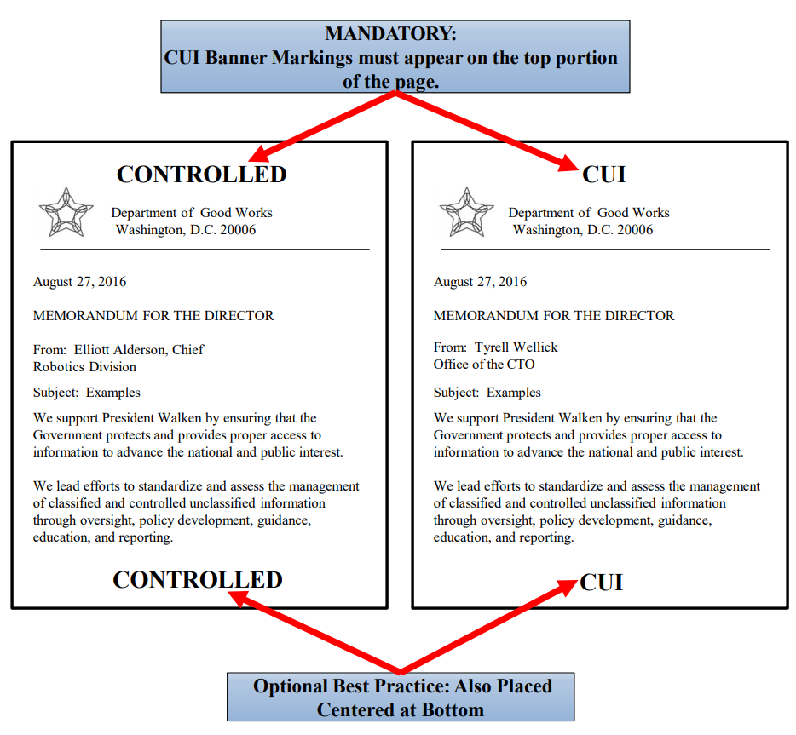

Slide 29

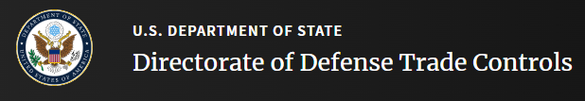

Do you have US Citizen only CUI?

Slide 30
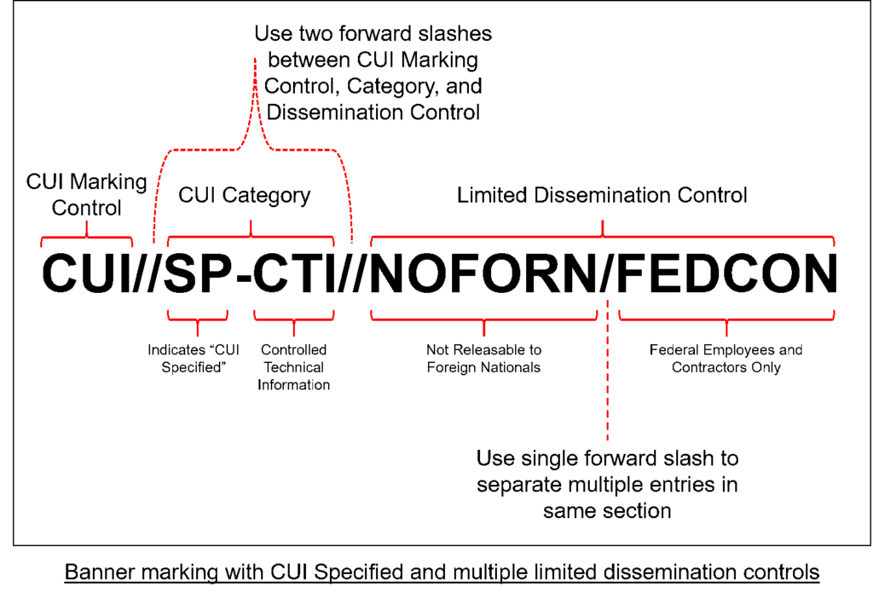

Slide 31
Is my organization affected?

Slide 32

Notes:
Do you have FCI or CUI and are taking DOD money directly or indirectly. Do you take federal money

Slide 33
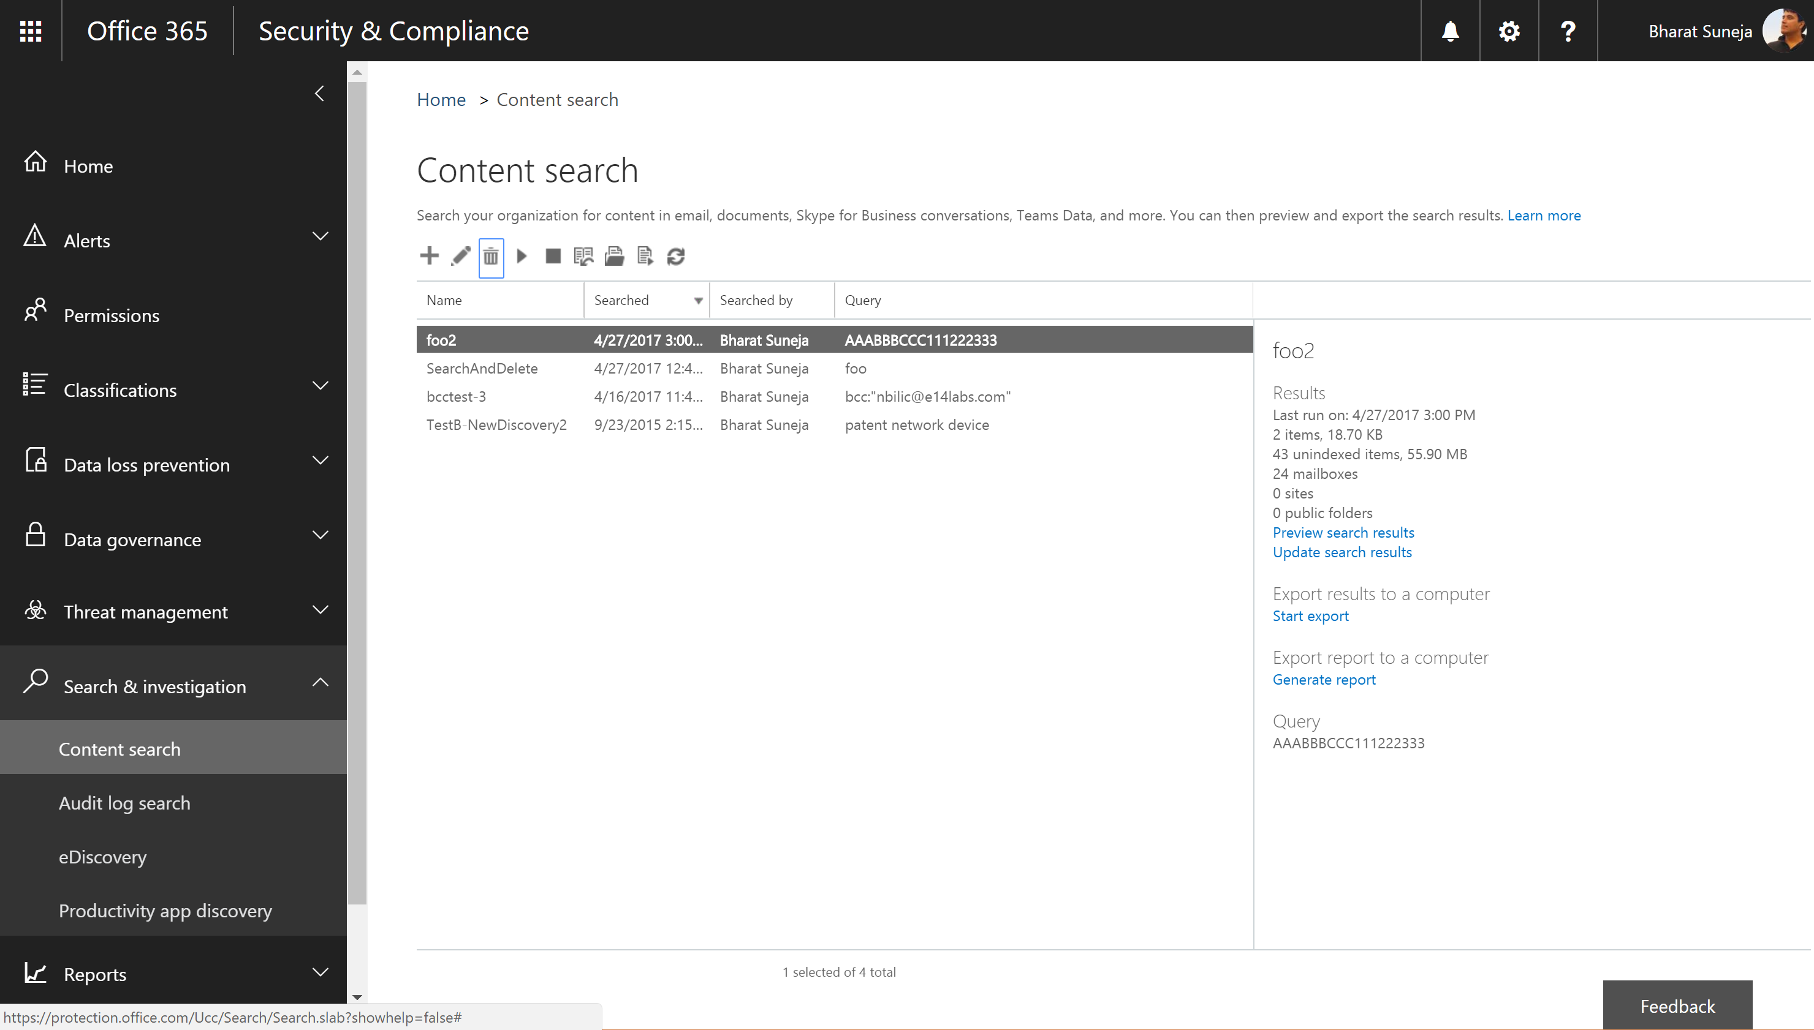

Slide 34

Doing business with Federal Government?
Directly
Indirectly
Agreed to Federal Acquisition Regulation (FAR)
Agreed to Defense Acquisition Regulation Supplement (DFARS)
Talk to Program Manager
Sub-contractor supporting a federal contract
Flow down requirement to you
Required by law, but possibly uninformed by prime
Talk with your Prime

Slide 35
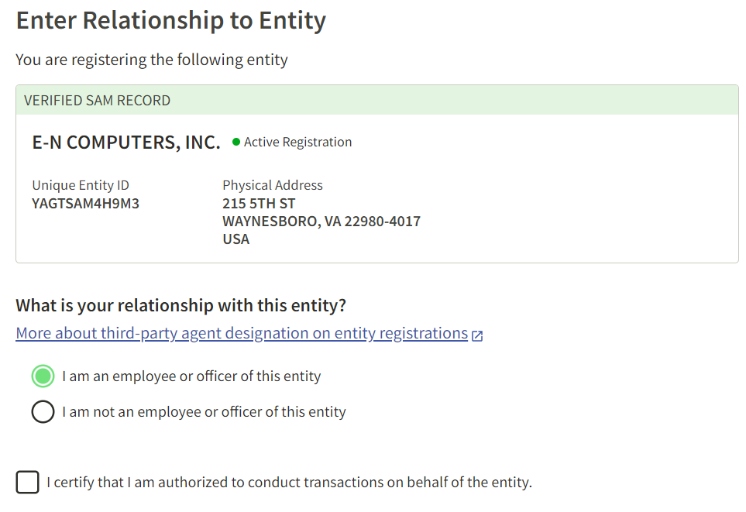

Slide 36
DOD’s DFARS Rule
https://www.acquisition.gov/node/36383/printable/pdf
Go implement NIST 800-171
https://dibnet.dod.mil/portal/intranet/#reporting
72 hours to notify on breaches

Slide 37
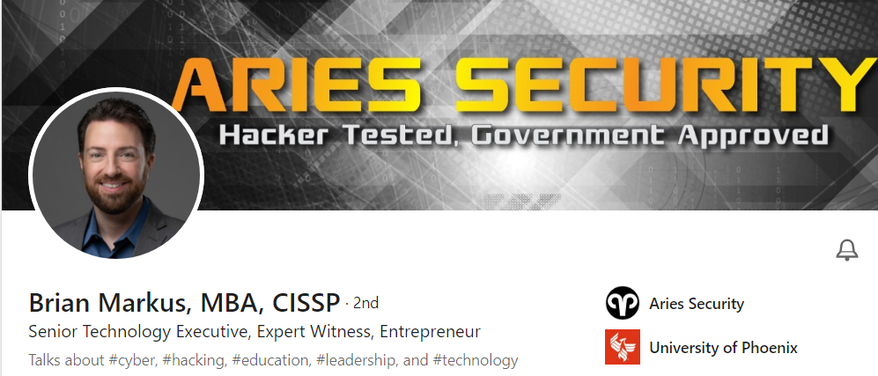
False Claims Act:
3X contract value plus $11,000 per claim
whistle blower can claim earn award of 30% of contract value

Slide 38
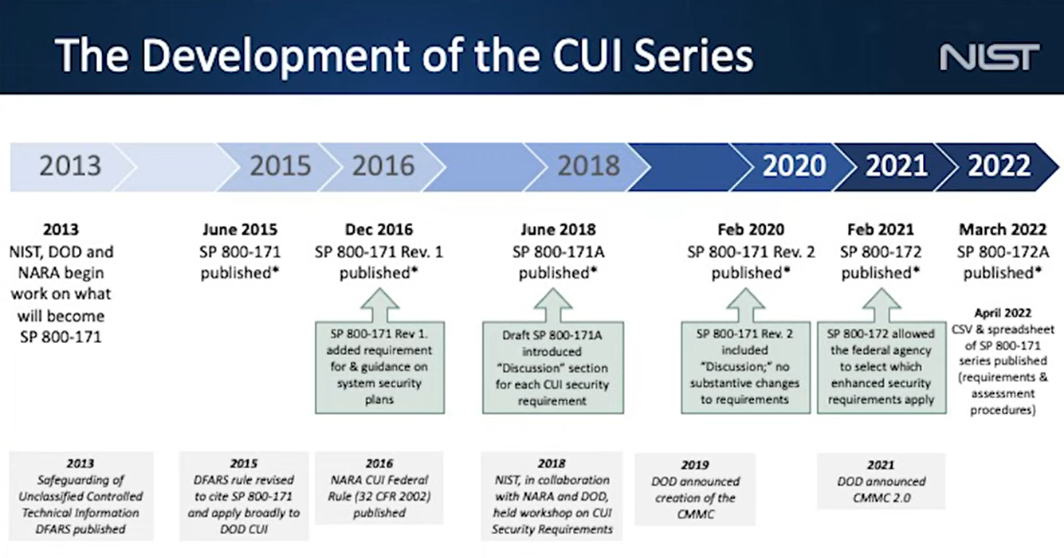

Slide 39
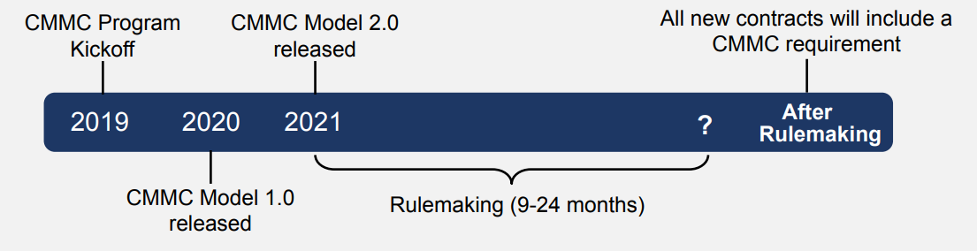
In contracts of 2024

Slide 40
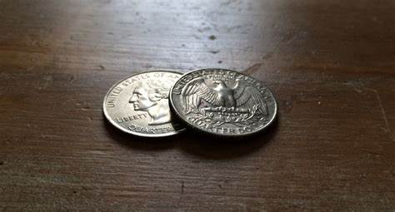
NIST 800-171
Security Framework
110 Things You Do
CMMC
Level 2
Certifies that you’ve done 110 NIST 800-171 to Protect CUI
CMMC
Level 1
27 of the 110 to Protect FCI
2016

Slide 41
Quick overview of the NIST 800-171 control families?
800-171 Version 2

Slide 42
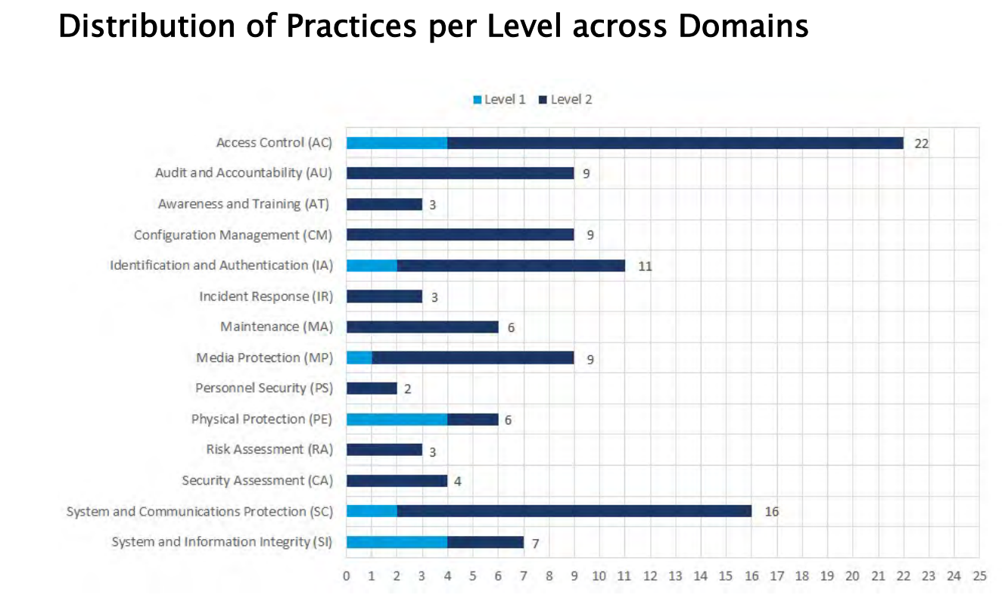
Notes:
Derived from the 2 pages of FAR Rules

Slide 43
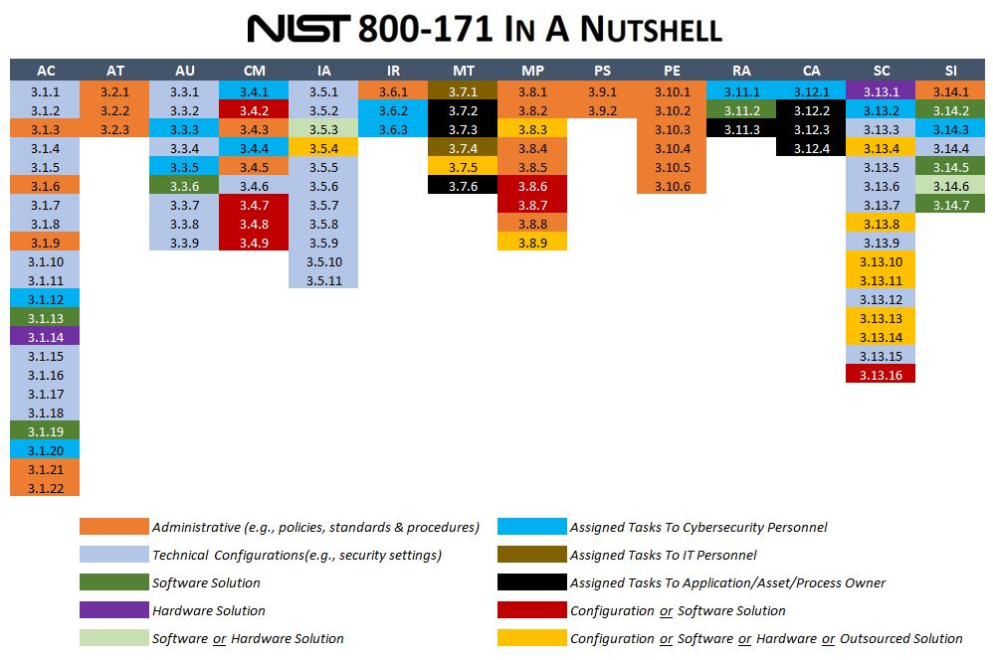
https://www.complianceforge.com/

Slide 44
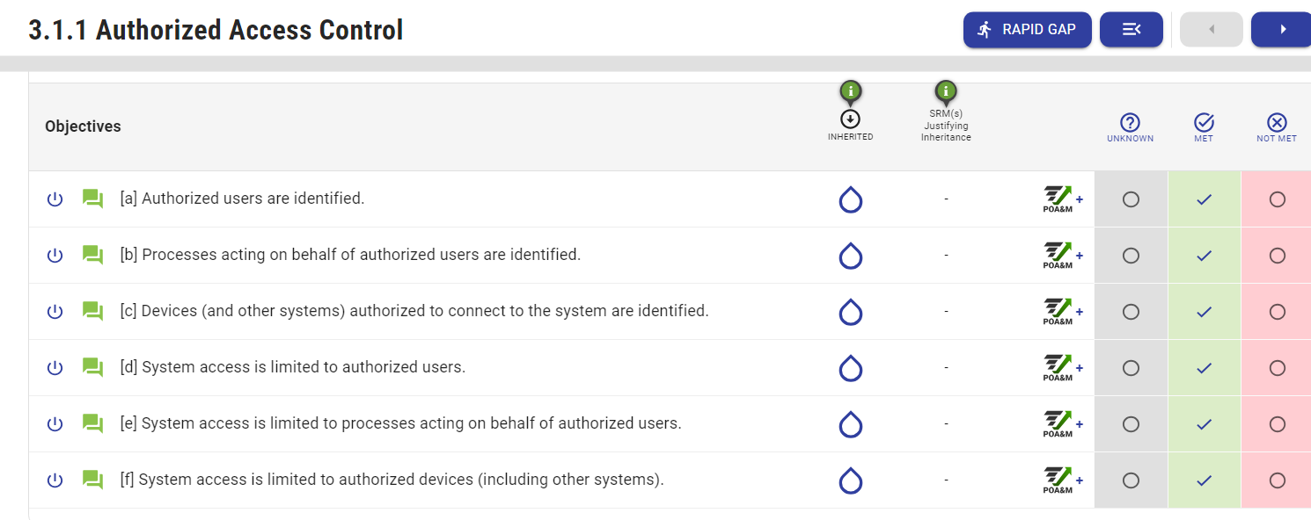
17 Domains, 110 Controls, 320 Objectives

Slide 45
What is your SPRS score?
Self-attestation methodology, prior to 3rd party audit

Slide 46
What is your SPRS score?
Under DoD's current CUI scoring system, contractors start with a score of 110 and lose points for each applicable NIST SP 800-171 control that is not met by the contractor's cybersecurity program. Contractors lose 1, 3, or 5 points for each unmet control based on the impact those controls have on the contractor’s cybersecurity program, with higher points associated with the more impactful controls
https://www.sprs.csd.disa.mil/

Slide 47
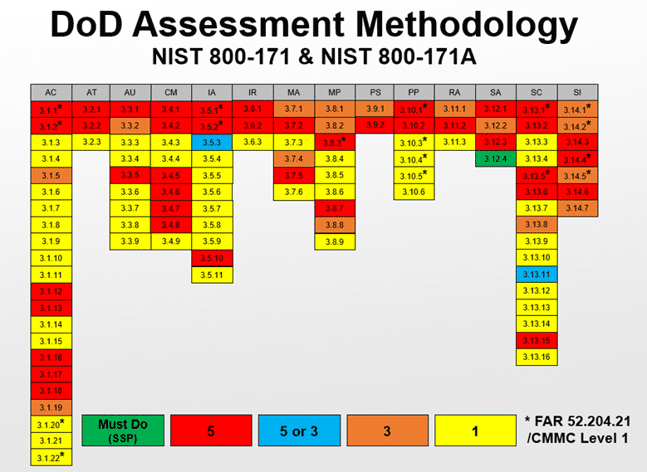

Slide 48
Self Assessment Guides
FCI Level 1
https://dodcio.defense.gov/Portals/0/Documents/CMMC/AG_Level1_V2.0_FinalDraft_20211210_508.pdf
CUI Level 2
https://dodcio.defense.gov/Portals/0/Documents/CMMC/Scope_Level2_V2.0_FINAL_20211202_508.pdf

Slide 49
CMMC Compliance Strategies

Slide 50

Does management need Level 1 or Level 2?
Notes:
ARE WE LEVEL 1

Slide 51
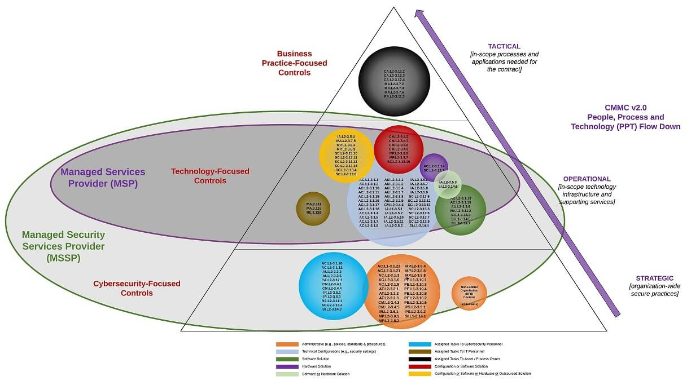
https://www.complianceforge.com/
Notes:
Level 2 much more engagement needed with the business

Slide 52

Make the most out of developing policies & procedures
Notes:
Polices and procedure serve the entire business

Slide 53
Engage your customer and suppliers
Talk to your program manager or prime about CUI shared
Give your program manager or prime instructions on how to securely communicate with you
Define the flow of CUI so you have your scope
Flow down your FAR / DFAR requirements to your sub-contractors
Cloud providers need to be FedRAMP Moderate Equivalent

Slide 54
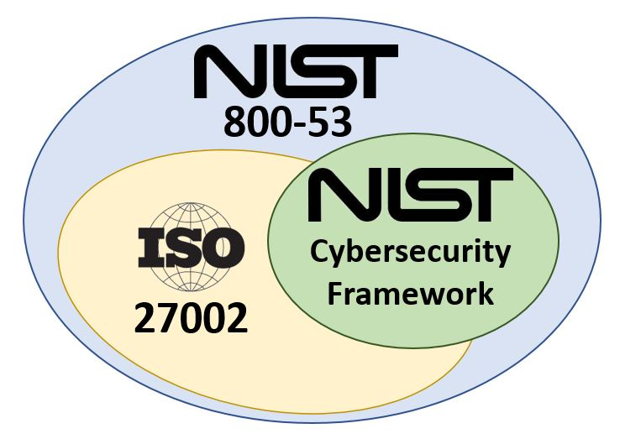
800-171 is a confidentiality framework
800-171 has gaps in aligning IT to business needs or business continuity
https://cyberab.org/News-Events/Town-Halls

Slide 55
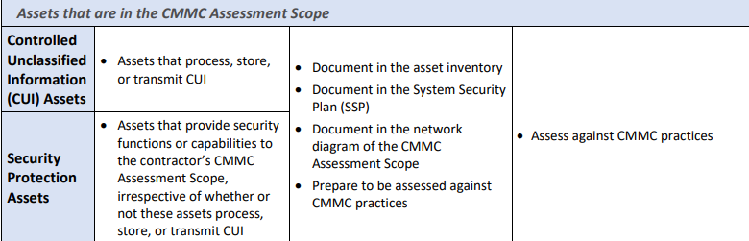
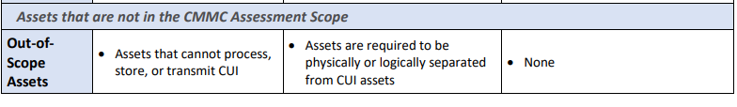

Slide 56

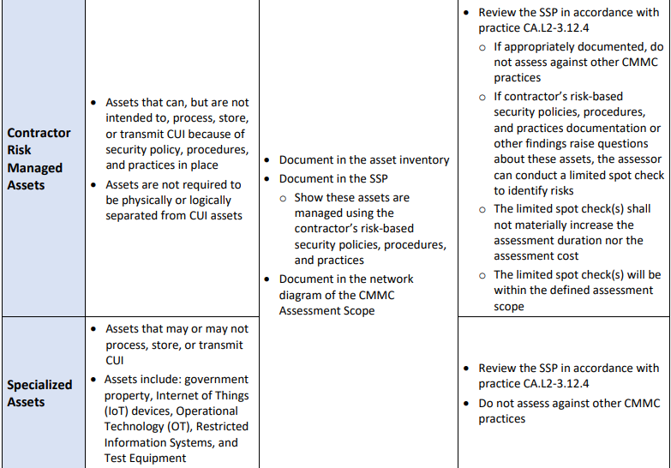

Slide 57

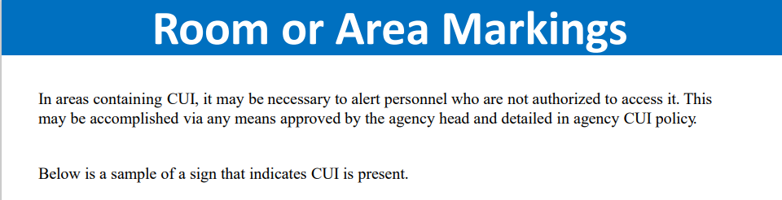
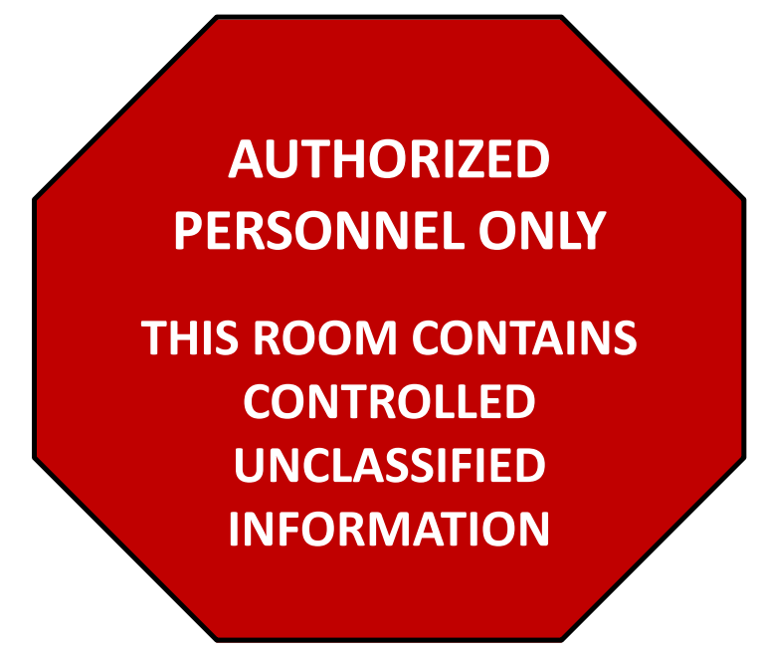

Slide 58

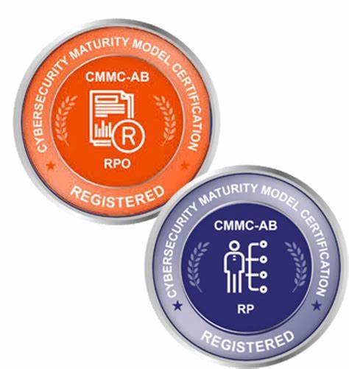
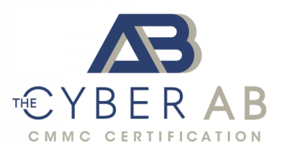
Implementation Consultants

Slide 59
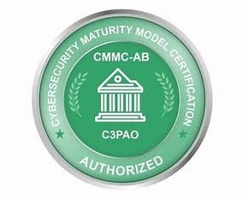
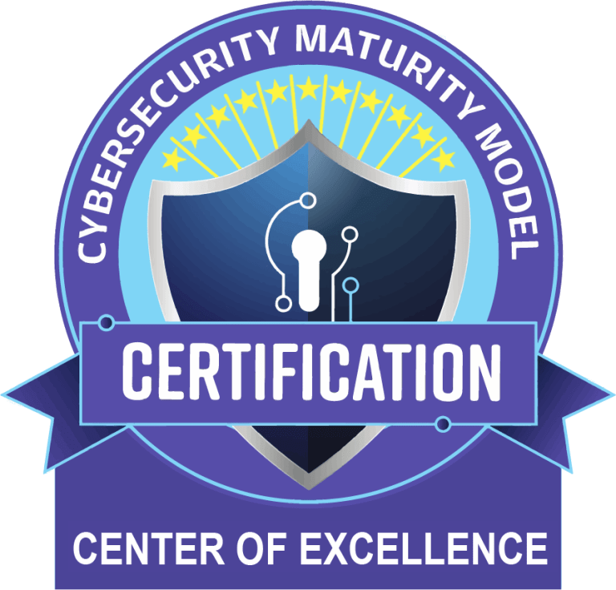
Auditors Providing Certification
42 C3PAO
Lead & Certified CMMC Assessor (CCA).
Certified CMMC Professional (CCP)
Level 1 or Level 2

Slide 60
How often do I asses?
Level 1
Level 2
FCI
Annual Self-Assessment
Update your score in SPRS system
CUI critical to national security 3rd party assessor every 3 years
Level 3 – Government Lead Assessments every three years for high priority defense programs

Slide 61
8 Steps to Achieving CMMC L2
Form Implementation Team
Identify CMMC Level
Define Compliance Scope
Gap Analysis
Remediation of Gaps, w/ RPro if needed (1-2 years)
Source C3PAO
Assessment by C3PAO, report submitted to DOD
  If at least 80% met, 180 days to remedy POA&M to 100%
CMMC L2 Certificate Issued by Cyber-AB

Slide 62
What’s new with NIST 800-171 in 2023?
Https://csrc.Nist.Gov/publications/detail/sp/800-171/rev-3/draft
Level 2 for CUI

Slide 63
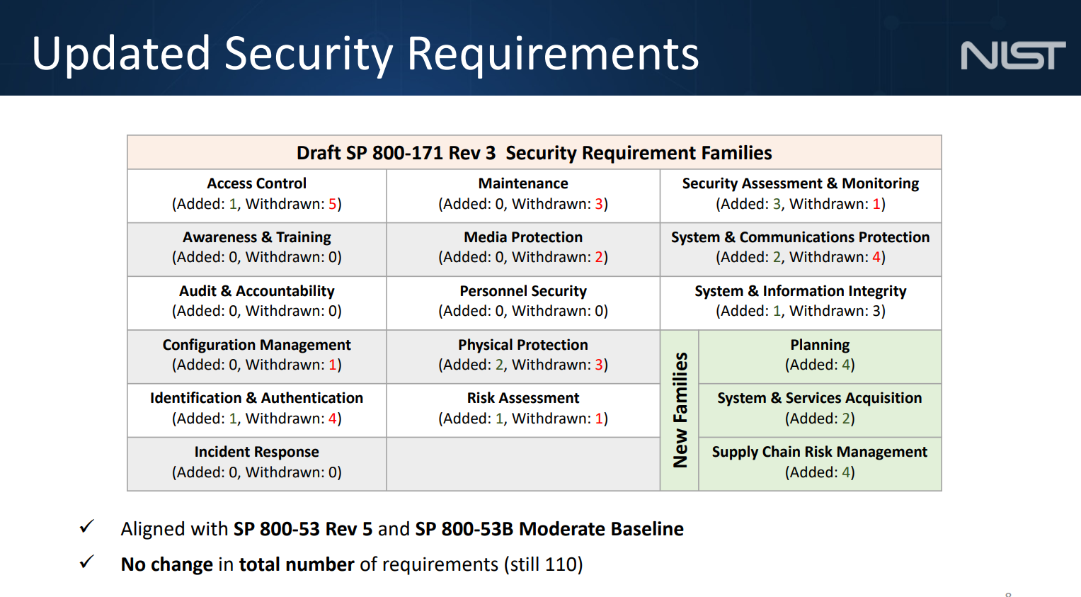
27 - / 27+
Notes:
Withdrawn often integrated
27 new controls 17 polices and procedures

Slide 64
The Easy-to-Read Draft
75% is consistent from 2016 initial publication
Coming out against split tunneling for VPN
Requiring 3rd party auditors
Supply chain risk management
Notes:
Auditors impact on other using NIST
Flow down legal

Slide 65
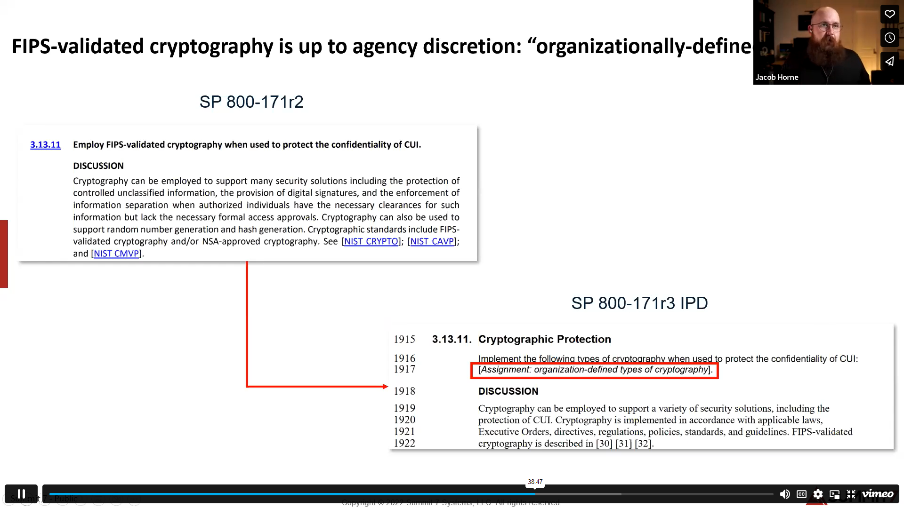

Slide 66
Organizational Defined Parameter (ODP)
65 controls have 107 Organizational Defined Parameter (ODP)
ODP set by whom?
  National Archives
  DOD
  ITAR – Department of State
  You the Contractor

Slide 67
Tailoring Symbol | Tailoring Criteria | SP 800-53 Revision 4 Moderate Baseline | SP 800-53 Revision 5 / SP 800-53B Moderate Baseline
 |  | SP 800-171 Revision 2 | IPD SP 800-171 Revision 3
NCO | Not directly related to protecting the confidentiality of CUI | 58 | 81
NFO | Expected to be implemented by nonfederal organizations without specification | 61 | 17
FED | Primarily the responsibility of the Federal Government | 18 | 21
CUI | Directly related to protecting the confidentiality of CUI | 125 | 168
NA | Not Applicable* Note that controls in the (SP 800-53 Rev 5/SP 800-53B) PM and PT families are considered NA since they are not included in the MODERATE baseline. For the purpose of this table, PT controls included in the Privacy Control Baseline and all PM controls are included in the NA count but not included in the total count for "Moderate Baseline Security Controls" or the Prototype CUI Overlay. | Tailoring criteria newly added in IPD SP 800-171 Rev 3 | 50
 | Moderate Baseline Security Controls Tailored by Revision | 262 | 287

Slide 68
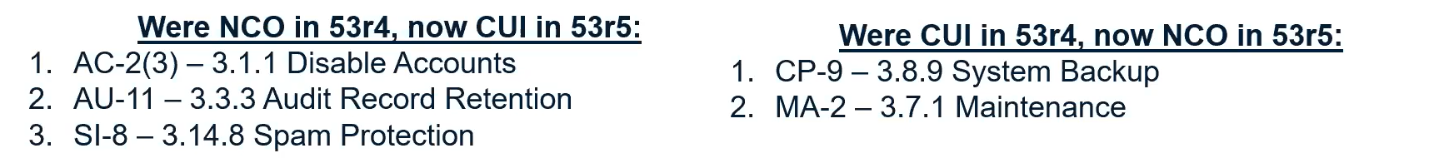
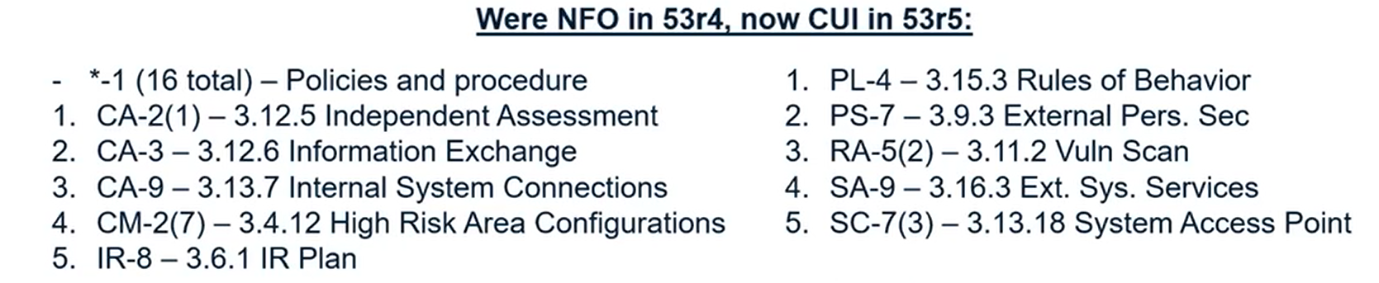
https://vimeo.com/831937501

Slide 69
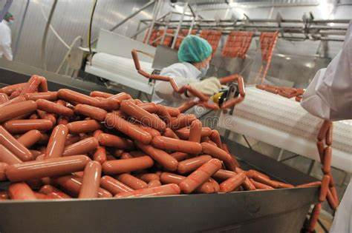
Keep your eye on -
CMMC Cert maybe on 800-171 Revision 3
2024 Go Live https://www.linkedin.com/in/robertmetzger/
The public comment period is open now through July 14, 2023

Slide 70
Tips and Tricks

Slide 71
Start: Define System Boundaries

Slide 72

Managing Change
Don’t get bogged down in access control
Don’t write you procedures before you’ve build the system
Train on document polices and procedures
Consider implementing other management that can help your org. manage change

Slide 73
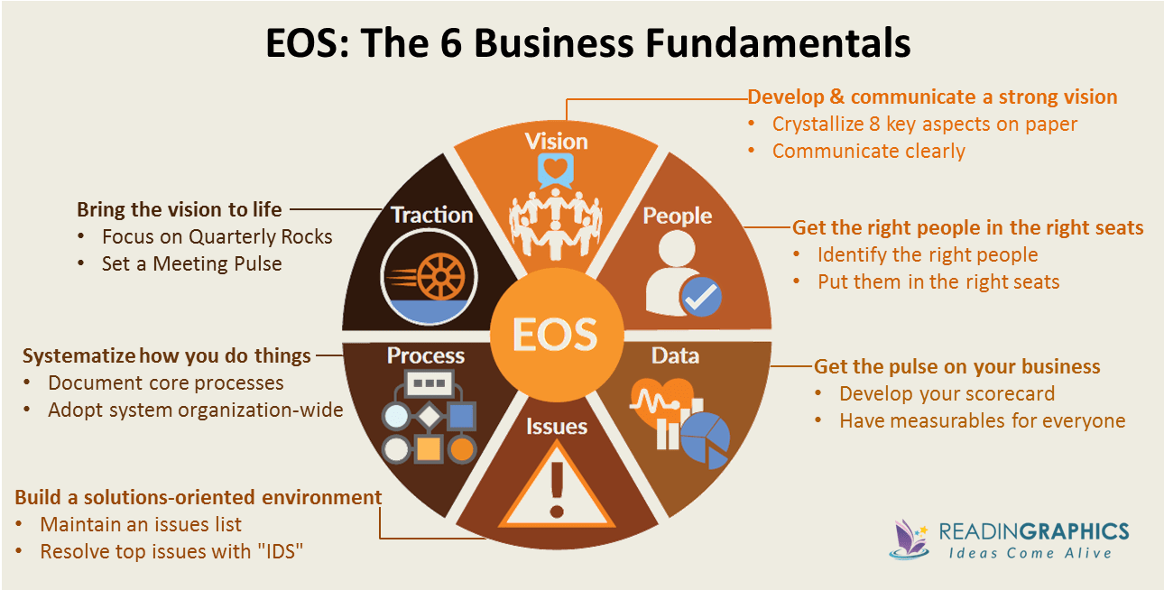

Slide 74


Slide 75

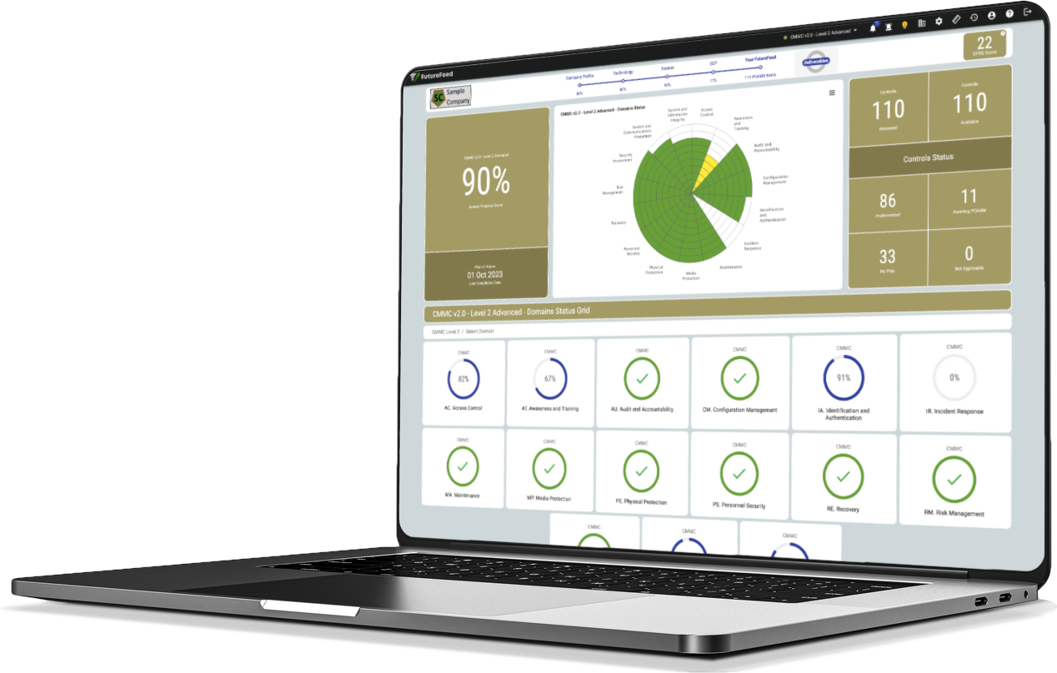
Governance, risk, and compliance tool
Project management
Ease of delegation
NIST Version’s Auto Update
Collaborate with vendors
HELPS WITH MANAGEMENT BUY-IN

Slide 76
Get Trained -
https://cyberab.org/CMMC-Ecosystem/Ecosystem-Roles/Consulting-and-Implementation
https://cmmctraining.academy/cmmc-documentation/
https://www.federalregister.gov/documents/2023/05/03/2023-09021/department-of-defense-dod-defense-industrial-base-dib-cybersecurity-cs-activities
https://www.projectspectrum.io/

Slide 77
Costs & pitfalls

Slide 78
Cost of compliance for 25 people, monthly
GRC Tool $325 per month
Microsoft GCC-High $52 per user
MSSP Tooling $50-70 per user
  SIEM and event logging
  Device Management
  Device Patching
  AV/EDR
  Whitelist tooling
  MFA
  Encryption
Security Training $10
CMMC Consulting $750 - $1,500
Level 2 Audit $25,000 - $50,000

Slide 79
Know Unknows
The quality of the 3rd party assessment workforce
Over use of CUI status in contracting

Slide 80
Align Business, IT & Compliance
Compliance vs. Security
The ITAR question – What level of FedRAMP is needed for our cloud?

Slide 81
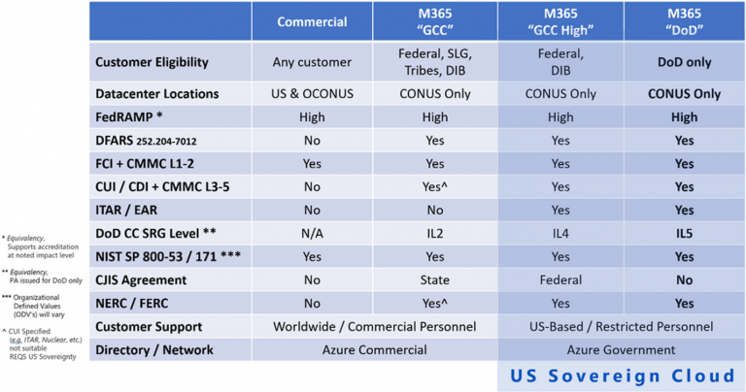

Slide 82
Customer experiences

Slide 83
References
TekFusion Global
MC3 Solutions, LLC
www.tekfusioninc.com
Dave Wolons
https://www.linkedin.com/in/dave-wolons-09126135/
mc3solutionsva.com
Cindy Collins
https://www.linkedin.com/in/cindy-collins-8085582b/

Slide 84


Slide 85

Ian MacRae
Download Slides
President| E-N Computers, Inc.
CMMC Registered Provider
phone: 804-729-8835
www.encomputers.com
Q&A

Slide 86
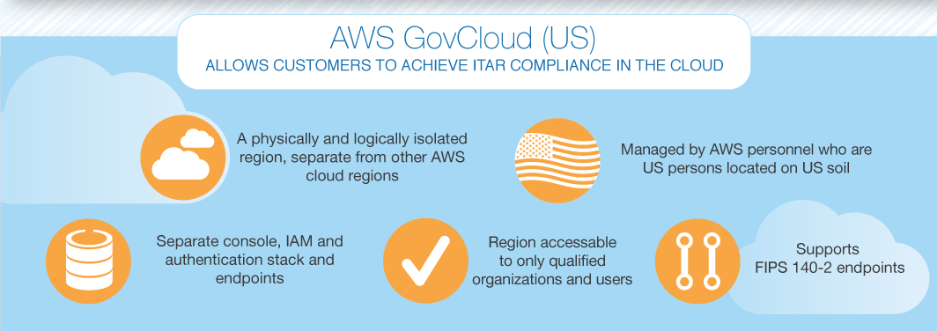

Slide 87
