Slide 1

State-Level Computer Security Issues and Enforcement
Gene Fishel
Senior Assistant Attorney General
Virginia Attorney General’s Office

Slide 2


Slide 3


Slide 4
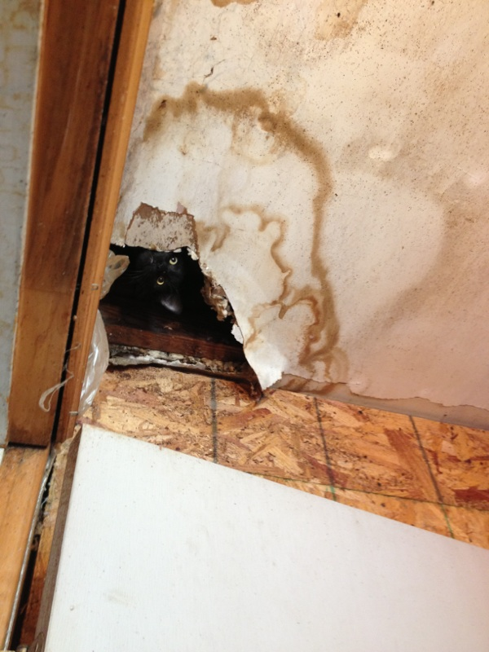

Slide 5




Slide 6
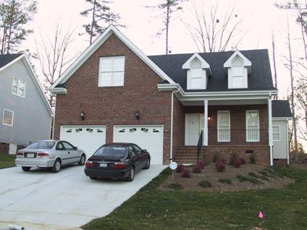


Slide 7
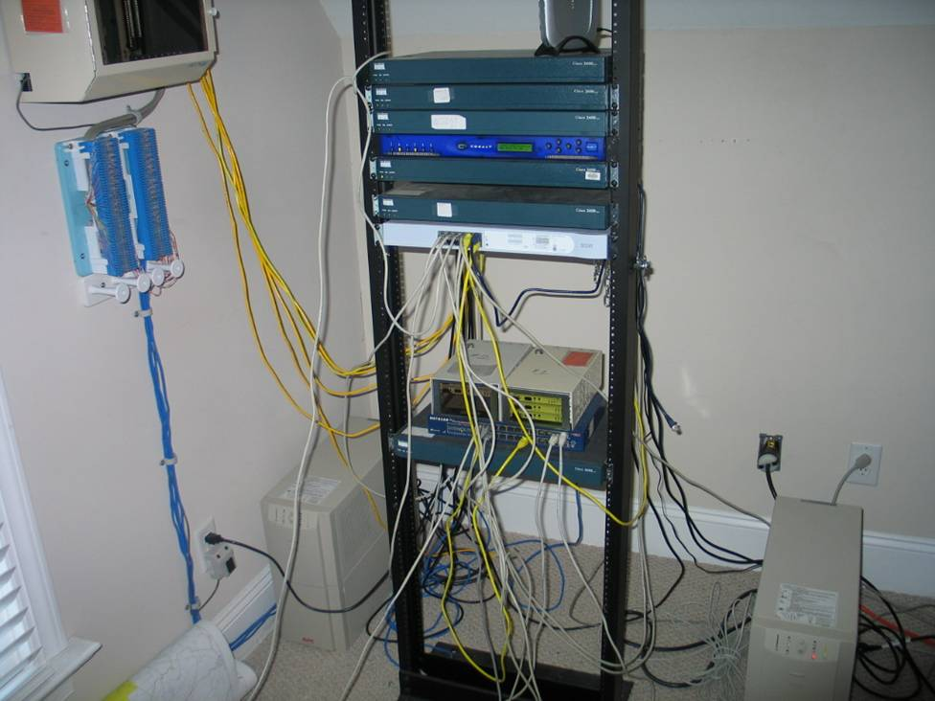

Slide 8
Outline
Database Breaches
Identity Theft
VA Computer Crimes Act

Slide 9
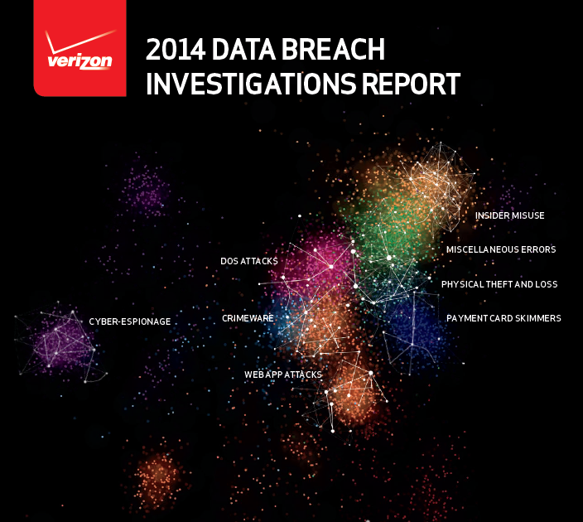

Slide 10
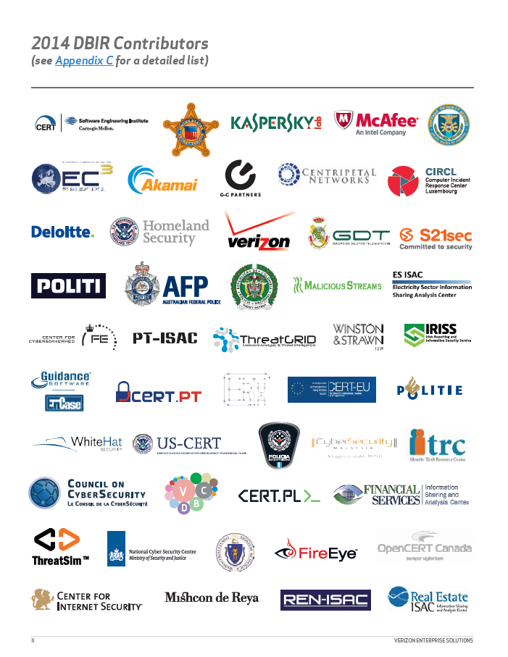

Slide 11
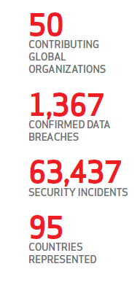

Slide 12
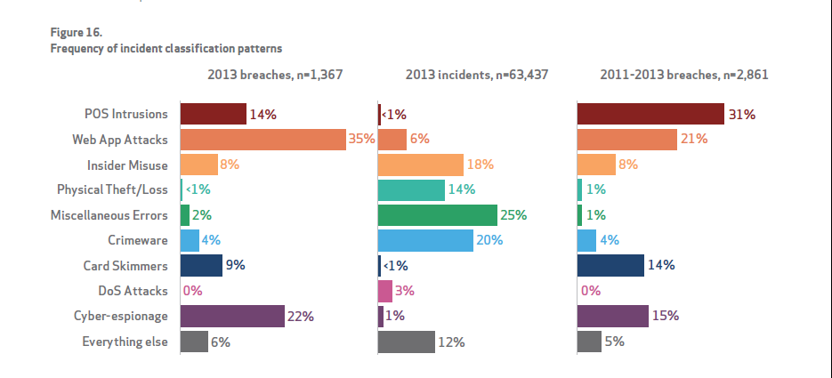

Slide 13

Enforcer’s Perspective
271 database breach notices received in VA In 2013
Broad cross-section of industry
Lost equipment, theft, intrusion are most common occurrences
Small breaches dominate

Slide 14
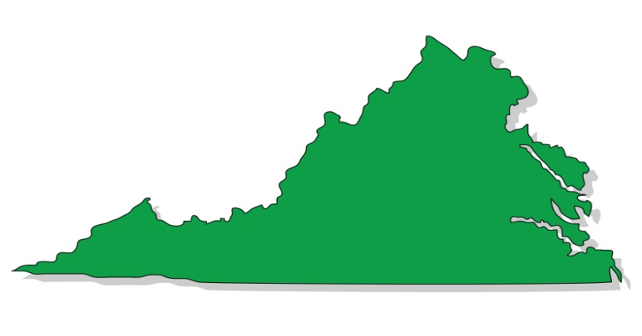
Enforcer’s Perspective
From 1 resident to over 1 million residents affected in a single breach
Work with your attorneys
Contact law enforcement
Work with our office

Slide 15
Database Breach Laws
State laws vary (47 of them)
Virginia Code Section 18.2-186.6
  Took effect July 1, 2008
  Crafted from Governor’s consortium of national business and consumer advocates
  Attempts to strike a balance
  Allows Graham Leach Bliley compliance

Slide 16
Database Breach Laws
Fairly standard provisions
Pertinent Provisions
  Applies to any legal entity; broad application
  Unencrypted data accessed or acquired by unauthorized person
  Must have caused or reasonably believe will cause fraud or identity theft to resident
  Must notify OAG and affected resident without unreasonable delay

Slide 17
Database Breach Laws
Pertinent Provisions
  Law enforcement delay acceptable
  Provisions also apply to encrypted data acquired in an unencrypted form or if person has access to the encryption key
  If more than 1,000 affected residents, must also notify consumer reporting agencies

Slide 18
Database Breach Laws
Pertinent Provisions
  Data = “personal information” to include name, SSN, financial acct/credit card numbers along with access code, driver’s license number
  Notice = written, electronic, telephone or substitute
  Substitute Notice = over $50K in cost, over 100,000 residents, or no sufficient contact info…can then post conspicuously on website, or notify statewide media

Slide 19
Database Breach Laws
Pertinent Provisions
  Notice must include:
    Incident in general terms
    Type of information accessed
    The general acts of entity to prevent further unauthorized access
    Telephone number for affected persons to call
    Advice directing person to remain vigilant of accounts and monitor free credit reports

Slide 20
Database Breach Laws
Pertinent Provisions
  Attorney General’s Office can bring civil enforcement action for failure to comply with notice provisions
  $150,000 penalty per breach
  Does not prohibit affected residents from filing individual claims

Slide 21


Slide 22
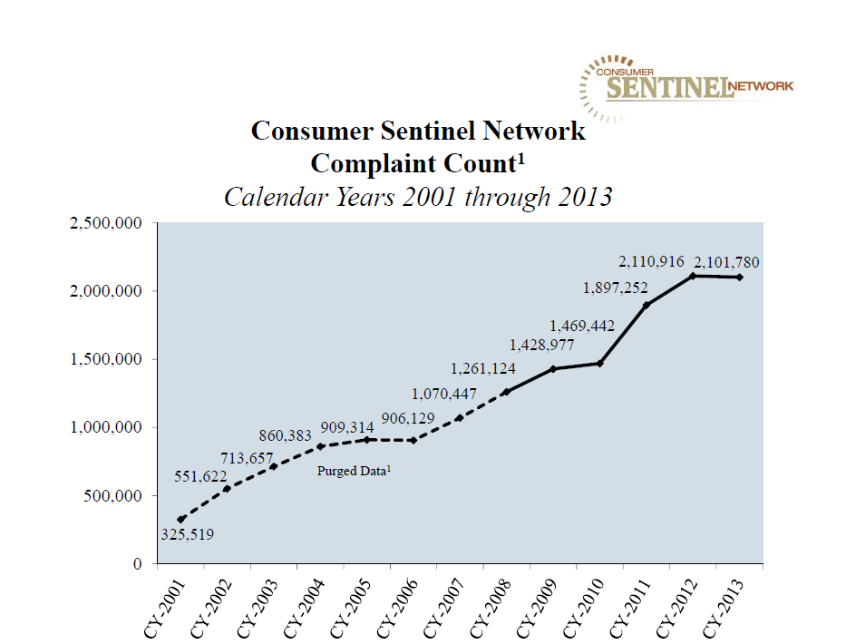

Slide 23
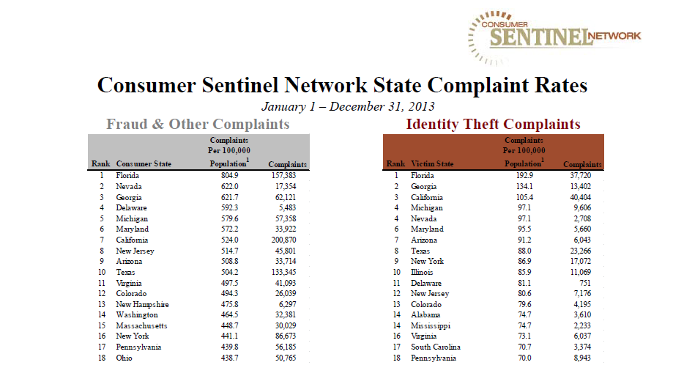

Slide 24
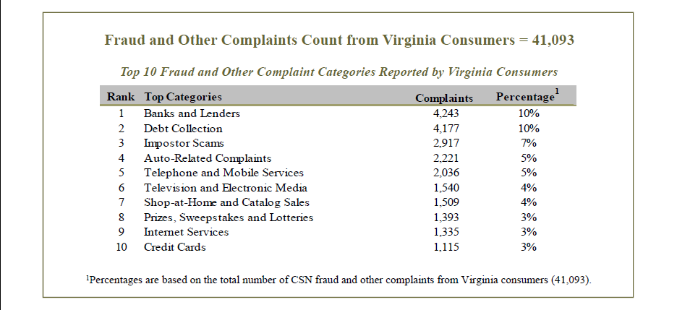

Slide 25
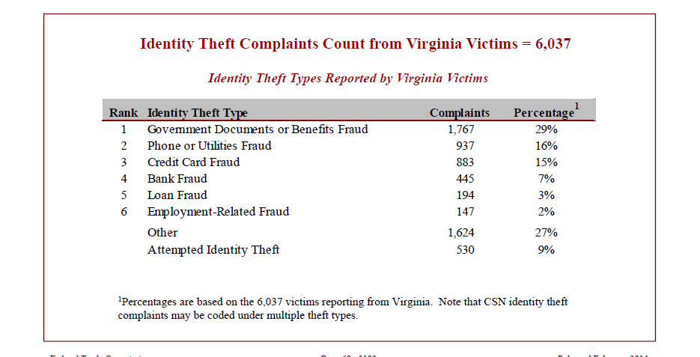

Slide 26
Identity Theft
  A. Unlawful for any person, without authorization….to:
  1. Obtain, record or access identifying information which is not available to the general public that would assist in accessing financial resources…;
  2. Obtain money, credit, loans, goods or services through the use of identifying information of such other person;
  3. Obtain identification documents in such other person's name

Slide 27
Identity Theft
  Identifying Information
    (i) name;
    (ii) date of birth;
    (iii) social security number;
    (iv) driver's license number;
    (v) bank account numbers;
    (vi) credit or debit card numbers;
    (vii) personal identification numbers (PIN);
    (viii) electronic identification codes;
    (ix) automated or electronic signatures;
    (x) biometric data;
    (xi) fingerprints;
    (xii) passwords; or
    (xiii) any other numbers or information that can be used to access a person's financial resources, obtain identification, act as identification, or obtain money, credit, loans, goods, or services.

Slide 28
Identity Theft
  - Penalties
    Up to 12 months jail
    If over $200, 1-5 years imprisonment
    If 50 or more person’s identifying info stolen, 1-5 years
    1-10 years if information is used to commit another crime

Slide 29
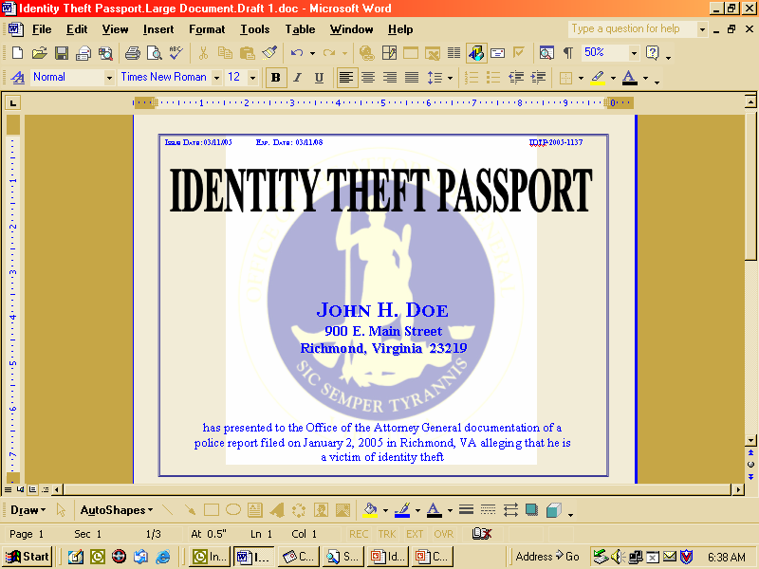
Identity Theft

Slide 30
VA Computer Crimes
Virginia Computer Crimes Act
  Computer Fraud
  SPAM
  Computer Trespass
  Computer Invasion of Privacy
  Theft of Computer Services
  Harassment by Computer
  Using Computer to Gather ID Info (Phishing)
  Civil Provision

Slide 31
VA Computer Crimes
  Computer Trespass
    Unlawful, with malicious intent, to:
      Remove, halt, or disable computer data or program
      Cause a network to malfunction
      Alter, disable, or erase computer data, programs, or software
      Effect the creation or alteration of financial instruments
      Use a computer to cause physical injury to property
      Use a computer to make unauthorized copy
      Install keystroke logger
      Install software to take control of computer in order to cause damage or disrupt transmissions

Slide 32
VA Computer Crimes
  Computer Trespass, cont.
    Penalties:
      Up to 12 months jail
      Damage over $1K, 1-5 years imprisonment
      Installs software on more than 5 computers, 1-5 years
      Keystroke logger violation, 1-5 years
      Exception for ISPs

Slide 33
VA Computer Crimes
  Computer Fraud
    Use a computer without authority to:
      Obtain property or services by false pretenses
      Embezzle or commit larceny
      Convert the property of another
    Value is $200 or more – 1-10 years imprisonment
    Otherwise up to 12 months in jail

Slide 34
VA Computer Crimes
  Phishing
    Using a computer to gather identifying information
    A. Unlawful to use a computer to obtain, access, or record, through the use of material artifice, trickery or deception, any identifying information – 1-5 years imprisonment
    B. Distribution of material – 1-10 years
    C. Uses such information to commit another crime – 1-10 years

Slide 35
VA Computer Crimes
  Civil Remedy
    Any individual wronged by any violation of aforementioned prohibitions may bring suit
    For any damages sustained and cost of suit
    Loss of profits
    Malicious intent NOT required

Slide 36
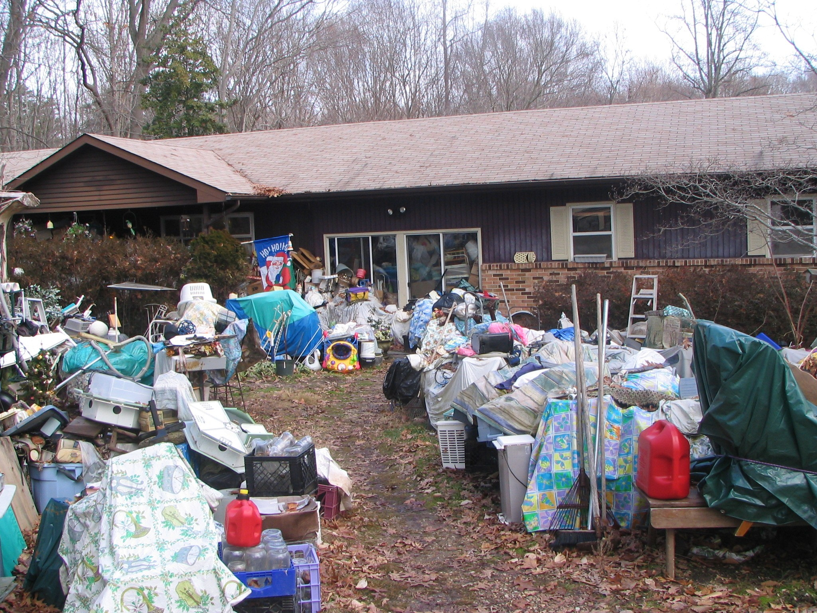

Slide 37
Thank You
Gene Fishel
Senior Assistant Attorney General
Virginia Attorney General’s Office
sfishel@oag.state.va.us
804-786-2071
www.ag.virginia.gov

