Slide 1
We’ve Done The Easy Stuff
Marcus J. Ranum
(mjr@tenable.com)
CSO
Tenable Network Security, Inc.

Slide 2
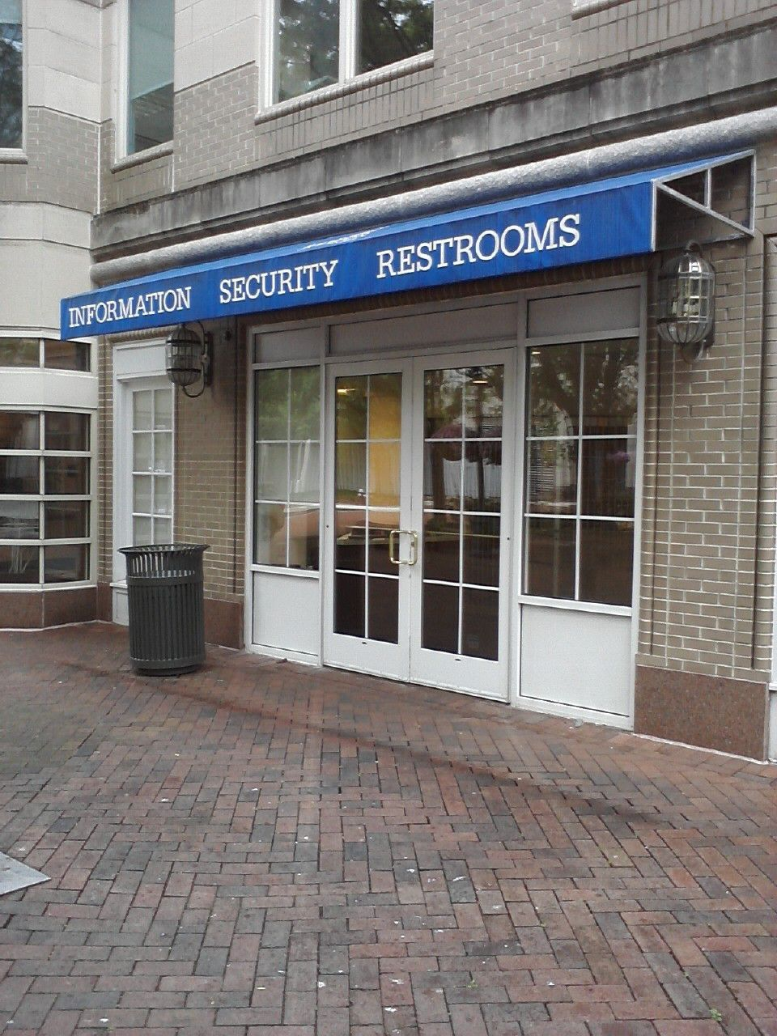
Reston, VA
last Tuesday; right
across from where I
ate breakfast.
They respect
INFOSEC in
Reston!

Slide 3
Warning
When you do a lot of public speaking, your talks turn into a series of ongoing pieces of inner monologue
  Sometimes
  This is one of those
    This is to explain why I am so depressed about where computer security is going

Slide 4
Security As Knowledge-Base
Consider most of what we have been doing in security as knowledge-base management
  Put another way: “You have stuff. Generally you don’t know what stuff you have, or what it does.”
  And: “You have data. Generally you don’t know who is its custodian, or where it has propagated to.”
  Or: “Something is wrong in a way that you don’t understand, with a piece of software you know nothing about.”

Slide 5
Where Have We Succeeded?
The easy stuff
What does that mean?
  The stuff where knowledge-bases can be executed simply
  And obtained by someone else
  I.e.: Where we can remain ignorant

Slide 6
What Does That Mean?
Consider antivirus as:
  Outsourcing our understanding of our runtime environment
Consider SIM/SEIM as:
  An exploratory tool for visually identifying outliers
  Haystack metaphor: a SEIM automates your search for needles in a haystack
  And what does that say about how well we understand “the hay”? Which is really the important part of the equation!

Slide 7
Another Possibility
Perhaps the hay stack is mostly composed of needles

Slide 8
More
Consider the “next generation firewall” as:
  Outsourcing our understanding of what good apps and bad apps look like on a network
  Simplifying our network access control policies even further (in search of the point where we cease to comprehend them)
    The state of the art of home user firewalls is “this is my inside interface, everything is OK”
    Meanwhile I’ve seen corporate firewalls with 5,000+ rules

Slide 9
Still More
Consider vulnerability management as:
  Outsourcing our understanding of the priority we should assign to fixing the horrible masses of software we run on our systems
  System administration has become so difficult because of shifting goal-posts and releases that the cost of system administration is “unacceptable” and triggers a veto-vote called
  “cloud computing”

Slide 10
That Was the Easy Stuff
I am not saying building a firewall, a/v system, SEIM, etc, is trivial!
  Far from it!
But they are tractable problems:
  Execution/evaluation engine that drives:
  A deep, complex, problem-specific knowledge-base

Slide 11
So, That’s the Set-up
The ongoing trend since the mid 1990s has been to dumb down security in the face of exponentially increasing complexity elsewhere in IT
  This makes sense; any other approach would break violently
  Maybe “dumb down” isn’t the right word: we’re leveraging externally-provided knowledge-bases more and more and letting go of comprehension of local terrain

Slide 12
Now For Some Cheerful Ideas

Slide 13
The Trend is Accelerating
“Cloud Computing” means “acknowledge that we can’t do cost-effective system administration”
  What’s next?
  Well, it’s sort-of also outsourcing network administration (because large-scale fault-resistant data networks are really hard to build!)
“Mobile Devices” represent throwing our hands up in despair

Slide 14
The Trend is Accelerating
App stores represent giving up on our runtime/software environment
  The final stage of a trend that began in the late 1990s (aka: “the endless beta-test”)

Slide 15
Convergence
con·ver·gence/k?n?v?rj?ns/
Noun:
The process or state of converging.
The tendency of unrelated animals and plants to evolve superficially similar characteristics under similar environmental conditions.

Slide 16
Convergence 2.0
Convergence
  As in “the freight train moving at 80mph converged with the car that was parked on the track.”

Slide 17
Compliance
The old “new thing” in security is compliance
  Consider as:
    Outsourcing your idea of what “good security” looks like to a committee that knows nothing about how your organization actually works
    Oh, that’s going to work.

Slide 18
Get More Done With Less
2008 financial crash coupled with cost savings offered by “cloud computing” are going to apply across-the-board pressure on staffing for IT security
  The “golden age” of persistently spiralling IT security infrastructure ended in November 2008
  All those knowledge-based solutions? They’re expert systems that amortize small numbers of experts across large numbers of organizations

Slide 19
Get More Done With Less
Amortizing more experts across large numbers of organizations is the only way to keep costs down

Slide 20
Now, The Train-wreck
I have a unique position in the industry
  Sometimes people call me up at 3:00am with interesting problems, just because they think I’m going to help, or will be amused, or something
  In the last 5 years I’ve gotten sucked into 4 extremely interesting incident responses
  Last summer’s incident response was the one which blew my mind

Slide 21
High Intellectual Cost Attacks
Dealing with a targeted attack (let alone one from a well-funded or highly motivated attacker) will quickly allow you to realize that all the knowledge-based expert systems everyone is building and deploying are not worth their weight in rotten bananas
  Sure, they may help, but only if they’re being used by skilled, clued-in, motivated, creative technical people

Slide 22
High Intellectual Cost Attacks
Last Summer’s incident response project:
  Involved me and 6 of the best technical people I know (being able to Call Tom Liston and Mike Poor and say, “hey, can you get your ass out there?” is not an ordinary experience)
  The fight lasted several weeks
  We were dealing with custom code being created on the fly (Being able to call Joel Yonts and say “hey, can you decompile this? Like, now?” is also not an ordinary experience)

Slide 23
High Intellectual Cost Attacks
The skills we need
The resources
we have

Slide 24
Messages
1) You are going to need a malware response team
  They will have to be able to deal with stuff that is outside of the packaged knowledge-bases
2) You are going to need to be doing monitoring and analysis above and beyond the “usual stuff”
  The “usual stuff” simply is not good enough
  Creativity will be the key to success

Slide 25
Messages
3) The trend-line of “do more with less” is going to break really hard when you have your first targeted attack (“when” not “if”)
4) Do full-system cost modelling
  The money you “save” by dumbing down your team will be spent in under a month by the army of expensive con$ultants you will need
  And that’s just the first time

Slide 26
Cheerful Conclusions
IT has done a pretty good job of avoiding tackling the hard problems
  We’ve done such a good job that most of us haven’t realized that’s what we’ve been doing
Targeted attacks and custom malware break the paradigm
  The only counter-paradigms on offer are:
    a) armies of con$ultants
    b) skilled, creative, motivated generalists on staff

Slide 27
Cheerful Conclusions - 2
Yeah, good luck selling that one.

