Slide 1
Reverse engineering an obfuscated .Net application
Travis Altman
RVAsec
June 2012

Slide 2
Huge thanks Curtis Mechling http://twitter.com/#!/curtismechling

Slide 3
Outline
This talk is for all audiences, no experience and seasoned .Net developers
I’ll be covering basic technology behind a .Net application
I’ll discuss simple and more complex ways to reverse an obfuscated .Net application
Demo reversing an obfuscated .Net app

Slide 4
Steps to reverse .Net app
Run the application to understand functionality
Decompile the application
Review source code and hone in on the functionality you’re trying to understand
If obfuscated look for key constructs to understand functionality
Optional: Modify app to achieve your desired functionality

Slide 5
Topic not new
Many others before me have discussed the insecurities of .Net applications
Mark Pearl
http://1dl.us/va3
Jon McCoy
http://digitalbodyguard.com/
Cory Foy
http://1dl.us/va4

Slide 6
Reversing and obfuscation
What exactly is reversing and obfuscation?
Reversing example
You’re given an EXE and tasked with determining how it performs its functionality, aka secret sauce
Could also mean you’re trying to subvert functionality such as licensing
Obfuscation
Equivalent to hiding

Slide 7
.Net basics
.Net, it’s a framework, nuff said
Blanket term for microsoft family of technologies
Most people think .Net web applications but that’s not the focus of this discussion
The focus of this talk are stand alone executables written in C sharp although the programming language doesn’t really matter

Slide 8
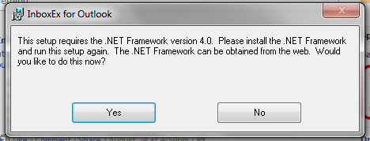
.Net basics
A stand alone executable built for .Net will run inside the application virtual machine, which sometimes may be referred to as the CLR (common language runtime)
The .Net application virtual machine is a requirement for all .Net executables

Slide 9
Executables
There are two main kinds of EXE’s
Compiled and interpreted
Compiled applications usually require an install, e.g Next > Next
Interpreted applications require an application virtual machine
So first you’ll have to install the application virtual machine before running the interpreted application

Slide 10
Executables
Compiled executables are often built with a higher programming language, such as C++, which then gets translated to a lower level language known as assembly machine language
Due to the nature of compiled executables they are “harder” to reverse back to original source because of different compilers, architectures, and lack of information during compilation

Slide 11
Executables
Interpreted executables, such as java and .Net, are much easier to reverse
The interpreted compilation (JIT) process is more structured and retains more information about the executable
Because of this it’s trivial to get original source code from executable
I repeat, getting source code is trivial

Slide 12
Obfuscation
Because it’s trivial to get source code from a .Net application developers will use obfuscation to hide a majority of their source code
There are a number of tools that will obfuscate your .Net application
Most obfuscators will hide things such as variable and class names

Slide 13
Determine type executable
There are a number of ways to determine the type of executable you’re dealing with
The tool I like the best is CFF explorer
http://www.ntcore.com/exsuite.php
Once installed you can simply right click on the executable to view the information via CFF explorer

Slide 14
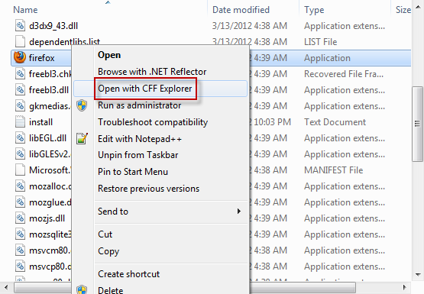
Firefox with CFF explorer

Slide 15
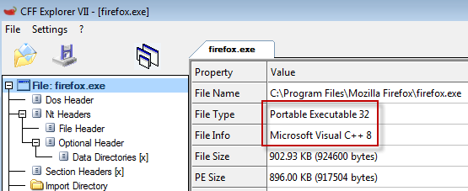
Firefox with CFF explorer

Slide 16
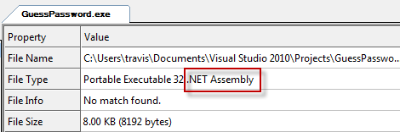
GuessPassword.exe in CFF explorer
GuessPassword.exe is a simple .Net application I wrote to check a password
We’ll continue to use GuessPassword.exe

Slide 17
Next step > decompile
Now you’ve identified the executable was built using .Net
Next step is to decompile
There are two tools that I like to use to decompile
Reflector
www.reflector.net (paid)
ILSpy
http://wiki.sharpdevelop.net/ILSpy.ashx (free)

Slide 18
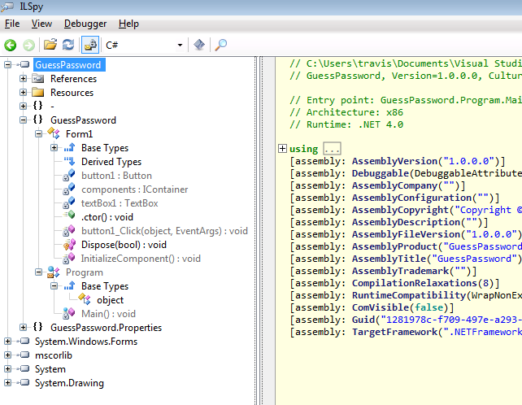
ILSpy

Slide 19
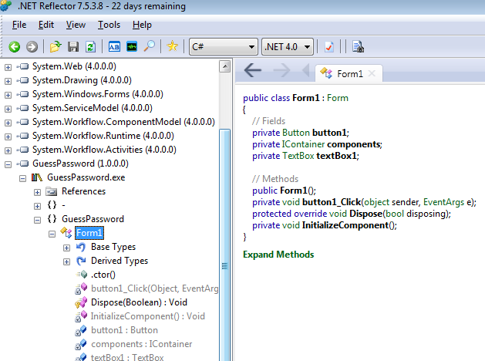
Reflector

Slide 20

Decompilation tips
Only analyze your exe tree and ignore dependencies that get pulled in

Slide 21
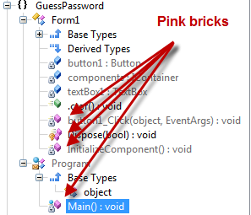
Decompilation tips
Only focus on the “real” code
Real code located in pink bricks

Slide 22
SafeAsHouses.exe
Let’s take a look at a real life example
SafeAsHouses.exe can be downloaded from from either download.com or softpedia.com
SafeAsHouses is a password keeper, it’s designed to keep all your passwords safe in one location

Slide 23
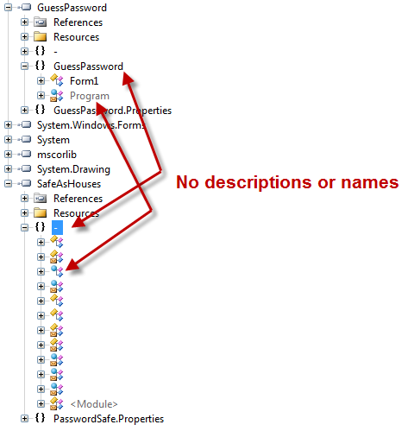
SafeAsHouses in ILSpy

Slide 24
SafeAsHouses in ILSpy
So soon as we open SafeAsHouses.exe in ILSpy we see signs of obfuscation
In the GuessPassword example we see the class names are clearly visible
SafeAsHouses masks this information to make it harder to understand the underlying functionality of the application

Slide 25
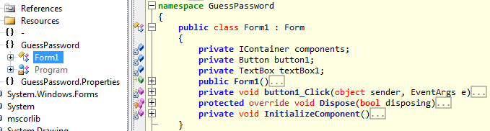
GuessPassword vs SafeAsHouses
Next let’s compare GuessPassword and SafeAsHouses in ILSpy
First GuessPassword

Slide 26
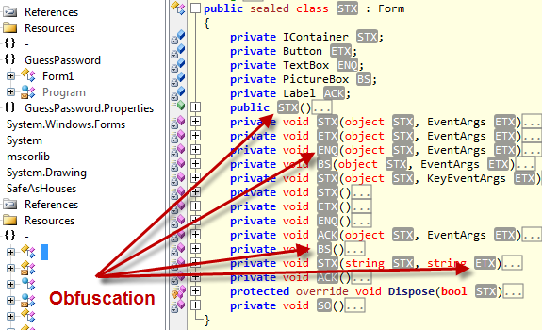
GuessPassword vs SafeAsHouses
SafeAsHouses

Slide 27
More obfuscation
Here we see more signs of obfuscation
In GuessPassword we see how things should look, we clearly get to see class names in the application
In SafeAsHouses however things are hidden
Instead of class names all we see are these grey boxes such as “STX”, “ETX”, etc
STX, ETX, etc

Slide 28
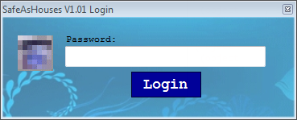
Understanding the app
Typically you would run the application first to get an idea of the functionality but wanted to show the obfuscation first
Run the application

Slide 29
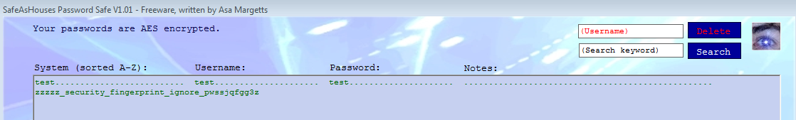
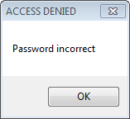
Understanding the app
If we authenticate with the correct password we are granted access to the application
Incorrect password we get denied

Slide 30
Items of interest
The application asks for input
Incorrect password presents a pop up stating “Password incorrect”
The application exits after you click OK when your password is incorrect
Successful authentication brings up another window

Slide 31
Items of interest
The main idea is to take certain areas of interest inside the application and find that functionality
Even if the application is obfuscated hopefully identifying an item of interest will lead us to the code we want to reverse
I’ve highlighted four items of interest but you could easily focus on other areas

Slide 32
Searching for items of interest
Now that we’ve done some recon and understand the type of functionality we want to go after we need to search for that
There are a number of ways to search for items of interest but I’ll highlight two
Decompile all code into one text file
Use the Reflector plugin “Code search”

Slide 33
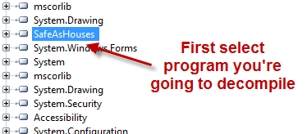
Decompile code into text file

Slide 34
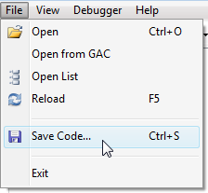
Decompile code into text file
Next choose File > Save Code

Slide 35
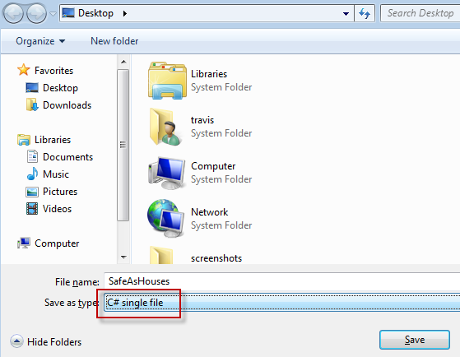
Decompile code into text file
Then save the file as a “C# single file”

Slide 36
Decompile code into text file
At this point you can use your favorite text editor to search through the decompiled code
Disadvantage is that searching through a flat file doesn’t present a lot of context
On the other hand it’s always handy to have a raw dump and the ability to save for historical purposes

Slide 37
Reflector code search plugin
Reflector’s code search plugin is very convenient in that you don’t have to leave the reflector tool
With the code search plugin you also don’t loose the context with where code functionality is located
Using code search we’ll search for all four items of interest
http://reflectoraddins.codeplex.com/wikipage?title=CodeSearch&referringTitle=Home

Slide 38
Items of interest
The application asks for input
Incorrect password presents a pop up stating “Password incorrect”
The application exits after you click OK when your password is incorrect
Successful authentication brings up another window

Slide 39
Application asks for input
A popular way of taking form input in a .Net application is through the text box class where the convention is “this.textBox1.Text”
Here textBox1 is a variable name
Most obfuscators will hide the variable name with something like “this.STX.Text”
So better to search for “this.*.Text” inside the code search reflector plugin

Slide 40
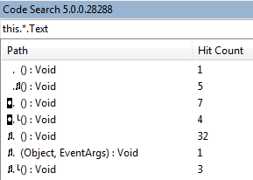
Application asks for input
Searching for this.*.Text revealed numerous hits, probably best to keep searching for different terms, you might also want to search for just *.Text

Slide 41
Pop up message
A pop up box is typically done with the “MessageBox.Show” method
Two arguments can be given to this method, window title and window message
MessageBox.Show(“title”, “message”)
Use code search to see how many message boxes are in the application, the idea is to hopefully pinpoint this functionality

Slide 42
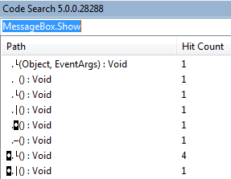
Pop up message
So quite a few hits on MessageBox.Show, let’s continue searching for other constructs

Slide 43
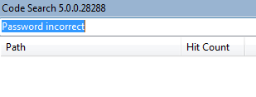
Pop up message
The pop up message states “Password incorrect”
We should search the code for strings like this
No dice, the phrase “Password incorrect” must be obfuscated

Slide 44
Application closes
If you enter an incorrect password you’ll get a pop up, after clicking OK the application will close
.Net can handle this in a couple of ways, with Application.Exit and Environment.Exit
Let’s search for these terms as well

Slide 45
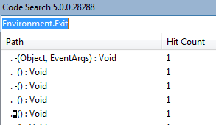
Application closes
Less results which means which means less manual reviewing of code

Slide 46
Successful authentication opens another window
Probably the most popular way to show one window then hide another is to use the window.Show() and window.Hide() methods
They are used in tandom
Even though they are commonly used in tandom it’s a good idea to search for both terms

Slide 47
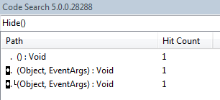
Successful authentication opens another window
Only three hits, we’re money

Slide 48
Code search plugin
Using this plugin we were able to narrow down to only three locations where our authentication functionality is most likely hiding
Click on each result to view the obfuscated code
Look for the other constructs, Environment.Exit, this.*.Text, etc
Code search is case sensitive

Slide 49
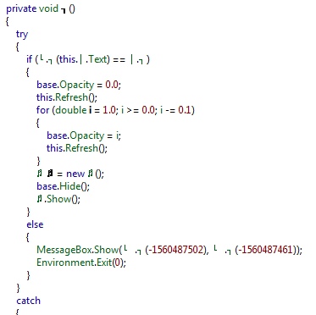
First hit, found the functionality

Slide 50
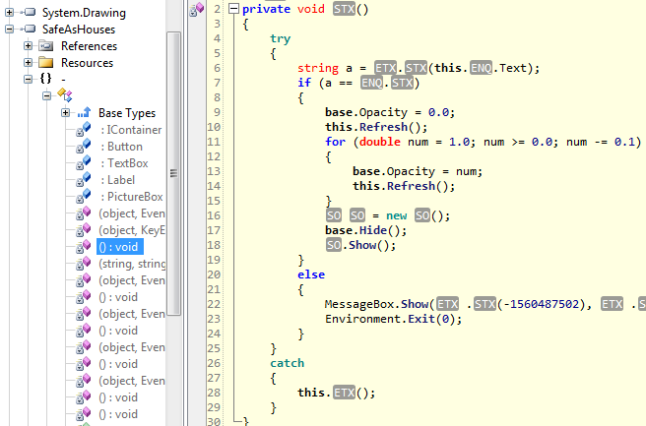
Same code in ILSpy

Slide 51
Explanation of code
Line 6: developer is assigning variable “a” to whatever you type into the text box
Line 7: if statement comparing password values
Line 17: if password is correct base.Hide will hide the login box
Line 18: will show the main window
Line 22: message box that tells you your password is incorrect
Line 23: closes the application

Slide 52
Subverting authentication
Now that we’ve found the code that performs the authentication we want to subvert that functionality to gain access without knowing the password
There are two tools that will allow us modify the executables
Graywolf
http://digitalbodyguard.com/GrayWolf.html
Reflexil
http://reflexil.net/

Slide 53
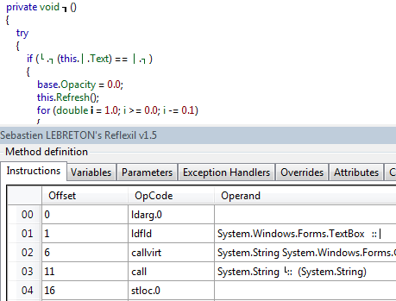
Reflexil

Slide 54
Reflexil
The bottom half of the previous screen shot shows the reflexil plugin to reflector
With reflexil we can edit the executable
We’ll be editing content in the “Instructions” tab within reflexil
These instructions are referred to as CIL (common intermediate language)

Slide 55
CIL
Lower level language used by the .Net application virtual machine
So your higher level programming, such as C#, gets converted to CIL (sometimes called IL)
The CIL instructions will then be JIT compiled into native machine code at run time
Opcodes are at the heart of CIL and tell the application what to do

Slide 56

CIL
Not that important to understand all the technical details behind CIL
On lines 01, 02, and 03 we can see these three lines are more than likely responsible for getting input from user via a text box

Slide 57
Modifying CIL
Looking through the code and CIL we see an interesting instruction on line 07
The operand to the instruction is “op_Equality” that compares passwords
The next opcode instruction on line 08 is “brfalse”
Stands for branch if false, so it’s the if statement

Slide 58
Modifying CIL
You’ll also notice the operand for the opcode on line 08 is “->(36)”
This means branch to line 36 if the password doesn’t match
This branches all the way down to the message box functionality
To break this functionality we can change the brfalse opcode to the opposite which is brtrue

Slide 59
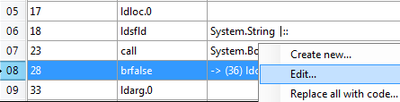
Modifying CIL
Right click on opcode and choose edit

Slide 60
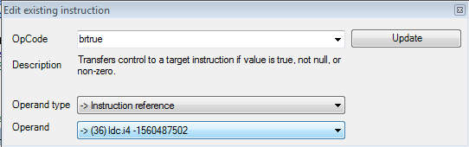
Modifying CIL
Next change to brtrue then click update

Slide 61
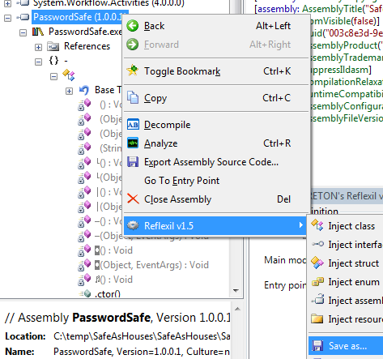
Modifying CIL
Next right click on root tree and save

Slide 62
Patched executable
Now you’ve successfully patched a .Net executable
If we run this we can provide the incorrect password and successfully authenticate but if we provide the correct password the application will close
We don’t have to stop there we can delete chunks of code to remove that functionality as well

Slide 63
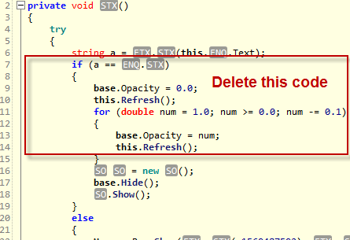
Deleting code blocks

Slide 64
Delete code blocks
Delete lines 1-28
Save the patched application
Run it again and now it won’t matter what password you type in because we’ve deleted that entire if statement that checks for the password
Next open the patched application in reflector to see if the code block was deleted

Slide 65
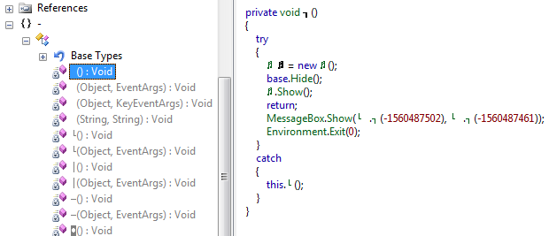
Missing code block

Slide 66
Great success
We’ve successfully modified the application to subvert authentication
If we had obtained this executable from another user then we would have all their passwords
Hopefully you see how easy it is to control and modify .Net applications to your heart’s content

Slide 67
Easier reversing via deobfuscation
There is a slightly easier way to go about reversing an obfuscated .Net application
If we can deobfuscate the obfuscated code then we’ll have a much easier time understanding the functionality of the application
Luckily reflexil can deobfuscate many obfuscation tools

Slide 68
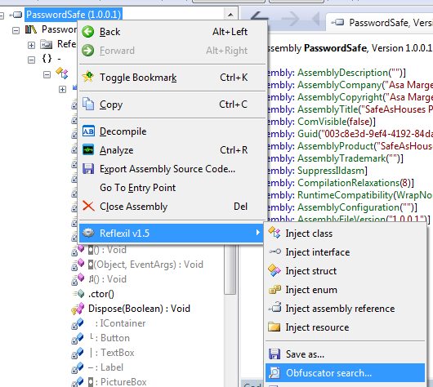
Reflexil deobfuscation
Right click > Reflexil > Obfuscator search

Slide 69
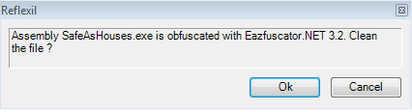
Reflexil deobfuscation
Next reflexil will try to determine the type of obfuscation used
Here it successfully determined it was obfuscated with Eazfuscator.NET 3.2

Slide 70

Reflexil deobfuscation
Next you save the executable, you can stick with the default *.Cleaned extension so you don’t accidentally write over the original exe
Next open your saved SafeAsHouses.Cleaned in reflector to view deobfuscated code

Slide 71
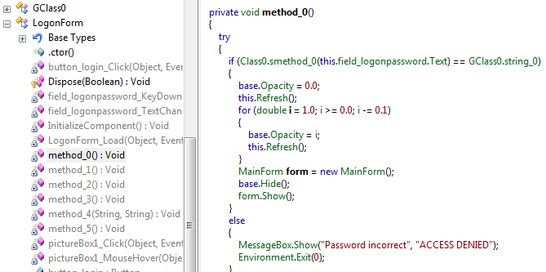
Deobfuscated code

Slide 72
Deobfuscated code
So reflexil actually does a nice job on getting us better source code
It may not retrieve original variables or class names but it will at least name them var1, var2, etc to give better meaning
In this case it actually revealed the pop up message of “Password incorrect” to whereas before that was obfuscated

Slide 73
Steps to reverse .Net app
Run the application to understand functionality
Decompile the application
Review source code and hone in on the functionality you’re trying to understand
If obfuscated look for key constructs to understand functionality
Optional: Modify app to achieve your desired functionality

Slide 74
Wrapping up
A standalone .Net executable will more than likely be very easy to decompile to get original source code
Obfuscation techniques only make it a little bit harder to figure out the original source code
If you want to save your intellectual property then don’t write the software that utilizes the .Net framework

Slide 75
Questions http://twitter.com/#!/curtismechling http://travisaltman.com

