Slide 1
Code Maturity: Is SDL a Waste of Time?
What is Security Development Lifecycle (SDL) and does it develop "demonstrably more secure software"?
Carsten Eiram
Chief Security Specialist

Slide 2
Security Development Lifecycle (SDL)
Created by Microsoft and made a company-wide initiative and mandatory policy in 2004 to implement security through the whole software development process.
”The goals of the SDL are twofold; the first is to reduce the number of security vulnerabilities and privacy problems, and the second is to reduce the severity of the vulnerabilities that remain.”^{[1]}
Similar initiatives adopted by other companies e.g. Adobe as Secure Product LifeCycle (SPLC).
[1]: Introduction to ”The Security Development Lifecycle” by Howard and Lipner.

Slide 3
Microsoft SDL - History
Up to mid-1998: Ad-hoc handling of vulnerability reports.
Mid-1998: Founding of SRT (Security Response Team) to handle vulnerability reports and STF (Security Task Force) to examine vulnerability causes and thus reduce number of vulnerabilities in the future.
2000: STF report coincides with final bug fix stage prior to release of Windows 2000. Deployed PREfix (static code analysis tool), created dedicated pen-test team to analyse Win2K, and created SWI (Secure Windows Initiative).
2000-2001: SWI starts teaching engineering teams. Enhancement of PREfix. Creation of PREfast for detecting buffer overflows in individual modules.
2002: Launch of TwC (Trustworthy Computing) initiative in January to fundamentally change addressing of security and privacy issues after Microsoft reputation was impacted by Code Red and Nimda in 2001. Michael Howard and David LeBlanc finish "Writing Secure Code", which is issued as training material during the security push late January through end of May where 8000+ Windows engineers are trained.

Slide 4
Microsoft SDL - History
2003: Launch of Windows Server 2003. Up to this point, security focus has been on the OS and core components, but not bundled applications like Internet Explorer. Microsoft now starts focusing on other applications including IE, SQL Server 2000 (SP3), Microsoft Office 2003, and Exchange Server 2000 (SP3).
2004-2006: Reflections on the security push during meetings in early 2004 between SWI team and product management. It is decided that almost all Microsoft products must meet a formalised SDL (Security Development Lifecycle).
2007: Windows Vista and Office 2007 are released. Both fully integrate SDL.

Slide 5
Microsoft SDL – The 7 Phases
Consists of seven phases:
Training (secure design, threat modeling, secure coding, security testing)
Requirements (establish security requirements and quality gates / bug bars and perform risk assessments)
Design (establish design requirements and perform attack surface analysis / reduction and threat modeling)
Implementation (define and list approved tools/settings, unsafe functions, static analysis)
Verification (perform dynamic analysis and fuzz testing and review the attack surface)
Release (create incident response plan, perform Final Security Review, and certify all requirements are met before archiving all relevant information / data)
Response (execution of incident response plan)
Source: http://www.microsoft.com/security/sdl/default.aspx

Slide 6
Microsoft SDL - Implementation
Overall securing of the code by implementing safer programming practises.
Addition of various safer functions^{[1]} to replace historically problematic functions.
E.g. StringCchCopy and strcpy_s replace strcpy, wcscpy, and similar APIs.
E.g. StringCchCat and strcat_s replace strcat, wcscat, StrCatBuff, StrCatChainW, and similar APIs.
E.g. StringCchPrintf and sprintf_s replace wsprintf, sprintf, and similar APIs.
E.g. StringCchCopyN and strncpy_s replace strncpy, StrCpyN, and similar APIs.
Addition of various arithmetic functions^{[2]} via Intsafe.h to reduce risk of integer overflows and type conversion vulnerabilities.
E.g. IntToShort allows converting value to type INT to type SHORT, returning INTSAFE_E_ARITHMETIC_OVERFLOW in case the original value is truncated.
E.g. DWordAdd and DWordSub allow adding/subtracting two values of type DWORD, returning INTSAFE_E_ARITHMETIC_OVERFLOW in case the result underflows/overflows.
[1]: http://msdn.microsoft.com/library/bb288454.aspx
[2]: http://msdn.microsoft.com/en-us/library/windows/desktop/ff521693%28v=vs.85%29.aspx

Slide 7
Microsoft SDL - Verification
Addition of Application Verifier to locate subtle memory corruption errors that may not be caught during code reviews and normal application testing.
Addition of BinScope to ensure binaries are built in compliance with SDL requirements and recommendations.
Use of automated, distributed file fuzz testing to identify potential vulnerabilities during development. During development of Office 2010, reportedly ~1800 bugs (not all vulnerabilities) were identified and fixed in this manner^{[1]}.
[1]: http://www.computerworld.com/s/article/9174539/Microsoft_runs_fuzzing_botnet_finds_1_800_Office_bugs
[1]: http://www.microsoft.com/en-us/download/details.aspx?id=20028

Slide 8
Microsoft SDL - Effectiveness
To date the effectiveness of (Microsoft’s implementation of) SDL has been discussed by:
Listing implemented security mechanisms
Counting and comparing number of crashes during fuzzing runs.
Counting and comparing reported number of vulnerabilities

Slide 9
Microsoft Office – Added Security Mechanisms
Addition of various defense-in-depth mechanisms have been added to protect against exploitation and reduce the severity of existing vulnerabilities.
These include:
DEP (Data Execution Prevention)^{[1]}
ASLR (Address Space Layout Randomization)^{[2]}
Protected View (read-only mode for files from unsafe locations)^{[3]}
File Block settings (prevents opening of outdated file types)^{[4]}
Office File Validation (verifies that binary files comply with expectations)^{[5]}
[1]: http://blogs.technet.com/b/office2010/archive/2010/02/04/data-excecution-prevention-in-office-2010.aspx
[2]: http://blogs.technet.com/b/srd/archive/2010/12/08/on-the-effectiveness-of-dep-and-aslr.aspx
[3]: http://office.microsoft.com/en-us/excel-help/what-is-protected-view-HA010355931.aspx
[4]: http://office.microsoft.com/en-us/powerpoint-help/what-is-file-block-HA010355927.aspx
[5]: http://support.microsoft.com/kb/2501584

Slide 10
Microsoft SDL – Fuzzing Comparison
In March 2011 a fuzzing test comparison of the different Office versions vs. OpenOffice is published by Dan Kaminsky, Adam Cecchetti, and Mike Eddington: http://dankaminsky.com/2011/03/11/fuzzmark/
A similar comparison is published in April 2011 by Will Dormann of CERT/CC: http://www.cert.org/blogs/certcc/2011/04/office_shootout_microsoft_offi.html

Slide 11
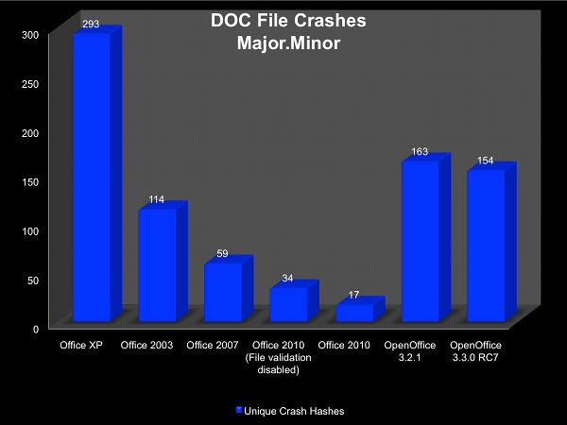
Microsoft SDL – Fuzzing Comparison
Crash results from CERT/CC analysis

Slide 12
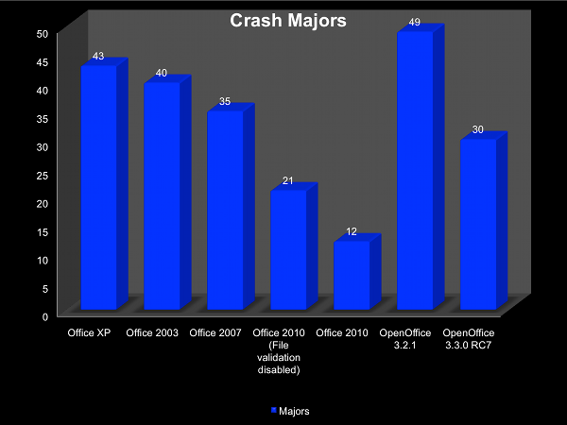
Microsoft SDL – Fuzzing Comparison
Crash results from CERT/CC analysis – Potential duplicates removed

Slide 13
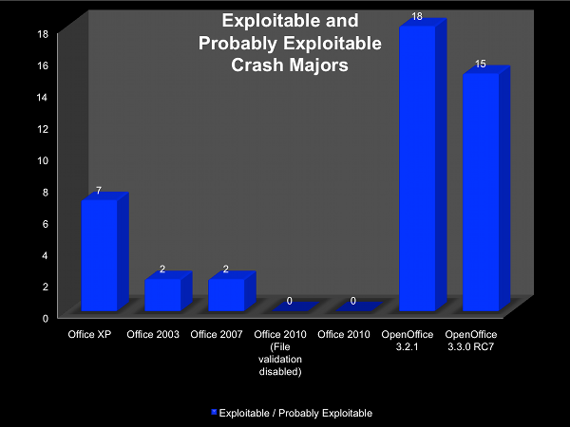
Microsoft SDL – Fuzzing Comparison
Probably Exploitable and Exploitable CERT/CC results returned by !exploitable

Slide 14
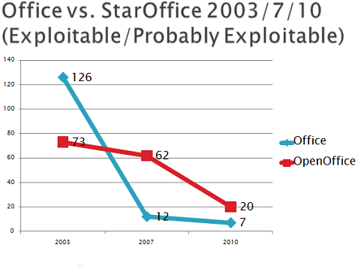
Microsoft SDL – Fuzzing Comparison
Kaminsky et.al. analysis results

Slide 15
Microsoft SDL – Fuzzing Comparison
Only proves the solidity of the code vs. common fuzzing techniques and the efficiency of the fuzzing tests implemented in SDL.
No insight into e.g. the code quality, types/complexity of vulnerabilities discovered.

Slide 16
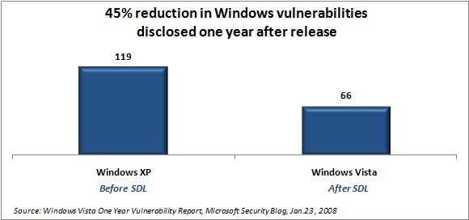
Microsoft SDL – Vulnerability Count Comparison

Slide 17
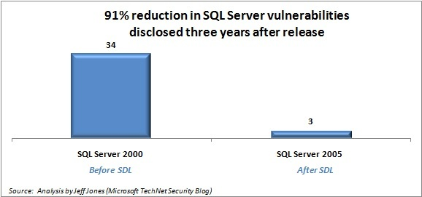
Microsoft SDL – Vulnerability Count Comparison

Slide 18
Microsoft SDL – Vulnerability Count Comparison
While counting vulnerabilities is one of the most popular ways to ”document” the security state of a product, it is a terribly uninteresting approach in an isolated manner as various factors affect the number of vulnerabilities reported – most importantly researcher focus.

Slide 19
Adobe Shockwave Player Vulnerability Trend
(number of vulnerabilities)
 | 2003 | 2004 | 2005 | 2006 | 2007 | 2008 | 2009 | 2010 | 2011 | 2012
Shockwave Player | 0 | 0 | 0 | 1 | 0 | 0 | 6 | 58 | 78 | 14
Various researchers including Secunia Research starts focusing on Shockwave Player late 2009 / early 2010. General focus quickly picks up momentum in 2010 after initial disclosures. Over the next 1½ year both Secunia Research and ZDI/DVLabs publish a large number of vulnerabilities. After a major update (47 vulnerabilities) in June 2011, Secunia Research slowly shifts focus away from Shockwave Player and ZDI also stops accepting vulnerability submissions. During the 2nd half of 2011 "only" 11 vulnerabilities are reported. Value for 2012 is per 12th June 2012.

Slide 20
Microsoft SDL – Vulnerability Count Comparison
Other potential factors impacting comparison could be:
Microsoft fixed more reported vulnerabilities in the latest version prior to its official stable release.
Microsoft fixed more vulnerabilities as ”variants” (i.e. silent fixes).
Vulnerability counts can also be used to ”prove” the opposite claim!

Slide 21
Microsoft SDL – Vulnerability Count Comparison
Number of vulnerabilities disclosed in Office versions one year after initial product release (based on Microsoft security bulletins)

Slide 22
Microsoft SDL – Vulnerability Count Comparison

Slide 23
Code Maturity
Even though it is flawed and does not provide any real information (and we all know it), many still focus on the number of vulnerabilities discovered in a product when evaluating a product’s security state.
Some may take into account details like severity, number of 0-days, Time-to-Patch, number of unpatched vulnerabilities etc. However, many of these metrics say more about the vendor’s responsiveness than the security state of the product.
Combining this information with the types and complexity of vulnerabilities being reported would be more interesting and says more about the security state of the software.

Slide 24
Code Maturity
This presentation will now discuss code maturity and strive to prove/disprove the effectiveness of Microsoft’s SDL implementation focusing on Microsoft Office.

Slide 25
Code Maturity
What is the concept of code maturity?
What are the premises for code maturity?
How can we measure code maturity?

Slide 26

Code Maturity
The idea of code maturity is that by evaluating the prevalence of the different vulnerability classes being discovered in a product, we can conclude the maturity of that product. We, naturally, focus on it from a security perspective.
Some code may be in an infantile stage…

Slide 27

Code Maturity
… and some code may be very mature!

Slide 28
Code Maturity – How to evaluate software
By looking at this historically for a specific piece of software, we can determine the development (if any). Either a consistent, high code maturity or continuously improving code maturity is wanted.
Evaluating code maturity also provides a more detailed comparison of different products (or different components of the same product) than just looking at the number of vulnerabilities, time-to-patch information etc.

Slide 29
Code Maturity - Scoring
Each vulnerability can be scored based on the vulnerability type and to a certain extent an evaluation of how easy it would have been to discover.
Researchers find simple vulnerabilities first - as simple vulnerabilities are eliminated, researchers move on to finding more complex vulnerabilities.
When a vendor secures the code, basic vulnerabilities are easier to spot and remedy or never introduce compared to more complex vulnerabilities.
Use of automated source code auditing tools will easily spot simple, classic vulnerabilities. Very complex vulnerabilities will generate less hits.

Slide 30
Code Maturity - Scoring
Makes sense from a source code auditing or reversing perspective, but does fuzzing also follow this premise? It seems it would be random vulnerability classes being discovered.
Fuzzers are made more complex to search more complex parts of code and to find more complex vulnerabilities when needed. Starting point is usually a very basic fuzzer (e.g. string expanding, integer value manipulation, single byte-flipping).
Fuzzers have come a long way in the past years when targeting high profile products as the simple fuzzers were no longer that successful.

Slide 31
Code Maturity - Scoring
Level 0: Vulnerabilities like classic buffer overflows (e.g. strcpy, sprintf, and sscanf) and format string vulnerabilities are prevalent.
Level 1: Vulnerabilities like buffer overflows due to incorrect size (e.g. memcpy and strncpy) and array-indexing errors are prevalent.
Level 2:Vulnerabilities like integer overflows/underflows, type conversion, and signedness errors are prevalent.
Level 3: Vulnerabilities like uninitialised variable, use-after-free, double-free, object type confusion, and various complex logic errors/design problems are prevalent.
Level 4: Reserved for Level 3 vulnerabilities considered extra complex.

Slide 32
Code Maturity - Scoring
A basic yet effective approach for scoring is by assigning a simple value based on the vulnerability class. This makes it easy to e.g. tie to CWE.
Optional adjustment score of +1/-1 could be applied based on evaluated complexity of discovery primarily via fuzzing (would e.g. simple string expansion trigger a use-after-free? If so it makes sense to decrement score accordingly).
When evaluating code maturity for the whole product, the sum of all the vulnerabilities’ code maturity scores is divided by the number of vulnerabilities.

Slide 33
Code Maturity – Scoring Applied (CVE-2009-1131)
Let us look at an example of a Microsoft Office 2000 only vulnerability to understand how to apply a code maturity score.
Fixed May 12, 2009 as CVE-2009-1131 by MS09-017.
Buffer overflow in POWERPNT.EXE when parsing user names in CurrentUserAtom records (record type 0FF6h) in the “Current User” stream.

Slide 34
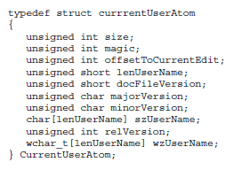
Code Maturity – Scoring Applied (CVE-2009-1131)
CurrentUserAtom record is defined as:
We specifically care about the unsigned short "lenUserName" value.

Slide 35
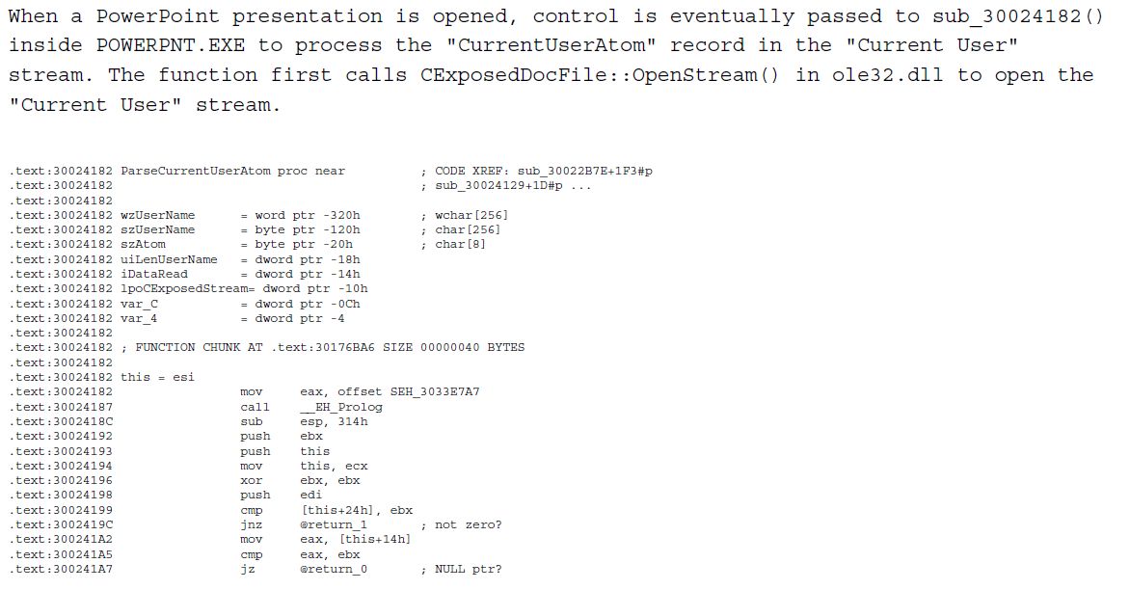
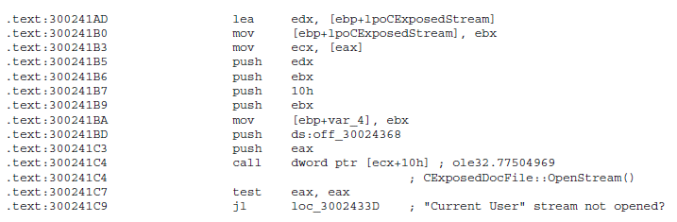
Code Maturity – Scoring Applied (CVE-2009-1131)

Slide 36
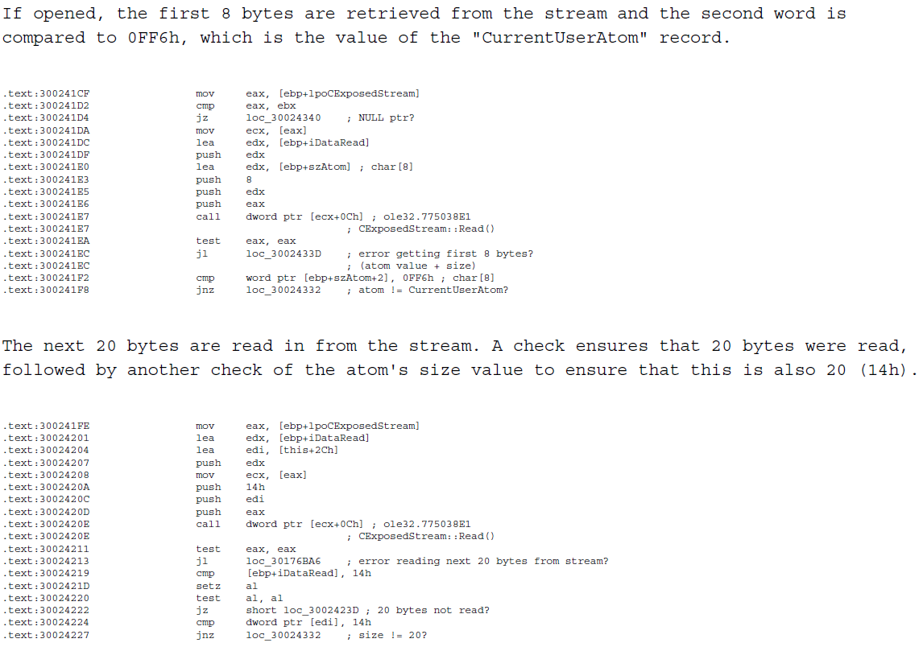
Code Maturity – Scoring Applied (CVE-2009-1131)

Slide 37
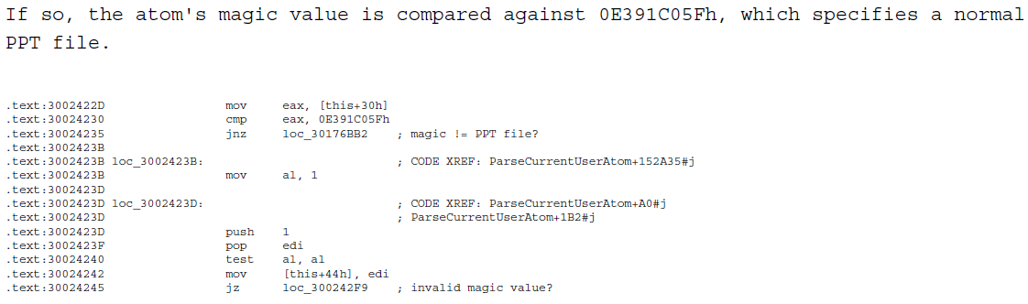
Code Maturity – Scoring Applied (CVE-2009-1131)

Slide 38
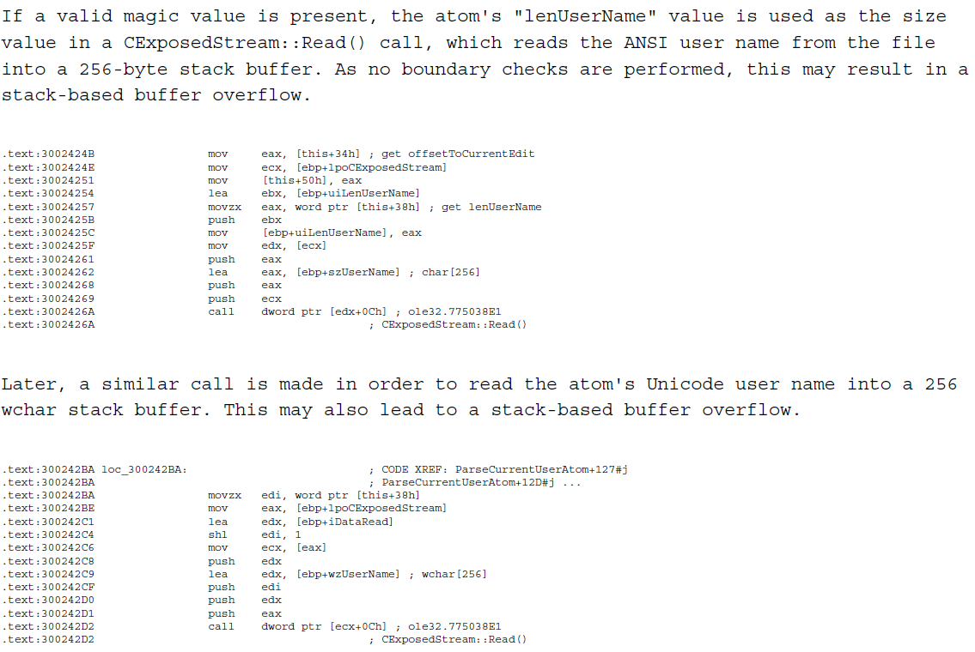
Code Maturity – Scoring Applied (CVE-2009-1131)
Code Maturity Score: 1

Slide 39
Code Maturity – Scoring Applied for Product
Let us briefly look at a Novell iPrint Client to understand how to apply code maturity scores and evaluate the security state of a whole product based on code maturity.

Slide 40
Code Maturity – Novell iPrint Client (2008)
SA27994: inline memcpy using src length as size (fixed: 4.34)
SA30709: x3 inline memcpy using src length as size + x1 wsprintfA (fixed: 4.36)
SA30667#1: inline memcpy using src length as size (fixed: 4.38 + 5.08)
SA30667#2: x2 wsprintfA without any checks (fixed: 4.38 + 5.08)
SA30667#3: lstrcpyA without checks (fixed: 4.38 + 5.08)
SA30667#4: x2 strcpy (fixed: 4.38 + 5.08)
SA30667#5: x3 wsprintfA (fixed: 4.38 + 5.08)
SA30667#6: inline memcpy using src length as size (fixed: 4.38 + 5.08)
SA30667#7: unsafe method (fixed: 4.38 + 5.08)
SA30667#8: inline memcpy using src length as size (fixed: 4.38 + 5.08)
SA30667#9: x3 strcpy (fixed: 4.38 + 5.08)
SA30667#10: inline memcpy using src length as size (fixed: 4.38 + 5.08)
SA31370: strcpy (fixed: 4.38 + 5.08)
NOTE: All calls to memcpy just use length of source buffer as size argument and are, therefore, no different than classic
buffer overflows e.g. caused by strcpy. For this reason, code maturity score is decremented for all of them.
1 points / 22 vulns

Slide 41
Code Maturity – Novell iPrint Client (2009)
SA37169#1: inline memcpy using src length as size (fixed: 5.32)
SA37169#2: inline memcpy using src length as size (fixed: 5.32)
0 points / 2 vulns

Slide 42
Code Maturity – Novell iPrint Client (2010)
SA40782#3: inline memcpy using src length as size (fixed: 5.42)
SA40805#1: wsprintfA (fixed: 5.44)
SA40805#2: uninitialised pointer (fixed: 5.44)
SA42298#1: strcpy (fixed: 5.56)
SA42298#4: strcpy (fixed: 5.56)
SA42298#?: wsprintfA (fixed: 5.56)
3 points / 6 vulns

Slide 43
Code Maturity – Novell iPrint Client (2011)
SA44811#1: strcpy (fixed: 5.64)
SA44811#2: strcpy (fixed: 5.64)
SA44811#3: strcpy (fixed: 5.64)
SA44811#4: strcpy (fixed: 5.64)
SA44811#5: strcpy (fixed: 5.64)
SA44811#6: strcpy (fixed: 5.64)
SA44811#7: strcpy (fixed: 5.64)
SA44811#10: custom copy function with no size checks (fixed: 5.64)
0 points / 8 vulns

Slide 44
Code Maturity – Novell iPrint Client (2012)
SA47867#1: strcat (fixed: 5.78)
SA47867#2a: uninitialised stack variable (fixed: 5.78)^{[1]}
SA47867#2b: uninitialised stack variable (fixed: 5.78)^{[1]}
[1]: Normally score would be 3, but vulnerability is easily triggered by just passing an overly long string (512 bytes or longer),
therefore, causing adjustment of -1.
4 points / 3 vulns

Slide 45
Code Maturity – Novell iPrint Client
iPrint Client 4.x had a code (im)maturity score of 1/22 = 0.05
iPrint Client 5.x currently has a code (im)maturity score of 8/36 = 0.22
Basic vulnerabilities are prevalent in both ienipp.ocx and nipplib.dll.
Based on the code maturity there does not seem to be any real development in the security state of Novell iPrint Client.
Novell’s approach to dealing with vulnerabilities in the product seems very much to be reactionary with no SDL in place.

Slide 46
Microsoft SDL - Office
Many Office 2000 and Office XP vulnerabilities were usually caused by copy operations using an incorrect size – often using values read from file as a length values during copy operations without checks.
Are we still seeing these types of vulnerabilities or have they changed in type in the last couple of years?

Slide 47

Code Maturity – Office (Vulnerabilities Analysed)
Office 2000: 62
Office XP: 103
Office 2003: 90
Office 2007: 47
Office 2010: 14

Slide 48
Code Maturity – Office (Vulnerability Type Prevalence)

Slide 49
Code Maturity – Office (Code Maturity Scores)

Slide 50
Code Maturity – Microsoft Office
(Vulnerabilities Only Present in Later Versions Including Type)
Office 2010:
CVE-2011-2010 (classic privilege escalation to SYSTEM – only Chinese versions)
Office 2007 only:
CVE-2007-1754 (logic error when encountering negative values allows bypassing sanitization code and use value from file as an object pointer)
CVE-2011-1990 (array-indexing error)
CVE-2011-3413 (unknown – according to ZDI: “Due to the application not properly checking the types of elements within containers, the application will incorrectly modify a property of the object.”^{[1]})
Office 2007 and 2010 only:
CVE-2011-0655 (use-after-free)
CVE-2011-1982 (uninitialized value used as object pointer)
CVE-2011-1983 (use-after-free)
CVE-2011-3396 (insecure library loading)
[1]: http://www.zerodayinitiative.com/advisories/ZDI-11-346/

Slide 51
Code Maturity – Microsoft Office (CVE-2011-1980)
Affects Office 2003 SP3 and Office 2007 SP2 and fixed by MS11-073. Introduced by MS11-023 and only affects installations without the Office File Validation add-in.
Microsoft Office included functionality in MSO.DLL to validate the storage of a file being opened. This can either occur via the included functionality or external libraries like the Office File Validation add-in.
If the Office File Validation add-in is not installed, a check returns a NULL string, which is passed to LoadLibraryW as a path, triggering an insecure library loading vulnerability.
Programmer likely expected that no library would be loaded, but LoadLibraryW searches the supplied path for a file extension. If not found, ”.dll” is appended and the API checks for the library using a search order, which includes CWD.

Slide 52
Code Maturity - Microsoft SDL Conclusion
Vulnerabilities are still present and will continue to be so. Even with a solid SDL, you are bound to miss something.
Microsoft has successfully weeded out and prevented introduction of many simple vulnerability classes as well as ensured a significant reduction in arithmetic vulnerabilities with new custom copy and arithmetic functions.
Though described on page 717 in ”Appendix A: Dangerous APIs” of ”Writing Secure Code 2nd Edition”, Microsoft is still having problems with insecure library loading vulnerabilities. Need to implement proper checks in the SDL to ensure they are not introduced.
Overall, Microsoft are making a solid effort at securing their code and has improved the code maturity of their products.
Implementing SDL is not a waste of time, but should be tailored to each organisation’s resources and requirements.

Slide 53
SDL – How To Get Started
Training: Make sure managers/team leaders understand importance of secure coding. Train developers/programmers and testers to develop/recognize secure code and identify the most critical interfaces. Many great resources are available e.g. the free, annual “CWE/SANS Top 25 Most Dangerous Software Errors” list. Maybe hire external consultants to assist in training.
Implementation: Deprecate historically problematic APIs and use safer versions instead for both copying input and arithmetic. Microsoft’s APIs are freely available. As resources permit have code auditing days where focus is on checking existing code instead of writing new.
Verification: At least test code using publicly available fuzzers. Application Verifier is freely available for catching subtle memory corruption errors.
Just starting there could help a lot by weeding out Level 0 vulnerabilities and significantly reducing the number of Level 1 and Level 2 vulnerabilities…

Slide 54
Questions?
Carsten Eiram
Chief Security Specialist
che@secunia.com

