Slide 1
Don't Be a Cog in the Wheel! Participating in the Infosec Community!
Chris Gerling

Slide 2
Who am I?
Founder of the SecuraBit podcast
Brief stint on Hak5
8 years in the US Navy
2 years at the Federal Reserve
Currently at RSA NetWitness
Tinkerer, Networker, Researcher
SecuraBit/Gh0st Lab

Slide 3
Our Community
Podcasts
Blogs
Social Networks
Group collaboration
Conferences
Organizations
Mentoring

Slide 4
Podcasts? Why?
Great way to get exposed to current events!
Networking!
Entertainment!
Popular tools, aka Podcatchers:
iTunes (bloatware but the most popular)
gpodder
Juice
http://en.wikipedia.org/wiki/List_of_podcatchers
Notes:
Remember when we used to "hang out" and do stuff together? Some of us still do of course, but most of us are just plain virtual.
Hackerspaces bring us together to make shit. Sometimes it's not just robots either.

Slide 5







What are some podcasts?
Many More!

Slide 6
Blogs
There are a lot of cool people who maintain blogs out there
Contagio for malware samples!
http://www.securitybloggersnetwork.com/security-bloggers-network-the-feed/ (300 blogs)
Great way to stay on top of things

Slide 7
Social Networks
Join the twitter fun!
Talk to people like Jack Daniel, SecBarbie, Rafal Los, etc!
Excellent late breaking stuff if you keep up with the hashtags and lists
FaceBook
Like our page!
LinkedIn (Change your password…)

Slide 8
Group Collaboration
Have you heard of github? If not, check it out:
www.github.com - Social Coding
Google Code
IRC
There are LOTS of networks and channels to join!
Find people who want to do cool things and organize or join!
Google Hangouts!

Slide 9
Conferences
Get out there and find a conference to attend!
One of the best networking tools available
They’re springing up all over (Bsides for example)
Defcon, Shmoocon, Derbycon are good sized
Don’t forget smaller venues like CarolinaCon, Day-Con

Slide 10
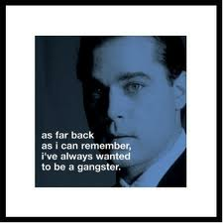
Organizations
ISSA
Infragard
2600
Local orgs like RichSec!
Join one and meet other people, often times there are smaller meetups that can be just as effective as a conference!
_{RIP 1943-2012}

Slide 11
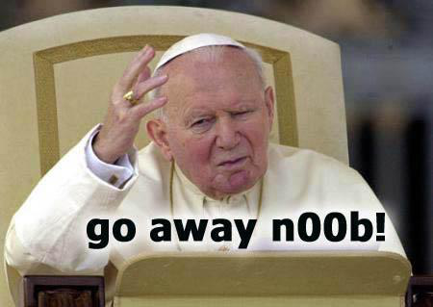
Mentoring
Look out for others
Ask questions and answer them
Nobody knows everything
Share what you find
Everyone’s a n00b at some point

Slide 12
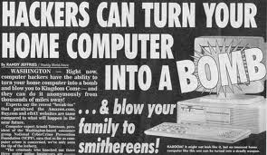
So why be involved?
Staying in your basement doesn’t help you or anyone else
We can create a better baseline of knowledge and avoid making the same mistakes
Education helps everyone

Slide 13
Helping out new generations
Here’s what we have locally that is still active as far as I know:
RichSec
SecuraBit (with Gh0st Labs)
Hack.RVA
ISSA
NoVA Hackers (You have participate to stay a member – this is a good thing!)

Slide 14
Don’t solve the same problems!
Do you want to keep fixing systems compromised by ancient vulnerabilities because an org doesn’t want to patch?
Embrace new technology and methodology
Share these with your colleagues!
Threat vectors change, risk management looks a lot different today!

Slide 15
The same problems continued…
Example:
PCI Compliance Investigations in 2011*
Over 97% were cited for insufficient firewall policies
Over 83% were cited for default or easily guessed passwords
99.2% failed to properly monitor internal network access!
How old are these problems? Do you have the power to affect change here?
*Source: Trustwave 2011 Global Security Statistics and Trends by Charles Henderson

Slide 16
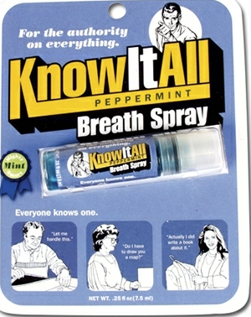
Do you know everything?

Slide 17
What can I do?
Participate!
Comment on blogs, videos, podcasts
Be active in IRC, Twitter
Write/Evaluate/Share code and ideas!
Start a podcast or blog
Challenge established entities
Join an existing one
Offer constructive criticism
We do ours because we want to stay connected!

Slide 18
What can I do? Continued…
Work with other parts of IT, we’re all on the same team!
Avoid the “9-5” mentality
This does NOT mean you have to work 100 hours a week
Question ineffective methodologies and don’t just “do your job”
Ignorance breeds incompetence which puts us all further behind the curve!

Slide 19
Rock Stars
We have them, they aren’t all what they seem though
They’re just people and are smart enough, nice enough, and gosh darn it, people like them!
We put them on a pedestal because they drive change
Say hi, they don’t bite too hard!
Be the change you want to enact and others will follow!

Slide 20
Questions?
Do you know anyone who doesn’t know about local security organizations?
Make them aware!

Slide 21
THANK YOU!!!

