Slide 1
PHP Insecurity
@grecs

Slide 2


Slide 3
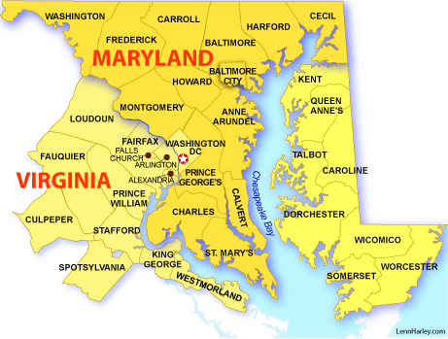

Slide 4

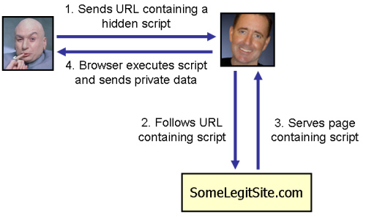

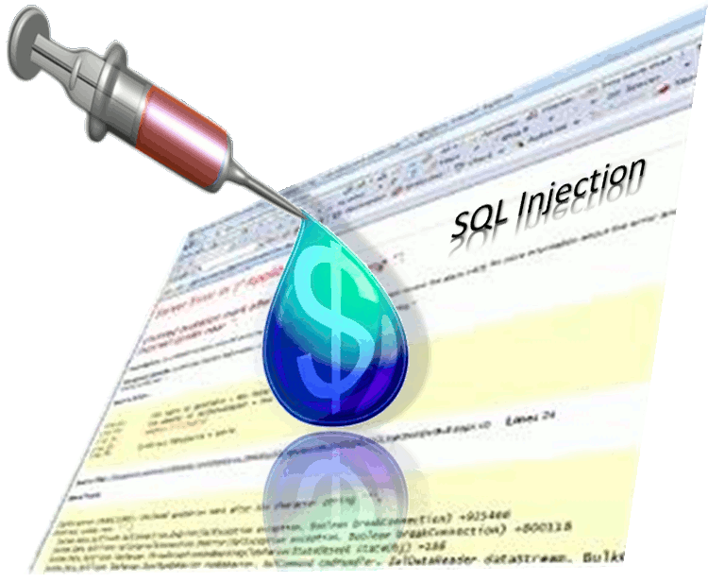
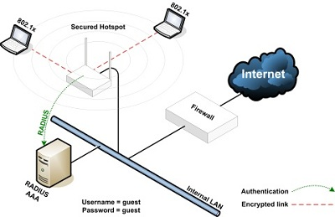

Slide 5


Slide 6

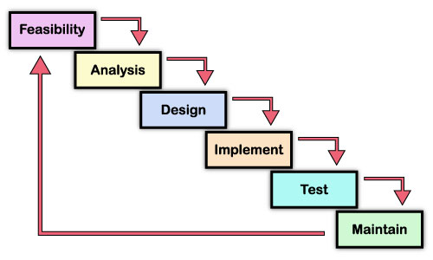

Slide 7
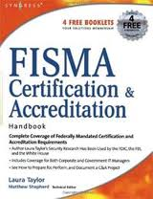
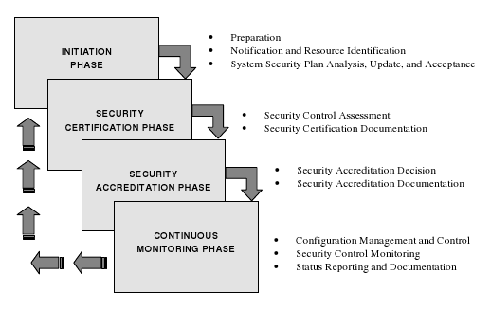

Slide 8

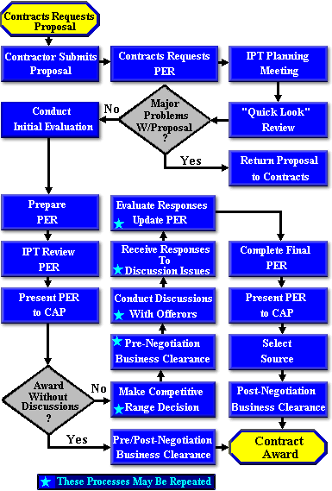
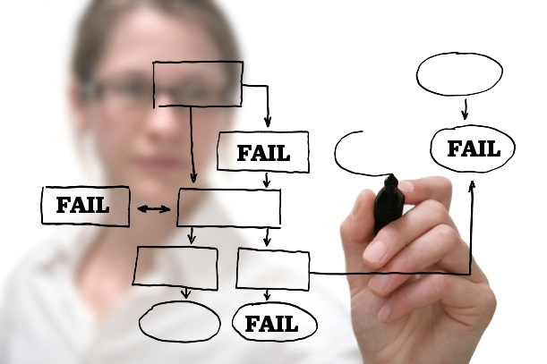

Slide 9


Slide 10
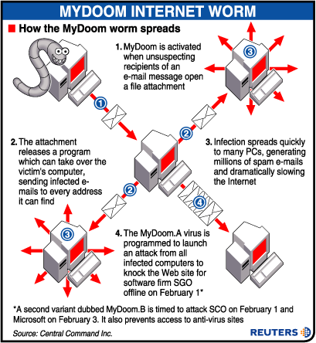
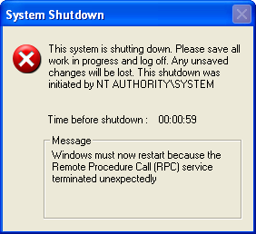
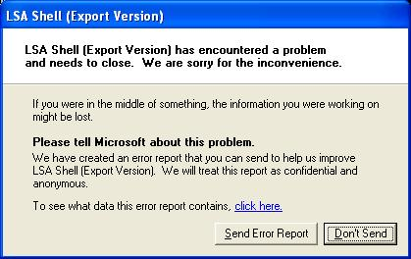
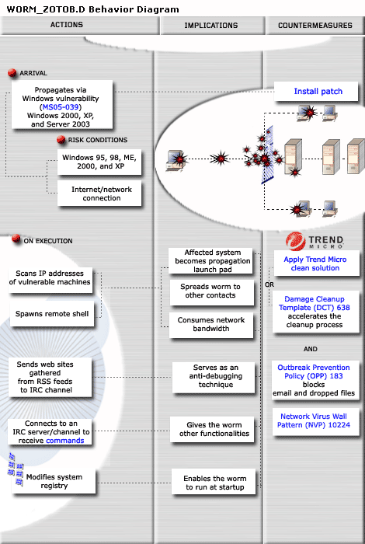


Pic of hacked sites; news articles of breaches, mid-2000s

Slide 11


Slide 12


Slide 13
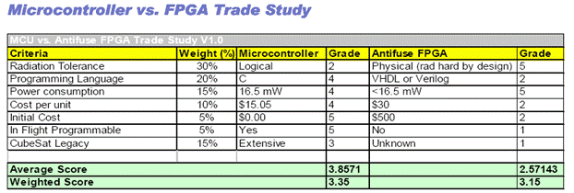

Infosec COTS

Slide 14
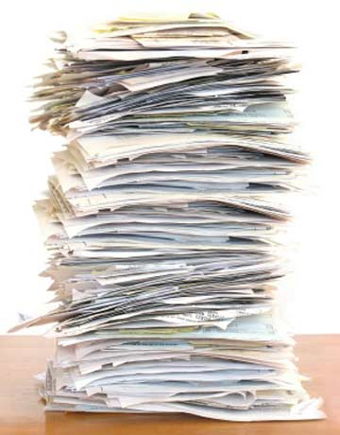

Slide 15


Slide 16


Slide 17
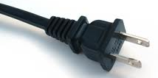
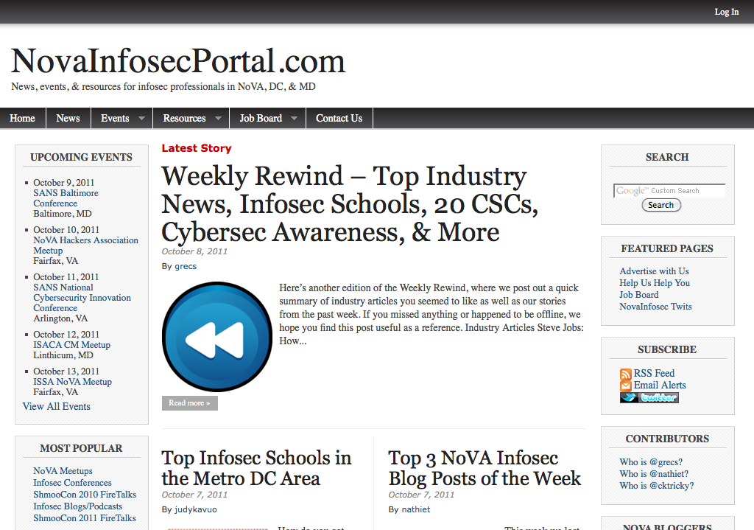

Slide 18


Slide 19
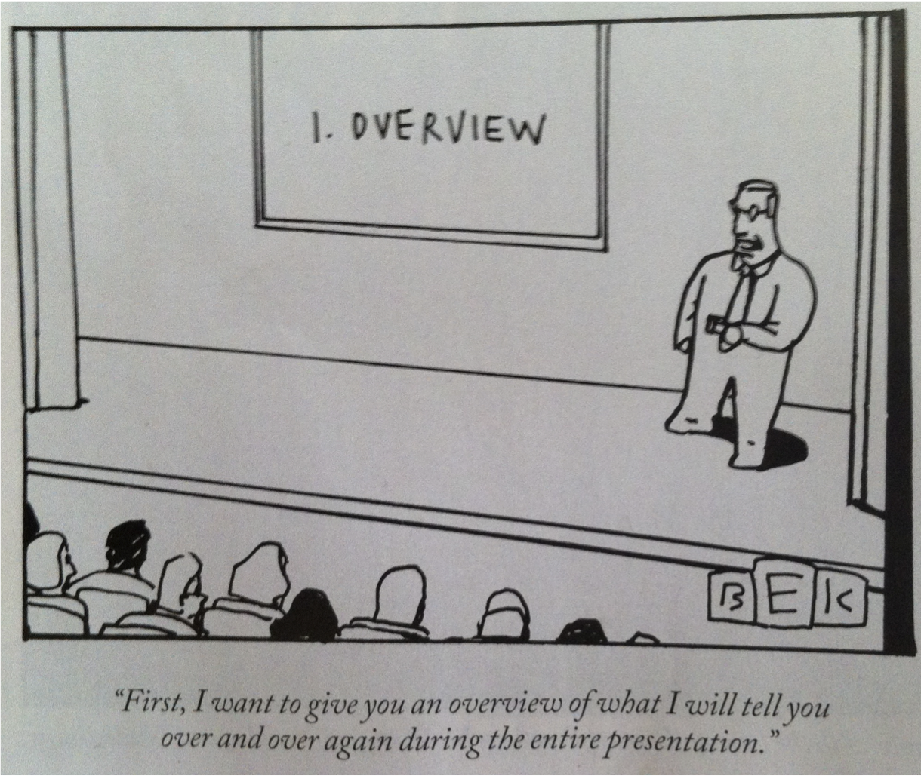

Slide 20
Overview
PHP Security
PHP Overview
Known Issues
Security Features
Detecting Attacks
PHPIDS Overview
Operations & Maintenance
Handling PHP in Your Environment
Risks Management
PHP Mitigations
Platform/Network Mitigations
General Thoughts

Slide 21
PHP Security
PHP Overview
Known Issues
“Standard” Practices

Slide 22
PHP Security PHP Overview
Rasmus Lerdorf (1995)
"Personal Home Page”
Background
General-Purpose Server-Side Scripting Language
Web Development -> Dynamic Web Pages
Interpreted
Free / Open Source
The PHP Group
"PHP: Hypertext Preprocessor"

Slide 23
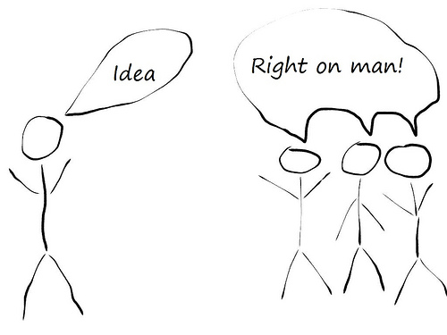
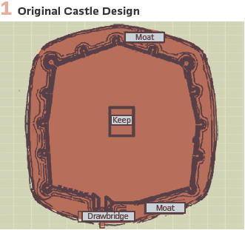
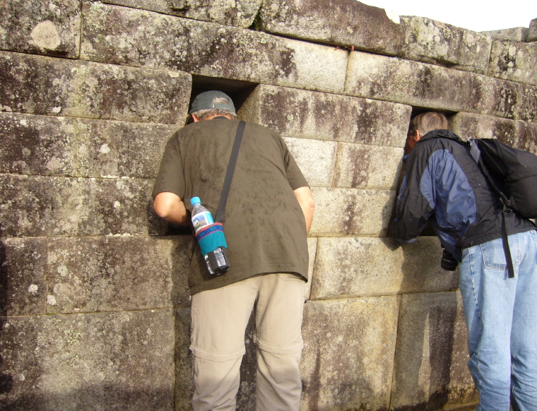
PHP Security PHP Overview

Slide 24
PHP Security Known Issues
History - PHP’s Bad Security Rap
Insecure Configurations
register_globals not Disabled by Default
Doesn't Force Type Definition
Good Practice to Always Define
Still … Variables Don’t Have to Be Initialized
Easy Initial Learning Curve
Noobs More Likely to Generate Insecure Code
Widely Deployed so Good Target

Slide 25
PHP Security “Standard” Practices
PHP Security “Standard” Practices
25 PHP Security Best Practices For Sys Admins
OWASP PHP Top 5

Slide 26
PHP Security “Standard” Practices 25 PHP Security Best Practices
#3: Restrict PHP Information Leakage
#4: Minimize Loadable PHP Modules (Dynamic Extensions)
#5: Log All PHP Errors
#8: Enable SQL Safe Mode
#11: Install Suhosin Advanced Protection System for PHP
#12 Disabling Dangerous PHP Functions
#15 Limit PHP Access To File System
#17 Keep PHP, Software, And OS Up to Date
#24 Watch Your Logs & Auditing
Bonus
PHPIDS
PhpSecInfo (phpinfo()-like app)
Just a Selection of their Goodies

Slide 27


PHP Security “Standard” Practices 25 PHP Security Best Practices
Suhosin
Advanced Protection System for PHP Installs
Protects from Known/Unknown Flaws in Apps/Core
Module 1: PHP Core Patch
Buffer Overflows
Format String Vulns
Module 2: PHP Extension (~50 features)
Runtime Protection
Session Protection
Filtering Features
Logging Features

Slide 28

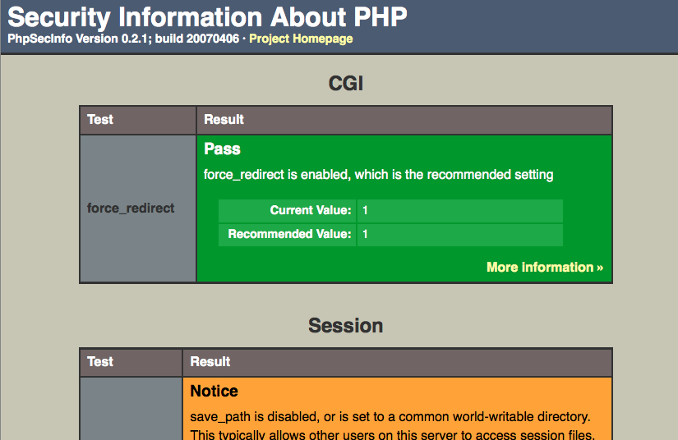
PHP Security “Standard” Practices 25 PHP Security Best Practices
PhpSecInfo
CGI
force_redirect
Session/Curl
save_path
use_trans_sid
file_support
Core
.
allow_url_fopen allow_url_include display_errors
expose_php file_uploads group_id
magic_quotes_gpc memory_limit open_basedir
post_max_size register_globals upload_max_filesize
upload_tmp_dir user_id

Slide 29

PHP Security “Standard” Practices OWASP PHP Top 5
P1: Remote Code Execution
Review existing code for file operations, include/require, and eval() statements
Disable allow_url_fopen in php.ini by setting it to 0; Enable safe_mode and set open_basedir restrictions
P2: Cross-Site Scripting
Disable register_globals and ensure all variables are properly initialized; Validate input properly for type, length, & syntax
Variables sent back to the user via URLs must be URL encoded using urlencode()
P3: SQL Injection
Validate data for correct type, length, and syntax; Always prefer white listing data over black listing
As a last resort, code should be using mysql_real_escape_string()
P4: PHP Configuration
Configure a .htaccess file … In particular, disable register globals and magic_quotes_gpc
During installation, test using ini_get() for common mistakes, such as allowing register_globals
P5: File System Attacks
Ensure that all variables are properly initialized prior to first use
Move secrets and logs out of the web root if at all possible
Enable safe_mode as appropriate; Use open_basedir restrictions
Just a Selection of their Goodies

Slide 30

Detecting Attacks
PHPIDS Overview
Operations & Maintenance

Slide 31
Detecting Attacks PHPIDS Overview – Definition
PHPIDS (PHP-Intrusion Detection System) is a simple to use, well structured, fast and state-of-the-art security layer for your PHP based web application. The IDS neither strips, sanitizes nor filters any malicious input, it simply recognizes when an attacker tries to break your site and reacts in exactly the way you want it to. Based on a set of approved and heavily tested filter rules any attack is given a numerical impact rating which makes it easy to decide what kind of action should follow the hacking attempt. This could range from simple logging to sending out an emergency mail to the development team, displaying a warning message for the attacker or even ending the user’s session.
PHPIDS enables you to see who’s attacking your site and how and all without the tedious trawling of logfiles or searching hacker forums for your domain. Last but not least it’s licensed under the LGPL!

Slide 32
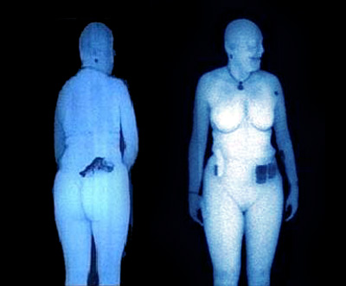
Detecting Attacks PHPIDS Overview – Detection Mechanisms
Anti-Evasion Normalizations
Converter.php
Signatures
default_filter.xml
Centrifuge
Incoming Strings > 25 Characters
Ratio = Count of Word Characters, Spaces, Punctuation / Non-Word Characters
Lower the Ratio ~ Greater Probability of Attack
Normal = 7.5; Attack Trigger < 3.5

Slide 33
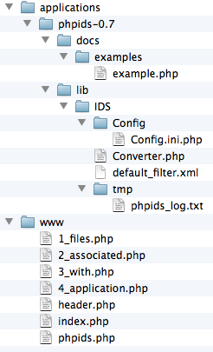
Detecting Attacks O&M – Calibration
Lots of Google Analytics Cookie False Positives
Add Exceptions to Config
Comes with Two Related Amazon Exceptions ~ GET
Add New Under Two Default Exceptions
exceptions[] = COOKIE.__utmz
“x.x.x.x,yyyy-mm-ddT19:31:03-05:00,12,”xss csrf id rfe lfi”,”COOKIE.__utmz=123456789.1234567890.1.1.utmcsr%3Dgoogle%7Cutmccn%3D%28organic%29%7Cutmcmd%3Dorganic%7Cutmctr%3DNOVA%20cyber%20defense”,”%2F2009%2F10%2F16%2Fin-focus-advertise-with-us%2F”,”xx.x.xxx.xxx”

Slide 34
Detecting Attacks O&M – Signature Updates
Signature Based → Keep Up to Date
Download from PHPIDS.org & Overwrite
default_filter.xml
Converter.php
Every 2 or 3 Months
Upgrading PHPIDS Software
Install in Peer Folder
phpids-0.8
Point phpids.php Paths to New Version

Slide 35
Detecting Attacks O&M – Threshold Responses
Modify phpids.php
Suggested
Log to File 10 → 24
Log to DB 25 → 49
Email Alrt 50 → 99
Terminate Page >= 100

Slide 36
Handling PHP in Your Environment
Risk Management
PHP Mitigations
Platform/Network Mitigations

Slide 37
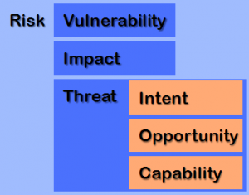
Handling PHP in Your Environment Risk Management
Secure Is in the Eye of the Beholder
Risk-Based Approach
NIST RMF, FAIR, OCTAVE
Security Level Directly Proportional to Costs
High Security → Costs More
Low Security → Costs Less
Get’s Back to Risk Management

Slide 38


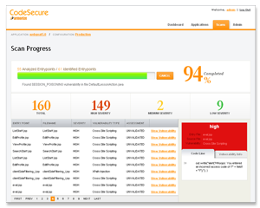

Handling PHP in Your Environment PHP Mitigations – Top 5
Harden Environment
Suhosin
PhpSecInfo
Analyze Source Code
N00b Programmers
Yasca
Incorporates PHPLint, Pixy
CodeSecure Community Edition
Limited to 10K LOC
Syhunt Sandcat Mini

Slide 39
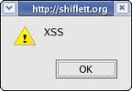
Handling PHP in Your Environment PHP Mitigations – Top 5
Sanitize Everything In & Out
Extension: Filter
Methods: htmlspecialchars(), strtr(), strip_tags()
System Calls: escapeshellcmd(), escapeshellarg(), : utf8_decode()

Slide 40
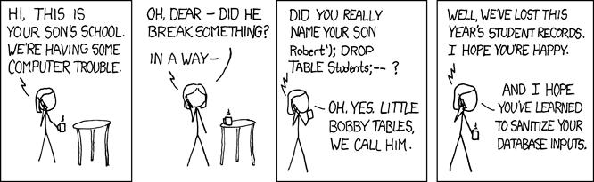
Handling PHP in Your Environment PHP Mitigations – Top 5
Avoid SQL Concatenated Strings Escape
Require PDO Class for Prepared DB Statements
mysql_real_escape_string() if Absolutely Can’t
https://xkcd.com/327/

Slide 41
Handling PHP in Your Environment PHP Mitigations – Top 5
Monitor, Monitor, Monitor

Slide 42
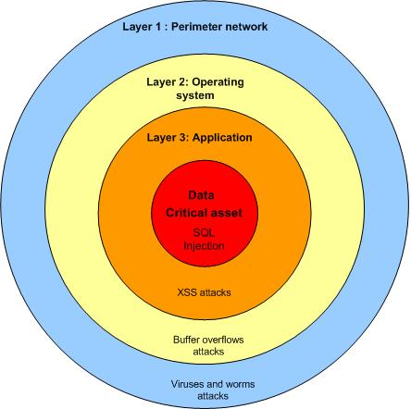
Handling PHP in Your Environment Platform/Network Mitigations
Network
Firewalls
IDS
Platform
Harden OS & Other Applications
Keep Everything Patched
Antivirus with Updated Sigs
Web
Harden Web Server
WAFs
Testing
Regular Vulnerability Testing
Periodic Penetration Testing

Slide 43
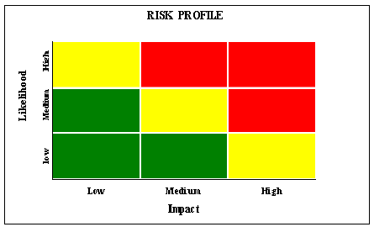
General Thoughts
Do as Many as Possible Quick Hits
Perhaps Some from Top 5
Perform Risk Assessment
Implement Mitigating Additional Controls
Perhaps Based on One of Best Practice Guidelines
Monitor Like Hell

Slide 44
General Thoughts
So … Is PHP Secure?
It Depends…
Asking Wrong Question…

Slide 45
General Thoughts
Is Using PHP a Risk to Your Organization?

Slide 46
General Thoughts
The Most Secure Language Is the One You Know How to Program Securely

Slide 47

Questions?

Slide 48
Contact Info
Twitter @grecs
Website NovaInfosec.com
Contact http://bit.ly/nispcontact

Slide 49
References & Resources Very Useful
25 PHP Security Best Practices For Sys Admins
http://www.cyberciti.biz/tips/php-security-best-practices-tutorial.html
OWASP PHP Top 5
https://www.owasp.org/index.php/PHP_Top_5#P4:_PHP_Configuration
PHP and the OWASP Top Ten Security Vulnerabilities
http://www.sklar.com/page/article/owasp-top-ten
Hardened-PHP Project (Suhosin)
http://www.hardened-php.net/suhosin.127.html
PHP Security Consortium (PHPSecInfo)
http://phpsec.org/
NovaHackers, Unallocated Space

Slide 50
References & Resources Other Goodies
PHP Manual
Security: http://www.php.net/manual/en/security.php
Filter: http://www.php.net/manual/en/book.filter.php
Tutorial: Filtering Data with PHP
http://www.phpro.org/tutorials/Filtering-Data-with-PHP.html
Why do people say that PHP is inherently insecure?
http://security.stackexchange.com/questions/643/why-do-people-say-that-php-is-inherently-insecure
OWASP Backend Security (2008)
http://www.scribd.com/doc/87396472/8/PHP-SECURITY-PROGRAMMING

Slide 51
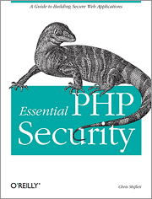
References & Resources Honorable Mentions
"Essential PHP Security”
Chris Shiflett (2005)
OWASP PHP Security Cheat Sheet
https://www.owasp.org/index.php/PHP_Security_Cheat_Sheet

Slide 52
References & Resources Static Code Analyzers
Yesca (2010)
http://sourceforge.net/projects/yasca/
PHPLint
http://www.icosaedro.it/phplint/
Pixy (2007)
*PHP-sat (2006)
http://www.program-transformation.org/
CodeSecure Community Edition (commercial too; $5-10K+)
http://www.armorize.com/codesecure/community.html
Syhunt Sandcat Mini (commercial too - $4-10K for Hybrid)
http://www.syhunt.com/?n=Sandcat.Mini

Slide 53
References & Resources PHPIDS
Intrusion Detection For PHP Applications With PHPIDS
http://www.howtoforge.com/intrusion-detection-for-php-applications-with-phpids
Getting Started with the PHPIDS Intrusion Detection System
http://www.h-online.com/security/features/Getting-started-with-the-PHPIDS-intrusion-detection-system-746233.html
PHPIDS FAQ
http://php-ids.org/faq/
http://forum.cmsmadesimple.org/index.php?topic=12884.msg173160
PHPIDS Install Notes
http://www.irongeek.com/i.php?page=security/phpids-install-notes
PHPIDS - Monitoring attack surface activity
https://docs.google.com/Doc?id=dd7x5smw_17g9cnx2cn&pli=1
http://holisticinfosec.org/toolsmith/docs/july2008.pdf
Wikipedia
https://en.wikipedia.org/wiki/PHPIDS
PHPIDS Forum

