Slide 1
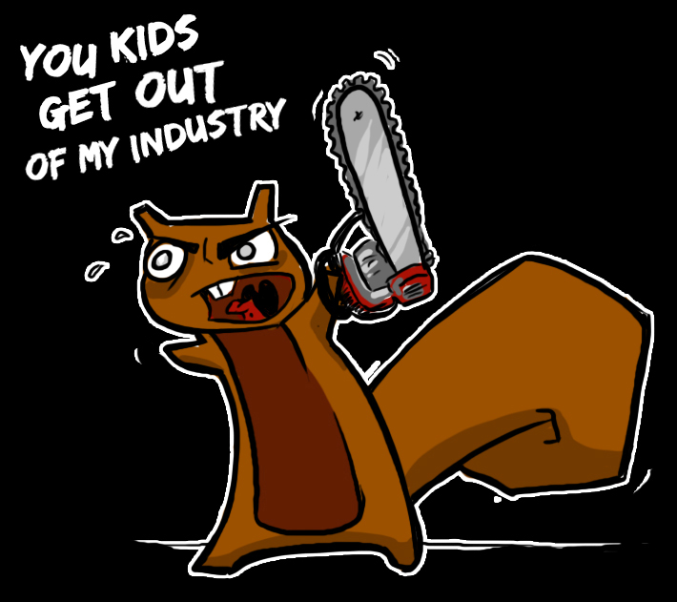
Errata Hits Puberty:
13 Years of Chagrin
Copyright 2012 attrition.org
Notes:
Chagrin: A keen feeling of mental unease, as of annoyance or embarrassment, caused by failure, disappointment, or a disconcerting event
Puberty is the process of physical changes by which a child's body matures into an adult body. The major landmark of puberty for males is the first ejaculation, which occurs on average at age 13. (This somehow seems quite appropriate for us.)
This is the first attrition talk since 2001 (our talk at BlackHat on the defacement mirror). We applied for BH/DC in 2005 for Dataloss, but the review board apparently didn’t think that it was a hot topic. I guess we were ahead of the time.
Alternate title idea: Crawling Through the Mud of InfoSec

Slide 2
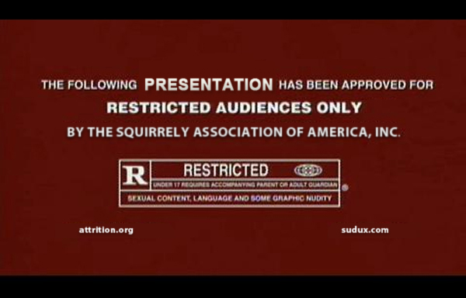

Slide 3
Disclaimer
We cite as much evidence as possible on Errata, to back our opinions and make a case or tell a story. It is up to the reader to decide the accuracy of both sides and make a decision. We encourage everyone to verify what a charlatan says, as well as what we say.
By listening to presenter, you agree to be bound by all of the terms and conditions below, which are intended to be fully effective and binding upon all RVAsec attendees. By watching this presentation, you agree not to hold us responsible for anything. And we mean anything. Ever. All material, opinions, insults, rants, and nervous breakdowns are solely on behalf of the presenter, not his employer, past employers, attrition.org staff, squirrels, probation officer, AA sponsor, physical therapist, favorite dealer, or family that has since disowned him. Still not responsible. By watching this presentation, you hereby agree to never malign small misunderstood creatures (e.g. squirrels, moles, voles, chinchillas, chipmunks, otters, possums, guinea pigs, alpacas, hedgehogs, sloths, aardvarks, nutria, capybara, porcupines, stoats, pygmy jerboas, prairie dogs, dormouse, turtles, ducklings, and pika). By sitting in this room, you further agree to praise the glory of llamas, mini pigs, goats, and sheep. Presentation may contain peanuts. For external use only. Nutrition information not available. Keep presenter out of reach of children, adults, and charlatans. Do not feed presenter after midnight. Do not let presenter get wet. Warning: presenter may become slippery if Vaseline liberally applied. Presenter not a contraceptive device. Presenter not approved by FAA regulations. Approved for FBI negotiations. Professional driver, closed course. Disclaimer may not be up to date. Still not responsible. By reading this sentence, you are hereby obligated to purchase one food or beverage item for the presenter in the next 60 days. If you are reading this disclaimer by mistake, please destroy all copies, don’t share this valuable information, and then gouge your eyes out for being in the wrong conference. Mileage may vary. Objects in presentation are bigger than they appear. Everything is true to the best of our knowledge. God kills a lawyer every time someone reads a legal disclaimer. Remember to spay or neuter your pets. This agreement shall be deemed to be an agreement entered into in the state of Colorado (or Guam). The laws of rational thinking and ethics shall govern this agreement. Complaints may be directed to the hostile, armed squirrel bodyguard. All sales are final.
Notes:
All content on Errata is our own; we provide evidence and a story. You should make a decision based on reading both sides of the story.

Slide 4
Who Polices the Industry?
You should!
Anonymous? APTs? (Any means necessary…)
Professional Groups e.g. (ISC)²? (Fear the code of ethics…)
Journalists? (Not for a long time…)
Bloggers? (Random acts of errata…)
Publishers? (Can’t hear us over their bottom line…)
The Law e.g. Attorney General (Their plates are full…)
Guess that leaves us in the meantime, until someone better comes along.
Notes:
And we really do hope that someone better comes along.

Slide 5

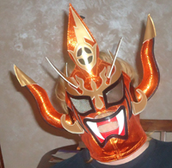

Errata Staff
cji – Senior Irony Analyst
Watches more cartoons than his 6 year old
Started dozens of RPGs. Finished none.
Writes more Errata than code
Lyger – Volunteer Herder (Ret.)
Collector of former Denver Bronco QB Jerseys
Proud owner of Keurig and Cuisinart whole bean grinder
Really does believe that InfoSec = professional wrestling
Jericho – Chief Curmudgeon Officer
Has rescued 9 guinea pigs from Colorado shelters
Would piss on a spark plug if he thought it would do any good
Wouldn’t mind seeing InfoSec industry burn to the ground
Notes:
Errata staff is NOT the same as attrition.org staff. Not all main staff work on Errata. Not all Errata staff work on the rest of the site.
Who/what we are? The who doesn't matter, does it? The information we post should stand on its own, be able to be externally validated, regardless of who signs a name to it.
Sometimes, a name is added if there is 'too much' opinion (where that threshold is really low). e.g., The charlatan watch list may have pieces with more opinion than others.
We have to be careful when receiving information from external sources. Some of them are “salted”, meaning they are provided by someone who has an agenda. Not always easy to realize the agenda. Presence of an agenda does not invalidate the information, just makes us scrutinize it more closely.

Slide 6
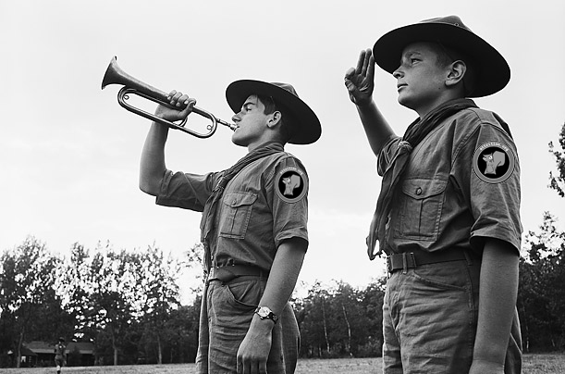
Errata Staffing Problem
Notes:
How many calls for volunteers? Two big calls in attempt to recruit volunteers.
How many stuck around? Two long term.
How many flaked? The rest.
One recent call for researchers, 4 serious bites, 1 stuck with it.
It requires almost no training, other than “research, verify, be thorough” (e.g., Googlez + a bit of OCD).
The project’s longevity is primarily due to a very small number of us crazies.

Slide 7


Attrition.org Background
Buck
Lazlo
Notes:
We can’t be huggly, it just doesn’t cut it. The nature of Errata demands that we entertain a certain level of honesty, which is perceived as brutality by some. Fair, the truth is brutal at times.
Like Batman, we needed a symbol to invoke fear.. thus, Lazlo.
‘Buck’ was drawn by Joanna Goldman, who does a wide variety of excellent animals. We commissioned her to create our mascot and simply asked her to “create the evil cousin of Buck”, and she did exactly that.

Slide 8
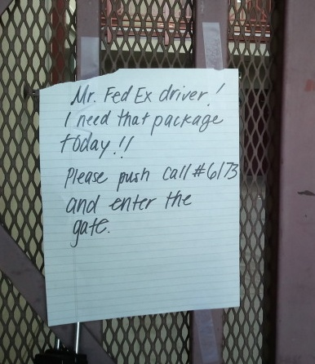
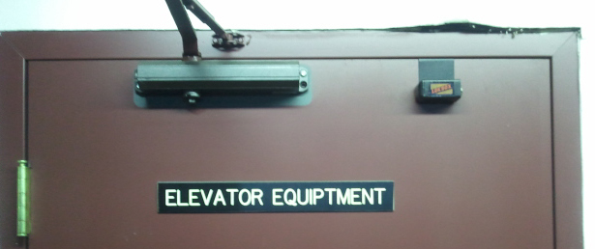
Errata All Around Us
Per Wikipedia, “the general definition of an audit is an evaluation of a person, organization, system, process, enterprise, project or product.”
In layman’s terms, Errata is an audit of sorts, or “we find bad shit”.
Notes:
Errata is all about showing the "bad" in our industry. It is no different than auditing. For naysayers, they can't resolve what we do for some reason, due to some weird disconnect.
Who in the audience performs audits, pen tests, or vulnerability assessments? This is the same thing.
“If you look, Errata is all around us.” Many auditors and hackers are like this, and they notice everything that is wrong in a given place or event. The examples above are what I call “quick wins” in the land of Errata (e.g., plagiarism review, CPO, AutoFail). They are easy to find, and more importantly, quick to document.
“Negative feedback is essential for negotiating life and social relations.” – Karen Wright, Psychology Today (Mar/Apr 2011)
“Criticism has a hallowed role in nearly every area of human endeavor.” – Unknown

Slide 9
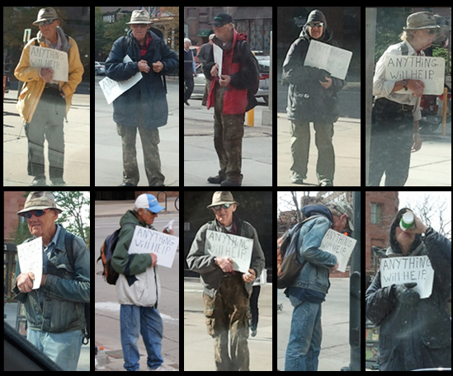
Errata Mindset
Notes:
On the other hand, there are more involved Errata projects. Take for example one of my local beggars. Any given day, seems ordinary. But if you stand back and look at the bigger picture, you see that he is clearly not homeless, just lazy. This is more akin to our bigger write-ups like Charlatans; time consuming, can’t go off a single picture (article).
Jackets: Yellow, blue, red/black, green/white, grey, corduroy == at least 6 total
Hats: fisherman, blue/white baseball, grey baseball, black baseball == at least 4 total
Daily drink: Starbucks == can’t be hurting too bad
Not pictured: Key ring hanging off his left hip, with keys to an apartment 6 blocks away == “anything helps (me avoid real work)”
Good things happen to bad people. (Charlatans, via deceit)
Bad things happen to good people. (Legitimate industry, via charlatans)
Bad things happen to bad people. (Where Errata comes in)

Slide 10
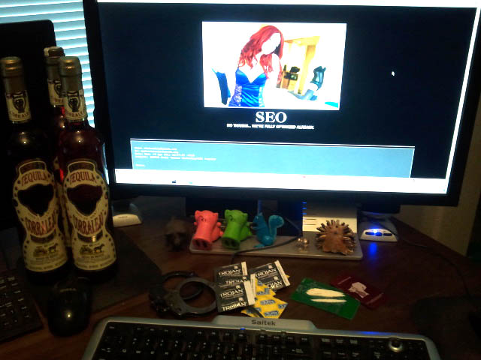
Errata Coping Mechanisms
Notes:
While we joke, working on Errata is not good for mental health. Steadily builds stress and feelings of depression, leads to unhealthy levels of anger. Those long periods of no updates are a result of this.
Imagine spending this much time pointing out the horrible shortcomings of an industry you once believed in. Reading article after article that highlights a lack of integrity or level of hypocrisy that eat at your soul. Spending time on a project that is largely ignored, even when thrust in the face of someone who should take note (e.g. the media when deciding if a charlatan should be quoted or used on TV). Every few months, it takes some soul searching to renew the resolve to work on the project. The desire to drop it completely is stronger than anyone realizes. Add to that, legal and physical threats, libel and slander in return for doing what is right. It wears you down, fast. Drunken rage fests on Twitter? Only follow a night of updating Errata.

Slide 11
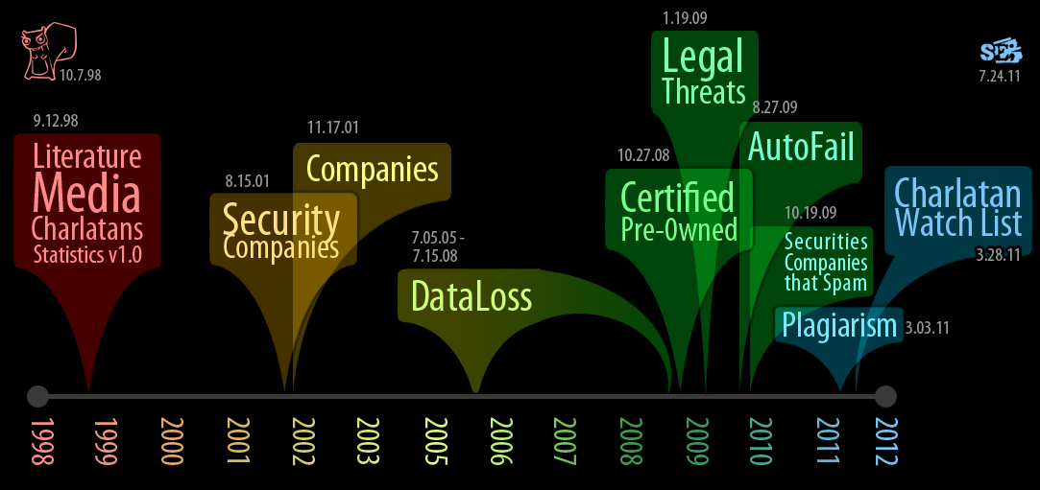
A Brief History of Errata
Notes:
The different sections of Errata and respective start dates:
Literature 09.12.98 [FIN]
Media 09.12.98
Charlatans 09.12.98
Statistics (v1.0) 09.12.98 (v2.0) 07.28.05 (v3.0) 04.29.10
Security Companies 08.15.01
Companies 11.17.01
DataLoss 07.05.05 -> 07.15.08 (moved to OSF, ran on both sites for ~ 2months during migration)
Certified Pre-0wned 10.27.08
Legal Threats 01.19.09
AutoFail 08.27.09
Securities Companies that Spam 10.19.09
Plagiarism 03.03.11
Charlatan Watch List 03.28.11
Errata project started 12.9.98. attrition.org registered on 10.7.98. Think we staged it on sekurity.org, my previous domain, then made it public with attrition.org launch. SecurityErrata.org was launched 11.24.11.

Slide 12
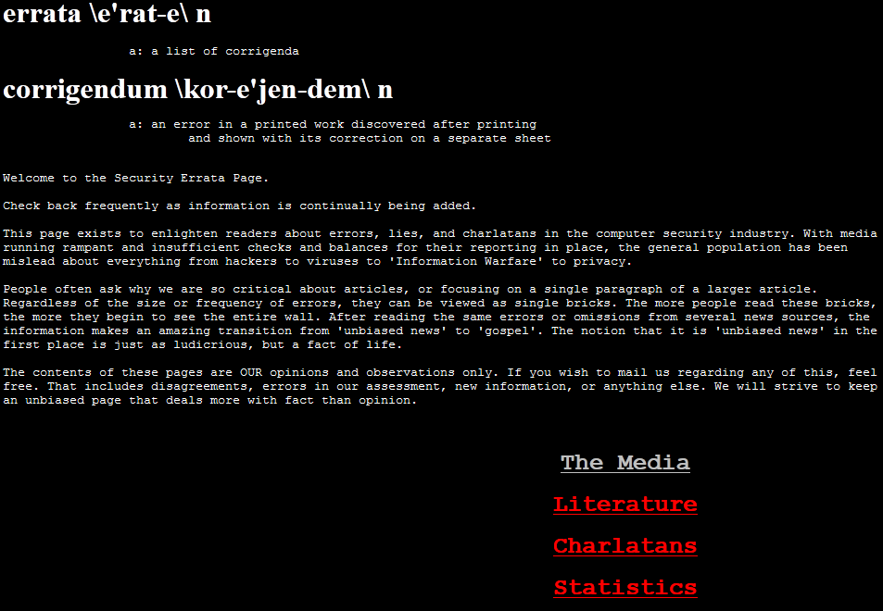
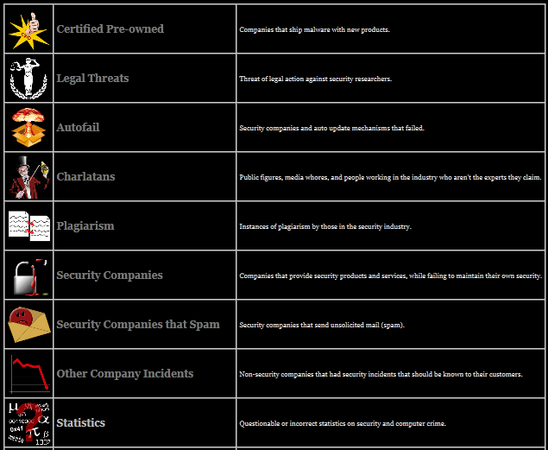
We’ve Changed (a bit)
April, 2012
(fancy HTML tables)
August, 2000
(<pre> tags 0wn)
Notes:
Bottom of Aug 2000 page says: [After a recent comment, I'd like to solicit ideas on a better name for the site. Feel free to mail root@attrition.org with ideas.]
Guess no one came up with a better idea, us included. (Archive.org only has as far back as Aug 2000)
As with the entire site, we firmly believe in substance over appearance. This gets mixed reviews every few weeks.

Slide 13
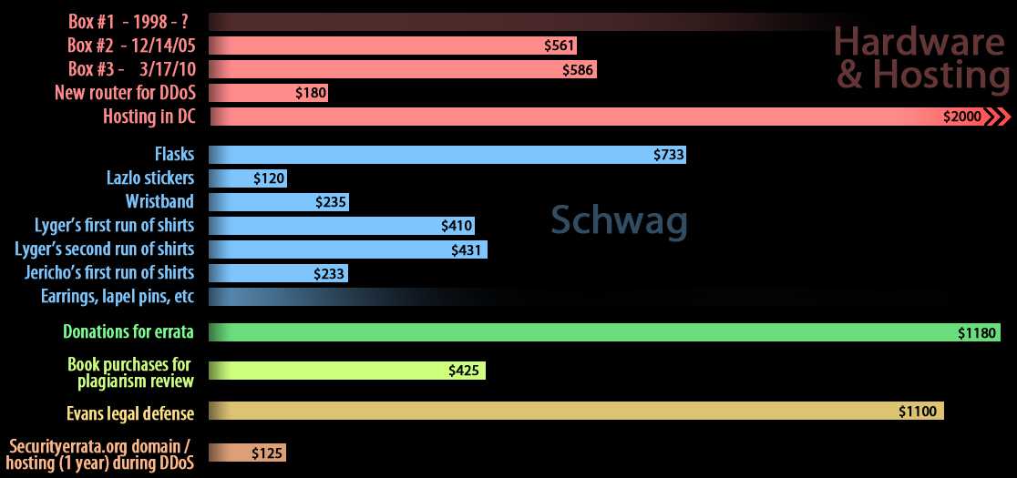
Ledger
Notes:
http://attrition.org/errata/ledger.html – Started this (too) late in the game. At some point I realized the donations coming in were picking up, primarily with the attention of the plagiarism articles. Started tracking all donations for Errata work, and all expenses related to it. Before this, donations were to the site in general (frequently for postal), and pretty rare. Created the ledger for transparency since many recent donations were specifically for Errata.
Hardware & Hosting:
Box #1 – 1998 - ?
Box #2 - 12/14/05 $561.00
Box #3 – 3/17/10 $586.36
New router for DDoS = ~ $180
Hosting in DC = ~ $2,000 (we received a *lot* of donated bandwidth)
Schwag:
Flasks $733 for 50 (but, I sold most of those to recover cost) - 11/18/09
Lazlo stickers $120 for 1000 - 7/8/11
Wristbands were $235 for 400 - 2/22/12
Lyger’s first run of shirts $410.95 for 20 - 1/29/08
Lyger’s second run of shirts $430.90 for 20 - 6/22/08
Jericho’s first run of shirts $233 for 20 - 7/18/11
Earrings, lapel pins, etc -> Make It Urz (we don’t sell or profit)
Con badges -> (not listed)
Donations for errata: $1180.14
Book purchases for plagiarism review: $425.38
Evans legal defense: $1100.00
Securityerrata.org domain / hosting (1 year) during DDoS: $122

Slide 14
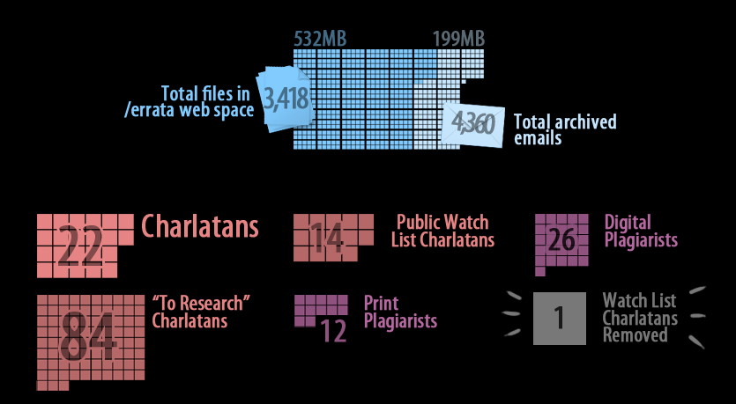
Stats - Errata
Notes:
Random Stats as of May 16, 2012:
Total archived Errata mails – 4,360 (~ 25% related to a single charlatan)
Total files in /errata web space – 3,418 (in 201 directories)
Total space taken by /errata web space – 532 megs (additionally, 199 megs for email)
Current number of charlatans – 22
Current number of public watch list charlatans - 14
Current number of “to research” charlatans – 83
Current number of print plagiarists – 12
Current number of digital plagiarists - 26
Current number of watch list charlatans removed - 1 (IT CAN HAPPEN)

Slide 15
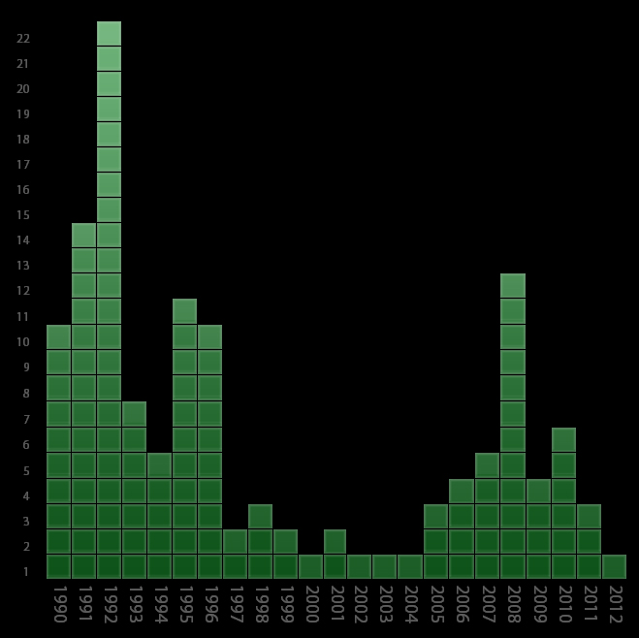
Stats – CPO (Certified Pre-Owned)
Notes:
CPO: When a vendor ships any form of media with malware already installed. (Term "certified pre-owned" courtesy of Dan Geer.)
http://attrition.org/errata/cpo/ - Stats as of May 16, 2012
2012 – 1
2011 – 3
2010 – 6
2009 – 4
2008 – 12
2007 – 5
2006 – 4
2005 – 3
2004 – 1
2003 – 1
2002 – 1
2001 – 2
2000 – 1
1999 – 2
1998 – 3
1997 – 2
1996 – 11
1995 – 12
1994 – 5
1993 – 7
1992 – 22
1991 – 14
1990 - 10

Slide 16
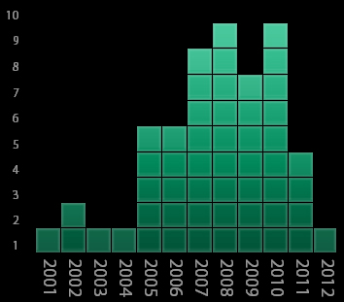
Stats – AutoFail (By Year)
Notes:
AutoFail: Automatic Update Mechanism Failre. Cases where automatic patches or automatic virus signature updates (etc) fail to work correctly, often having disastrous side effects. These are the companies that “protect” you.
http://attrition.org/errata/autofail/ - Stats as of May 16, 2012
2012 – 1
2011 – 4
2010 – 9
2009 – 7
2008 – 9
2007 – 8
2006 – 5
2005 – 1
2004 – 1
2003 – 2
2002 – 1
- Autofail
How many days/hours lost productivity, as admins recover from these vendor screw-ups? If 1 incident takes 1 hour, x customer #....

Slide 17
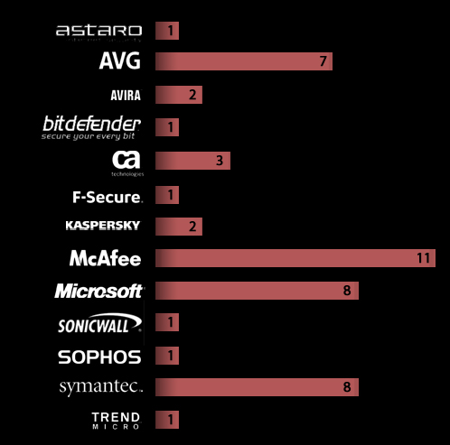
Stats – AutoFail (By Vendor)
Notes:
http://attrition.org/errata/autofail/ - Constantly amazed that companies that sell integrity and bend your machine over faster than a hacker. The cases where $vendorA flags $vendorB (their competition) as malware.
Stats – AutoFail (as of May 16, 2012). Some ‘fails’ worse than others (a few highlights below). As you can imagine, the software EULA protect these companies from this flagrant abuse and stupidity.
Astaro – 1 (bad update blocked legit network traffic)
AVG – 7 (1 update put Win7 into reboot loop, 1 FP for iTunes, 1 FP for Adobe Flash, 1 FP on Windows, 1 FP on ZoneAlarm, 1 FP on Adobe Reader)
Avira – 2 (1 update cripples millions of PCs)
BitDefender – 1 (FP on Windows)
CA – 3 (2x update bricks Windows, FP on legit JavaScript)
F-Secure – 1 (1 FP deleted some clean files)
Kaspersky – 2 (FP on Google Adwords, FP on MSIE)
McAfee – 11 (stopped many users from receiving mail one weekend, bad update put XP in reboot loop, 2x update bricks more windows, FP on Spotify, FP on Vista, FP on legit JavaScript)
Microsoft – 8 (1 FP deleted Google Chrome, 1 MS update BSoD’s XP, update breaks Office, Piracy check flags legit copies, 1 FP on Gmail, 1 FP on Symantec)
SonicWall – 1 (update disables firewall/email scanning)
Sophos – 1 (1 FP on Mac OS X)
Symantec – 8 (1 FP on WoW, FP on Spotify, bug where updates couldn’t be dated correctly for them to keep working, 1 FP on CyberSitter, 1 FP on a NASA app, blocks AOL user internet access, bricks Macs)
Trend Micro – 1 (update freezes some PCs)

Slide 18
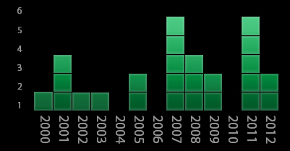
Stats – Legal Threats
Notes:
Legal Threats: Cases of vendors using the threat of legal action (e.g., lawsuit, DMCA) to stifle or suppress security research.
http://attrition.org/errata/legal_threats/ - Stats as of May 16, 2012
2012 – 0
2011 – 5
2010 – 0
2009 – 2
2008 – 3
2007 – 5
2006 – 0
2005 – 2
2004 – 0
2003 – 1
2002 – 1
2001 – 3
2000 – 1

Slide 19
Stats – Legal Threats
✔
✔X ✔
✔X ? X ✔✔
✔X ✔
Carrier IQ
First State Superannuation
Trans Link Systems
Magix AG
RSA
Comerica Bank
Orange.fr
Sequoia Voting Systems
Massachusetts Bay Transit Authority
NXP (formerly Philips Semiconductors)
Autonomy Corp., PLC
U.S. Customs
BeThere (Be Un limited)
X
✔X ✔X
✔
✔X ✔
✔
HID Global
TippingPoint Technologies, Inc.
Cisco Systems, Inc.
Sybase, Inc.
Blackboard Transaction System
Hewlett-Packard Development Company, L.P. (HP)
Adobe Systems Incorporated
Tegam International Viguard Antivirus
Secure Digital Music Initiative (SDMI), Recording Industry Association of America (RIAA) and Verance Corporation
Motion Picture Association of America (MPAA) & DVD Copy Control Association (DVD CCA)
Notes:
http://attrition.org/errata/legal_threats/ - How many of these companies do you support by using or buying their software?
24 threats: 15 ultimately did not stop publication of research. 8 resulted in cancellation of talk/publication. 1 unknown (details not published)

Slide 20

Stats – Legal Threats (Special Irony Callout – Follow the Madness)
2002 – HP uses DMCA to threaten SNOsoft over Tru64 vulnerability research
2005 (Jan) – 3COM acquires TippingPoint
2005 (Jul) – TippingPoint founds Zero Day Initiative (ZDI)
2007 - TippingPoint tries to quiet David Maynor / ErrataSec for reversing TP IDS signatures. Pressured Errata to cancel talk, had FBI show up at their office.
2009 – HP acquires 3COM
See the irony yet? It went full circle…
HP tries to DMCA vulnerability research, then buys 3COM which owns TippingPoint, which founded ZDI who buys exploits from researchers and will release information w/o a vendor fix between 15 days (if no vendor ACK) and 6 months (maximum). And HP is known for ~ 1000 days w/o patching, even simple XSS.
Notes:
2002 – HP uses DMCA to threaten SNOsoft over Tru64 Unix vuln research
2005 (Jan) – 3COM acquires Tipping Point
2005 (Jul) – TippingPoint founds Zero Day Initiative (ZDI) http://www.hpenterprisesecurity.com/products/hp-dvlabs/zero-day-initiative-zdi
2007 – TippingPoint tries to quiet David Maynor / ErrataSec for reversing TP IDS signatures. Pressured Errata to cancel talk, had FBI show up at their office.
2009 – HP acquires 3COM - http://www.hp.com/hpinfo/newsroom/press/2009/091111xa.html
So HP tries to DMCA vuln research, then buys 3COM which owns TippingPoint, which founded ZDI who buys exploits from researchers and will release information w/o a vendor fix between 15 days (no ack) and 6 months (max). And HP is known for ~ 1000 days w/o patching, even simple XSS. - http://www.zerodayinitiative.com/advisories/disclosure_policy/
ZDI-CAN-206 Hewlett-Packard High 2007-07-17, 848 days ago
ZDI-CAN-177 Hewlett-Packard High 2007-03-19, 968 days ago
ZDI-CAN-105 Hewlett-Packard High 2006-10-10, 1128 days ago

Slide 21

Stats - Charlatans
Notes:
http://attrition.org/errata/charlatan/ (as of May 16, 2012)
Charlatans: 15 individuals, 2 journalists, 5 companies
Watch list: 14 individuals (2 fringe)

Slide 22
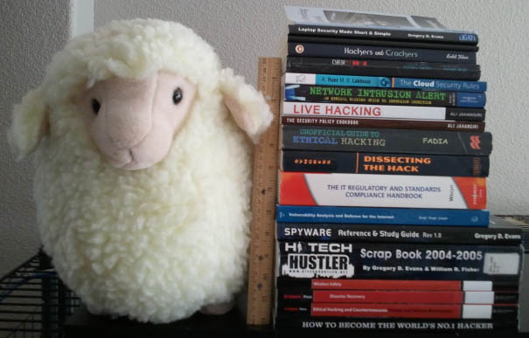
Stats - Plagiarism
Notes:
http://attrition.org/errata/plagiarism/
12 print authors for 17 books (19 pictured, holding back 2 articles -> see blowback)
18 online (some cross over to print). 8 of them companies, 10 individuals

Slide 23
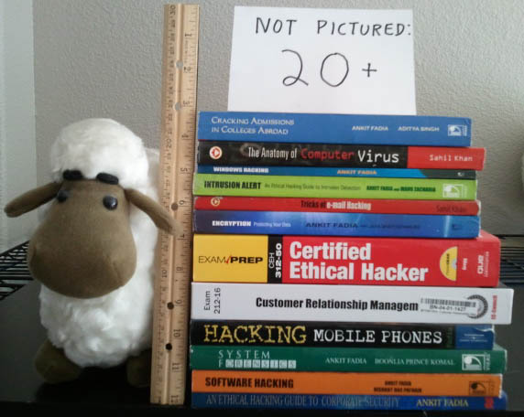
Stats – Plagiarism (todo)
Notes:
http://attrition.org/errata/plagiarism/
Plagiarism review – Typically the most time consuming, but also the fastest/easiest win.
Amazon et al have no provision to report books, so they keep getting sold. Even academic research sites tend not to have an obvious complaint procedure, while selling questionable works.
The biggest problem is that most books w/ plagiarism are self published, or vendors don't seem to care (e.g., Cengage). This problem will only get worse with Print-On-Demand.

Slide 24
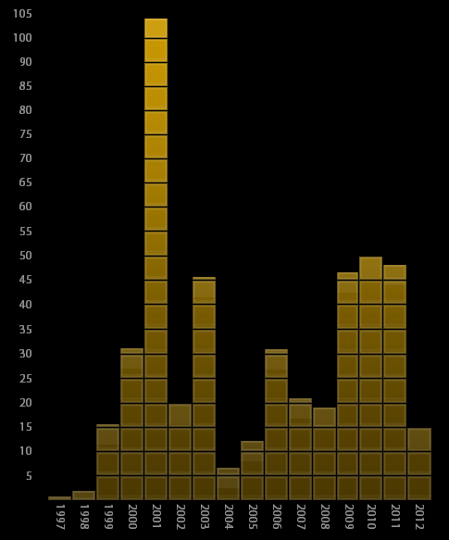
Stats – Security Companies
Notes:
Security Companies: Cases where security companies botched security, often in an ironic and embarrassing fashion.
http://attrition.org/errata/sec-co/ - Stats as of May 16, 2012
Attrition.org on there twice! (for defacements: Fluffy Bunny in 2001, PHC in 2003)
Biggest offenders: Microsoft (52), McAfee (19 or 21), Symantec (28)
2012 – 15
2011 – 48
2010 – 50
2009 – 47
2008 – 19
2007 – 21
2006 – 31
2005 – 13
2004 -7
2003 – 46
2002 – 20
2001 – 104 (why? Defacements.)
2000 – 32
1999 – 16
1998 – 2
1997 – 1

Slide 25
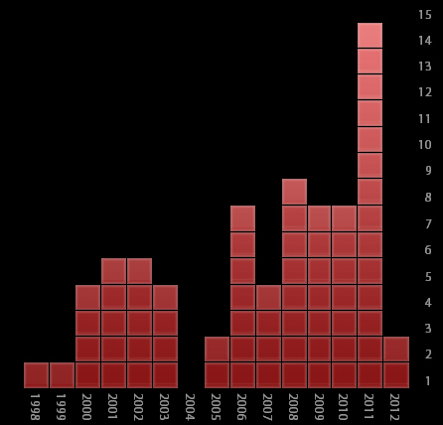
Stats - Spam
Notes:
Security Companies that Spam: Companies that sell integrity, some that sell anti-spam solutions, are the same ones that don’t hesitate to blast mail out to strangers.
http://attrition.org/errata/spam/ - Stats as of May 16, 2012
Worst offender: TruSecure (4)
2012 – 2
2011 – 14
2010 – 7
2009 – 7
2008 – 5
2007 – 4
2006 – 7
2005 – 2
2004 – 0
2003 – 4
2002 – 5
2001 – 5
2000 – 4
1999 – 1
1998 – 1

Slide 26
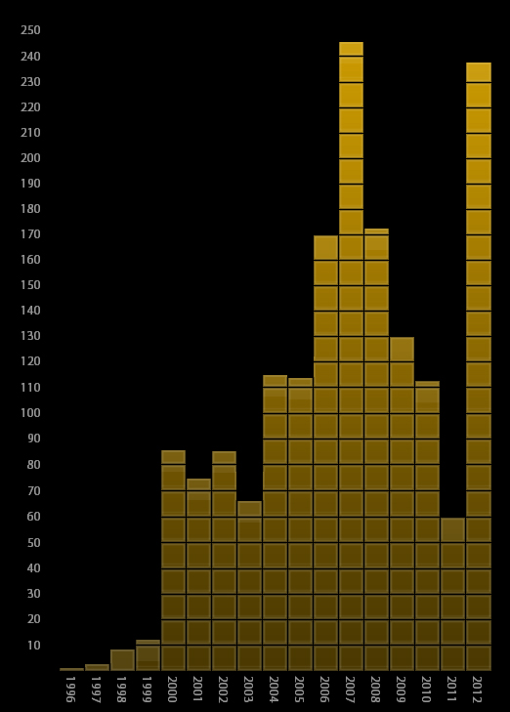

Stats – Security Software
Notes:
http://osvdb.org/search -> Select “security software” classification.
Stats as of May 16, 2012
Total: 1704 (out of 80,845 in OSVDB = just over 2% of all documented vulns)
2012: 238
2011: 60
2010: 113
2009: 130
2008: 173
2007: 246
2006: 170
2005: 114
2004: 115
2003: 68
2002: 85
2001: 75
2000: 86
1999: 17
1998: 9
1997: 4
1996: 1
Source: OSVDB.org

Slide 27
Errata Done Right: Dataloss
Original concept in 2001
Implemented on attrition.org in 2005
Project moved to Open Security Foundation (OSF) in 2008
Date: Wed, 18 Apr 2001 19:57:03 -0600 (MDT)
From: security curmudgeon <jericho@attrition.org>
To: errata submission <errata@attrition.org>
Message-ID: Pine.LNX.3.96.1010418195610.10849O-100000@forced.attrition.org
X-Copyright: This e-mail copyright 2001 by jericho@attrition.org where applicable
X-Encryption: rot26
we need a new section (and i have several saved pieces for it) that list
companies who exposed CC numbers and the like. whether they are security
companies or not, i wanna keep a list w/ articles of any of them that
leaked CC info
We're not "the popular kids", but when we get stuff done, we do it right. -- Lyger
Notes:
Credit where due: PrivacyRightsClearinghouse was getting all of the news, but took their info from Dataloss (on attrition.org) and PogoWasRight. News went batshit crazy when 100 million record mark reached. Except, we had hit that total six months prior. No news outlet came to talk to us to get the real stats. Is there a word for web site discrimination? We sure seem to run into it a lot.
100 million... the gloves come off.
Thu Dec 14 20:31:40 EDT 2006
http://attrition.org/security/rant/dataloss/100million.html

Slide 28
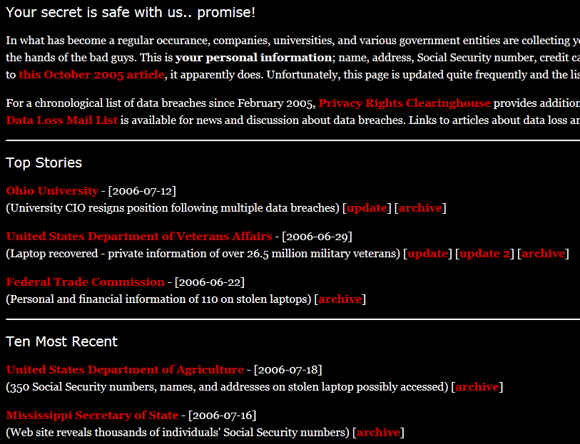
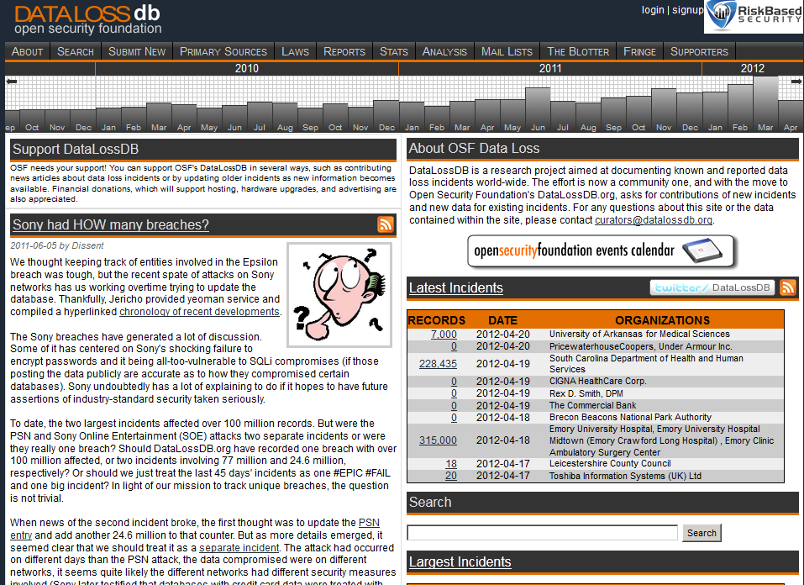
Errata Done Right: Dataloss
Database distributed in CSV
No native search
No metrics
Weak classification system
Dedicated site
Actual developers (Dave)
Extensive metrics
Expanded sources of information
Anyone can submit
Extended classification system
Dedicated data input (Dissent)

Slide 29
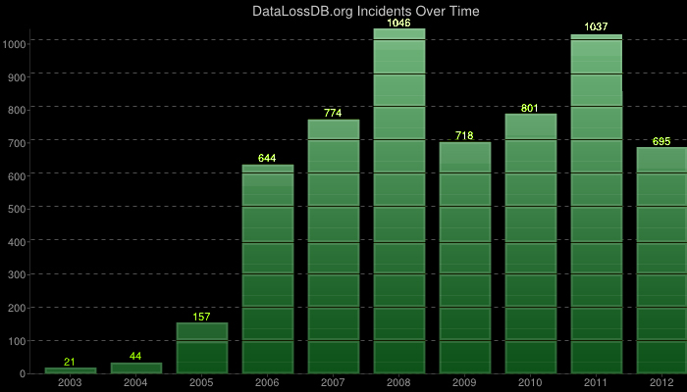
Stats - Dataloss
Notes:
http://datalossdb.org/statistics
Odds are, your information has been leaked. You may not know about it yet.

Slide 30

Confronting Charlatans
Notes:
Confronting charlatans. Does it happen? Yes, more frequently than most realize.
Confronting Charlatans:
Ankit Fadia in Denver - http://attrition.org/errata/charlatan/ankit_fadia/scared/ (I tried…)
Sahil Khan Email & Chat - http://attrition.org/errata/charlatan/watch_list/sahil_khan/2011-03-26-chat.html
Frédéric Bourla of HTBridge Email - http://attrition.org/errata/charlatan/htbridge/emails.html
Kim ‘Kimble’ Shmitz Email - http://attrition.org/postal/z/legal/yihat/
Barry ‘Lou Cipher’ Schlossberg Emails – (covered more later)
Email but not published: Cattechie, Arthur ‘Wesley’ Kenzie (aka Securikai), Frank Jones (under different name), EC-Council (Jay Bavisis), Infosec Institute, Voice of Grey Hat, Craig Wright, 7Safe, Dafinoiu, Foresec, The Hacker News, Rizky Ariestiyansyah / IBT. Historic: JP, Meinel
Twitter or DMs: Ankit Fadia, John Flowers (and many of the above)

Slide 31
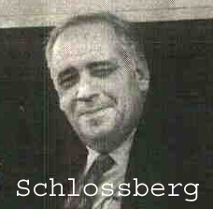

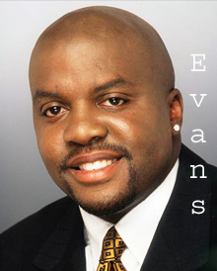

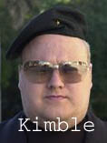
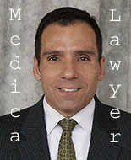
Blowback
an unforeseen and unwanted effect, result, or set of repercussions
Notes:
Standing up to charlatans invariably results in some blowback. This has been everything from casual insults, threats of physical violence, libel/slander, attempts to get me fired from my day job, civil lawsuit, criminal charges…
The obvious response is, “we must be doing it right”. This is the prime reason there are relatively no names on Errata, and one semi-public face to the project. Volunteers are hard enough to come by; if they received this blowback, they would not stick around.
Only a few truly challenge the information we have published, and typically in a poor manner. Screaming “you’re wrong” over and over doesn’t make your case. Others attempt to correct us, and we work with them until they get fed up (likely realizing we won’t just delete the entire page). Many lash out with personal attacks, go after friends or employer, etc. That, to me, says that they can’t argue with what we have published because we’re right and they know it.
In no particular order…

Slide 32
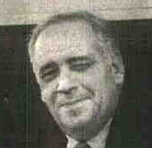
Blowback - Schlossberg
From: Louis Cipher (loucifer@s-mail.com)
Date: Sat, 27 Aug 2011 05:52:24 +0000
Subject: you are full of shit
Hello It appears you don't want anyone to put a locate on you. I would hazzard a guess you don't want to be served with a suit. There are many ways to accomplish this. You have been a digital bully to long. I think 2011 and 2012 are going to be interesting years for you, legally that is. I look forward to a summary judgment(with a fraud component, to prevent discharge in bankruptcy) followed by levies, garnishments, etc etc etc. I hope you have saved up some serious money, as you will need it for legal defense, unless of course you elect to go pro se or get some meatball attorney to go pro bono. You will probably publish this email, and give a specious rant as to whatever BS you can conjure up.
Gramps, take it easy on me, I wouldn't want to get help from some of my friends.
… and I still don't, but I do look forward to meeting you.
Everybody has to pay their taxes, do you.
You now have some Israeli groups interested in who the f_ck you are, good luck.
Notes:
Started with a threat of lawsuit, with a “fraud component”! Turned into vague physical threats in the middle of him demonstrating he was really bad at using the Googles. Remember, his entire public reputation was built on the stories of him taking a team of guys to a hacker’s house they tracked, breaking in, and threatening (or beating) them with a baseball bat.
http://attrition.org/errata/charlatan/watch_list/barry_schlossberg/legal_threat.html
http://attrition.org/errata/charlatan/watch_list/barry_schlossberg/more_mails.html

Slide 33

Blowback -
From: "Droz Johan (PJ)" johan.droz@justice.ge.ch
To: "'staff@attrition.org'" <staff@attrition.org>
Date: Tue, 10 Apr 2012 09:42:28 +0000
Subject: Criminal proceeding against attrition.org
Dear Sirs,
I am in charge of a criminal proceeding against the persons behind attrition.org and "Jericho" in particular.
The criminal complaint was deposited by High-Tech Bridge SA.
Could you please give me the names of the persons who manage the internet site and their adress, in order for me to be able to have them heard.
Thank you in advance
Johan DROZ, Procureur Sct I
Ministère public
Route de Chancy 6B, case postale 3565
CH-1211 Genève 3
Tel +41 22 327 64 64 - Fax +41 22 327 65 00
Notes:
Emails between Bourla and I show that I was striving for accuracy. Based on additional information provided, I removed some content and made updates to other:
http://attrition.org/errata/charlatan/htbridge/emails.html
Despite that, HTBridge filed criminal defamation charges in Switzerland against me. Apparently, Bourla couldn’t figure out Google 101 either, as the charges are against “jericho”, and not by real name. They didn’t even tell the prosecutor which country I lived in, or give him my email address. Finally, Bourla waited around 8 months to file the charges; Switzerland requires you file the complaint within three months of knowledge of the issue #oops! Despite that, Swiss prosecutor is not dropping the charges (yet?), and this is dragging out.
Mails from Bourla say he thinks I was duped into posting this information, and later he says “But honestly, we don't care who we are for you, as anyone has the right to have his own opinion? Should it be a wrong one.” Both of these actually *counter* the claims of defamation, as the charge requires “knowingly post false information”. He apparently wants it both ways.

Slide 34
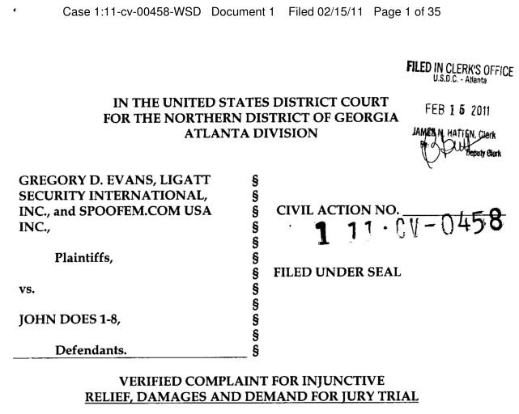
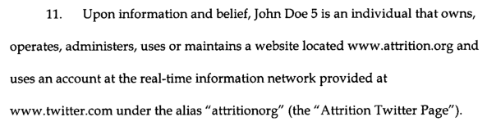
Blowback – Evans
Notes:
Gregory Evans blowback has been the most by volume for sure. Despite us having the most material on him, he has gone after us legally a single time, for a single image on one page.
1. The big one is a court case in which he named attrition.org. Like other charlatans, he also couldn’t figure out Google 101 to put any names with it. That, or he used it as a transparent legal strategy in attempt to get overly broad discovery for his case. This ended up being one of many bad legal ploys, including notifying us of the case less than a week before the first hearing. Forced us to find a lawyer quickly. The case was very diverse, where each of the 8 Does were included for wildly different reasons. For us, we ended up agreeing to remove 1 image (a screenshot of a document from his leaked mail spool). We removed the image, which did nothing to change or remove content on the page, as it was added a while after original publication. So instead of his lawyer sending a C&D or trying to work it out, he jumped straight to a lawsuit (no surprise).
2. There was a phase where Evans was hiring private investigators to look into and/or follow detractors. We know he did so for at least two people, but never determined if he did so for me or attrition.org staff. There were tweets from Evans or word of mouth that he was targeting us, but that is all. For example:
Fri Oct 14 22:48:15 +0000 2011 @GregoryDEvans Gregory D. Evans says: its time to put my PI on a few people and there close ones.

Slide 35
Blowback – Evans
From: Gregory Evans gregoryevans@ligatt.com
Date: Mon, 25 Oct 2010 19:20:12
To: [redacted]
Subject: Re: [SPAM] Re: [SPAM] Fw: Manhattan lease app
1st. I do not want to rent your place.
2nd. You or who ever pulled this thing up is very ignorant. This is not a investor website it is racist hacker website. This is the same site if you go through it that called me niggers and niggers don't no computers. It is also a site that says they need +to hack all Jews technology companies. The information they posted on this board is false!!!!!
3rd. My mom was going to rent the place as a second home not me or a company. Your rent is is only $1900 a month, add $500 on to that an it still would not be one of my car payments.
4. What you should have did is went to CNN or Forbes and looked it....dumb!
5. See this just prove my point, that know matter what race or education background you may have there are still can be a just a dumb ass!
6. I will be posting this to my 50,000 + twitter followers and my >5,000 facebook fans. This is soooooooo funny to me. You went and pulled up a racist website.
Notes:
Gregory Evans blowback continued:
3. Libel in Email – In 2010, Evans was trying to rent an apartment under his mother’s name, because he apparently does not maintain any bank accounts under his own name. When the company did their due diligence, they found a write-up of Evans’ company finances (LIGATT) on attrition.org. The person mailed Evans the link and said his stock price was a concern, and to please give his response to the article for their consideration. It was a fair reply and not insulting. Evans took it as an insult and replied with the above. At the time, he had less than 1,000 Twitter followers and a fraction of Facebook fans. It wasn’t until early 2012 that he paid a company for Twitter followers, and jumped up to 10,001 in less than 24 hours; still way under the 50k he threatens. Regardless, his 2nd point is the libelous and blatantly false remarks against attrition.org.
4. Libel on Blog/Podcast – After ‘hacker happy’ sent a libelous email to hundreds of security people (including my employer), Evans jumped on the bandwagon and posted several blogs and did a podcast where he not only republished everything, but added his own lies. On the podcast, he claims that attrition.org was hacked and rm’d, and that we had no backups. This was towards the end of the DDoS, when the site was back up and all of the web content freely available to Evans. As we know, the truth doesn’t much matter to him. - http://www.blogtalkradio.com/nationalcybersecurity/2011/12/19/ncs-121911
Partial transcript: “Some believe Martin has done interviews where he has given out false information just to make himself look better. Recently his website that posted information about people on his hitlist was hacked and destroyed. Now, the question is how could this happen to Martin when he is supposed to be a computer security expert and respected by all of the computer security industry according to Martin. Martin allegedly had no backups of the attrition.org web site. How could any computer security expert not have regular backups.”
5. Evans never could figure out that ‘Errata Security’ (consulting firm in Atlanta) is not the ‘attrition.org Errata Project’. So he visited their office one day. He stormed in demanding to speak to someone, scared the poor receptionist who had no clue what he was talking about, called security, and had Evans escorted out. Sorry @ErrataRob et al!

Slide 36
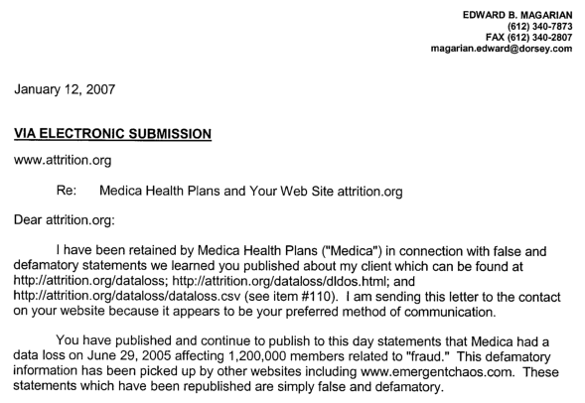
Blowback - Medica
This is not our first trip to the legal threat rodeo, sir.
Jared E. Richo
attrition.org
Notes:
http://attrition.org/postal/z/legal/medica/
While Dataloss was part of Attrition, we received a legal threat from Dorsey & Whitney LLP, on behalf of Medica Health Plans. Despite their frivolous claims, we did not defame Medica at all. The lengthy email battle between Magarian and myself (written with help from Lyger) show just how short-sighted and ridiculous lawyers can be.

Slide 37
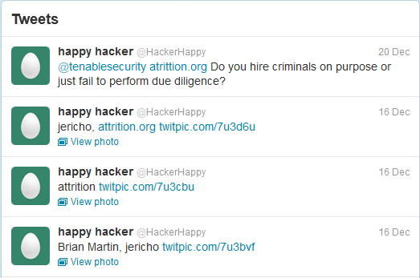
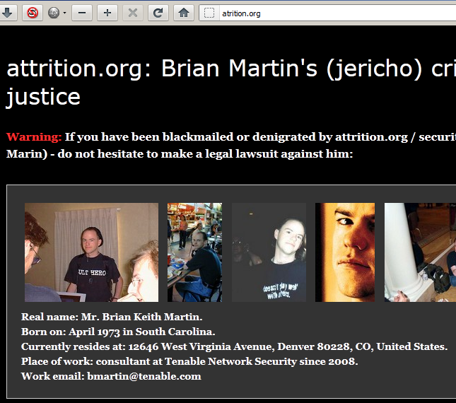
Blowback – ‘Hacker Happy’
aTrition.org
From: happy-hacker@atrition.org
To: [long list of security people]
Date: Thu, 15 Dec 2011 05:23:04 -0600 (CST)
Subject: Brian Martin's (jericho) crimes and frauds exposed for justice
Notes:
On December 15, I received several copies of a mail to a few lists I help run, as well as forwards from dozens of security professionals. The mail was a summary of “crimes and frauds” by me supposedly. They sent copies to my employer, as well as Tweeted to them from @HackerHappy. Despite the name, this is not Meinel. Anyone spending a couple minutes reading the accusations and claims will realize how absurd they are. By their ‘doxing’, I have three middle names (Keith, Allan, Andrew). They also have the wrong birthday, have my address in Denver wrong, associate several cases in Arizona with me that are not me, etc.
http://gregorydevans.com/2011/12/15/brian-martin%E2%80%99s-jericho-crimes-and-frauds-exposed-for-justice%E2%80%A6part-2/
Greg Evans picked this up and printed additional ‘facts’ about me. The wording suggests it was ‘HackerHappy’ that sent him the extended write-up, and Evans reprinted it as is. It included gems such as being kicked out of college (I dropped out), that I am paranoid “caused by psychological disorder, alcohol and drugs poisons his everyday life”, am a drug-addict for many years (insulin count?), am into animal pornography, and that I am ‘hiding from justice’. One comment also claims that they have access to my home computer, yet haven’t leaked a single thing from it.

Slide 38
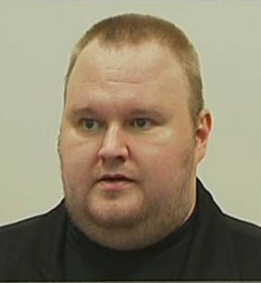
Blowback - Kimble
From: Kim Schmitz <kim@kimvestor.com>
X-Sender: kim@194.221.6.35
To: security curmudgeon <jericho@attrition.org>
Date: Mon, 22 Oct 2001 16:04:47 +0100
Subject: Re: Terrorist cell operating from attrition.org
i think you will soon hate me even more.
have a suprise for you, be prepared.
ciao
K.
In reply to the original YIHAT mail: good job, they are fucked soon!
In reply to my taunting him: you make it even worse ;-)
In reply to Comega taunting him: ;-) words words words... i dont talk, i do.
Further reply to Comega: i can only smile about you my cute little boy ;-)
Notes:
http://attrition.org/postal/z/legal/yihat/
YIHAT (Young Intelligent Hackers Against Terrorism), a ‘group’ Kimble supposedly founded. One of their members contacted us with a brain-dead request. Apparently, he missed the ‘I’ in YIHAT. Ultimately, my reply led Kimble to jump in and make a few veiled threats.

Slide 39
Blowback - Kimble
From: Kim Schmitz <kim@kimvestor.com>
X-Sender: kim@194.221.6.35
To: Cancer Omega comega@attrition.org
Date: Wed, 24 Oct 2001 08:27:08 +0100
Subject: kimble on attrition.org
Thank you so much... i honestly love your dedication.
please go on and find more "burn the witch" material.
The funny thing is, i am sitting here in my 10 million
dollar penthouse with a pretty girl and a milkshake
and cant stop laughing about you guys. i 0wn you!!!
and yes i hacked a military laser satellite and yes
i am going to burn you and your friends to hell...
and hey, report this to authorities aswell, fux0r ;-)
please release this on your site!!!
LOL
Kimble
Notes:
Hard to understand how anyone could ever take him seriously. “I hacked a military laser satellite” and “I 0wn you!!!” just screams ‘talented hacker’.
Yes, that is the same Kimble in the current MegaUpload fiasco. Picture courtesy of one of his court appearances this year.

Slide 40
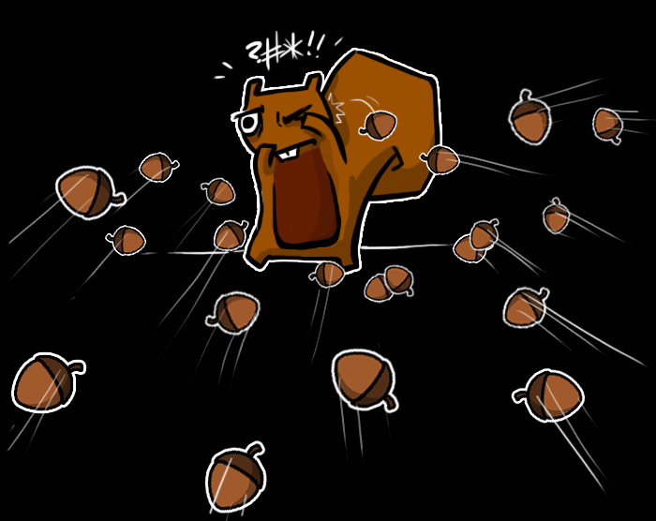
Blowback - DDoS
Notes:
Nov 21, 9:20a CST - Start of attack, initially GET requests to /attrition/fin.html, then POST requests too.
Dec 24, 8a CST - Attack stopped largely, just a few stragglers still hitting the box. [~ 34 days total]
Defensive measures:
Physical: Upgraded router, Corero Anti-DDoS Device (huge thanks to them!)
Software: Apache reconfiguration, IPTables reconfiguration, web server shut off at times
Service: CloudFlare
Logistical: New domain created to mirror content (securityerrata.org)
Other points:
ISP (Cox) was zero help, sent out a technician to do line tests, didn't comprehend the concept of "denial of service" when explained to him. “Everything looks fine on our side!”
Had access to most of the Botnet C&Cs during the attack (mostly in India and Russia). Could see who else they were attacking. Determined it was a botnet-for-hire.
Dec 2, 1:15p MST ->Dec 3, 6:30a CST, attack stopped for some reason.
Dec 1, 12:01p MST -> Dec 1, 9:48 MST, how long it took us to realize CloudFlare did absolutely nothing to protect us.
-We are pretty sure Errata was a fundamental part of why it happened but to this day, aren’t 100% positive.

Slide 41
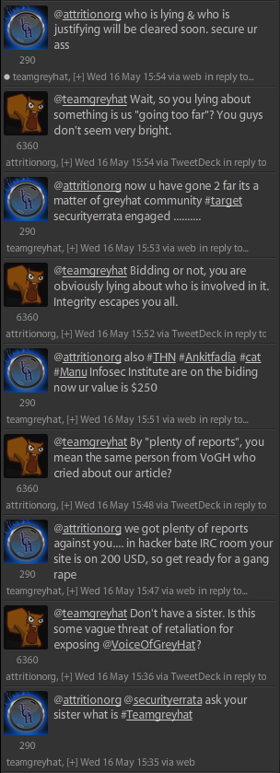

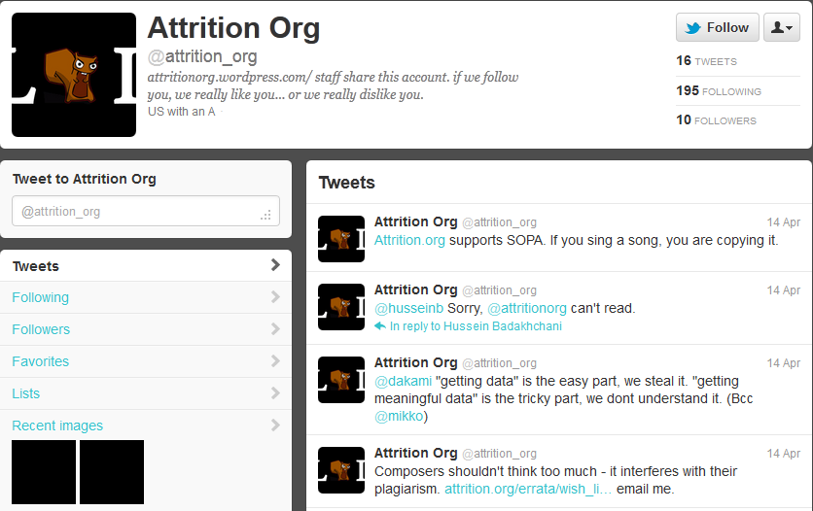

Blowback – The Rest
Notes:
As with any site or person that gets a little attention, there will be other incidents. Some not quite blowback, but most a result of what we published:
- Twitter @attrition_org imposter. Unfortunately, not even humorous. We expect better from spoofs.
- Charlatan groupies (Vaidehi Sachin / Cattechie had several in email or Twitter including James Attrition)
- Backchannel: EC-Council planning to “come after me”. If they do, I have several more articles ready to release.
- Voice of Grey Hat and @TeamGreyHat threatened to hack our server after exposing VoGH plagiarism.

Slide 42
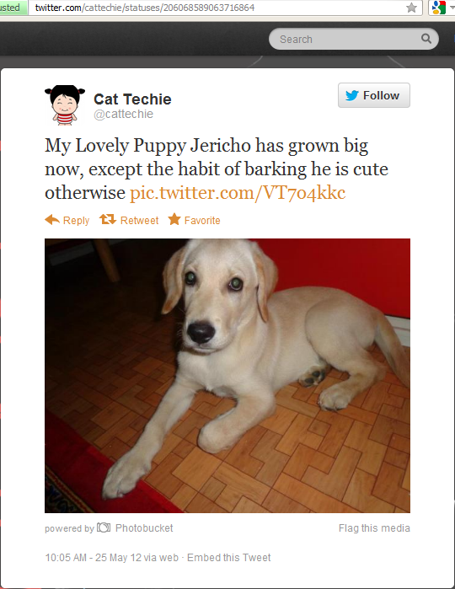
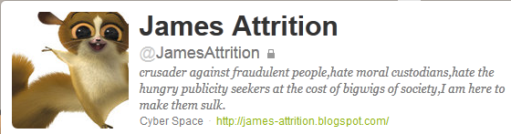
Blowback The (scary) Rest
Notes:
At least one seems to have a love / hate relationship with me. I am pretty sure she got her puppy after we had several email threads. She is also reportedly behind the “James Attrition” alias, a sockpuppet persona who leaps to her defense any time someone gives her grief. Since exposing her plagiarism, she has also turned into someone that reports other people’s plagiarism to us. Cat Techie, my #1 fan? *shudder*

Slide 43
Errata’s Errata (everyone makes mistakes)
In ~ 13 years…
Less than 10 redactions that I can recall
One security spam removed (was an “FYI I am moving companies” mail, but he understands how it was perceived as spam. Removed because he has a history of integrity.)
One sec-co article due to confusion of timeline of events.
Etc…
One article proactively removed (about Evans, after listening to him do an interview)
Around a dozen articles edited for clarity or with new information made available to us (e.g., HTBridge, Schlossberg, EC-Council, Infosec Institute, etc), typically due to email discussion with the party
One charlatan watch-list candidate removed (after sit-down at conference, extensive discussion, and additional review of material not originally considered)
Hundreds of typos and stupid grammer errors
Fail to meet deadlines I set for myself (e.g., “I will review that in the next few days” turns into weeks or months.)
Notes:
Maybe attrition needs a SLA: All email will be answered within 48 hours, even if Jericho has to forward it to Lyger so Lyger can say "go fuck yourself“.
One of the reasons we don’t have to yank much material or do serious edits, is that Errata is *heavily* based on citing sources. Every article that goes up is done in a way to present a logical argument, with links to the resources or information to back it up. “Cite your source” is something I am fond of saying, and I believe in it strongly.

Slide 44

Why Errata Works?
As open and transparent as possible
Cite our sources
Articles are generally peer reviewed
Will update / retract
Attempt to follow ethical journalism practices
Nothing to gain (other than greater integrity in industry)
Stand up and defend our articles to the best of our ability
We maintain a blacklist, not a whitelist (e.g. SECore)
Notes:
We don't care where the info came from, if it is public it is fair game.
LIGATT / Hacking, e-mails released. We used one, ended up taking it down because $1k was cheaper to get out of court, than fight it on 1st amendment ground. (Supreme Court is on our side, Georgia State Courts are not - Bartnicki v. Hopper (99-1687)).
Sometimes, ends justify the means.

Slide 45

It Really Works!
Frequently feels like pissing in the wind, but sometimes effective.
Examples (through positive interaction):
Sahil Khan
Jayson Street
InfoSec Institute
Examples (through persistence):
Greg Evans (rejected from some confs, some media refuses him)
Christian Valor / se7en (out of industry)
Michelle Delio (dumped from Wired)
What have we accomplished?
Awareness
A sliver of sunshine in an otherwise cloudy industry
Notes:
Sahil Khan, changed his ways after an IM chat
Jayson Street. “I will never run from or try to hide my mistakes & it started with a major one.”
InfoSec Institute. Long chain of emails, they implemented new standards to ensure plagiarism didn’t happen again.
Evans denied at conferences, denied getting some media interviews.
Christian Valor / se7en, essentially run out of the industry after higher profile media exposure.
Michelle Delio, lost job at Wired after her fabrications were reviewed by editorial staff.
Several companies after appearing on Spam, thanked me for bringing it to their attention. Marketing departments were chastised.
Questions from Twitter:
“What significant changes have you seen in those years & have they been positive or negative. More or less FUD & charlatans?”
The field is slowly taking the downward spiral and doesn’t seem to be improving. Money still trumps integrity. Definitely a lot more FUD, because that leads to money. Charlatans are on a slow uptick, slower than we imagined.
“Successes & Failures. In short, what approaches have been most effective in exposing/countering errata?”
Most successful is persistence. When we released a new article on Evans every week for several months, kept up the pressure on Twitter, contacted conferences he was speaking at, contacted media about his appearances, I think it put a dent in his ability to work. Also, resulted in a great group of Twitter groupies.

Slide 46
Helping – Why Care?
"We must fear evil men and deal with them accordingly, but what we must truly guard against, what we must fear most, is the indifference of good men." -- Boondock Saints
Ethical thing to do (for real)
Ethical thing to do (mandatory, e.g., CISSP makes you)
Ethical thing to do (gets you dates) [1]
Revenge (petty? sure. fun? absolutely.)
Selfish (less competition in industry)
Really, we don’t care why you help, as long as your work is solid and well sourced.
[1] Errata work has not resulted in a date for any attrition.org staff member.

Slide 47
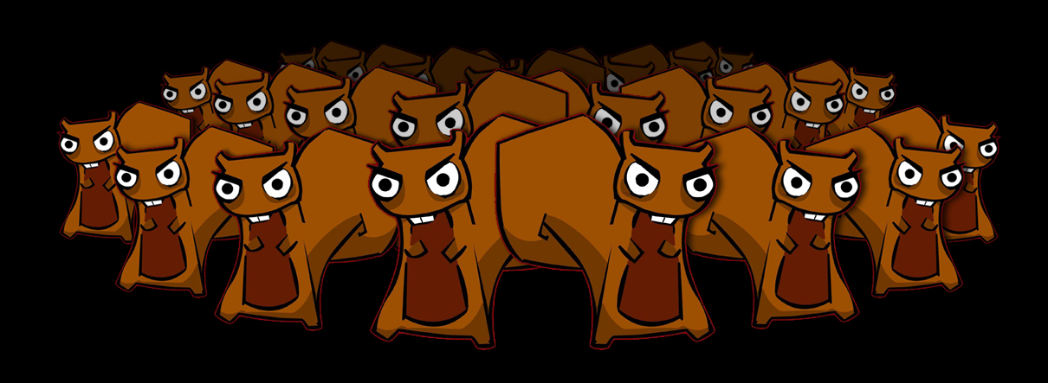
Helping
Have you reported an incident / charlatan? Why not?
Hidden agendas generally don’t stay hidden for long. Help them escape!
No more “won’t name names”. Grow a pair already. Sometimes it can’t be avoided, but not always.
Send us information! (but do a little leg work for us)
Blog, Tweet, Tumblr, whatever. Summarize our findings. Saturation is the key.
Notes:
Have you reported an incident or charlatan to errata? No? Why not? Our business is that of professional skepticism. Many of us get paid stupid amounts of money to go around pointing out the 'bad' in things. We're supposed to see flaws, shortcomings, lies, and deceit. Why does that end when the paycheck ends or you are off the clock?
- No more “wont name names”. We're grownups. Protecting them doesn't encourage them to become more honest. We know people are fallible. The important factor is how they respond to the criticism.
Send us information. Quick tips help, but you actually doing some leg work helps more. The “to-do” list is insane. A random name thrown our way is low priority.
Write your own blog / summary of our articles! Saturation is the best weapon. If the top 10 Google results have more negative than positive, it will do far more than errata alone can do. Can’t just be a mirror, need different voices, different people, different names, and your own perspective.
- So many professional/personal agendas get outed eventually.

Slide 48
Expectations
Why errata hasn't lived up to expectations…
Ours:
Community support is dismal (e.g. few volunteers, almost none stick around)
Overall, barely having an affect – most charlatans still in business
To do it right, takes a lot of time
Community:
Want more, faster, more frequently
Want all the work done for them
Why?
Long-term and short-term burnout (i.e. working on Errata too much)
Personal/Professional situations change (e.g., employer backlash)
Resources (e.g., limited manpower, already spread thin with family, job, other projects)
Volunteers see it is not glamorous and bail quickly

Slide 49
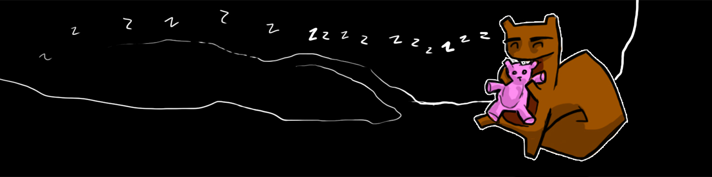
Dreaming What Errata would be like if…
We had 13 years and 1 full time person that entire time? 3 people?
A real budget to fight anything, including first amendment threats?
More in the industry wanted to take charlatans to task?
More journalists covered our findings?
We could cover all sources:
Bugtraq – Vendors, HTBridge, etc.
Full-Disclosure – Aditya K. Sood, others.
Conference Talks – e.g., 2010 ShmooCon FemToCell
Media – How many bad articles have you read?
Every company and conference used it as a resource before hiring/selecting
Every media outlet checked Errata before inviting charlatans on a show
Notes:
- Security arena is vendor-driven; vendors don't like to take up the topic unless they benefit from it, so it's even harder to find unbiased sources of information and unbiased people to look at all aspects of a situation before making informed and accurate judgments.
OSVDB is another case study on “what if”. Serious lack of community support, essentially no financial support. Ultimately, a lot of the great ideas on evolving a VDB are still on hold.

Slide 50

Thanks! (In no particular order)
Mar (sudux.com) – Art, Graphics (Errata and more)
Cupcake – Errata Graphics
Lyger – Spel Checker, Admin, Sanity Checker, Sanity Destroyer, Designated Wrestler
Jay Dyson – fellow curmudgeon, skeptic, admin
Apacid – DNS, admin
Rob Rosenberger / Vmyths.com - skeptic
Space Rogue / HNN - skeptic
Former Errata volunteers: Mcintyre, Zodiac, Quine, Sawaba, dsmcr, Irish, Deepquest, Flipz, Fell, Robert Winkel
Copyright 2012 attrition.org

Slide 51
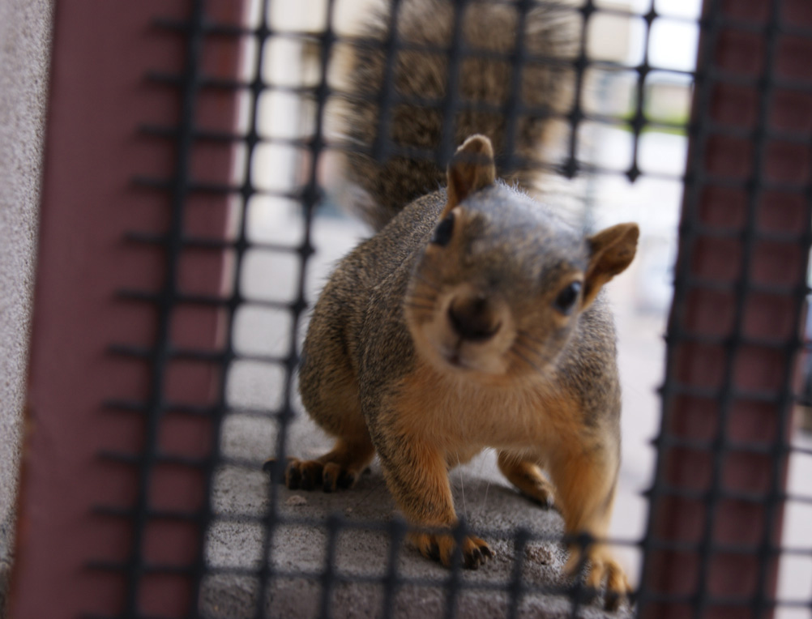
Questions?
Copyright 2012 attrition.org

Slide 52

Expect Us! (Eventually)
Apologies to Anonymous.

