Slide 1

The Digital Battlefield

Slide 2
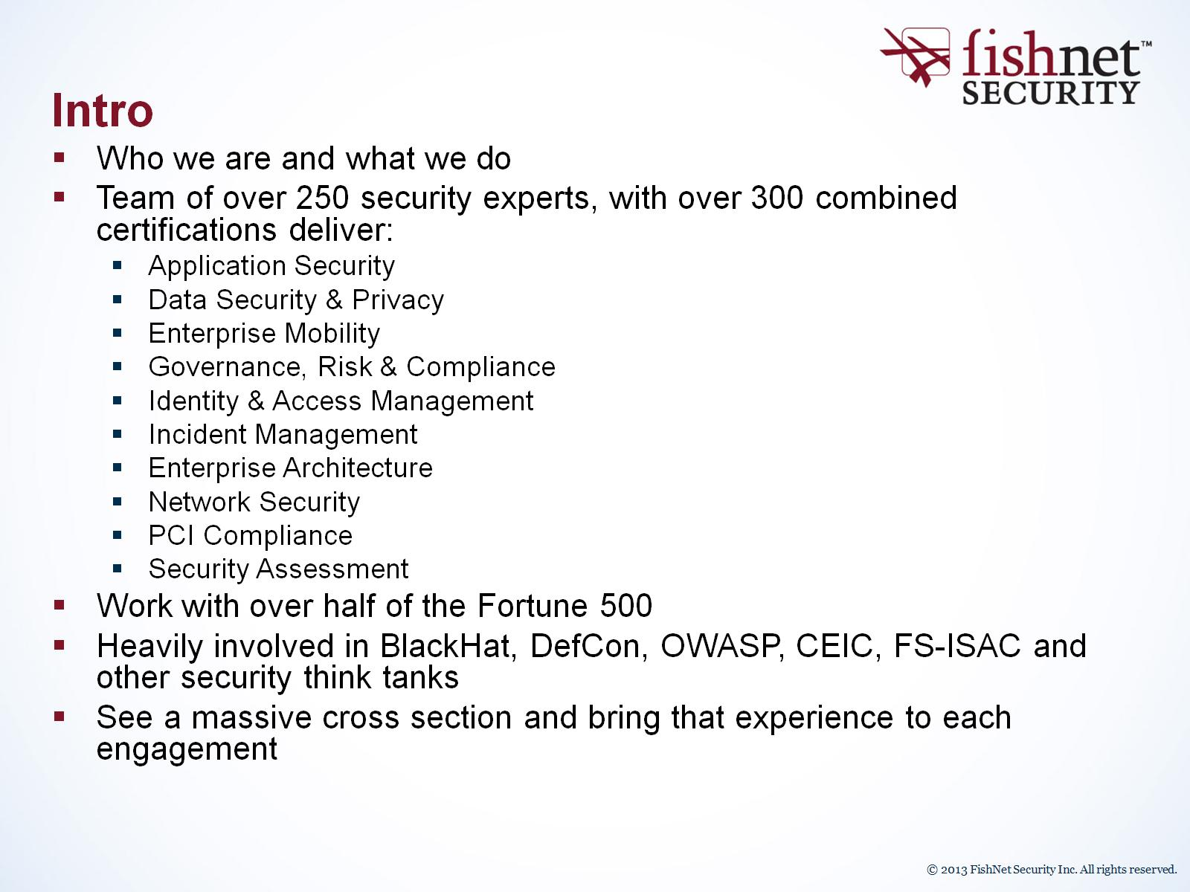
Intro

Slide 3
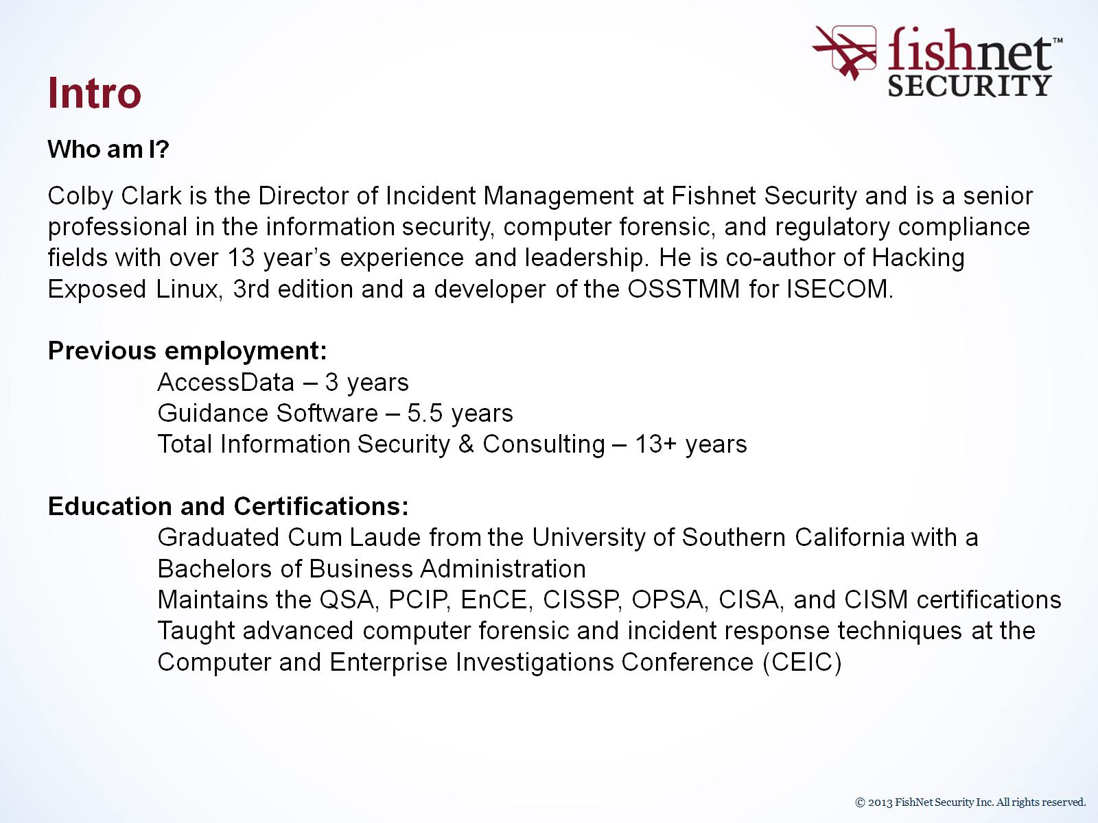
Intro

Slide 4
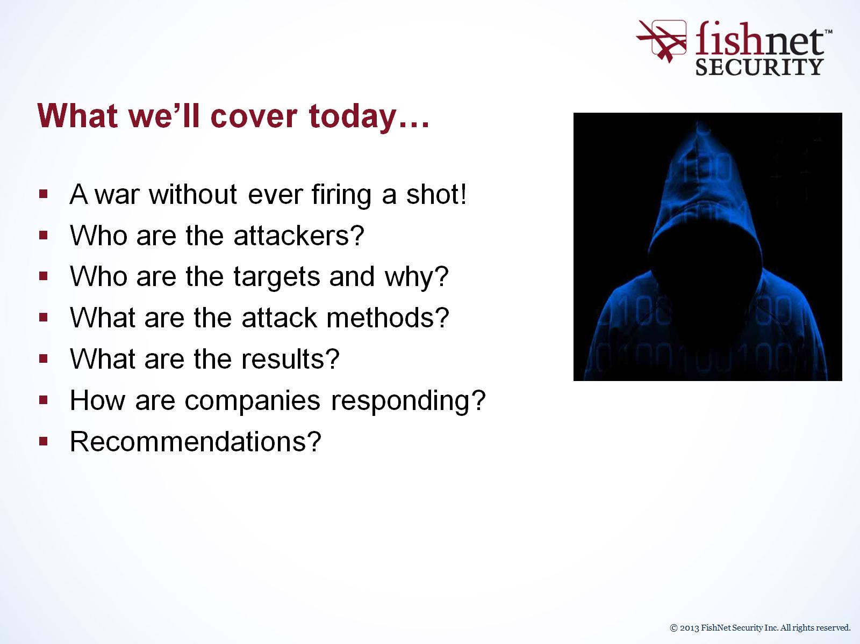
What we’ll cover today…

Slide 5
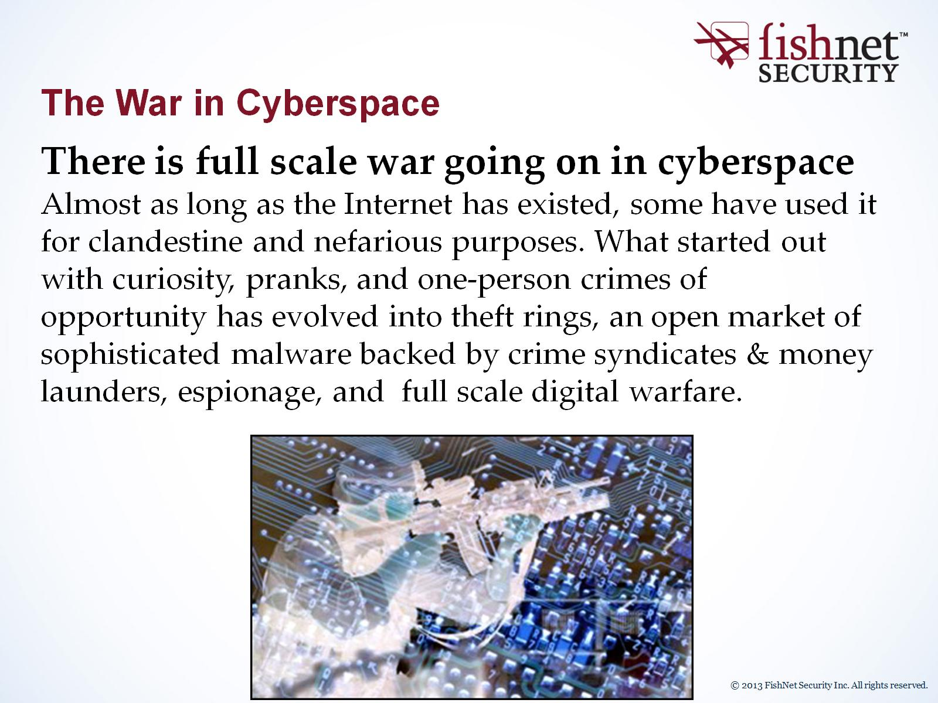
The War in Cyberspace

Slide 6
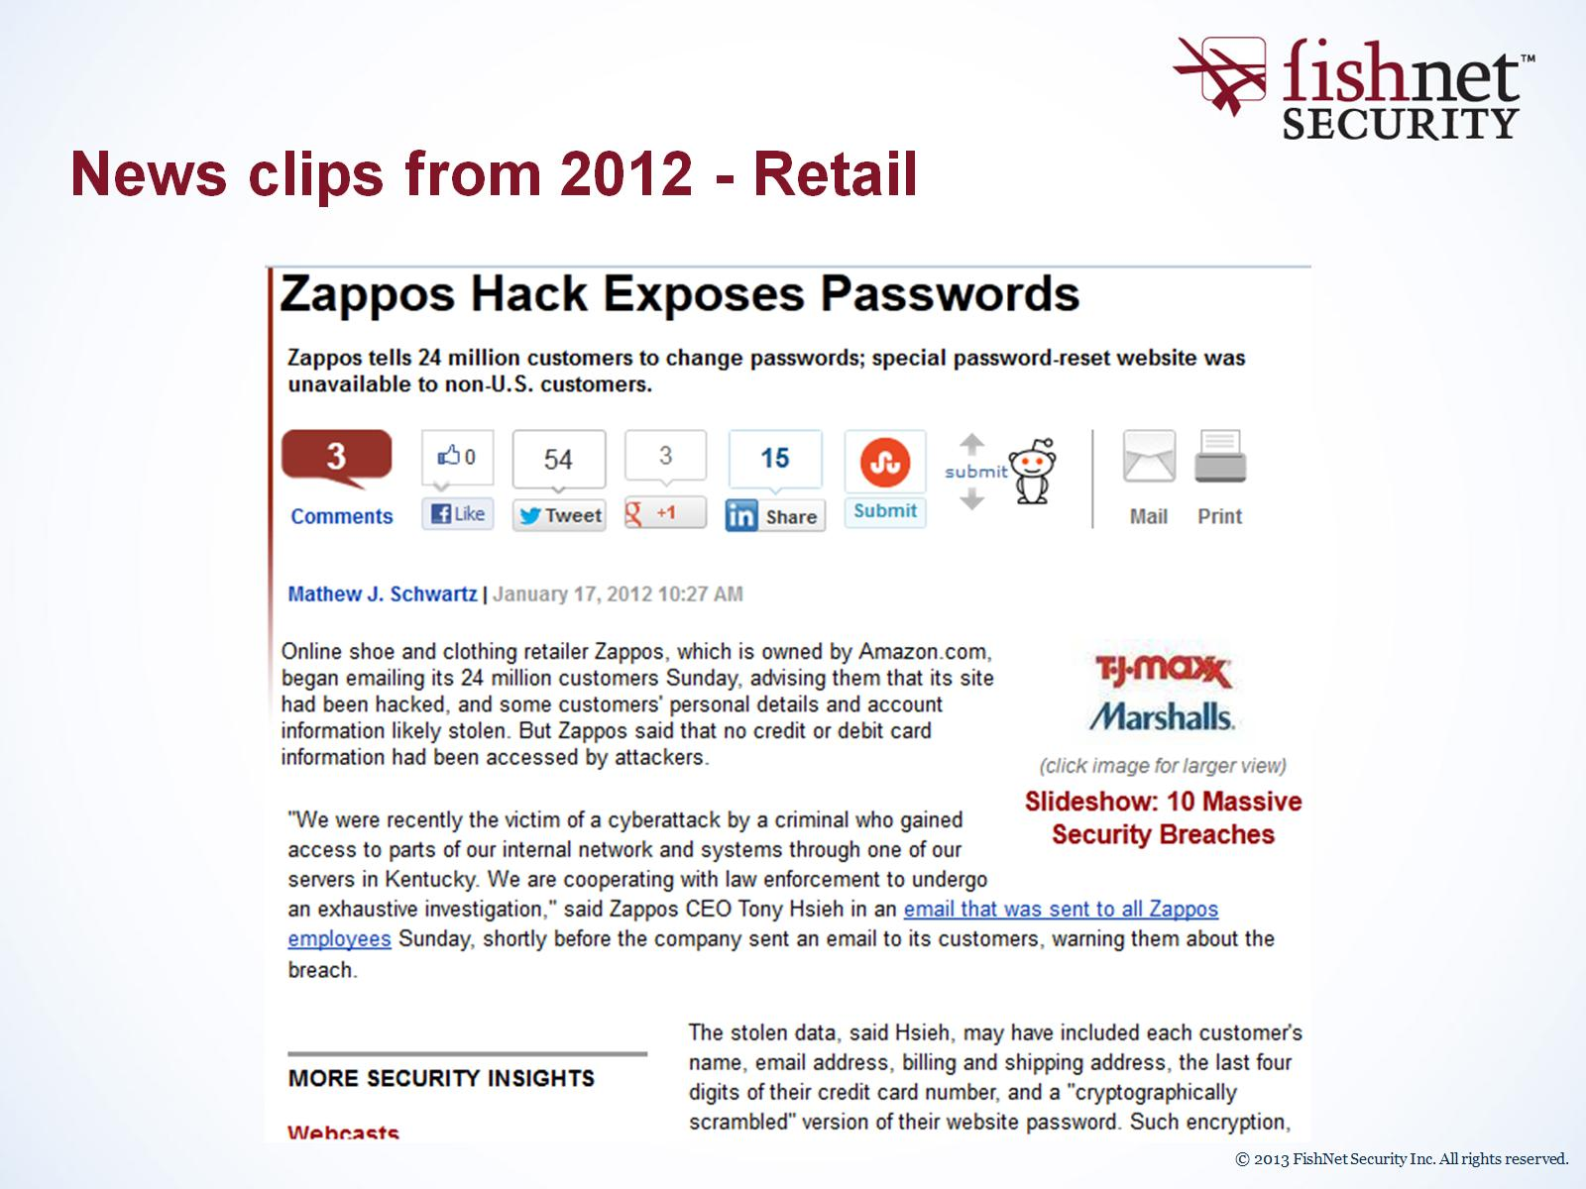
News clips from 2012 - Retail

Slide 7
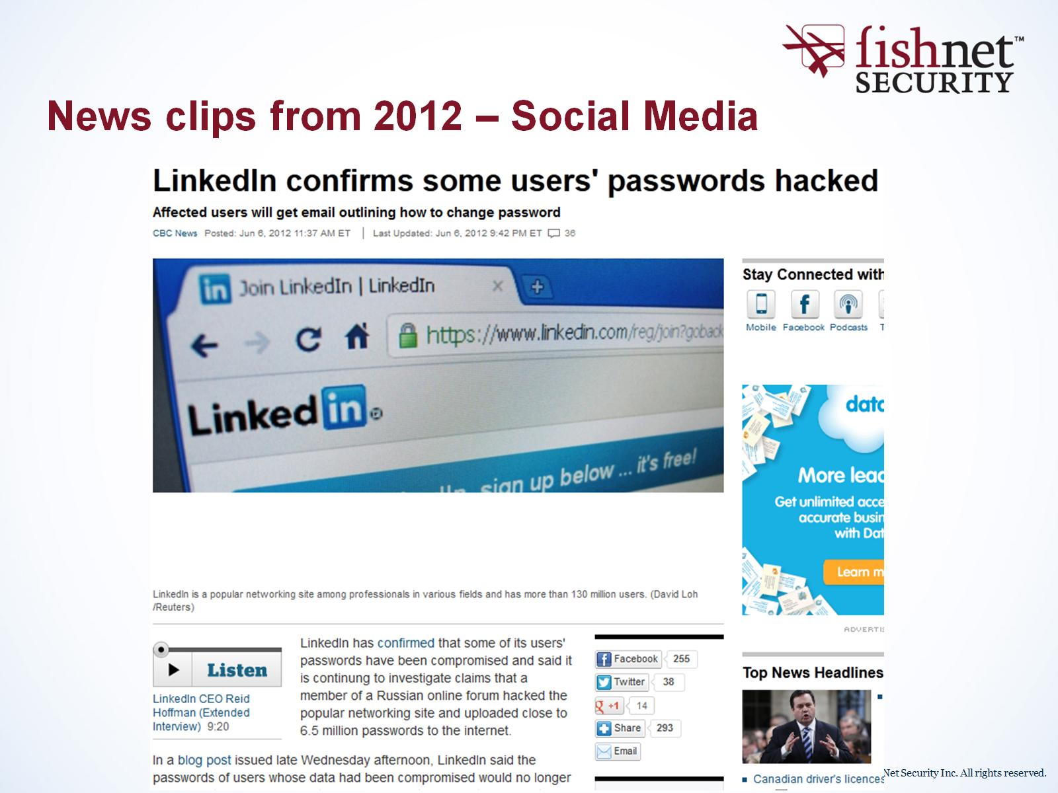
News clips from 2012 – Social Media

Slide 8
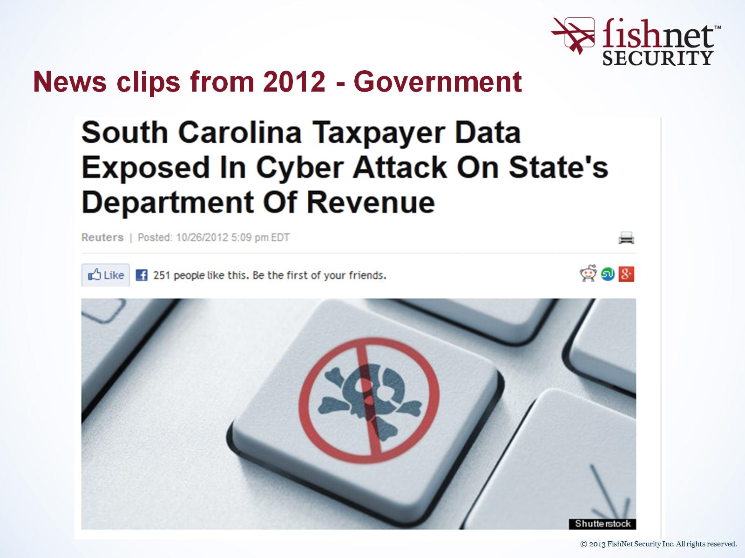
News clips from 2012 - Government

Slide 9
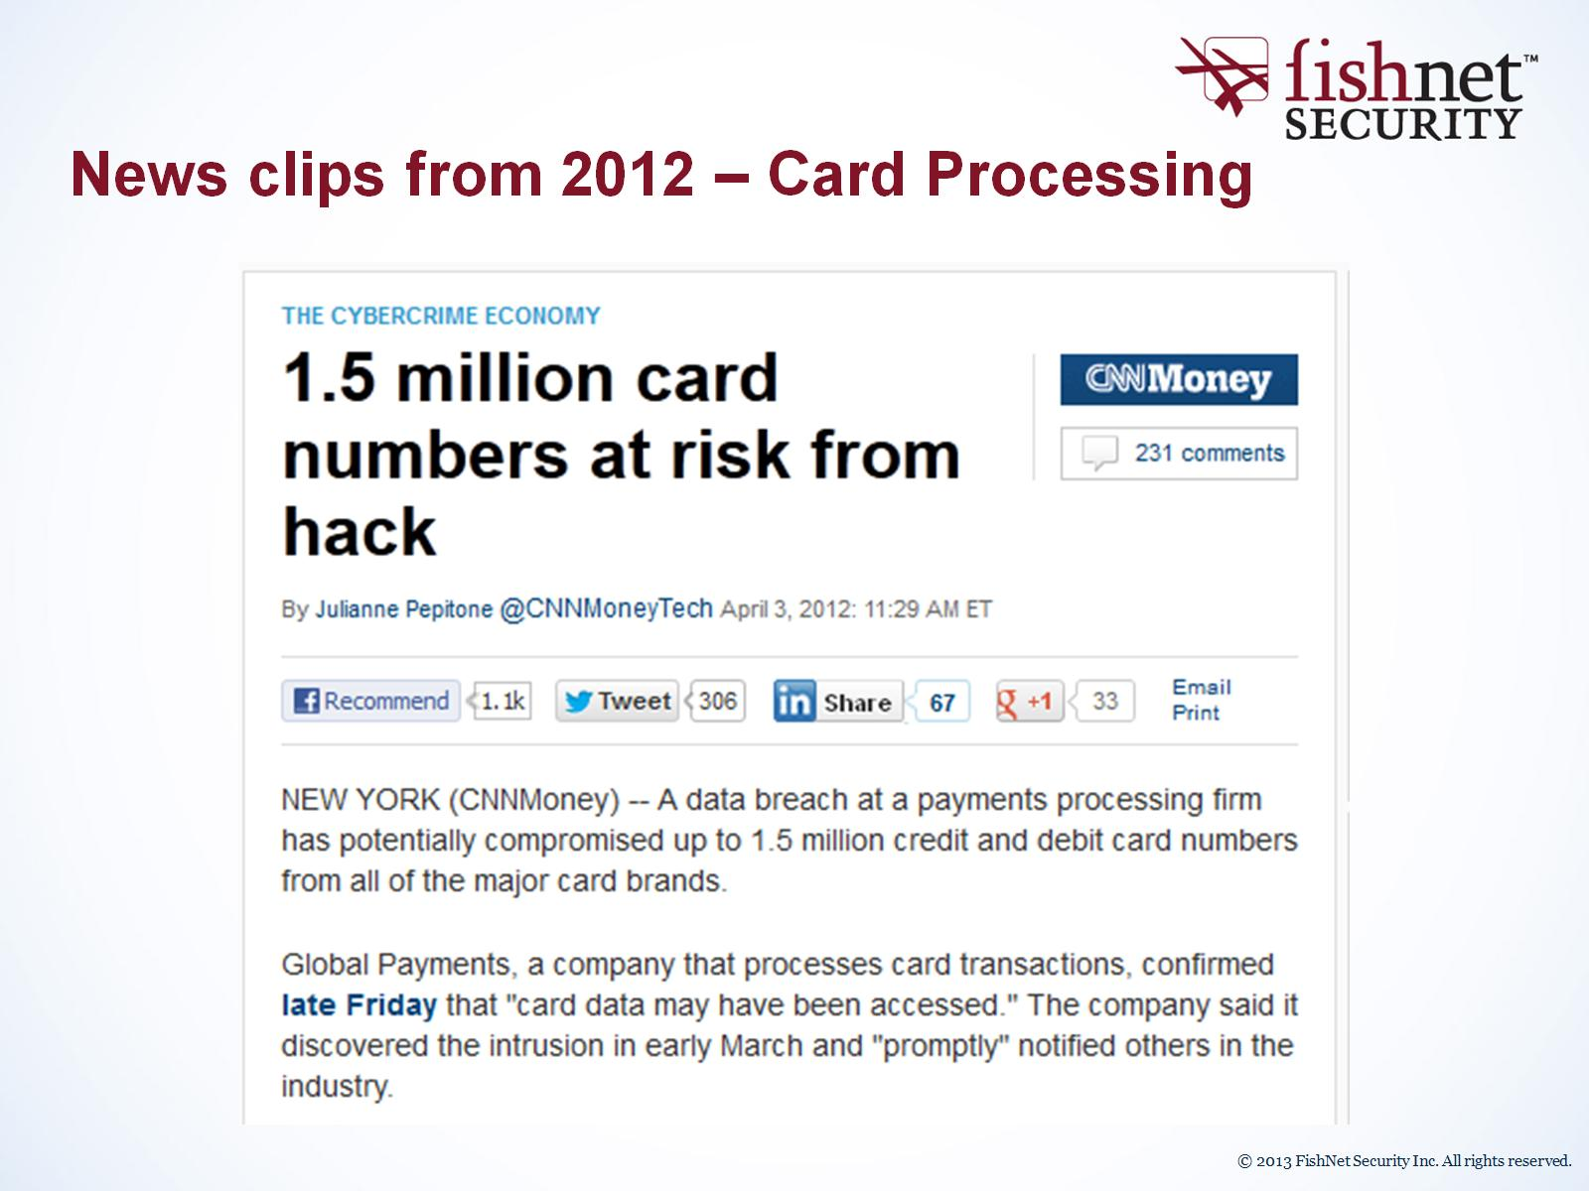
News clips from 2012 – Card Processing

Slide 10
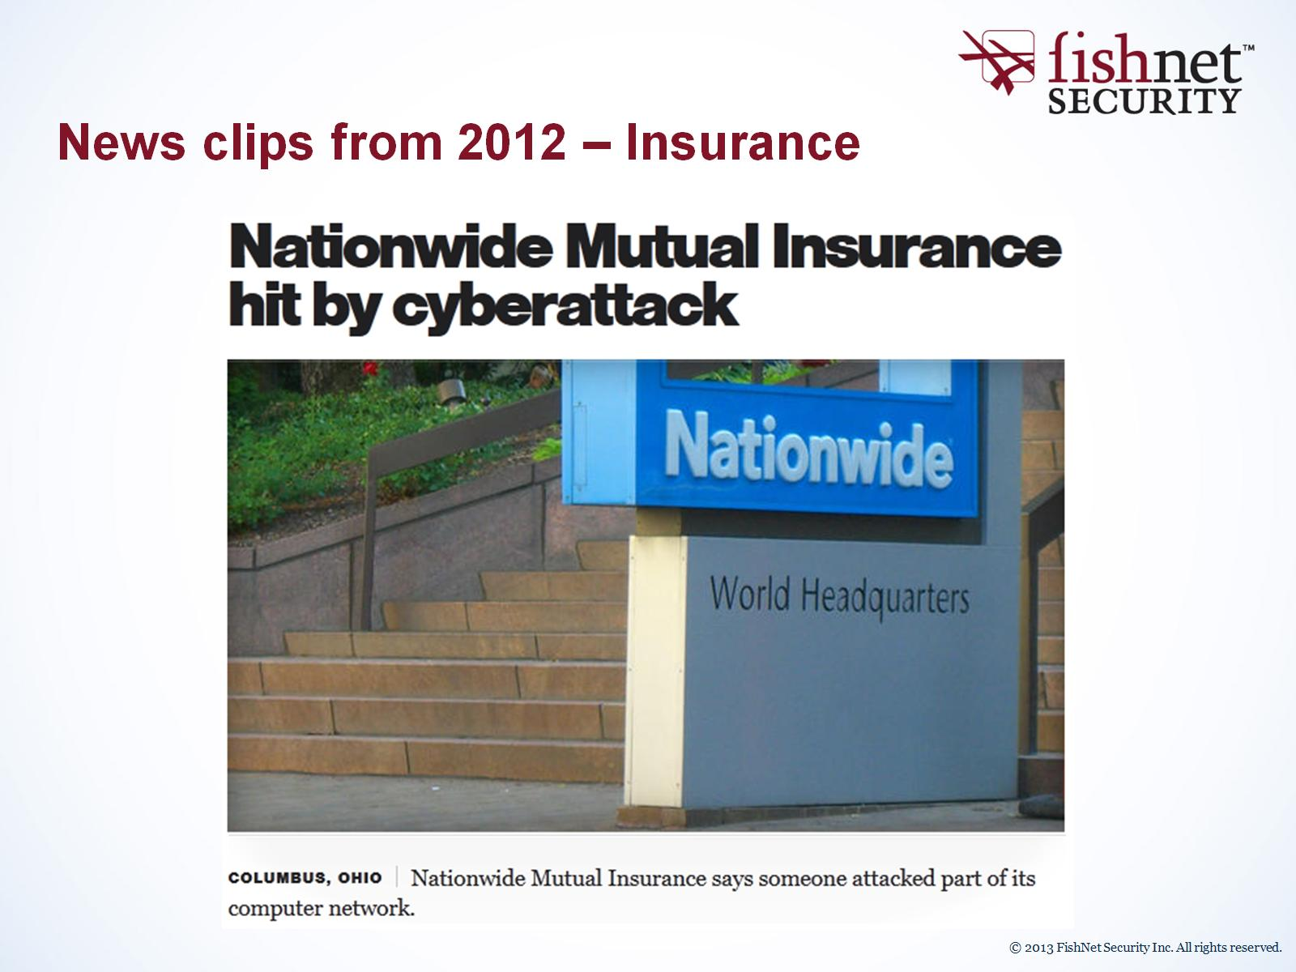
News clips from 2012 – Insurance

Slide 11
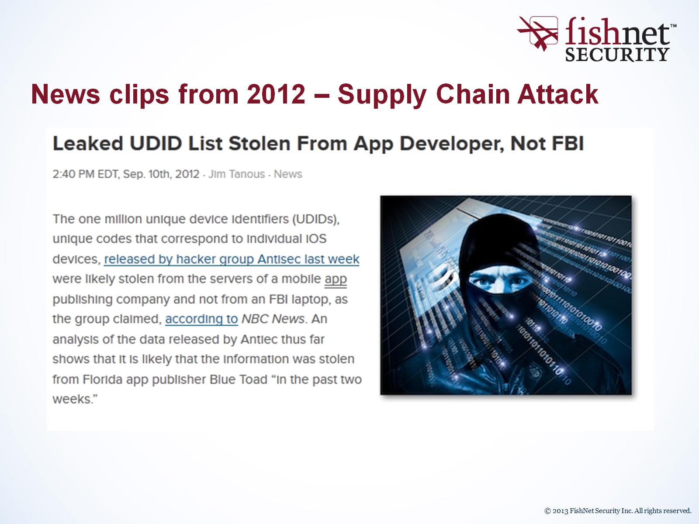
News clips from 2012 – Supply Chain Attack

Slide 12
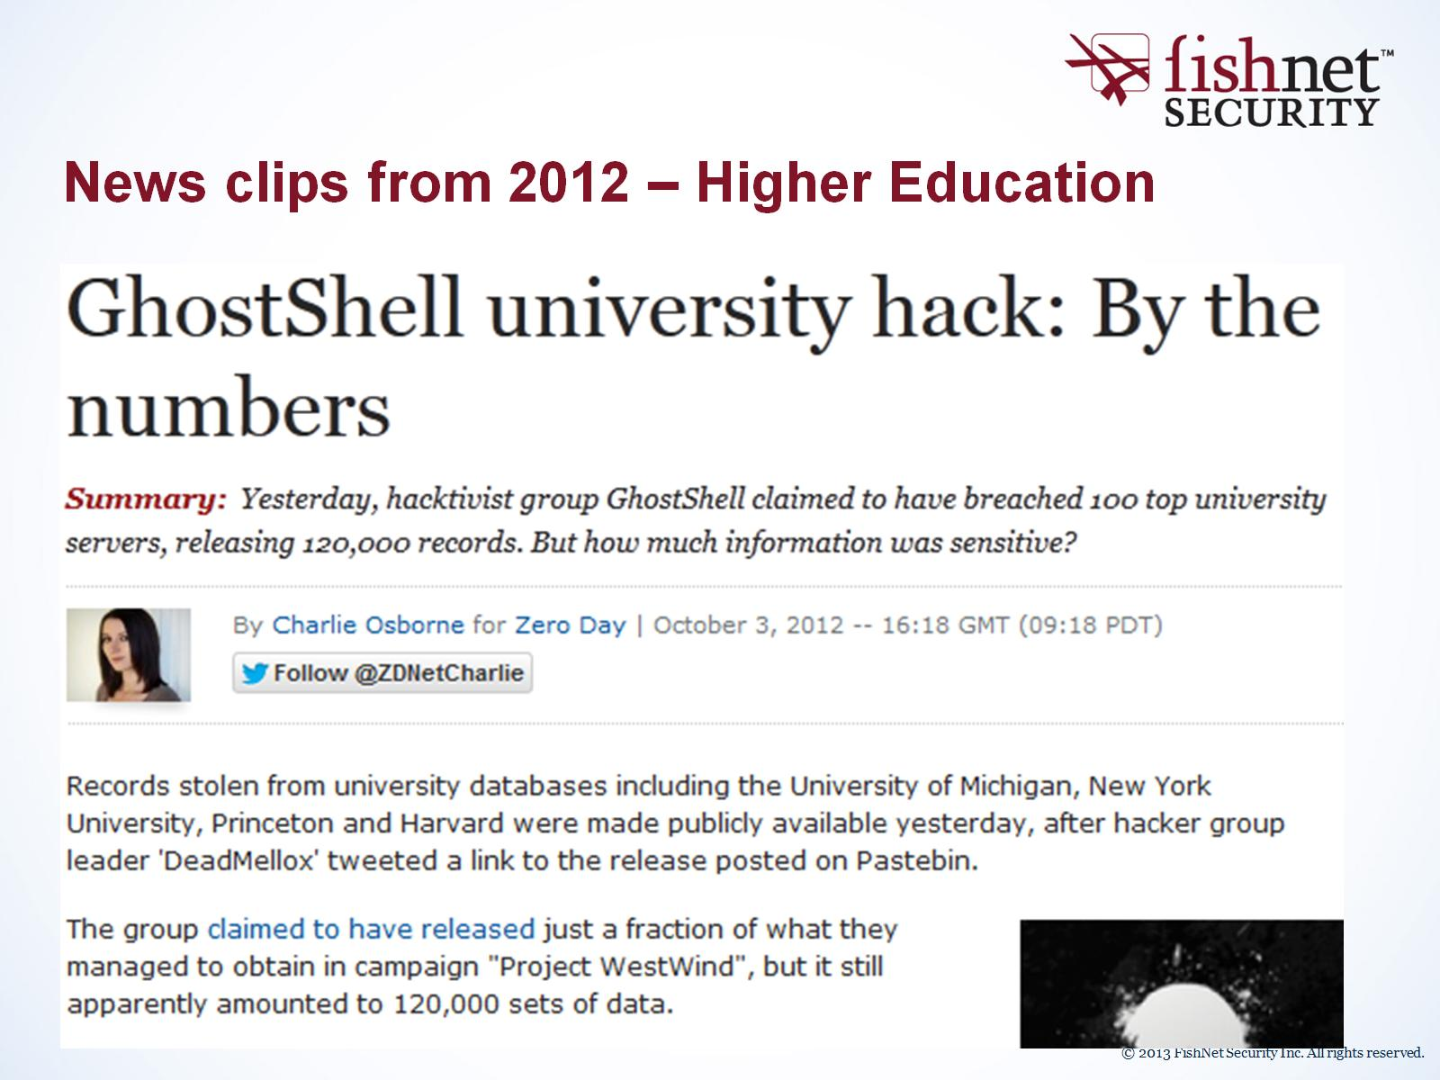
News clips from 2012 – Higher Education

Slide 13
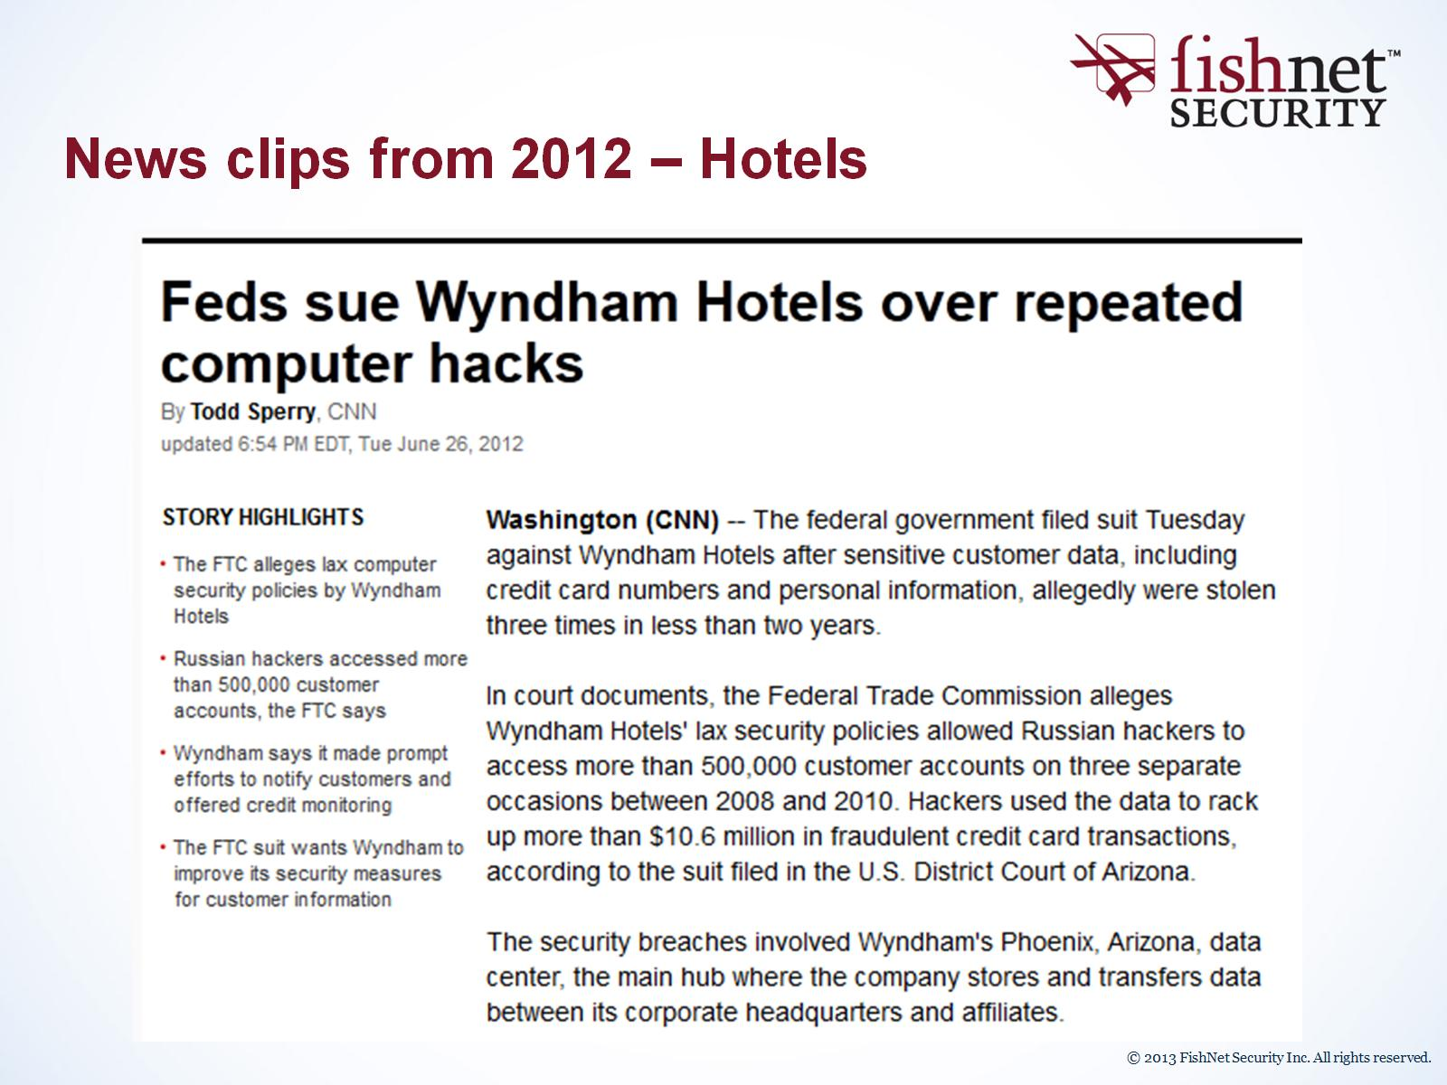
News clips from 2012 – Hotels

Slide 14
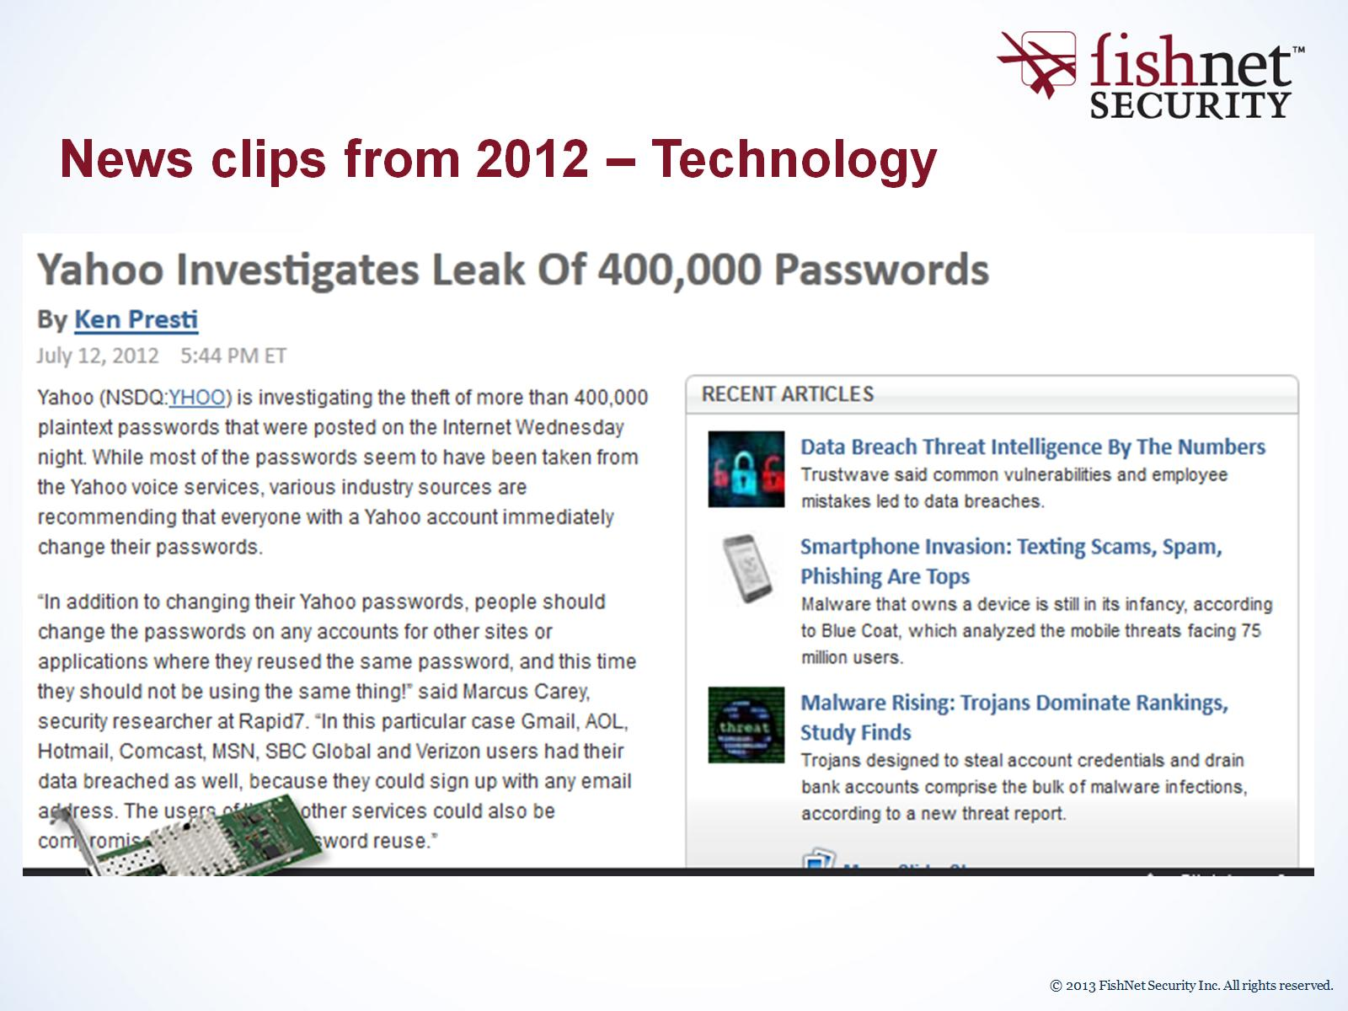
News clips from 2012 – Technology

Slide 15
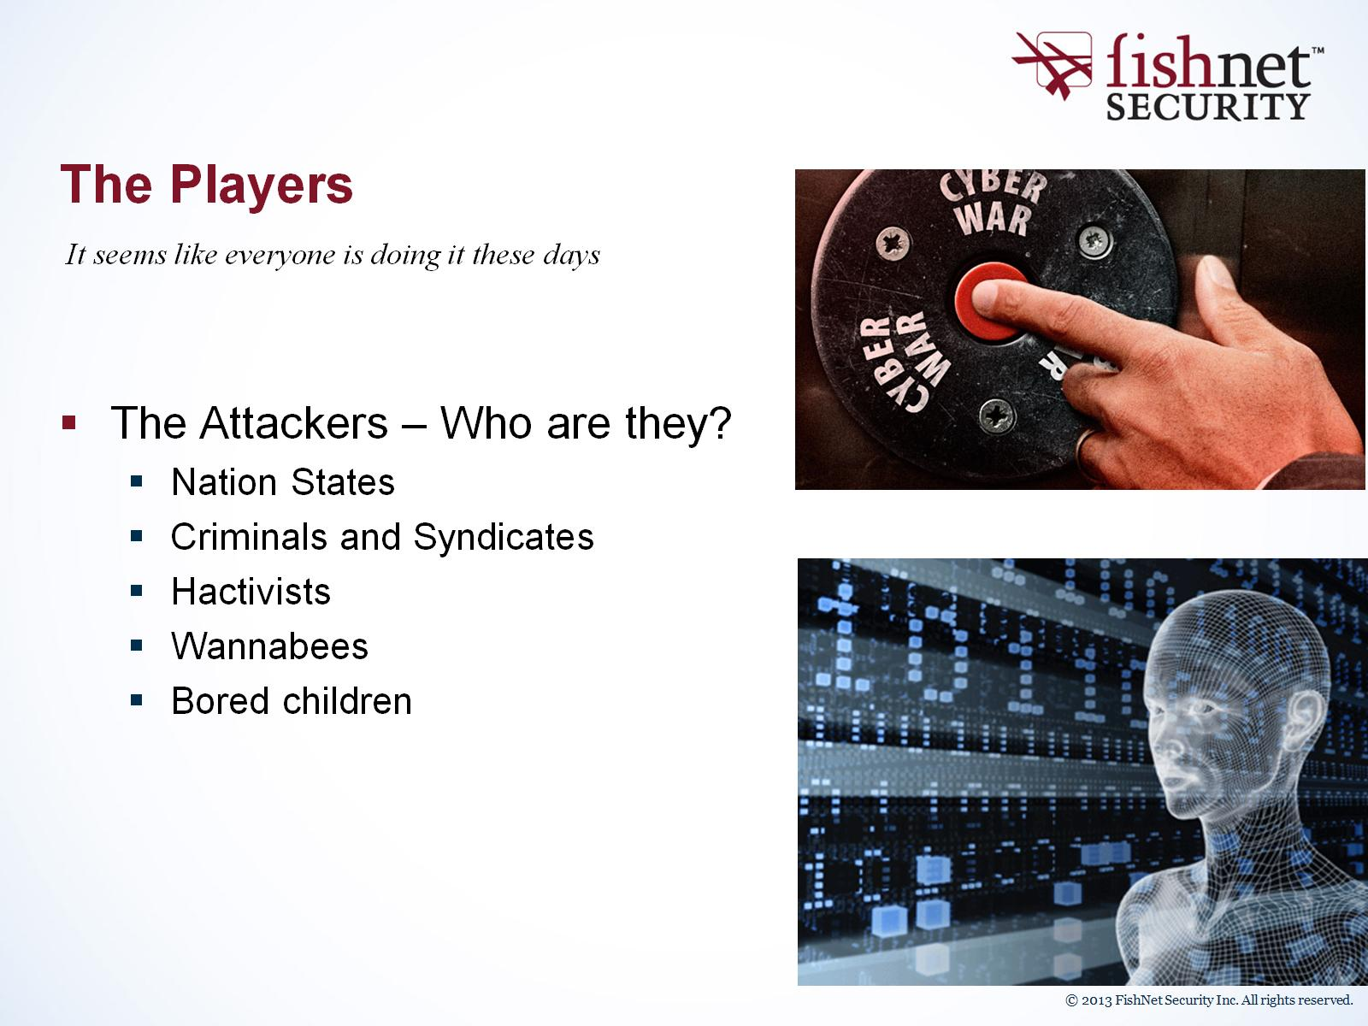
The Players

Slide 16
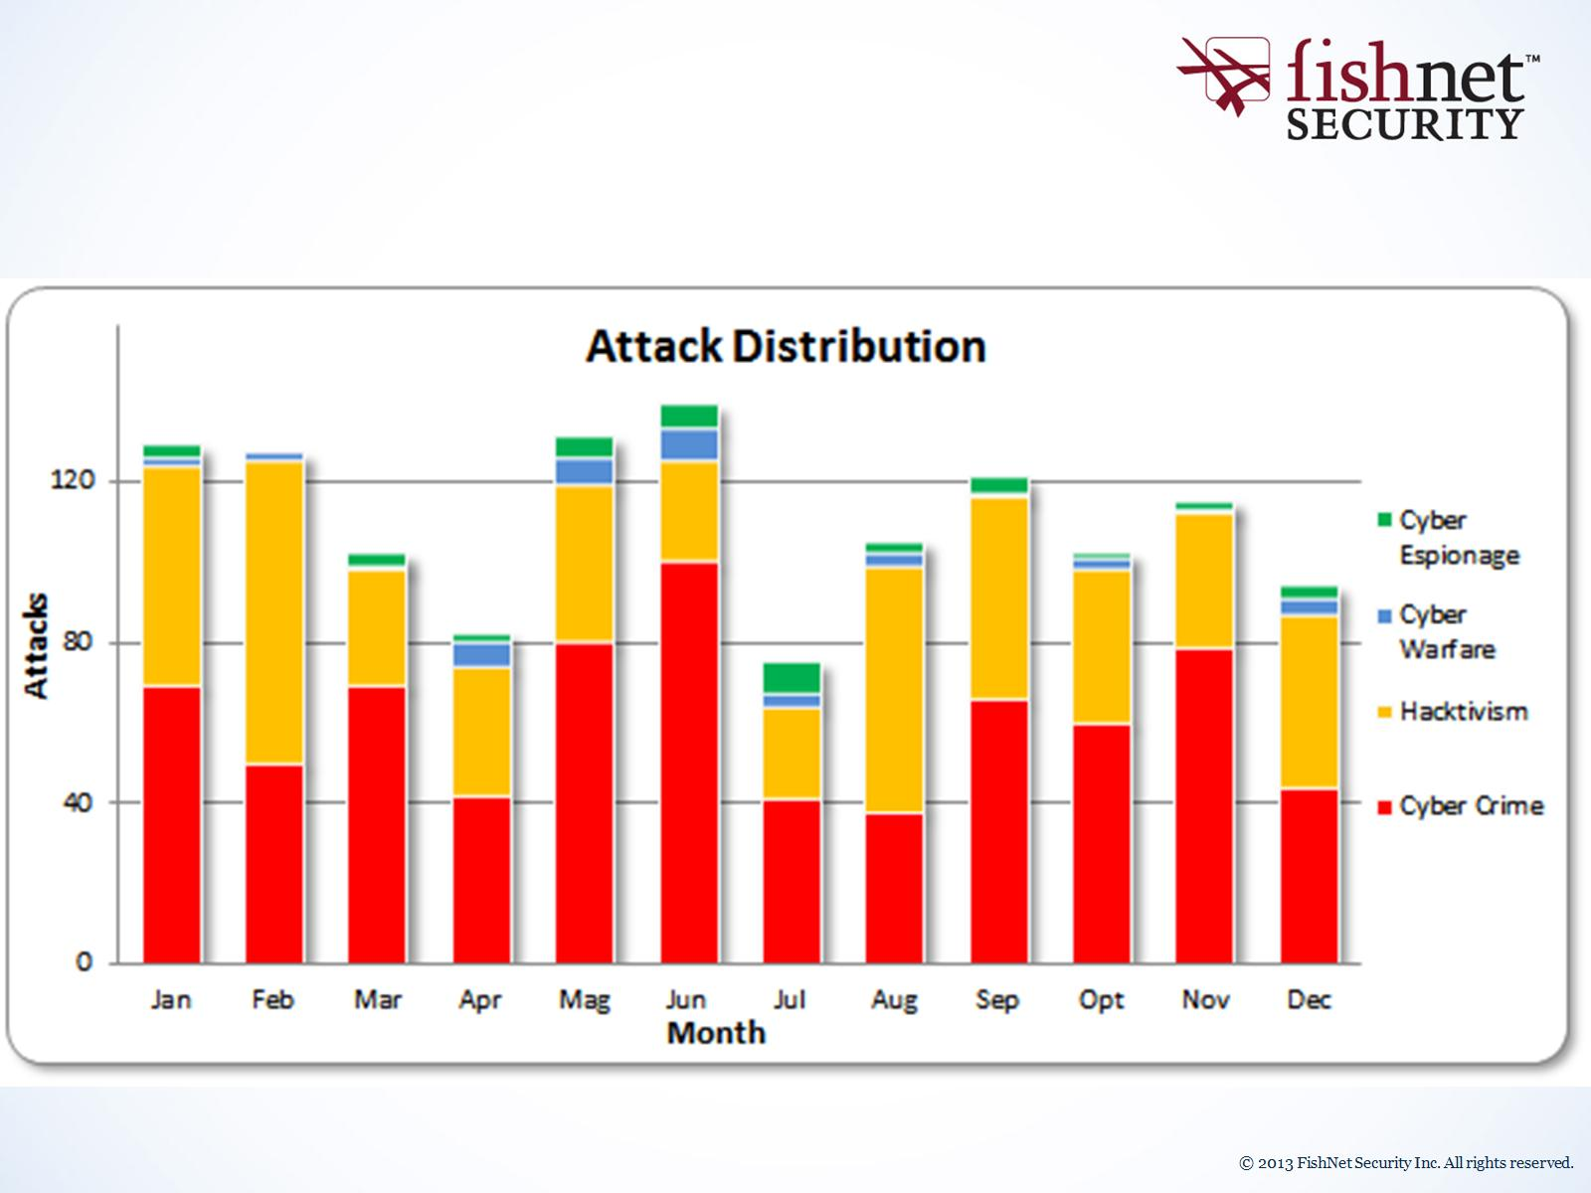

Slide 17
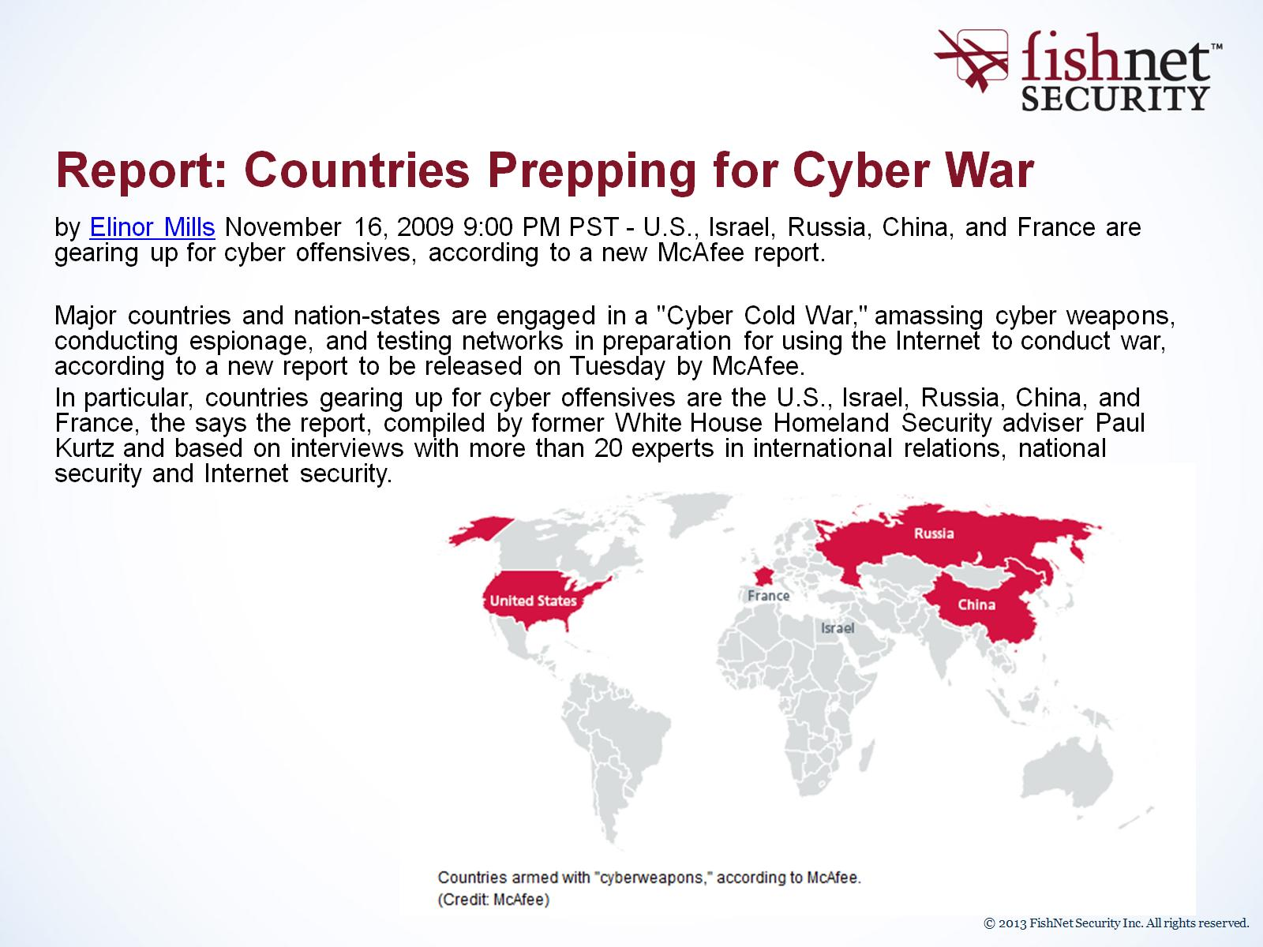
Report: Countries Prepping for Cyber War

Slide 18
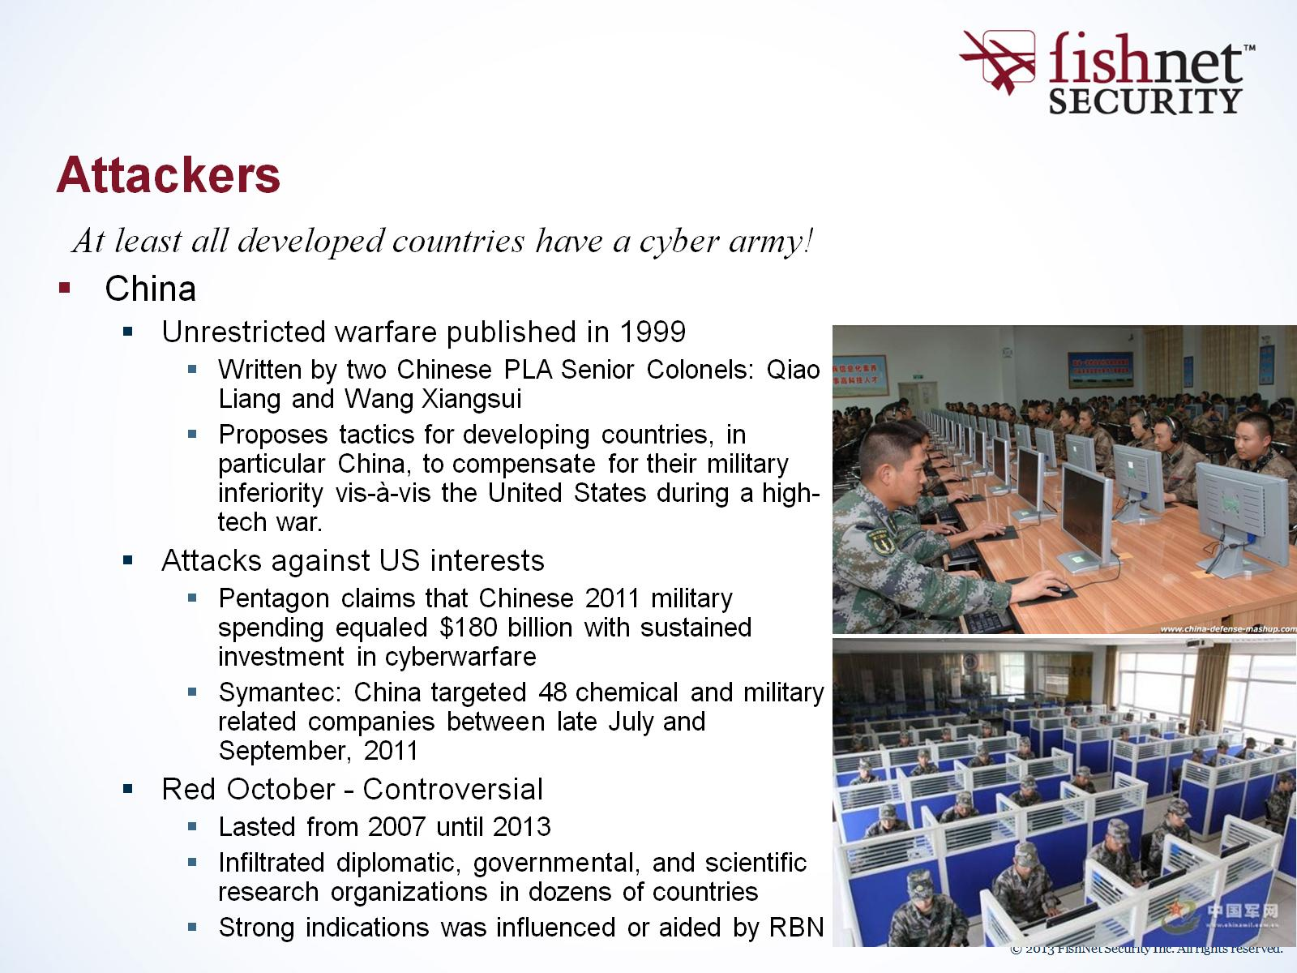
Attackers

Slide 19
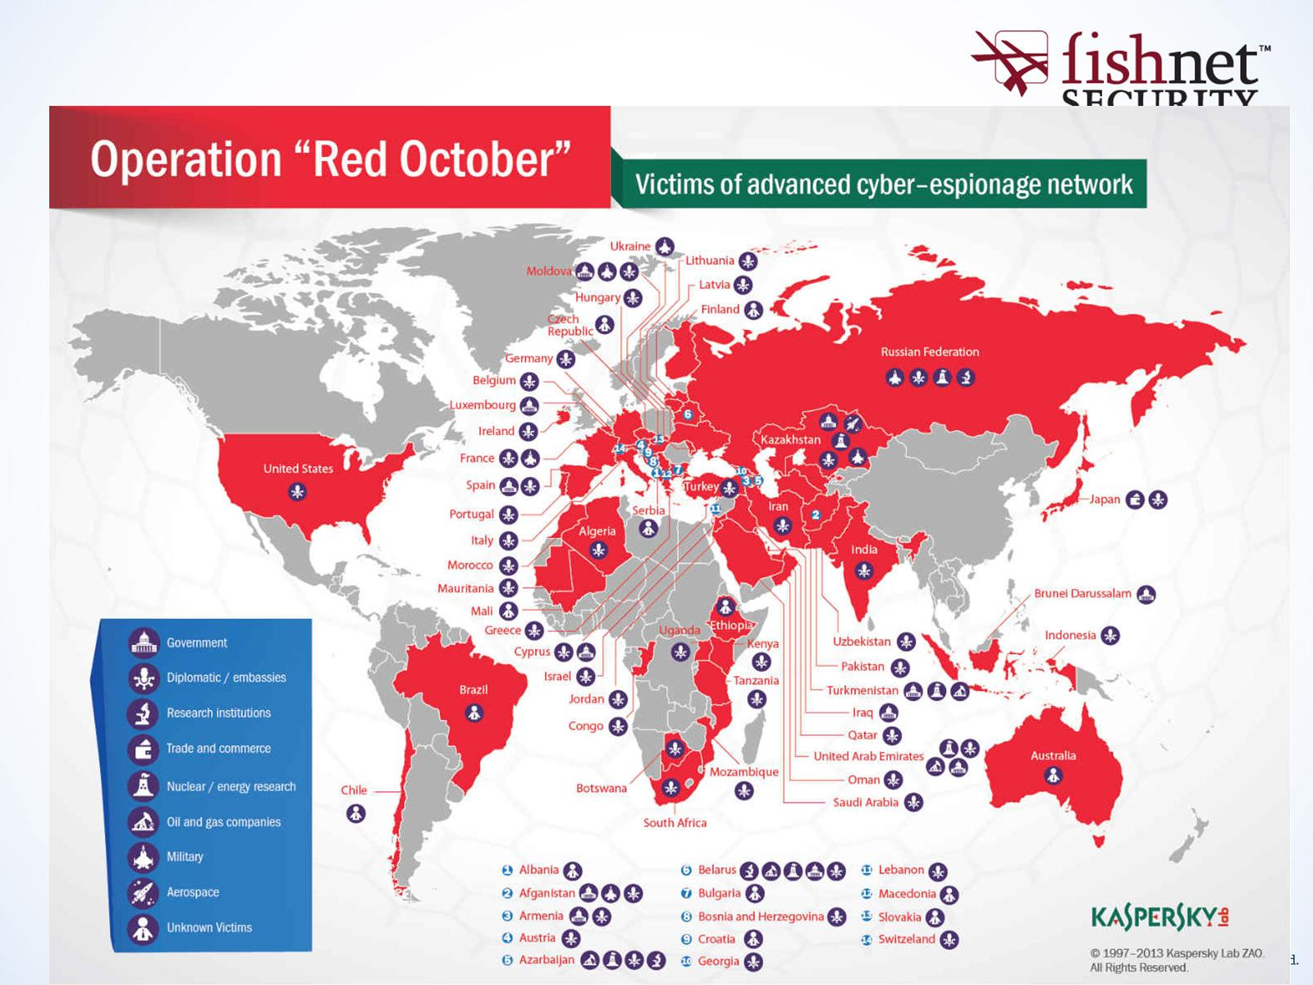
Current Events

Slide 20
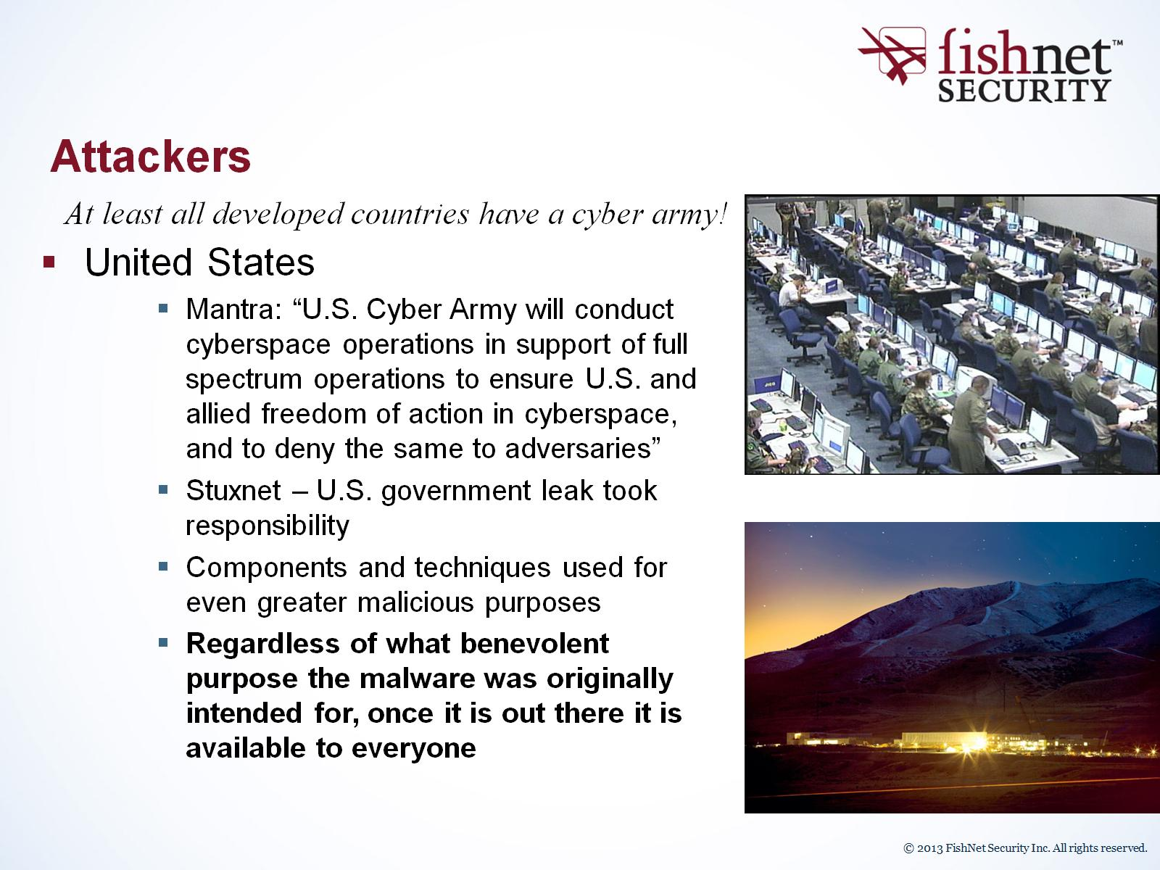
Attackers

Slide 21
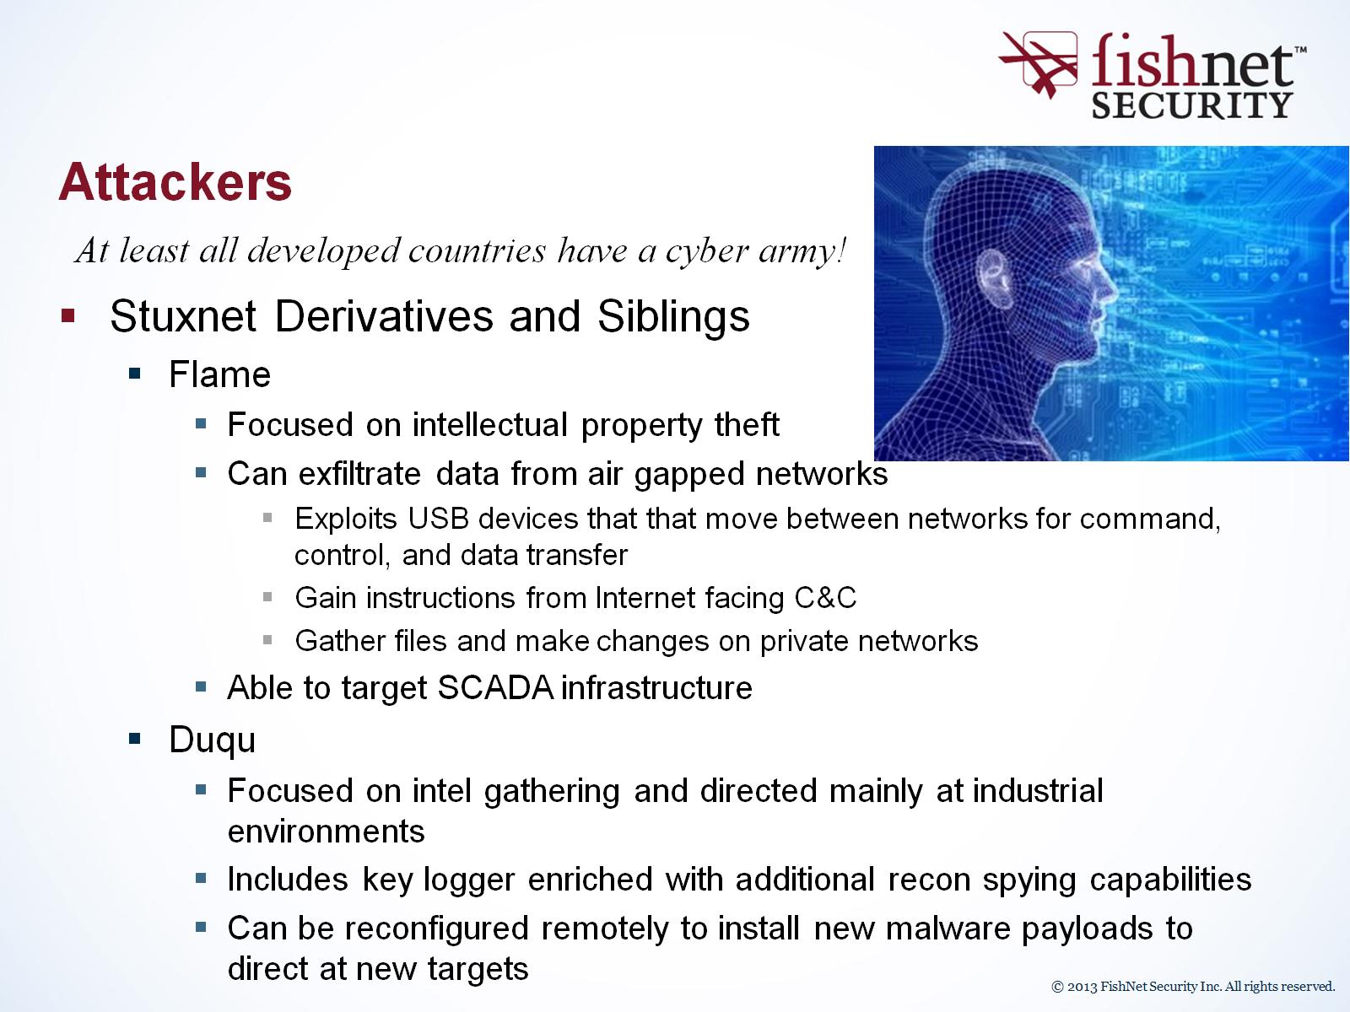
Attackers

Slide 22
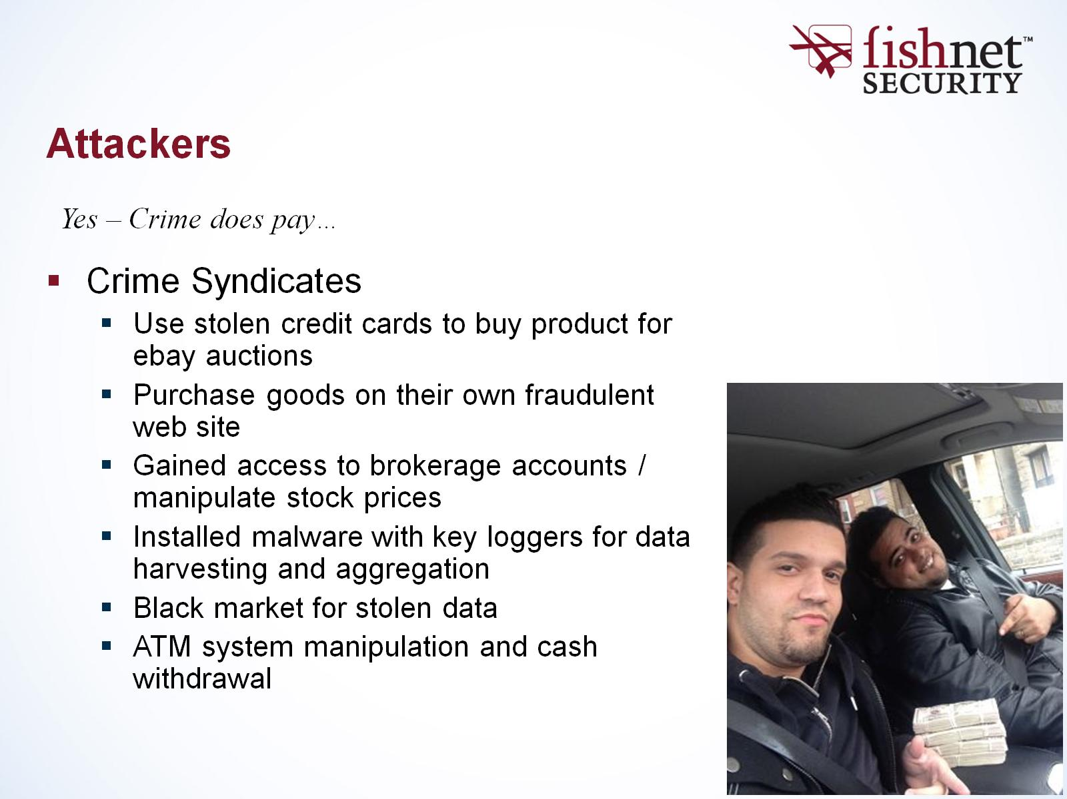
Attackers

Slide 23
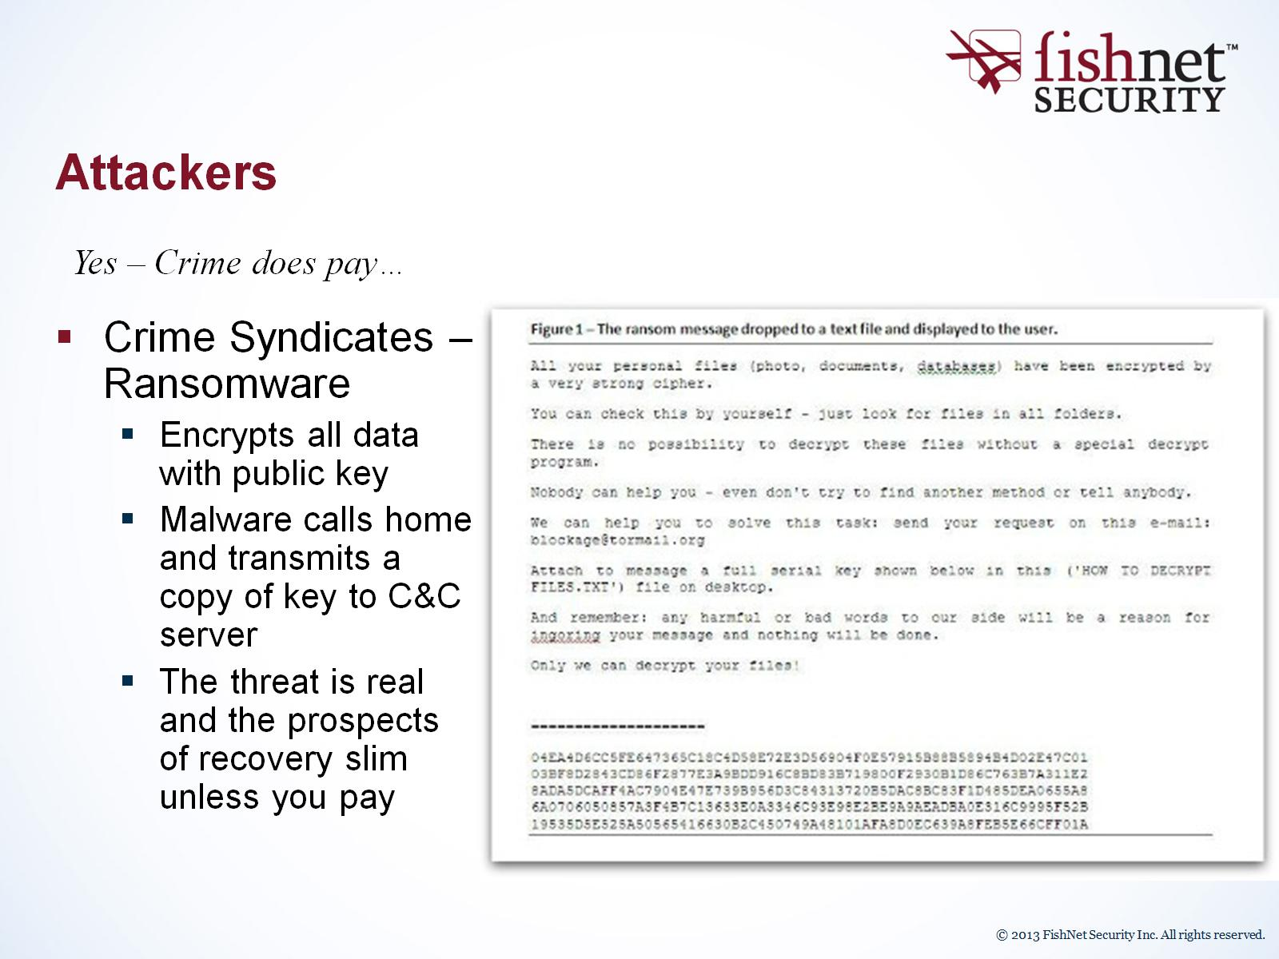
Attackers

Slide 24
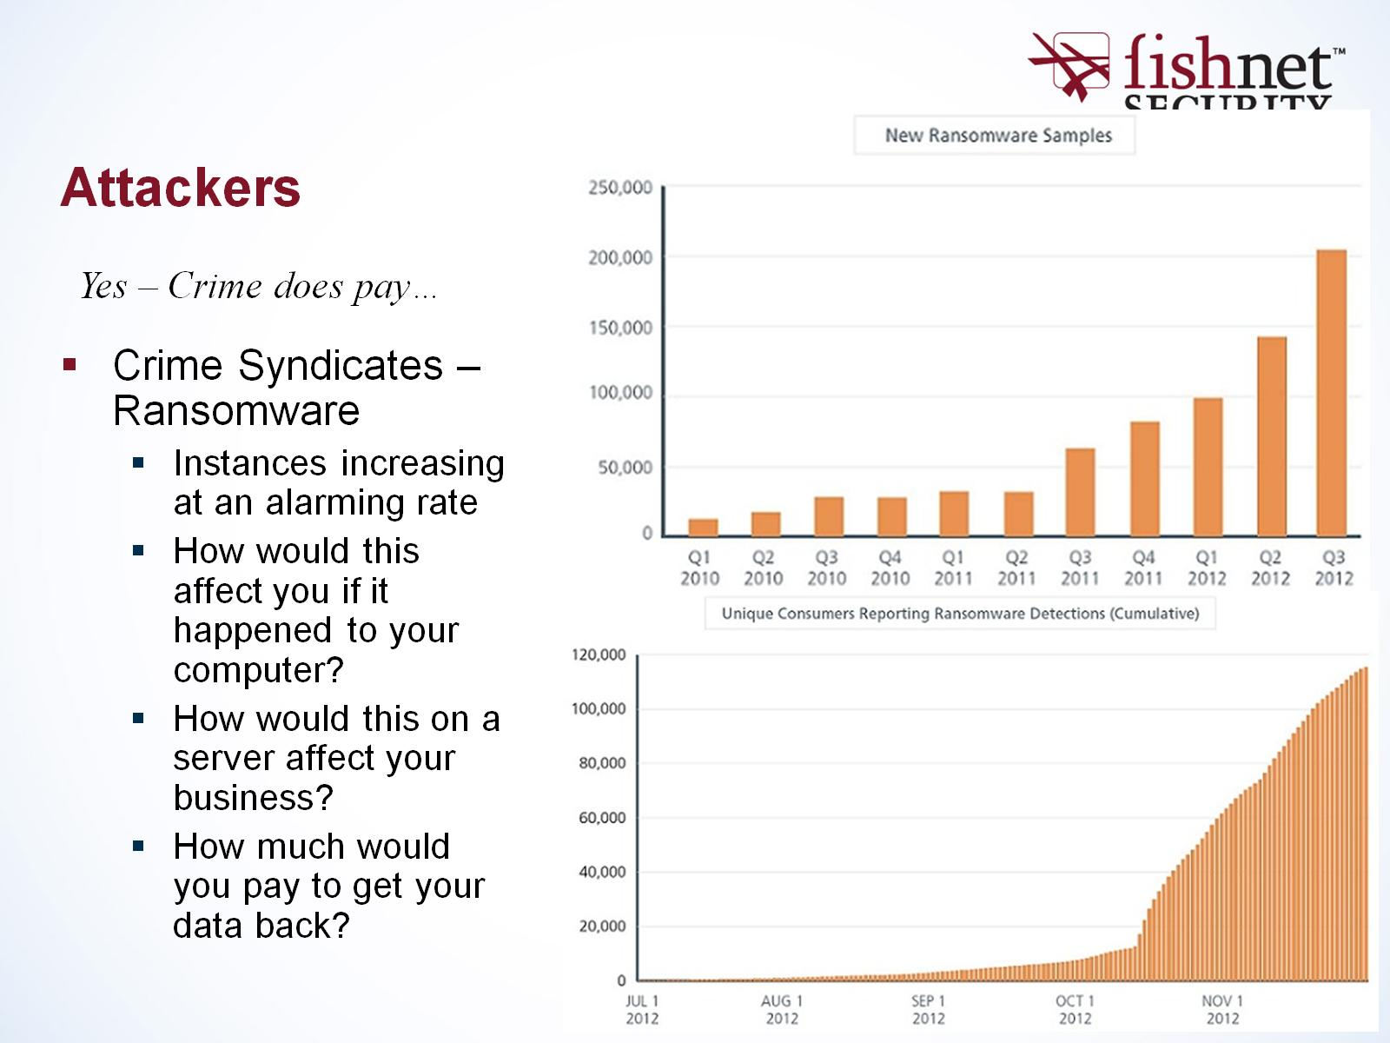
Attackers

Slide 25
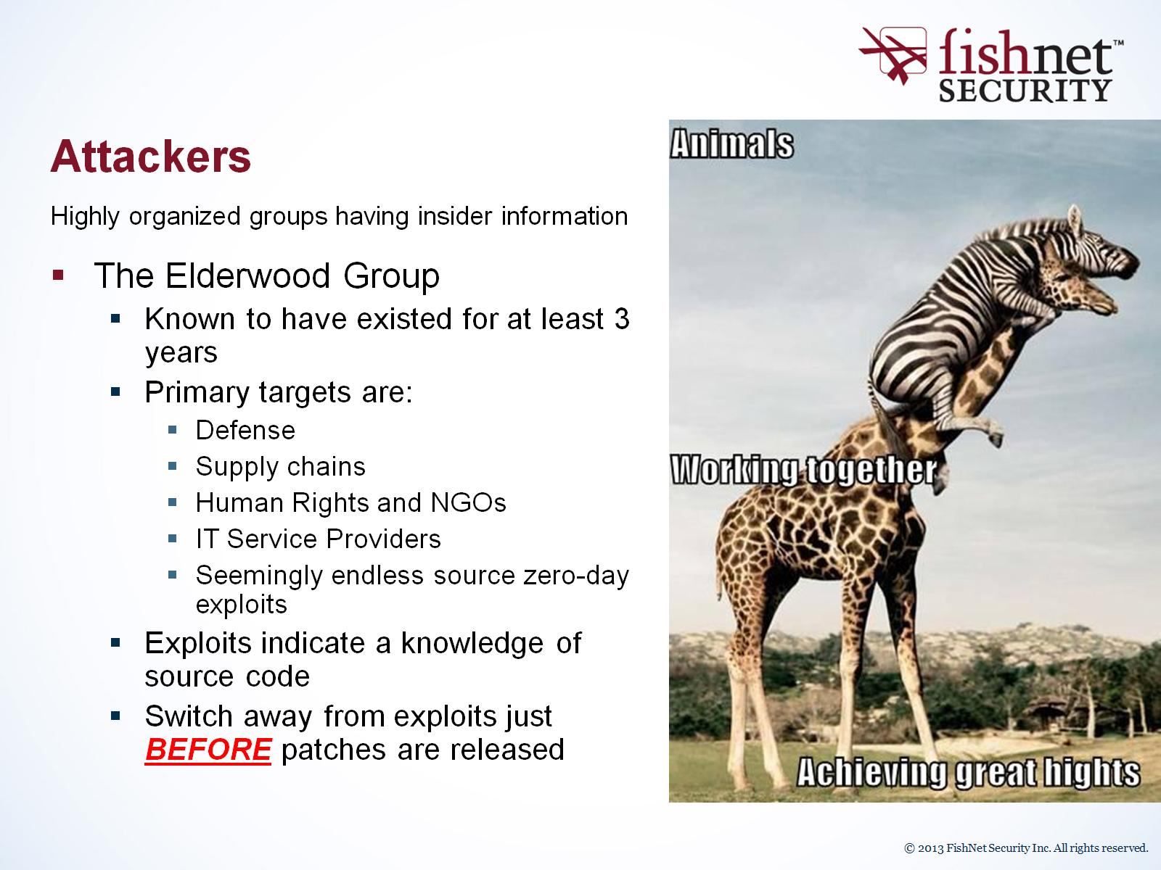
Attackers

Slide 26
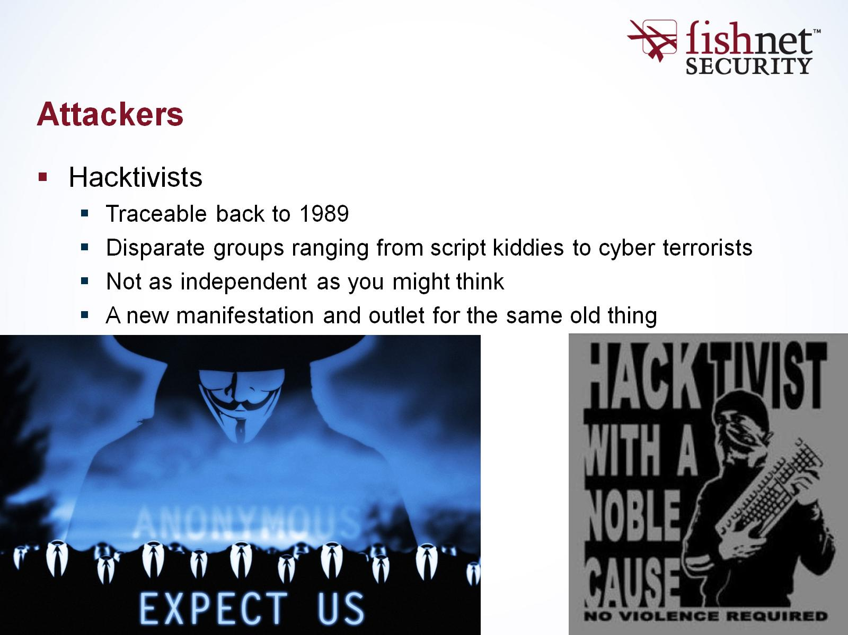
Attackers

Slide 27
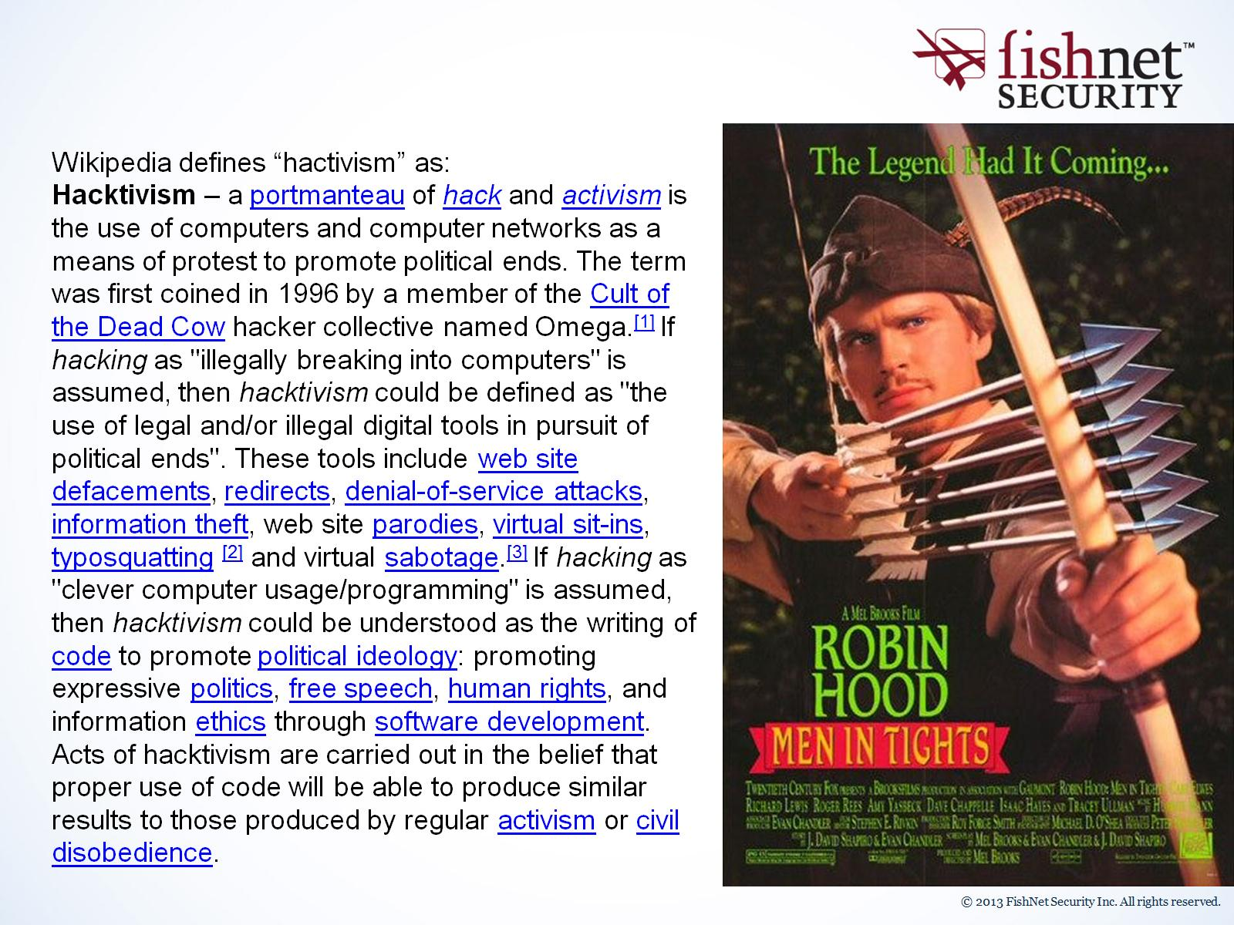

Slide 28
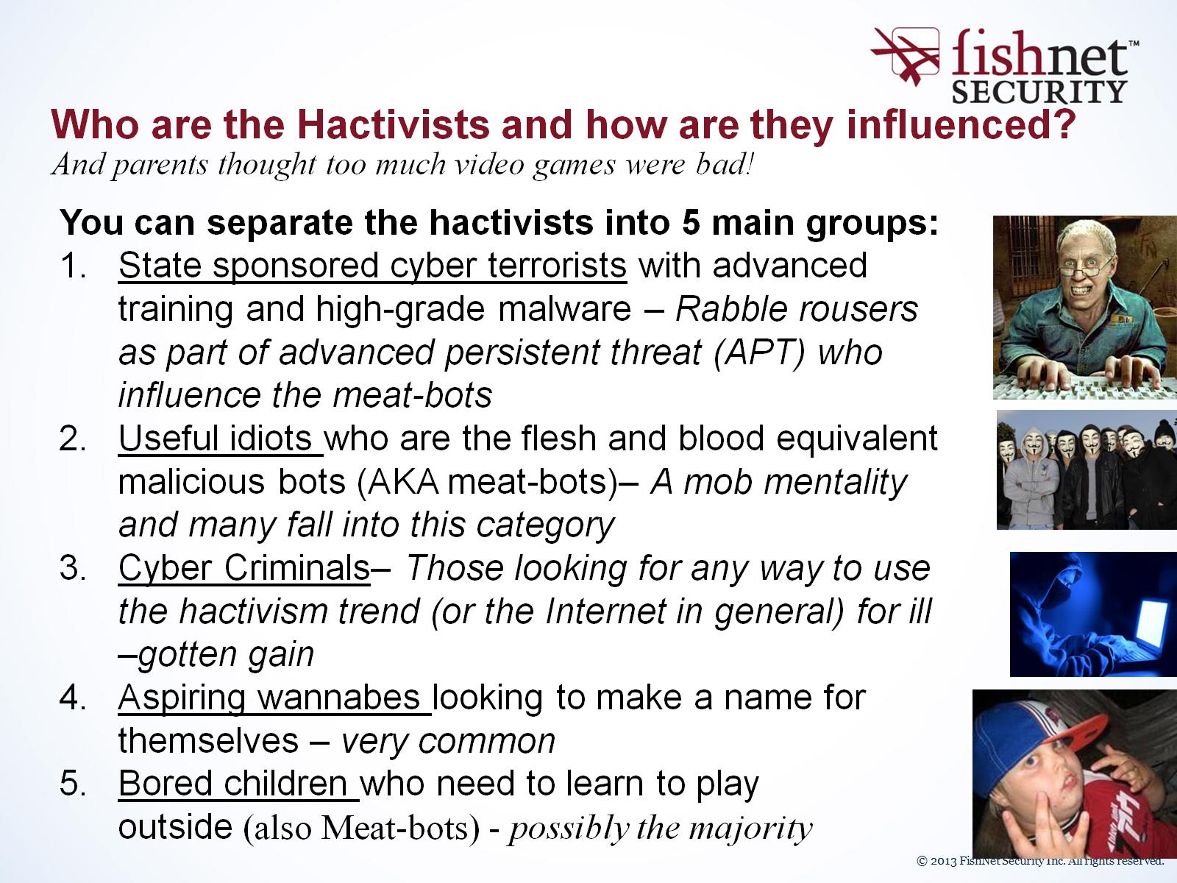
Who are the Hactivists and how are they influenced?

Slide 29
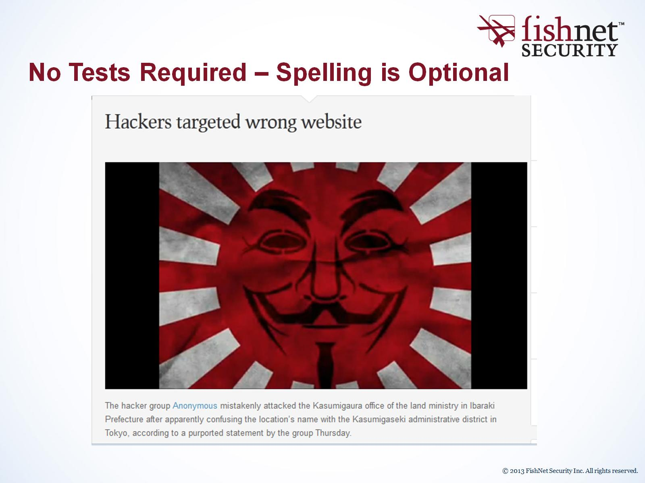
No Tests Required – Spelling is Optional

Slide 30
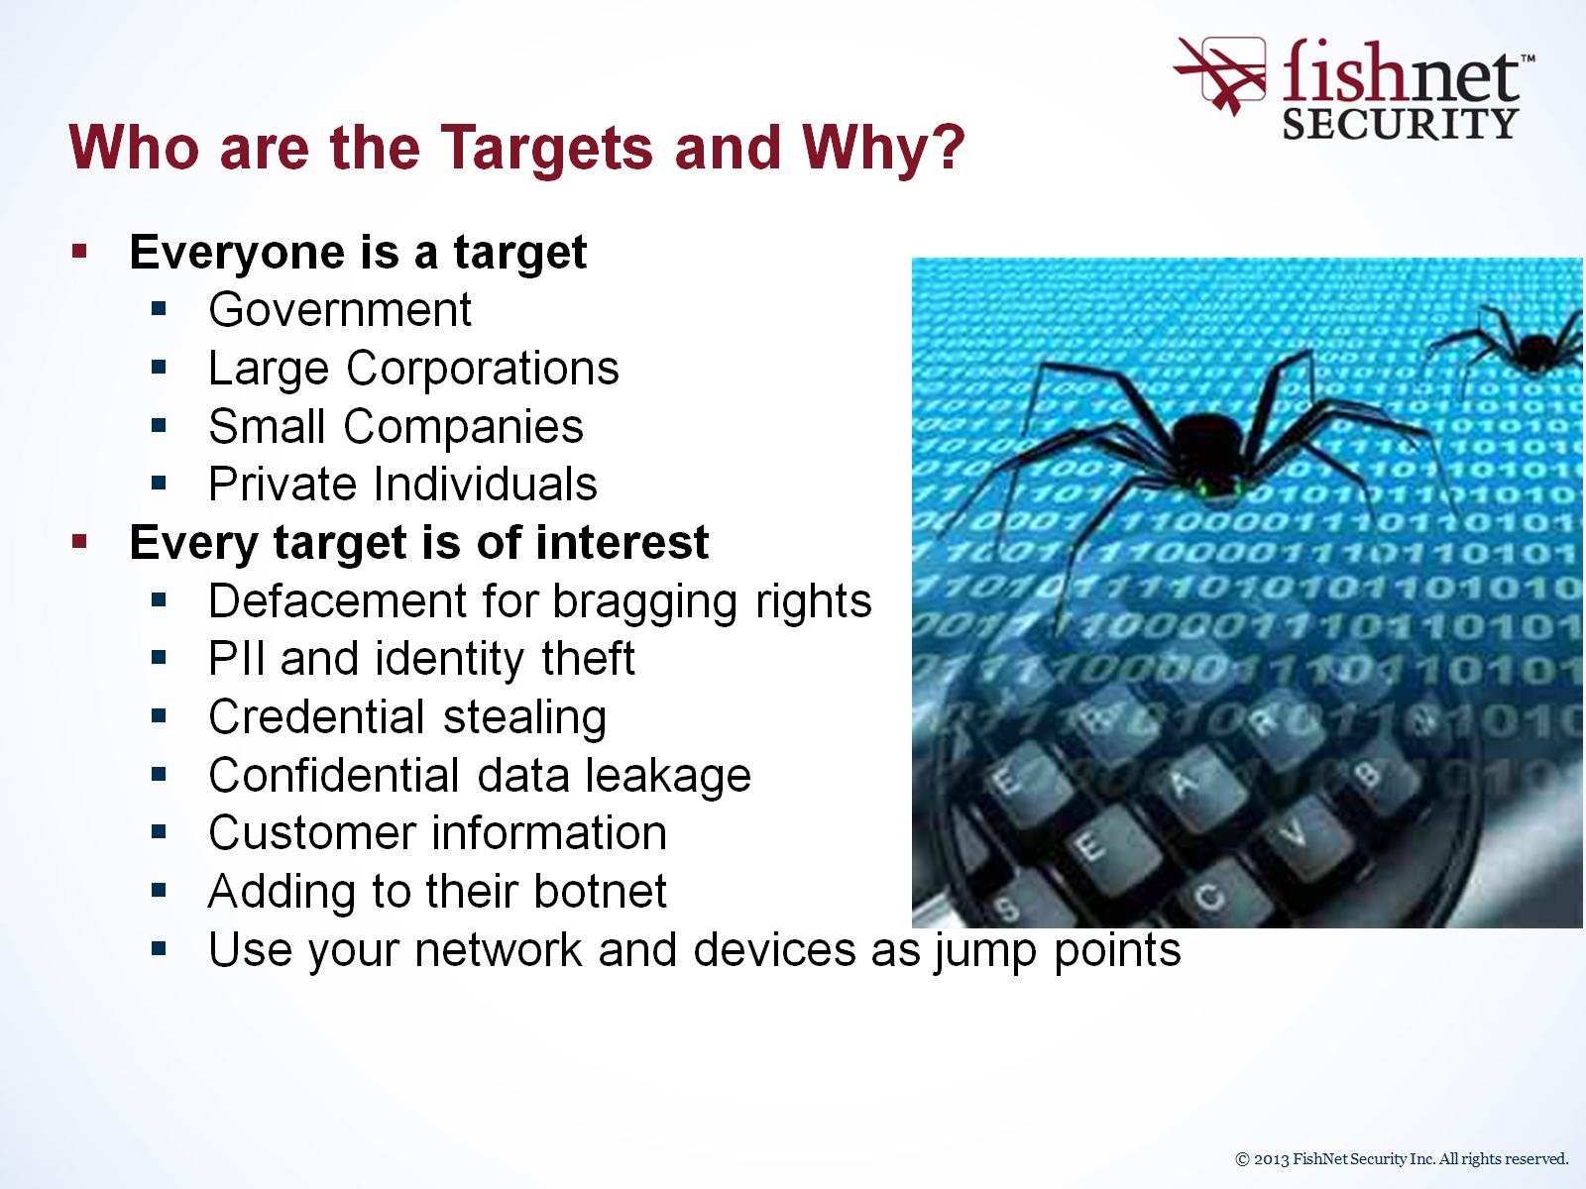
Who are the Targets and Why?

Slide 31
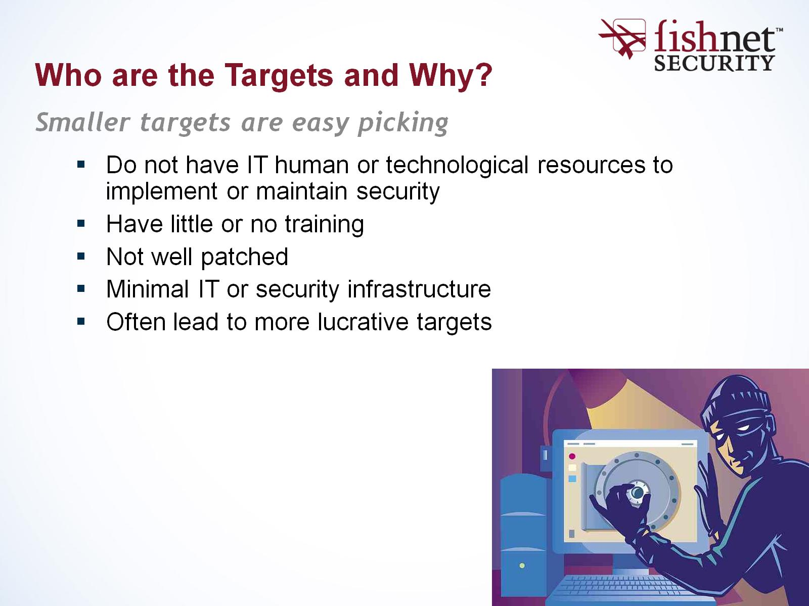
Who are the Targets and Why?

Slide 32
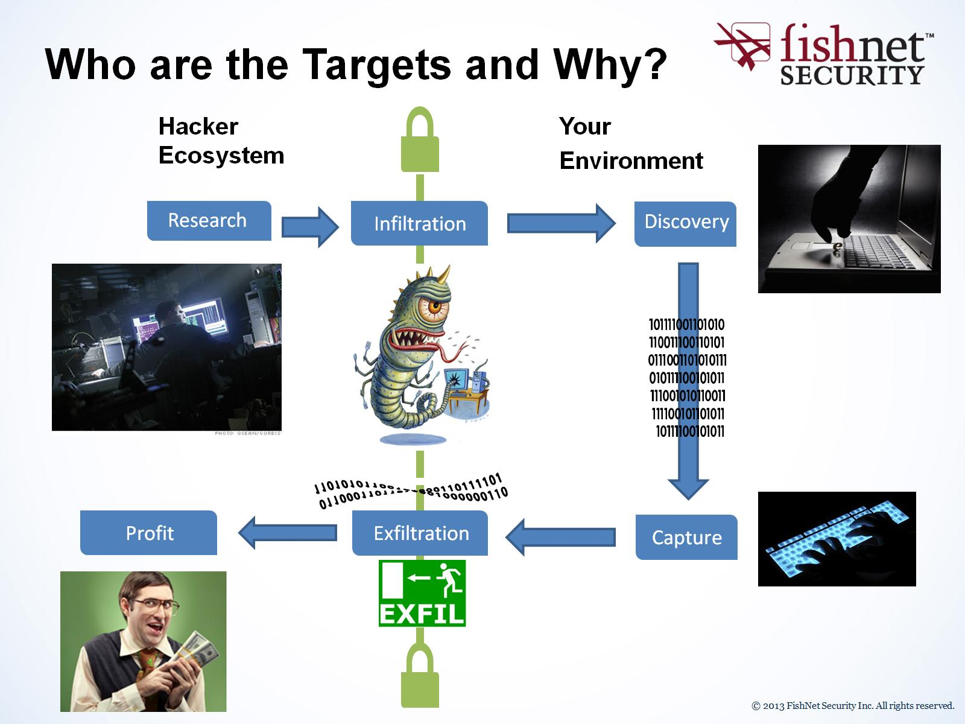
Who are the Targets and Why?

Slide 33
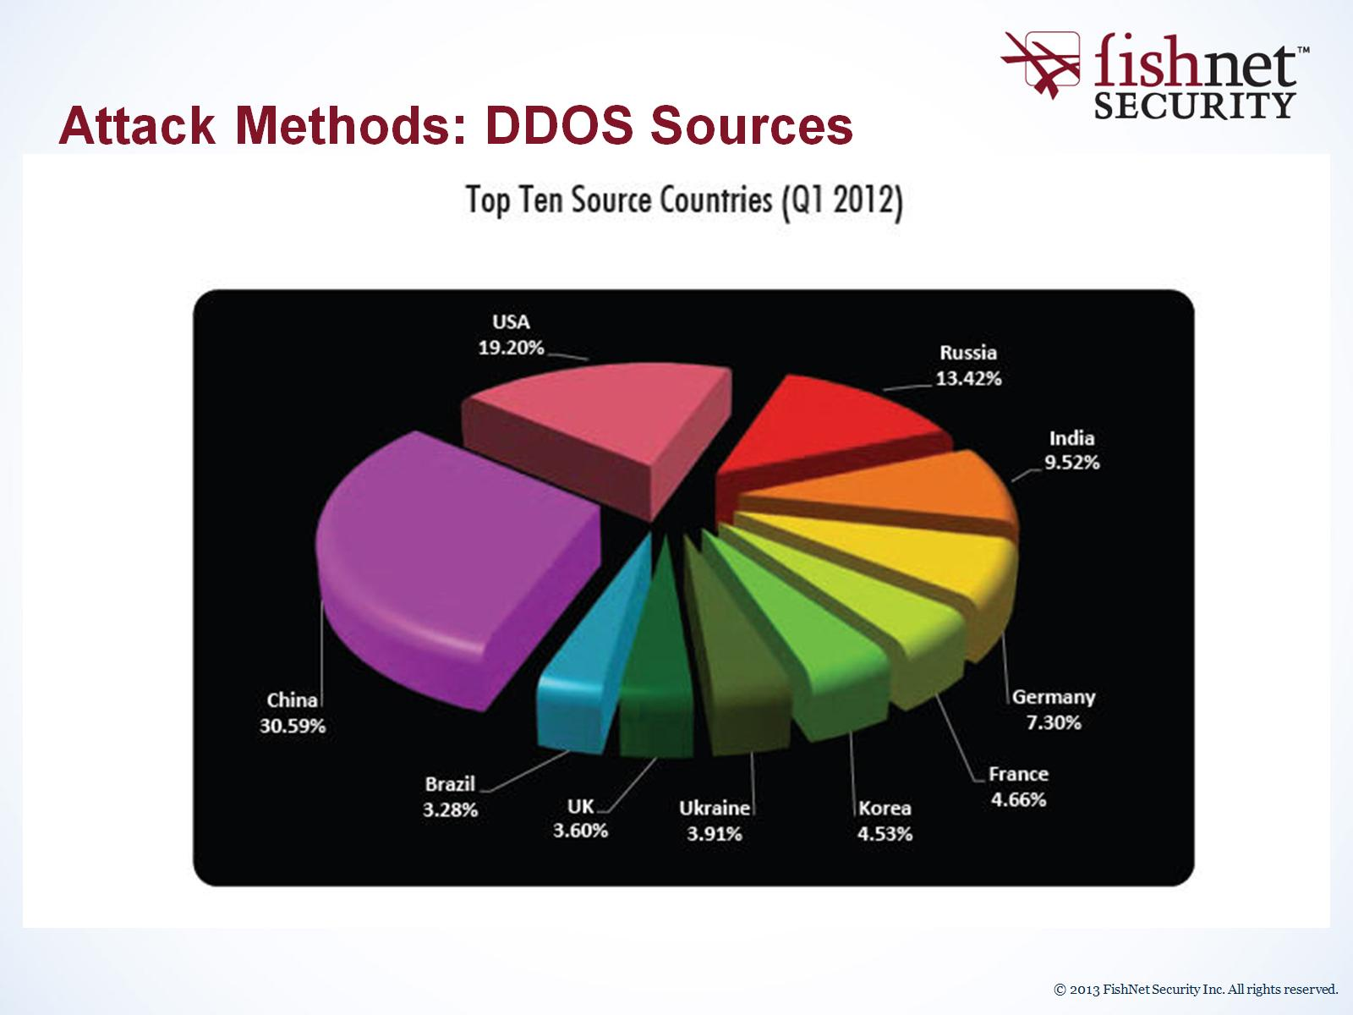
Attack Methods: DDOS Sources

Slide 34
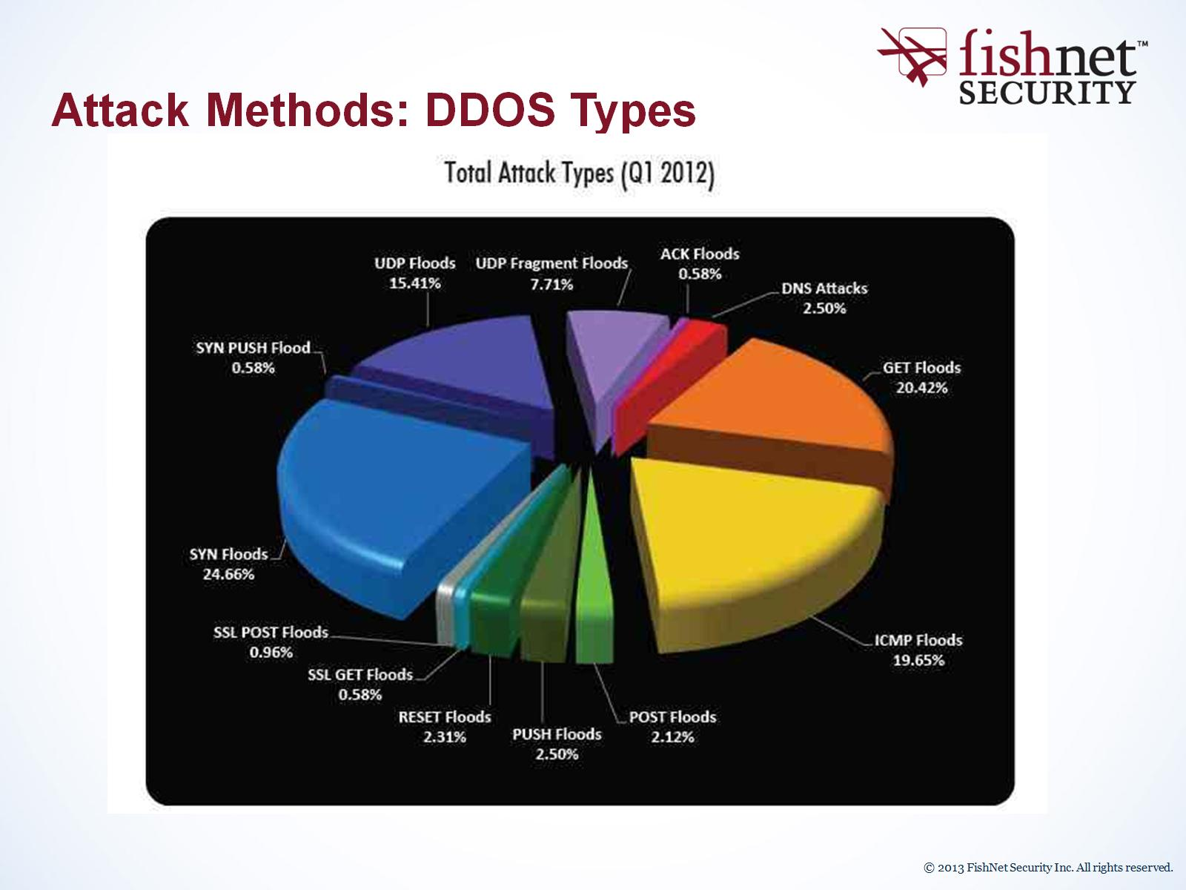
Attack Methods: DDOS Types

Slide 35
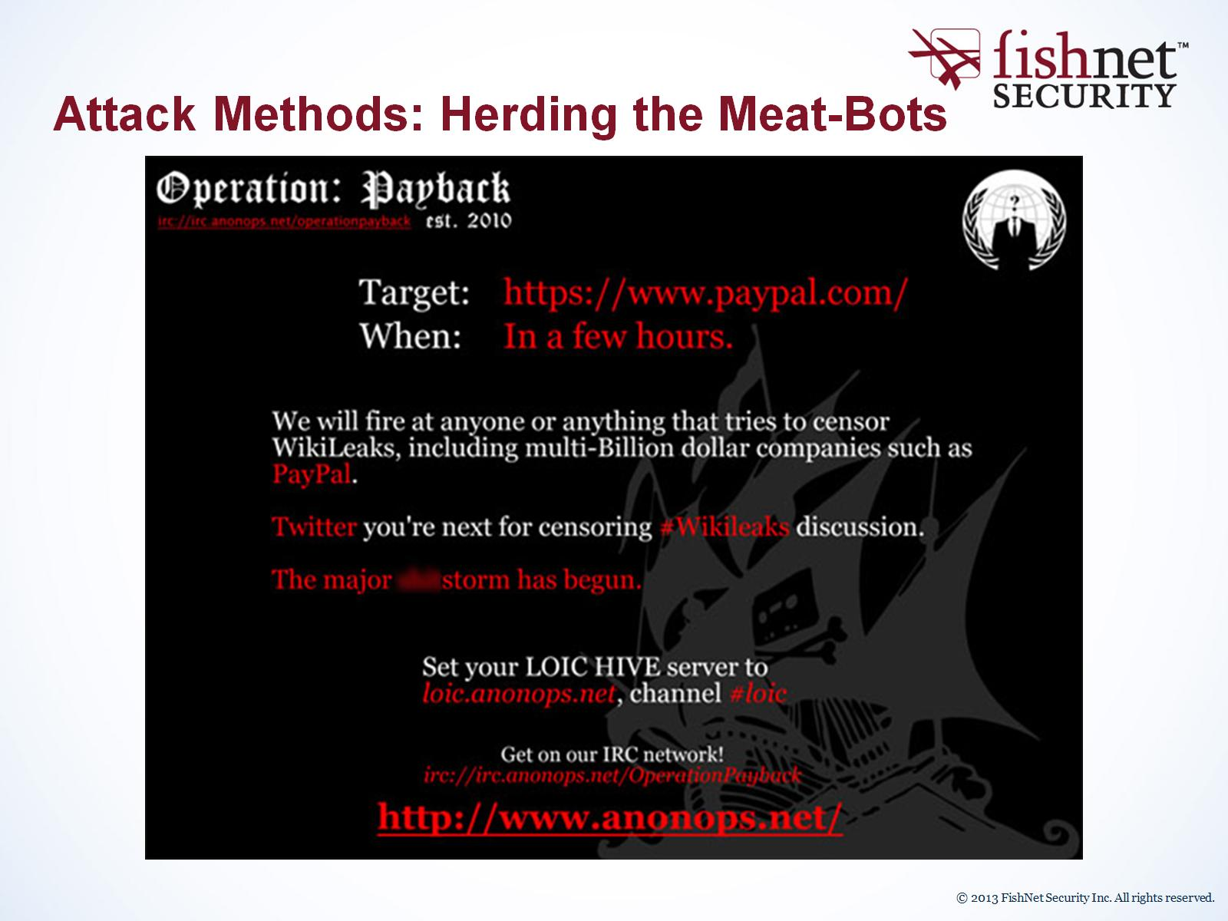
Attack Methods: Herding the Meat-Bots

Slide 36
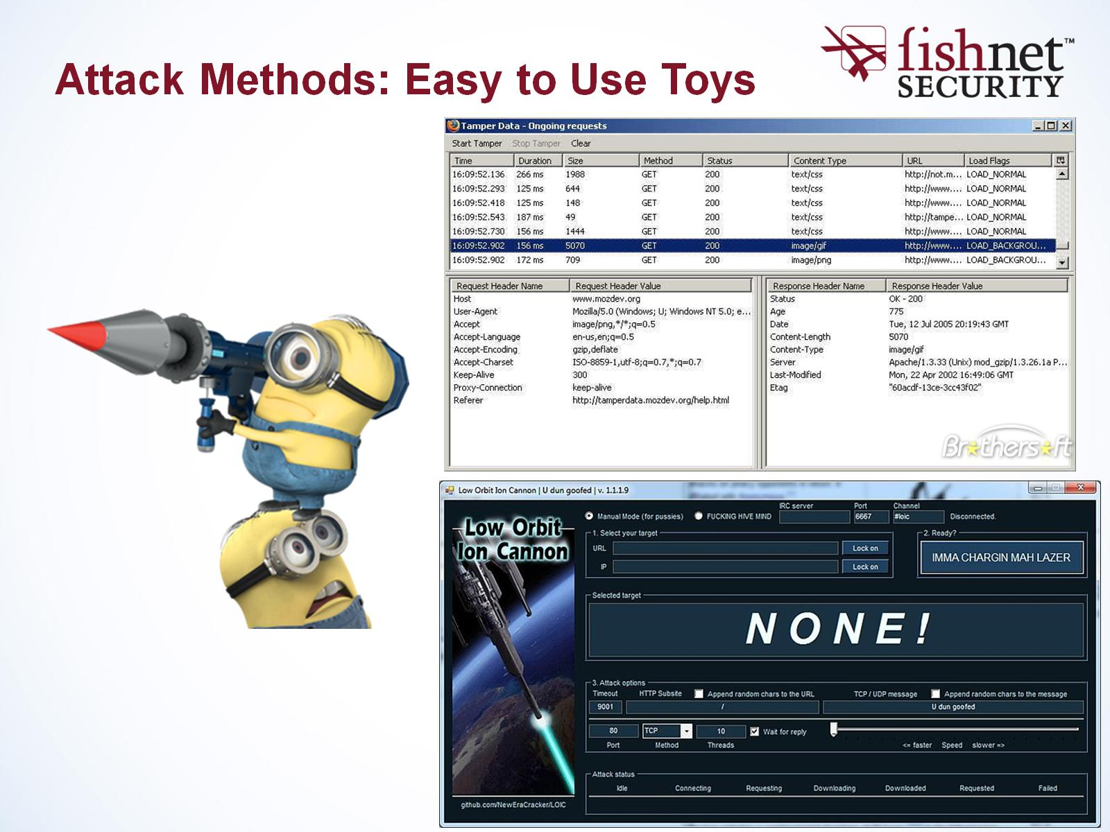
Attack Methods: Easy to Use Toys

Slide 37
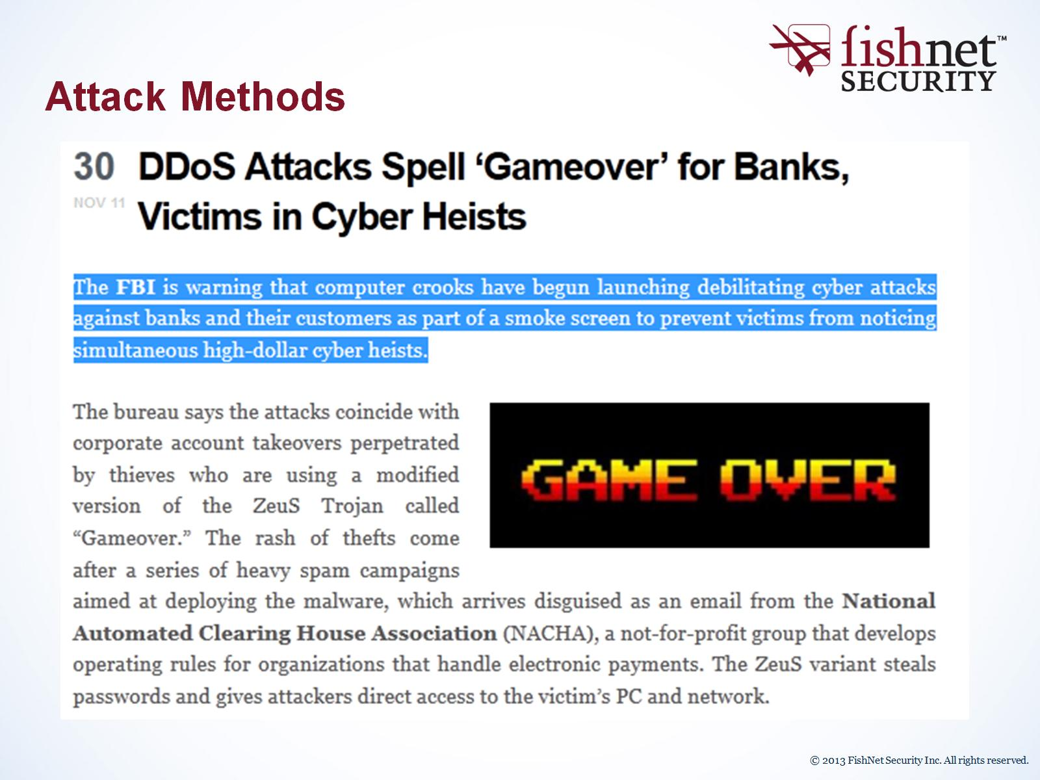
Attack Methods

Slide 38
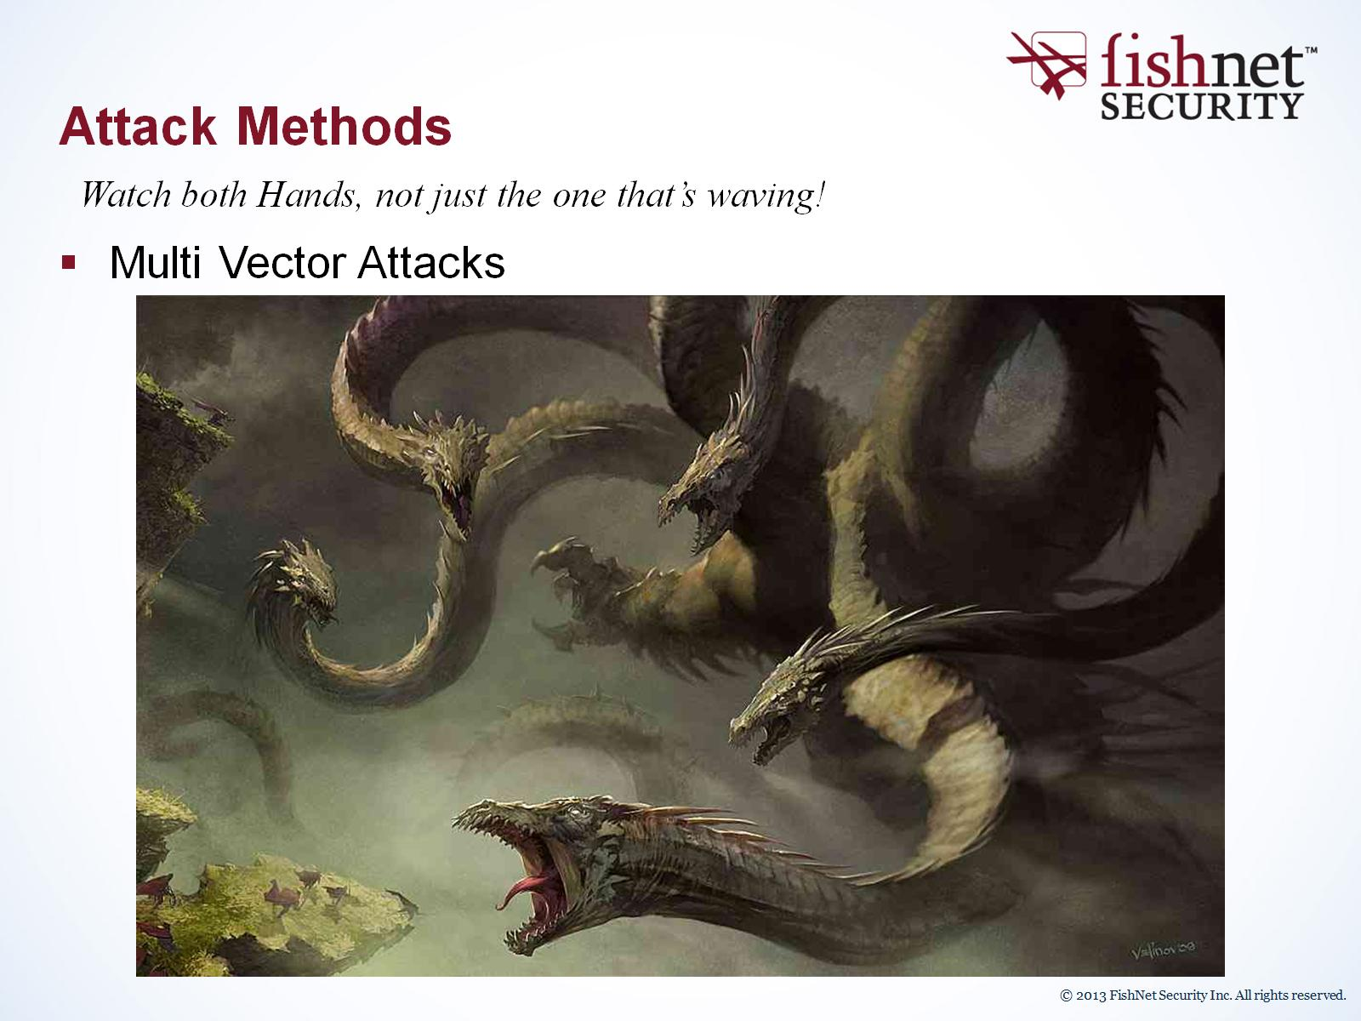
Attack Methods

Slide 39
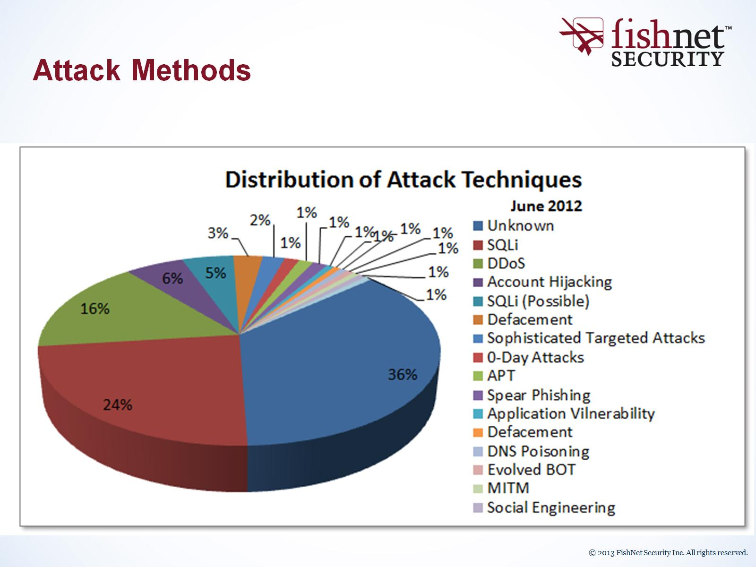
Attack Methods

Slide 40
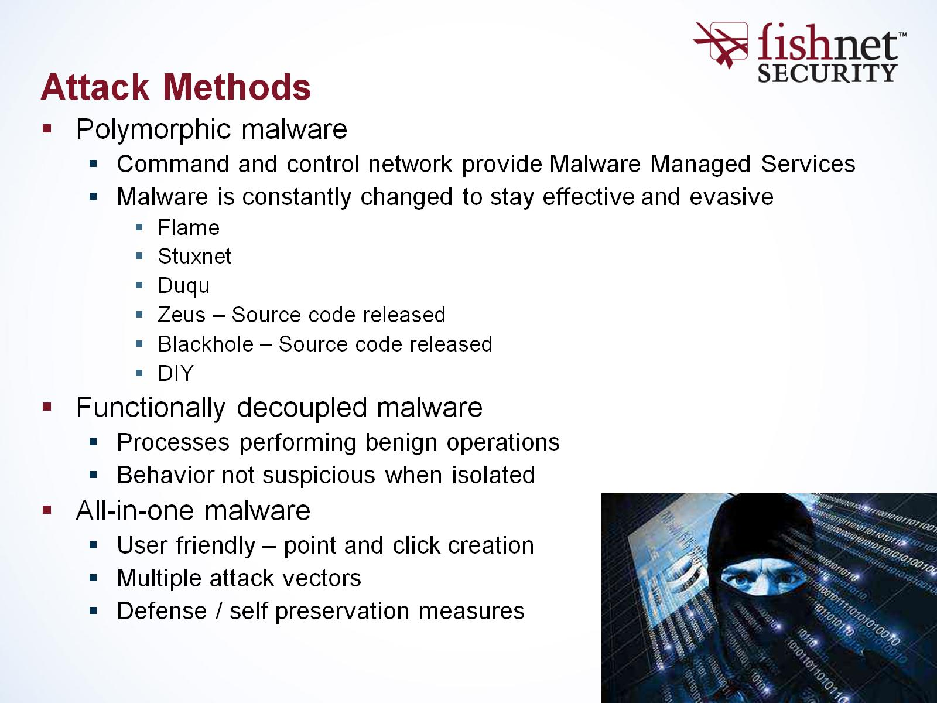
Attack Methods

Slide 41
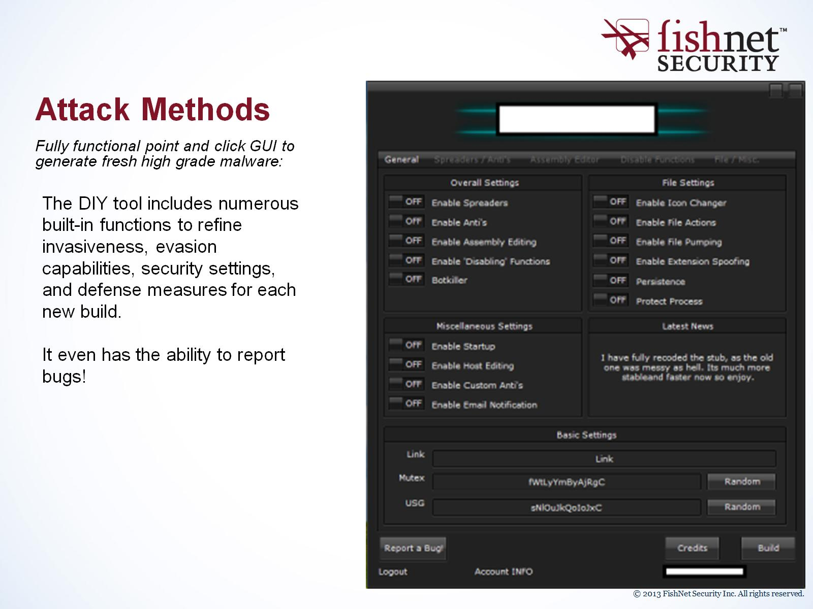
Attack Methods

Slide 42
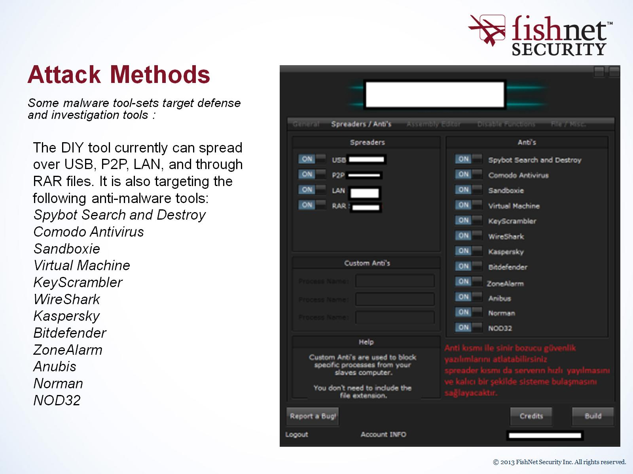
Attack Methods

Slide 43
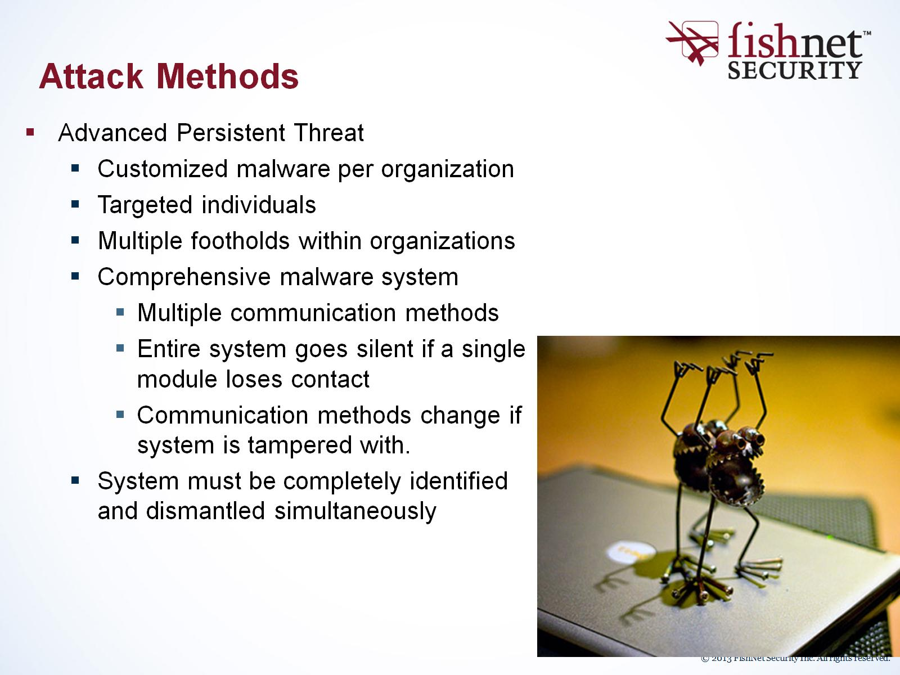
Attack Methods

Slide 44
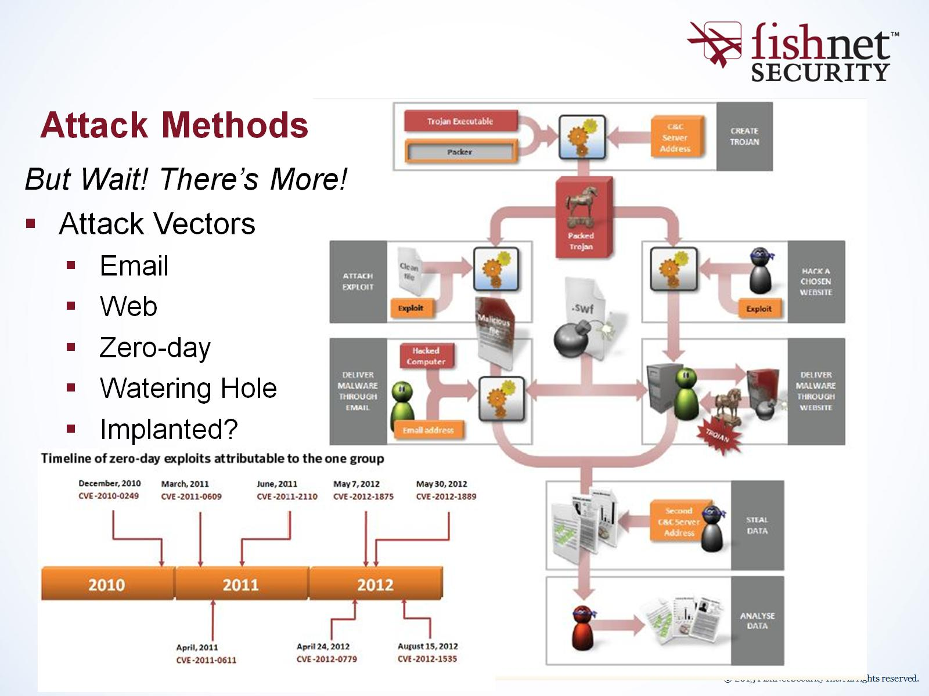
Attack Methods

Slide 45
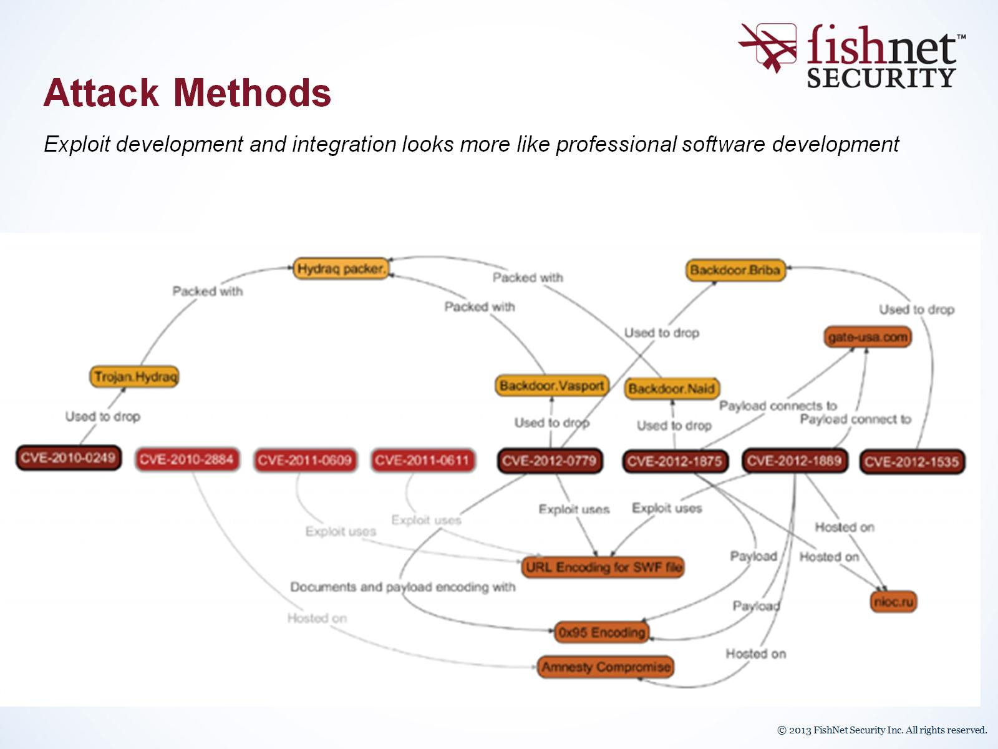
Attack Methods

Slide 46

Attack Methods

Slide 47
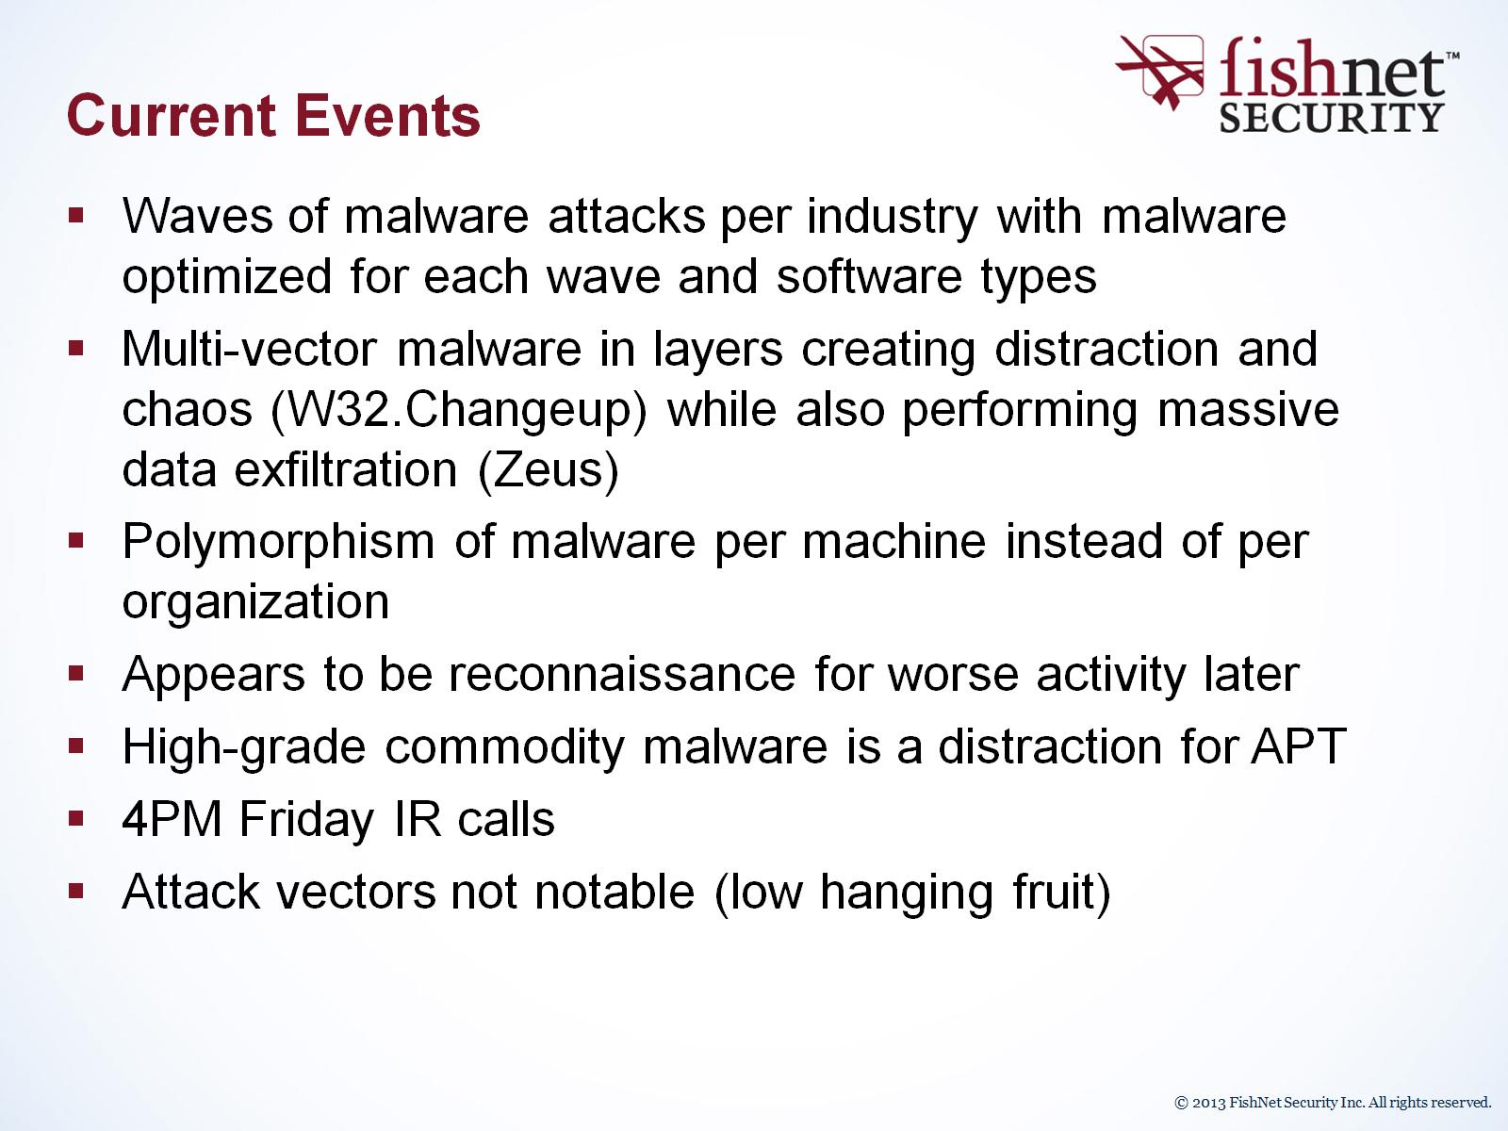
Current Events

Slide 48
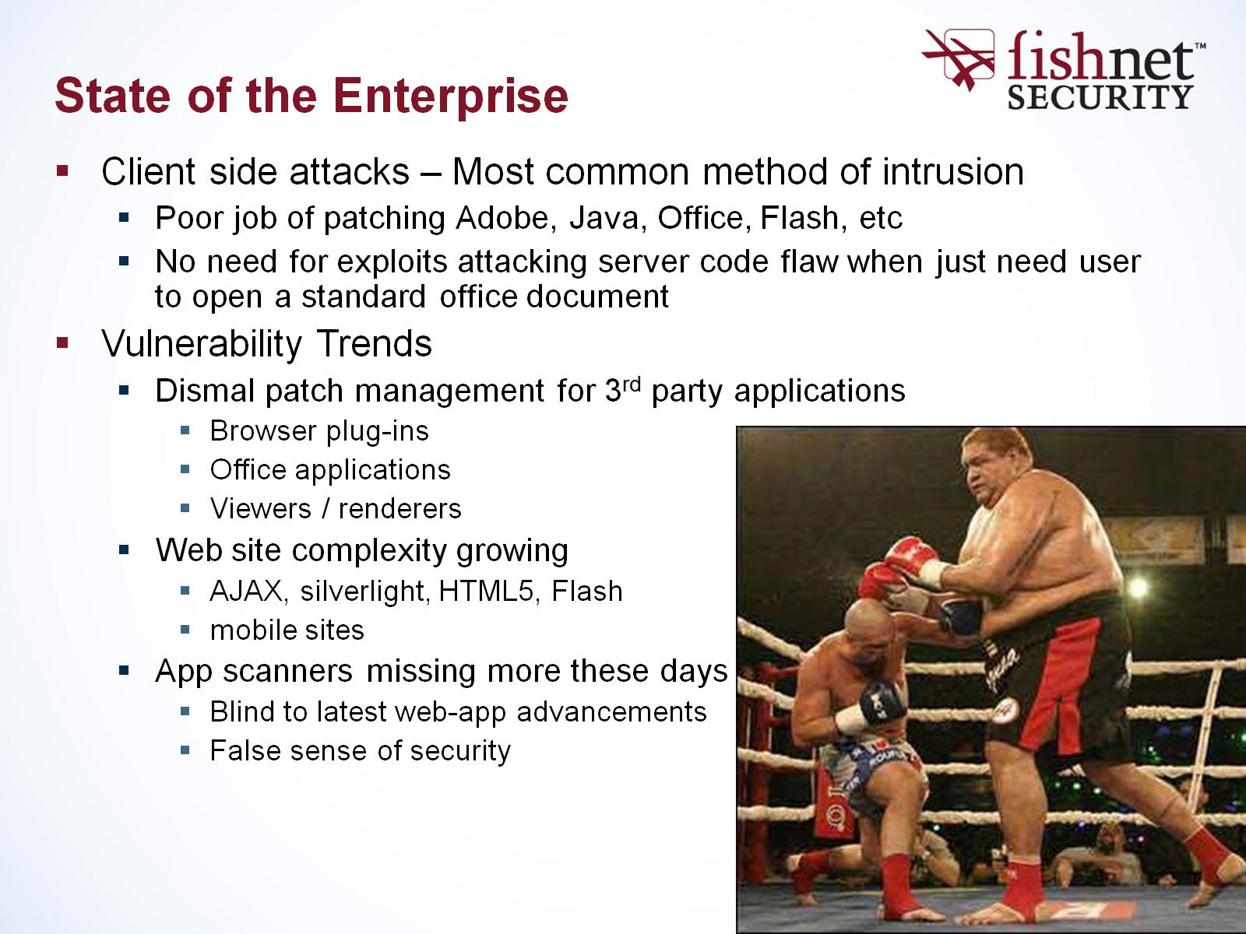
State of the Enterprise

Slide 49
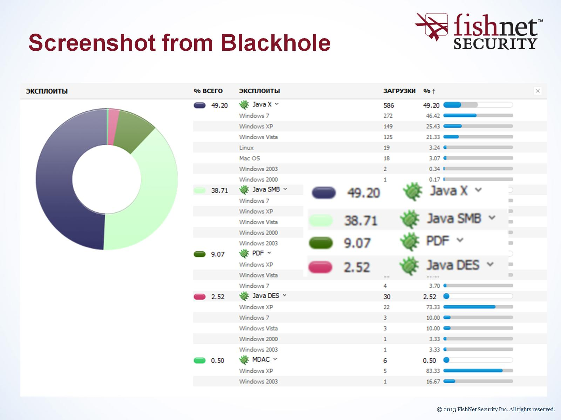

Slide 50
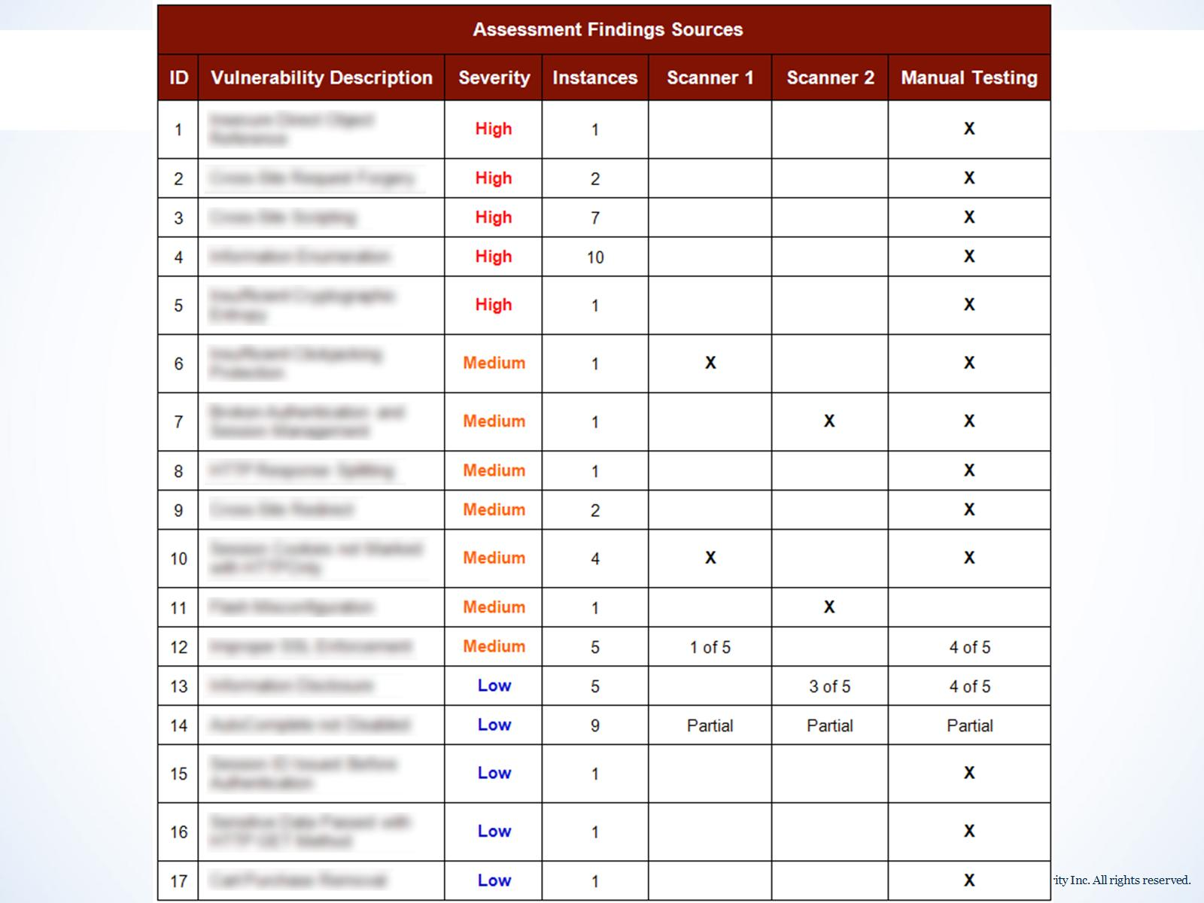

Slide 51
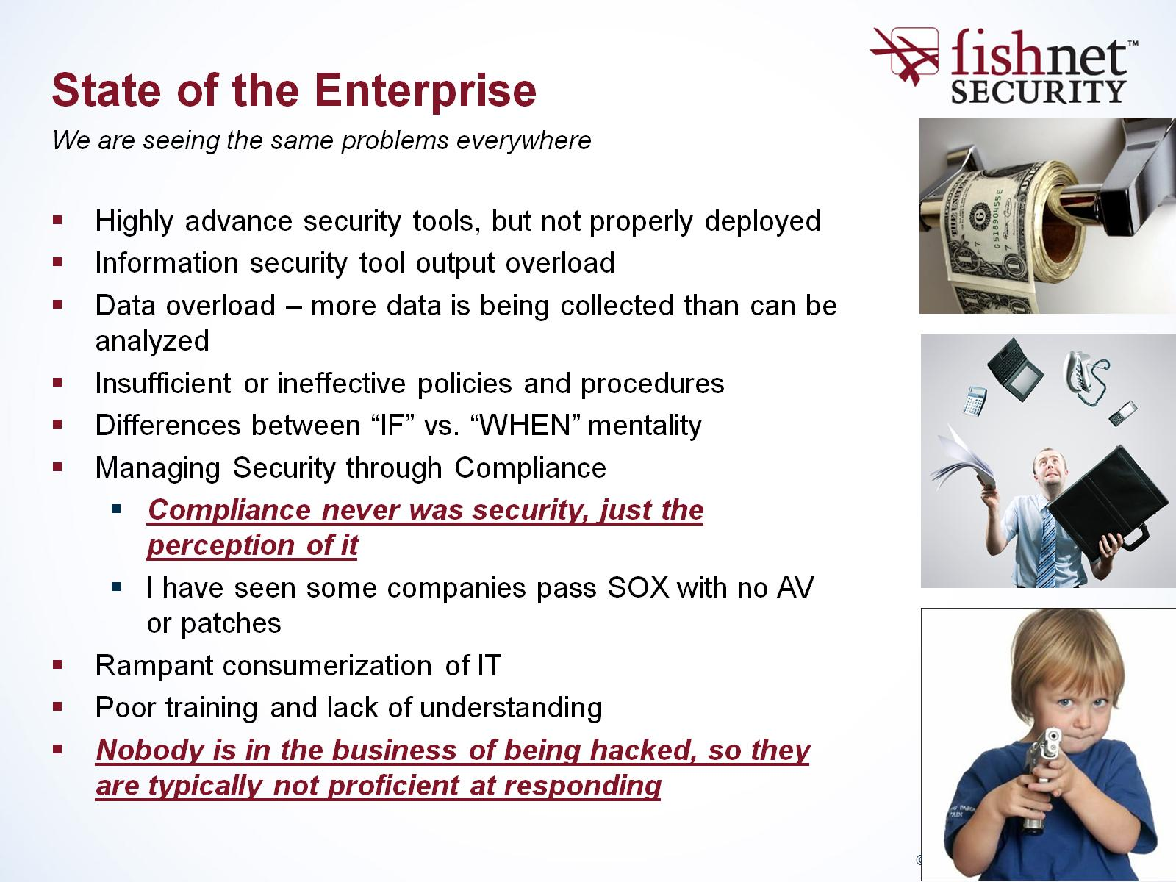
State of the Enterprise

Slide 52
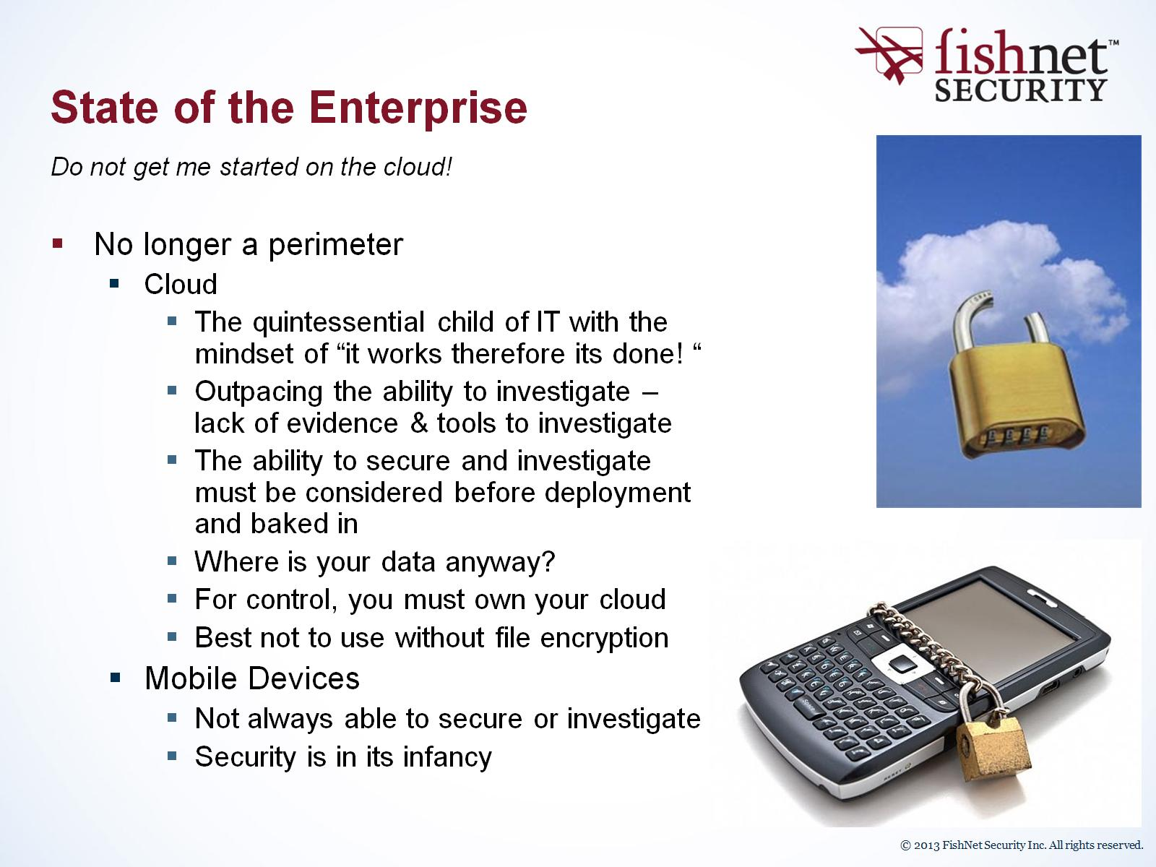
State of the Enterprise

Slide 53

State of the Enterprise

Slide 54

Future National Defense

Slide 55

Recommendations

Slide 56

FNS Incident Management Framework

Slide 57

Recommendations

Slide 58

Recommendations

Slide 59


