Slide 1
BYOD: Risks, Maturity, and Solutions
Adam Ely
adam@bluebox.com
www.bluebox.com
@BLUEBOXSEC

Slide 2
About Me + Shameless Plug
Co-founder & COO Bluebox Security
CISO Heroku at salesforce
Tivo, Walt Disney….
We’re hiring:
Product Manager
Front end/Rails
rockstars@bluebox.com

Slide 3
BYOD Empowers Employees
Consumer software > enterprise software
Easy access, Easy workflow
Increased productivity
“
benefits include enhanced collaboration
- PWC

Slide 4
BYOD empowers employees but SCARES security teams
How much of a security threat Does I.T. think mobile poses?

Slide 5
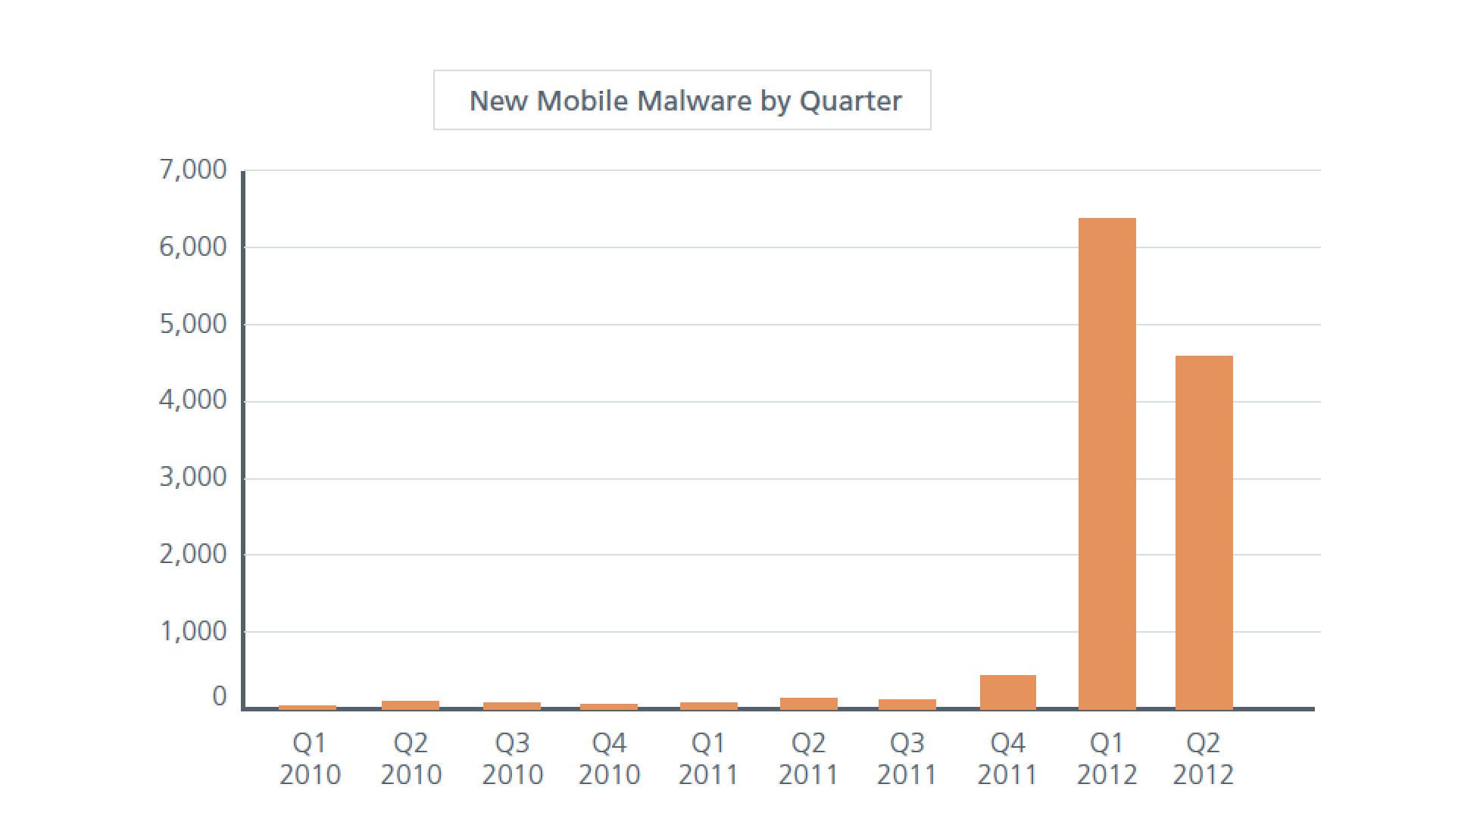
Why is BYOD RISKY?

Slide 6
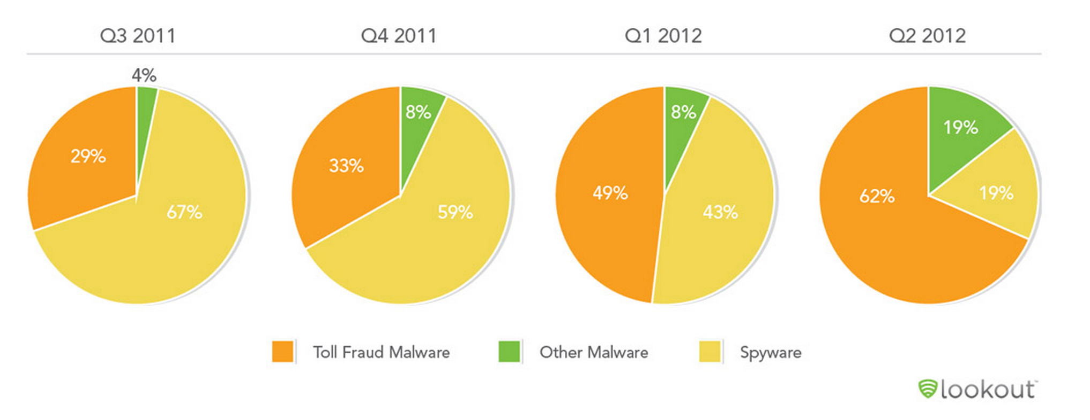
Why is BYOD RISKY?

Slide 7

Why is BYOD RISKY?
55% of Employees send work email or documents to their personal email accounts on their phones
Nearly 1/2 of all people log into Unsecured wireless networks
An internal survey of IBM workers discovered they were "blissfully unaware" about the security risks from popular apps.
Average user has 41 Apps Installed

Slide 8
BYOD Risks
Lost devices
Malicious apps
Malware
Employment termination
Cloud storage
Regulatory Requirements
Lack of enterprise control
Jail Broken Devices
App Permissions
Insecure Device configuration
Device patching
We fear our loss of control
It’s really data risk – not byod

Slide 9

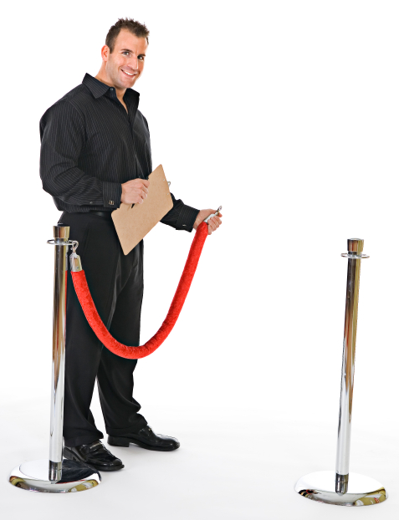
IT SECURITY IS STRUGGLING TO KEEP UP with Changes
OLD SECURITY
NEW SECURITY

Slide 10
WHAT do we NEED TO TRUST BYOD?
Fortune 500 CISOs corporate data Control:
Insight into where data is transmitted and stored
Who is accessing what data
Ability to control and remove access to data
User acceptance

Slide 11
WHAT do users NEED TO TRUST the enterprise?
Privacy
Near zero impact to productivity
Single user experience
Users drive it change
It change drives security change

Slide 12



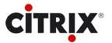




WHICH APPS DO ENTERPRISES TRUST & BUY?
Enterprises currently buy…
But, Employees want …
IT Supports BYOD, But
Isn’t aligned with Employee needs

Slide 13
IS BYOD Worth IT?
Risk, security, cost, impact, management
Why?

Slide 14
Enable Productivity and security
Transparent to the user
Empower productivity
Focus on the real risks
Give the user something
Enable users and they will behave
User impact decreases security

Slide 15
Byod + security = securely enabling business
No more kinkos
No more printers
No more delays
Information everywhere, anytime
Happy users
Pair new and existing controls
Invest in the future or pay more later

Slide 16
MOBILE SECURITY LANDSCAPE
MDM
Container
MAM
App Reputation
Pros | Cons
Set it and forget it | Disrupt workflow
Separate work/personal | App install
 | Limited Features
Pros | Cons
On boarding process | Restricted to API
Pincode Restrictions | No data control
Wiping the device | Not granular
Pros | Cons
Control of App | Disrupts workflow
Container per App | Lacks off device data protection
Custom Encryption
Pros | Cons
Rates bad apps | Misses OS Malware
Always updated
AV for apps
Detects Insecure code

Slide 17
Security across the workflow
On-device controls
Off-device controls
Logging & reporting
User empowerment
Pair new and existing controls
Invest in the future or pay more later

Slide 18
Strategy
a comprehensive device-agnostic approach can simplify and strengthen security of networks, data and applications.
-PWC
“
Byod + security = everyone happy

Slide 19
BYOD is changing the game
Adam Ely
adam@bluebox.com
www.bluebox.com
@BLUEBOXSEC

