Slide 1
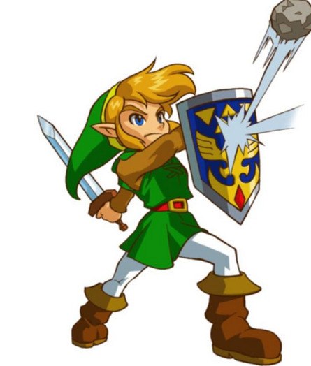

How to Defend Against FISMA Gus Fritschie and Andrew Du
FISMA Compliance
June 1st, 2013

Slide 2
Presentation Overview
Who we are
Why this talk
FISMA 101
What is good about FISMA
What is bad about FISMA
Organizational view of FISMA
Assessor view of FISMA

Slide 3
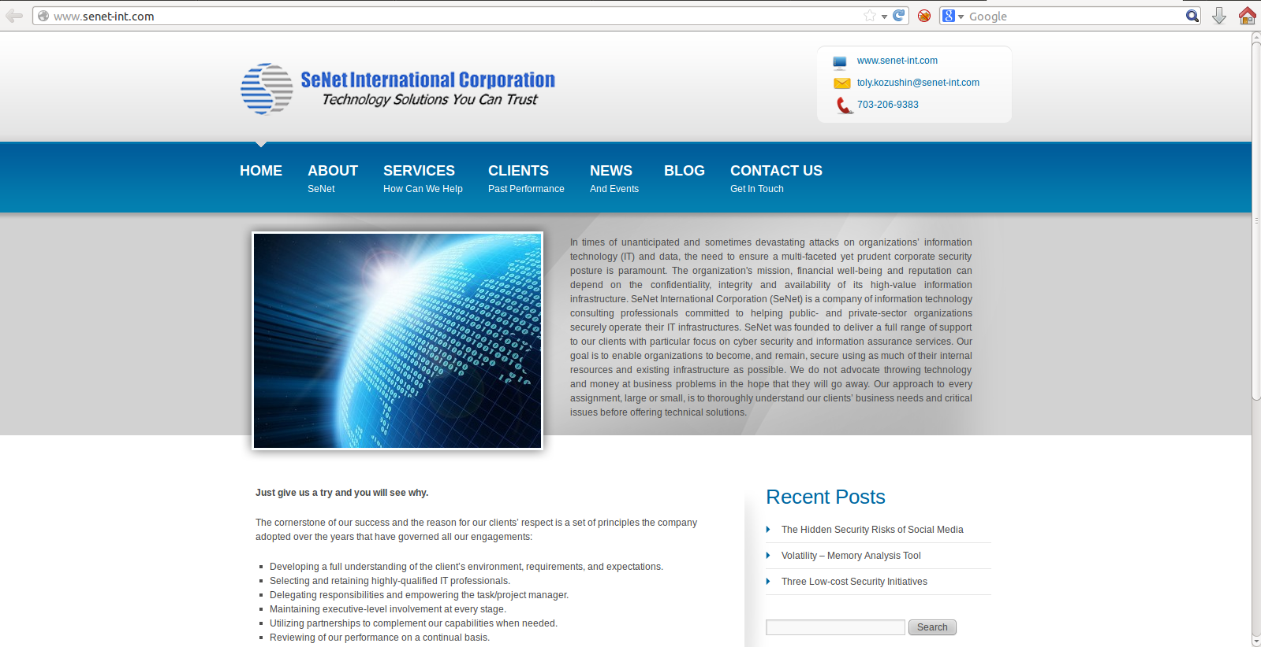
Who We Are – SeNet International

Slide 4
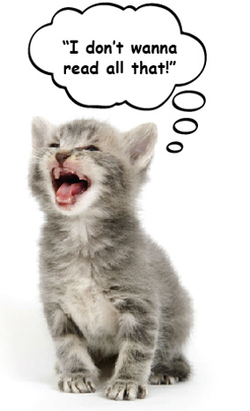
Disclaimer
The opinions expressed in this presentation are our own personal opinions and do not represent our employer’s view in any way. All examples in this presentation have been redacted and in some cases modified. We really enjoy doing FISMA and C&A work and would like to continue that (maybe).

Slide 5
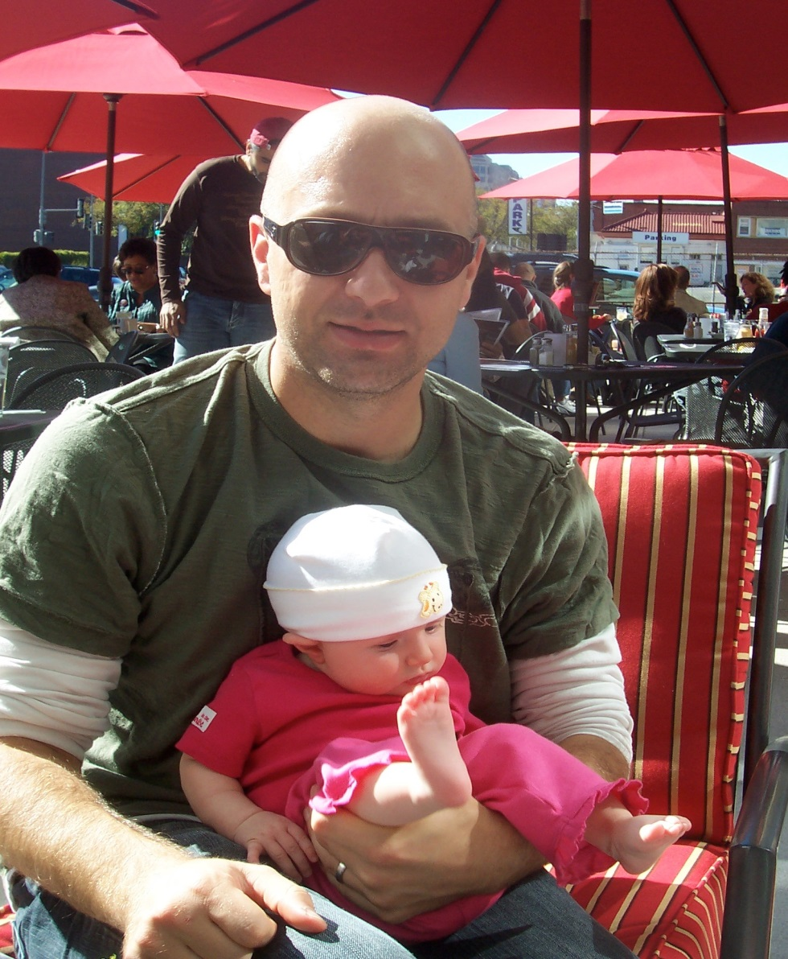
Who We Are – Gus Fritschie
CTO of SeNet International
Knows more about FISMA and C&A then I like to admit
Have lost count on the number of times have gotten drawn into arguments on whether a vulnerability maps to CM-6 or CM-7
Most importantly hold the highly coveted CAP certification <sarcasm>
@gfritschie

Slide 6

Who We Are – Andrew Du
Work for a Richmond-based federal contractor.
A security "hobbyist" since childhood, security architecture by profession, reverse engineer by passion.

Slide 7
Why This Talk?
First, nobody is here for Department of Commerce right?
We don’t really dislike FISMA (really we don’t)!
But because you, or someone you know, relative, or significant other, currently, recently, or in the future will be tasked to certify your system because it supports or integrates with some sort of federal information somewhere somehow.
We want you to know the pros and cons and how to best “defend” against FISMA and get real value out of the process.

Slide 8
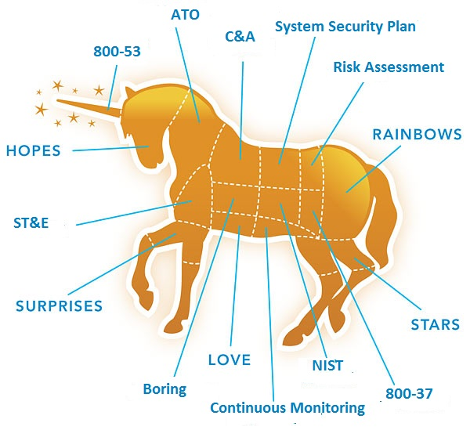
What is FISMA?

Slide 9
Brief History of FISMA
Federal Information Security Management Act of 2002 (FISMA) is a United States federal law enacted in 2002 as Title III of the E-Government Act of 2002
Prior to this we had OMB A-130, which is still valid and started this whole mess
NIST was given the authority to establish guidelines and have releases a series of the Special Publications and FIPS

Slide 10
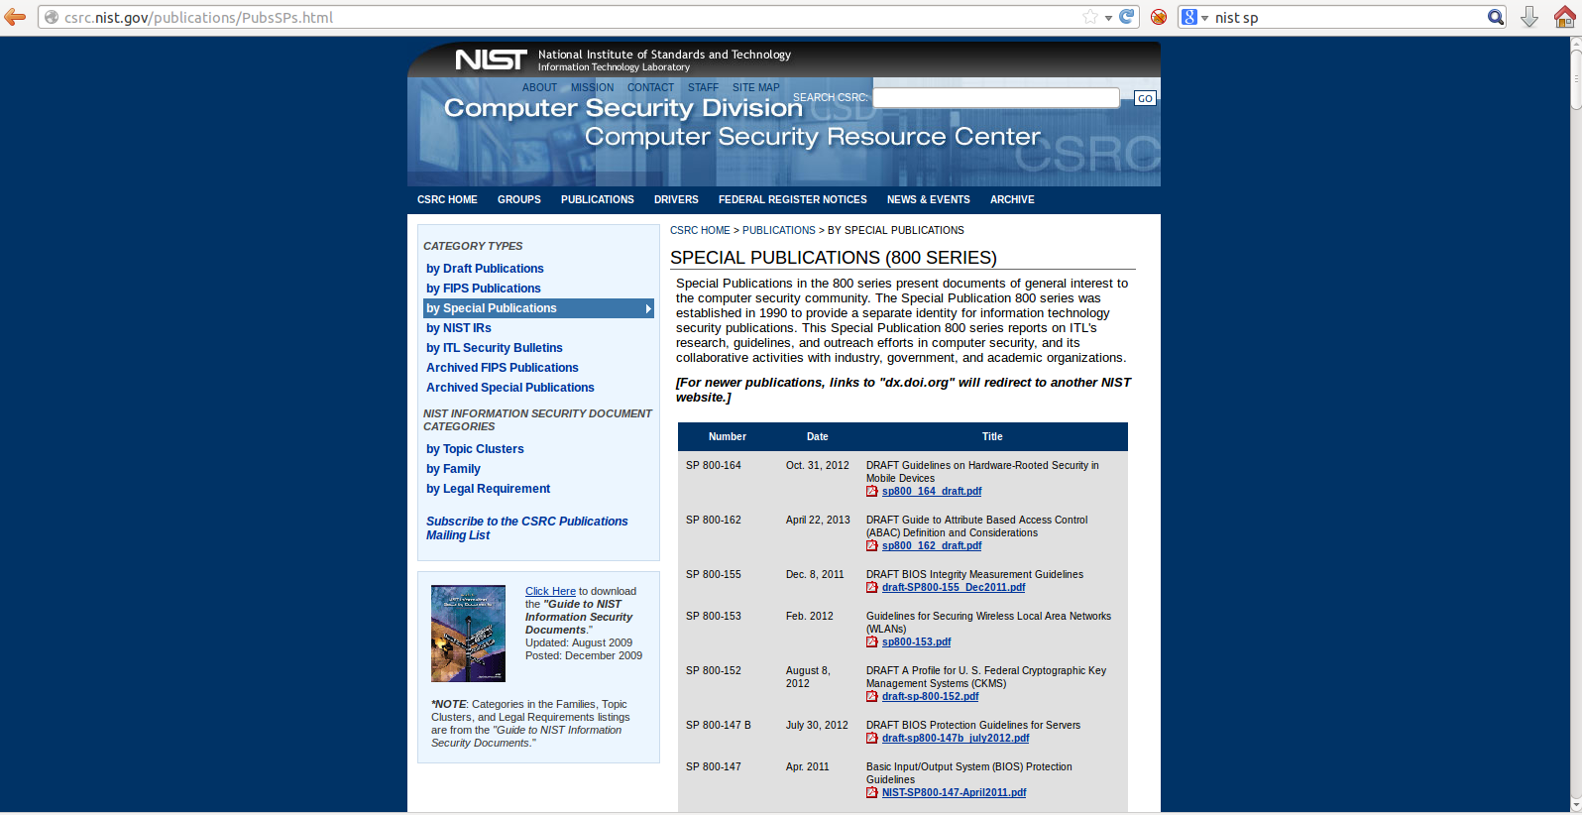
Brief History of FISMA (Cont.)
FIPS 199 and 200
FIPS vs. SP’s

Slide 11
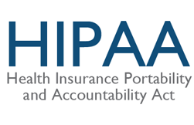
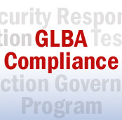
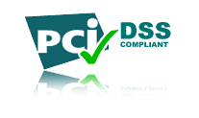
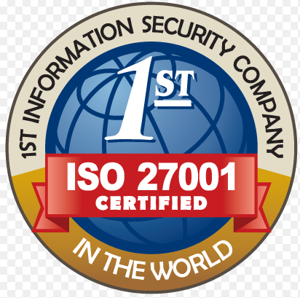

Other Compliance Standards

Slide 12
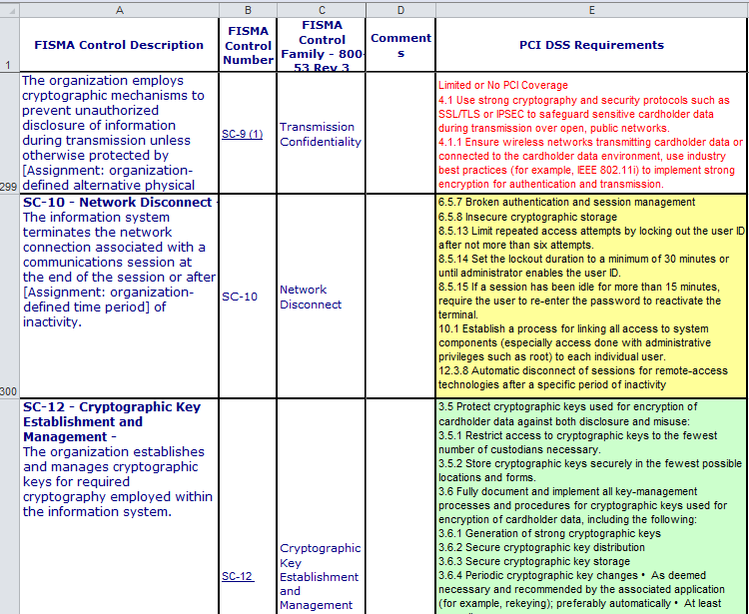
Other Compliance Standards (Cont.)
What is different about these standards?
Have you ever had to do a cross-walk between them?

Slide 13
Current State of FISMA
800-137 Continuous Monitoring
800-60 Rev1 Security Categorization
800-53 Rev3 Security Controls (Rev4 just released April 2013)
800-53A
800-37 Rev1 Risk Management Framework
800-34 Rev1 Contingency Planning
800-30 Rev1 Risk Management
800-18 Rev1 Security Plans

Slide 14
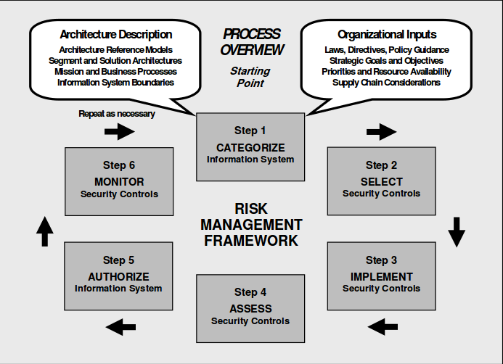
800-37 and the RMF

Slide 15
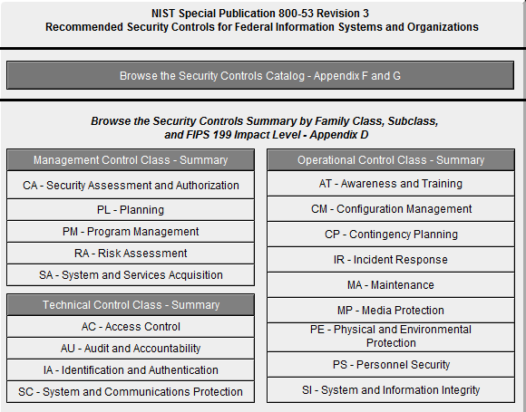
800-53 Controls
In my opinion one of the most important components.

Slide 16
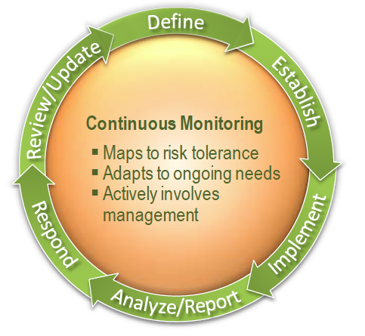
Continuous Monitoring, What?
This will solve all of our problems, right?

Slide 17
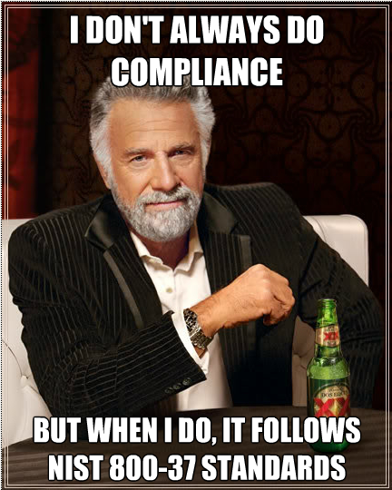
FISMA’s Good Points

Slide 18
FISMA’s Good Points (Cont.)
It is a good starting point and better than not doing anything
A lot of smart people and organizations had input into it
It raises the level of attention of information security
The controls selected cover a wide range of important areas
There is a lot of flexibility in how it is implemented

Slide 19
What is Wrong with FISMA
It is just a starting point
Organizations comply with FISMA for the wrong reasons
Controls are easy to confuse or misinterpret
Focuses attention/money on specific security controls (sometime the wrong ones)
Has become somewhat of a paper drill

Slide 20

Top 10 FISMA Mistakes

Slide 21
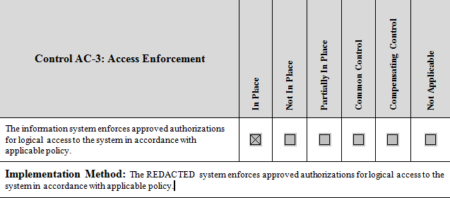
FISMA Mistake #1
Copying the control requirements and restating them as your compliance statement.

Slide 22
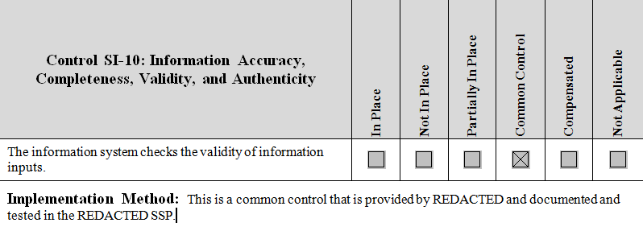
FISMA Mistake #2
Inheriting controls that you can’t and/or having controls listed as common when they really are hybrid.

Slide 23
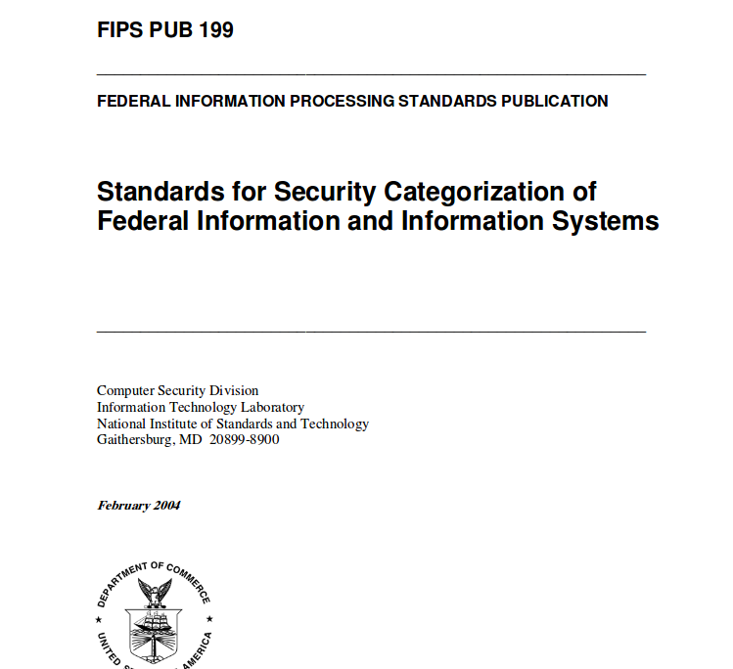
FISMA Mistake #3
Systems that have incorrect security categorizations.
System A “I’m a very important system so I have to be a high system. What? I have to implement and document all these other controls? On second thought…….”
System B “Yeah, so what I have PII and sensitive financial information. It is not important and nobody uses this system, I must be a low.”

Slide 24
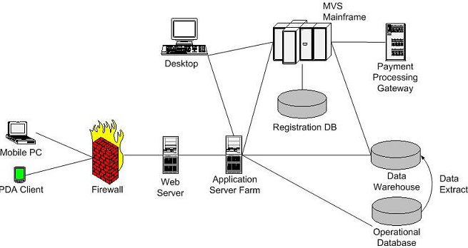
FISMA Mistake #4
Incorrect system boundaries

Slide 25

FISMA Mistake #5
ISSO’s not keeping the C&A documentation updated on a regular basis

Slide 26
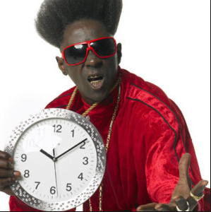
FISMA Mistake #6
Waiting too long to start the process

Slide 27
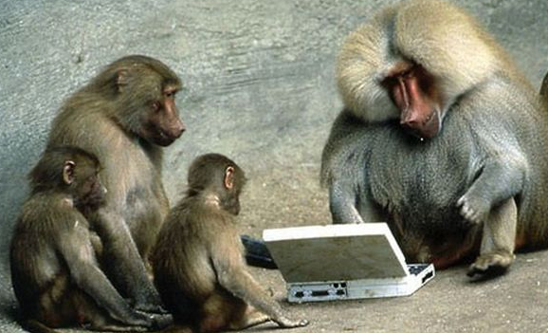
FISMA Mistake #7
Not having skilled/technical personnel to prepare the documentation and perform the testing

Slide 28
FISMA Mistake #8
Assuming since you have an ATO you are secure
ATO != Secure

Slide 29

FISMA Mistake #9
Moving to the cloud will solve all your FISMA problems

Slide 30
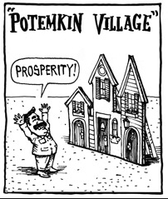
FISMA Mistake #10
Treating the C&A process as building a Potemkin village

Slide 31
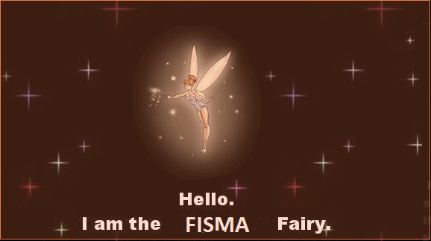
How Organizations Really Comply With FISMA

Slide 32
How Organizations Really Comply With FISMA (Cont.)
Parent agency inherited minimum requirements + baselines
Gov't contract written requirements and impact assessments
Internal security certification/authorization programs
Privacy impact assessment
Separation of impact levels by system partitioning
External authentication risk analysis
Corporate security policies
Rules of behavior
Risk based decisions
Significant user identification
Self-assessments and system test + evaluations

Slide 33
How Organizations Really Comply With FISMA (Cont.)
Access control management programs
Budgeting
Inventory management
Configuration management and/or change control
Intrusion management
Incident response program
Prototyping labs
Third-party vulnerability assessments
PMO integration
Interconnection agreements

Slide 34
Risk Management
Creating an internal risk acceptance process
Standardizing internal asset impact assessment and weighting
Effect on OLA's and SLA's
Building it into the architecture

Slide 35
Defenders POV 800-53 Management
C&A, SCA (CA-1: Certification, Accreditation, and Security Assessment Policies and Procedures) + (PM-1: InfoSec Program)
Possibly the most important from an implementer’s perspective.
Inject organizational security policies and risk management.
Organizational information authorization procedures.
Address elevated roles specifically and separately.
Dedicated InfoSec budgeting (SA-2: Allocation of Resources)
Ok, you know federal budgeting is key, right??
Don’t just keep renewing and upgrading; revisit the implementation.
Vulnerability scanning schedule (RA-5)
It’s much more than just network scanning!
Appliances, autonomous stuff, session reconstruction and some really cool, but shady stuff…
Code stuff.
Development Config Management + Security Testing (SA-10)
Better code and quality?
Code-level, vs assembly-level, vs application-level.
It’s not just code.

Slide 36
Defenders POV 800-53 Operational
Baseline Configuration (CM-2)
Why this is really, really important. And no, a backup does not count.
From all angles – network, servers, application
Disaster recovery criteria (CP-7)
Dual purpose site.
Return from failover.
Retention criteria.
Media Transport (MP-5)
True cost of information loss.
Realistically securing the endpoint.
System monitoring (SI-4)
SIEM dependence on shared infrastructure.
Importance of time sync.
Error event correlation with audit events.

Slide 37
Defenders POV 800-53 Technical
Access control policy and procedures (CA-1)
Accepting/accounting for ACL risk exposure
Admin account review intervals
Least privilege (AC-6)
ACLs
Impersonation vs delegation
Kerberos constrained delegation
Federated authentication
Monitoring/accounting for compliance
Group policies
Audit record retention (AU-11)
Tiered retention by risk exposure.
Session concurrency, lock, replay (AC-10, AC-11)
Securing external identifiers
Preventing app “nesting”
Architectural design elements (all SC’s)
System partitioning from the ground (physical) and up
Careful with resource sharing – esp with virtualization

Slide 38
Examples From Good Organizations
Organizational InfoSec program
Service management initiatives + PMO integration
Architecture and design
Software development
Code reviews
Coding policies, standards
QA security function

Slide 39
Built Into the SDLC
Important!
Risk-based approach vs compliance-only focus.

Slide 40
Built Into the SDLC (Cont.)
Security integration to system development is critical to front-end design (not to confuse the term "front-end" with network design terms).

Slide 41
Built Into the SDLC (Cont.)
Align the application design to your corporate information security program initiatives (you have one, right??).

Slide 42
Built Into the SDLC (Cont.)
Examples:
Audit logging design
possibly include redundancy, retention, and reliability (unintentional 3 r's there);
Session design
possibly include concurrency control, lock, identification, replay
Access, authentication, and authorization (intentional 3 a's there)
Error handling design
Unit test automation by check-in gates
Code coverage
Design for functional testing
Information input restriction
RBAC
Partitioning
Information validation
Rules engine/input validation, app firewall

Slide 43
Built Into the SDLC (Cont.)
Writing documentation sucks, but...
Risks behind an insufficiently documented system

Slide 44
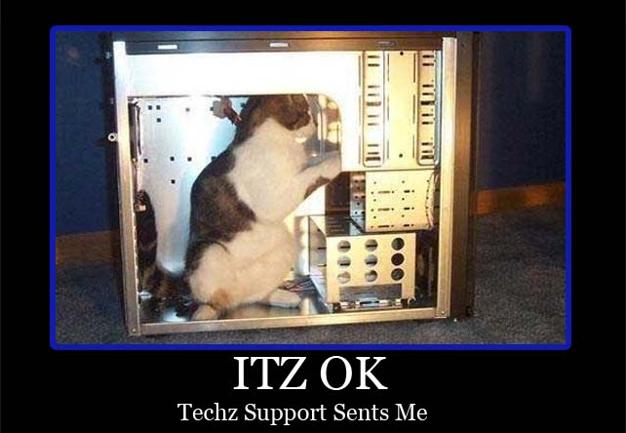
How Do These Controls Get Assessed
800-53A
Interviews
Examinations
Testing*
* This is the phase that suffers the must in C&A testing.

Slide 45
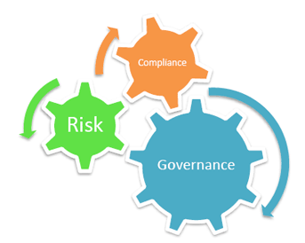
Tools that Perform 800-53 Compliance
ASSERT
CSAM
Trusted Agent FISMA
RSAM
Maybe more?

Slide 46
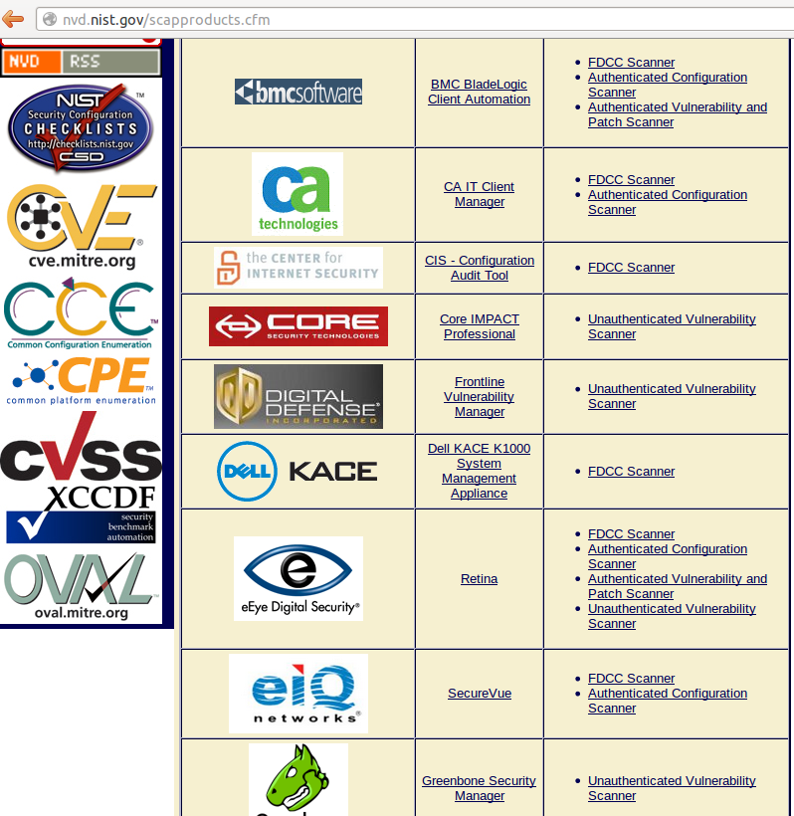
SCAP Tools
The U.S. Office of Management and Budget has required, in the August 11, 2008, M-08-22 memorandum to Federal CIOs, that "Both industry and government information technology providers must use SCAP validated tools with FDCC Scanner capability to certify their products operate correctly with FDCC configurations and do not alter FDCC settings. Agencies will use SCAP tools to scan for both FDCC configurations and configuration deviations approved by department or agency accrediting authority. Agencies must also use these tools when monitoring use of these configurations as part of FISMA continuous monitoring."

Slide 47
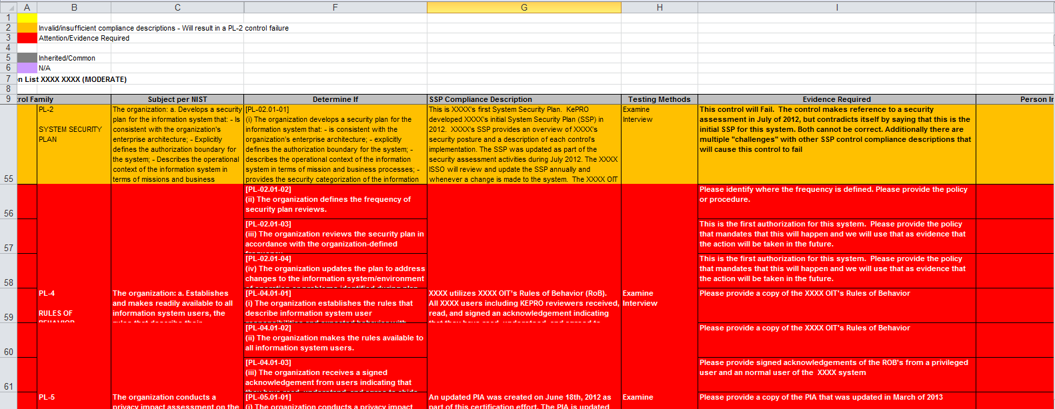
Assessors POV 800-53 Management
Most often assessed via interviews and document collection.
While important concepts, rarely do they equate to the direct security of a system.

Slide 48
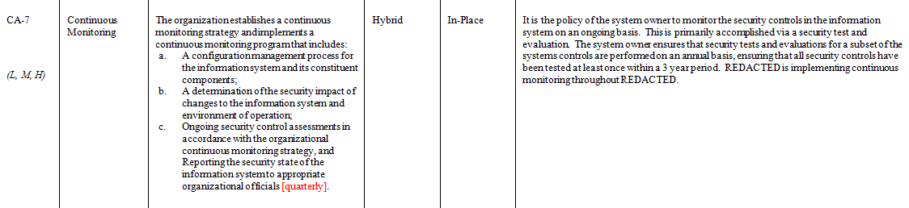
Assessors POV 800-53 Management (Cont.)
Often assessing these controls is easy and straightforward. Do some interviews and collect some evidence.
But you still have to be careful because you will get compliance descriptions like this that may look right but really aren’t.

Slide 49
Assessors POV 800-53 Operational
The largest control class, with several critical controls that directly impact the security posture of the system.
Some aren’t that important IMO (AT, PS, MA)
But the CM and SI have several critical controls that can indicate a fundamental flaw in processes and procedures (CM-3, CM-6, CM-7, SI-2)
Others like CP are important, but often are overlooked and don’t get the attention they deserve (CP tests).
While still assessed mostly via interviews and examination, more technical testing is required here. Many of you technical findings can be mapped back to CM-6 or SI-2.

Slide 50
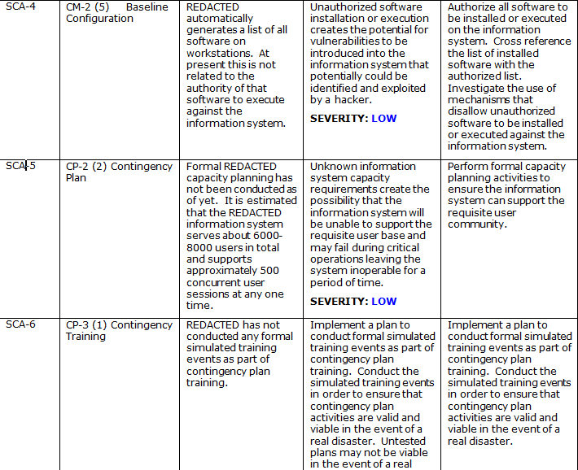
Assessors POV 800-53 Operational (Cont.)
We get a lot of “non-technical” findings in the Operational class

Slide 51
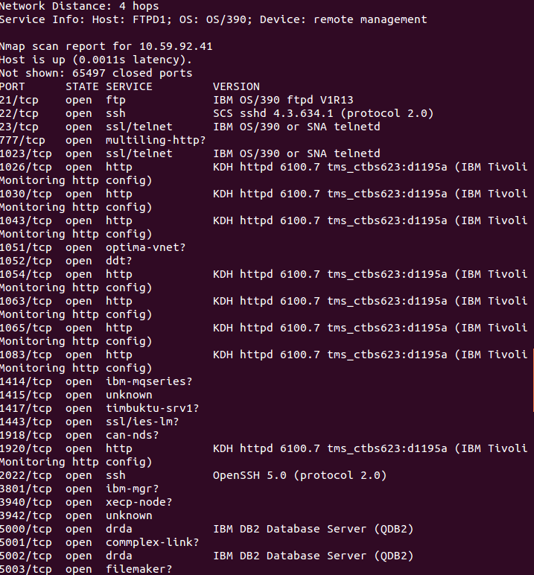
Assessors POV 800-53 Operational (Cont.)
But we also get to have some fun by running tools like Nessus and Nmap. At least it is something……….

Slide 52
Assessors POV 800-53 Technical
Don’t let this trick you plenty of interviews and examinations still take place at this level.
Have spent hours going over AC-2 and all of its enhancements if done right (often it is not).
This is the phase where we can have some fun (Yeah penetration testing!!!) sorta.
Also an area where many mistakes are made on the development of documentation side because they do not have technical resources working on it.

Slide 53
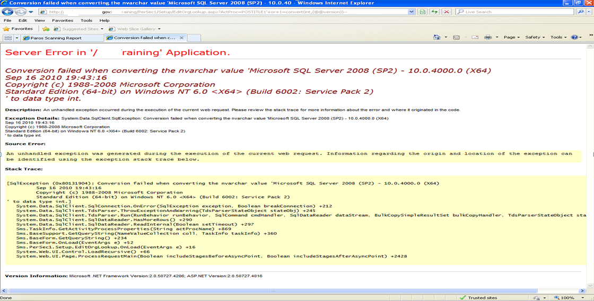
Assessors POV 800-53 Technical (Cont.)

Slide 54
Assessors POV 800-53 Technical (Cont.)
So just a typical SQLi issue, why is this important?
Because the SSP for this system states for SI-10 (actually an operational control) that the application validates all input and prevents against these types of attacks
And the exact same application had been through a C&A and granted an ATO at another agency……

Slide 55
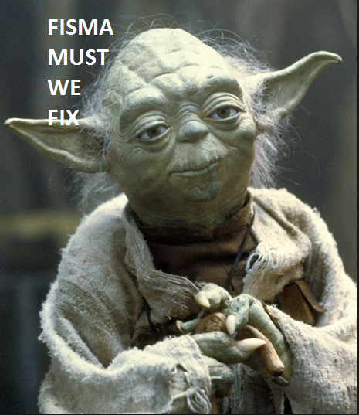
How Can We Fix FISMA?
Some laws have recently been passed or are close to being passed.
Executive Order 13636
Federal Information Security Amendments Act of 2013
Other organization have alternatives.
SANS Twenty Critical Security Controls
Other ideas?
Require organizations and people to be certified to perform C&A activities. Though it is debatable how well that has worked for QSA and the PCI sectors……

Slide 56
Conclusion
It is easy to comply with FISMA, it is harder to build real security into our systems and networks.
Until we move beyond the “paperwork” drill this problem will not be fixed.
Making sure these controls are integrated into the SDLC and then properly monitoring them is the key.
Believe we are and will continue to see these regulations changing and adapting, for the better.

Slide 57
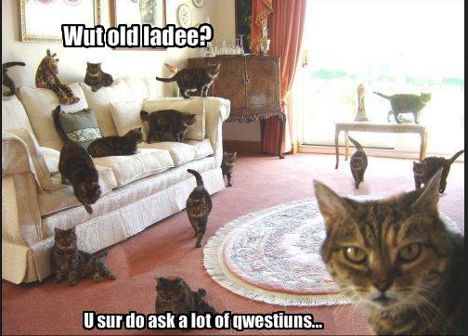
Questions

