Slide 1

Our Straw House: Vulnerabilities
(Jake rushed me on the title. #jerk)
Jericho / Brian Martin – RVAsec -- June 1, 2013
Notes:
CFP:
The Ugly Truths About Vulnerability Databases;
(and why it has affected you all these years)
If you use a vulnerability scanner, IDS, IPS, firewall, or any significant security product, you are probably relying on a vulnerability database (VDB) of sorts. You may not know it, but they are often the foundation of how some products are designed, and how most correlate information. VDBs may be public or private, outsourced or home-grown, but they all share an amazing variety of crippling attributes that make them all suck to one degree or another. Your security solutions are typically built on incomplete databases that frequently overlook serious vulnerabilities, sometimes by design. Incomplete and inaccurate statistics on vulnerability trends, based on VDBs, can affect your budget and incorrectly influence spending. Your tax dollars support redundant, and inadequate government funded VDBs. This is the tip of the proverbial iceberg, what about the 90% of problems you haven’t seen?
A vendor like Adobe offers a product we are all familiar with, Adobe Reader. However, did you know that Reader’s third-party software notifications has declarations for 113 pieces software from other vendors, used to some degree within their own? And that is from one of 361 current Adobe products that carry third-party software declarations. In short, if a VDB is notifying you of vulnerabilities in Adobe Reader, are they aware that vulnerabilities in hundreds of other products can also affect it? VDBs make decisions on your behalf; that “no-name” software “ICU” that they opt not to follow affects you. The problem is that such libraries are used widely, and vulnerabilities in that “no-name” software pop-up all over the place (e.g. CVE-2010-1390 for Apple Safari, CVE-2010-4409 for PHP, CVE-2011-2791 for Google Chrome). This is ONE example of why VDBs are failing their users, and any company that builds a product or service based on them are in turn failing their customers.
Despite decades of tracking vulnerabilities, the ability to produce meaningful and accurate vulnerability statistics is lost on most everyone. When high profile statistics confuse a vulnerability with an advisory or CVE identifier (that may contain multiple vulnerabilities), we’re doomed. Factor in the bad habits of most VDBs, and you end up with statistics that are not only inaccurate, but completely misleading. This talk will examine several published vulnerability statistics, tear them apart, and hopefully bury them for the sake of the security industry. Oh, it will throw out examples of considerably more reasonable statistics while showing you the pitfalls of generating them.
This talk will expose VDBs, their practices, and their shortcomings. Most importantly, it will explain how these decisions and faults directly affect you as a security practitioner. By knowing these problems, you have a chance of working around them and better preparing for your job, and a better shot at protecting your organization.

Slide 2
Presentation Outline
Caveats – (14 days, why me, bias)
W’s – (what? who? why care?)
History – (set stage for outrage)
Players – (know who to blame)
Suckage - (the outrage)
Evolution – (continue the suckage)
Suffering – (what good VDBs suffer)
Impact – (why this all hurts you)
Notes:
Will build up to ‘suffering’ where I show you examples, with names, of the world of disclosure stupidity.

Slide 3
Presentation Outline
Caveats – (14 days, why me, bias)
W’s – (what? who? why care?)
History – (set stage for outrage)
Players – (know who to blame)
Suckage - (the outrage)
Evolution – (continue the suckage)
Suffering – (what good VDBs suffer)
Impact – (why this all hurts you)
Notes:
Will build up to ‘suffering’ where I show you examples, with names, of the world of disclosure stupidity.

Slide 4

Notes:
http://www.filmratings.com/downloads/cara_poster_7.pdf
Image from filmratings.com, and modified a bit.

Slide 5


Disclaimer
I didn’t get much warning…
Two week version of a talk
that needs four months of
research...
This won’t be sexy…

Slide 6


Jericho
Brian
Chief Curmudgeon for attrition.org
CFP Reviewer for DEF CON, RVASec, more.
Tech Editor at large. Books, papers, more.
Contributor to DatalossDB, Cloutage,
Secore.Info
Random Facts
Waiting for Industry Cyber-Pompei
More passionate about VDBs than Errata
Original owner of lemming.com
Things I’ve been doing
Disruptive Rants and Twitter Replies
InfoSec Industry Errata
BSidesDenver Planning
Security Failings
Squirrels
President / COO of Open Security Foundation
Content Manager for OSVDB
Director of Non-profit Activity at Risk
Based Security
Random Facts
CVE Editorial Board Member since 2008
First VDB maintained in 1994
Joined OSVDB as volunteer in 2003
Things I’ve been doing
Vulnerability Databases
Everything about them.
Really, everything remotely related.
History of vulnerabilities
Vulnerability Disclosure Errata
Bugs (of the software variety)
216 blogs for OSVDB since 2005
Notes:
Need fresh new bio. Why am *I* giving this talk? Been doing VDBs a long time.
I’m the C-whatever at OSF. Doesn’t much matter, because the other title is the one I embrace; Content Manager for OSVDB

Slide 7

Bias, I Have It
OK, a lot of it…
I’ve worked on OSVDB for ~10 years
We are a competitor to VDBs mentioned
Our serious commercial offering started ~ 1 year ago
License has always required $ for commercial use
Piece of shit companies never honored it
Call it advertising, or call it facts!
Not really “buy us”, more “don’t use shitty VDBs”!
Notes:
http://web.archive.org/web/20070420103923/http://www.iss.net/about/timeline/index.html
http://web.archive.org/web/19991111162235/http://xforce.iss.net/about.php3
https://twitter.com/jonamato/status/334819325561171968 1 FT in 6/99
http://www.securityfocus.com/about
http://web.archive.org/web/20010607171450/http://icat.nist.gov/icat.cfm
http://news.softpedia.com/news/Milw0rm-To-Shut-Down-116112.shtml
https://twitter.com/scooterthetroll/status/334884876031492096 / https://twitter.com/scooterthetroll/status/334886221048340480

Slide 8
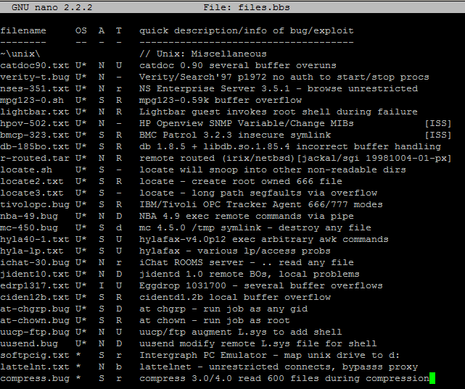
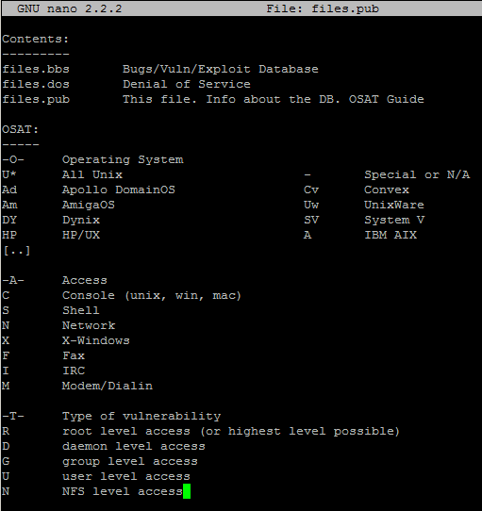
My Early VDB Days
Notes:
Figure out how to make one display, then other after click
I was affiliated with a hacker group back in the early 90’s, and like any good hacker group, we maintained a list of vulnerabilities we used to break into systems. Since BBSs were prevalent, and the Internets were still random tubes laying on the ground, we kept the database in the classic FILES.BBS format. At some point that name stuck, but we re-formatted. Even back then, we had a primitive classification system (OSAT), and preliminary references (advisory IDs and/or publisher). I took over maintaining it at some point, and kept it up until 1998.
Of course, we weren’t the first to create a database of vulnerabilities…

Slide 9
Presentation Outline
Caveats – (14 days, why me, bias)
W’s – (what? who? why care?)
History – (set stage for outrage)
Players – (know who to blame)
Suckage - (the outrage)
Evolution – (continue the suckage)
Suffering – (what good VDBs suffer)
Impact – (why this all hurts you)
Notes:
Will build up to ‘suffering’ where I show you examples, with names, of the world of disclosure stupidity.

Slide 10

VDBs … huh?
Did you have to look up ‘VDB’ or think about the initialism?
Did you have to think why you care? Could you even come up with a reason? I hope so…
You rely on them a lot more than you realize...
Their accuracy is important critical to you. Trust me.
Notes:
It’s not an acronym! http://www.lyberty.com/encyc/articles/abbr.html
Image from:
http://www.uniquepicturehunter.com/wp-content/uploads/2008/06/crazyanimalsfunnyanimalpicturespichunter-3.jpg

Slide 11


Why Important?
Risk Management (identifying vulns/threats)
Compliance (based on illusion of having no vulns)
Cryptography (works when no vulns in algorithm)
“In computer security, a vulnerability is a weakness which allows an attacker to reduce a system's information assurance.”
More fundamentally: “open to attack or damage”
“Without vulnerabilities there is no risk.” - @JKouns
Notes:
http://en.wikipedia.org/wiki/Vulnerability_(computing)
http://www.merriam-webster.com/dictionary/vulnerability?show=0&t=1369528177

Slide 12
Who Uses Them? (you)
Vulnerability Scanners / Exploit Frameworks
Firewalls / IDS / IPS for references
SIEMs for correlation and vuln trending
Analysis firms (Intelligence, Statistics, etc)
Pentest groups / Hackers
Threat intel warning group thingies
Do you / your org fall in any of these categories? Then you should must care.

Slide 13

What is a VDB?
Broader term than many use it.
Any collection (database) of vulnerability information.
Bug trackers are often a VDB of sorts!
Specialty VDBs all over the place, by design.
Even if limited in volume, still can be a VDB specific to a cause.

Slide 14





Reference
How many context-dependent Java vulns?
History of security of your favorite blog?
How many Reader vulns in Dec, 2012?
How many DoS vs RCE in Windows?
More or less vulns in MySQL after
acquisition?
Notes:
It’s not an acronym! http://www.lyberty.com/encyc/articles/abbr.html

Slide 15

Cornerstones
Based on where VDBs are used; they are a cornerstone of many offerings.
If the VDB is incomplete or inaccurate, what then?
Didn’t really need to find / detect / correlate / remediate those vulnerabilities, right?
Notes:
Photo courtesy of:
http://smallbusiness.uprinting.com/wp-content/uploads/2013/02/missed-target.png

Slide 16
Presentation Outline
Caveats – (14 days, why me, bias)
W’s – (what? who? why care?)
History – (set stage for outrage)
Players – (know who to blame)
Suckage - (the outrage)
Evolution – (continue the suckage)
Suffering – (what good VDBs suffer)
Impact – (why this all hurts you)
Notes:
Will build up to ‘suffering’ where I show you examples, with names, of the world of disclosure stupidity.

Slide 17
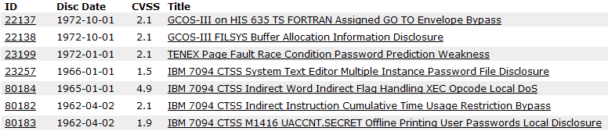
History (brief)
If a cornerstone of our industry…
… and so important to our technology…
… with ‘modern’ computer vulnerabilities disclosed in 1962…
… when did we start databases of them?
Notes:
‘modern’ meaning early IBM 7094, but not earlier as in the Enigma machine or Marconi Wireless Telegraph

Slide 18


Recent History of VDBs
How far back do they go? A long, long way…
ISS X-Force (Aug, 1997)
SecurityFocus BID (Jun, 1999)
CVE (Sep, 1999)
NIST ICAT / “CVE Metabase” (~1998 – ~1999 *)
SecurityTracker (Jan, 2001)
OSVDB (Aug, 2002)
Secunia (Oct, 2002)
US-CERT (Sep, 2003)
Milw0rm (2004 – 2009)
Exploit-DB (Nov, 2009)
Notes:
http://web.archive.org/web/20070420103923/http://www.iss.net/about/timeline/index.html
http://web.archive.org/web/19991111162235/http://xforce.iss.net/about.php3
https://twitter.com/jonamato/status/334819325561171968 1 FT in 6/99
http://www.securityfocus.com/about
http://gcn.com/Articles/2005/08/19/NIST-relaunches-database-of-IT-vulnerabilities.aspx?Page=2 Aug 19, 2005 – “Mell said he began work on ICAT seven years ago”
* ICAT began as a separate database independent of CVE, then converted to be a CVE Metabase late 1999
http://news.softpedia.com/news/Milw0rm-To-Shut-Down-116112.shtml
https://twitter.com/scooterthetroll/status/334884876031492096 / https://twitter.com/scooterthetroll/status/334886221048340480

Slide 19
Older History of VDBs
CERT/CC (Dec, 1988) – CERT/KB (Sep, 2000)
Guy Helmer’s Incomplete List of UNIX Vulnerabilities (1994)
ISS, SATAN, Ballista, Nessus (1995 – 1999)
Fyodor’s Exploit World (Mar, 1996)
Packet Storm (Jun, 1997)
Hacker Groups / Private (e.g. ADM, TNO, w00t)
Security Co’s / Private VDBs (e.g. ISS, E&Y, RSI)
Notes:
http://web.archive.org/web/19981205062116/http://www.insecure.org/sploits.html
http://web.archive.org/web/19970428233506/http://www.cs.iastate.edu/~ghelmer/unixsecurity/unix_vuln.html
ISS (1992), SATAN (1995), Ballista/CyberCop (1997), Nessus (1998)
http://www.nationmaster.com/encyclopedia/Ken-Williams-%28network-security%29

Slide 20



Eh?
“The first workshop on Research with Security Vulnerability Databases was sponsored by NIST in 1996. […] Since the workshop, many different vulnerability databases have been produced, but there are no publicly known cases of database sharing.” -- Pascal C. Meunier and Eugene H. Spafford, January 1999
Notes:
Images from:
http://www.lolbrary.com/content/239/derp-20239.jpg
http://s3-ak.buzzfeed.com/static/enhanced/webdr06/2013/5/7/10/enhanced-buzz-16842-1367938322-0.jpg
http://catmacros.files.wordpress.com/2009/09/cat_durr2.jpg

Slide 21
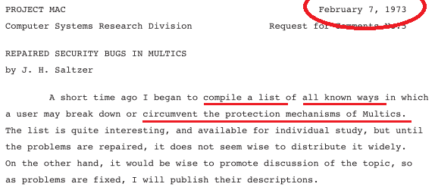
The Real History of VDBs
Repaired Security Bugs in Multics (1973)
Air Force Tiger Team (1979)
Matt Bishop’s List of UNIX Holes (1985)
Note: All limited distribution, or private.
Notes:
http://web.mit.edu/Saltzer/www/publications/CSR-RFC-5.pdf
http://www.airpower.maxwell.af.mil/airchronicles/aureview/1979/jan-feb/schell.html
http://securitydigest.org/unix/archive/006

Slide 22
Presentation Outline
Caveats – (14 days, why me, bias)
W’s – (what? who? why care?)
History – (set stage for outrage)
Players – (know who to blame)
Suckage - (the outrage)
Evolution – (continue the suckage)
Suffering – (what good VDBs suffer)
Impact – (why this all hurts you)
Notes:
Will build up to ‘suffering’ where I show you examples, with names, of the world of disclosure stupidity.

Slide 23













Current Players

Slide 24
Broad vs Speciality
“No. CVE is not a vulnerability database. CVE is designed to allow vulnerability databases and other capabilities to be linked together, and to facilitate the comparison of security tools and services.” – CVE FAQ
CVE – ExploitDB – PacketStorm = Specialty
OSVDB – ISS – BID = Comprehensive
Secunia – CERT = Blended
Private VDBs = Specialty / Focused, based on company or offering, or comprehensive
Notes:
[1] http://cve.mitre.org/about/faqs.html

Slide 25

The .gov Mess
CVE (Sep, 1999)
NIST ICAT (~1999)
US-CERT (Sep, 2003)
^ Remember this history?
CVE (founded 1999 – DHS sponsored 2003)
NIST NVD (founded 1999 – DHS sponsored 2005)
US-CERT (founded 2003 – DHS sponsored 2003)
ICS-CERT (founded 2009 – DHS sponsored 2009)
Notes:
http://en.wikipedia.org/wiki/United_States_Computer_Emergency_Readiness_Team
http://gcn.com/articles/2005/08/19/nist-relaunches-database-of-it-vulnerabilities.aspx
https://inlportal.inl.gov/portal/server.pt?open=514&objID=1555&mode=2&featurestory=DA_563577
Image:
https://encrypted-tbn0.gstatic.com/images?q=tbn:ANd9GcSSC5jKxHE_ufKSTjCX9ITZ8_MNItEn5b3H2OLZ2pBQ5-vuq8ZVuQ

Slide 26

The .gov Mess
CVE, NVD, US-CERT, ICS-CERT .. How much funding, how much redundancy? None of them really excel over the others. #mypoortaxdollars
How much do these programs cost?
Let’s play the FOIA game!
Notes:
http://en.wikipedia.org/wiki/United_States_Computer_Emergency_Readiness_Team
http://gcn.com/articles/2005/08/19/nist-relaunches-database-of-it-vulnerabilities.aspx

Slide 27
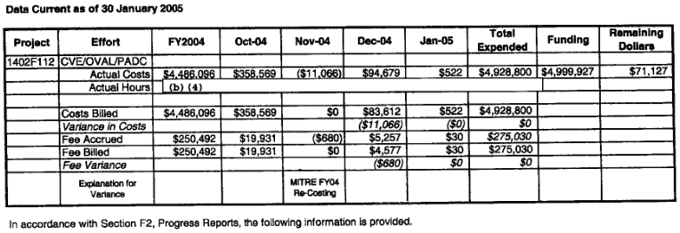
FOIA Fun! - CVE
Through FOIA, found out how much CVE cost to operate one year.

Slide 28
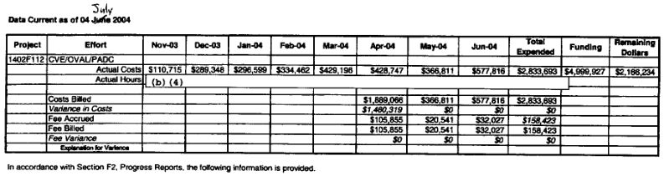
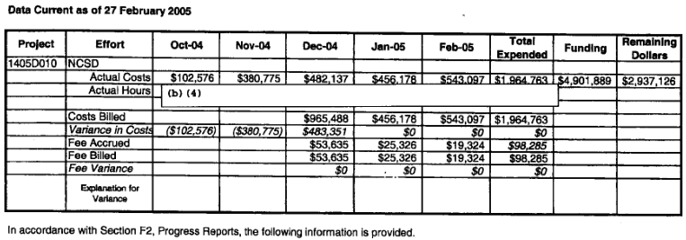
FOIA Fun! - CVE

Slide 29
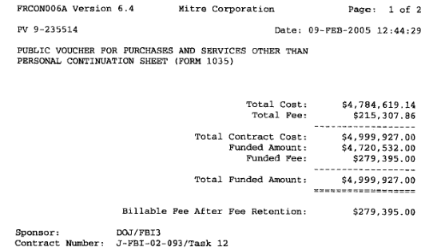
FOIA Fun! - CVE

Slide 30
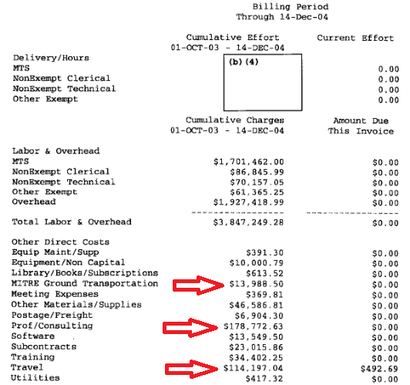
FOIA Fun! - CVE

Slide 31


FOIA Fun! - NIST
Through FOIA, found out how to piss off a rival VDB!
Find out how much they pay to outsource CVSS/CPE calculation and input ($23 per vuln)
Find out 2004 salary of Peter Mell, main guy running database ($107,687)
Ask for more detailed information, and get junkpunched in return!
Notes:
http://en.wikipedia.org/wiki/United_States_Computer_Emergency_Readiness_Team
http://gcn.com/articles/2005/08/19/nist-relaunches-database-of-it-vulnerabilities.aspx

Slide 32
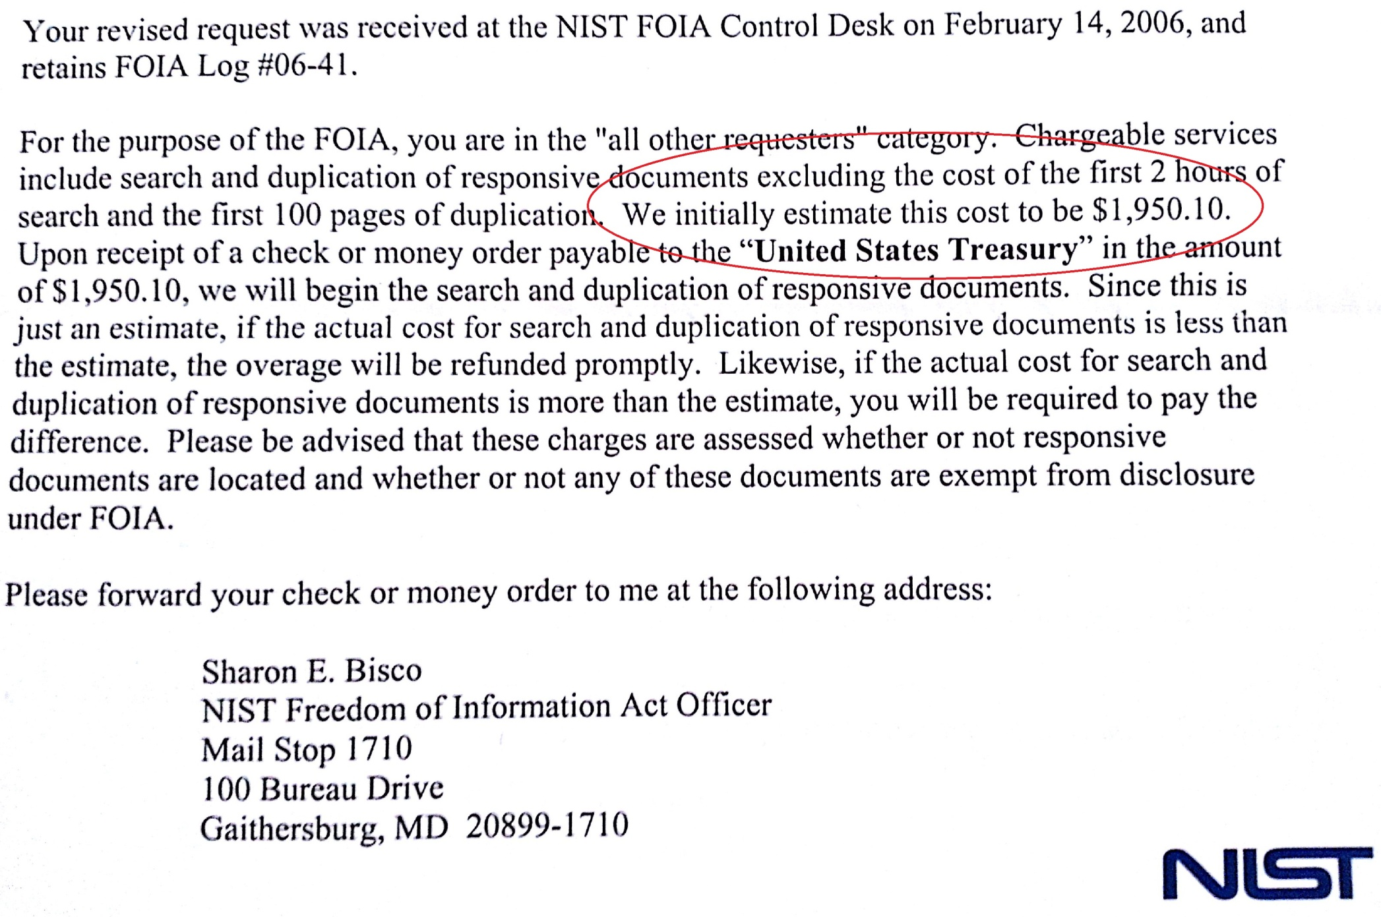
FOIA Fun! - NIST
Notes:
http://en.wikipedia.org/wiki/United_States_Computer_Emergency_Readiness_Team
http://gcn.com/articles/2005/08/19/nist-relaunches-database-of-it-vulnerabilities.aspx

Slide 33
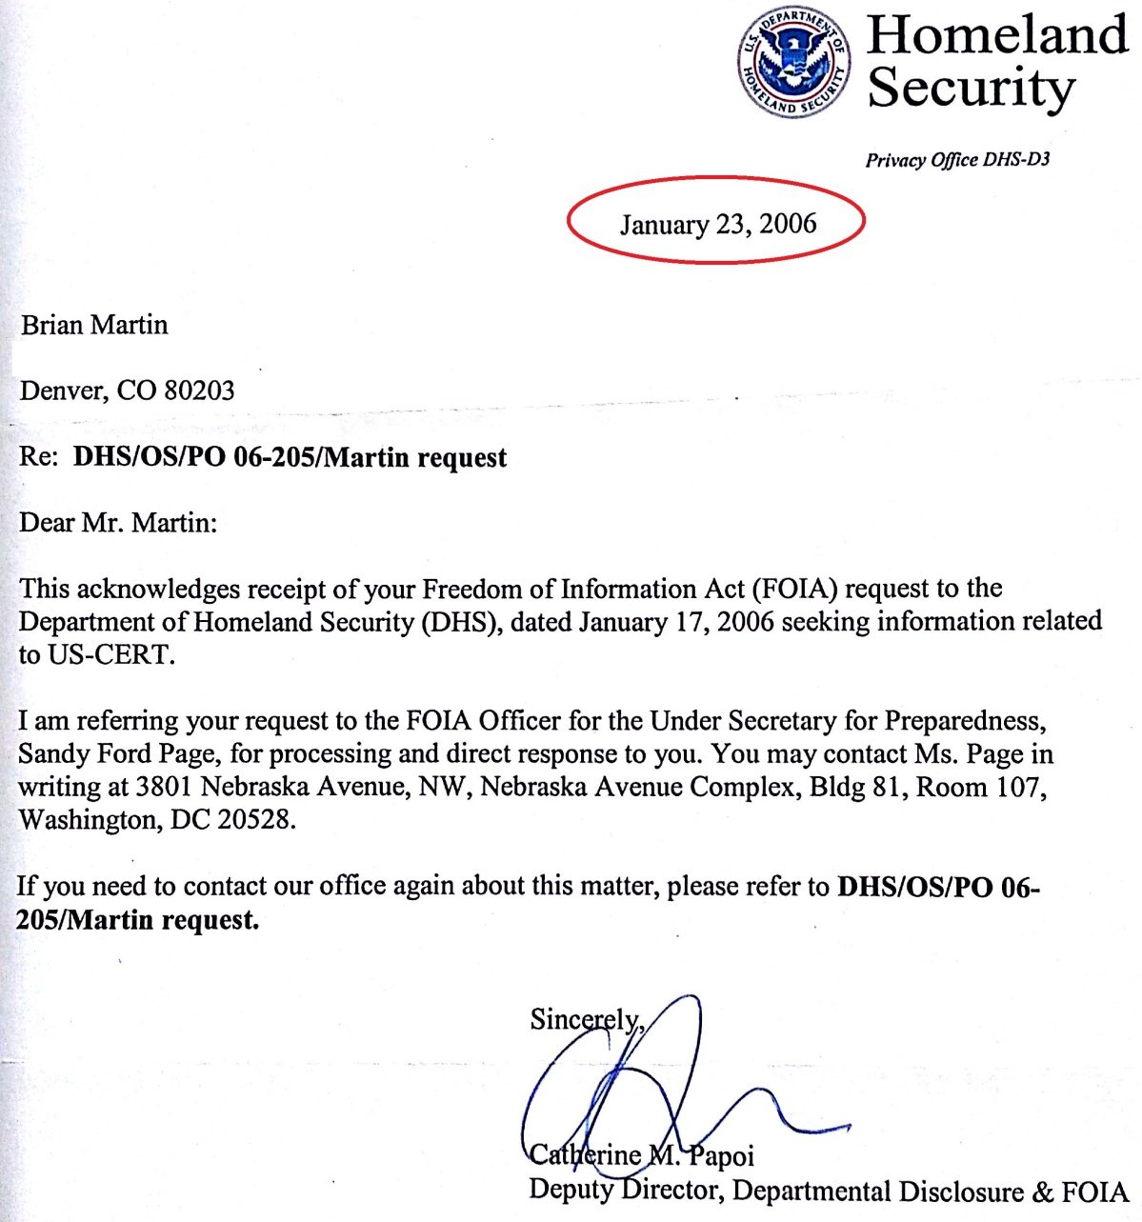
FOIA Fun! – US-CERT
Through FOIA, found out how backlogged DHS is.
Still
Waiting…
Notes:
http://en.wikipedia.org/wiki/United_States_Computer_Emergency_Readiness_Team
http://gcn.com/articles/2005/08/19/nist-relaunches-database-of-it-vulnerabilities.aspx

Slide 34
FOIA Fun! – CERT.org
Through FOIA, found out how … WTF?
Request to DOD (2006-01-09)
DOD Reply, ask USSTRATCOM (2006-01-23)
Request to USSTRATCOM (2006-02-24)
USSTRATCOM clarification (2006-03-13)
Clarification to USSTRATCOM (2006-04-02)
USSTRATCOM reply “no records” (2006-04-11)
Simplified request to USSTRATCOM (2006-05-22)
Request forwarded to Hanscom AFB (2006-06-01)
Hanscom reply “CERT not subject to FOIA” (2006-06-06)
Challenge sent to Hanscom AFB (2006-07-31)
Notes:
http://en.wikipedia.org/wiki/United_States_Computer_Emergency_Readiness_Team
http://gcn.com/articles/2005/08/19/nist-relaunches-database-of-it-vulnerabilities.aspx

Slide 35
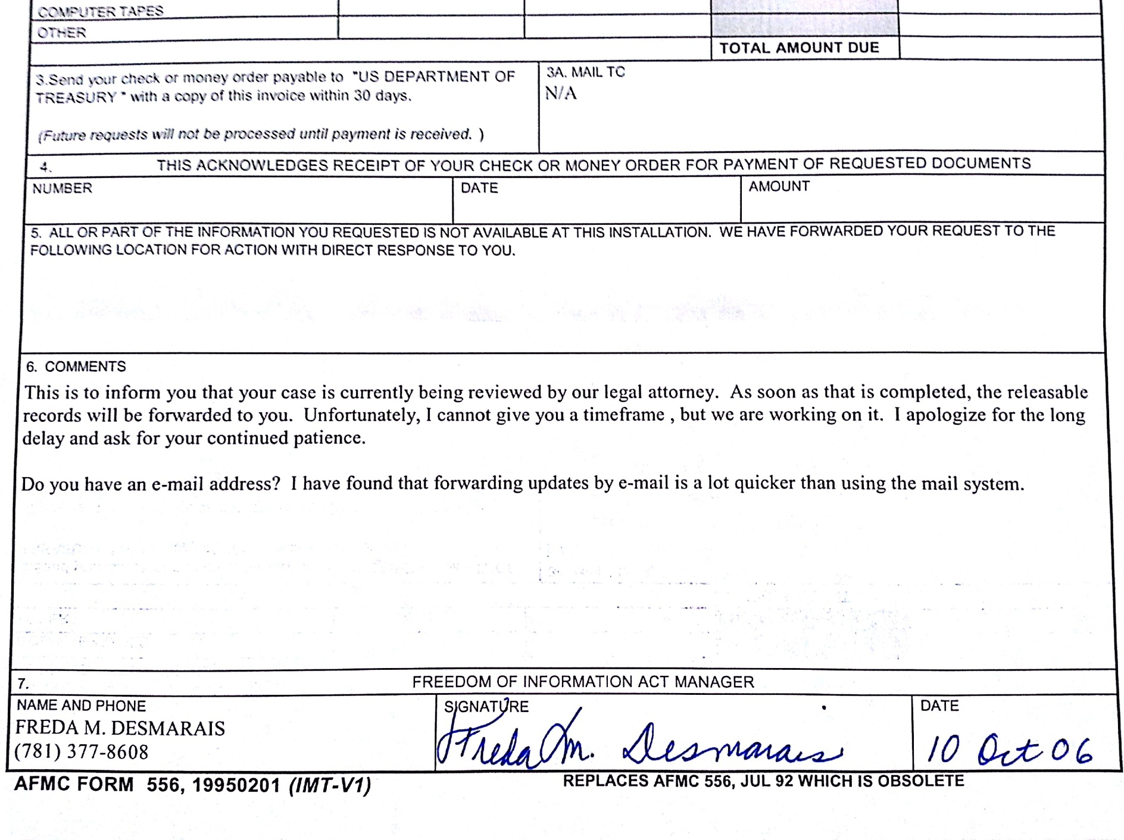
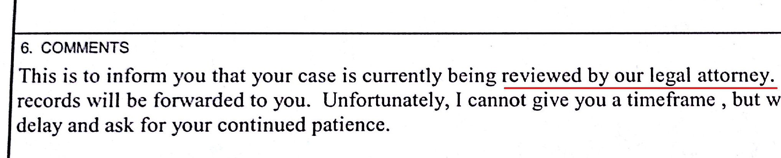
FOIA Fun! – CERT.org
Notes:
http://en.wikipedia.org/wiki/United_States_Computer_Emergency_Readiness_Team
http://gcn.com/articles/2005/08/19/nist-relaunches-database-of-it-vulnerabilities.aspx

Slide 36
Presentation Outline
Caveats – (14 days, why me, bias)
W’s – (what? who? why care?)
History – (set stage for outrage)
Players – (know who to blame)
Suckage - (the outrage)
Evolution – (continue the suckage)
Suffering – (what good VDBs suffer)
Impact – (why this all hurts you)
Notes:
Will build up to ‘suffering’ where I show you examples, with names, of the world of disclosure stupidity.

Slide 37


Why VDBs Suck (All of us…)
Many reasons; some minor, but they add up..
Foolishly believe helping other VDBs or public in any way is bad for business.
Operate very differently.
Mendoza Line (min required effort for relevance)
Notes:
http://en.wikipedia.org/wiki/Mendoza_Line
Images from:
http://bp0.blogger.com/_e-10JWQSmus/R93cGIk1gyI/AAAAAAAAAYk/Yvvi4jwBsxo/s1600/Funny%2Bhedgehog2.jpg
http://blogs.friendlybeings.com/fun/wp-content/uploads/2011/06/hedgetube.jpg

Slide 38
Who Plays With Who? (publicly)
VIM – Vulnerability Information Managers List
April 2005 -> May 2013
VDB / Reps | Post Count
BID x8 (includes parent Symantec) | 94 *
CERT | 6
CVE x3 | 1061
ISS x4 (includes parent IBM) | 5
OSVDB x3 (includes parent OSF) | 792
Secunia | 14
Securiteam | 42
SecurityTracker | 0
Post count != actual contribution necessarily!
Notes:
forced /usr/local/mailman/archives/private/vim# find . -type f -name \*.txt -print | grep -v attachment | sort
forced /usr/local/mailman/archives/private/vim# find . -type f -name \*.txt -exec grep -i secunia\.com {} \; | grep -v attachment | grep From\:
forced /usr/local/mailman/archives/private/vim# find . -type f -name \*.txt -exec grep -i mitre\.org {} \; | grep -v attachment | grep From\: | wc –l
forced /usr/local/mailman/archives/private/vim# find . -type f -name \*.txt -exec grep -i cert\.org {} \; | grep -v attachment | grep From\: | wc –l
Etc etc

Slide 39
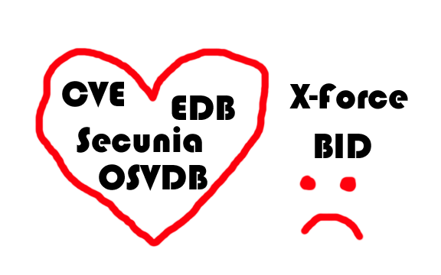
Who Plays With Who? (privately)
Forget the numbers, who actually talks to who behind the scenes?
ISS is after Jun, 2004
Secunia is before Dec, 2012
Notes:
http://www.theregister.co.uk/2003/03/26/conspiracy_theories_abound_in_security/print.html
http://lists.grok.org.uk/pipermail/full-disclosure/2009-April/068770.html

Slide 40

Problems of VDBs – In a Nutshell (and why it affects you)
Assumptions
Assume they know what vulns you are interested in
Assume they know what aspects of vulns are important
Assume they know which vulns aren’t worth adding
Assume everyone uses a VDB the same way
.. Know what they say about people who ‘assume’. Means the VDB sucks ASS .. ume? Whatever. They suck.
Notes:
They assume no one audits medical, e-voting, etc. They assume that no pentester finds bad crypto in use and wants to reference it.

Slide 41

Problems of VDBs – Yes, More…
Largely on business hours (vuln disclosers are not).
Little to no follow-up on posted vulns.
Track “disclosed to them” date, not actual. disclosure date. Can be months, or even a year off.
Few share point of disclosure.
Few care about x-ref to anything but CVE.
Notes:
Image from:
http://i.stack.imgur.com/jiFfM.jpg

Slide 42

Abstraction
Abstraction is the way we catalog a vulnerability or group several vulnerabilities.
Each VDB does it differently.
One CVE can map to 66 vulns (e.g. CVE-2006-2063)
Some VDBs change their abstraction over the years
Microsoft Message Queuing RPC code execution (45537)
Microsoft Windows KB 951071 not installed (45538)
(Same vuln, 2 IDs for 2 different reasons)
Notes:
http://www.cve.mitre.org/cgi-bin/cvename.cgi?name=CVE-2006-2063

Slide 43
Presentation Outline
Caveats – (14 days, why me, bias)
W’s – (what? who? why care?)
History – (set stage for outrage)
Players – (know who to blame)
Suckage - (the outrage)
Evolution – (continue the suckage)
Suffering – (what good VDBs suffer)
Impact – (why this all hurts you)
Notes:
Will build up to ‘suffering’ where I show you examples, with names, of the world of disclosure stupidity.

Slide 44
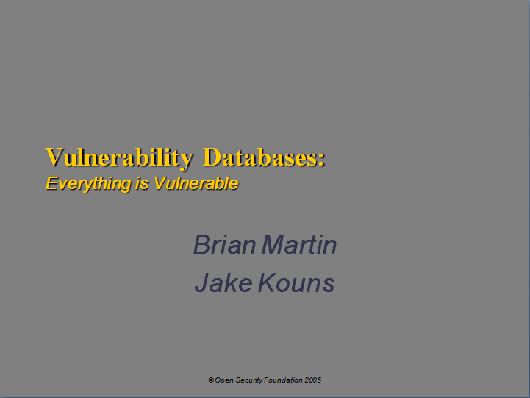
Back in 2005…
Jake and I presented on VDBs…
Predominant theme was VDBs aren’t evolving…
Has anything changed?

Slide 45
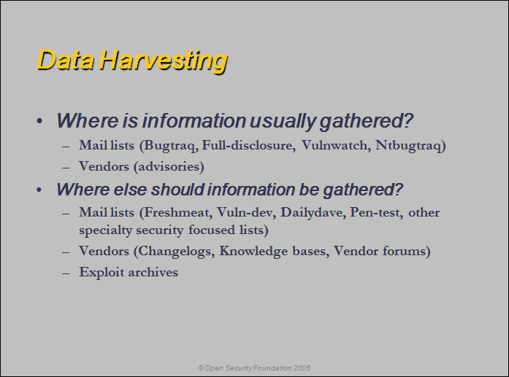
Back in 2005…
Still largely the same for most VDBs…

Slide 46
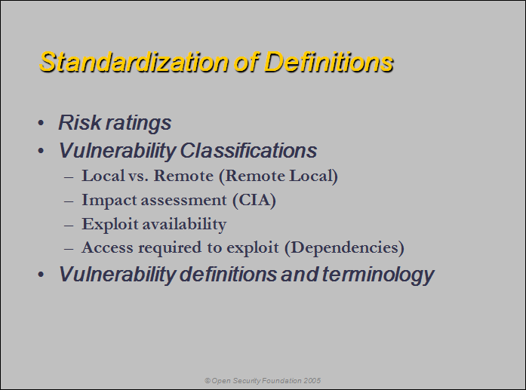
Back in 2005…
CVSS adopted by most.
Classifications still primitive for almost all…

Slide 47
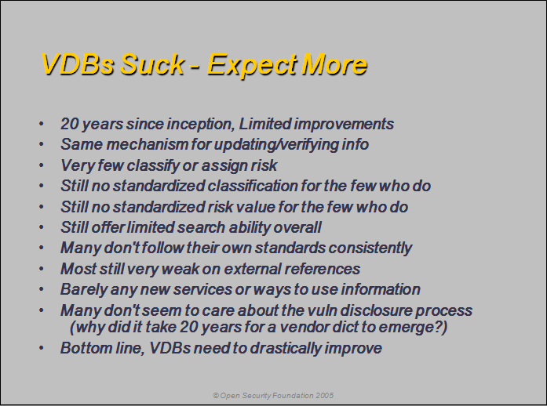
Back in 2005…
No one expected more. VDBs delivered no more.

Slide 48

Evolution - In Summary
Lack of Evolution – Same VDBs they were 10 20 years ago, with very few exceptions.
Do you keep using/buying software that doesn’t change that long? Rarely.
Yet you keep using the same VDB you know and love and rely on? Odd.
Why no evolution? There’s certainly demand, as seen by other services/software.
Mostly due to complacency (Mendoza Line)

Slide 49
Presentation Outline
Caveats – (14 days, why me, bias)
W’s – (what? who? why care?)
History – (set stage for outrage)
Players – (know who to blame)
Suckage - (the outrage)
Evolution – (continue the suckage)
Suffering – (what good VDBs suffer)
Impact – (why this all hurts you)
Notes:
Will build up to ‘suffering’ where I show you examples, with names, of the world of disclosure stupidity.

Slide 50

Suffering (we haz it)
Notes:
Image from:
http://www.prowallpapers.ro/download/emo_everybody_hurts-1280x800.jpg

Slide 51

Challenges We Face
I can’t begin to describe the headache we deal with on a daily basis.
Truly unhealthy levels of rage.
We walk away from the computer to avoid violent outbursts.
Hackers? Morons mostly.

Slide 52

What we suffer through - Researchers
MustLive
We know, you found 2938423 vulns. All of them the same 4 base vulns in 2938419 WordPress themes.
Vulnerability Lab (Vuln Lab)
Hey ThreatPost, quit encouraging them.
Not every shitty iOS app deserves an article.
Can’t write an advisory to save baby Jesus’ life.
Refuse our offers to help them write better advisories.
Packetstorm/EDB - No versions included
They tend to test old versions. Guess which!
LFI vs Traversal, same thing right??
Not at all, you are just ignorant.
Tip of the iceberg…
Notes:
http://threatpost.com/remote-code-injection-vulnerabilities-discovered-in-ios-apps/
^ not the first article giving them attention for absolute shitty research
^ I’ve called ThreatPost out on it before too, little care or follow-up in fixing articles

Slide 53
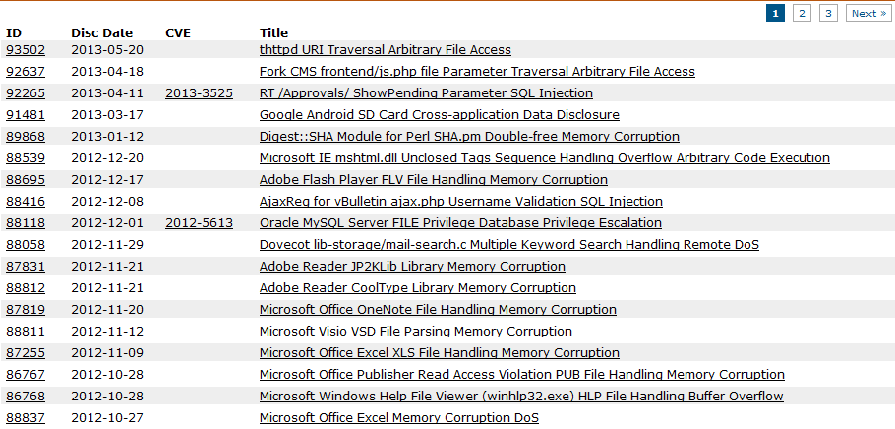
What we suffer through - Researchers
Inaccurate reports! (p.s. How many VDBs track that?)
Myth/Fake
Notes:
http://threatpost.com/remote-code-injection-vulnerabilities-discovered-in-ios-apps/
^ not the first article giving them attention for absolute shitty research
^ I’ve called ThreatPost out on it before too, little care or follow-up in fixing articles

Slide 54
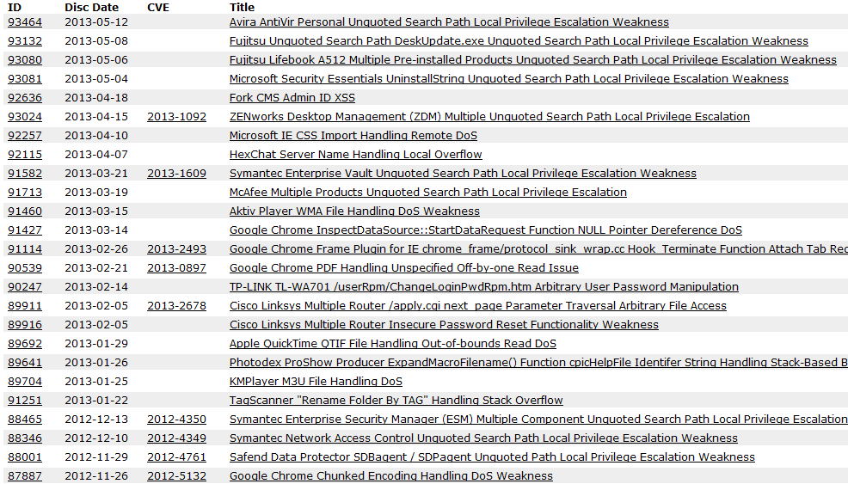
What we suffer through - Researchers
Inaccurate reports! (p.s. How many VDBs track that?)
Not a vulnerability (i.e. crash / stability, by design, etc)

Slide 55

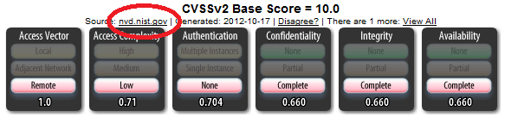
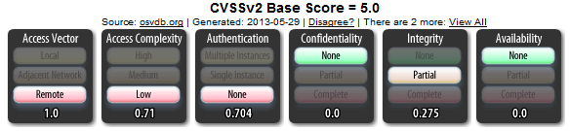

What we suffer through - Vendors
Oracle, like many, changed URL schemes for security advisories. 404 hell now
Oracle and CVSS .. Meh.

Slide 56
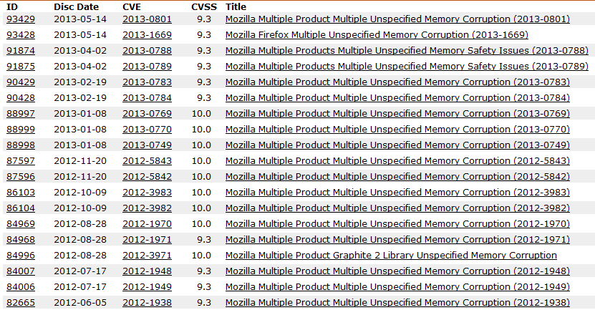
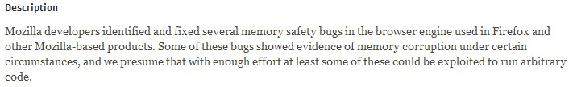
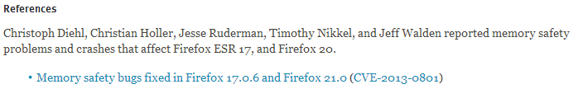

What we suffer through - Vendors
Mozilla vague lumps of serious issues. Only references are closed bug reports.
Notes:
http://www.mozilla.org/security/announce/2013/mfsa2013-41.html
Now we have to go check those bug reports every month or two to see if they are open, so we can get details.

Slide 57
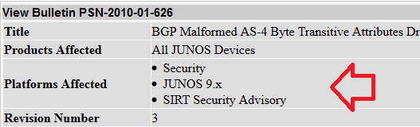

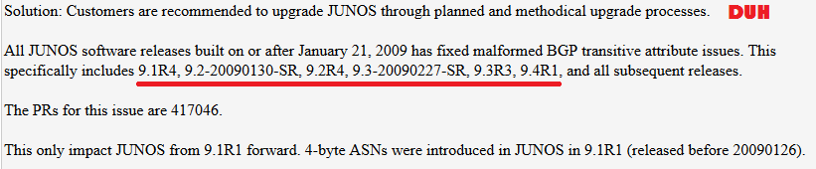
What we suffer through - Vendors
Juniper required login, had advisories spread over 21 different pages.
They were vague and contradictory.
Notes:
Juniper finally consolidated all advisories to one page, made them public, and began including more detailed information on affected platforms.
Downside? Added another tracking ID scheme to all advisories, including past ones.

Slide 58
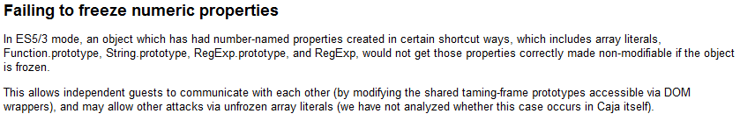
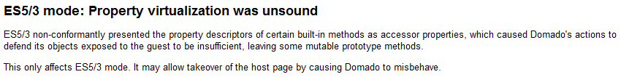

What we suffer through - Vendors
They speak a different language sometimes.
Notes:
Image from:
http://l.yimg.com/ea/img/-/130123/cat1_18fuo1d-18fuo82.jpg?x=500&q=80&n=1&sig=9x6uxQn7ws7XdMniPdIPyg--

Slide 59
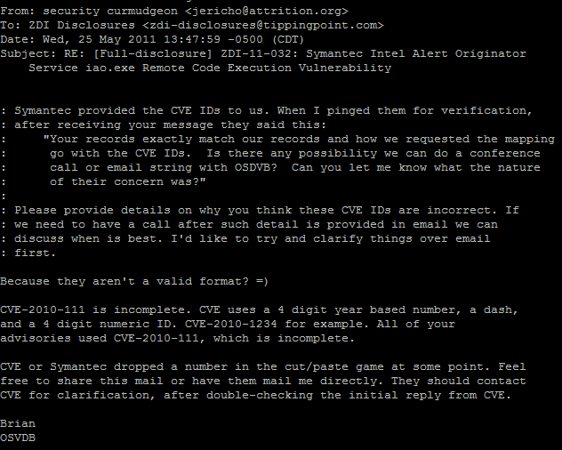

What we suffer through - Others
HP/ZDI and CVE errors – several the past year+
Worse, have to educate them on CVE
Notes:
Original image from:
http://cdn.ebaumsworld.com/mediaFiles/picture/1989829/81579669.jpg
(then DERPified)

Slide 60
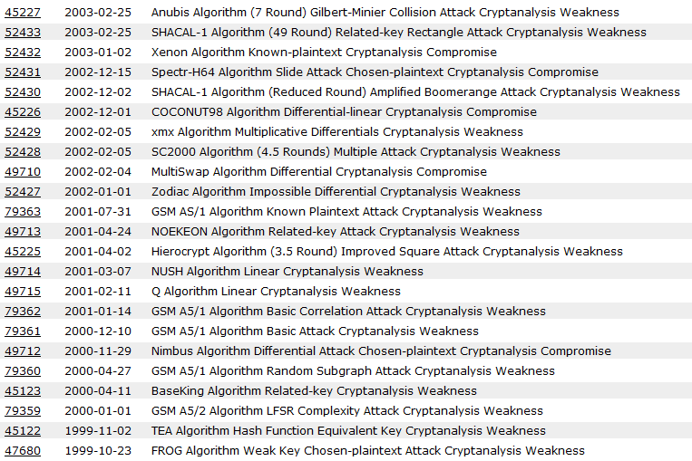
What we suffer through – Self-imposed
Crypto Algorithms? CHECK!

Slide 61
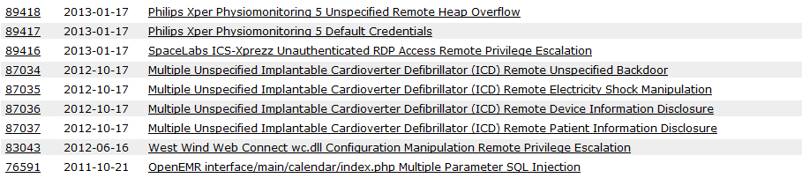
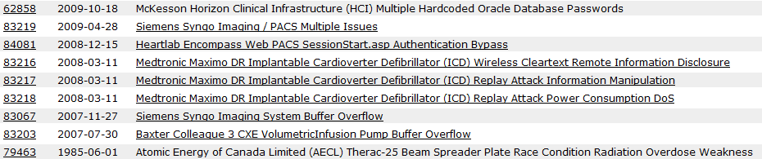
What we suffer through – Self-imposed
“Obscure” hardware (Medical)? CHECK!

Slide 62
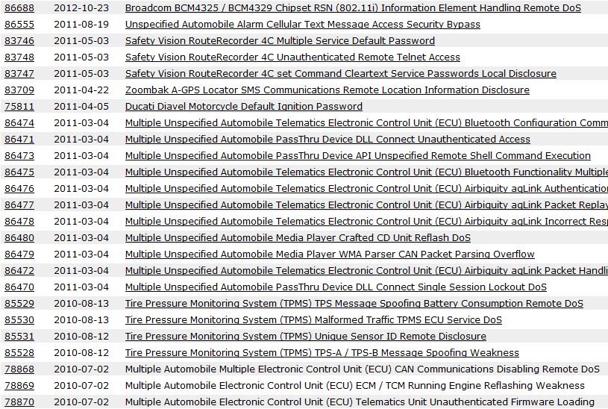
What we suffer through – Self-imposed
“Obscure” hardware (Automotive)? CHECK!

Slide 63
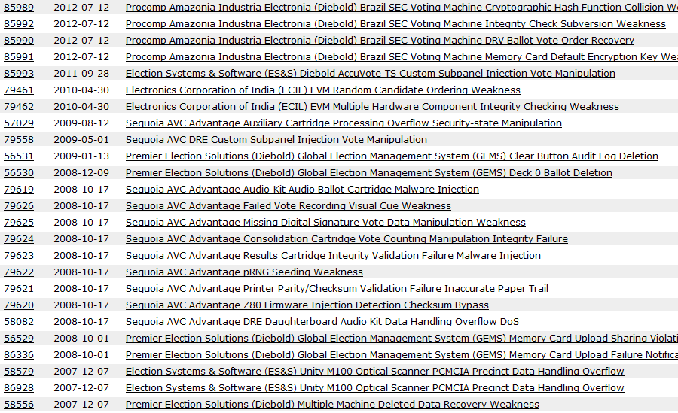
What we suffer through – Self-imposed
“Obscure” hardware (Electronic Voting Machines)? CHECK!

Slide 64
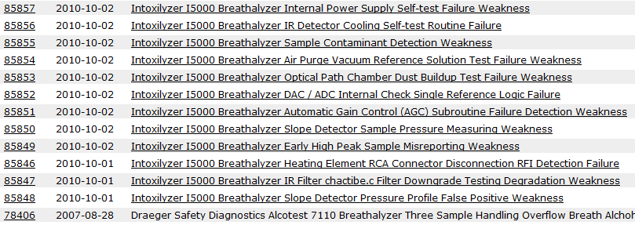

What we suffer through – Self-imposed
“Obscure” hardware (Breathalyzer)? CHECK!

Slide 65
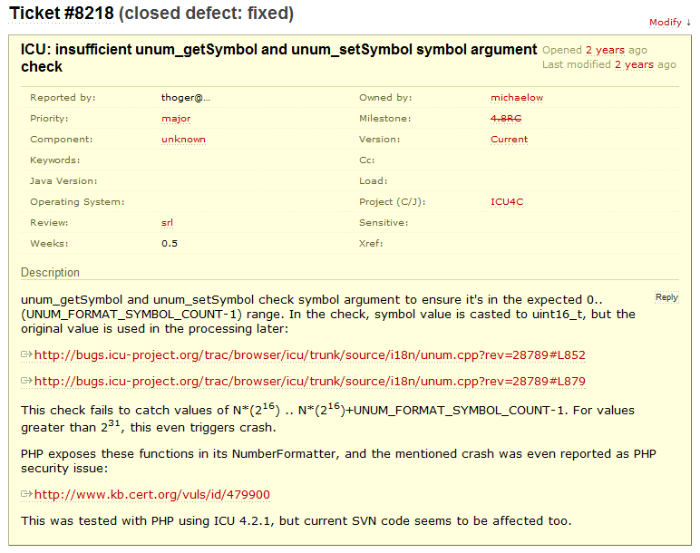

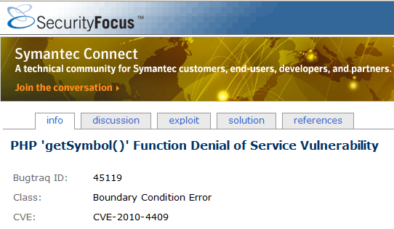
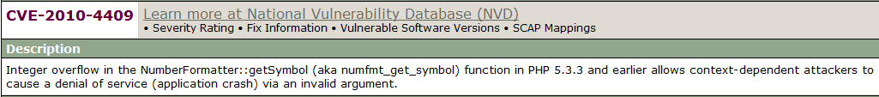
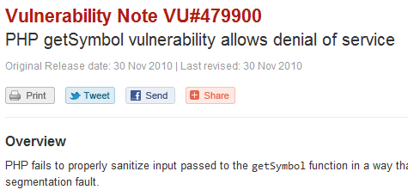
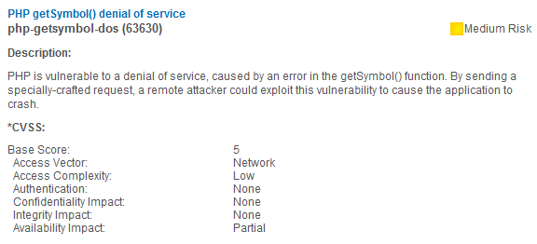
What we suffer through – Trivial Details
Disclosed vuln in PHP function, simple.
ended up being ICU code, that was how PHP manifested

Slide 66
What we suffer through – Libraries
Like PHP/ICU, illustrates the “library” problem.
Most big software uses third-party code.
Can figure out some of it via Third-Party EULA.
Required distribution with product per licenses.
Some vendors try to obscure which software they use “for security reasons”
Vuln in third-party software means vuln in product using it.
May manifest as DoS in one, code exec in other.

Slide 67
What we suffer through – Libraries
Example: Adobe Reader = 113 third-party dependencies
Henry Spencer, Regents of the University of California
Netscape Communications
RSA Security, Inc.
Eric Young
Sam Leffler, Silicon Graphics, Inc
Greg Roelofs
Independent JPEG Group, Thomas G. Lane
Massachusetts Institute of Technology (MIT)
TWAIN Working Group
Hewlett Packard (HP)
NeXT Inc
Apache Software Foundation
Regents of the University of California
Silicon Graphics, Inc
University of Utah and the Center for Software Science at the University of Utah
RSA Data Security, Inc
James Clark
Sam Leffler, Pixar
Regents of the University of California, X Consortium
3Com, Palm Computing Division
OpenSSL Project, Eric Young
Apache Software Foundation
WIDE Project
Regents of University of California
Massachusetts Institute of Technology (MIT), CERN
P.J. Plauger, Hewlett Packard (HP)
Apache Software Foundation, Contributors
International Business Machines (IBM)
Apple Computer, Inc.
Silicon Graphics Computer Systems, Inc.
Free Software Foundation, Inc
Boost Contributors
Julian Smart, Robert Roebling
Silicon Graphics, Inc.
Massachusetts Institute of Technology (MIT)
Apple Computer, Inc.
Netscape Communications
Massachusetts Institute of Technology (MIT)
Regents of the University of California
Unicode, Inc.
OpenVision Technologies, Inc
Ginger Alliance
Info-ZIP
Massachusetts Institute of Technology (MIT)
FOGRA (Forschungsgesellschaft Druck)
Intel
JMI Software Consultants
Digital Equipment Corporation
Open Group
Open Group, The XFree86 Product, Inc.
Info-ZIP
Keith Packard, The XFree86 Project, Inc.
Jean Loup Gailly, Mark Adler
Princeton University
FreeType Project, David Turner, Robert Wilhelm, Werner Lemberg
Mitsubishi Electric Research Laboratories, Inc. (MERL)
On2 Technologies, Inc.
Nellymoser, Inc.
Sorenson Media, Inc
Open BSD Project, Contributors
Jean-loup Gailly, Mark Adler
Common Development and Distribution License (CDDL) Contributors
Hewlett Packard (HP), Silicon Graphics Computer Systems, Inc.
Andrei Alexandrescu
Spirit Technologies
Greg Colvin, Beman Dawes; Andrei Alexandrescu
Jean-loup Gailly, Mark Adler
www.graphicsgems.org, Eric Haines
Philip Hazel/University of Cambridge
Apple Computer, Inc
MPEG LA LLC
Thomson Licensing, Fraunhofer
FlexLib Contributors
Free Software Foundation
Christophe Devine
Red Hat, Inc.
Henri Torgemane and RSA Data Security, Inc.
University of Cambridge, Google, Inc.
Jean-Marc Valin, Xiph.Org Foundation
Olivier Gay
Bernard Desgraupes
Futurescale, Inc.
Open Cascade SAS,Open CASCADE (Open CASCADE Technology Public License)
Free Software Foundation, Inc.
Keith Packard
World Wide Web Consortium (W3C), Massachusetts Institute of Technology (MIT), Institut National de Recherche en Informatique et en Automatique, Keio University
Autodesk, Inc
Google, The Chromium Authors
Mozilla Corporation and contributors
Code Project Open License, Author
Eastman Kodak Company
Verisign Inc.
Mike Sharov
The Android Open Source Project
Hamcrest
Solid Documents LLC
Autodesk, Inc
Mark Adler
Gilles Vollant
Christos Zoulas
Glenn Randers-Pehrson
The Android Open Source Project
Jean-loup Gailly and Mark Adler
NVIDIA
Kevin B. Hendricks
Grant Skinner
www.mozilla.org.
RSA Security Inc.
Mark Hammond
Colosseum Builders
Linux Foundation, IBM Corp. 2006, Sun Microsystems, Inc
OpenOffice.org
Sphinx
Notes:
http://www.adobe.com/products/eula/third_party/
Adobe Acrobat XI Pro, Standard and/or Reader
http://www.adobe.com/products/eula/third_party/acrobat/11/Acrobat_Reader_XI_3rd_Party_Read_Me_ver_1.pdf
61 pages, 113 external software used at least. software copyrights range from 1981 to 2012

Slide 68

What we suffer through – Libraries
flv_player.swf
tagcloud.swf
ZeroClipboard.swf
Jplayer.swf
TinyBrowser / Tiny
SPAW Editor
FCKEditor
TimThumb

Slide 69
What we suffer through – Libraries
OpenSSL
OpenSSH
BIND
Java
Apache HTTP Server
Libpng
LibTIFF
ICU
etc.. etc..

Slide 70
Presentation Outline
Caveats – (14 days, why me, bias)
W’s – (what? who? why care?)
History – (set stage for outrage)
Players – (know who to blame)
Suckage - (the outrage)
Evolution – (continue the suckage)
Suffering – (what good VDBs suffer)
Impact – (why this all hurts you)
Notes:
Will build up to ‘suffering’ where I show you examples, with names, of the world of disclosure stupidity.

Slide 71

Obvious Impact
Incomplete VDB = products are also incomplete that rely on them.
Patching decisions made based on VDBs.
Vuln severity (CVSS)
Exploit availability
More you know how your favorite VDB operates, more you can work around shortcomings
Other industry-wide metrics & stats based on the info in VDBs….

Slide 72
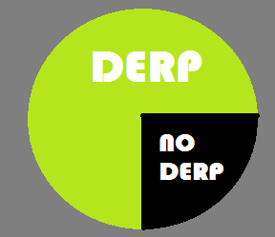
Why Vuln Stats are Worthless
Inconsistent abstraction
Significant gaps in coverage of vulns
Specific focus and not caring about historical
Bad analysis, no method for us to validate
Sweeping assumptions about outside influences on stats or patterns
Entries not created on root-cause
Notes:
http://blog.osvdb.org/category/vulnerability-statistics/
http://krebsonsecurity.com/2010/11/why-counting-flaws-is-flawed/
http://citeseerx.ist.psu.edu/viewdoc/download?doi=10.1.1.203.5387&rep=rep1&type=pdf
The Use, Misuse, and Abuse of Statistics in Information Security Research by Julie J.C.H. Ryan & Theresa I. Jefferson

Slide 73
Why Vuln Stats are Worthless - Abstraction
Remember the abstraction bit? Means externally, some VDBs are worthless for generating stats.
Almost no one gives criteria for a vulnerability or explains their abstraction. Secunia even disclaims their stats are not ideal (2011 yearly, page 6)
Secunia has 28 advisories for CVE-2013-1493 (a single vuln).
IBM 31541 = 1 entry for entire oracle CPU (30 different CVE).
IBM 45537 / 45538 = 2 entries for same CVE (actual vuln / missing patch for vuln)
Notes:
http://secunia.com/gfx/pdf/Secunia_Half_Year_Report_2010.pdf
P1: A group of ten vendors, including Microsoft, Apple, Oracle, IBM, Adobe, and Cisco, account on average for 38 percent of all vulnerabilities disclosed per year.
P5: Apple, Oracle, Microsoft, HP, Adobe, IBM, VMware, Cisco, Google, Mozilla
P2: Since 2005, no significant up-, or downward trend in the total number of vulnerabilities in the more than 29,000 products covered by Secunia Vulnerability Intelligence was observed.
http://news.softpedia.com/news/Number-of-Vulnerabilities-Expected-to-Double-this-Year-147186.shtml
According to vulnerability research company Secunia, the number of vulnerabilities is expected to double in 2010 compared to last year.
http://www-958.ibm.com/software/data/cognos/manyeyes/visualizations/vulerabilities-per-year
Created at: Mar 30 2011 IBM documented more than 8,000 new vulnerabilities, a 27 percent rise from 2009.
1996 – 2010 by year
http://www.symantec.com/threatreport/topic.jsp?id=vulnerability_trends&aid=total_number_of_vulnerabilities
2006 – 2011 breakdown of vulns per year, source “Symantec cloud”
The total number of new vulnerabilities reported in 2011 stood at 4,989. This figure works out to approximately 95 new vulnerabilities a week.
http://www.cert.org/stats/
1995 – 2007 breakdown of vulns per year
http://www.ibm.com/common/ssi/cgi-bin/ssialias?subtype=XB&infotype=PM&appname=SWGE_WG_WG_USEN&htmlfid=WGE03019USEN&attachment=WGE03019USEN.PDF
At the mid-year point in 2012.. IBM X-Force data continues to demonstrate declines in true exploits, with only 9.7 percent of all publically disclosed vulnerabilities subjected to exploits.

Slide 74
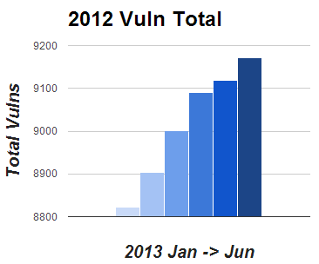
Why Vuln Stats are Worthless
There were “$num vulns in $year” should make you run. There were between 4,842 and 10,896 vulnerabilities in 2006 depending on the VDB you use.
Notes:
4,842 = http://www.symantec.com/threatreport/topic.jsp?id=vulnerability_trends&aid=total_number_of_vulnerabilities
10,896 = http://osvdb.org/ (Search by date range)
OSVDB searching by date range on the following dates. This shows we’re constantly adding older entries that affect per-year totals.
2013-01-03 = 8822 vulns in 2012
2013-02-01 = 8904 vulns in 2012
2013-03-03 = 9002 vulns in 2012
2013-04-01 = 9091 vulns in 2012
2013-05-01 = 9118 vulns in 2012
2003-05-29 = 9171 vulns in 2012

Slide 75
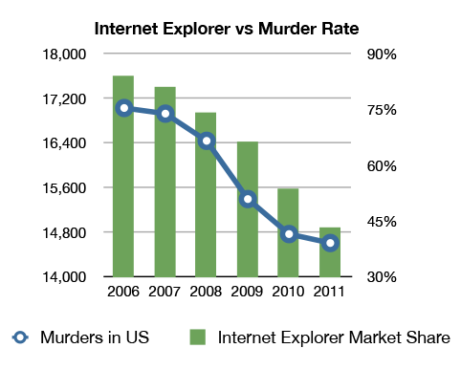
Why Vuln Stats are Worthless
These stat issues and other reasons lead to really bad assumptions.

Slide 76
Impact - CVE Creation
Showed how much money goes into CVE
CVE can’t keep up with ID assignment [1]
CVE’s top CNA can’t handle mass assignments [2]
“We are not able to handle your request for CVEs for all of the issues that OSVDB has published. Unfortunately, CVE can no longer guarantee full coverage of all public vulnerabilities.” – Steve Christey of MITRE/CVE
Notes:
[1] http://cve.mitre.org/data/board/archives/2012-11/msg00012.html
http://cve.mitre.org/data/board/archives/2012-06/threads.html
http://attrition.org/pipermail/vim/2013-March/002657.html
[2] http://seclists.org/oss-sec/2013/q1/588
Other’s notice: http://seclists.org/oss-sec/2013/q2/136

Slide 77

Impact - CVE Creation vs Analysis
CVE -> NVD
CVE -> CVEDetails
CVE -> vFeed
More time is going into analyzing the data, than building a better data set. Common problem.
Notes:
http://nvd.nist.gov/
http://cvedetails.com/
http://www.toolswatch.org/vfeed-the-open-source-correlated-cross-linked-vulnerability-xml-database/

Slide 78
VDB Stat Failure
“The Secunia Advisory count is a first order approximation for the number of Vulnerability Events, which is the number of administrative actions required to keep the specific product secure throughout a given period of time.”
“Vulnerability/CVE counts are a viable metric for the number of distinct vulnerabilities found in software.” [1] – WRONG
If a VDB can’t get stats right, we’re screwed.
Notes:
[1] http://secunia.com/gfx/pdf/Secunia_Half_Year_Report_2010.pdf

Slide 79
Take-aways
The more you learn how VDBs operate, the more you see it’s the foundation of a straw house.
Is there any wonder bad guys have so much success?
Every company that relies on CVE/NVD is only missing 23,935 vulnerabilities. That we know of…
That number is very low. We know where to find more, just lacking resources (time).
Demand more from your VDB. Evolve bitchez.
VDBs are not vulnerability gospel.

Slide 80

Thanks!
Jake Kouns, Carsten Eiram, Daniel Moeller
Steve Christey
Lyger, Steve Tornio, CJI, Chris Sullo, Marlowe, Alexander Koren, Zach Shue
Andre Frech, James Williams, Stuart Moore, Ryan Russell, Art Manion
D2D & Peter
Notes:
Image from:
https://encrypted-tbn2.gstatic.com/images?q=tbn:ANd9GcSjb3C0L0Vs1iqF5Bh6CfYxxpy-rNdgoSROUQ_g00zr01xuenLL

Slide 81
Questions for the Straw House?
Notes:
This is Tater, my guinea pig. She will eat your spleen.

