Slide 1


IADFI.org
Social Media Forensics Investigator

Slide 2
IADFI.org
Social Media Forensics Investigator
ComputerForensics@live.com
Post questions / comments
To IADFI in the forum.
Http://iadfi.com

Slide 3
Social Media Forensics
Why???
Criminal reasons
Missing Persons
Infidelity
Malware
Scams, Fraud, Human trafficking…
Child Pornography
Illegal media sharing...

Slide 4

IADFI.org
Social Media Forensics Investigator

Slide 5
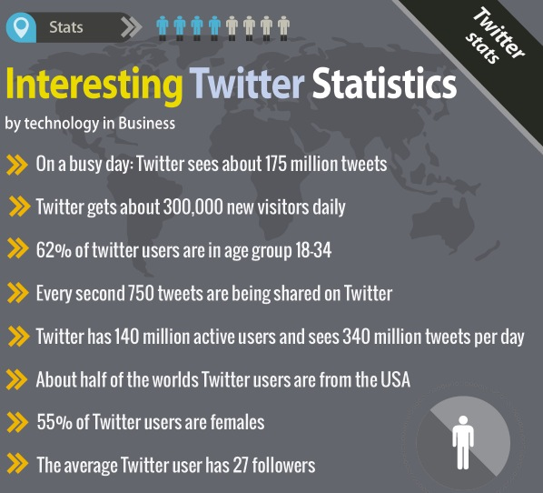
Social Media Forensics

Slide 6
Social Media Forensics
https://twitter.com/BarackObama
http://twitter.com/MichelleObama

Slide 7
Social Media Forensics
TwitPic
https://twitter.com/search?q=twitpic&src=typd
Yfrog
http://yfrog.com/
Instagram
http://instagram.com/p/VCpc9ugVxz/

Slide 8
ow.ly
SmugMug
Posterous
Mobypicture
Flickr
Twitgoo
TwitrPix

Slide 9
Social Media Forensics
TwitPic
https://twitter.com/search?q=twitpic&src=typd
https://twitter.com/MichelleObama/status/292020802738606080/photo/1
Yfrog
http://yfrog.com/
Instagram
http://instagram.com/p/VCpc9ugVxz/

Slide 10
Social Media Forensics
New Twitter Video Network
http://vine.co/
Mobile apps. Keep an eye on this...

Slide 11
Social Media Forensics
Twitter RSS feed
Undocumented...
http://api.twitter.com/1/statuses/user_timeline.rss?screen_name=MichelleObama
http://api.twitter.com/1/statuses
/user_timeline.rss?screen_name=MichelleObama
Twitter API. Every user has a unique #
id: 409486555, screenname: MichelleObama
Names may change! Twitter ID unique!

Slide 12
Social Media Forensics
Twitter Directory Sites
topsy.com
twellow.com
twbirthday.com
http://twtbizcard.com/MichelleObama
http://amplicate.com/search?q=MichelleObama
http://tweetreach.com/reach?q=%23dfir

Slide 13

Social Media Forensics
Facebook

Slide 14
Social Media Forensics
Facebook...
Profile Information, Location, Photos...
Text and Links, Checkins
Friends / Close Friends / Family
Apps
Pages
Groups
Interests ***

Slide 15
Social Media Forensics
Facebook Rumor!!!
A Dating Site???
All the profile information is there
It fits the criteria
They need to make money :)
Promoted Posts...

Slide 16
Social Media Forensics
New~ “Facebook Graph Search”
Not Open Graph
Not Graph API
Turn on
http://www.facebook.com/about/graphsearch
Article
http://za.news.yahoo.com/graph-search-power-facebook-amplified-050548321.html

Slide 17
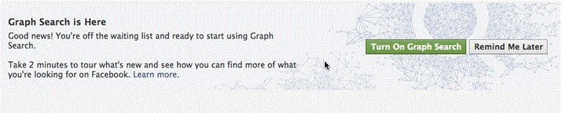
Social Media Forensics
New~ “Facebook Graph Search”

Slide 18
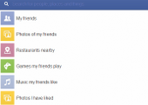
Social Media Forensics
New~ “Facebook Graph Search”

Slide 19
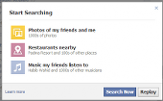
Social Media Forensics
New~ “Facebook Graph Search”

Slide 20
Social Media Forensics
Facebook Apps ~ Security concerns
Facebook Security ~ Moving target
Unfriend someone ~ They may still be able to see your content!

Slide 21
Social Media Forensics
Facebook Warning!
Someone may easily “clone” your account!
Invite your friends to join YOU.
Ask them to install an app...
Ask them to click an infected link...
...

Slide 22
Social Media Forensics
Why???
Criminal reasons
Missing Persons
Infidelity
Malware
Scams, Fraud, Human trafficking…
Child Pornography
Illegal media sharing...

Slide 23

Social Media Forensics

Slide 24
Social Media Forensics
LinkedIn User Profiles
http://www.linkedin.com/in/assist
http://www.linkedin.com/profile/view?id=3480686
LinkedIn Company Profiles
LinkedIn Groups
Advanced Search
http://www.linkedin.com/search?trk=advsrch
Premium Accounts

Slide 25

Social Media Forensics

Slide 26
Social Media Forensics
Meetup.com
Groups based...
http://www.meetup.com/indy-tweetups/
Profiles...
http://www.meetup.com/indy-tweetups/members/10259475/
Photos uploaded... User tagged.
Relationships. You know... Both members...
Meetup Blog uses Tumblr ???

Slide 27
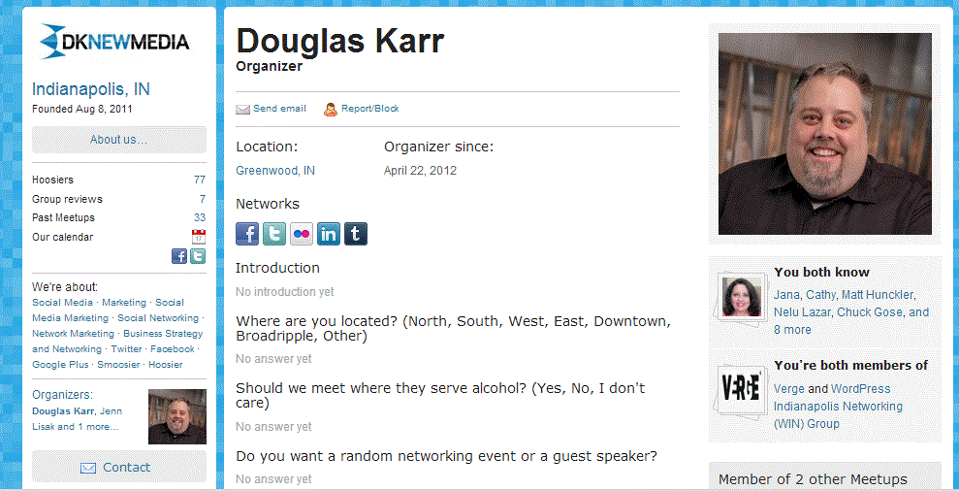
Social Media Forensics

Slide 28

Social Media Forensics

Slide 29

Social Media Forensics

Slide 30
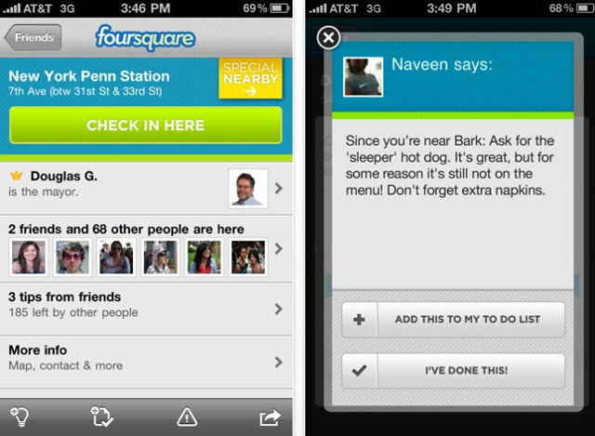
Social Media Forensics

Slide 31
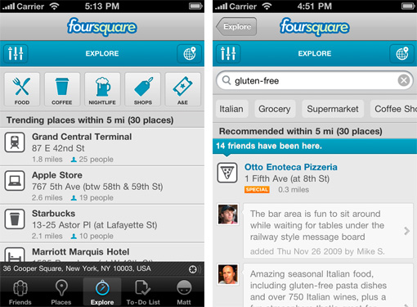
Social Media Forensics

Slide 32
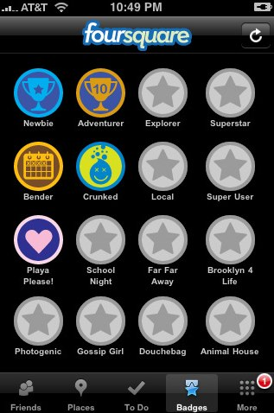
Social Media Forensics

Slide 33

Social Media Forensics

Slide 34
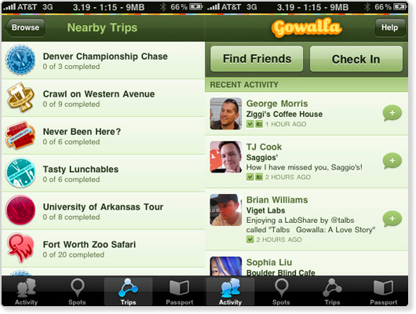
Social Media Forensics

Slide 35
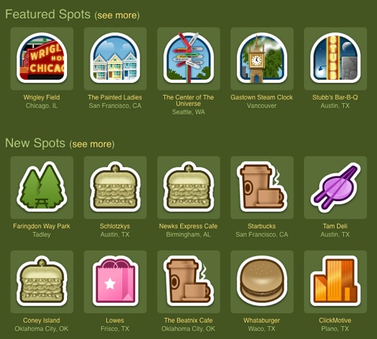
Social Media Forensics

Slide 36
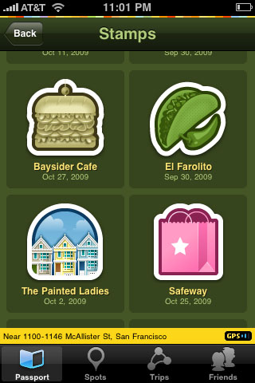

Social Media Forensics

Slide 37
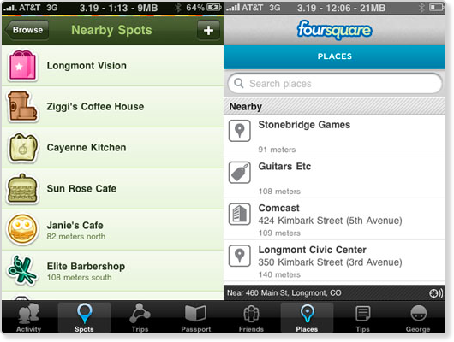
Social Media Forensics

Slide 38

Social Media Forensics

Slide 39
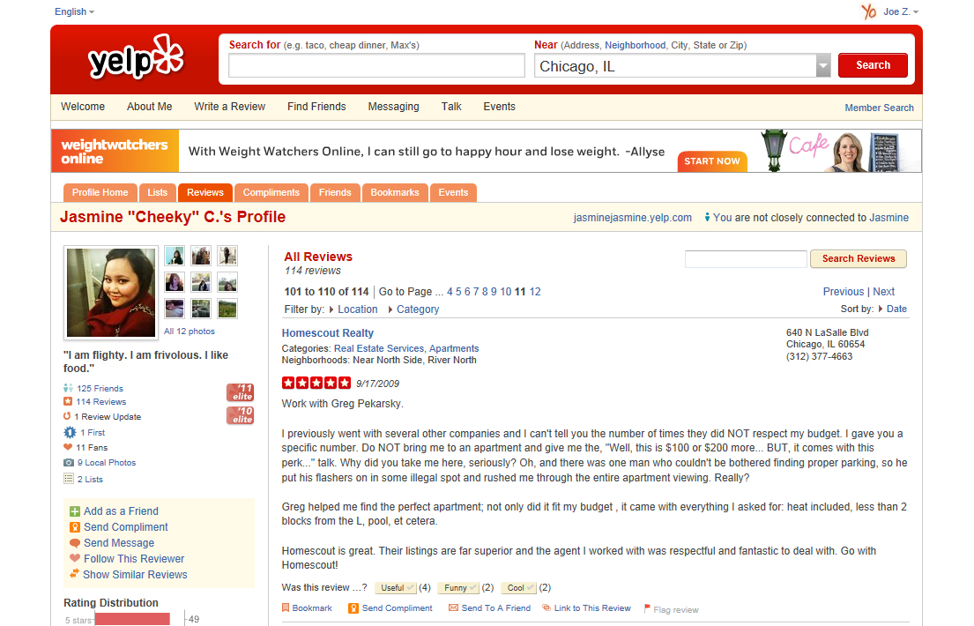
Social Media Forensics

Slide 40
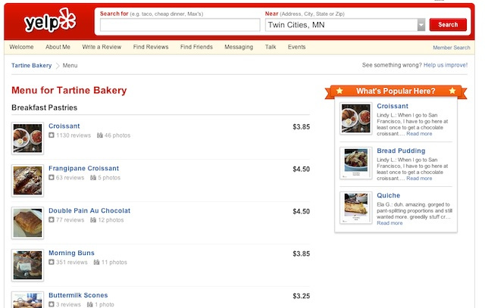
Social Media Forensics

Slide 41
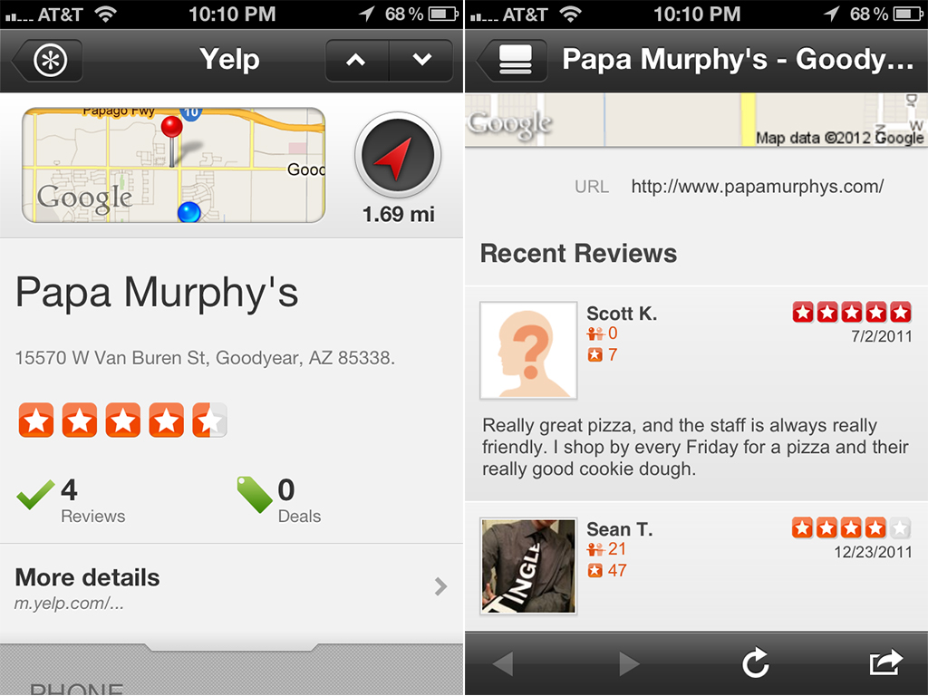
Social Media Forensics

Slide 42
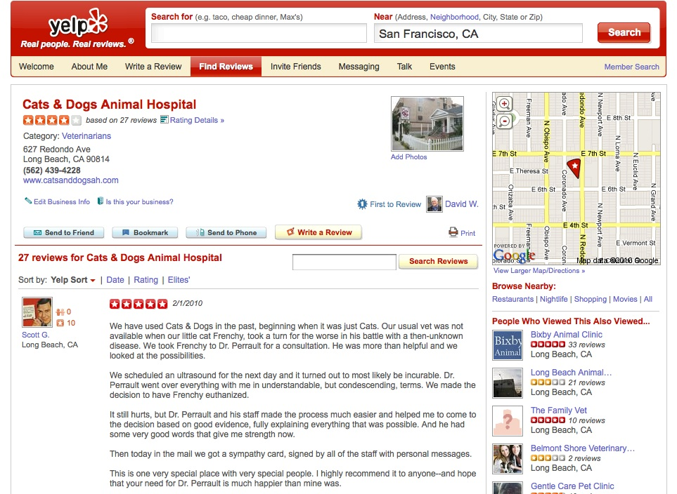
Social Media Forensics

Slide 43
Social Media Forensics

Slide 44
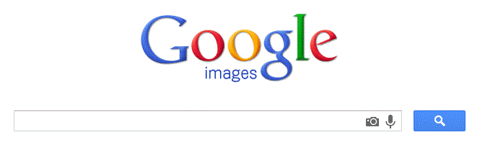
Social Media Forensics

Slide 45
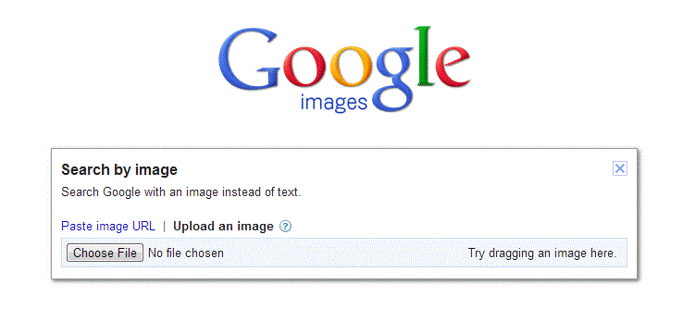
Social Media Forensics

Slide 46
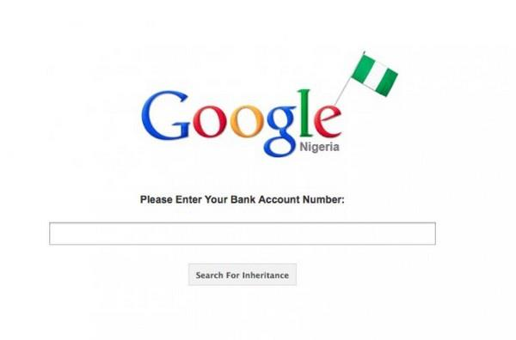
Social Media Forensics

Slide 47


Slide 48
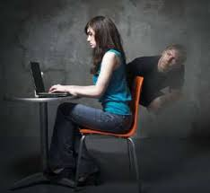
Why Social Media Forensics?

Slide 50
IADFI.org
Social Media Forensics Investigator
Brian Lockrey
@iadfi
@InfoSecMash
ComputerForensics@live.com

