Slide 1



Slide 2
Future of Government Info Sharing
Chris Wysopal
CTO & Co-founder Veracode

Slide 3

The Future of Disclosure?
Notes:
Do we want a military and intelligence community vision of information sharing?

Slide 4

Enhanced Cybersecurity Services
Collect and Hide Information
Secret black boxes with secret signatures to protect you while maintaining ability of US Government to fight offensively
Notes:
Government vision of Information sharing is reactive. Attack signatures and Attack sources

Slide 5
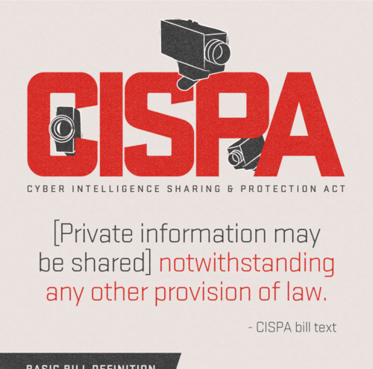
US Government Vision for Information Sharing
Threat information only
Attack signatures and Attack sources
Collected by Govt and Industry
Shared in secret

Slide 6

Or do we treat information risk as a health and safety issue

Slide 7




Collect and Share Information
Notes:
CDC - Mandatory Reporting of Infectious Diseases by Clinicians
Under the OSHA Recordkeeping regulation (29 CFR 1904), covered employers are required to prepare and maintain records of serious occupational injuries and illnesses, using the OSHA 300 Log. This information is important for employers, workers and OSHA in evaluating the safety of a workplace, understanding industry hazards, and implementing worker protections to reduce and eliminate hazards.
Dangerous Products (Section 15) - Manufacturers, importers, distributors, and retailers are required to report to CPSC under Section 15 (b) of the Consumer Product Safety Act (CPSA) within 24 hours of obtaining information which reasonably supports the conclusion that a product does not comply with a safety rule issued under the CPSA, or contains a defect which could create a substantial risk of injury to the public or presents an unreasonable risk of serious injury or death, 15 U.S.C. § 2064(b). Companies can use our on-line form to report a potentially defective or hazardous product.
NTSB Federal regulations require operators to notify the NTSB immediately of aviation accidents and certain incidents. An accident is defined as an occurrence associated with the operation of an aircraft that takes place between the time any person boards the aircraft with the intention of flight and all such persons have disembarked, and in which any person suffers death or serious injury, or in which the aircraft receives substantial damage. An incident is an occurrence other than an accident that affects or could affect the safety of operations. (See 49 CFR 830.)

Slide 8
Mandatory Reporting
CDC - Mandatory Reporting of Infectious Diseases by Clinicians
Under the OSHA Recordkeeping regulation (29 CFR 1904), covered employers are required to prepare and maintain records of serious occupational injuries and illnesses, using the OSHA 300 Log. This information is important for employers, workers and OSHA in evaluating the safety of a workplace, understanding industry hazards, and implementing worker protections to reduce and eliminate hazards.
CPSC - Dangerous Products (Section 15) - Manufacturers, importers, distributors, and retailers are required to report to CPSC under Section 15 (b) of the Consumer Product Safety Act (CPSA) within 24 hours of obtaining information which reasonably supports the conclusion that a product does not comply with a safety rule issued under the CPSA, or contains a defect which could create a substantial risk of injury to the public or presents an unreasonable risk of serious injury or death, 15 U.S.C. § 2064(b).
NTSB Federal regulations require operators to notify the NTSB immediately of aviation accidents and certain incidents. An accident is defined as an occurrence associated with the operation of an aircraft that takes place between the time any person boards the aircraft with the intention of flight and all such persons have disembarked, and in which any person suffers death or serious injury, or in which the aircraft receives substantial damage. An incident is an occurrence other than an accident that affects or could affect the safety of operations.

Slide 9
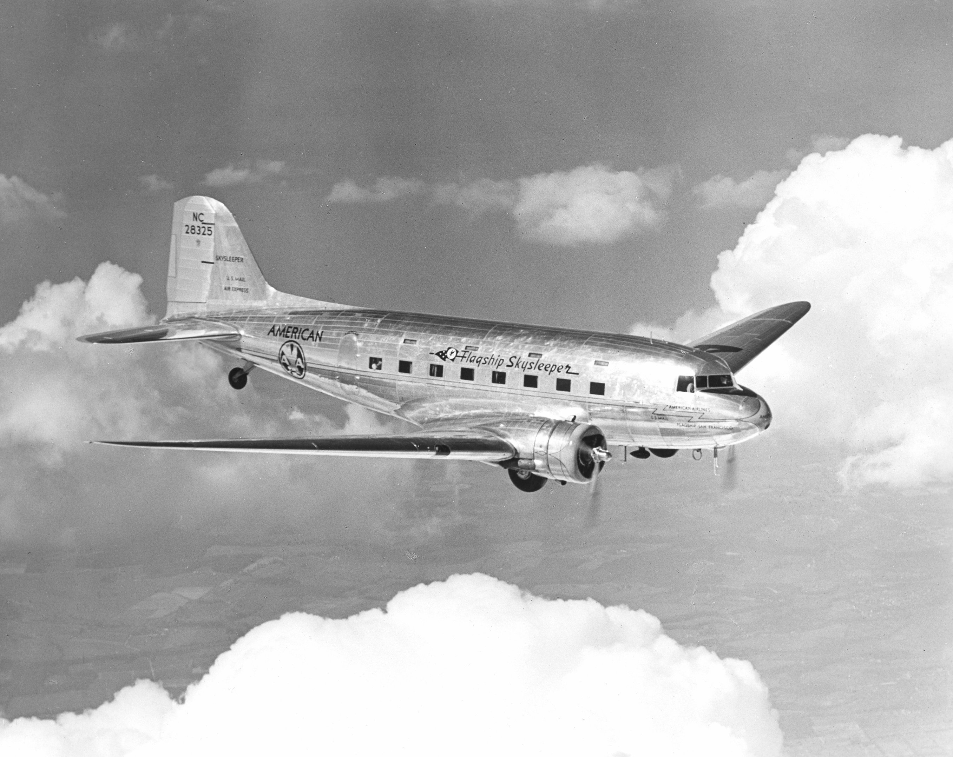
Commercial Airlines
First commercial air transportation began in early 1920’s transporting mail
Late 1920’s first passenger travel. Seen as supplementing rail service
1930’s first international flights. LA to Shanghai and New York to London.
1930’s Airlines become profitable.
Air accidents in the hundreds/year by 1940
Notes:
Douglass DC-3 was first practical commercial aircraft

Slide 10

NTSB History
National Transportation Safety Board
Investigates Air, Rail, Commercial Vehicle, Ship, Pipeline accidents
Evaluates the effectiveness of other government agencies' programs for preventing transportation accidents
Grew out of Civil Aeronautics Board created by Bureau of Air Commerce Act in 1938
First Major investigation was Douglas DC-3A crash in August 1940.
Approx 20 years after commercial air transportation begins, formal incident investigation starts
Notes:
The NTSB is an independent agency charged with determining the probable cause of transportation accidents and promoting transportation safety. The NTSB investigates accidents, conducts safety studies, evaluates the effectiveness of other government agencies' programs for preventing transportation accidents, and reviews the appeals of enforcement actions involving aviation and mariner certificates issued by the Federal Aviation Administration (FAA) and the U.S. Coast Guard (USCG), as well as the appeals of civil penalty actions taken by the FAA.
The help prevent accidents, the NTSB develops safety recommendations based on its investigations and studies. These are issued to federal, state, and local government agencies and to industry and other organizations in a position to improve transportation safety. Recommendations are the focal point of the NTSB's efforts to improve the safety of the nation's transportation system.

Slide 11
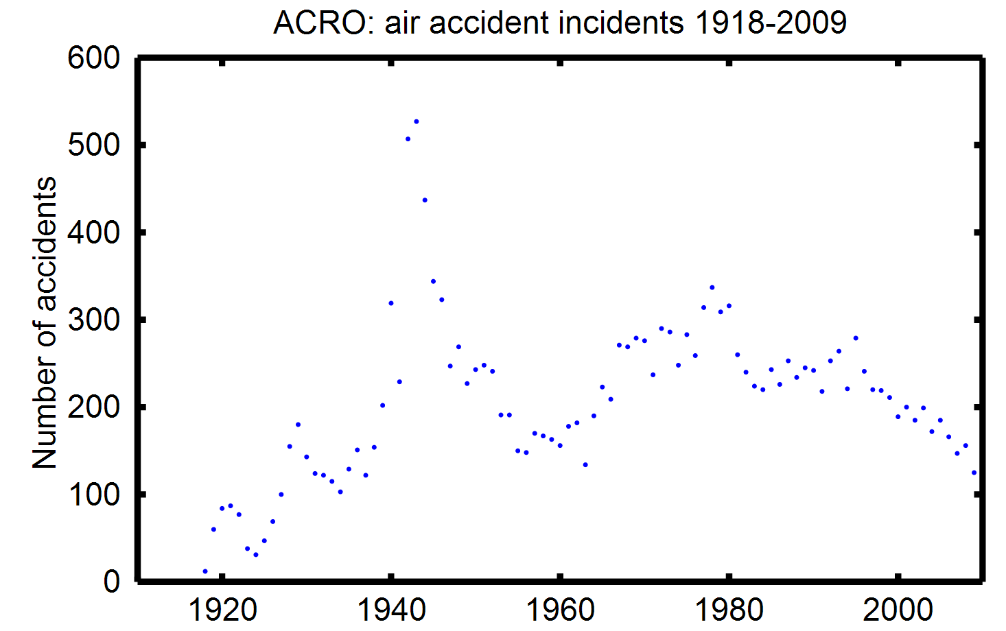
Incident Disclosure

Slide 12
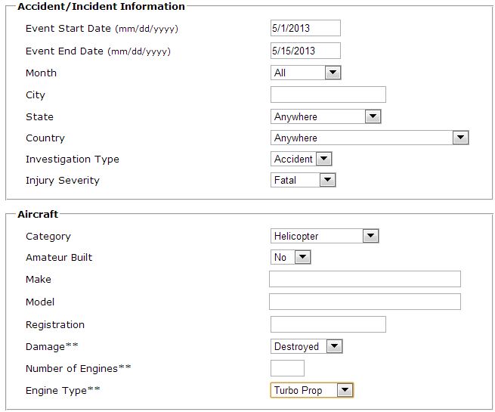
NTSB Aviation Disclosure
http://www.ntsb.gov/aviationquery/

Slide 13
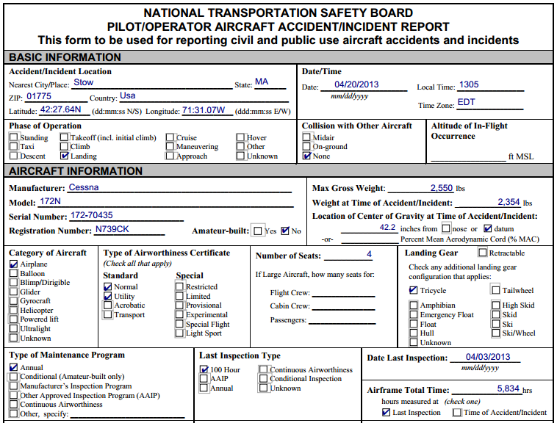

Slide 14
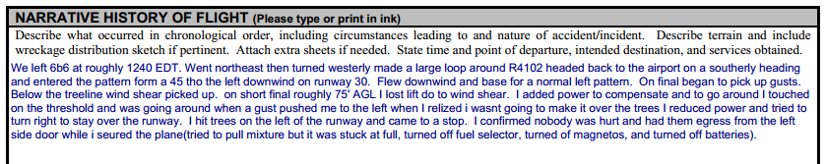
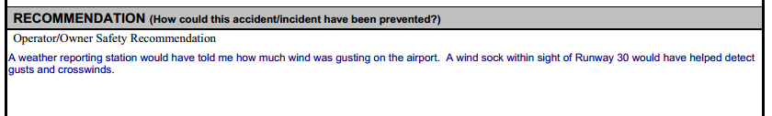

Slide 15
NTSB Incident Reports
Designed to learn from incidents and Improve
Root cause analysis
Recommendations
Public Investigation for serious incidents
Follows sound engineering principle of learning from failures.

Slide 16

Outcome is Safety Recommendations and Safety Alerts
“Recommendations are sent to the organization best able to address the safety issue, whether it is public or private.”
Notes:
Safety Recommendations
Safety recommendations are issued by the NTSB following the investigation of transportation accidents and the completion of safety studies. Recommendations usually address a specific issue uncovered during an investigation or study and specify how to correct the situation. Letters containing the recommendations are sent to the organization best able to address the safety issue, whether it is public or private. Learn More >
Safety Alerts
Take action to improve your safety and the safety of your family and friends by following the suggestions in these NTSB Safety Alerts. NTSB Safety Alerts provide safety information you can use, and urge you to encourage lawmakers to improve safety at the State level.

Slide 17
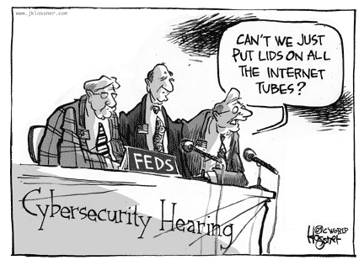

Slide 18


Internet Incident History
DARPA funds CERT/CC at Carnegie Mellon following Morris Worm incident in 1988
Commercial Internet began in 1992. Congress allows NSFNET to carry commercial traffic
It’s 20 years later. Where are our formal incident investigations?
Notes:
This why Al Gore says he “invented the internet”

Slide 19
Data Breach for PII Disclosure
Data breach disclosure requirements vary widely based on type of information compromised and jurisdiction
Most states require PII to trigger mandatory disclosure
CA recently passed disclosure requirement for account information breach

Slide 20
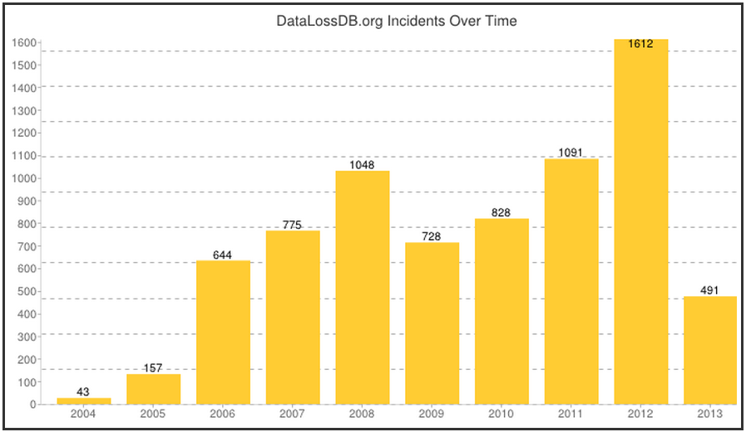

Slide 21
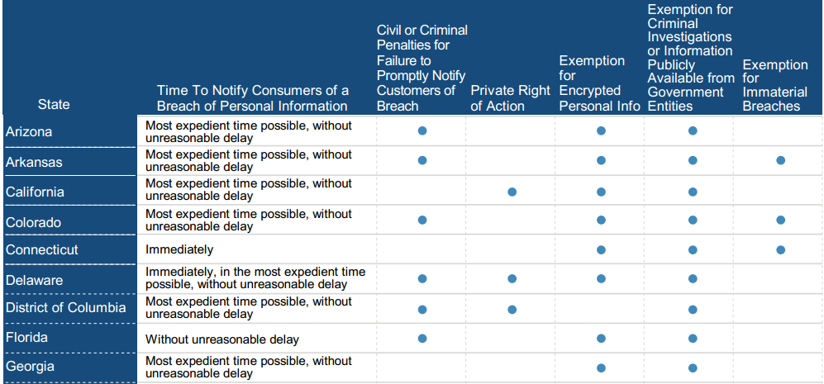
State Laws Vary

Slide 22

What’s in the Breach Disclosure?
Notify the effected people what data was compromised
No requirement to disclose root cause
Imagine if NTSB incident reports were only “plane crashed on date, x, at location y”
If someone asked “how” there would often be no answer

Slide 23
Why won’t they help us?
Drupal.org
Ross declined to name the third party responsible for the flaw, saying only that the company has worked with the software vendor to confirm the known vulnerability, which has been publicly disclosed. “We are still investigating and will share more detail when it is appropriate,” she said.
Federal Reserve
"The Federal Reserve System is aware that information was obtained by exploiting a temporary vulnerability in a website vendor product," a Fed spokesman told BankInfoSecurity on Feb. 7. "The exposure was fixed shortly after discovery and is no longer an issue. This incident did not affect critical operations of the Federal Reserve System."

Slide 24
6 Biggest Breaches of Early 2012
Entity | Impact | Root Cause | Lesson Learned
1. Zappos | 24 million records, including names, email addresses, phone numbers, last four digits of credit card numbers, and encrypted passwords | Unknown | None
2. University of North Carolina | 350,000 records including SSNs | back-end systems exposed on the Internet | Need change control and auditing for access control
3. Global Payment Systems | 7 million consumer records, including 1.5 million credit cards | Unknown | None
4. South Carolina Health and Human Services | 228,435 patient records | Employee e-mailed them to exfiltrate | Inadequate DLP
5. University of Nebraska | 654,000 student records including SSNs | Unknown | None
6. LinkedIn | 6.5 million user names and passwords | Unknown | None
Source: Dark Reading, 6 Biggest Breaches Of 2012 So Far
Notes:
4 or 6 breaches we don’t know the root cause

Slide 25
10 Top Government Data Breaches Of 2012
Entity | Impact | Root Cause | Lesson Learned
1. South Carolina DoR | 3.3M unencrypted bank acct #, 3.8M tax returns | Phishing attack stole employee credentials | Database activity monitoring & network awareness may have detected
3. Utah Department of Health | Health info/PII of 780,000 Utah citizens | poor authentication configuration | Inadequate testing pre-deployment
5. United States Bureau of Justice Statistics | 1.7 GB of sensitive data, emails, etc | Unknown | None
6. City of Springfield | 1,000 vehicle from police reports and records from 280K summons | Unknown. SQL injection speculated | None
7. United States Navy & DHS | usernames, passwords, email IDs, and security questions | Blind SQL injection | Adequate security testing for SQL injection required
8. Wisconsin Department of Revenue | seller information about more than 110,000 people and businesses who sold property in 2011 | Mistakenly published online | Need change control process for online publishing
10. New Hampshire Department of Corrections | Inmates accessed main offender management database system | Improper access control and network segmentation | Need change control and auditing for access control
Source: Dark Reading, 10 Top Government Data Breaches Of 2012
Notes:
7 of 10 Breaches were technical hacks. 2 did not have enough information to learn from.

Slide 26
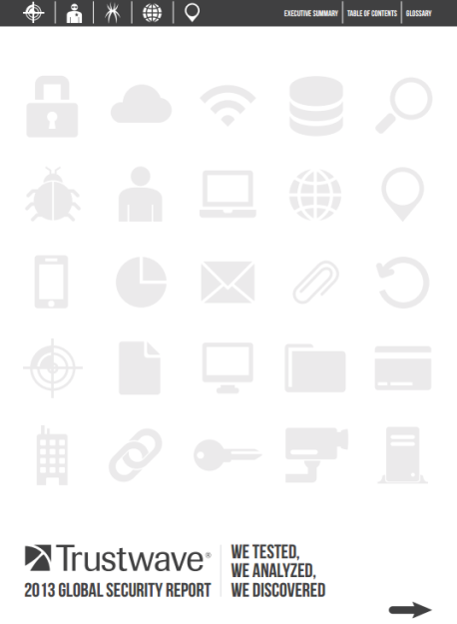

Commercial Breach Reports
Biased by customer base
Only summary data available
Imagine “11 planes had metal fatigue”
Each report slices data differently

Slide 27
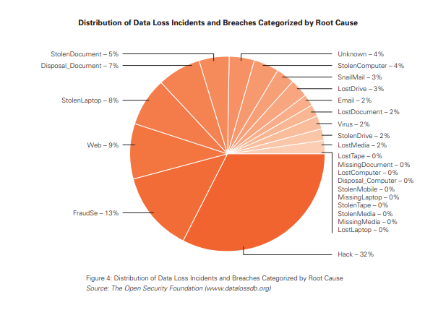
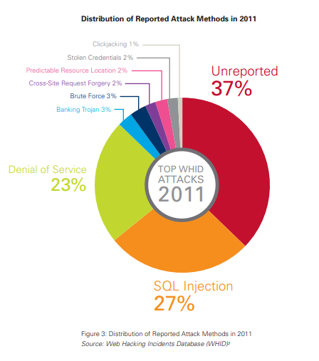
Current Root Cause Data is Weak

Slide 28
Can root cause disclosure and a culture of learning from failure change the growth in breaches?

Slide 29

A National Cyber Safety Board?
Reporting must be automated and consistent
Goal is actionable knowledge
Businesses want anonymity. We could still learn from breaches but there wouldn’t be additional incentive of staying out of news.
Need root cause analysis
Cyber

Slide 30
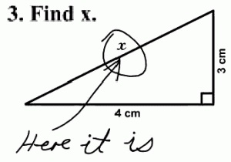
What Can We Learn
What classes of application vulnerabilities are being attacked.
What is the exploit rate of known vulnerabilities
Understand how non-regulated entities and/or non-regulated data are attacked
What are the vectors used by hacktivists and spies

Slide 31
Prevalence of Apps With Flaws by Language

Slide 32
1st to 2nd Test Improvement by Language
Notes:
Wouldn’t it be nice to prioritize fixing based on actual realized threats?

Slide 33
Conclusion
Ultimately, a National Data Breach Reporting Law should breed best practices for information sharing “for the good of the community.” The fact that we’re not thinking about data breach investigation and notification like the NTSB shows how immature the IT security industry really is

Slide 34
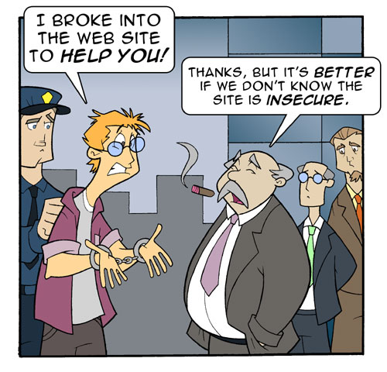
Questions
Chris Wysopal
cwysopal@veracode.com
@weldpond

