Slide 1
Real World Intrusion Response - Lessons from the Trenches
David Sharpe and Katherine Trame

Slide 2
Disclaimer
Opinions expressed in this presentation are our own. We are speaking for ourselves, not for GE, nor anyone or anything else.

Slide 3
Introductions
Katherine Trame
Current: GE-CIRT Advanced Threats team
Prior: intelligence analyst with the Hampton, VA Police Division for five years. Worked in tactical/operational intelligence and computer forensics.

Slide 4
Introductions
David Sharpe
Current: GE-CIRT Advanced Threats team.
Prior: Wide range of IT experience spanning 19 years. Served in a variety of roles in Fortune 10 and Fortune 500 companies, ranging from systems programmer writing device drivers and operating system components, to large scale systems administration, to IT security.

Slide 5

Short GE-CIRT Background
Based on idea "defenses fail,
so get great at IR”
That approach and philosophy worked very well, and still serves us well today…

Slide 6
Today’s GE-CIRT
What today’s GE-CIRT is doing is building on that great foundation.
We are taking the best from the past, and making it even better.

Slide 7
The Process
Intel
Detect
Respond
Prevent
Prepare
Great
People

Slide 8
Trends
Types of attacks we have seen (since 2011):

Slide 9
Trend – Attacks Through Third Party and Partner Connections
So, what if you have a perfectly well defended network? What about what connects to you?
You also need to worry about third party connections.

Slide 10
Trend – Hostile Office Documents
For targeted spearphishing, malicious Office documents took the #1 spot in 2012, and have held it ever since. By far, the biggest offender is CVE-2012-0158.
Not just a problem for us – is industry wide in the APT world.

Slide 11
Trend – Java Remains a Problem
(SOURCE: contagio.blogspot.com)
CVE Description
CVE-2011-3544 vulnerability in the Rhino Script Engine
CVE-2012-0500 Sun Web Start Plugin Command Line Argument Injection
CVE-2012-0507 AtomicReferenceArray
CVE-2012-1723 Remote Code Execution
CVE-2012-4681 crafted applet that bypasses SecurityManager restrictions
CVE-2012-5076 Arbitrary Code Execution
CVE-2013-0422 JMB/MBEAN and Reflection API allow a crafted applet to bypass SecurityManager restrictions
CVE-2013-0431 abuses the JMX classes from a Applet to run arbitrary code outside of the sandbox
CVE-2013-0437 Unspecified vulnerability in the Runtime Environment (JRE) via unknown vectors related to 2D.
CVE-2013-1488 via unspecified vectors involving reflection, Libraries, "improper toString calls," and the JDBC driver manager
CVE-2013-1493 The color mgmnt (CMM) functionality in the 2D - an out-of-bounds read or memory corruption in the JVM
CVE-2013-2423 SE 7 Update 17 and earlier allows remote attackers to affect integrity via unknown vectors related to HotSpot.
CVE-2013-2460 Oracle SE 7 Update 21 and earlier, and OpenJDK 7 - "insufficient access checks" in the tracing component.
CVE-2013-2463 < Update 21 6 Update 45 and earlier, and< 5.0 Update 45, and OpenJDK 7 -Incorrect image attribute verification in 2D.
CVE-2013-2465 Memory Corruption Vulnerability
CVE-2013-2471 < 7 Update 21, < 6 Update 45, and < 5.0 Update 45, and OpenJDK 7 - Incorrect IntegerComponentRaster size checks
CVE-2013-2472 < SE 7 Update 21, < 6 Update 45, < 5.0 Update 45, and OpenJDK 7 Incorrect ShortBandedRaster size checks in 2D

Slide 12
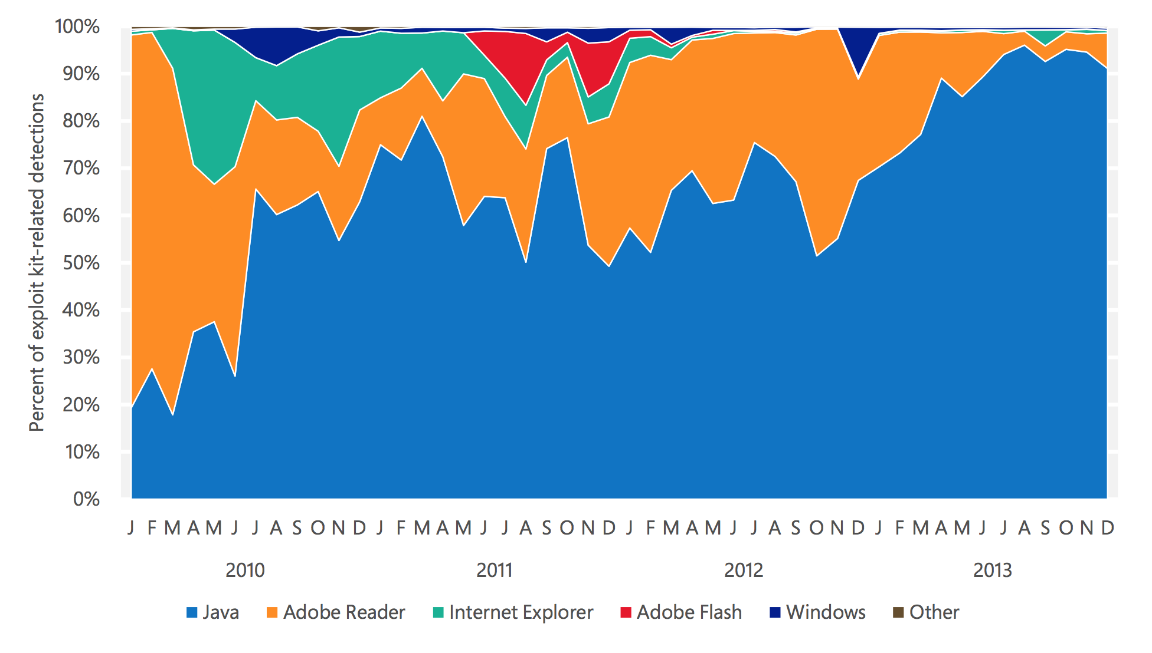
Java’s Near Complete Domination
SOURCE: Microsoft’s Security Intelligence Report May 2014

Slide 13
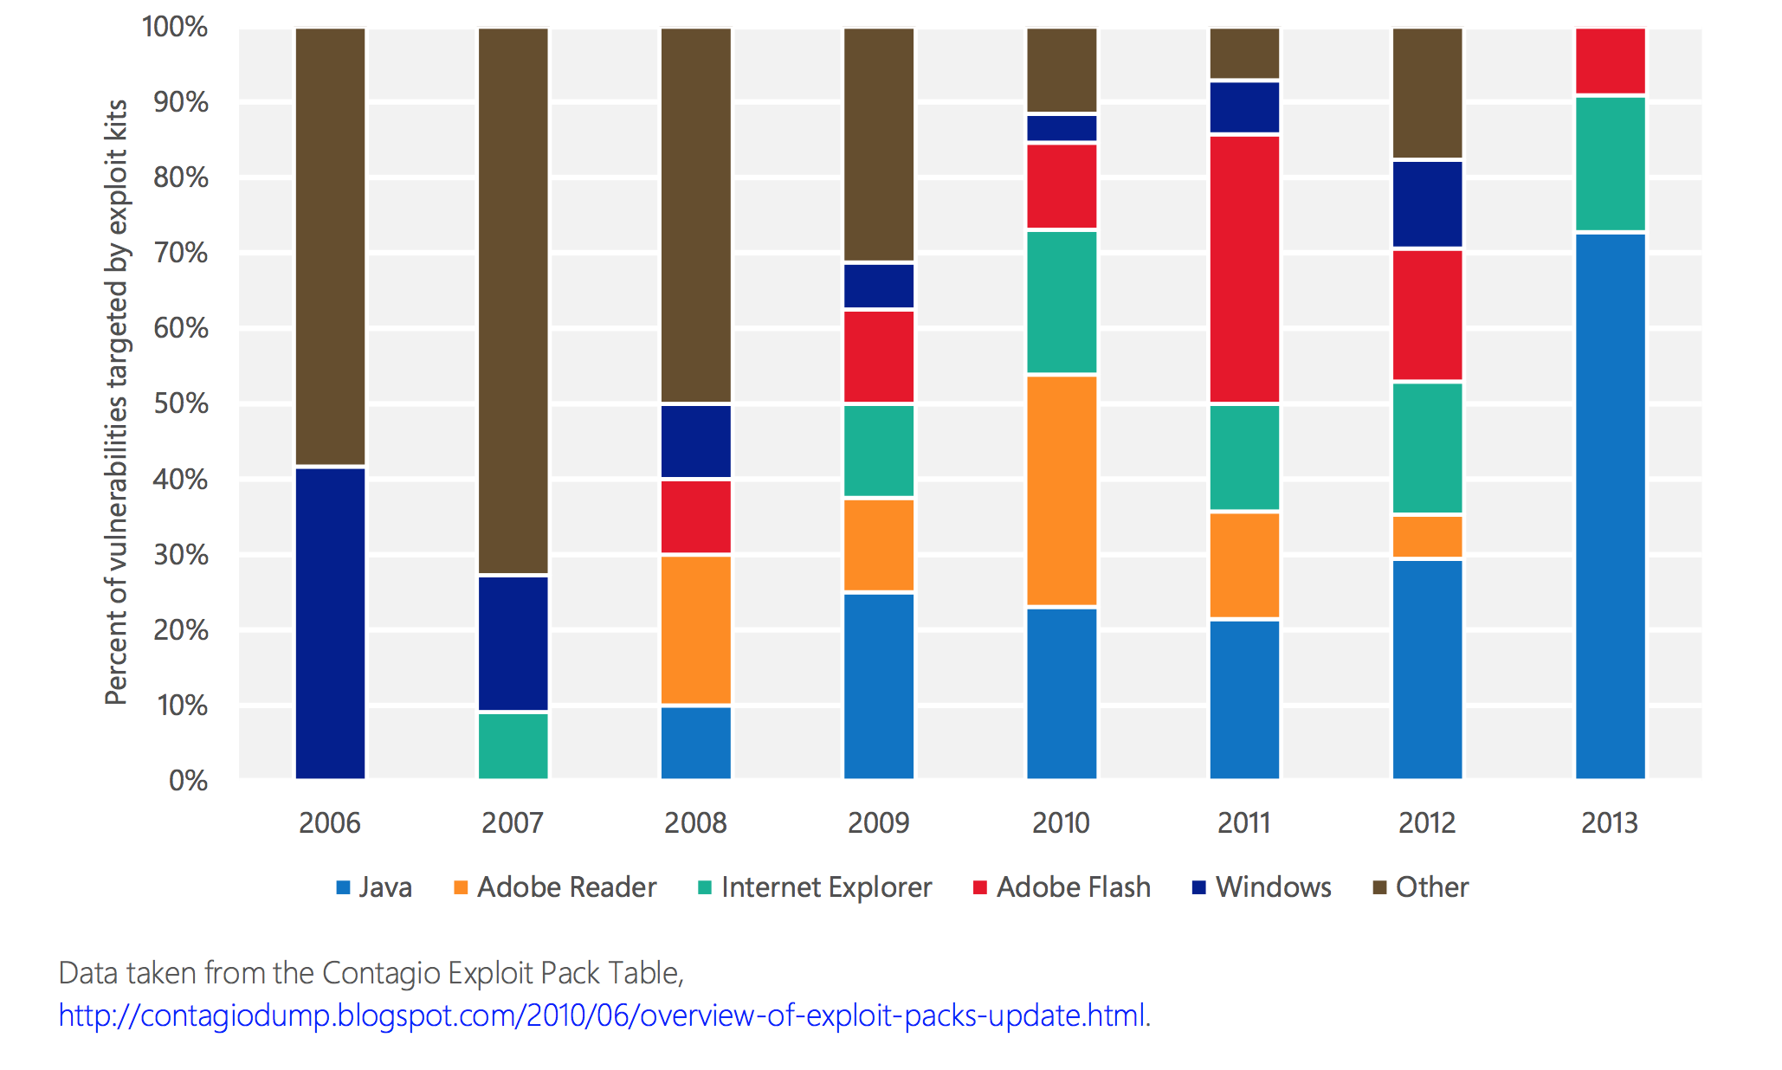
Java Trend – From Contagio

Slide 14
Trends – APT is Getting Personal
People are being approached through social media sites (e.g. Linkedin and Facebook) from fake accounts OUTSIDE of work.
Old problem, seeing renewed activity in 2014 from some actors.

Slide 15
INTEL
Intel
Detect
Respond
Prevent
Prepare
Great
People

Slide 16
Value of Different Types of Intel
VALUE | EXAMPLES
Best | Unique intruder toolmarks, lateral movement techniques, distinctive C2, IP addresses and domain names for active watering holes, domain names of legit but actively compromised sites
Good | user agent strings related to known C2, AV streetnames (quality depends on AV vendor)
Limited | File names, file hashes, almost all IP addresses, almost all domain names, user agent strings from recon

Slide 17
Intel – Sharing Between Organizations
A significant percentage of our workload started with shared intel.
Avail yourself of ISACs. Not all information sharing resources are equally effective.
We need a DSIE equivalent for the U.S. Energy sector!!!!

Slide 18
Open Source Intel (OSINT)
What if you cannot participate in any of the great shared intelligence services out there?
Some sample good OSINT sources:
FireEye
Sourcefire VRT
AlienVault
many more

Slide 19
OSINT – Example
Sourcefire’s VRT
http://vrt-blog.snort.org/2014/05/anatomy-of-exploit-cve-2014-1776.html

Slide 20
OSINT Example (cont)
Quote from http://vrt-blog.snort.org/2014/05/anatomy-of-exploit-cve-2014-1776.html
“We’ve associated the following subjects with this campaign so far: Welcome to Projectmates! Refinance Report What's ahead for Senior Care M&A UPDATED GALLERY for 2014 Calendar Submissions Associated domains so far: profile.sweeneyphotos.com web.neonbilisim.com web.usamultimeters.com inform.bedircati.com”

Slide 21
Intel- Where to Put it All?
CRITS - shared repository is better than private collections of intel that are not shared
http://www.mitre.org/research/technology-transfer/technology-licensing/collaborative-research-into-threats-crits
Going open source soon?

Slide 22
Intel – When You Have Too Much
VALUE | EXAMPLES
Best | Unique intruder toolmarks, lateral movement techniques, distinctive C2, IP addresses and domain names for active watering holes, domain names of legit but actively compromised sites
Good | user agent strings related to known C2, AV streetnames (quality depends on AV vendor)
Limited | File names, file hashes, almost all IP addresses, almost all domain names, user agent strings from recon
KEEP THESE
CAN EXPIRE
CAN EXPIRE

Slide 23
Detection
Intel
Detect
Respond
Prevent
Prepare
Great
People

Slide 24
What Works For Us?
What types of detection are working for us for finding attacks?
80% - network-based detection
20% - other means (mostly AV logs, web proxy hits, or host-based detection)

Slide 25
What Works Best for Us for Detection?
VALUE | EXAMPLES
Best | Unique intruder toolmarks, lateral movement techniques, distinctive C2, IP addresses and domain names for active watering holes, domain names of legit but actively compromised sites
Good | user agent strings related to known C2, AV streetnames (quality depends on AV vendor)
Limited | File names, file hashes, almost all IP addresses, almost all domain names, user agent strings from recon

Slide 26
Detection – A Practical Example
A large percentage of intrusions we see involve the use of a password dumping tool at some point.
If that happens so often, why not analyze all those tools, harvest intel from those tools that you can alert on, and deploy some detection?

Slide 27
Handling Password Dumpers
The 5 tools we most commonly see in APT intrusions are: WCE, pwdump, gsecdump, fgdump, and mimikatz
Does your IT staff or anyone regularly run any of those in production? Probably not.
Consider: tool moving over network in cleartext, behavior on execution as HIPS see it, and AV streetnames in case AV detects any of these tools

Slide 28
Did a Password Dumper Run?
Look for execution attempts for each tool (WCE, pwdump, gsecdump, fgdump, and Mimikatz)
Examples:
All recent WCE versions attempt to load a DLL into LSASS.EXE out of %temp%.
FGDUMP loads PWDUMP out of %temp%
Unusual processes opening a process handle to LSASS.EXE (thanks Rob!).

Slide 29
Password Dumpers (AV hits)
Find your antivirus street names for all common credential dumpers used in intrusions (WCE, pwdump, gsecdump, fgdump, and Mimikatz) and look for those, whitelist out whatever is normal in your environment

Slide 30
How Do You Find Data Exfil?
Data transfer to some place that shouldn’t have happened
Look for signs data was bundled up on attacked host
Look for what files were accessed and created while intruder was on machine.
RAR files

Slide 31
Detection – Reviews
Periodically review existing deployed detection that is based on things like file format specifications, and specifics of how application protocols work

Slide 32
RAR Files
RAR file format header from 1.5 through 4.x was 7 bytes long:
But it CHANGED – switching to 8 bytes with version 5.0
52 61 72 21 1A 07 00 (Rar!...)
52 61 72 21 1A 07 01 00 (Rar!....)

Slide 33
SMB Protocol Considerations
The SMB protocol has changed over the years. There is now SMB 2.0 (Vista) and SMB 3.x (Windows 8 and Server 2012).
Old detection might break. Retest detection between old → new, new → old and new → new.

Slide 34
Detection - Get Creative
Can you detect on what application whitelisting blocks?
Can you mine your discovered software asset inventory for known files, services, drivers?
Can you mine the data discovered from your internal vulnerability scans for remnants of intrusions?
Mine your autoruns data

Slide 35
Response
Intel
Detect
Respond
Prevent
Prepare
Great
People

Slide 36
Responding to What Exactly?
What are you up against on the APT side?
Roughly, process at a high level is like this:
Intelligence officer task operators because they are interested in something you have. Operators first breach the target, move laterally once inside, and lastly collect and extract the requested data.

Slide 37
Responding to What Exactly?
“Operator” can be one person, a team, or specialized teams.
Skill levels of operators vary widely, ranging from amazingly effective, PhD level down to more junior skill levels.
High value targets get the best teams assigned.

Slide 38
Understand How Your Adversary Thinks – The Initial Breach
Attacker best practice – “The initial breach always makes the most noise. Did someone hear me?”
Responder – “Speed and accuracy. Respond quickly. More brains are better than one to determine what happened and scope the incident”

Slide 39
Understand How Your Adversary Thinks – On Speed
Attacker best practice – “Moving slowly gets you caught earlier, and more often. You need a plan, and you need to manage time on target effectively”
Responder – “Contain all affected systems quickly, to halt further intruder progress. Make sure you quickly find all tools used to automate recon, lateral movement, etc by the intruder”

Slide 40
Understand How Your Adversary Thinks – Getting Caught
Attacker best practice – “I might get caught, so I have to have a backup plan, for both outside-in access, and inside-out”
Responder – “I cannot assume just the one machine I caught is the only one owned. I need to check to see if this attacker owns any other machines like it, or anywhere else on my network”

Slide 41
Understand How Your Adversary Thinks – Leaking Intel
Attacker best practice – “Understand how our tactics and procedures appear on the wire and on target machines. Example: the order that we deploy 0-days and custom tools might give our identity away”
Responder – “Don’t leak what you know back out publicly. This intel isn’t easy to come by, and you don’t want to just give what you know away unnecessarily”

Slide 42
Understand How Your Adversary Thinks – Hiding Your Tracks
Attacker best practice – “Encrypt wherever possible for tool transfer, C2, and data exfil”
Responder – “Encryption makes my life a lot harder, but I need to understand my adversary might use it often.”

Slide 43
Understand How Your Adversary Thinks – Value of Teamwork
Attacker best practice – “More brains are better, and provide more consistently desirable outcomes”
Responder – “Understood, but even the teams seem to operate one person at a time mostly. At best they may be working in pairs at a single keyboard at each stage of the attack.”

Slide 44
Responding How?
You need to be good at:
Host analysis: analysis of log files, memory dumps, filesystem activity
Network analysis: to find the breach, lateral movement, signs of data exfil
Malware analysis: What does the malware do, does it talk on the network, how does the malware persist

Slide 45
DEFENSE and PREVENTION
Intel
Detect
Respond
Prevent
Prepare
Great
People

Slide 46
Put More Kill in Your Kill Chain
“Cyber Kill Chain” (courtesy of Lockheed Martin)
note the “kill” part of it
Heavier focus on PREVENTION is the right direction for Incident Response – not forever working the same types of intrusions

Slide 47
Java
So just patch right, or don’t deploy Java runtimes on your Windows clients? Yes. Exactly.
Patching Java matters, so do that as broadly as you can.

Slide 48
What if You Can’t Patch Java Everywhere?
(SOURCE: contagio.blogspot.com)
CVE Description
CVE-2011-3544 vulnerability in the Rhino Script Engine
CVE-2012-0500 Sun Web Start Plugin Command Line Argument Injection
CVE-2012-0507 AtomicReferenceArray
CVE-2012-1723 Remote Code Execution
CVE-2012-4681 crafted applet that bypasses SecurityManager restrictions
CVE-2012-5076 Arbitrary Code Execution
CVE-2013-0422 JMB/MBEAN and Reflection API allow a crafted applet to bypass SecurityManager restrictions
CVE-2013-0431 abuses the JMX classes from a Applet to run arbitrary code outside of the sandbox
CVE-2013-0437 Unspecified vulnerability in the Runtime Environment (JRE) via unknown vectors related to 2D.
CVE-2013-1488 via unspecified vectors involving reflection, Libraries, "improper toString calls," and the JDBC driver manager
CVE-2013-1493 The color mgmnt (CMM) functionality in the 2D - an out-of-bounds read or memory corruption in the JVM
CVE-2013-2423 SE 7 Update 17 and earlier allows remote attackers to affect integrity via unknown vectors related to HotSpot.
CVE-2013-2460 Oracle SE 7 Update 21 and earlier, and OpenJDK 7 - "insufficient access checks" in the tracing component.
CVE-2013-2463 < Update 21 6 Update 45 and earlier, and< 5.0 Update 45, and OpenJDK 7 -Incorrect image attribute verification in 2D.
CVE-2013-2465 Memory Corruption Vulnerability
CVE-2013-2471 < 7 Update 21, < 6 Update 45, and < 5.0 Update 45, and OpenJDK 7 - Incorrect IntegerComponentRaster size checks
CVE-2013-2472 < SE 7 Update 21, < 6 Update 45, < 5.0 Update 45, and OpenJDK 7 Incorrect ShortBandedRaster size checks in 2D

Slide 49
EMET
Highly effective if:
You can deploy it without breaking production
And if you keep EMET patched and up-to-date
See warning later about Java coverage

Slide 50
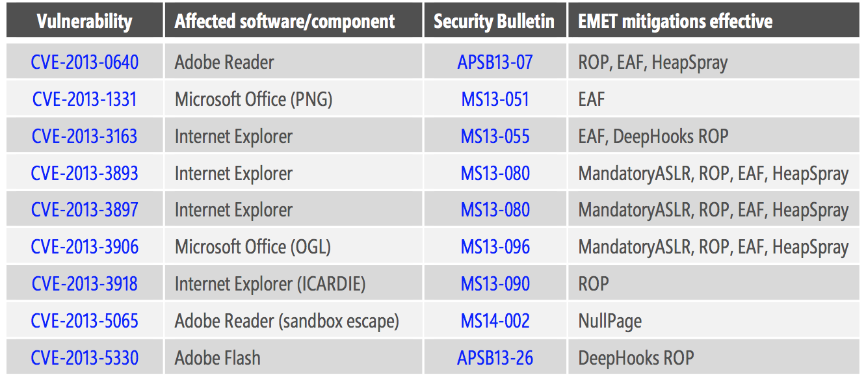
EMET and Java
SOURCE: Microsoft Security Intelligence Report May 2014

Slide 51
Where EMET Helps
Not Here →

Slide 52
Application Whitelisting – How We Think About It
effective on clients with relatively static configurations like kiosks, call center machines, ATMs, point of sale terminals, maybe call center machines.
effective on domain controllers, maybe some utility servers with relatively static configurations.

Slide 53
Dealing with Hostile Office Documents
Recall where we said malicious Office documents took the #1 spot for targeted spearphishing in 2012.
Why is that, and what do we do about it?

Slide 54
What to Do About Attacks Through Third Party and Partner Connections
Know the security staff at partner organizations.
Know what a breach coming over that connection would look like.
Consider funneling third parties through a very small number of network chokepoints.
Reduce the attack service exposed from your own network to partner connections.

Slide 55
Good Security is Good Security
Good security is still good security, and pretty much the same defenses work effectively on both the APT and non-APT sides.

Slide 56
People
Intel
Detect
Respond
Prevent
Prepare
Great
People

Slide 57
People 101
Treat people with respect
Don’t suppress or discourage questions or ideas
Continuously improve the average skill level of your team
Hold yourself to a high standard
Manage your people to a high standard, and set your people up for success

Slide 58
Documentation and Training
Wiki captures tribal knowledge - one shared repository versus multiple repositories
Discourage/stigmatize knowledge hoarding
Consider using videos to capture experts' training sessions

Slide 59
Communicate
Talk to colleagues
Talk to leadership
Talk to vendors
Talk to red team/internal pentesters
Talk to customers

Slide 60
Surveys (Yes, Really!)
Do your customers think your team is as good at incident response as you think you are?
We have found simple surveys invaluable. We use a survey based on the “Ultimate Question” (http://www.netpromotersystem.com/book/index.aspx)

Slide 61
Just One Question Works For Us
“The Advanced Threats team strives to provide world-class incident response services focused on preventing and stopping active APT attacks against GE network resources. Your feedback is critical to helping us ensure we are meeting that goal.” Then we ask for a rating from 1-10 on how we are meeting that goal, with a space for free form feedback supporting that rating.

Slide 62
Closing Thoughts
Intel
Detect
Respond
Prevent
Prepare
Great
People

Slide 63
Questions?
Sincere thanks to all former and current GE-CIRT members, and all of our colleagues across GE!
Katherine Trame - @ktrame
David Sharpe - @sharpesecurity

