Slide 1
Man-In-The-Front
Modifying the Android OS for Mobile Application Testing
Ray Kelly Innovation and Research, HP Fortify on Demand March 2014

Slide 2
Introduction
Ray Kelly Innovation and Research, HP Fortify on Demand
Lead Developer of WebInspect
Work with FoD Mobile Team
Penetration Testing Background
Web and Mobile Application Testing
Creator of MineChat for iOS and Windows Phone
ray.kelly@hp.com

Slide 3
Agenda
Challenges of Mobile Testing
Overview of the Android operating system
Identify key Android source code files for modification
The Android build process
Demonstrate a custom Android OS with intercepting code

Slide 4
Inspiration
Notes:
Why is there a problem, and why do you need application security?
Like all organizations, you’ve undoubtedly, invested a lot of time and money attempting to insulate and protect your assets.
Your networks are protected – firewalls are in nearly every devices that connects to a network.
Your servers are protected, thanks to advances in intrusion prevention systems.
But your software applications are still largely unprotected and vulnerable.
Companies believed that if you protect the perimeter (network and server), the software will be unreachable and therefore not breachable. However, that has not proven to be the case: software is the New Entry Point.
Let’s take a look at how…

Slide 5

Inspiration

Slide 6
Challenges of Mobile Testing
Notes:
Why is there a problem, and why do you need application security?
Like all organizations, you’ve undoubtedly, invested a lot of time and money attempting to insulate and protect your assets.
Your networks are protected – firewalls are in nearly every devices that connects to a network.
Your servers are protected, thanks to advances in intrusion prevention systems.
But your software applications are still largely unprotected and vulnerable.
Companies believed that if you protect the perimeter (network and server), the software will be unreachable and therefore not breachable. However, that has not proven to be the case: software is the New Entry Point.
Let’s take a look at how…

Slide 7
Why is Mobile Testing Important
Mobile development is the hottest type of development right now. New surface area equals dangerous surface area
If anyone’s going to put features over security to get the product out the door, it’s likely to be a mobile team
Many enterprise mobile developers haven’t had the security training that other types of developers have had
Many assume that because mobile back ends aren’t visited directly they are more secure (obscurity assumption)

Slide 8
Challenges of Mobile Testing
Client
Network
Server
Injection flaws
Authentication
Session management
Access control
Logic flaws
Credentials in memory
Credentials on filesystem
Data stored on filesystem
Poor cert management
Cleartext credentials
Cleartext data
Backdoor data
Data leakage

Slide 9
OWASP Mobile Top 10 Risks
M1 – Insecure Data Storage | M6 – Improper Session Handling
M2 – Weak Server Side Controls | M7 – Security Decisions via Untrusted Inputs
M3 – Insufficient Transport Layer Protection | M8 – Side Channel Data Leakage
M4 – Client Side Injection | M9 – Broken Cryptography
M5 – Poor Authorization and Authentication | M10 – Sensitive Information Disclosure

Slide 10
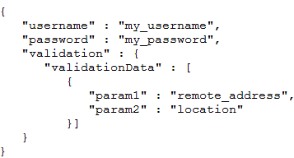
Challenges of Mobile Testing: Server Side
Mobile API’s are vulnerable to most of the same vulnerabilities as standard websites e.g. SQL Injection, XSS, path traversal etc.
Testing JSON/XML based API’s should need to be tested with valid structures as well as invalid structures.
Need to Man-In-The Middle – Set up proxy configuration
Not all app respect device proxy settings (especially Global HTTP proxy on iOS)
Difficult to test when using SSL and Certificate Pinning

Slide 11
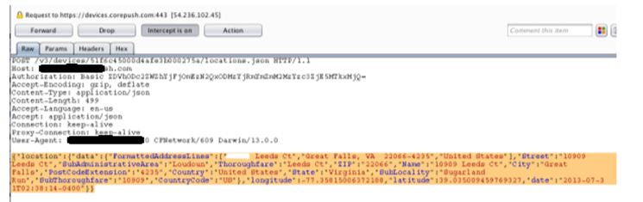
Challenges of Mobile Testing: Network
Privacy/data leakage, clear text data
Need to MiTM, same challenges as server side
Difficult to test when using SSL and Certificate Pinning

Slide 12
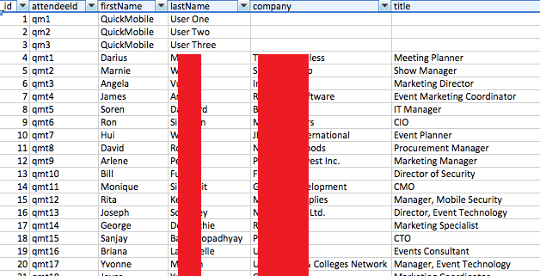
Challenges of Mobile Testing: Client
The big unknown especially without source code. Even with source code its not always easy (what is sensitive input?)
What’s the concern, my data safe right? Once jail broken, all bets are off.
What is being written to the file system?
Credentials
Private information
Sensitive photos outside of sandbox
SQL Lite
Application storage
iOS WebKit cache (includes query string)
Example, RSA 2014 Mobile App
source: IOActive

Slide 13
Common vulnerabilities: Promiscuous client-side storage
Perhaps the most abused functionality is client-side storage
Storage of credentials in plist files, SQLite databases
Failure to use KeyChain to store credentials
Storage of sensitive application data on filesystem
Apps (e.g.: banks) storing their images in the public folder rather than in their sandbox
Applications logging to the system log, but sending sensitive app data along with it

Slide 14
The Android OS
Notes:
What problem are we solving?

Slide 15
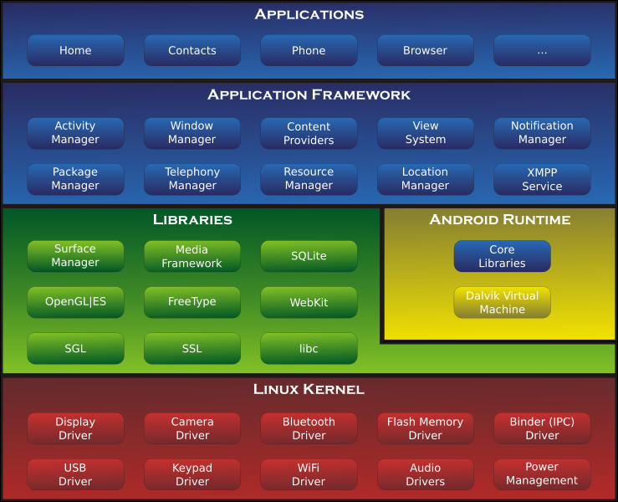
The Android OS: How Low Can We Go
source: Wikipedia

Slide 16
The Android OS: How Low Can We Go
WebKit
SQLite
HTTPClient
File Access
Source: Wikipedia

Slide 17
Building the Android OS
Notes:
What problem are we solving?

Slide 18
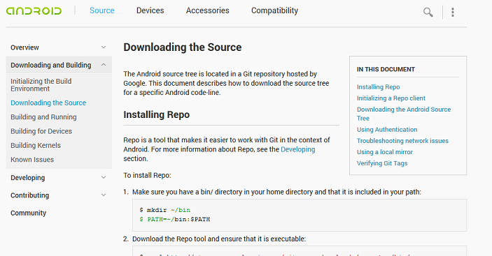
The Host And Environment
Ubuntu 12.04 64bit
Sounds crazy, but follow the instructions!
http://source.android.com/source/downloading.html

Slide 19
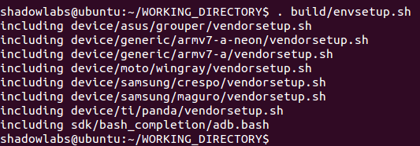
Building
Run “build/envsetup.sh” to setup the environment

Slide 20
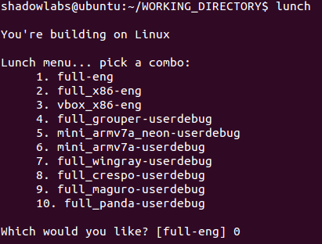
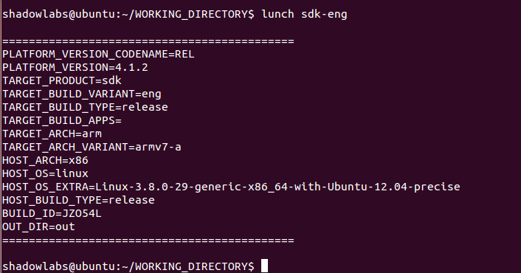
Building
Run “lunch sdk-eng” to select the sdk target and images
Don’t bother with the lunch menu

Slide 21
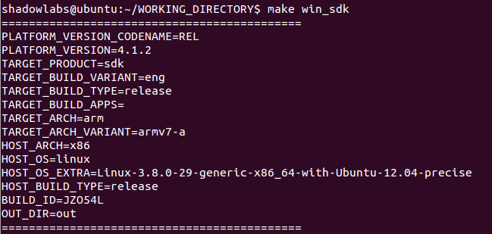
Building
Start the build “win_sdk” or “sdk”

Slide 22
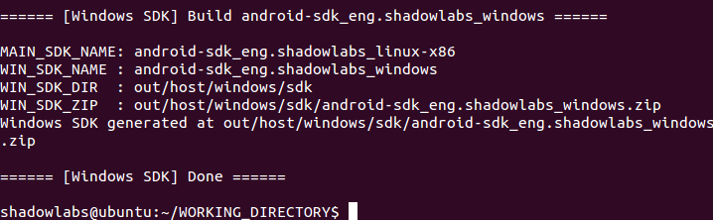
Building
Success!

Slide 23
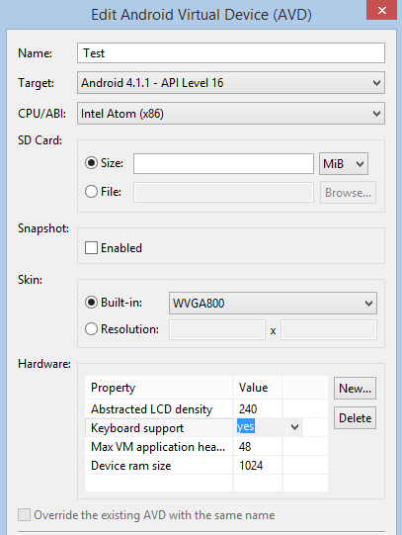
Building For x86
Use x86 build target for better emulator performance
Little to no documentation
Another hidden “lunch” target
win_sdk target does not build x86
Copy linux x86 system-images folder
build/envsetup.sh
lunch sdk_x86-eng
make sdk

Slide 24
Modifications
Notes:
What problem are we solving?

Slide 25
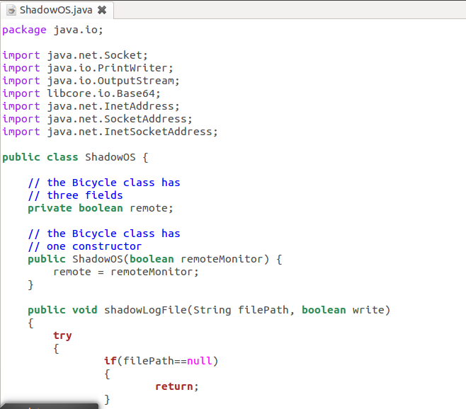
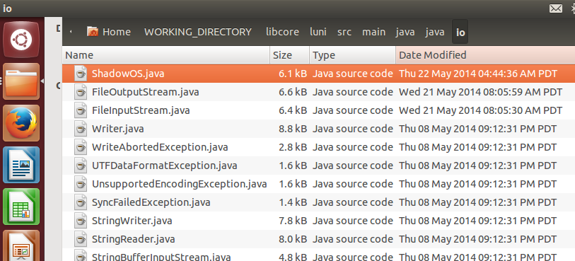
Modifications Helper Class
Common class for logging and monitoring
Place class in java.io

Slide 26
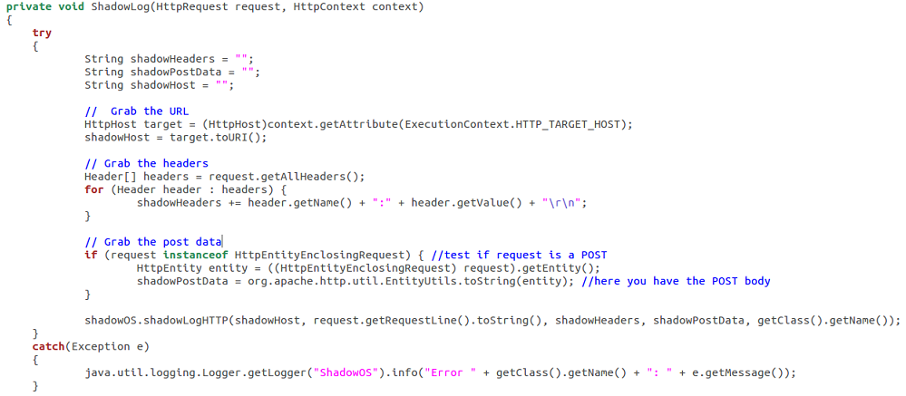
Modifications HTTP
There are a few places to capture HTTP traffic
Most apps utilize Java.Net and Apache.HTTP
/libcore/luni/src/main/java/libcore/net/http/HttpEngine.java
/external/apache-http/src/org/apache/http/protocol/HttpRequestExecutor.java

Slide 27
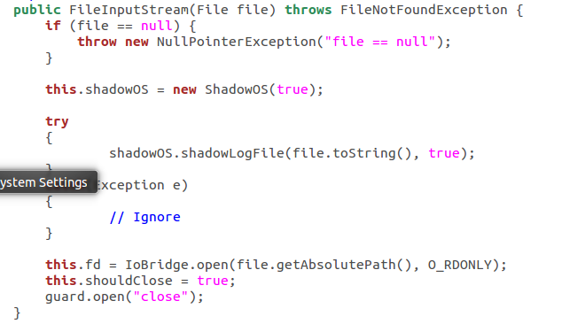
Modifications File System
Common read/write functions
/libcore/luni/src/main/java/java/io/FileInputStream.java
/libcore/luni/src/main/java/java/io/FileOutputStream.java

Slide 28
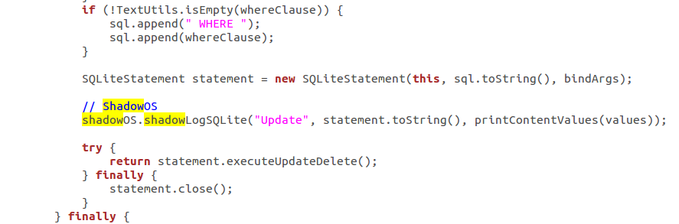
Modifications SQLite
One main SQLite class
/frameworks/base/core/java/android/database/sqlite/SQLiteDatabase.java
Main functions for logging
Constructor SQLiteDatabase for Open
insertWithOnConflict for Insert
updateWithOnConflict for Update

Slide 29
Monitoring
Notes:
What problem are we solving?

Slide 30
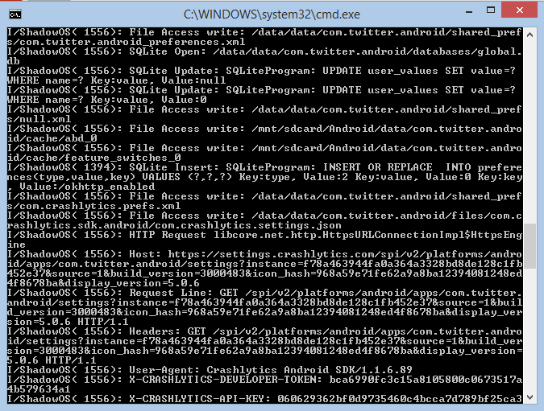
Monitoring With logcat
adb.exe logcat -s "ShadowOS"

Slide 31
Monitoring With Remote Monitor
Using socket connection to specific port
Data formatted in XML
Configure hosts file and push with adb
Must start emulator with “partition-size” parameter to avoid “Out Of Memory” error
emulator -avd Test -partition-size 512
adb.exe push hosts /system/etc

Slide 32
To Do
Two way communication (filters)
Interception of more content e.g. Contacts, Sockets, Geolocation
Logger integrations (WebInspect, Burp, Encoders/Decoders)
Logger modify and push hosts file (adb.exe)
Logger upload of applications (adb.exe)

Slide 33
Reach out
Ray.kelly@hp.com
@vbisbest

Slide 34

Questions

