Slide 1


Offensive Mobile Forensics
Joey Peloquin
Director, professional services

Slide 2

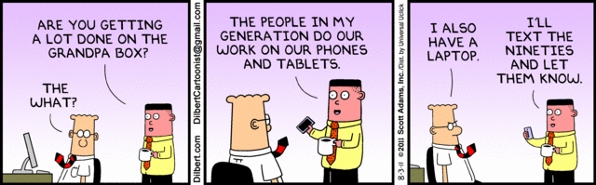

Agenda
Intro
Tools
Apple iOS
Google Android
© 2013 GuidePoint Security
CONFIDENTIAL AND PROPRIETARY

Slide 3

Introduction
© 2013 GuidePoint Security
CONFIDENTIAL AND PROPRIETARY

Slide 4

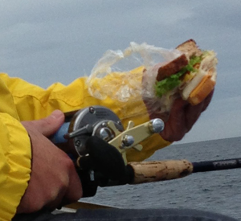
Introduction
Who am I?
Mobile threats
Define: Offensive Mobile Forensics
Take-aways
Questions?
“There are a lot of security issues in the design of the iPhone that lend themselves to retaining more personal information than any other device.”
– Jonathan Zdziarski
© 2013 GuidePoint Security
CONFIDENTIAL AND PROPRIETARY

Slide 5

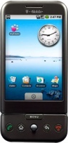

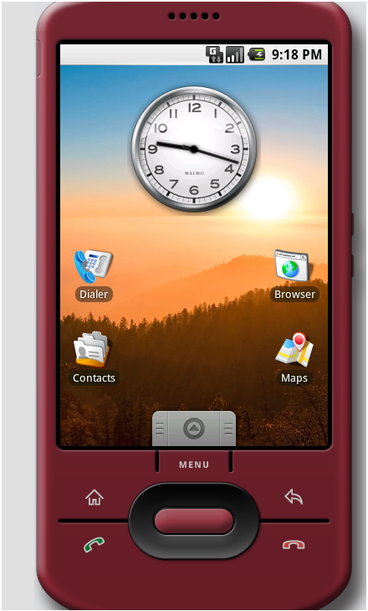
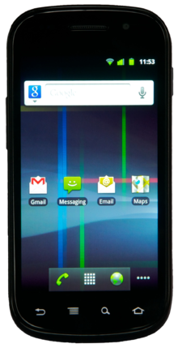
Introduction
Google Stats
400m+ devices sold per Qtr
15 Smartphone manufacturers
12 Tablet manufacturers
51.8% Market Share (0913)
Version | Codename | Distribution
2.3.3 - 2.3.7 | Gingerbread | 19%
3.2 | Honeycomb | 0.1%
4.0.3 - 4.0.4 | ICS | 15.2%
4.1.x | Jelly Bean | 35.3%
4.2.2 |  | 17.1%
4.3 |  | 9.6%
4.4 | KitKat | 2.5%
© 2013 GuidePoint Security
CONFIDENTIAL AND PROPRIETARY

Slide 6

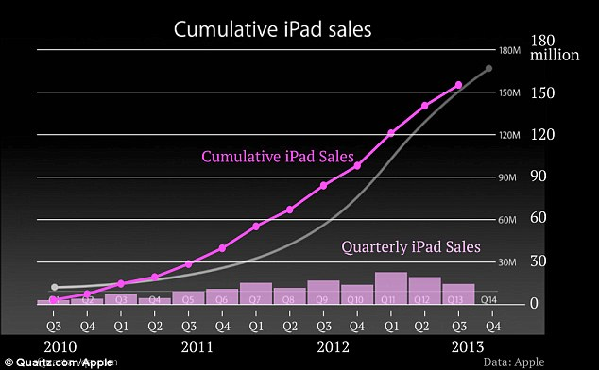
Introduction
Apple Stats
40.6% Market Share
170m iPads sold
9m 5s/c sold first weekend
© 2013 GuidePoint Security
CONFIDENTIAL AND PROPRIETARY

Slide 7
Tools

Slide 8
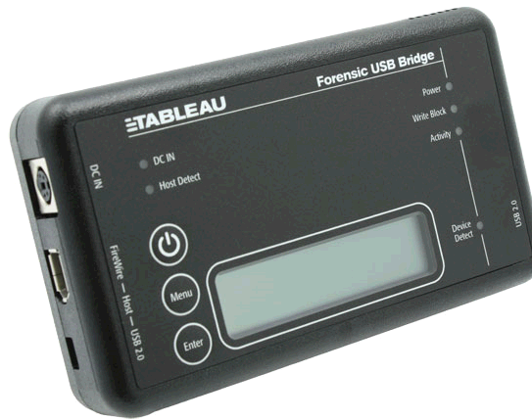
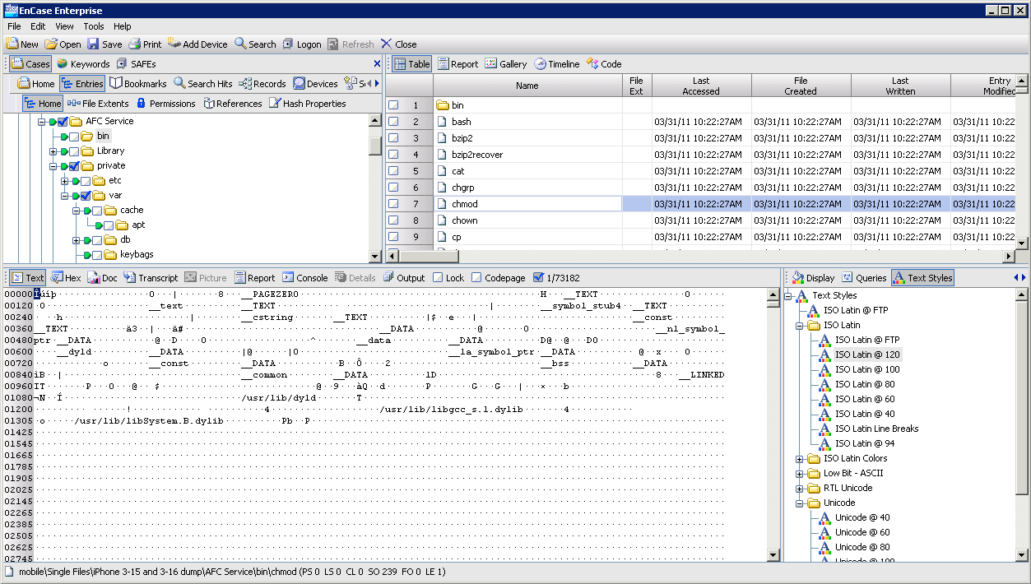
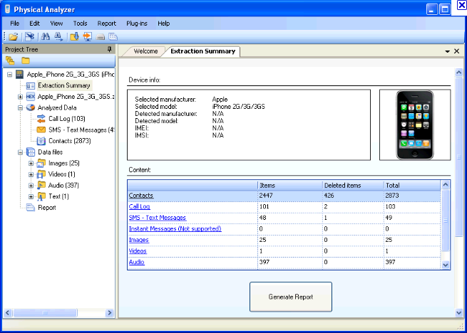
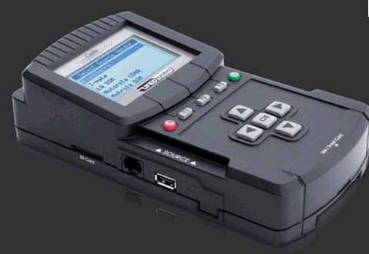
Tools
© 2013 GuidePoint Security
CONFIDENTIAL AND PROPRIETARY

Slide 9
Tools (iOS)
Name | Description
evasi0n / Redsn0w / ? | jailbreaking tools
TinyUmbrella | Request/playback secure signature hash (SHSH)
Cydia | AppStore for jailbroken iOS devices
OpenSSH | FOSS SSH distribution
Rbrowser | SSH/SFTP GUI for Mac ($29)
Property List Editor / plutil | Property list editor/viewer from Xcode
RazorSQL / Base | SQLite GUI clients
iPhone Analyzer | Analyze iTunes backups or connect over SSH
PhoneView | Access data stored on your iPhone ($20)
OpenSSL | Cryptography toolkit implementing the SSL and TLS
hexedit | Hexidecimal editor/viewer
strings | Extract printable strings from binary files
Xcode | IDE for developing Mac and iOS applications
© 2013 GuidePoint Security
CONFIDENTIAL AND PROPRIETARY

Slide 10
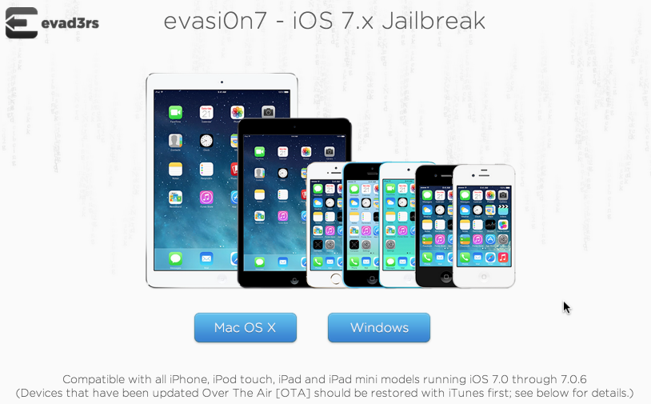
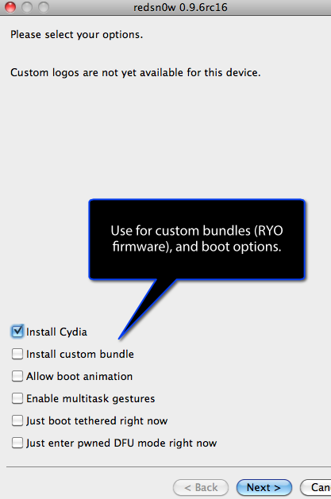
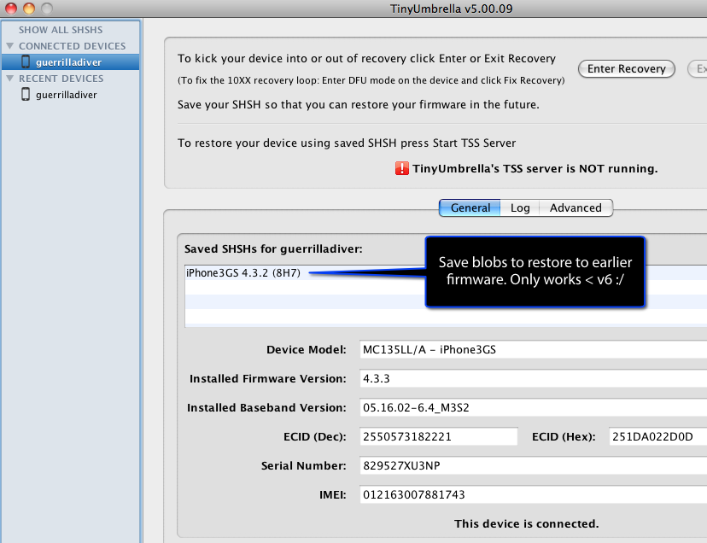
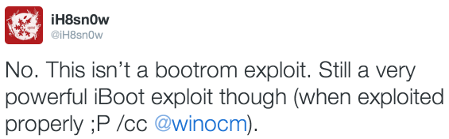
Tools (ios)
© 2013 GuidePoint Security
CONFIDENTIAL AND PROPRIETARY

Slide 11
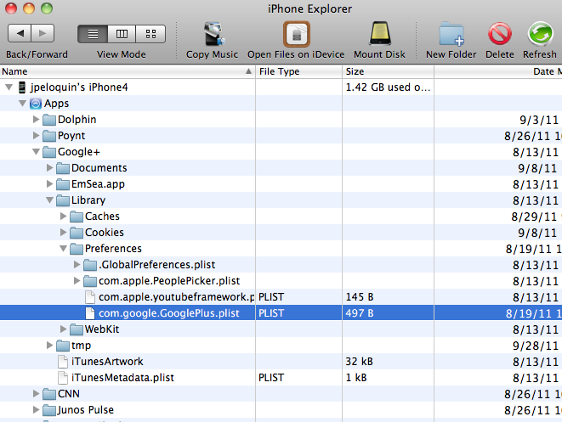
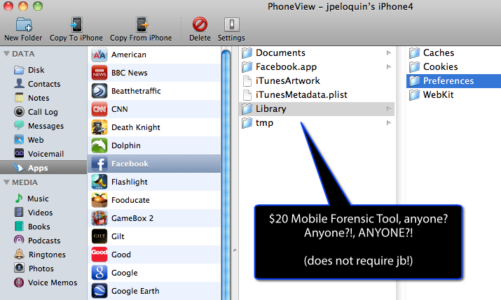
Tools (ios)
© 2013 GuidePoint Security
CONFIDENTIAL AND PROPRIETARY

Slide 12
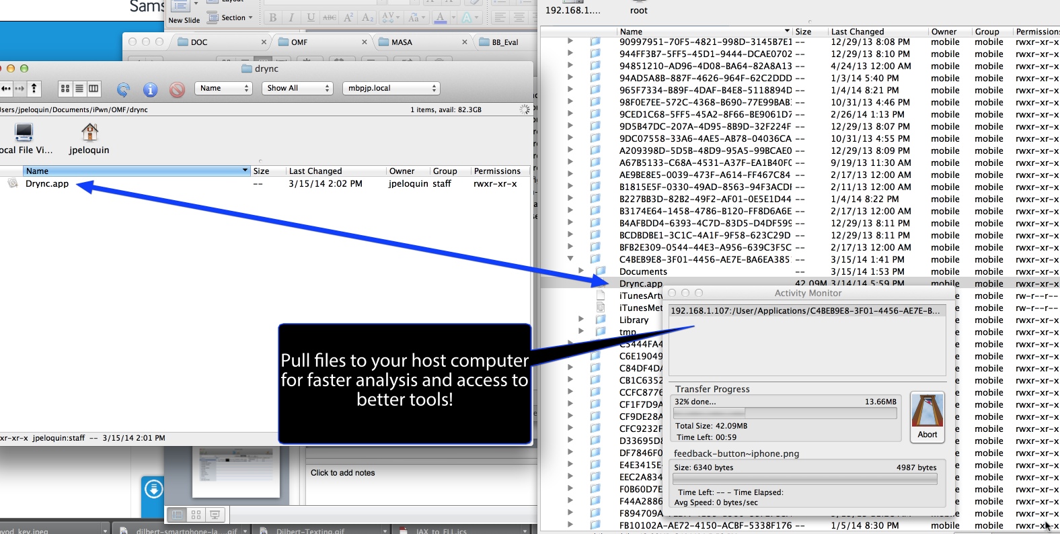
Tools (ios)
© 2013 GuidePoint Security
CONFIDENTIAL AND PROPRIETARY

Slide 13
Tools (Android)
Name | Description
Saferoot, de la Vega, NRT | Root exploits
Clockwork Recovery, TWRP | Recovery
Custom ROM | Optional
SuperSU, Busybox | Privilege escalation, linux utilities
Adbd / adb | Android debug bridge
QtADB | GUI for adb
logcat | ‘adb shell logcat’ system and application debug msgs
dumpsys | ‘adb shell dumpsys’ information re services, accounts
RazorSQL | SQLite GUI client
TSK | Open source digital forensics suite
hexedit | Hexidecimal editor/viewer
strings | Extract printable strings from binary files
Eclipse | IDE for developing Android applications
© 2013 GuidePoint Security
CONFIDENTIAL AND PROPRIETARY

Slide 14
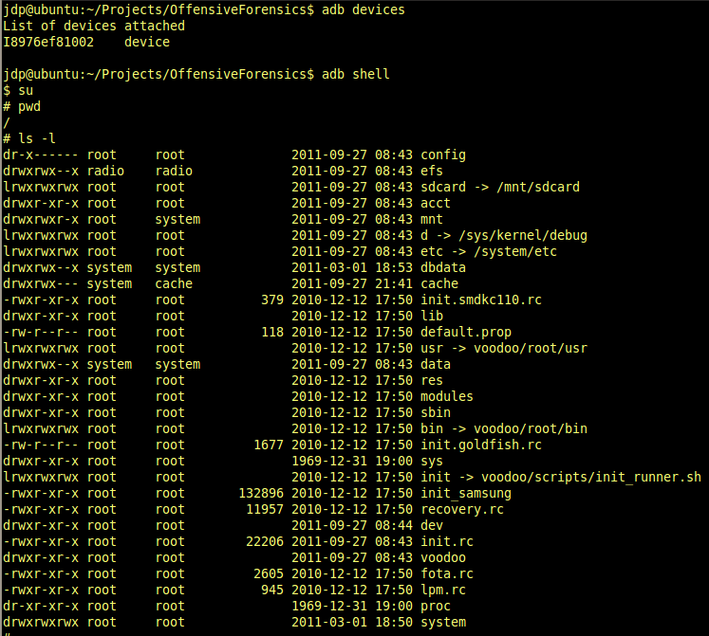
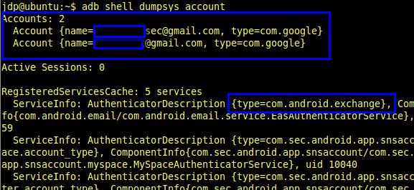
Tools (Android)
© 2013 GuidePoint Security
CONFIDENTIAL AND PROPRIETARY

Slide 15
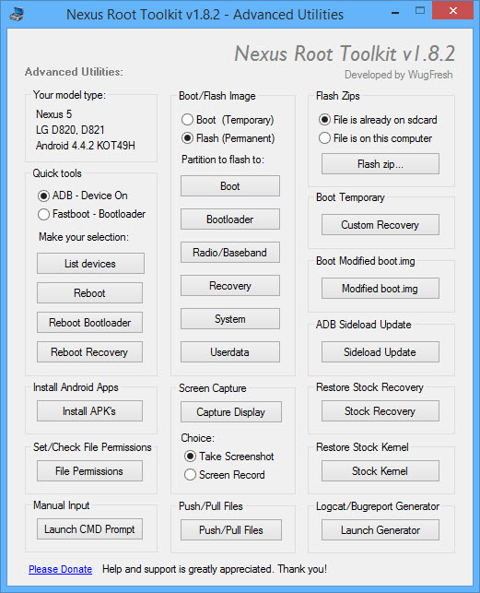
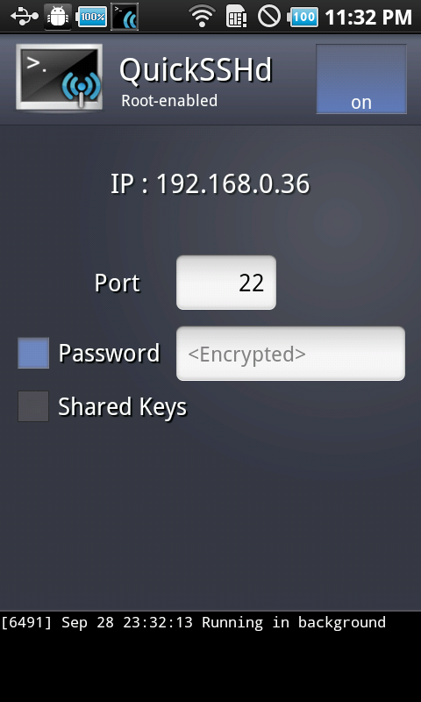
Tools (Android)
© 2013 GuidePoint Security
CONFIDENTIAL AND PROPRIETARY

Slide 16
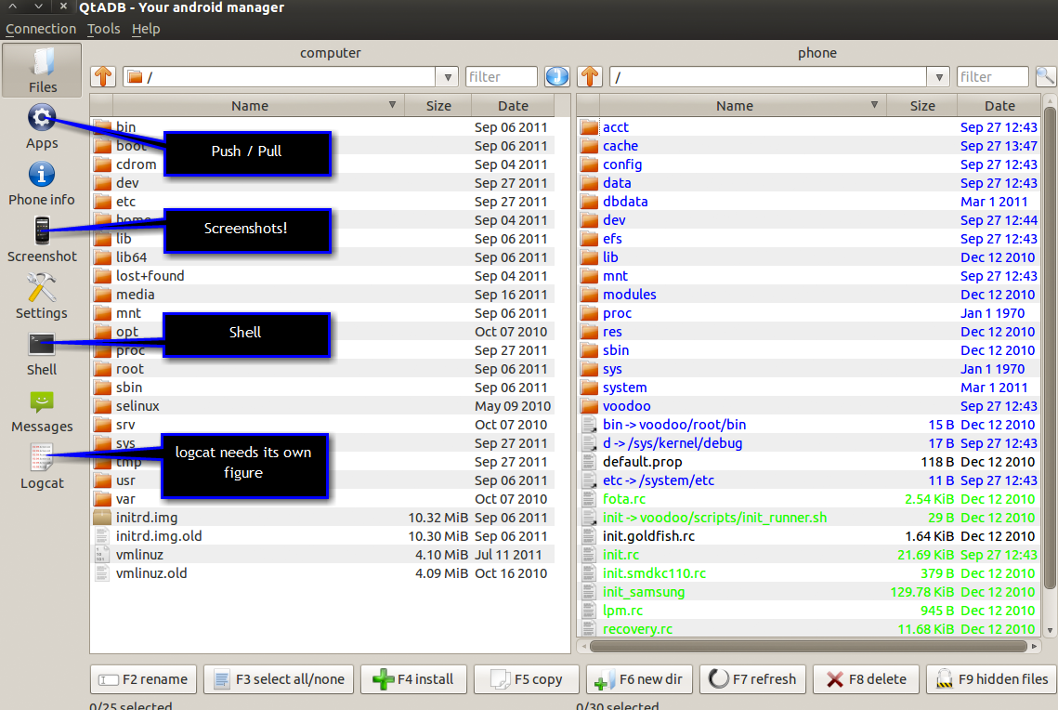
Tools (Android)
© 2013 GuidePoint Security
CONFIDENTIAL AND PROPRIETARY

Slide 17
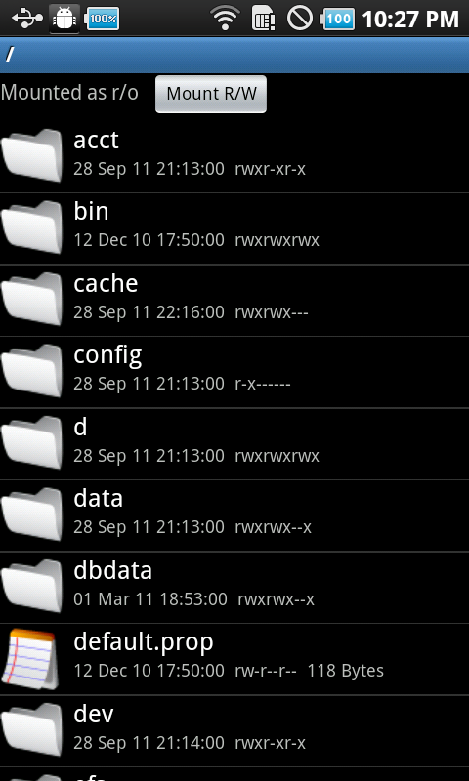
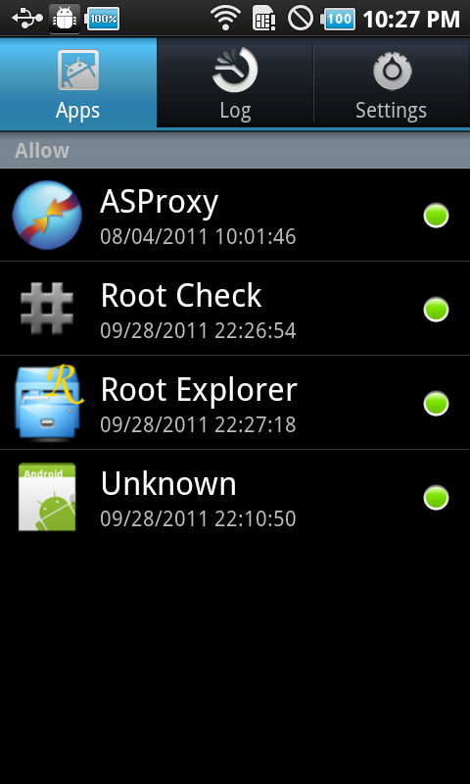
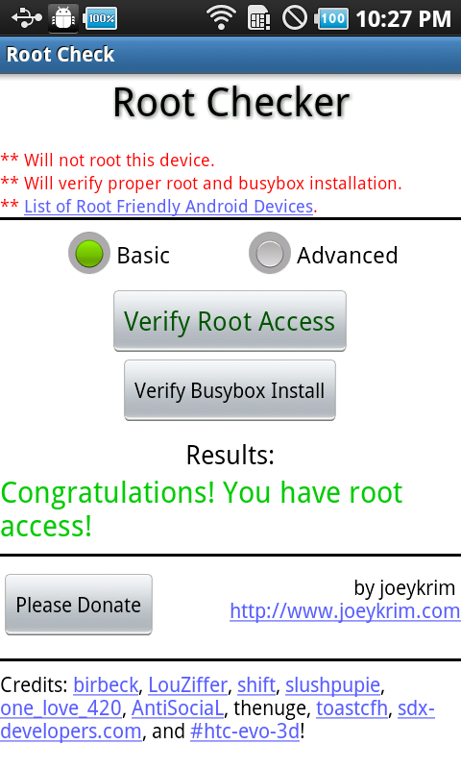
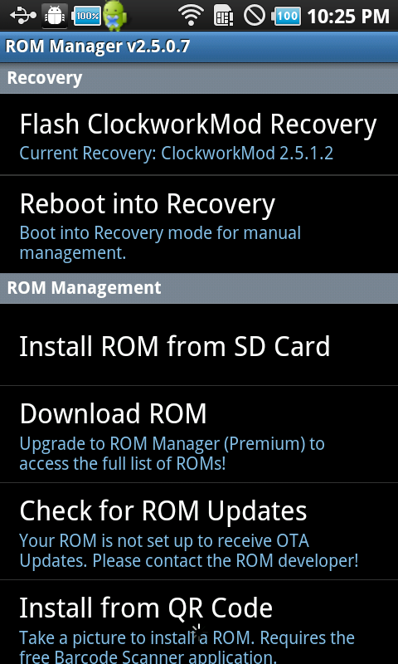
Tools (Android)
© 2013 GuidePoint Security
CONFIDENTIAL AND PROPRIETARY

Slide 18
Got Data? (ios)

Slide 19
Loc Data (IOS)
4.3.2
Location | Description
/var/mobile/Library/AddressBook/AddressBook.sqlitedb | also AddressBookImages.sqlitedb
/var/mobile/Library/Caches/MapTiles/MapTiles.sqlitedb | previously displayed map tiles for Google Maps "binhex" encoding - covert to binary
/var/mobile/Library/Maps/History.plist | google maps lookup cache - check Directions.plist as well
/var/mobile/Library/Calendar/Calendar.sqlitedb | sqlclient / strings
/var/mobile/Library/Callhistory/call_history.db | sqlclient / strings / odd number (FLAGS) outgoing, even incoming
/var/mobile/Library/Mail/Envelope Index
/var/mobile/Library/Notes/notes.sqlite | sqlclient / strings
/var/mobile/Library/SMS/sms.db | sqlclient / strings / FLAGS-low order bit set for sent (odd), off for received (even)
/var/mobile/Library/Voicemail/voicemail.db | voicemail database
/var/mobile/Library/Voicemail/ | vm recordings
/var/mobile/Library/Cookies/Cookies.binarycookies | Safari cookies - use strings
/var/mobile/Library/Preferences | settings, config files for apps
/var/mobile/Library/Safari/Bookmarks.db
/var/mobile/Library/Safari/History.plist
/var/mobile/Library/Safari/SuspendState.plist | browser state when closed, crashed, etc.
/var/mobile/Library/Preferences/com.apple.mobilesafari.plist
/var/mobile/Media/DCIM/100APPLE | photos taken with onboard camera
/var/mobile/Library/Logs
/var/mobileDevice/ProvisioningProfiles
/var/log
/var/logs
/var/preferences/SystemConfiguration/com.apple.network.identification.plist
/var/preferences/SystemConfiguration/com.apple.wifi.plist
/var/preferences/SystemConfiguration/preferences.plist
/var/stash | ringtones, wallpaper, default apps, /bin dir
/var/wireless/Library/CallHistory
/var/wireless/Library/logs
/var/wireless/Library/Preferences
/root/Library/Lockdown/data_ark.plist | apple id, owner info, firmware
/var/Keychains | download keychains databases
© 2013 GuidePoint Security
CONFIDENTIAL AND PROPRIETARY

Slide 20
Loc Data (IOS)
4.3.2
Location | Description
/User/Library/Keyboard/dynamic-text.dat | analyze keyboard cache
/User/Library/Caches/com.apple.UIKit.pboard/pasteboardDB | convert to XML to analyze pasteboard cache
/User/Library/Caches/com.apple.WebAppCache/ApplicationCache.db | Origins table
/User/Library/Caches/Snapshots | Pics of apps when Home is pressed
/User/Applications | user-installed applications
/User/Applications/<app GUID>/<appname.app> | app assets - nibs, images, plists, code signature, etc.
/User/Applications/<app GUID>/Documents | images, text files, etc
/User/Applications/<app GUID>/Library
/User/Applications/<app GUID>/Library/Caches
/User/Applications/<app GUID>/Library/Caches/Snapshots
/User/Applications/<app GUID>/Library/Cookies/Cookies.binarycookies
/User/Applications/<app GUID>/Library/Preferences | plists-a-plenty
/User/Applications/<app GUID>/Library/WebKit
/User/Applications/<app GUID>/Library/WebKit/LocalStorage
/User/Applications/<app GUID>/tmp
/User/Library/Logs/CrashReporter | Application crash logs
© 2013 GuidePoint Security
CONFIDENTIAL AND PROPRIETARY

Slide 21
Loc Data (IOS)
5.1.1
Location | Description
/var/mobile/Library/AddressBook/AddressBook.sqlitedb | also AddressBookImages.sqlitedb
/var/mobile/Library/Caches/MapTiles/MapTiles.sqlitedb | previously displayed map tiles for Google Maps "binhex" encoding - covert to binary
/var/mobile/Library/Maps/History.plist | google maps lookup cache - check Directions.plist as well
/var/mobile/Library/Calendar/Calendar.sqlitedb | sqlclient / strings
/var/mobile/Library/Callhistory/call_history.db | sqlclient / strings / odd number (FLAGS) outgoing, even incoming
/var/mobile/Library/Mail/Envelope Index
/var/mobile/Library/Notes/notes.sqlite | sqlclient / strings
/var/mobile/Library/SMS/sms.db | sqlclient / strings / FLAGS-low order bit set for sent (odd), off for received (even)
/var/mobile/Library/Voicemail/voicemail.db | voicemail database
/var/mobile/Library/Voicemail/ | vm recordings
/var/mobile/Library/Cookies/Cookies.binarycookies | Safari cookies - use strings
/var/mobile/Library/Preferences | settings, config files for apps
/var/mobile/Library/Safari/Bookmarks.db
/var/mobile/Library/Safari/History.plist
/var/mobile/Library/Safari/SuspendState.plist | browser state when closed, crashed, etc.
/var/mobile/Library/Preferences/com.apple.mobilesafari.plist
/var/mobile/Media/DCIM/100APPLE | photos taken with onboard camera
/var/mobile/Library/Logs
/var/mobileDevice/ProvisioningProfiles
/var/log
/var/logs
/var/preferences/SystemConfiguration/com.apple.network.identification.plist
/var/preferences/SystemConfiguration/com.apple.wifi.plist
/var/preferences/SystemConfiguration/preferences.plist
/var/stash | ringtones, wallpaper, default apps, /bin dir
/var/wireless/Library/CallHistory
/var/wireless/Library/logs
/var/wireless/Library/Preferences
/root/Library/Lockdown/data_ark.plist | apple id, owner info, firmware
/var/Keychains | download keychains databases
© 2013 GuidePoint Security
CONFIDENTIAL AND PROPRIETARY

Slide 22
Loc Data (IOS)
5.1.1
Location | Description
/var/Keychains | download keychains databases
/var/mobile/Library/Caches/com.apple.dataaccess.dataaccessd | iCloud login ID and persistent server
/var/mobile/Library/Caches/com.apple.mobilecal | ?
/var/mobile/Library/Caches/com.apple.mobilemail | mobile mail image blobs + URLs
/var/mobile/Library/Caches/com.apple.mobilenotes | ?
/var/mobile/Library/Caches/com.apple.mobilesafari | Cached images + URLs from Safari
/var/mobile/Library/Caches/Maps/MapTiles | db of previously displayed maptiles (google maps)
/var/mobile/Library/Caches/Safari/RecentSearches.plist | Recent search strings from Safari. Also check the Thumbnails subfolder for snapshots.
/var/mobile/Library/Caches/Snapshots | Last screens for camera, mmail, mcal, mnotes, mphone, and many others.
/User/Library/Caches/com.apple.WebAppCache/ApplicationCache.db | Origins table
/User/Applications | user-installed applications
/User/Applications/<app GUID>/<appname.app> | app assets - nibs, images, plists, code signature, etc.
/User/Applications/<app GUID>/Documents | images, text files, etc
/User/Applications/<app GUID>/Library
/User/Applications/<app GUID>/Library/Caches
/User/Applications/<app GUID>/Library/Caches/Snapshots | pic of the app's state when home button pushed
/User/Applications/<app GUID>/Library/Cookies/Cookies.binarycookies
/User/Applications/<app GUID>/Library/Preferences | plists-a-plenty
/User/Applications/<app GUID>/Library/WebKit
/User/Applications/<app GUID>/Library/WebKit/LocalStorage
/User/Applications/<app GUID>/tmp
© 2013 GuidePoint Security
CONFIDENTIAL AND PROPRIETARY

Slide 23
Loc Data (IOS)
6.1.2
Location | Description
/var/mobile/Library/AddressBook/AddressBook.sqlitedb | also AddressBookImages.sqlitedb
/var/mobile/Library/Caches/MapTiles/MapTiles.sqlitedb | previously displayed map tiles for Google Maps "binhex" encoding - covert to binary
/var/mobile/Library/Maps/ | google maps lookup cache, Directions, bookmarks
/var/mobile/Library/Calendar/Calendar.sqlitedb | sqlclient / strings
/var/mobile/Library/DataAccess | IMAP accounts
/var/mobile/Library/Mail/ | personal and corporate mail, icloud
/var/mobile/Library/Notes/notes.sqlite | pull written notes out of db - sqlclient / strings
/var/mobile/Library/SMS/sms.db | sqlclient / strings / FLAGS-low order bit set for sent (odd), off for received (even)
/var/mobile/Library/Keyboard | dynamic-text.dat - use strings, CloudUserDictionary.sqlite
/var/mobile/Library/Voicemail/ | vm recordings and voicemail database (metadata)
/var/mobile/Library/Cookies/Cookies.binarycookies | Safari cookies - use strings
/var/mobile/Library/Preferences | settings, config files for apps
/var/mobile/Library/Safari/ | bookmarks, history, browser state when closed or crashed, etc.
/var/mobile/Library/Mobile Documents | keynote and pdf reader - neither using the folders
/var/mobile/Library/Preferences/com.apple.mobilesafari.plist
/var/mobile/Media/DCIM/100APPLE | photos taken with onboard camera
/var/mobile/Library/Logs | support, itunes, facetime, siri, etc.
/var/mobileDevice/ProvisioningProfiles | Provisioned enterprise apps
/var/log | kernel, ppp, jb
/var/logs | keybag, lockdown
/var/preferences/SystemConfiguration/com.apple.network.identification.plist | ALL networks this device has ever connected to
/var/preferences/SystemConfiguration/com.apple.wifi.plist | ALL wifi networks (SSID, etc.) this device has ever connected to
/var/preferences/SystemConfiguration/preferences.plist | Interesting network information. VPN clients that save passwd and fail to encrypt outed here.
/var/stash | ringtones, wallpaper, default apps, /bin dir
/var/wireless/Library/CallHistory | call_history.db
/var/wireless/Library/Logs | core, baseband
/var/wireless/Library/Preferences | commCenter
/root/Library/Lockdown/data_ark.plist | apple id, owner info, firmware
/var/keybags | Master keys for protection classes (AES)
© 2013 GuidePoint Security
CONFIDENTIAL AND PROPRIETARY

Slide 24
Loc Data (IOS)
6.1.2
Location | Description
/var/Keychains | download keychains databases
/var/mobile/Library/Caches/com.apple.dataaccess.dataaccessd | iCloud login ID and persistent server
/var/mobile/Library/Caches/com.apple.mobilecal | ?
/var/mobile/Library/Caches/com.apple.mobilemail | mobile mail image blobs + URLs
/var/mobile/Library/Caches/com.apple.mobilenotes | ?
/var/mobile/Library/Caches/com.apple.mobilesafari | Cached images + URLs from Safari
/var/mobile/Library/Caches/Maps/MapTiles | db of previously displayed maptiles (google maps)
/var/mobile/Library/Caches/Safari/RecentSearches.plist | Displays recent search strings from Safari. Also check the Thumbnails subfolder for snapshots.
/var/mobile/Library/Caches/Snapshots | Last screens for camera, mmail, mcal, mnotes, mphone, and many others.
/User/Library/Caches/com.apple.WebAppCache/ApplicationCache.db | Origins table
/User/Applications | user-installed applications
/User/Applications/<app GUID>/<appname.app> | app assets - nibs, images, plists, code signature, etc.
/User/Applications/<app GUID>/Documents | images, text files, etc
/User/Applications/<app GUID>/Library
/User/Applications/<app GUID>/Library/Caches
/User/Applications/<app GUID>/Library/Caches/Snapshots | pic of the app's state when home button pushed
/User/Applications/<app GUID>/Library/Cookies/Cookies.binarycookies
/User/Applications/<app GUID>/Library/Preferences | plists-a-plenty
/User/Applications/<app GUID>/Library/WebKit
/User/Applications/<app GUID>/Library/WebKit/LocalStorage
/User/Applications/<app GUID>/tmp
/var/mobile/Library/Accounts/Accounts3.sqlite | gmail, icloud, twitter,etc., accounts
/var/mobile/Library/Application Support/Ubiquity/peer-* | item-info.db
/var/mobile/Library/Assistant/ManagedObjects.sqlite | Siri-used reminders - use strings, e.g. "Call lawn care service America/New_York"
/var/mobile/Library/DataAccess | IMAP, iCloud accounts
/var/mobile/Library/Passes | Passbook - Flight, Hotel info
© 2013 GuidePoint Security
CONFIDENTIAL AND PROPRIETARY

Slide 25
Loc Data (IOS)
7.0.6
Location | Description
/var/mobile/Library/AddressBook/AddressBook.sqlitedb | also AddressBookImages.sqlitedb
/var/mobile/Library/Caches/MapTiles/MapTiles.sqlitedb | previously displayed map tiles for Google Maps "binhex" encoding - covert to binary
/var/mobile/Library/Maps/ | google maps lookup cache, Directions, bookmarks
/var/mobile/Library/Calendar/Calendar.sqlitedb | sqlclient / strings
/var/mobile/Library/DataAccess | IMAP accounts
/var/mobile/Library/Mail/ | personal and corporate mail, icloud
/var/mobile/Library/Notes/notes.sqlite | pull written notes out of db - sqlclient / strings
/var/mobile/Library/SMS/sms.db | sqlclient / strings / FLAGS-low order bit set for sent (odd), off for received (even)
/var/mobile/Library/Keyboard | dynamic-text.dat - use strings, CloudUserDictionary.sqlite
/var/mobile/Library/Voicemail/ | vm recordings and voicemail database (metadata)
/var/mobile/Library/Cookies/Cookies.binarycookies | Safari cookies - use strings
/var/mobile/Library/Preferences | settings, config files for apps
/var/mobile/Library/Safari/ | bookmarks, history, browser state when closed or crashed, etc.
/var/mobile/Library/Mobile Documents | keynote and pdf reader - neither using the folders
/var/mobile/Media/DCIM/100APPLE | photos taken with onboard camera
/var/mobile/Library/Logs | support, itunes, facetime, siri, etc.
/Library/MobileDevice/ProvisioningProfiles | Provisioned enterprise apps
/var/mobile/Library/Caches/com.apple.UIKit.pboard | Copy/paste buffer
/Library/Logs | kernel, ppp, jb, keybag, lockdown
/Library/Preferences/SystemConfiguration/com.apple.network.identification.plist | ALL networks this device has ever connected to
/Library/Preferences/SystemConfiguration/com.apple.wifi.plist | ALL wifi networks (SSID, etc.) this device has ever connected to
/Library/Preferences/SystemConfiguration/preferences.plist | Interesting network information. VPN clients that save passwd and fail to encrypt outed here.
/var/stash | ringtones, wallpaper, default apps
/var/wireless/Library/CallHistory | call_history.db
/var/wireless/Library/Logs | core, baseband
/root/Library/Lockdown/data_ark.plist | apple id, owner info, firmware
/var/keybags | Master keys for protection classes (AES)
© 2013 GuidePoint Security
CONFIDENTIAL AND PROPRIETARY

Slide 26
Loc Data (IOS)
7.0.6
Location | Description
/var/Keychains | download keychains databases
/var/mobile/Library/Caches/com.apple.dataaccess.dataaccessd | iCloud login ID and persistent server
/var/mobile/Library/Caches/com.apple.mobilecal
/var/mobile/Library/Caches/com.apple.mobilemail | Complete emaill threads; sender/recipient, message, attachments
/var/mobile/Library/Caches/com.apple.mobilenotes
/var/mobile/Library/Caches/com.apple.mobilesafari | Thumbnails,ad URI cache, recent searches (plist)
/var/mobile/Library/Caches/Maps/MapTiles | db of previously displayed maptiles (google maps)
/var/mobile/Library/Caches/Safari/RecentSearches.plist | Displays recent search strings from Safari. Also check the Thumbnails subfolder for snapshots.
/var/mobile/Library/Caches/Snapshots | Last screens for camera, mmail, mcal, mnotes, mphone, and many others.
/User/Library/Caches/com.apple.WebAppCache/ApplicationCache.db | Origins table
/User/Applications | user-installed applications
/User/Applications/<app GUID>/<appname.app> | app assets - nibs, images, plists, code signature, etc.
/User/Applications/<app GUID>/Documents | images, text files, etc
/User/Applications/<app GUID>/Library
/User/Applications/<app GUID>/Library/Caches
/User/Applications/<app GUID>/Library/Caches/Snapshots | pic of the app's state when home button pushed
/User/Applications/<app GUID>/Library/Cookies/Cookies.binarycookies
/User/Applications/<app GUID>/Library/Preferences | plists-a-plenty
/User/Applications/<app GUID>/Library/WebKit
/User/Applications/<app GUID>/Library/WebKit/LocalStorage
/User/Applications/<app GUID>/tmp
/var/mobile/Library/Accounts/Accounts3.sqlite | gmail, icloud, twitter,etc., accounts
/var/mobile/Library/Application Support/Ubiquity/peer-* | item-info.db
/var/mobile/Library/Assistant/ManagedObjects.sqlite | Siri-used reminders - use strings, e.g. "Call lawn care service America/New_York"
/var/mobile/Library/DataAccess | IMAP, iCloud accounts
/var/mobile/Library/Passes | Passbook - Flight, Hotel info
© 2013 GuidePoint Security
CONFIDENTIAL AND PROPRIETARY

Slide 27
Ios Findings!

Slide 28
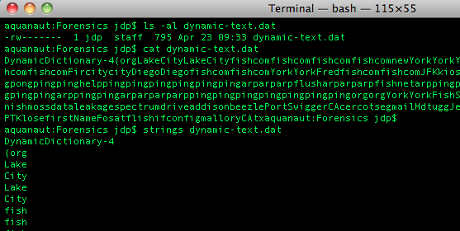
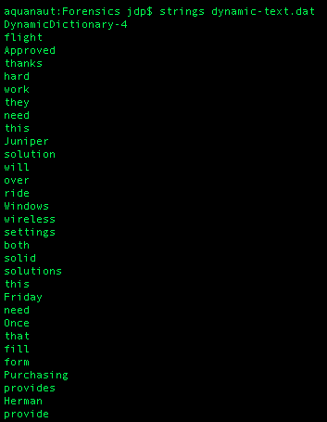
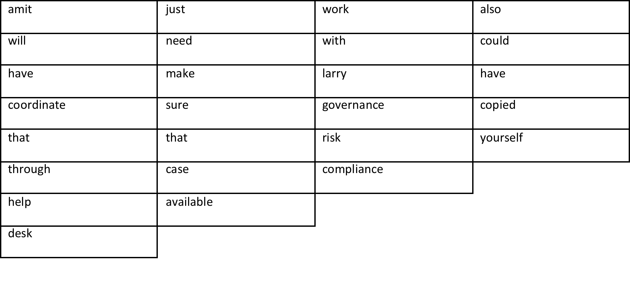
Keyboard cache
© 2013 GuidePoint Security
CONFIDENTIAL AND PROPRIETARY

Slide 29
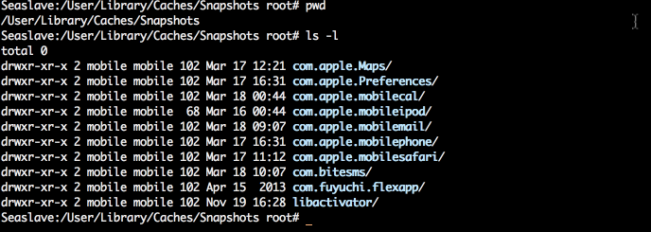
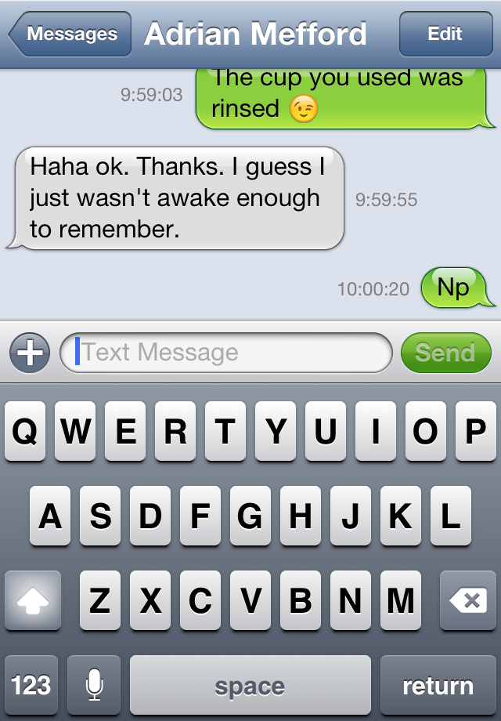
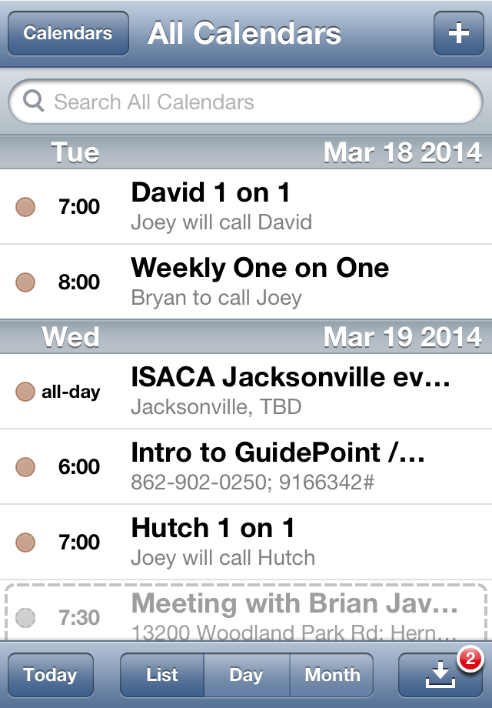
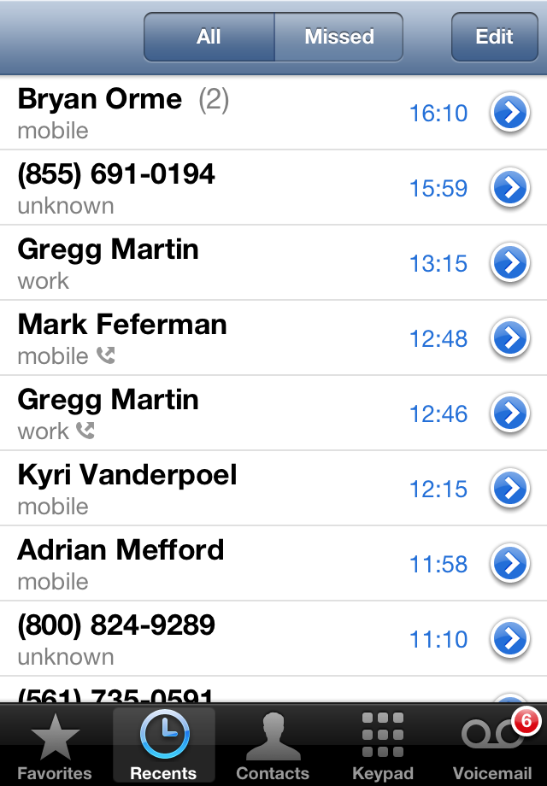
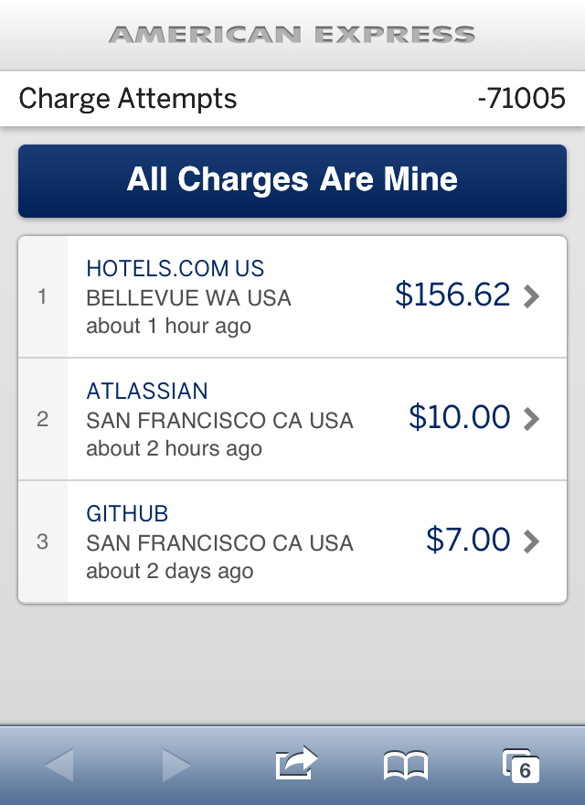
snapshots
© 2013 GuidePoint Security
CONFIDENTIAL AND PROPRIETARY

Slide 30
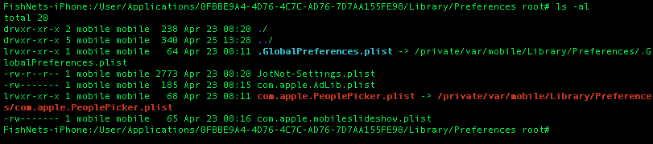
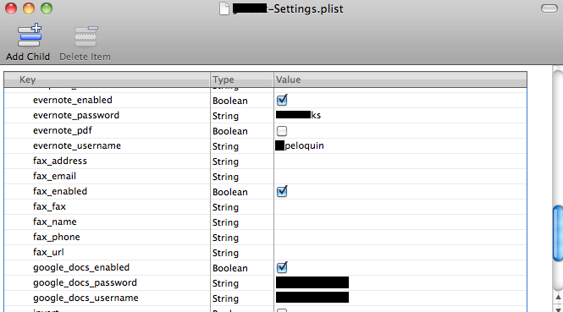
Xpense mgmt app
© 2013 GuidePoint Security
CONFIDENTIAL AND PROPRIETARY

Slide 31
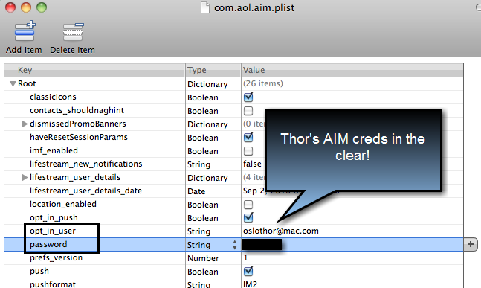
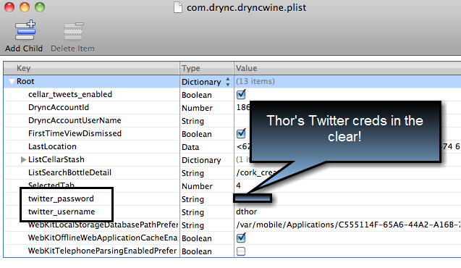
Chat / social apps
© 2013 GuidePoint Security
CONFIDENTIAL AND PROPRIETARY

Slide 32
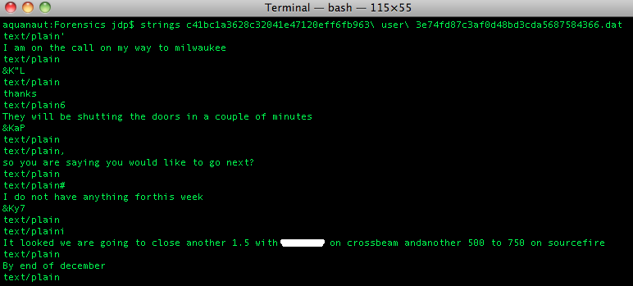
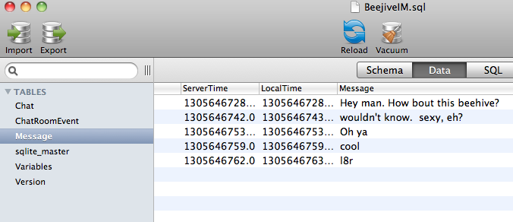
Chat / social apps
© 2013 GuidePoint Security
CONFIDENTIAL AND PROPRIETARY

Slide 33
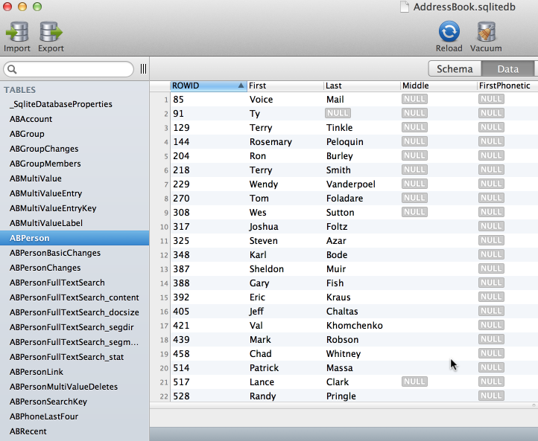
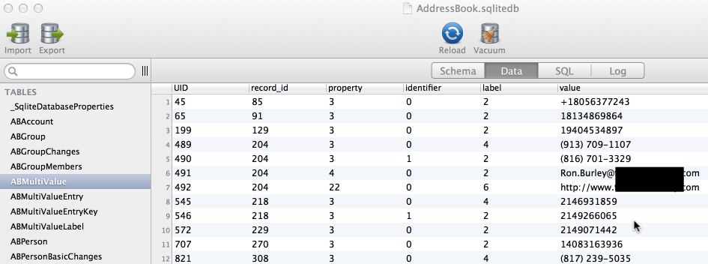
contacts
© 2013 GuidePoint Security
CONFIDENTIAL AND PROPRIETARY

Slide 34
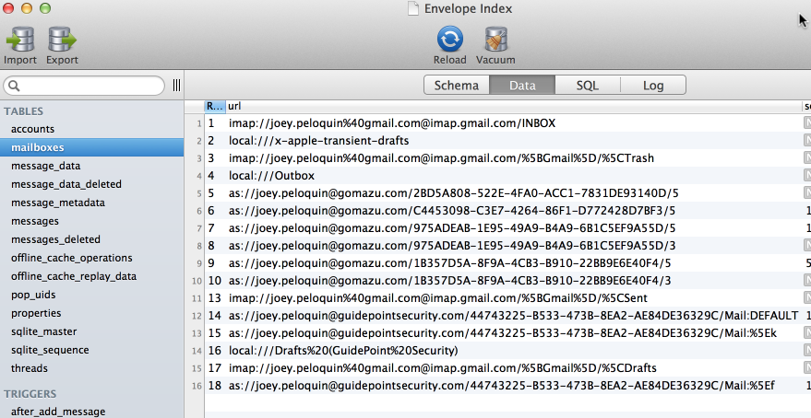
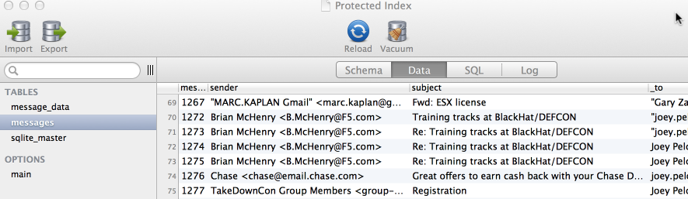
mail
© 2013 GuidePoint Security
CONFIDENTIAL AND PROPRIETARY

Slide 35
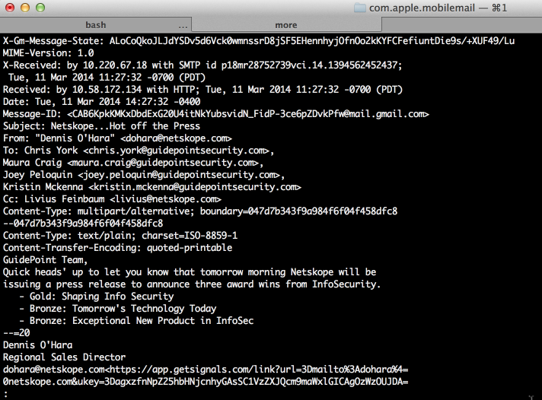
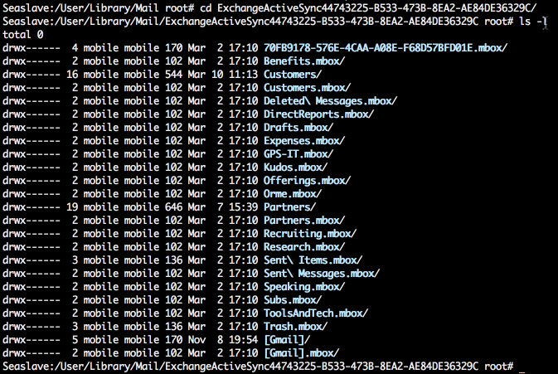
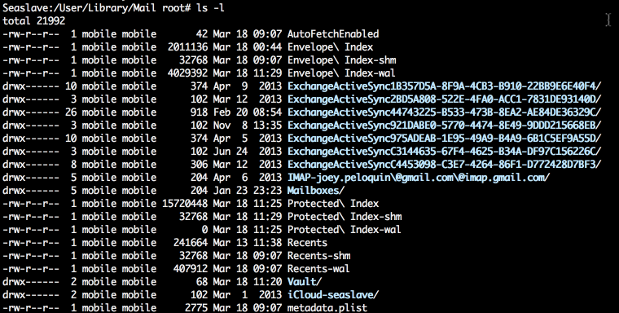
Mo’ mail
© 2013 GuidePoint Security
CONFIDENTIAL AND PROPRIETARY

Slide 36

Demo!

Slide 37
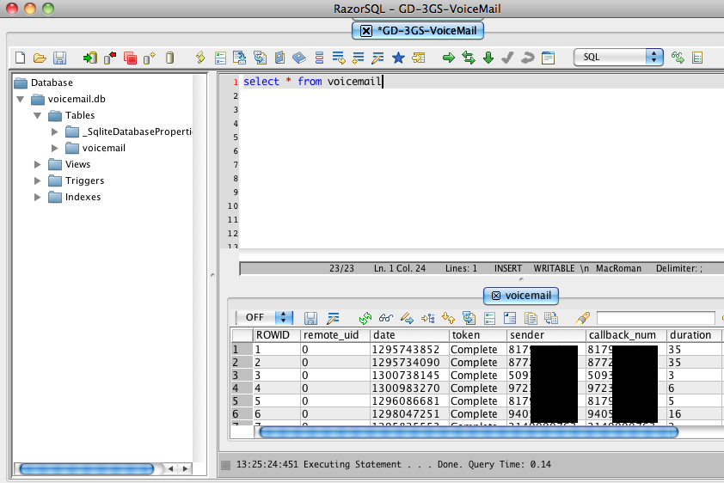
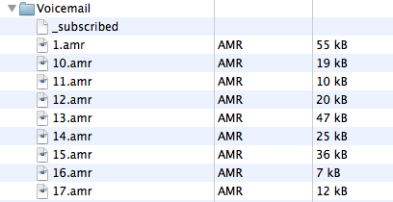
Voicemail
© 2013 GuidePoint Security
CONFIDENTIAL AND PROPRIETARY

Slide 38
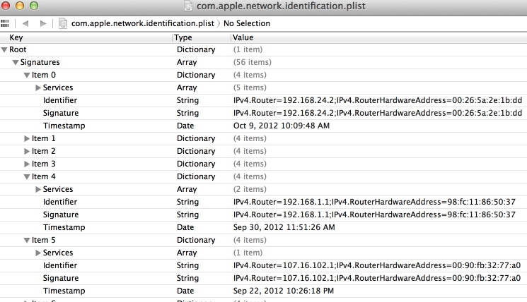
Network config
© 2013 GuidePoint Security
CONFIDENTIAL AND PROPRIETARY

Slide 39


Wifi config
© 2013 GuidePoint Security
CONFIDENTIAL AND PROPRIETARY

Slide 40

keychain
© 2013 GuidePoint Security
CONFIDENTIAL AND PROPRIETARY

Slide 41


Passbook, Accounts
© 2013 GuidePoint Security
CONFIDENTIAL AND PROPRIETARY

Slide 42


Ubiquity, Assistant
© 2013 GuidePoint Security
CONFIDENTIAL AND PROPRIETARY

Slide 43
Got data? (android)

Slide 44
Loc Data (android)
2.3.4 Gingerbread
Location | Description
/data/data/<app name> | Application data
/data/data/com.android.providers.userdictionary | User dictionary, aka keyboard cache
/data/data/com.android.email | Email data – creds, messages, etc
/data/data/com.osp.app.signin | oAuth tokens, certs
/data/log | Error dumps
/data/misc/vpn | VPN profiles
/data/misc | Memory dumps
/data/system/sync | Sync accounts, sync targets (authorities)
/data/system/accounts.db | Account credentials, auth tokens, etc. (similar to KeyChain)
/data/wifi | Configured wifi networks – UID, PSK, etc
/dbdata/system/registered_services/packages.xml | Delegated permissions across device
/dbdata/databases/<app name> | Application database storage and preferences files
/dbdata/databases/com.android.providers.contacts | Accounts, contacts, calls
/dbdata/databases/com.android.providers.settings | Device settings
/dbdata/databases/com.android.providers.telephony | Mmssms details – sender/receiver, message, timestamp
/dbdata/databases/com.android.vending | Market downloads (account), carrier billing info
/dbdata/databases/com.google.android.gm | Gmail accounts, gmail data
/dbdata/databases/com.google.android.gsf | Google services settings, email disclosure
/dbdata/databases/com.sec.android.app.memo | Database of ‘memo’ entries
/dbdata/databases/com.sec.android.app.sns | Account information for social networking
/dbdata/databases/com.sec.android.provider.logsprovider | Log db
/dbdata/databases/com.sec.android.providers.drm | DRM details
/mnt/sdcard/data/browser | Browser cache tables and databases
/mnt/sdcard/data/crash | Crash logs
/mnt/sdcard/DCIM | Photos
/mnt/sdcard/Voodoo | Logs
© 2013 GuidePoint Security
CONFIDENTIAL AND PROPRIETARY

Slide 45
Loc Data (android)
4.0.4 Ice Cream Sandwich
Location | Description
/data/app/<appname> | user-installed APKs
/data/app-private/ | user-installed apps with private storage
/data/misc | keychain, keystore, wifi, vpn - Wifi creds still in the clear!
/data/system | package permissions, entropy.dat?
/data/log | Error dumps
/data/misc/vpn | VPN profiles
/data/misc | Memory dumps
/data/misc/wifi | Configured wifi networks – SSID, UID, PSK, etc
/data/system/sync | Sync accounts, sync targets (authorities)
/data/system/accounts.db | Account creds, auth tokens, etc. - Creds still in the clear!
/data/system/packages.xml | Delegated permissions across apps
/datadata/<app name> | Applications and data (user and native)
/datadata/com.android.providers.userdictionary | User dictionary, aka keyboard cache
/datadata/com.android.email | Email data – creds, messages, etc
/datadata/com.google.android.gm | Gmail accounts, gmail data
/datadata/com.android.providers.contacts | Accounts, contacts, calls
/datadata/com.android.providers.settings | Device settings
/datadata/com.android.providers.telephony | Mmssms details – sender/receiver, message, timestamp
/datadata/com.android.vending | Market downloads (account), carrier billing info
/datadata/com.google.android.gsf | Google services settings, email disclosure
/datadata/com.sec.android.providers.drm | DRM details
/datadata/com.android.browser | cache, autofill, geo loc
/mnt/sdcard/DCIM | camera photos
© 2013 GuidePoint Security
CONFIDENTIAL AND PROPRIETARY

Slide 46
Loc Data (android)
4.2.2 Jelly Bean
Location | Description
/data/app/<appname> | user-installed APKs
/data/app-private/ | user-installed apps with private storage
/data/misc | keychain, keystore, wifi, vpn - Wifi creds still in the clear!
/data/system | package permissions, entropy.dat?
/data/log | Error dumps
/data/misc/vpn | VPN profiles
/data/misc | Memory dumps
/data/misc/wifi | Configured wifi networks – SSID, UID, PSK, etc
/data/system/sync | Sync accounts, sync targets (authorities)
/data/system/accounts.db | Account creds, auth tokens, etc. - Creds still in the clear!
/data/system/packages.xml | Delegated permissions across apps
/datadata/<app name> | Applications and data (user and native)
/datadata/com.android.providers.userdictionary | User dictionary, aka keyboard cache
/datadata/com.android.email | Email data – creds, messages, etc
/datadata/com.google.android.gm | Gmail accounts, gmail data
/datadata/com.android.providers.contacts | Accounts, contacts, calls
/datadata/com.android.providers.settings | Device settings
/datadata/com.android.providers.telephony | Mmssms details – sender/receiver, message, timestamp
/datadata/com.android.vending | Market downloads (account), carrier billing info
/datadata/com.google.android.gsf | Google services settings, email disclosure
/datadata/com.sec.android.providers.drm | DRM details
/datadata/com.android.browser | cache, autofill, geo loc
/mnt/sdcard/DCIM | camera photos
© 2013 GuidePoint Security
CONFIDENTIAL AND PROPRIETARY

Slide 47
Android Findings!

Slide 48


accounts
© 2013 GuidePoint Security
CONFIDENTIAL AND PROPRIETARY

Slide 49

Bookmarks
© 2013 GuidePoint Security
CONFIDENTIAL AND PROPRIETARY

Slide 50



Browser data
© 2013 GuidePoint Security
CONFIDENTIAL AND PROPRIETARY

Slide 51

cache
© 2013 GuidePoint Security
CONFIDENTIAL AND PROPRIETARY

Slide 52


Mail creds
© 2013 GuidePoint Security
CONFIDENTIAL AND PROPRIETARY

Slide 53


mail
© 2013 GuidePoint Security
CONFIDENTIAL AND PROPRIETARY

Slide 54

contacts
© 2013 GuidePoint Security
CONFIDENTIAL AND PROPRIETARY

Slide 55

Wifi config
© 2013 GuidePoint Security
CONFIDENTIAL AND PROPRIETARY

Slide 56


applications
© 2013 GuidePoint Security
CONFIDENTIAL AND PROPRIETARY

Slide 57


Applications
© 2013 GuidePoint Security
CONFIDENTIAL AND PROPRIETARY

Slide 58

What now?!

Slide 59
Mitigation
Mobile Security Policy
Mobile Security Education
Mobile Device Management
MADIM (app + Device + InFO)
Offensive Mobile Forensics
Secure Mobile Development
“In the popular culture, the availability of 10,000 applications for my smart phone is viewed as an unalloyed good. It is not — since each represents a potential vulnerability. But if we want to shift the popular culture, we need a broader flow of information to corporations and individuals to educate them on the threat. To do that we need to recalibrate what is truly secret.”
– Gen. Michael Hayden, ret.
© 2013 GuidePoint Security
CONFIDENTIAL AND PROPRIETARY

Slide 60

Samsung KNOX
Secured bootloader
0x0, 0x1
REMOVE? DISABLE?
kernels and recoveries
Container; dual persona system
© 2013 GuidePoint Security
CONFIDENTIAL AND PROPRIETARY

Slide 61

Samsung KNOX
KNOX 2.0
S5
WORKSPACE
EMM
MARKETPLACE
CUSTOMIZATION
© 2013 GuidePoint Security
CONFIDENTIAL AND PROPRIETARY

Slide 62

Samsung KNOX
© 2013 GuidePoint Security
CONFIDENTIAL AND PROPRIETARY

Slide 63

Thank you!
Joey Peloquin
joey@guidepointsecurity.com
© 2013 GuidePoint Security
CONFIDENTIAL AND PROPRIETARY

