Slide 1
Subverting iOS Data Protection
Cracking the Passcode (PIN)

Slide 2
Commands
Step 1: Boot ramdisk and custom kernel on device
./redsn0w_mac_0.9.15b3/redsn0w.app/Contents/MacOS/redsn0w -i iPhone3,3_5.1.1_9B206_Restore.ipsw -r myramdisk_n90ap.dmg -k kernelcache.release.n90.patched
Step 2: Establish connection to phone (ssh over usb using ssl, aka usbmux, or USB Multiplexing)
python usbmuxd-python-client/tcprelay.py -t 22:2222 1999:1999
Step 3: Bruteforce passcode
python python_scripts/demo_bruteforce.py
Step 4: Profit!

Slide 3
Passcode Complexity
Passcode Length | Complexity | Time
4 | Numeric | 18 minutes
4 | Alphanumeric | 19 days
6 | Alphanumeric | 196 years
8 | Alphanumeric | 755 thousand years
8 | Alphanumeric Complex | 27 million Years
Source: iOS Hacker’s Handbook

Slide 4
Tools
FOSS
iPhone Data Protection Suite
Up to iOS 5.1.1
A4 chipset (3GS, iPhone4, iPod Touch 2,3,4)
Crack passcode, image device, decrypt image, recover deleted files (limited), file analysis
https://code.google.com/p/iphone-dataprotection/wiki/README
Zdziarski’s iOS forensic tools
Acquisition, PIN bypass, decryption, analysis
iOS 3.x / 4.x

Slide 5
Tools
Commerical
Elcomsoft iOS Forensic Toolkit
iOS 3.x to 7.x
A4 chipset, A5 requires jailbroken device
Crack simple passcode, image device, decrypt image, recover deleted files, file analysis
http://www.elcomsoft.com/eift.html
Paraben, Cellebrite, Oxygen

Slide 6
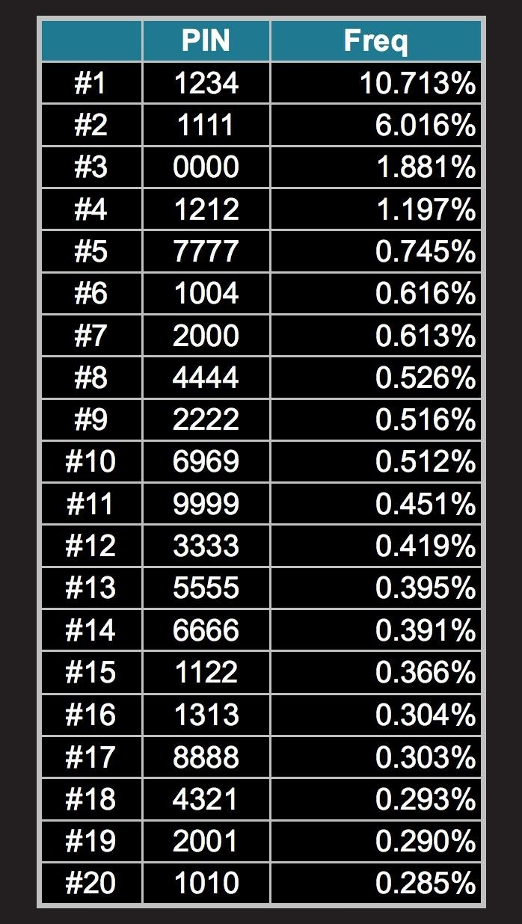
Moral of the Story?
10,000 combinations of 4-digit PIN using 0-9
Out of 3 million PINs analyzed, 27% are represented by the dataset to the left
DOH!

