Slide 1
Zero Trust “Lite” Architecture to Securely Future-Proof your Network
Jeremy Dorrough – RVASEC 2017
Notes:
Chris, Jake and Karen

Slide 2

Disclaimer
Opinions expressed in this presentation are my own. I am speaking for myself, not Optiv, nor anyone else.

Slide 3





About Me
10+ years in IT Security industry
Worked in defense, utility & financial sectors
Presented at Defcon, UNC, JMU, RISE, FBI Infragard
CISSP, GIAC GPPA, CCSK, CISM, CEH, PCNSE
Currently a Client Solutions Architect at OPTIV

Slide 4
Agenda
3 Tier Architecture
History of Zero Trust
Definition of Zero Trust and key terms
Current events related to Zero Trust
Challenges I’ve experienced with Zero Trust
My suggestions to successfully embrace Zero Trust

Slide 5
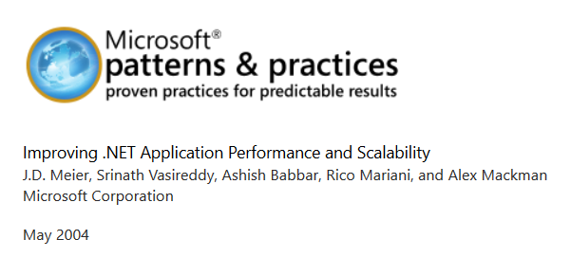
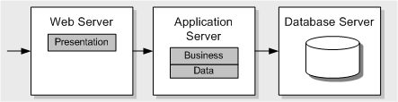
3-Tier Architecture

Slide 6


Slide 7
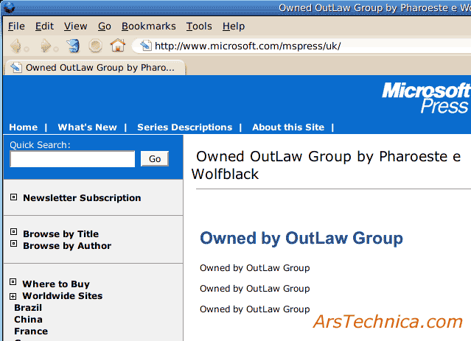

Slide 8


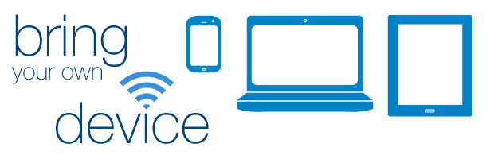
3-Tier Architecture
PCI, HIPAA, PII, PHI, FISM, Company Competitive Data

Slide 9

Challenges
Limited visibility once traffic is Trusted
Lack of enforcement options in Trusted zones
Typically relied on layer-4 enforcement
Application designs increasingly diverge from 3-tier topology
Cloud offerings move critical data to offsite locations making perimeter protections useless
BYOD increases risk of introducing threats inside Trusted zones
External connections are difficult to control once given access to any internal Trusted resource

Slide 10
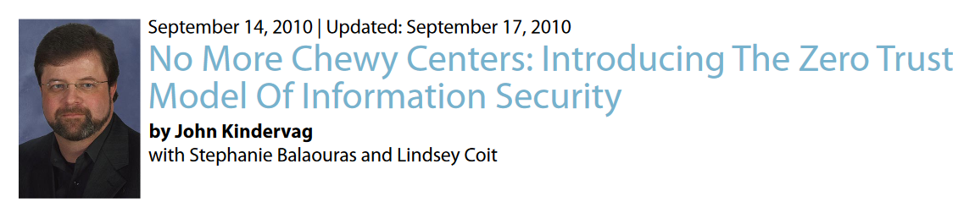
What is Zero Trust?
Notes:
VP, Principal Analyst, Forrester Research

Slide 11
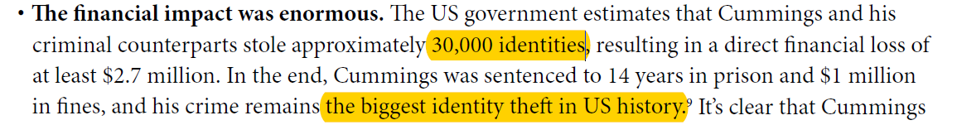
-“No More Chewy Centers: Introducing The ZeroTrust Model Of Information Security” September 14, 2010
Notes:
Philip Cummings, stole credit reports Equifax, Transunion, Experian

Slide 12





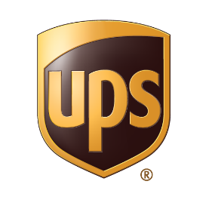






Breaches since 2010…
Notes:
Databreaches.net
Playstation- 77 million lulzsec
Home Depot – 56 million
Target – 70 million
Yahoo - 500 million
Ebay – 145 million
LinkedIn- 117 million
DropBox – 68 million
Adobe – 36 million
UPS- 4 million
Living Social – 50 million
JP Morgan – 76 million
Tumblr – 65 million

Slide 13
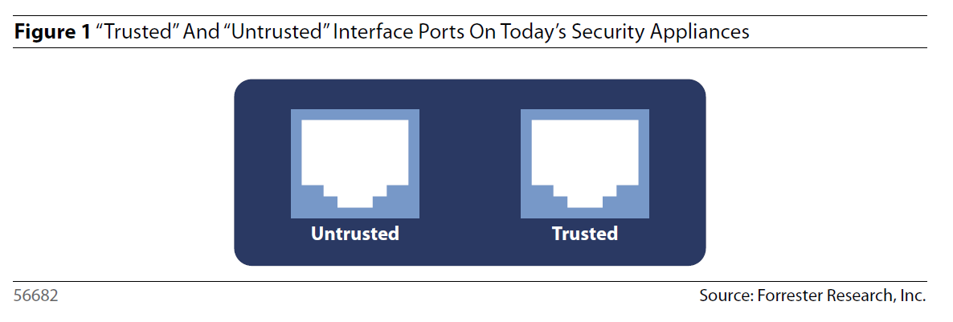
Zero Trust Fundamentals
Untrusted

Slide 14
Zero Trust Fundamentals
All resources are accessed in a secure manner regardless of location.
Access control is on a “need-to-know” basis and is strictly enforced.
Verify and never trust.
Inspect and log all traffic.
The network is designed from the inside out.

Slide 15
Zero Trust Terminology
Segmentation Gateway (SG) – High speed security device providing Firewall, IPS, WAF, NAC, VPN and Encryption services
Microcore and Perimeter (MCAP) – Physically segmented by SG interface zone that shares similar functionality and global policy attributes
Data Acquisition Network (DAN) – Facilitates the extraction of network data – typically, packets, syslog, or SNMP messages to a central inspection point
MGMT Server – Backplane that acts as a jump host in separate MCAP for management of devices

Slide 16
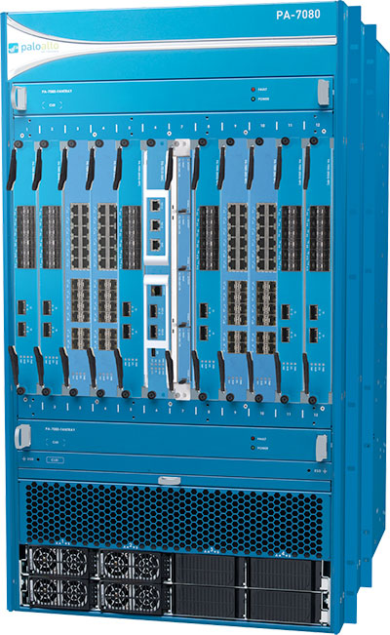
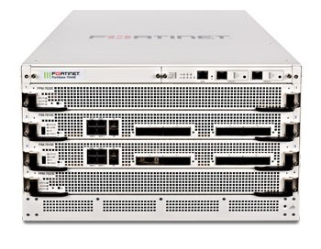
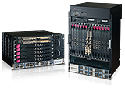
Segmentation Gateway (SG)
Next Generation Firewall
Spec’d to handle very high throughput
Virtual offering to support cloud and fabric environments
Needs to integrate with user identity strategy
Automated rule base support
Compatible with DAN

Slide 17
Microcore and Microperimeters (MCAP)
Every Interface connected to SG
Creates protected L2 switching zone
Members of MCAP should share similar functionality and global policy attributes
Can be more specific than traditional DMZ

Slide 18
Data Acquisition Network (DAN)
Confined network dedicated to log analysis
All traffic to and from each SA interface logged
Security Information and Event Management (SIEM)
Network Analysis and Visibility (NAV)
Enables quicker TTR and event discovery

Slide 19
Network Design
WLAN MCAP
WWW MCAP
Users MCAP
Application MCAP
3rd Party MCAP
MGMT MCAP
DAN MCAP
Database MCAP

Slide 20
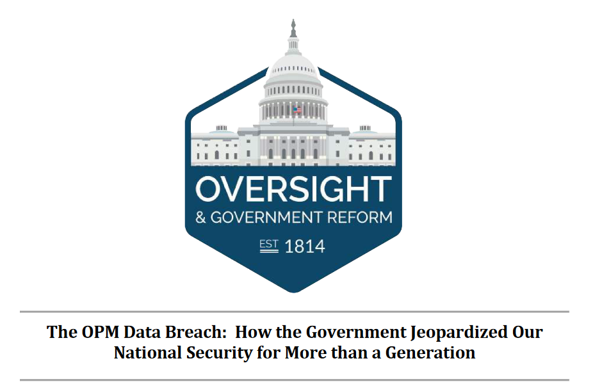

“
…Recommendation 2 – Reprioritize Federal Information Security Efforts Towards a Zero Trust Model…
“”
Notes:
13 recommendations 2nd only to “Ensure Angcy CIOs are Empowered, Accountable, and Competent”
OMB should provide guidance to agencies to promote a zero trust IT security model. The OPM data breaches discovered in 2014 and 2015 illustrate the challenge of securing large, and therefore high-value, data repositories when defenses are geared toward perimeter defenses. In both cases the attackers compromised user credentials to gain initial network access, utilized tactics to elevate their privileges, and once inside the perimeter, were able to move throughout OPM’s network, and ultimately accessed the “crown jewel” data held by OPM. The agency was unable to visualize and log network traffic which led to gaps in knowledge regarding how much data was actually exfiltrated by attackers. To combat the advanced persistent threats seeking to compromise or exploit federal government IT networks, agencies should move towards a “zero trust” model of information security and IT architecture.

Slide 21

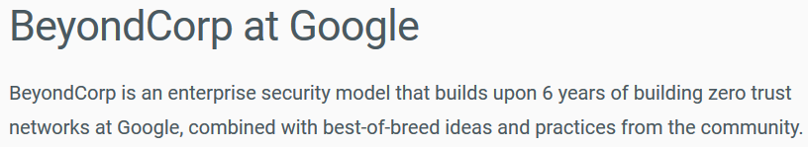
“
https://cloud.google.com/beyondcorp/
”

Slide 22
Limits I find within Zero Trust
Costly in time and money to redesign large enterprise network
Virtualization segmentation adds complexity
Organizations may not be equipped to make use of additional logging data
Network infrastructure may not support throughput/connectivity to route all traffic to Security Gateway
Possibly limits productivity if user experience is degraded

Slide 23
My Suggestions when Rolling out Zero Trust
Classify data based on business criticality
Identify data flows
Prepare log analytic tools for total network visibility
All access mediums must support user identification
Deploy SG with critical MCAPs first
Any new systems should be deployed in MCAP

Slide 24

Classify Data
Forrester suggest using “Unclassified, Toxic, Radioactive” scale
Aligned data classification with business impact
Difficult but imperative step and often skipped
Tools available to help locate data based on pattern match
Ongoing process as new data will continue to be created
Internal training should align to data classification strategies

Slide 25
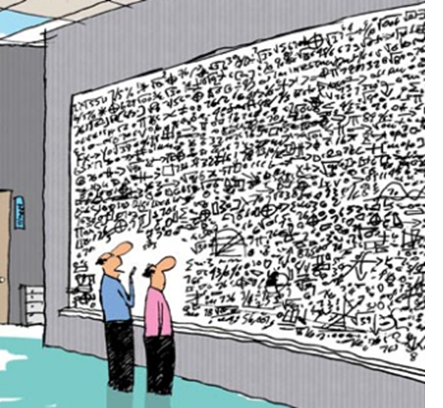
Identify data flows
Map data lifecycle of critical data
Identify all points of possible compromise
This exercise creates blueprints for MCAP segmentation

Slide 26
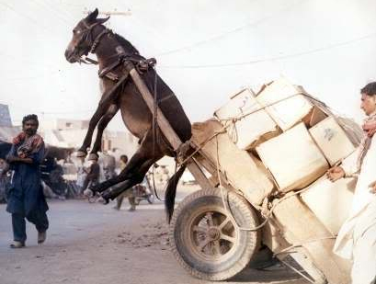
Prepare DAN toolsets
Forecast throughput and flow metrics
Factor in future growth expectations
Develop configuration strategy to obtain all relevant logging
Upgrade or acquire tools as necessary

Slide 27
Implement Holistic User Identification
Assign username to every packet that is generated by end user
Choose tools that integrate
Imperative for automated security policy
Agent, Cert, Captive Portal, AD Logs, Exchange Logs, Syslog, etc.

Slide 28
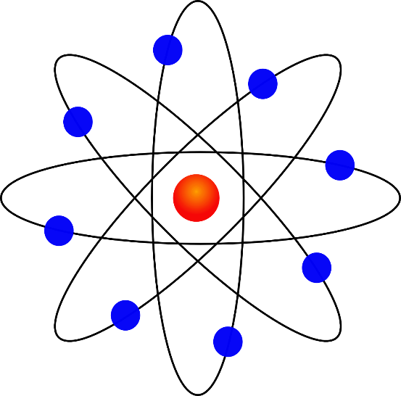
Deploy SG in phased approach
Place SG in nucleus of network
Prioritize segmentation based on business criticality
User MCAP will likely be most challenging
Utilize sample user groups
Minimize downtime by leveraging DAN output

Slide 29
Continually Reassess MCAP Business Alignment
Policies and Procedures should reinforce Zero Trust strategy
Recurring review of Data delineation
All new business functions should undergo review process BEFORE adoption
Future compliance requirements become much easier once Zero Trust model is deployed

Slide 30
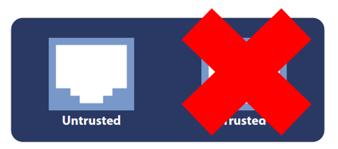
Final Thoughts
Trust will be exploited therefore “Untrust and Verify”
No Silver Bullet
Zero Trust is a theoretical end state
End results should yield higher security posture with less operational overhead

Slide 31
?

