Slide 1

Cyber Security 2017
Trends and Start Ups

Slide 2
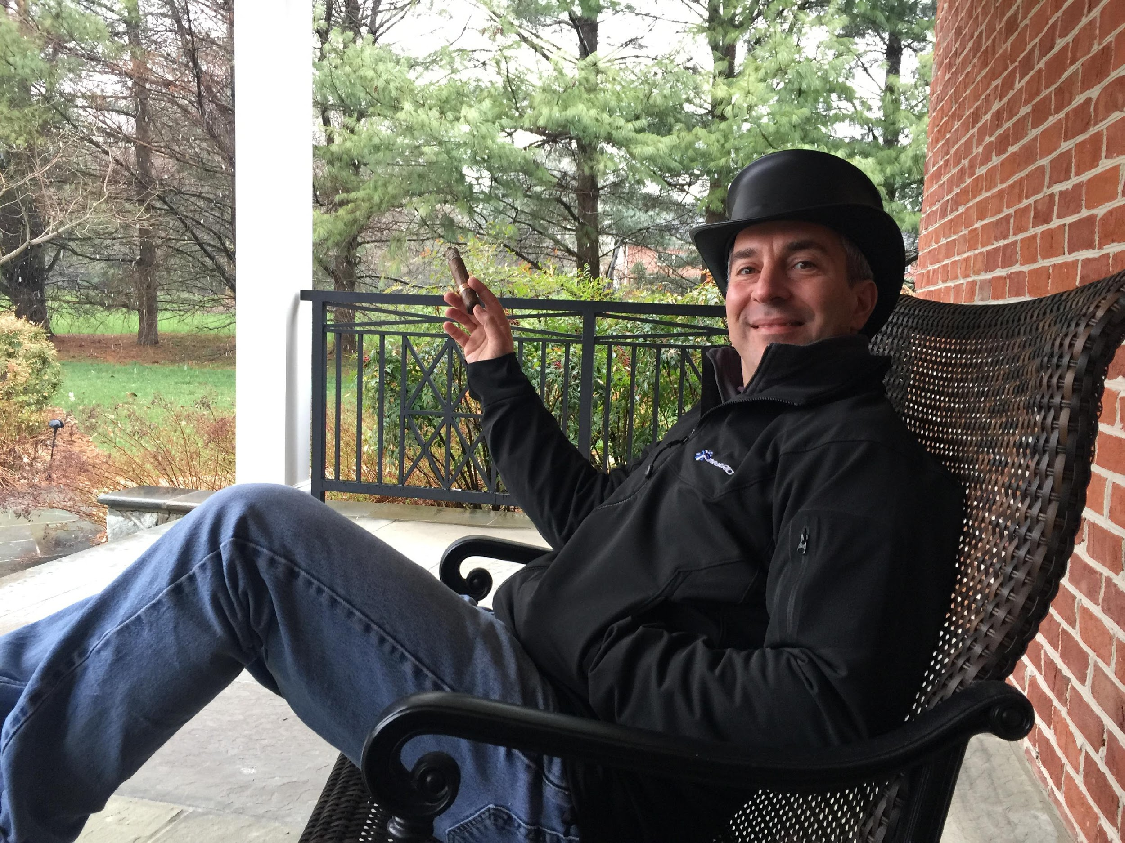
Ron Gula
1996 NSA PEN TESTER
1998 COMMERCIAL HONEYPOTS
1999 CLOUD SECURITY - USi
2000 DRAGON INTRUSION DETECTION SYSTEM
2002 TENABLE NETWORK SECURITY (NESSUS!)
2017 GULA TECH ADVENTURES
Married, 2 boys, into sci-fi, cigars, scuba, progressive music, travel and most forms of alcohol

Slide 3
Agenda
Cyber Market, How to Pitch and the Future!

Slide 4
Cyber Market
Find Bad, Find Good & Build New Good

Slide 5
Finding Cyber Bad
EDR, Threat, Forensics, ML/AI, UBA, Cloud, Insider, Honeypots

Slide 6
RISK = THREAT X VULNERABILITY

Slide 7


Slide 8
Finding Cyber Good
VM, Audit, Frameworks, Risk, Insurance, Third Party, Employee Testing

Slide 9
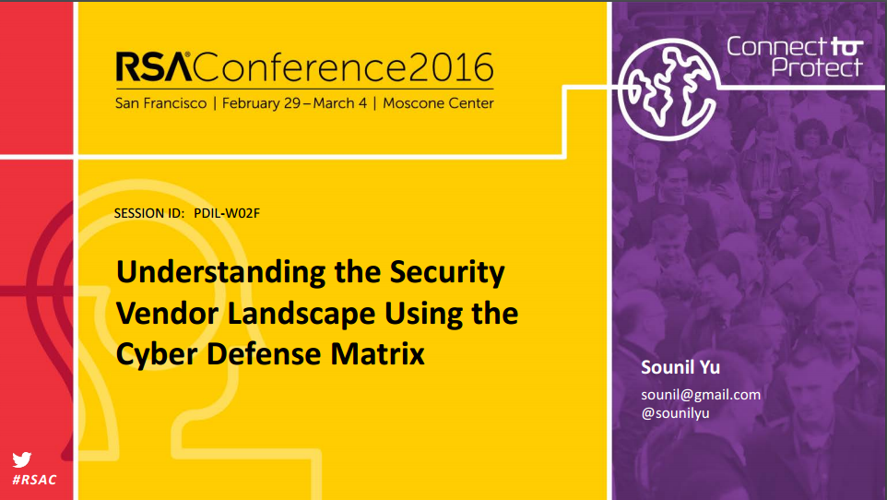

Slide 10
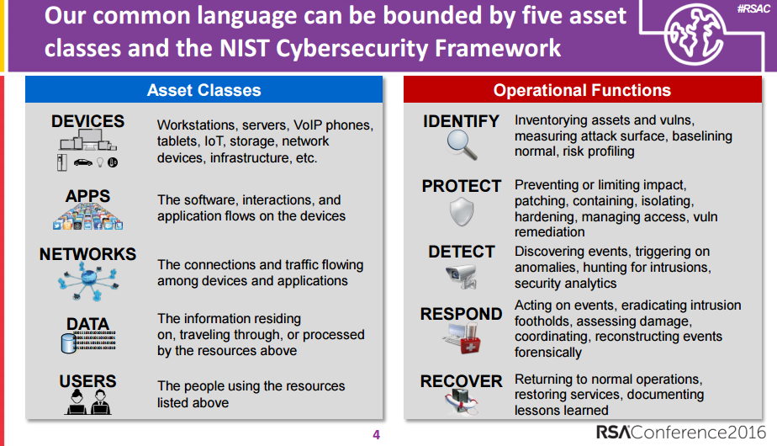

Slide 11
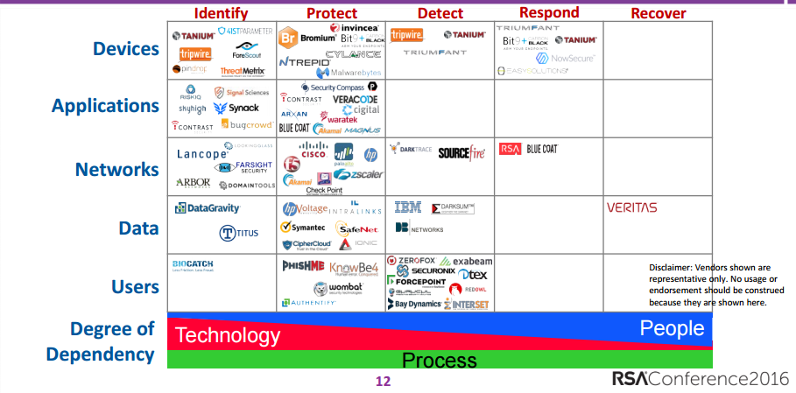

Slide 12
Building Cyber Good
Cloud Migration, Hard Endpoints, Secure Web, Migrating Off Legacy & Employee Training

Slide 13
Cyber Start Ups
New Ideas, RSA & How to Pitch

Slide 14
1. What PROBLEM Are You SOLVING?

Slide 15
2. How do you SOLVE it?

Slide 16
3. Show some PROOF

Slide 17
4. What FUNDS do you need to do what?

Slide 18
5. What is your VISION?

Slide 19
What isn’t in the 5-slide deck?
BACKUP SLIDES
Team Bios
Company Advisors
Customer Success Stories
Funding to Date
Media Coverage
Market Size and Growth with huge numbers

Slide 20


Slide 21
Predicting The Future 10+ years from now !!!

Slide 22


Slide 23
How long will legacy stuff hang around?

Slide 24


Slide 25
How bad will the next 5 billion IOT devices be?

Slide 26


Slide 27
Will the move to the cloud ever be reversed?

Slide 28


Slide 29
What will the social response be to government back-dooring everything?

Slide 30


Slide 31
What will the terms “network”, “vulnerability” and “privacy” even mean in 2028?

Slide 32

Questions?
@RonGula ron@gula.tech RonGula

Slide 33
















 | Automated white listing web application firewall |  | Container orchestration to increase utilization of virtual resources
 | Cloud based patch management for Win, OSX and Linux |  | Secure voice and text communications, even on hostile phone network
 | Blocks 100% of your threat intel and undesirable countries on premise and in cloud |  | Privileged account management for cloud and on-prem
 | Like Slack but encrypted and secure |  | Uses computer vision to connect all of your security technologies
 | Leading RASP solution to secure web sites from the inside out. |  | Malware sandbox focused on evasive malware
 | Insider threat prevention and visibility through hardware base application enforcement |  | Tests network and host based security tools with attack simulations
 | Online cyber certification and training for your team |  | Threat intelligence platform and orchestrator
 | Produces cyber threat intelligence related to fraud and terror. |  | Removes bots from your web leads

