Slide 1

Adventures in (Dynamic) Network Segmentation
or And That's How I Got This Scar
Rick Lull, Consulting Engineer, SyCom Technologies
Shannon Yeaker, Lead Consultant, GRC Practice, Impact Makers

Slide 2
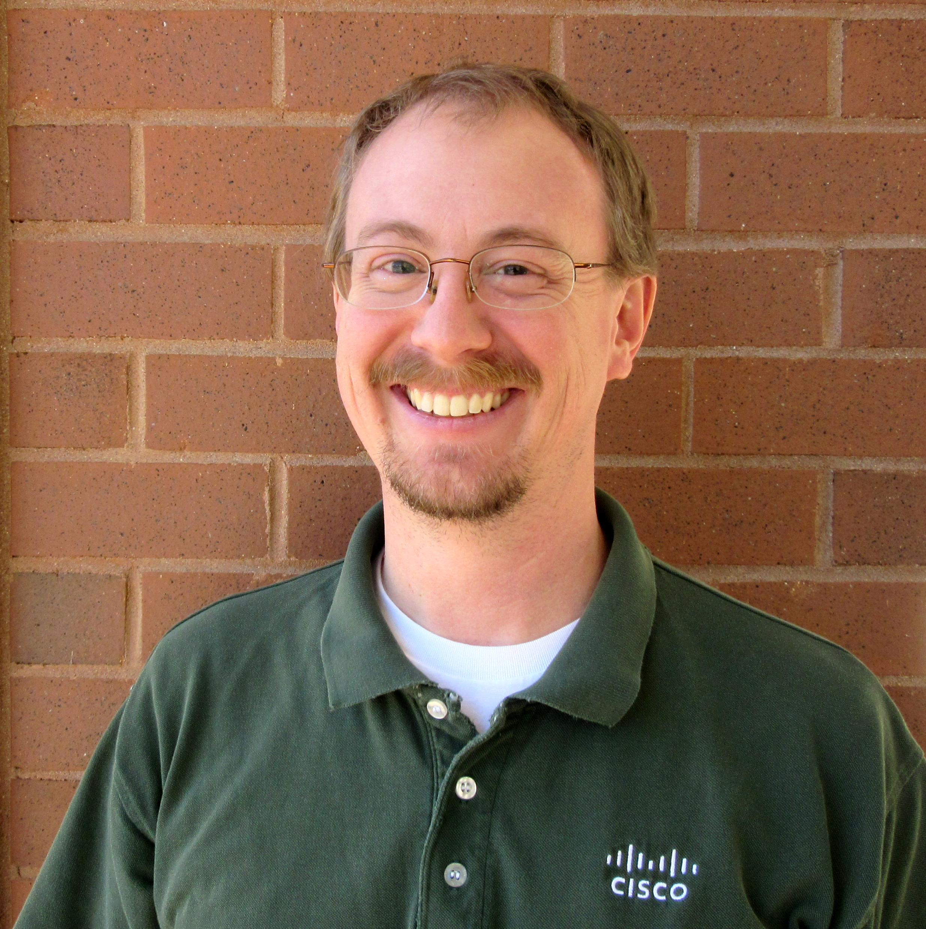
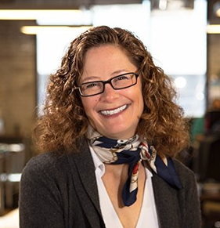
Meet the Presenters
Rick Lull
Currently at SyCom Technologies in the Technical Services Group – Network Infrastructure
Which is where the security “blue team” hangs their hat
20+ years in IT, half of it doing information security related “stuff”
CCNP-Security, CCNA, C | EH
Don’t hate the player, hate the game
First time RVASec presenter but long time attendee ☺
Goal – STFU Sign!
Shannon Yeaker
Project Manager and Lead Consultant, GRC Practice at Impact Makers
20+ years in IT, majority of the time in GRC related roles
CISA, PMP, CAHIMS
Put up with Rick’s shenanigans during project
Rick
Shannon

Slide 3
Agenda Items
What and Why
Benefits
Risks
Requirements
Implementation Steps
Showing management the outcomes
Closing
Q&A

Slide 4
This talk – Dynamic Network Segmentation. What is it?
Network segmentation is a great way to build a foundation for a thorough approach to defense in depth as part of your security program.
The benefits can be great, but the path is not without some risk of its own. This talk will review some of the challenges and successful strategies to create a solid and sustainable practice and get your arms around what is out there and on your network.
The presenters, fresh from a large-scale project at a health system, will cover tips, tricks and pitfalls to let you approach this very useful tool with your eyes wide open.

Slide 5
Benefits - Why Do It?
The obvious
Control what connects to your network
Configure levels of access
Limit the lateral movement of an attacker
The not-so-obvious
Helps maintain an asset list
Provides an additional push to endpoint standardization
Know what is out there

Slide 6
Risks
The world relies on its (your) networks!
We’ve built a ecosystem where the network is “everywhere” and “just works”
So, putting access to all those applications available on it at risk, can will be daunting to the business.
This means you should aim for the broadest base of what will work in the beginning and be prepared to establish workarounds or roll back changes.

Slide 7

Risks or “Oh, the things you run over”
We are talking your network access layer so that means:
PCs
Printers
VoIP
Wireless access points
But don’t forget the:
Timeclocks
Bootleg VMWare ESX servers (Or HyperV or any virtualization, really)
Physical access control systems (door badge readers)
Cell phone boosters
Credit card terminals
Medical devices or other business critical embedded systems
Vending Machines (No, really…)

Slide 8
The things you run over, continued
PC Supplicant Issues
Windows 7’s built in supplicant is serviceable, but can be challenging to deal with
Be prepared to apply hotfixes ☺
Windows 8, 8.1 and 10 seem a little better
Mac OS – Will only do PEAP so keep that in mind
And you need to configure them to trust your PKI environment since they probably aren’t joined to your domain
Oh, didn’t I mention PKI already? Oops. ;)
Linux
I got Debian to work; but wasn’t a priority on this particular project

Slide 9
Let’s take a step back and talk some baseline
What this requires, minimum:
Reasonably modern network infrastructure that supports 802.1X
RADIUS Server(s)
Internal PKI infrastructure
Management Approval and Buy In
Nice to haves:
Add on supplicant for Windows
Speeds the implementation process dramatically
For authentication and authorization options
Wedge for posture assessments
Profiling features in your RADIUS server(s)
Write once, use many
Write one rule, get 50 credit cards machines back on the network

Slide 10
Herding Cats and The Definition of Done

Slide 11
Herding Cats and The Definition of Done
Procurement
Change Control
ISE Appliance Install
Add Switches
to ISE
Implement
Monitor Mode
Generate
Network
Inventory
Report
Remediate
Switch
Code
Revision Issues
Change Control
Stakeholder Communications
Implement Low Impact Mode
By Creating and Activating Enforcement Policies
Switch Replacements
Switch IOS Upgrades
Implement Switch
Templates
Produce List of Workstations
Change Control to Deploy Supplicant
Deploy Supplicant
Generate Authentication Report for Missing Supplicant Clients
Remediate Missing
Supplicant Clients
Create Policy Sets
Establish Naming Conventions
Prioritize Closets
Generate Device Lists
Identify Missing Devices
Create Data Flows
Review Data Flows with SMEs
Train Local Phone Resources
Deploy Phone Certificates
 | Local Network Administrator
 | NOC
 | Local Desktop /Phone Resources
 | Software Delivery

Slide 12
The Art of Delivery
Communicate Early, Communicate Often
Engage Stakeholders Throughout the Journey
Allow Resources to Play
Reinforce Learnings
Formally Kick Off Each Deployment Phase
Status Checks and Progress Metrics

Slide 13
Implementation Size Steps, In Order
Small proof of concept
Great if you can get a switch, a couple of older PCs and tie into your production environment for PKI.
Limited production pilot
Picking a spot that is mostly 9 to 5 users really helps!
Limited Production expansion
Completing the closet or floor or building that the pilot was on
Slice the rest of your environment into small chunks and begin moving forward
Leverage the knowledge of your desktop and other IT teams to help steer where and when

Slide 14
Ongoing Support
Training the support folks at all tiers
Establishing processes and procedures
Deciding the standards on how exceptions are handled
Don’t be afraid to make changes to what you are doing if it doesn’t work as great as you want
“tell the workbench switch tale”
Governance
Establishing who/how/what/where after the dust settles and the day to day support starts
Who can grant exceptions? Who can write authentication and authorization rules? Who can approve those rules? Who audits those rules?

Slide 15

Ongoing Support – Governance, continued
Who can validate new network buildouts? Who can build new network buildouts?
How often are reports provided to management with regards to system status?
How does the SOC interact with this new process?

Slide 16
Outcomes and Management ^{of} Management
Tracking what is important to you AND your management is crucial
Be prepared to show multiple different metrics as the project matures
But do try to avoid too much goalpost moving
“Perfect is the enemy of good”
Answer the important question for them: “What’s in it for me?”
Don’t forget to have them experience how it works live
A normal process – your asset and user access everything as before
No problems, boss!
An personal asset
Note how we are applying controls to this connection; we have reduced this risk and now have additional insight into what connect.

Slide 17
Closing
Communicate
Not a silver bullet
Part of an overall strategy
Solid Foundation that can be built upon
Communicate

Slide 18
Question and Answer Session
In which your humble presenters try to convince you it’s worth all the pain. ☺

