Slide 1
Recent Developments in Linkography Based Cyber Security
Robert Mitchell rrmitch@sandia.gov 703.597.3730

Slide 2
Agenda
Introduction to Linkography
Concept of Operations
Machine Learning
Subsessionization
Abstractions
Ontologies
Dynamic Defense
Game Theory
Shareables
Conclusions

Slide 3
Introduction to Linkography
Founded by Gabriela Goldschmidt
The fields of architecture and design first used linkographs to support the training process
Linkographs visualize the creativity of a human’s behavior or the interaction of a group
Linkographs reveal insights to humans (via shape and size) and machines (via features)
Novice architect linkographs differ from experienced architect linkographs
Linkographs generated from cyber attackers differ from legitimate user linkographs
Attacker A linkographs differ from attacker B linkographs

Slide 4
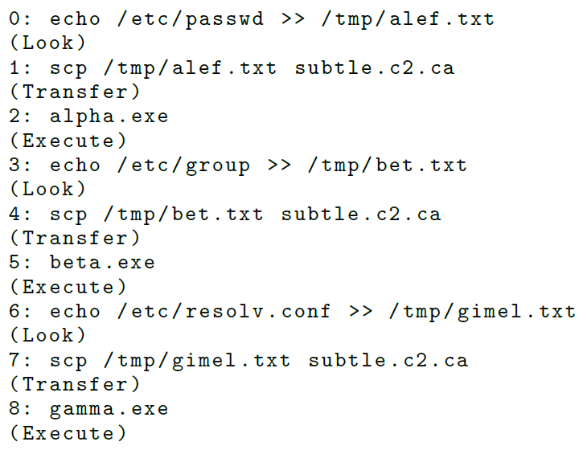
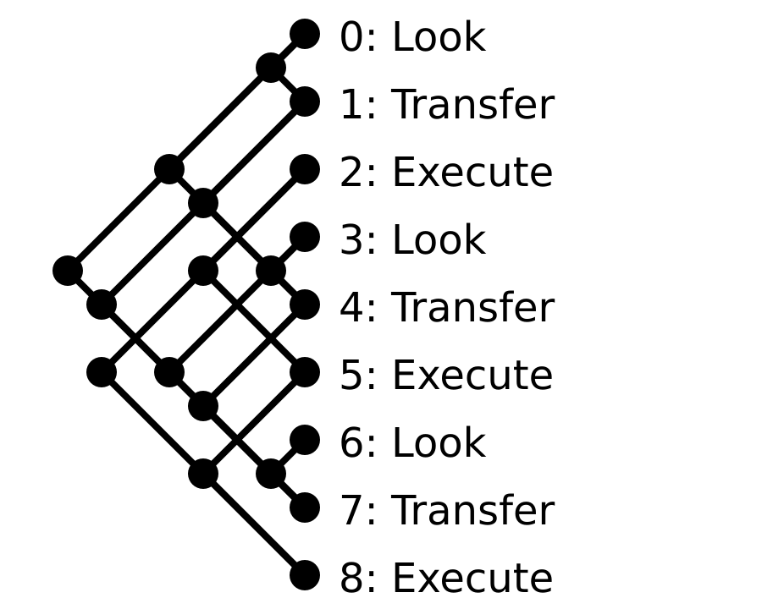
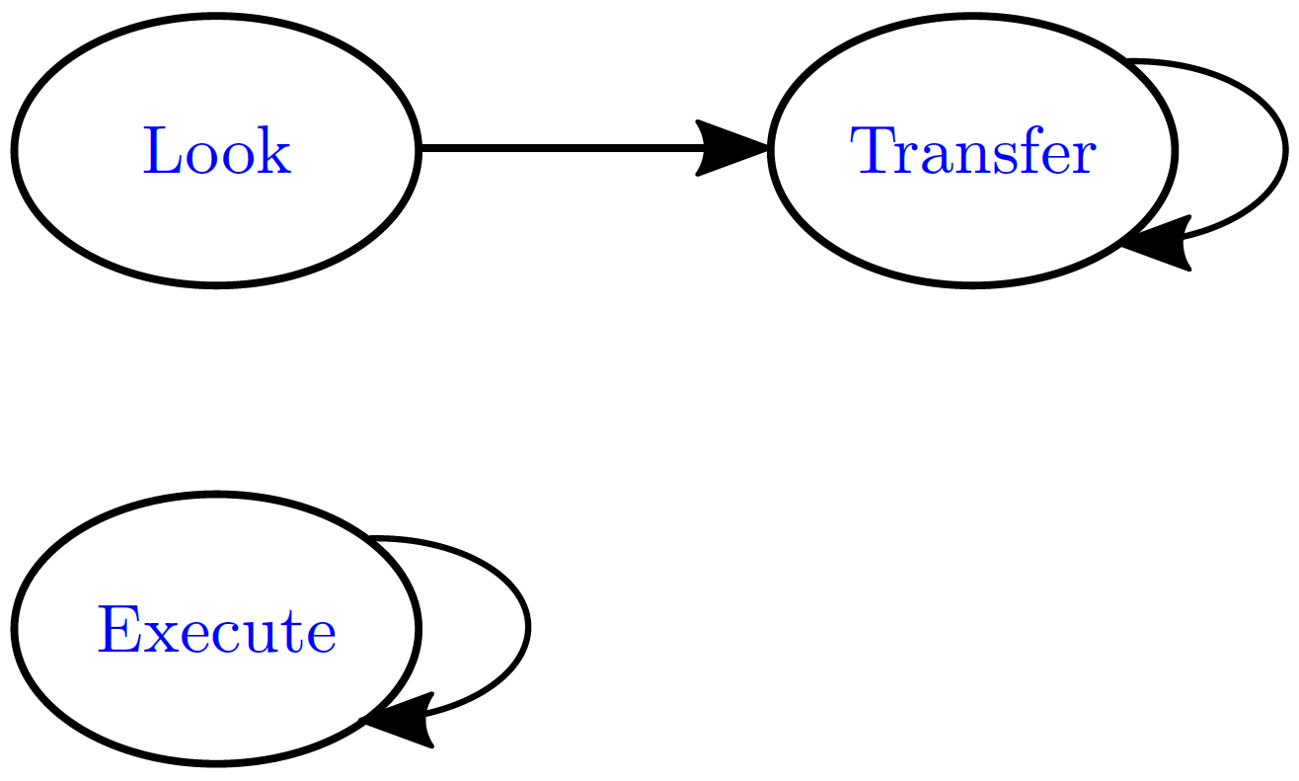
Introduction to Linkography

Slide 5
Concept of Operations
Rectangles are logic blocks
Parallelograms are data at rest
Green blocks are complete
Yellow indicates preliminary research results
Red blocks identify future work

Slide 6
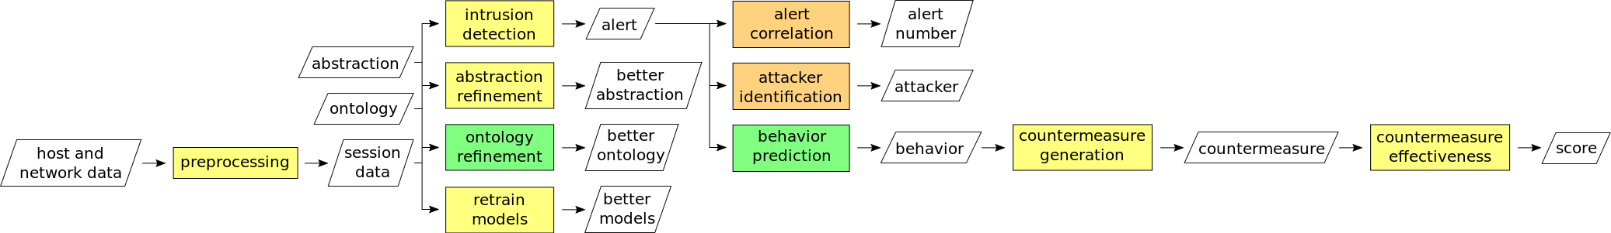
Overall Concept of Operations

Slide 7
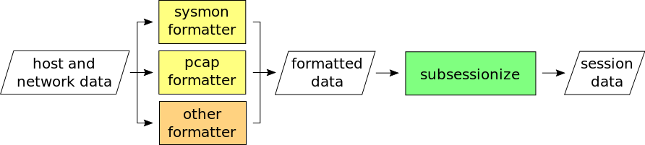
Preprocessing Detail

Slide 8
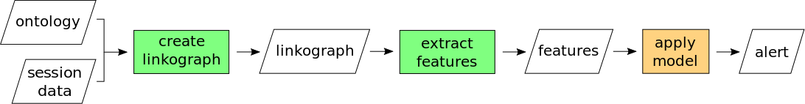
Intrusion Detection Detail

Slide 9
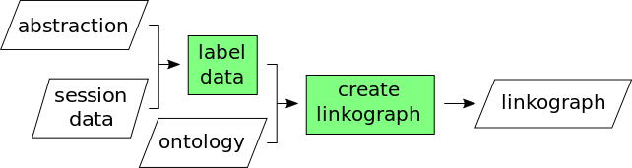
Create Linkograph Detail

Slide 10
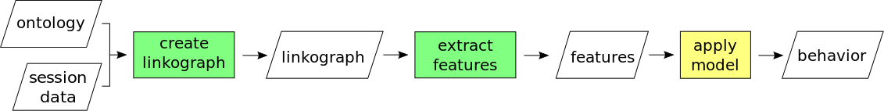
Behavior Prediction Detail

Slide 11
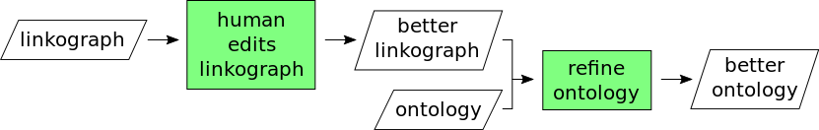
Ontology Refinement Detail

Slide 12
Machine Learning
Please see our CyberSci 2015 presentation “Dimension Reduction for Cyber-attack Detection and Analysis” for additional detail on linkography-related:
Dimension Reduction
Behavior Prediction
Clustering

Slide 13
Subsessionization
Substringing and subsequencing approaches
Time-based substringing
Source-based substringing
Linkograph entropy-based substringing
Statistical substringing
Offline and online approaches

Slide 14
Abstractions
Static Cyber Attacker Abstraction
Move
Execute
Look
Transfer
Cleanup
Static Cyber Defender Abstraction
Research
Collaborate
Annotate
Remediate
Functional Abstractions

Slide 15
Ontologies
Naïve: Self Loop, Empty, Complete
Thoughtful: Forward Progress
Dynamic: Ontology Refinement

Slide 16
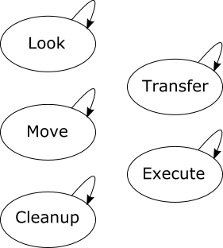
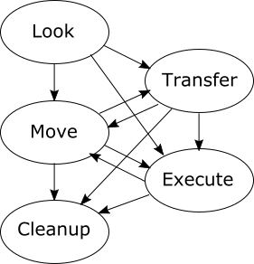
Ontologies: Naïve and Thoughtful
Self Loop Ontology
Forward Progress Ontology

Slide 17
Ontologies: Ontology Refinement
Ontology Refinement Formulation: (O, L) -> O’
Brute Force Minimum Similarity
High Impact First Minimum Similarity
MapReduce Prototype

Slide 18
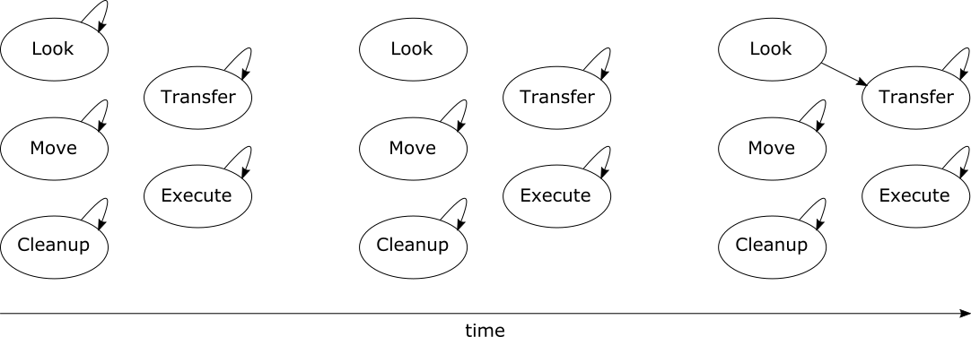
Ontologies: Ontology Refinement

Slide 19
Dynamic Defense
Ontology Refinement
Retrain Machine Learning Models
Generating Honeycues
Measuring Honeycue Effectiveness

Slide 20
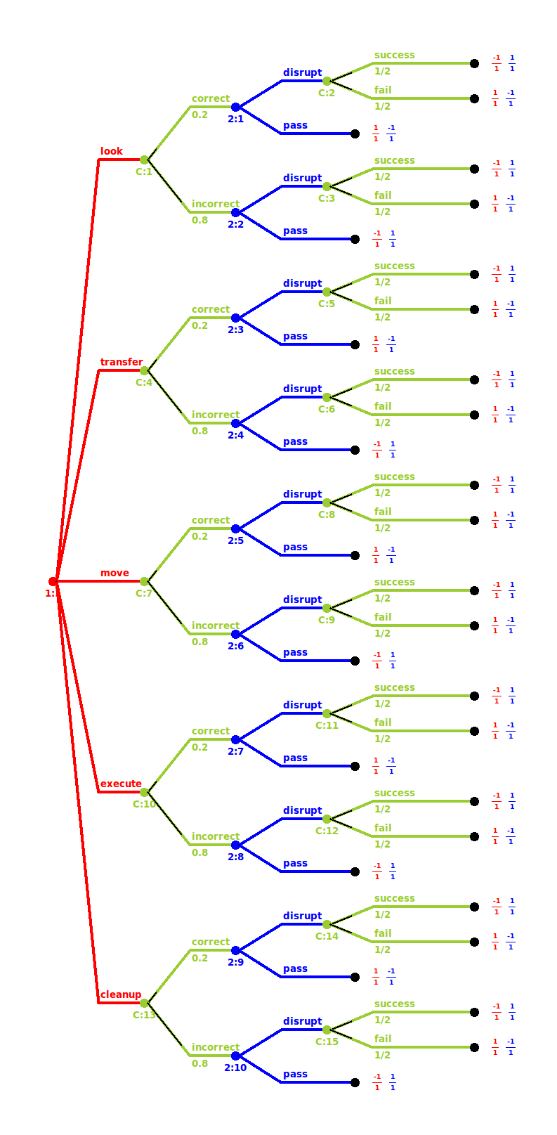
Game Theory
Key Components
Players
Information
Actions
Payoffs
Variant
Noncooperative
Asymmetric
Imperfect Information
Zero Sum

Slide 21
Shareables
Python linkshop Package
SAND Report: “Using Linkography of Cyber Attack Patterns to Inform Honeytoken Placement”
IEEE CNS Paper: “Using Linkography to Understand Cyberattacks”
IEEE CCWC Paper: “Linkography Ontology Refinement and Cybersecurity”
IEEE MILCOM Paper (submitted): “Linkography Abstraction Refinement and Cybersecurity”
Seminar at Your Worksite

Slide 22
Conclusions
Lessons Learned
Interdisciplinary Research Challenges
Current Cyber Attack Models are Macroscale
Humans In The Loop
Future Work
Subsequence-Based Subsessionization
Alert Correlation
Additional Data Sources
Human Subject Research
Training Pivot

Slide 23
Recap
Introduction to Linkography
Concept of Operations
Machine Learning
Subsessionization
Abstractions
Ontologies
Dynamic Defense
Game Theory
Shareables
Conclusions

Slide 24
Recent Developments in Linkography Based Cyber Security
Robert Mitchell rrmitch@sandia.gov 703.597.3730

