Slide 1
Best Practices for securing Hybrid CLouds
Greg Pepper
Head of Engineering – Data Center
gpepper@checkpoint.com
@pepper_greg

Slide 2
THE CLOUD IS HERE
ADOPTION
GROWTH
SECURITY
80% OF ENTERPRISES ARE COMMITTED TO CLOUD STRATEGY BY 2017
(IDC)
40% OF IT BUDGETS WILL BE CLOUD-BASED BY 2018
(Forbes)
SECURITY IS THE MAIN INHIBITOR FOR CLOUD ADOPTION
(Gartner)
Notes:
http://www.techrepublic.com/article/it-will-spend-more-than-one-third-of-its-budget-on-cloud-in-2017-says-new-report/
http://www.datamation.com/cloud-computing/cloud-will-have-a-1-trillion-impact-on-it-spending-by-2020-gartner.html
http://www.forbes.com/sites/louiscolumbus/2016/03/23/cios-are-prioritizing-big-data-analytics-cloud-computing-and-security-in-20162017-budget-cycles/#2ea8816b54f6

Slide 3


WHY CLOUD?
AGILITY
Fast to react
ELASTICITY
Fast to grow

Slide 4

NEW IT DEMANDS
Self
Service
Enable business agility, streamline processes, enhance competitive advantages, and lower IT costs
Centrally Orchestrated
Fully Automated
Software Defined
Notes:
As a result, enterprise IT is evolving from a hardware-centric to an application-centric model, enabling businesses to streamline processes, enhance competitive positioning and improve end-user experiences. IT is now viewed as playing a more strategic role in the overall success of the business, putting pressure on IT organizations to rapidly transform in order to keep pace with business demands.

Slide 5


THE MODERN
NETWORK
Software Defined Networking
(SDN) and IaaS allow IT to
deliver applications and
services in a fraction of the cost and time
Notes:
The need to run processes more efficiently, improve time-to-market and enhance user experience is subsequently driving more and more businesses to embrace the cloud – either private, public or a hybrid combination of both - as part of their IT strategy.
The rising tide of cloud deployments is providing sufficient proof-points of the business benefits and fueling further cloud adoption. It is no longer a question of “if” but “when” an organization will start moving data and workflows to the cloud. Once the decision has been made, the next dilemma is determining which cloud deployment model meets the technology needs of the organization.
However, this new, more dynamic infrastructure breaks the traditional network boundaries and security controls used to protect legacy infrastructure and introduces a variety of new challenges . . .

Slide 6
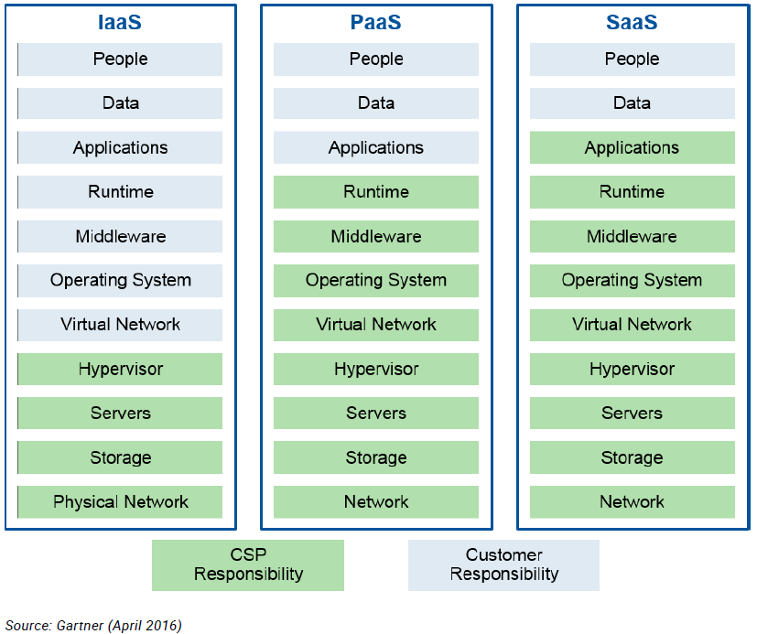
CLOUD SHARED RESPONSIBILITY

Slide 7

SECURITY IN THE CLOUD & SDN WORLD
Must prevent lateral move of threats between applications and not only at the perimeter
Should protect new IT services and applications in seconds not in weeks
Should automatically be provisioned and scale within the environment without operational overhead

Slide 8
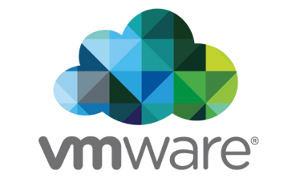

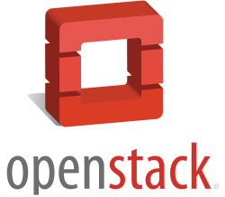
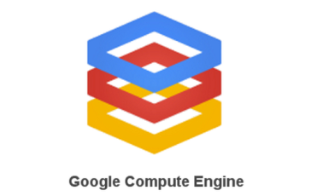


Multiple Cloud & SDN Platforms
Computing Cloud

Slide 9


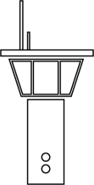
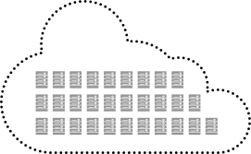
SDDC Conceptual design
SDN Controller
Orchestrator
Cloud Management
Computing Cloud
Notes:
Different new concepts and solutions are introduced to improve datacenter turning them into Software-defined:
Computing virtualization. Creating a computing cloud
Cloud management solution
SDN solution
Orchestrators

Slide 10
SECURITY AUTOMATION USE CASES
PERFORM THESE OPERATIONS…
KNOWING THAT….
Change application’s networking
Security is automatically provisioned
Application is instantly secured
Application admin never waits
No tickets overhead
Everything is auditable
Scale up your application
Virtual Patching
Provision a new application
Connect a new IOT device

Slide 11


CHANGE APPLICATION NETWORKING
App owner opens ticket to FW Admin to change policy
FW admin changes the policy
New policy is published on the weekend
Legacy Way
Changing
Web VM IP
Many Days / Manual process
Security dynamically learns about this change from SDN and all virtual and physical GWs are instantly updated
DevOps Way
Seconds / Dynamic Process

Slide 12
SCALE UP YOUR APPLICATION
Open ticket to FW Admin to change policy
FW admin changes the policy
New policy is published on the weekend
Legacy Way
Add a new Web VM cluster
Many Days / Manual process
VM is automatically added to web SDN Group
Security dynamically learn about the change and instantly update GW policy
DevOps Way
Seconds / Dynamic Process

Slide 13
PROVISION A NEW APPLICATION
Develop a manual procedure for new Database
Manually configure the FW to secure the new Database
Legacy Way
Many hours / Manual process
Develop an orchestration recipe for new Database with security
Recipe is executed and provision the FW policy
DevOps Way
Seconds / Automation Process

Slide 14
EVOLUTION AND MIGRATION TO CLOUD
MOVING TO CLOUD IS A STRATEGIC MOVE
IT TAKES TIME AND EFFORT TO REALIZE THE FULL POTENTIAL
Phase #1:
New Infrastructure
Phase #2:
New Applications
Phase #3:
New Operation
Compute (Hypervisor)
SDN (Network)
Software Defined Applications
DevOps &
Orchestration
SECURITY MUST ORCHESTRATE WITH DEVOPS

Slide 15
Understand CLOUD & SDN Capabilities

Slide 16
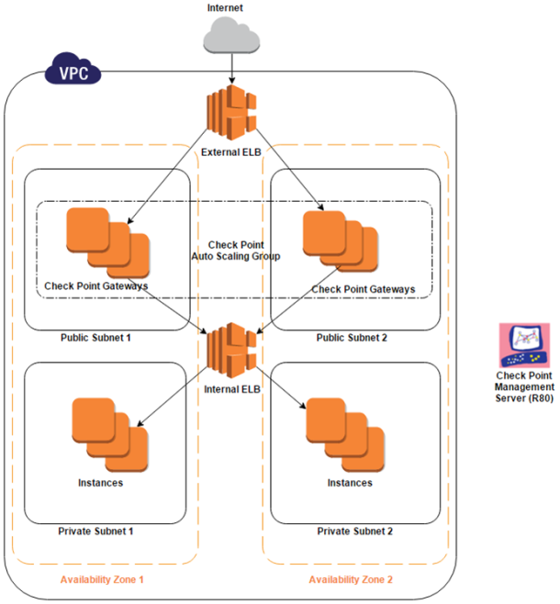
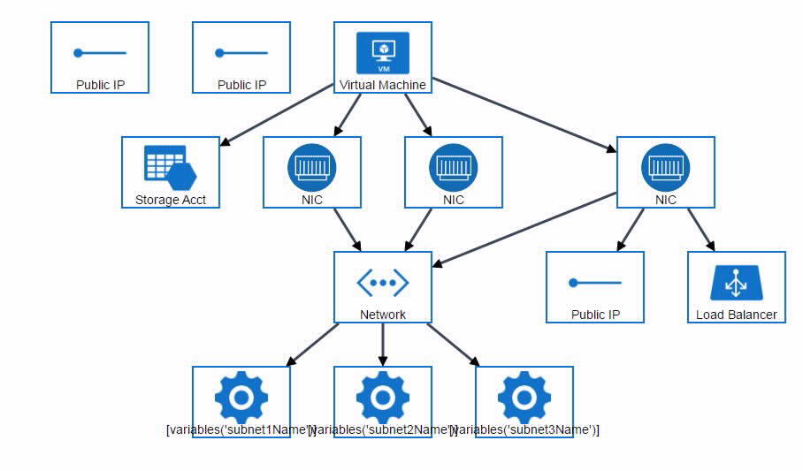
Automatic Deployment of Security
Templated Deployments
AWS Cloud Formation Templates
Azure ARM Templates
OpenStack HEAT/YAML Templates
vAPP NSX Deployment
Orchestrator Integrations
Deployment of Security
Creation of Policies
Creation of Security Tags
SDN Traffic Steering

Slide 17
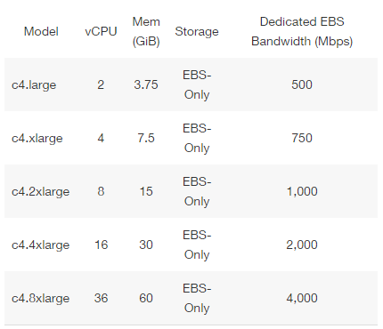
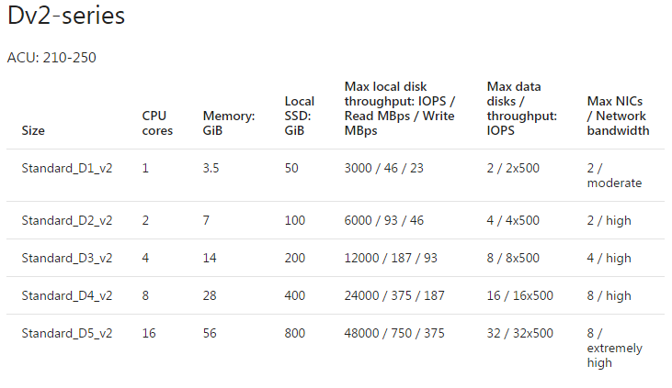
Scale-Up & Scale-Out
Vertical Scalability
Larger Instance Sizes
Compute & Network I/O
Horizontal Scalability
Native Cloud Scale Groups
AutoScaling Groups
Scale-Up & Scale-Down
DNS Load Balancing
https://docs.microsoft.com/en-us/azure/virtual-machines/linux/sizes-general
https://aws.amazon.com/ec2/instance-types/

Slide 18
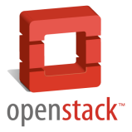


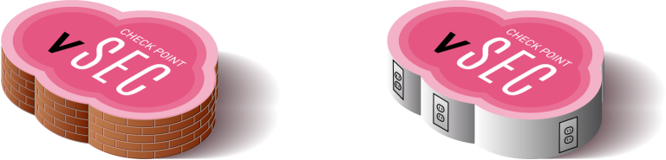




Cloud & SDDC Service Chaining
Inter & Intra Zone Visibility
Datacenter
Inspects North-South & East-West Using Route & NAT
Dynamic Access Controls with Advanced Threat Prevention
Tightly integrate with leading SDN

Slide 19
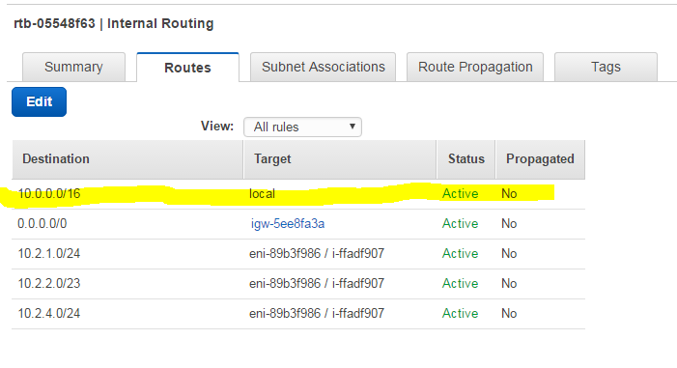
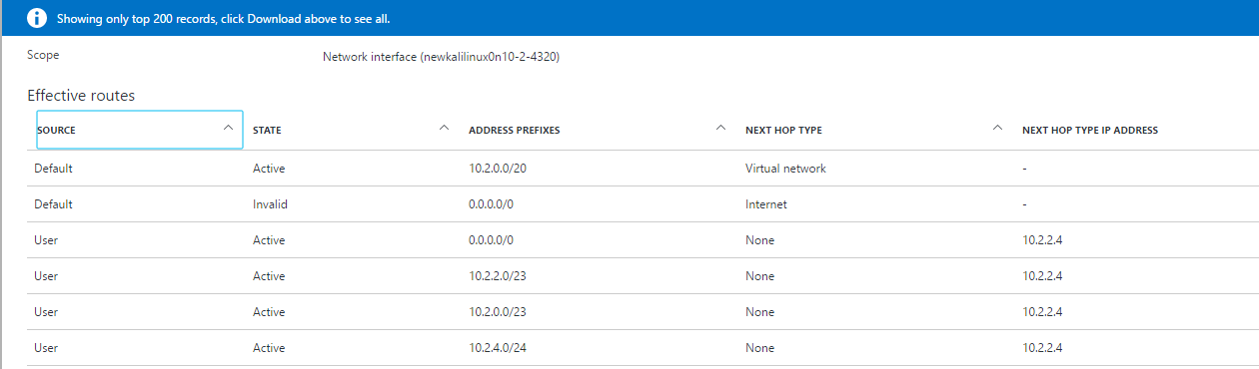
Routes in AWS and Azure
In an AWS VPC, every routing table has a route to the effect that every node “one hop away” from any other in the same VPC
In Azure VNET, Intra-VNET routes can override the “Everyone is one hop away” system Route

Slide 20
AWS deployment with VNF
Traffic entering to the web site
Traffic originating from web server
Traffic between subnets
Routing
Routing
Notes:
After this slide go to show how GW looks like in the smart console & show imported objects for the tag “Web” & DB server in a rule.

Slide 21
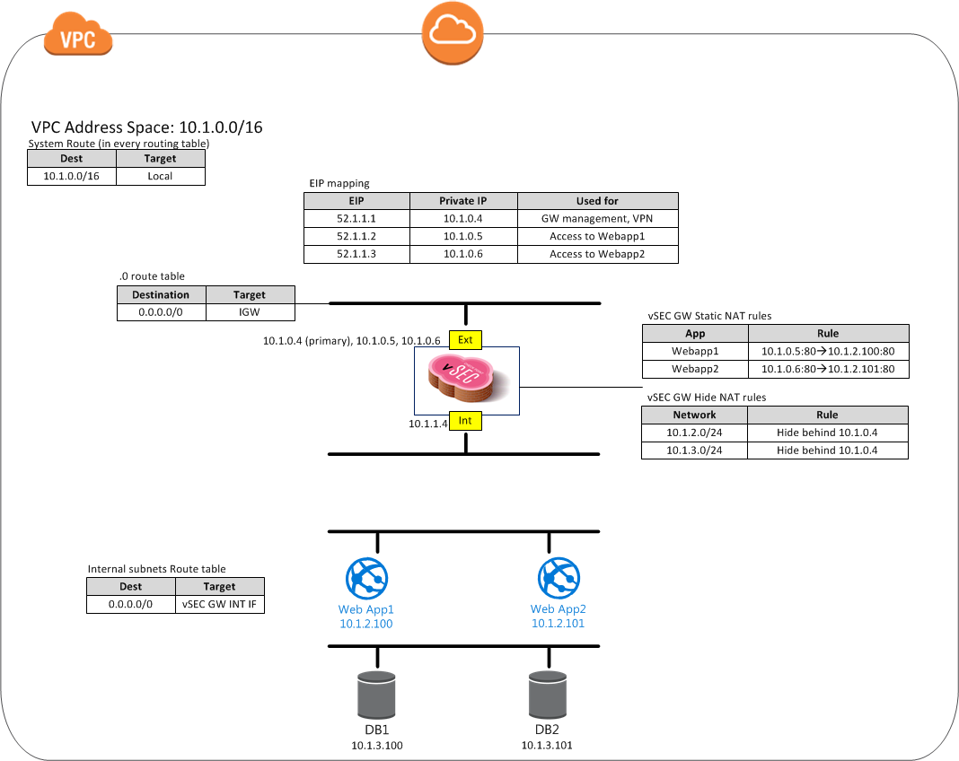
Basic single GW Architecture
2 NIC GW
N/S traffic flows through vSEC GW
Ingress because EIP mapping & Static NAT
Egress because default route & Dynamic NAT
Intra-VPC traffic not inspected

Slide 22
Azure deployment with VNF
Traffic entering to the web site
Traffic originating from web server
Traffic intra subnet
Traffic between subnets
Notes:
After this slide go to show how GW looks like in the smart console & show imported objects for the tag “Web” & DB server in a rule.

Slide 23
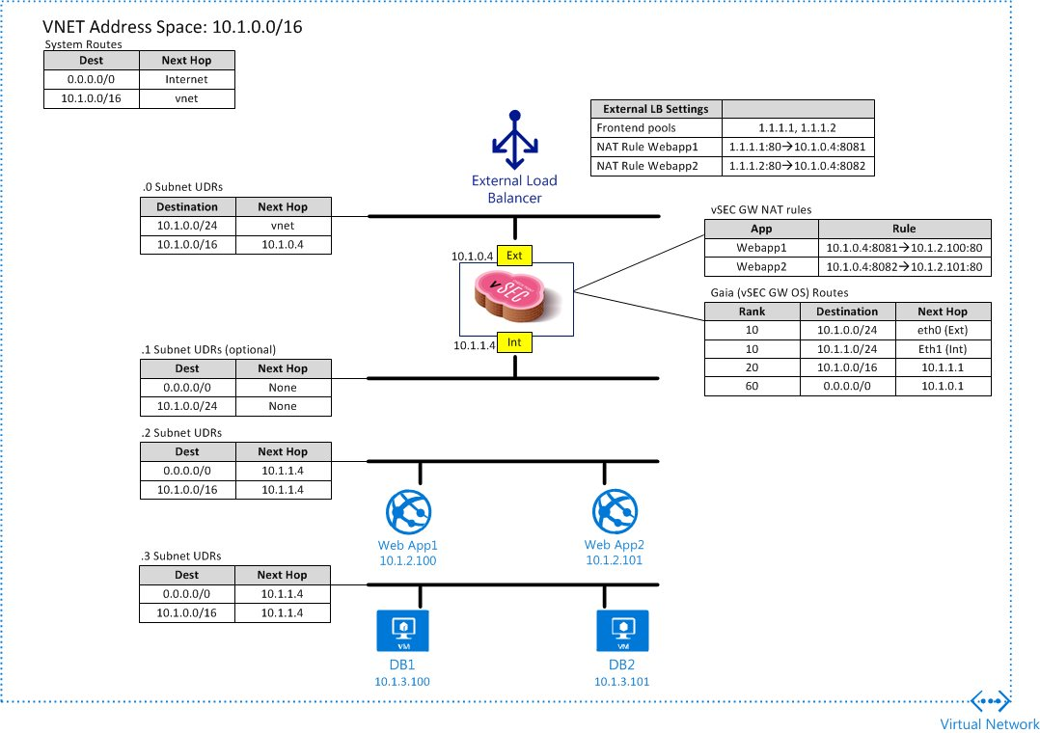
Single GW in Azure
2 NIC GW
N/S traffic flows through vSEC GW
Ingress because LB and GW Static NAT
Egress because default route & Dynamic NAT
Loadbalancer is used when you need additional PIPs for NATing internal resources
Intra-VPC traffic inspected if needed!

Slide 24







LB Sandwiched Autoscaling Group
Autoscaling Groups for N/S Perimeter
Secondary Gateways for IPSec VPN and or Egress Controls
Dynamic Policies Mapped to Security Tags and Security Groups
Listens on port 80
Forwards to vSEC GWs on port 8081
External ingress LB
Ingress
Check Point vSEC GW
Check Point vSEC Autoscale Cluster
Egress proxy web
AZ1/10.0.0.0
AZ2/10.0.1.0
VPN, Admin Ingress, Egress other
Listens on port 8080
Forwards to vSEC GWs on port 8080
Listens on port 8081
Forwards to Web Servers on port 80
Internal egress “proxy” LB
Internal ingress LB
Web Servers
AZ1/10.0.2.0
AZ2/10.0.3.0

Slide 25
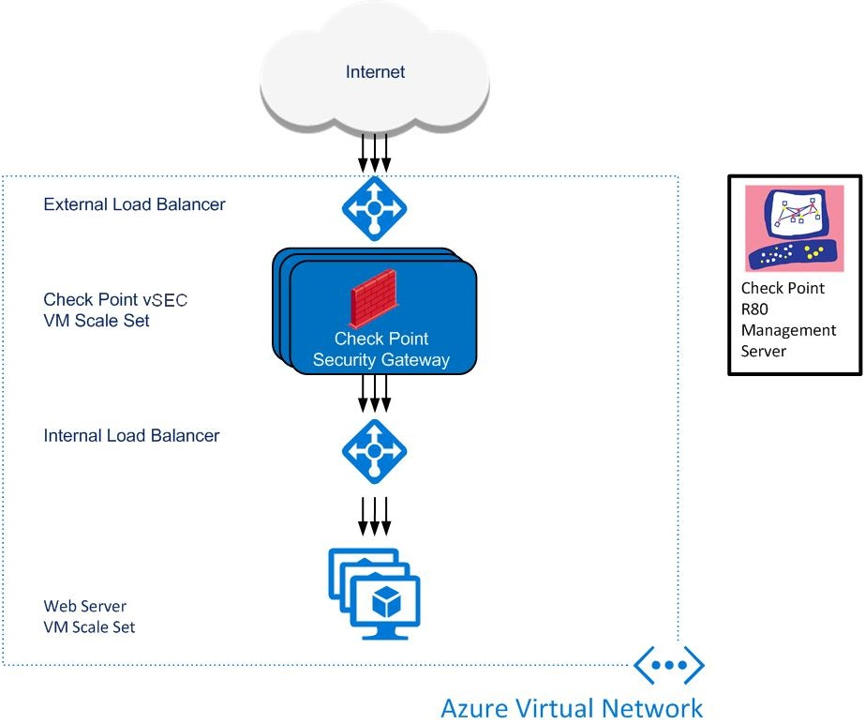
VM Scale Set

Slide 26


AUTOMATE, AUTOMATE, AUTOMATE
Multi-Portal
RESTful API
API web-server
web-services
API Container
CPM
Postgres SQL
Management Console
Secure IAM Roles for Policy Orchestration
Delegated Role Based Access by Controls and Zones
Monitoring of API Server Access & Audit Logs

Slide 27
IAAS CLOUD SECURITY PLAN

Slide 28
STEP #1: CONTROL THE APP PERIMETER
Use advanced threat prevention at the cloud perimeter
Securely connect your cloud with your on-premise environment
CLOUD
ON-PREMISE

Slide 29
STEP #2: SECURE THE CLOUD FROM THE INSIDE
Micro-segment your cloud to control inside communication
Prevent lateral threats movement between applications
App
App
App
App

Slide 30



STEP #3: MANAGE CONSISTENT SECURITY FOR HYBRID ENVIRONMENTS
Deploy unified security management for your hybrid cloud (On-Premise and Cloud)
Ensure policy consistency
Reduce operation cost
CLOUD
ON-PREMISE

Slide 31



STEP #4: AUTOMATE YOUR SECURITY
Security should be as elastic and dynamic as your cloud
Auto-provisioned
Auto-scaled
Adaptive to changes

Slide 32



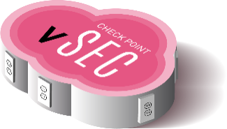
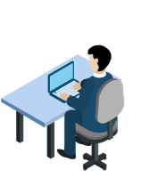
Enterprises want a single vendor to secure their modern datacenter with more automation and higher security between applications
Security at the Speed of DevOps
PRIVATE
CLOUD
PUBLIC
CLOUD
Public & Private Cloud
Service Chaining
Dynamic Cloud Aware Policies
Unified Cloud Visibility
Complete Automated Deployment & Policy Orchestration of
Hybrid Cloud

