Slide 1
Notes:
Hacking Intelligence: The Use, Abuse, and Misappropriation of Intel for Fun and (Mostly) Profit

Slide 2


Introductions
Mark Arnold:
Mark Arnold, PhD, GXPN, CISSP, CISM has more than 20 years of technical and senior leadership in the information security space. He’s an advisory board member for OWASP Boston, SOURCE Conference, Boston Application Security Conference (BASC), and recently InfoSecWorld 2018. He is CISO/Sr. Director at Navisite and most recently a cloud researcher at Optiv
Will Gragido:
Will Gragido is a seasoned security professional with over 20 years’ experience in networking and information security. Will’s extensive background is the result of his service as a United States Marine, a consultant with the world renowned International Network Services, Internet Security Systems (now IBM ISS), McAfee, Damballa, Cassandra Security, RSA NetWitness, Carbon Black, Digital Shadows and now Digital Guardian where he leads the organization’s Advanced Threat Protection Product Line as its Director. Lead author and co-author of three Syngress Press titles.
Notes:
We should consider using this for quick introductions and just letting the audience know they can look us up if they want / need more information.

Slide 3
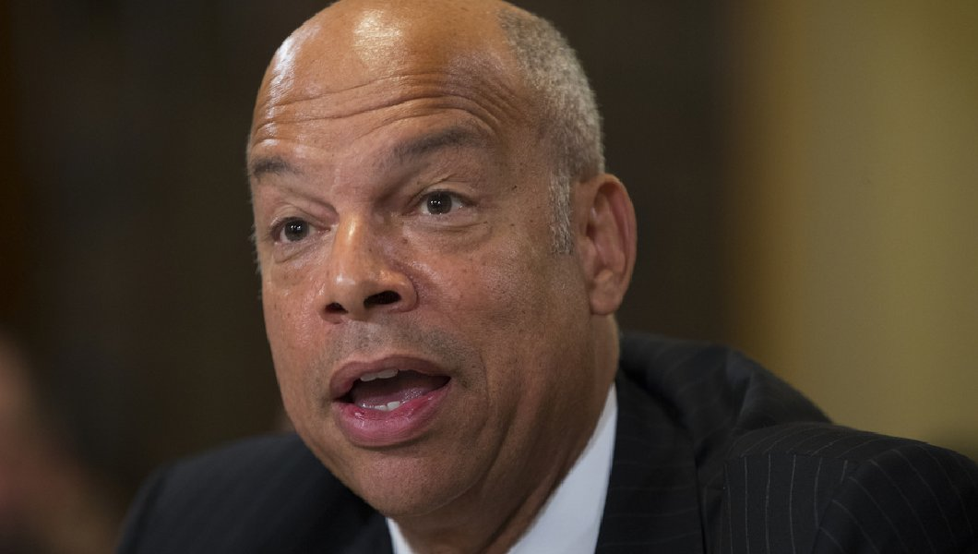
“…If you’re not reading the intelligence you’re flying blind…”
– Jeh Charles Johnson, 4th United States Security of Homeland Security
Notes:
Jef Charles Johnson said this recently while a guest on NBC’s “Meet The Press” in regards to a question he was asked about the 45th POTUS documented lack disregard of daily intelligence briefings. To be clear and thorough he said the Daily Intelligence Briefing is the “eye’s and ears” and that ignoring it is the moral equivalent of flying blind.
We think he’s right and he’s not alone in sharing that view of intelligence.
https://www.nbcnews.com/meet-the-press/video/jeh-johnson-on-trump-s-daily-briefings-if-you-re-not-reading-you-re-flying-blind-1158128195976
Photo credit: http://cdn.washingtonexaminer.biz/cache/1060x600-cacdb5a9047697077286b5e63b461ef1.jpg

Slide 4
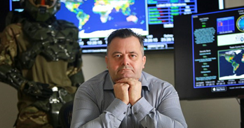
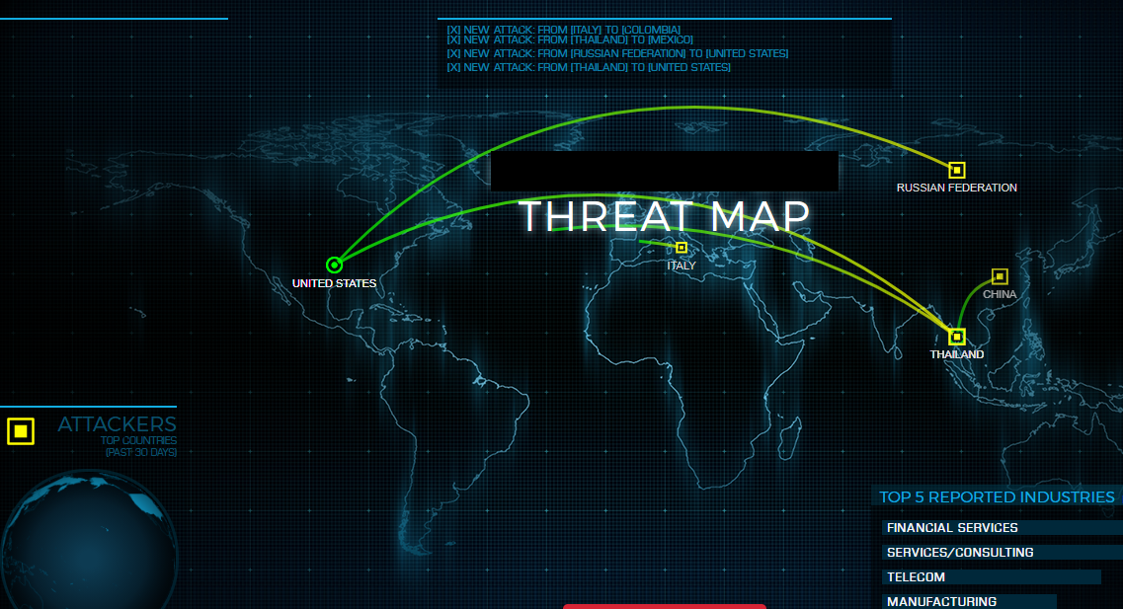
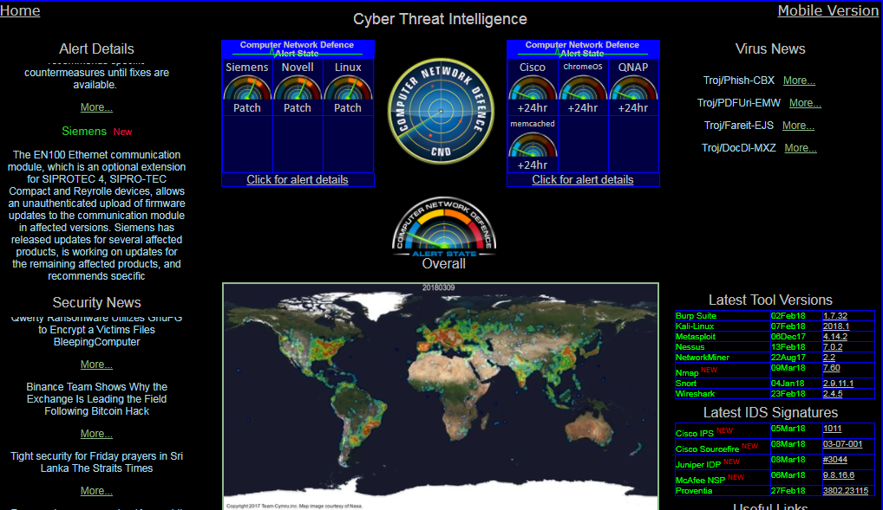
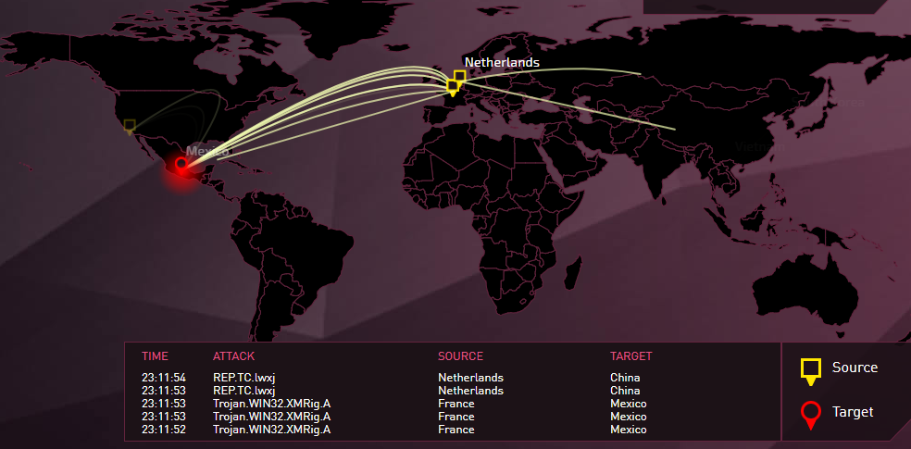
What does tI look like?

Slide 5
Barriers

Slide 6
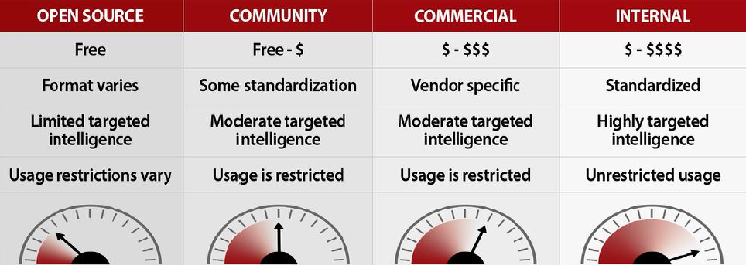
The cost to play
Notes:
Mark Orlando. Threat Intelligence is Dead. Long live threat intelligence. RSA 2015

Slide 7

Friends with benefits
Notes:
Alien Vault recently reported that 76% of survey respondents reported a “moral obligation to share threat intelligence.” McAfee says sharing threat intelligence “is the only way we win” (that isn’t even remotely true). However, it’s not working.
Why Threat Intelligence Sharing is Not Working: Towards An Incentive-Based Model (

Slide 8


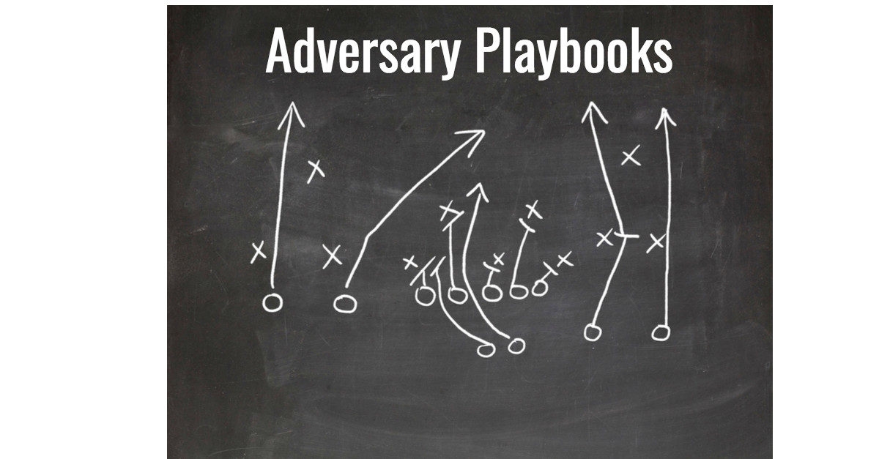
No way getting around it?
Exchanges
Local, Regional agencies
Closed Source
“It seems the OTX database is a crowd-sourced list of suspicious sites, but as with a lot of anti-malware software, it provides little insight into how severe the threat is or the expertise of those who make the determination to put it in your database.
I think the problem is the data is missing context.”
-end user
Internally or locally-sourced TI, the ultimate in home cooked, organic, locally grown juicy TI, that is actually good for you – if you can afford it.
- Chauvakin circa 2014.
The core problem with Fusion Centers, of which Austin Regional Intelligence Center (ARIC is one, is the institution's ongoing mission creep. Originally founder to facilitate "counter-terrorism", the "fusion center concept" was quickly expanded to include "all crimes"
Notes:
“What is threat intelligence” accessed March 20, 2018 https://www.threatconnect.com/threat-intelligence/
Without understanding context, relevance, accuracy, or known associations, however, you can’t see the broader picture…
Sergio Caltagirone
http://www.activeresponse.org/author/sergio/
the sharing narrative is a net positive for them. The more data and intelligence they receive strengthen their products and services adding value to their organization. Security vendors have strong incentives to promote threat intelligence sharing
It requires significant cost to integrate externally shared threat intelligence effectively.
Once you consume that threat intelligence you quickly discover it may consume your security team with poor quality – and requires significant tuning. There is risk.
Establishing a sharing mechanism, program, and process is costly. It usually requires engineering effort.
Management support for sharing usually requires political capital from network defense leaders. They must prove that the resources spent on sharing are more important than the 20 other components competing for resources. Also, let’s not forget about the legal support.

Slide 9
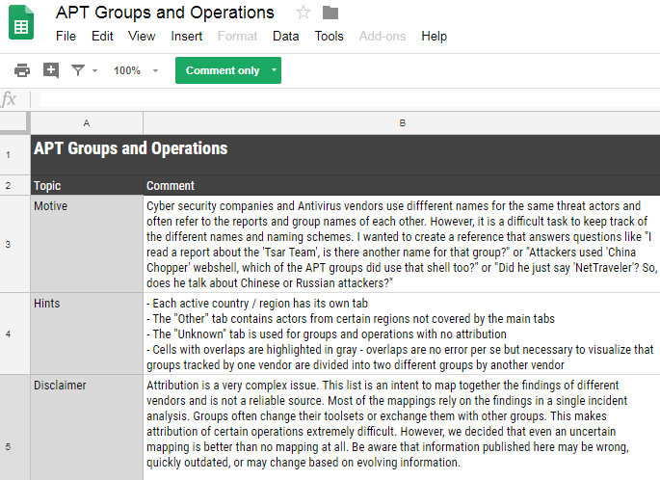
CrowdSourced Intel?: Prudent? Responsible?
DOC DISCLAIMER - Attribution is a very complex issue. This list is an intent [sic] to map together the findings in a single incident analysis
Notes:
Site disclaimer – TLP:White v. fee-based. ‘Please let me know if confidential information has been disclosed.’ http://apt.threattracking.com – Maintained by Halvar Flake

Slide 10
Bias
Notes:
Before we talk about what intelligence is

Slide 11

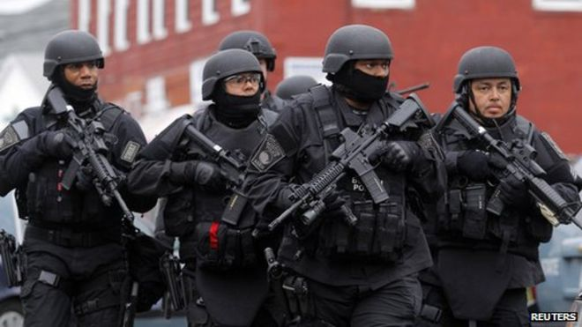
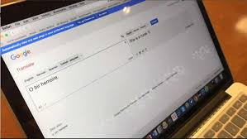
Political Bias: Not Your Average Bears
Political Bias
Cognitive Bias
Semantic Bias
“I really hope you've missed me a lot. Though I see they didn't let you forget my name.”
- Guccifer
"We were very worried about Sunil and about each other because of how fast completely unsubstantiated claims were spreading."
- Sangeeta Tripathi sister of Sunil Tripathi
We have a situation where these artificial intelligence systems may be perpetuating historical patterns of ……
Arvind Narayanan, an assistant professor of computer science Center for Information Technology Policy (CITP) , Princeton & Stanford Law School’s
Center for Internet and Society.

Slide 12
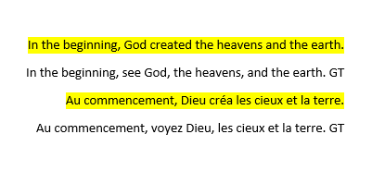
Semantic Bias: Named Entity Resolution (NER) in Social Media (Waters, 2016)
Notes:
Lexical bias is lexical choices without local context

Slide 13
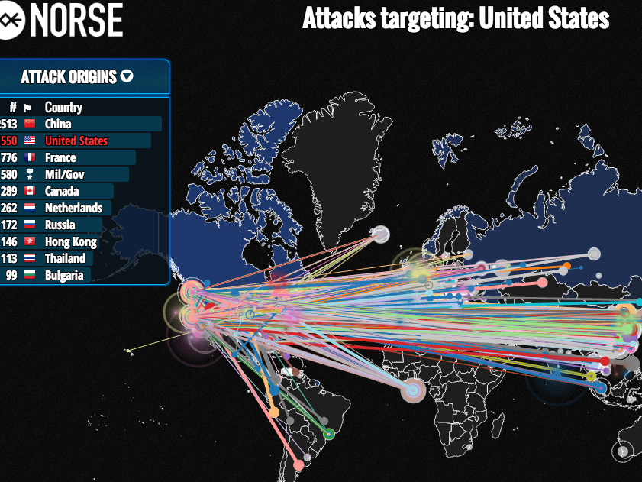
ABSOLUTE BIAS: Fall from Grace (2016)
The Growing Cyber threat from Iran, a.k.a. The Initial Report of Project Pistachio Harvest report was deemed “deeply biased” and “headline-grabbing” based on false data.
- Brian Krebs
Notes:
Criticalthreats.org After that experience, McClure said he decided not to work with Norse on either the Sony report or the Iran investigation. Cylance ended up releasing its own report on Iran’s cyber capabilities; that analysis — dubbed “Operation Cleaver” (PDF) — was later tacitly acknowledged in a confidential report by the FBI.
Conversely, Norse’s take on Iran’s cyber prowess (PDF) was trounced by critics as a deeply biased, headline-grabbing report. It came near the height of international negotiations over lifting nuclear sanctions against Iran, and Norse had teamed up with the American Enterprise Institute, a conservative think tank that has traditionally taken a hard line against threats or potential threats to the United States.
In its report, Norse said it saw a half-million attacks on industrial control systems by Iran in the previous 24 months — a 115 percent increase in attacks. But in a scathing analysis of Norse’s findings, critical infrastructure security expert Robert M. Lee said Norse’s claim of industrial control systems being attacked and implying it was definitively the Iranian government was disingenuous at best. Lee said he obtained an advanced copy of an earlier version of the report that was shared with unclassified government and private industry channels, and that the data in the report simply did not support its conclusions.
“The systems in question are fake systems….and the data obtained cannot be accurately used for attribution,” Lee wrote of Norse’s sensor network. “In essence, Norse identified scans from Iranian Internet locations against fake systems and announced them as attacks on industrial control systems by a foreign government. The Norse report’s claims of attacks on industrial control systems is wrong. The data is misleading. The attention it gained is damaging. And even though a real threat is identified it is done in a way that only damages national cybersecurity.”
After that experience, McClure said he decided not to work with Norse on either the Sony report or the Iran investigation. Cylance ended up releasing its own report on Iran’s cyber capabilities; that analysis — dubbed “Operation Cleaver” (PDF) — was later tacitly acknowledged in a confidential report by the FBI.
Conversely, Norse’s take on Iran’s cyber prowess (PDF) was trounced by critics as a deeply biased, headline-grabbing report. It came near the height of international negotiations over lifting nuclear sanctions against Iran, and Norse had teamed up with the American Enterprise Institute, a conservative think tank that has traditionally taken a hard line against threats or potential threats to the United States.
In its report, Norse said it saw a half-million attacks on industrial control systems by Iran in the previous 24 months — a 115 percent increase in attacks. But in a scathing analysis of Norse’s findings, critical infrastructure security expert Robert M. Lee said Norse’s claim of industrial control systems being attacked and implying it was definitively the Iranian government was disingenuous at best. Lee said he obtained an advanced copy of an earlier version of the report that was shared with unclassified government and private industry channels, and that the data in the report simply did not support its conclusions.
“The systems in question are fake systems….and the data obtained cannot be accurately used for attribution,” Lee wrote of Norse’s sensor network. “In essence, Norse identified scans from Iranian Internet locations against fake systems and announced them as attacks on industrial control systems by a foreign government. The Norse report’s claims of attacks on industrial control systems is wrong. The data is misleading. The attention it gained is damaging. And even though a real threat is identified it is done in a way that only damages national cybersecurity.”

Slide 14
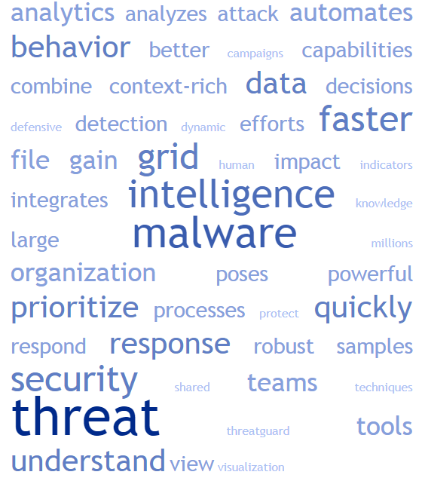
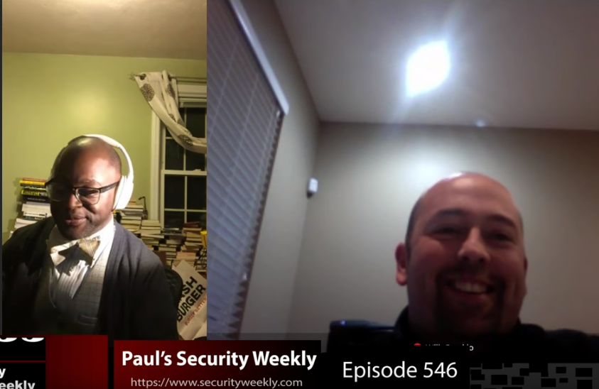
All the Threat Things. ALL the promises
“I saw your InfoSecWorld interview. I liked how you guys discussed understanding effectiveness of an ecosystem against weaponized intelligence specific to that organization or ecosystem. At <vendor> we've seen our innovative platform help with that. The architecture allows for the safe execution of real attack behaviors, and while we have content available for organizations to sequence the actions into behavior for launch, we also allow for intel from organizations like [SourceA] or info from an [SourceB] to be weaponized.”
Notes:
TAG CLOUD – Slide regarding Vendor speak
I saw your InfoSecWorld interview. I liked how you guys discussed understanding effectiveness of an ecosystem against weaponized intelligence specific to that organization or ecosystem. I also learned that your organization has upwards of 900 ecosystems! I'd love to learn more about how you manage that, test and validate.
At Verodin we've seen our innovative platform help with that. The architecture allows for the safe execution of real attack behaviors, and while we have content available for organizations to sequence the actions into behavior for launch, we also allow for intel from organizations like Anomali or info from an ISAAC to be weaponized.

Slide 15
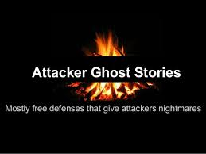
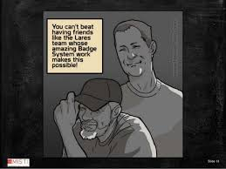
KNOW THYSELF
Best Practice – Better than best
Attacker Ghost Stories (Mubix)
Nightmares of a Pentester (Nickerson)

Slide 16
Threat intelligence received yesterday is already irrelevant
Dani Wood
Director of Advisory Services
Cybereason

Slide 17
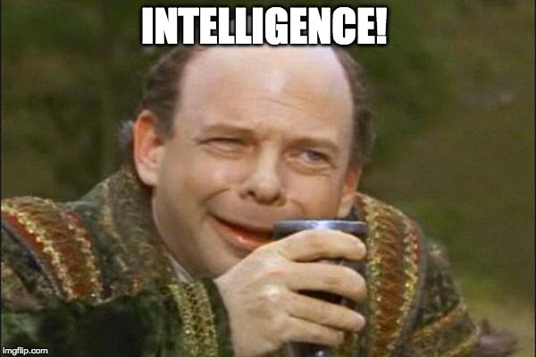

Slide 18
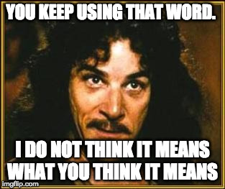

Slide 19

Following Suit…We’re Going to Try and Answer the Following
What is “intelligence” as it is defined by the military and intelligence communities?
Why in the last decade has “doing” intelligence become so important to SMBs and enterprises alike?
Intelligence Tradecraft – are the organizations seeking to “do” intelligence prepared, equipped, and capable of conducting tradecraft successfully?
Notes:
Are the majority of those concerned with “doing” intelligence pursuing it because they understand its net effect on their organizations, partners, and people or are they pursuing it because it has become fashionable to do so?
If it’s the former, what are the KPIs of their success?
If it’s the latter, why?
How do we arrive at a place where Information becomes Intelligence?
And is the information / cyber security industry prepared and capable of Generating Useful / actionable intelligence?
Two very important questions with respect to “Intelligence”. Neither are simply answered. And as a result, both warrant their due.
In order to arrive at a place where information becomes intelligence quite a lot of work must be undertaken and it is important to recognize and understand that there are no short cuts in the intelligence arena. There simply are none.
Throughout this presentation, we will explore what is required to move raw, unqualified, and in some cases qualified sources and pieces of information from just that to intelligence.
We’ll discuss the life cycle as it were and the various perspectives associated with it. We’ll discuss tradecraft and perhaps most importantly, we’ll discuss and debate whether or not our industry and those within it are grossly capable and prepared to perform all of the above to and including the analysis (multi-dimensional) of said intelligence resulting in some decision(s) being made.
Fasten your seatbelts, as we’re about to engage in ride that you and we won’t soon forget.

Slide 20
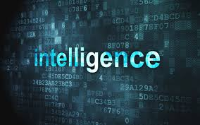
Intelligence Defined
”
Dictionary of United States Military Terms for Joint Usage (Revision of February 1957) "Intelligence - the product resulting from the collection, evaluation, analysis, integration, and interpretation of all available information which concerns one or more aspects of foreign nations or of areas of operation and which is immediately or potentially significant to planning.”
A Training Handbook "Intelligence-The product resulting from the collection, evaluation, collation, interpretation, [and] analysis of all available information concerning the intentions, capabilities and objectives of other countries which are significant to a government's development and execution of plans, policies, decisions, and courses of action.”
Notes:
Notes:
All good definitions in that they artictulate intelligence as a process 1&4 in addition to a product 2&3
None mention counter intelligence (CI) but can easily be adjusted to do so
CIA definitions:
Webster's Unabridged (1956) "Intelligence. 5. The obtaining or dispensing of information, particularly secret information; also, the persons engaged in obtaining information; secret service.
R.A. Random "Intelligence is the official, secret collection and processing of information on foreign countries to aid in formulating and implementing foreign policy, and the conduct of covert activities abroad to facilitate the implementation of foreign policy
Will says ‘Intelligence’ in this context can be defined in the following way:
“Intelligence is the collection of information (unqualified) which is then processed (vetted, tested for veracity, de-duplicated, normalized, enriched, analyzed), for military or political value for domestic and foreign applications and as part of CI operations. In other words, intelligence is information (data), that has been collected via a variety of methods from a variety of sources which aids analysts in formulating an understanding of events, individuals, organizations, movements, and governments. It is both a process and a consumable, actionable product.”
Mark says xyz
But is this the case? And if it is, does our industry – the information / cyber security industry really understand definition and put it into practice or has intelligence been hijacked for the purposes of selling goods and services?
Resources:
https://www.cia.gov/library/center-for-the-study-of-intelligence/kent-csi/vol2no4/html/v02i4a08p_0001.htm

Slide 21

Types of Intelligence and Intelligence Gathering Disciplines
Intelligence Gathering Disciplines
HUMINT
Collected by and from people on the ground
GEOINT / IMINT
Collected via satellite, aerial photograph, and mapping & terrain data
MASINT
Measurement and signal intelligence
OSINT
Collected from open sources
SIGINT
Collected from intercepted signals
TECHINT
Collected by analysis of weapons and equipment used by the armed forces of foreign nations, or environmental conditions.
CYBINT/DNINT
Collected from cyber space
FININT
Collected from the analysis of monetary transactions
Notes:
NOTES:
Conversation here” Which of these bubble up in marketing speak?
Resources:
https://en.wikipedia.org/wiki/List_of_intelligence_gathering_disciplines
http://www.yourdictionary.com/dod-intelligence-glossary

Slide 22
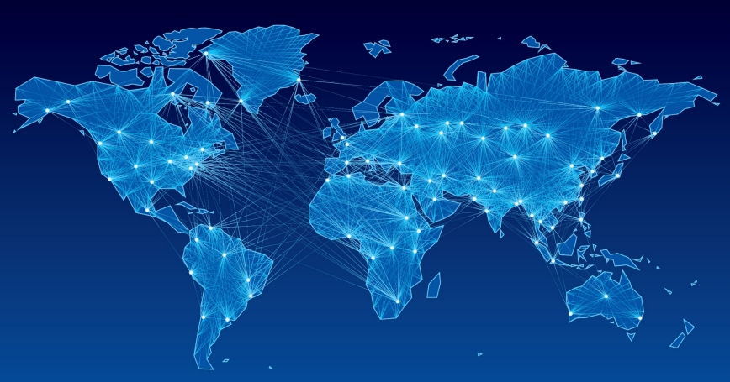
What Lead to the Explosive Popularity of Intelligence Security and Why are Organizations Pursuing it en masse?
Generic “hacker” / “miscreant” behavior?
Evolution and maturity of cyber criminals (advent of traditional organized criminal organizations entering “cyber”)?
Advanced Persistent Threat (APT)?
Nation State proxy?
Nation State?
Overly aggressive marketing entities?
Notes:
All of the above?
Are organizations seeing differences being made in their programs, their risk postures due to their pursuit of intelligence?
Are they pursuing it in the absence of said differentiation due to it being “fashionable”?

Slide 23

Efficacy: Organizations “doing” Intelligence Good, Bad, Ugly?
Are organizations endeavoring to “do” intelligence doing so successfully?
The numbers (DBIR for example), would suggest that we’ve got some work to do….
Are they equipped properly?
Are their results differentiating? Do they show in quantifiable and qualitative ways that their efforts are paying dividends?
This goes for vendors of threat intelligence too…
Notes:
NOTES:
The costs associated with alerting events and incidents are increasingly significant as they are more often than not, tied to breaches. In the 2017 Verizon Data Breach Investigations Report (DBIR), approximately 42,068 incidents were observed across 21 industry verticals resulting in 1,935 breaches. In comparison, the 2016 DBIR had observed approximately 64,199 incidents across the same those same 21 industry verticals resulting in 2,260. And though there was a drop in both the number of incidents (22,031 fewer incidents in the 2017 DBIR than in the 2016) and breaches observed (325 fewer breaches in the 2017 DBIR than in the 2016) by Verizon in their 2016 and 2017 reports, the reality is that breaches and compromises due to the activity of insiders and external actors is an ongoing problem. And though it appears that at least some progress has been made according to the report for 2017 by the team at Verizon, the fact remains that this will likely remain an issue for the foreseeable future as evidenced via the following points derived from Verizon’s findings.

Slide 24
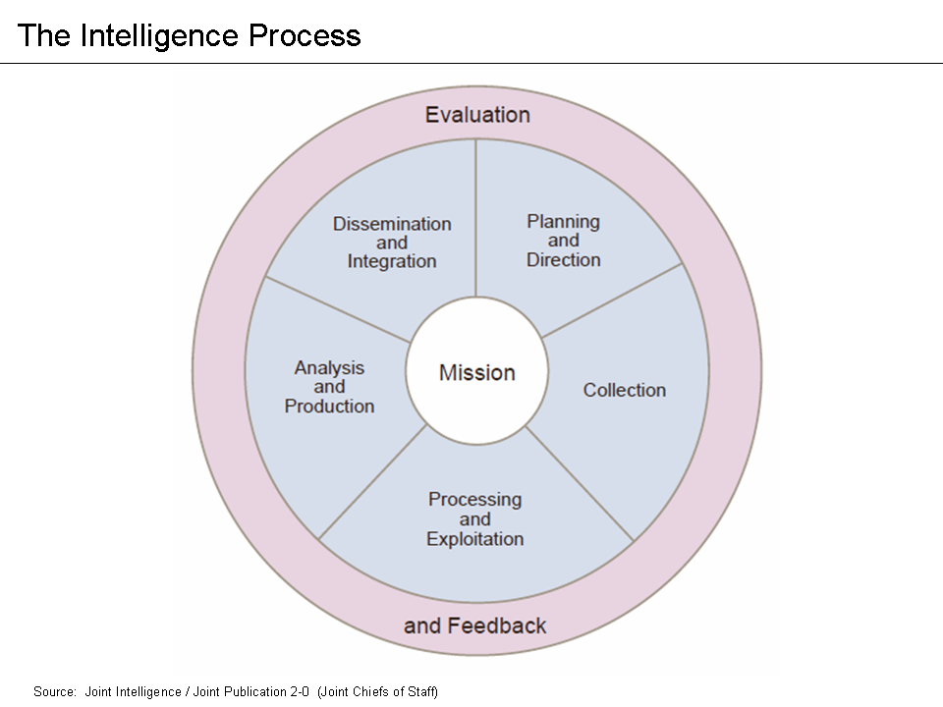
Intelligence Tradecraft
What is “tradecraft”
(DoD/IC) tradecraft can be defined as:
Techniques, methods, and technologies used in espionage.
In information / cyber security circles it can be defined as:
Techniques, methods, and technologies used in defending organizations, personnel, and their interests against adversaries – internal and external alike
Notes:
Tradecraft
Within the intelligence community, tradecraft has been traditionally defined as the:
Techniques, methods, and technologies used in espionage
BLUF:
Tradecraft is the art & science of intelligence operators, strategists, and analysts within military IC and the non-militarily oriented IC (where that exists)
In information / cyber security:
Tradecraft is the art & science of defenders AND offenders….and yet, we have to ask ourselves whether or not most practioners are actually schooled, educated, and knowledgeable in intelligence tradecraft understanding how it is used and apply to their missions
Analytic Techniques:
Methods of Analysis, Decomposition, Re-composition, Methods for Fusion, Case Studies in Analysis, Cognitive Bias, Credibility and Reliability of Sources, Confidence Levels, Analysis of Competing Hypothesis, SOPs, Flow into Hunt, Detect, CSIRT, TTPs, IoCs, Inductive/Abductive/Deductive Reasoning, Historic trending and campaign analysis, Intelligence for organizational resilience.
Production Workflows:
Standing Orders from Leadership, Analytic Writing, BLUF, AIMS, Types of Reports, Product Line Mapping / Report Serialization, and Dissemination, Cyber and Threat Intelligence Program Strategic Plan, Goals, Objectives, Cyber Operations Order (Cyber OPORD).
Resources:
https://niccs.us-cert.gov/training/search/treadstone-71/cyber-intelligence-tradecraft-certification

Slide 25
Information / Cyber Security Tradecraft
Understanding of the “Intelligence” life cycle
Priority Intelligence Requirements (PIR)
Collections process flow
Collections tools and targeting
Hunting
Understanding and incorporation of TTPs, IOCs, IOAs
Adversarial profiling
Organizational & personnel profiling
Understanding of which intelligence gathering disciplines play a role in “cyber” for the lay person
Understanding of to taxonomical models
Glossary terms
Analytic techniques
Production workflows
Deliverable production and dissemination
Notes:
Given what we’ve covered and reviewed thus far, how confident are we that organizations endeavoring to do “something” with intelligence are prepared to do so?
What about vendors? Are they they all created equal?

Slide 26
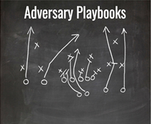
Future of Intelligence: Adversary Playbooks (Howard, 2018)
The norm of the day is to share indicators of compromise about adversaries with little or no context about the sequence of events or the motivations. Most of us have no idea if we have multiple controls in place down the kill chain for specific adversaries. We kind of treat security controls as giant sets of prevention and detection instead of focusing on the adversaries that are attacking us
- Rick Howard, CSO Palo Alto Networks
Notes:
Specific controls for specific adversaries - precise controls for specific adversaries at every stage of the kill chain. This requires work and automation and a change of thinking by the network defender community.

Slide 27
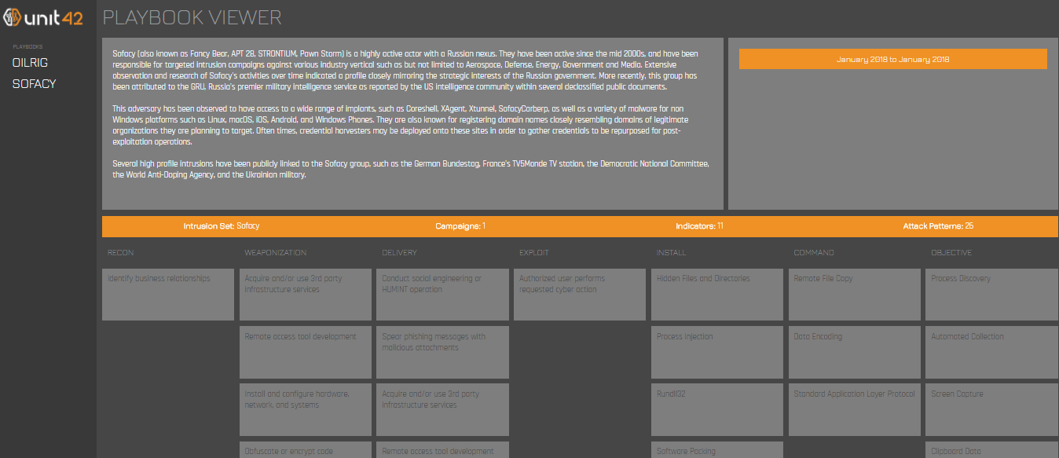
Notes:
Specific controls for specific adversaries - precise controls for specific adversaries at every stage of the kill chain. This requires work and automation and a change of thinking by the network defender community.

Slide 28
Sources | References
Brown, Rebekah and Roberts, Scott. Intelligence-Driven Incident Response: Outwitting the Adversary. Minneapolis: O’Reilly, Sebastopol 2017
Gragido and Pirc. Cybercrime and Espionage: An Analysis of Subversive Multi-Vector Threats. Syngress, 2011
Christopher Nickerson. Nightmares of a Pentester. Accessed, March 1, 2018 http://www.securitytube.net/video/14978
Robert Fuller. Attacker Ghost Stories accessed March 1, 2018 https://www.youtube.com/watch?v=yxhQF6E8kO0
Sergio Caltagirone. “Why Threat Intelligence Sharing is Not Working: Towards An Incentive-Based Model” accessed March 13, 2018. http://www.activeresponse.org/threat-intelligence-sharing-not-working-towards-incentive-based-model/
Layton, R., and Paul A. Watters, eds. The Automating of Open Source Intelligence Waltham, Syngress, 2016.

