Slide 1

Red Team Apocalypse
Derek Banks (@0xderuke)
Beau Bullock (@dafthack)

Slide 2

About
Your organization has a vulnerability management program and regularly patches
You implemented application whitelisting and network egress controls
The latest round of pen testers didn’t find anything too concerning
You have the latest Cyber Anti APT Blinky box appliance
Your organization’s critical database is being sold on the dark web.
What happened?!

Slide 3

About Us
Pentesters at Black Hills Information Security
Have a number of SANS, OffSec, and other certs…
CitySec Meetup Organizers
CigarCitySec – (Tampa, FL)
CitrusSec – (Orlando, FL
TidewaterSec – (Hampton, VA)
Tradecraft Security Weekly and Hacker Dialogues podcasts
Avid OWA enthusiasts

Slide 4

Original Pentest Apocalypse
Vulnerability Management Program
Group Policy Preferences
Widespread Local Administrator Account
Weak Passwords (Password Spraying)
Over Privileged Users
Sensitive Data in File Shares
Intranet Information Disclosure
NetBios and LLMNR Poisoning
Local Workstation Privilege Escalation

Slide 5

Red Team vs Pen Test
Penetration test goals tend to be find as many vulnerabilities in the allotted time
Use COTS tools automated tools like vulnerability scanners
Generally not concerned with alerting the blue team
Red teams engagements model real world adversaries and are focused on achieving a goal
May use custom written malware and tools
Generally attempt to be stealthy and not alert the blue team

Slide 6

Red Team Methodology
Reconnaissance
Compromise
Persistence
Command and Control
Asset Discovery
Privilege Escalation
Lateral Movement
Actions on Objectives

Slide 7
Calendar Event Injection

Slide 8

Google Calendar Event Injection
Silently inject events into calendars
Creates urgency via reminders
Include a link to a fake agenda
An email isn’t necessary, simply add a Google user to an event and select checkbox to not notify them
Google will automatically add it to their calendar
This presents a unique phishing situation

Slide 9

Google Calendar Event Injection
A few ideas:
Include a link to a conference call site but have it pointing to a credential collection page
Include a malicious “agenda”
Have victims navigate to a fake Google Auth page and collect creds
Gets more fun with Google API
It’s possible to make it look like they already accepted the invite!
This completely bypasses the setting in G-calendar for not auto-adding events.

Slide 10
Email Attacks

Slide 11

Business Email Capture
Externally accessible email portals are a target
Even if they are 2FA
OWA I’m looking at you
Cloud services are a target too (Gmail, O365, etc.)
Pen testers may overlook email systems as a target
Threat actors (and Red Teamers) do not
Email is a huge resource for an attacker to learn more about your environment

Slide 12

Business Email Capture
MailSniper
https://github.com/dafthack/MailSniper
Domain / Username enumeration
Password Spraying
GAL Download
Open Inbox delegation discovery
Email searching for terms like passwords, 2FA codes, etc…
Bypasses some 2FA products by connecting to EWS instead of OWA

Slide 13
Unicode Domain Names

Slide 14
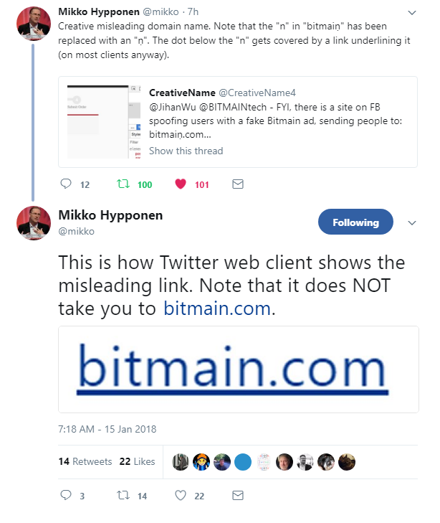
Unicode Domain Names
Use of domain names that include unicode characters such as letters with a dot (.) under them like: ṇ
Creates a really great look-alike domain for phishing
The dot gets completely hidden when hyperlinked with a line underneath
Gotta be careful with some spam filters though

Slide 15
Expired Categorized Domains

Slide 16

Expired Categorized Domains
Technique used to circumvent categorization web proxy blocks for C2
Uses previous categorization for some length of time
Trivial to find
expireddomains.net
Domainhunter.py
Simulates using a compromised 3rd party website

Slide 17
Domain Fronting

Slide 18

Domain Fronting
Another technique used to circumvent web proxy restrictions for C2
Hides the true endpoint of an HTTP connection
Initial target domain for the traffic redirects to secondary host
Can use a Content Delivery Network such as AWS Cloudfront
Can be difficult to detect and block

Slide 19
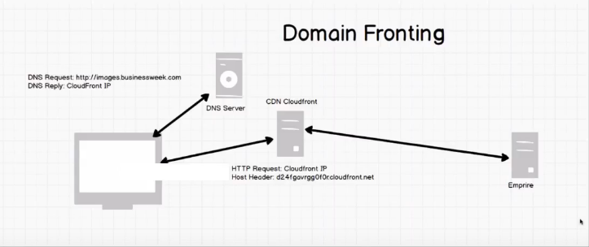
Domain Fronting

Slide 20
Hashes Just Want to Be Cracked

Slide 21

Kerberoasting
Ability for any domain user to query the domain for a Service Principal Name for an account associated with running a service
A request to authenticate over Kerberos results in a service ticket where a portion is encrypted with the service account hash
Effectively any domain user can get a hash of a service account with an SPN and take the resulting ticket offline and attempt to crack it

Slide 22

Evil Twin Wireless Attack
Evil Wireless AP that uses the same ESSID as the target AP
Goal is to trick a user into joining the evil AP and gather the NetNTLMv2 hash from the authentication attempt
Eaphammer from s0lst1c3
https://github.com/s0lst1c3/eaphammer
Hostapd-wpe
https://github.com/OpenSecurityResearch/hostapd-wpe
Aircrack suite

Slide 23
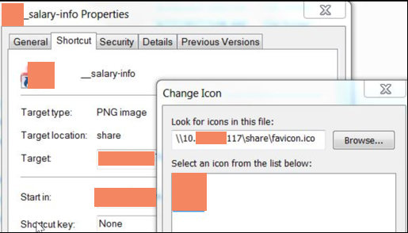
Weaponized LNK File
Place shortcut file located on a commonly used public share
Icon for shortcut points back a UNC location on attacker system
SMB Listener on attacker controlled system
Can use Inveigh for the listener
https://github.com/Kevin-Robertson/Inveigh
Gather NetNTLMv2 hashes

Slide 24
Onsite Attacks

Slide 25

NAC Bypass
Spoof another device
Find a printer or VOIP phone; Spoof MAC and/or IP
Voiphopper to hop VLAN’s
For Wi-Fi NAC spoof MAC and User Agent of connected device
Layer 2 and 3 NAT device
Helps avoid triggering port security rules on 802.1X
Device spoofs both sides of wire
Passively learns MAC addresses

Slide 26
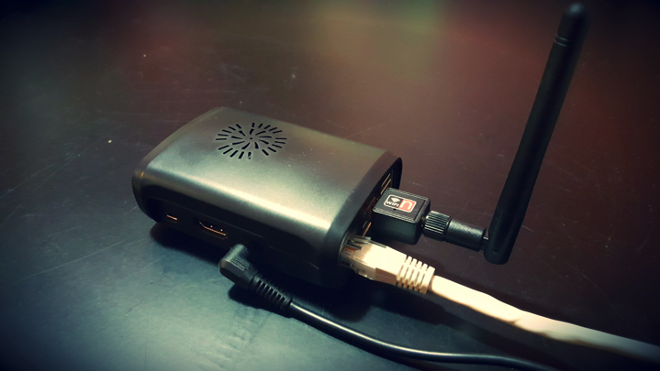
Dropbox
Fully functional pentesting device to leave at onsite
Persistent reverse SSH tunnels
Can be controlled over WiFi
Relatively unnoticeable
ODROID-C2 build instructions here:
https://www.blackhillsinfosec.com/how-to-build-your-own-penetration-testing-drop-box/

Slide 27
PXE Booting Attacks
Obtain the “Golden” image from the network
Set VM to “Boot from network”, boot VM, and get the image
Mount image & profit
Steal Admin hashes
Set local admin pass pre-boot
Overwrite Sticky keys (sethc.exe)

Slide 28
Post Exploitation

Slide 29

PowerUp SQL
PowerShell tool for attacking MSSQL
https://github.com/NetSPI/PowerUpSQL
SQL Server discovery
Weak configuration auditing
Privilege escalation
Data sample searches
OS command injection
All at scale across the enterprise

Slide 30

Living off the Land
Using built in Windows tools to avoid dropping malware
Internal user and group recon
Remote file listing and copying data
Remote process spawning
Lateral movement

Slide 31
Living of the Land
Net commands
net groups “DOMAIN ADMINS” /DOMAIN
Listing files on remote hosts
dir \\host\C$\files
WinRM to run remote commands (port 5985)
Invoke-Command -ComputerName -ScriptBlock {Command Here}

Slide 32

Stealthy Host/Domain Enumeration
More and more AV, behavioral analysis, app whitelisting, etc. products are starting to either block or alert on built-in system commands
Ex. net, ipconfig, whoami, netstat, etc.
HostRecon PowerShell instead of built-in commands
https://github.com/dafthack/HostRecon
Combine with PowerShell Without PowerShell technique for added bonus

Slide 33
Detection and Prevention

Slide 34
Solid Systems Administration
Systems and software inventory (yes, CSC Top 20 are useful)
Workstations should never talk to workstations - client to server communication only
Windows firewall or Private VLANS
Baseline images with GPO enforcement
All inbound and outbound network traffic go through an application proxy system
Any exceptions for direct outbound communication are by documented exception only

Slide 35
Enforce Good User Behavior
Change every inbound email subject line with a tag such as (External):
Inform your users that any email with that tag needs extra scrutiny
Minimum of 15 characters for any domain account password
If you have to compromise to sell it to the business, no complexity requirements and 6 month change interval
Consider additional credential defenses
Commercial offerings available
CredDefense Toolkit for Free
https://github.com/creddefense

Slide 36
Host Log Consolidation
Consolidate key logs from endpoints, servers, and appliances to a central location
Specifically monitor PowerShell and process execution
Sysmon a powerful and free option for gaining insight into host based activity
Once the logging foundation is in place, alert on “abnormal commands” like net commands
Can be done on the cheap:
https://www.blackhillsinfosec.com/end-point-log-consolidation-windows-event-forwarder/

Slide 37
Network Logging
NetFlow, Bro, or Full Packet Capture?
Depends on your budget and staff capabilities
Bro is a good balance between NetFlow 5-Tuple and Full Packet Capture mass storage requirements
Out of the box captures common protocols into text based files
Can provide an amount of visibility into SSL traffic without breaking SSL
Abnormal certificate information
SSL fingerprinting - JA3 project - https://github.com/salesforce/ja3
Beacon detection with RITA (AIHunt)
https://www.blackhillsinfosec.com/projects/rita/

Slide 38

Red Team Prepper
Don’t wait on the Red Team prepare on your own
Use @vysecurity’s Red Team Tips to find techniques to try to detect
https://github.com/vysec/RedTips
MITRE ATT&CK Framework for threat actor techniques
https://attack.mitre.org/wiki/Main_Page
Red Canary’s Atomic Red Team - portable scripts to test ATT&CK framework
https://github.com/redcanaryco/atomic-red-team

Slide 39
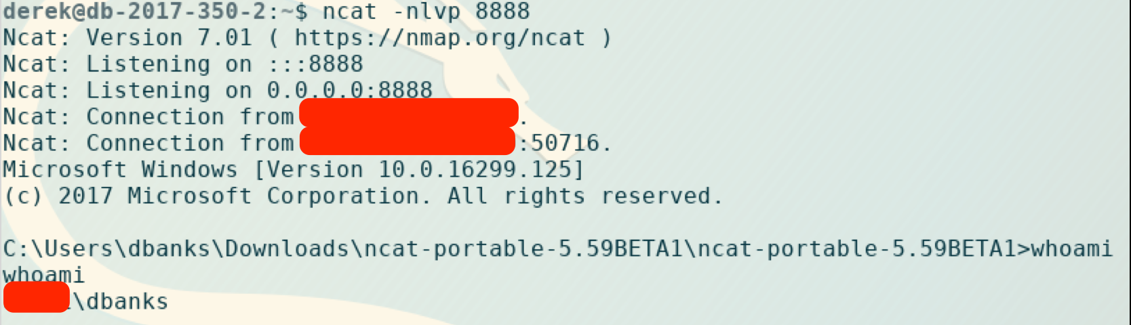
About that Bypass Technique
Recently some products have been getting a little better…
But they still seem to be getting better at catching pen testers and common tools
And then sometimes its just stupid simple to get past a well known security product

Slide 40
Summary and Conclusions
Black Hills Information Security
http://www.blackhillsinfosec.com
@BHInfoSecurity
Beau Bullock @dafthack
Derek Banks @deruke
Questions?

