Slide 1
From Grief to Enlightenment: Getting Executive Support for Information Security
June 8, 2018

Slide 2

Picture It…

Slide 3





5 Stages of Grief
Denial
Anger
Bargaining
Depression
Acceptance

Slide 4
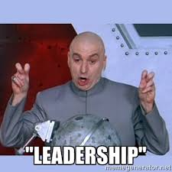
Importance of Leadership Identification
“We aren’t the only one with the problem…”
Power Dynamic of Non-Disclosure
“We’re losing them.”
Help me to help you…
Successful Leaders now have high
Emotional Intelligence (or Emotional Quotient)!

Slide 5

Phase 1: Denial
Common Phrases
“There is no way that this is going to be required.”
“That’s not my job.”
“They can’t take the whole <fill in the blank> down because of this.”
“What we don’t know can’t hurt us.”
“This is just a paperwork exercise.”
Common Behaviors
Amnesia
Lack of Priority
Avoidance
Isolation

Slide 6

What To Do
Recognize: This is a defense mechanism.
Focus: Getting past feeling overwhelmed
Action:
Space – “Gone but not forgotten.”
Education and Preliminary Plan to Start Conversation

Slide 7

Phase 2: Anger
Common Phrases
“This is a business tax!”
“That’s not fair!”
“I have too much to do already!”
“Let them just try to come after us!”
Common Behaviors
Blaming
Passive Aggressive/Undermining
“Low Man-it is”

Slide 8
Phase 3: Bargaining
Common Phrases
“Maybe they won’t check this time.”
“Maybe we can put it off on the vendor.”
“If we don’t have the budget…”
“If we had just <known sooner, planned, understood, etc.>”
Common Behaviors
Extreme Control Avoidance
Elaborate Plans To Postpone or Protect Themselves
Focusing on “Should” and Not On Action

Slide 9

What To Do
Recognize: Need to regain control.
Focus: Helping them to reality.
Action:
Compliance/Action Plan Developed
Redirect Conversation – What can we control?

Slide 10

Phase 4: Depression
Common Phrases
“We are never going to get this to work.”
“This is going to cost more.” (Not necessarily!)
“I didn’t sign up for this.”
“Why me?”
Common Behaviors
Sadness/Avoidance

Slide 11

What To Do
Recognize: Reaction to loss (in whatever form).
Focus: Helping them with practical implementation.
Action:
Securing Resources
Executive Conversations
Audit Card (use sparingly)

Slide 12

Phase 5: Acceptance
Common Phrases
“What do we need to do to get this fixed?”
“I want to do this…”
“Resistance is futile.”
Common Behaviors
Elimination of previous behaviors.
Calm
Focus on Solutions
Assignment of Resources
Don’t let the picture fool you!

Slide 13

Final Thoughts on Stages
Grief is not linear
You may have your own grief – ego check
More than one conversation is needed
You are not a therapist – Know when to let it go
Think in terms of 1-3 years

Slide 14
Common Governance Issues
If the world were perfect, it wouldn’t be. – Yogi Berra

Slide 15

Common Governance Issues (and how to avoid them)
No board policy for “information” security
Support must come from the top
Simple policy includes major items such as:
Statement of support/requirement
Commitment of resources
Accountable party(ies)
Reporting
Focus on “the ask”
Before the board meeting…

Slide 16

Common Governance Issues (con’t.)
2. No line item for information security/no budget authority
Every budget should have a line item for information security separate from IT
CISO or CRO (or comparable position) should have spend authority
Must make the business case (ex. Conflict of interest)
Make the business case first to finance

Slide 17

Common Governance Issues (con’t.)
3. CISO wants to only stay in their box
Position has transformed from individual performer to advisor/manager
Communicate on their level not yours
Sell, sell, sell…
Business initiative
Know when to use the audit/compliance card

Slide 18
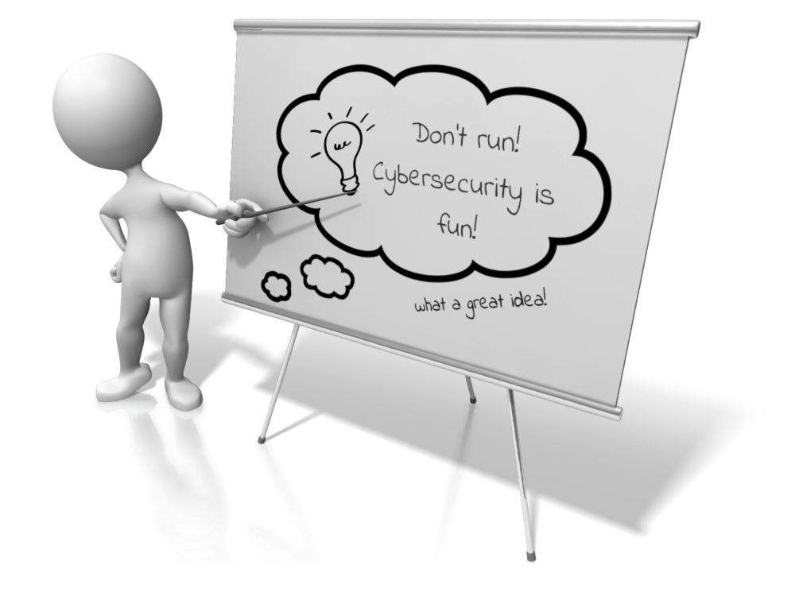
Common Governance Issues (con’t.)
4. No initial or ongoing board/executive training
Most board members and executives have no background in information security (not do they want to – don’t get offended)
Cannot oversee/govern what they do not know/understand – Training needed!
Do not expect technical proficiency
Focus on roles/responsibilities/expectations
Keep it less than 30 minutes (preferably 15 minutes)
No “hell in a handbasket” updates!

Slide 19


