Slide 1

Doxing Phishers: Analyzing Phishing Attacks from Lure to Attribution
Crane Hassold
Director of Threat Intelligence
@CraneHassold
June 8, 2018

Slide 2


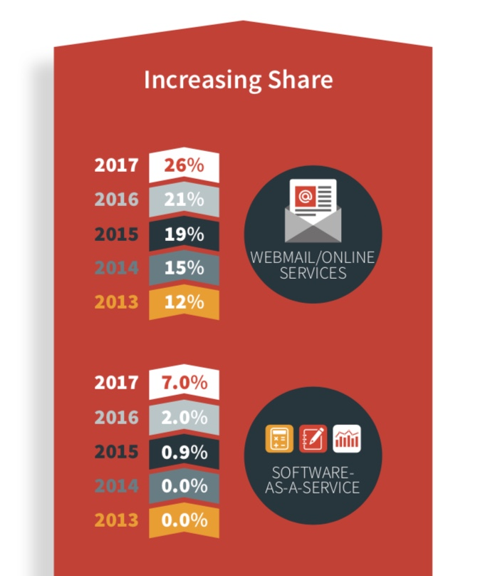
Who Cares About Credential Phishing?
Malware usually gets all the attention
Some of the biggest breaches in recent years initiated with credential phishing attacks
2017 saw a shift in who credential phish target
Evolution from individuals to enterprise users
Business-oriented services saw major increases
Email services became the #1 targeted industry – driven by Office365/OWA phish
SaaS attacks more than tripled – driven by Adobe/DocuSign phish
Follows similar evolution of ransomware targeting in 2016
Facilitates BEC attacks, data/IP theft/ransom

Slide 3
Why is Phishing Intelligence Important?
Having a better understanding of the threat allows us to better adapt and react
Phishers give us all the information needed to defeat them
Lures (the “delivery mechanism”)
Phishing sites (the “finished product”)
Phish kits (the “recipe”)
How does this help?
Quicker phish confirmation
Fewer false positives
Overcome anti-detection hurdles
Identify the biggest threats

Slide 4
Analysis of Phishing Lures
Phishing lures are the initial exposure a victim has to an attack
Lures generally follow the same basic themes
Suspicious activity
Account validation
Account suspension/expiration
Awareness of new lures gives us an opportunity to alert potential victims
Point us to the phishing site
Email headers give us information about campaign distribution infrastructure

Slide 5
Analysis of the Phishing Site
The phishing site provides us a significant amount of intelligence that can be used to track campaigns and enhance detection
Source code analysis
URL pattern analysis
Malicious domain correlation

Slide 6
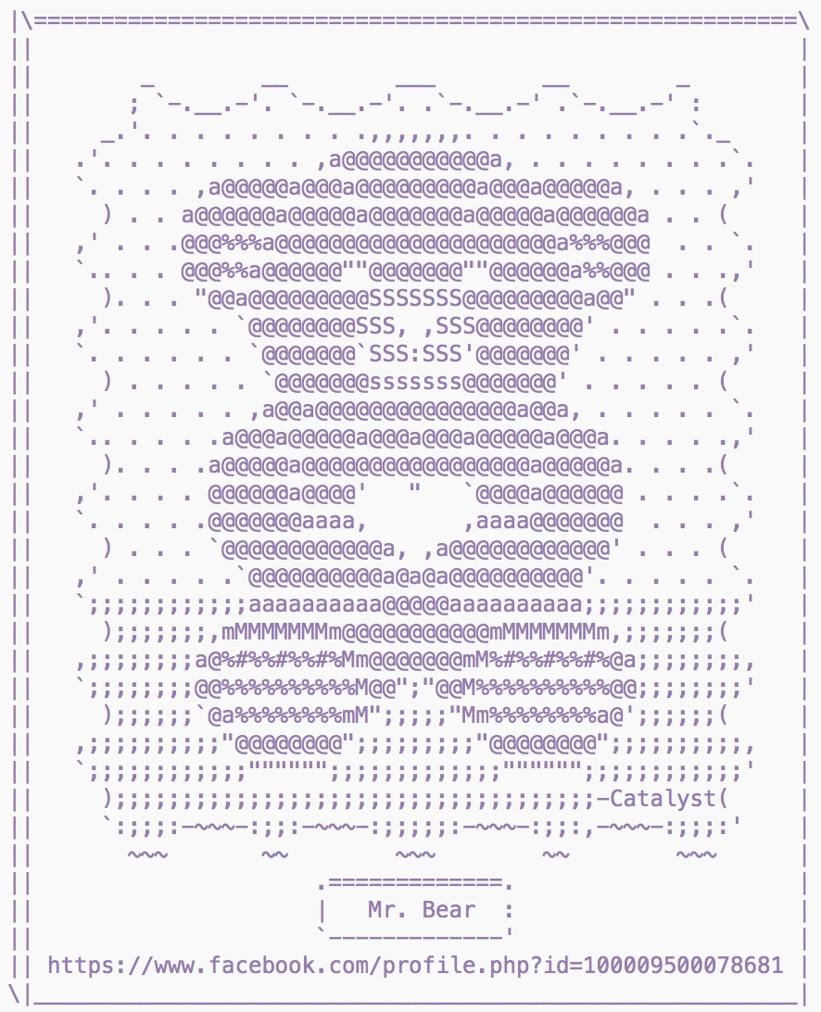
Source Code Analysis
Analyzing the source code of a phishing page allows us to extract unique strings that can enhance detection
Can also be used to link sites to a specific kit or actor
Some components that can provide unique strings include:
HTML title tags
Form posts
Comments
Signatures

Slide 7
URL Pattern Analysis
Identifying patterns in phishing URLs can be used to cluster attacks into families
Landing page names
Directory structure
Content hashes
Indications of defensive tactics (directory generators, URL parameters)
This type of analysis allows us to:
Shrink the overall phishing ecosystem
Identify unique URL characteristics
Identify the most significant threats

Slide 8

Malicious Domain Correlation
Some phishers register “look-alike domains” used to host phishing content
Whois information for these domains can provide a gold mine of intelligence data
Valuable intelligence information includes:
Registrant organization
Registrant email address
Website title
Registration dates
This information can then be used to identify additional potential active or inactive phishing sites
PassiveDNS analysis to identify other malicious domains on same infrastructure
THANKS GDPR!

Slide 9
Analysis of Phish Kits
Kits are the “recipe” for creating most phishing sites
Collecting & analyzing kits give us a more in-depth understanding of techniques used to carry out phishing scams
Anti-detection techniques
Access controls
Code obfuscation
Data exfiltration
Notes:
Proactive approach – that is, instead of waiting for a phishing site to be identified, take steps to mitigate an attack BEFORE IT EVEN HAPPENS!

Slide 10
Anti-Detection Techniques
Two primary ways phishers attempt to evade detection
Access controls
Dynamic URL alteration
HTACCESS files and/or PHP blocklists generally used to control access to a phishing site by:
IP address
User agent string
HTTP referrer
Hostname
Creating a unique URLs for each visitor is meant to evade browser-based blocking
Dynamic directory generation
Random URL parameters

Slide 11
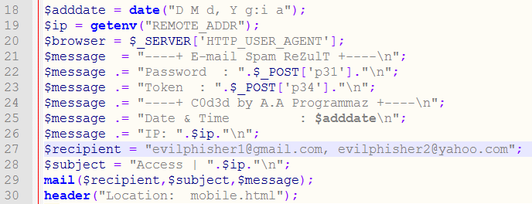
Drop Accounts
Analyzing kits allows us to see exactly where compromised data is going
Compromised information generally sent to phisher via email
Other notable tactics:
Storing information on the compromised server
Sending information to a secondary domain controlled by the phisher
Sending information via Jabber
We can also identify backdoors inserted by the kit’s author

Slide 12
Genealogical Analysis & Kit Clustering
Countless phishers, but few sophisticated phish kit authors
Many phishers simply make minor modifications to freely-available kits and pass them off as their own
Over time a “family tree” of phish kits is created
By analyzing kits, we are able to identify unique artifacts that allow us to cluster them into families
This allows us to:
Shrink the overall phishing ecosystem
Identify the most significant threat actors
Detect common anti-detection techniques

Slide 13
Case Example: Netflix Phishing Campaign Analysis

Slide 14
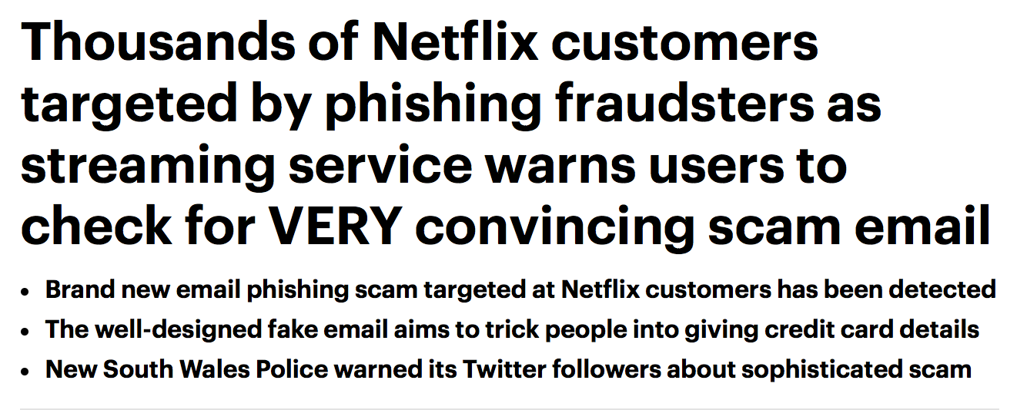
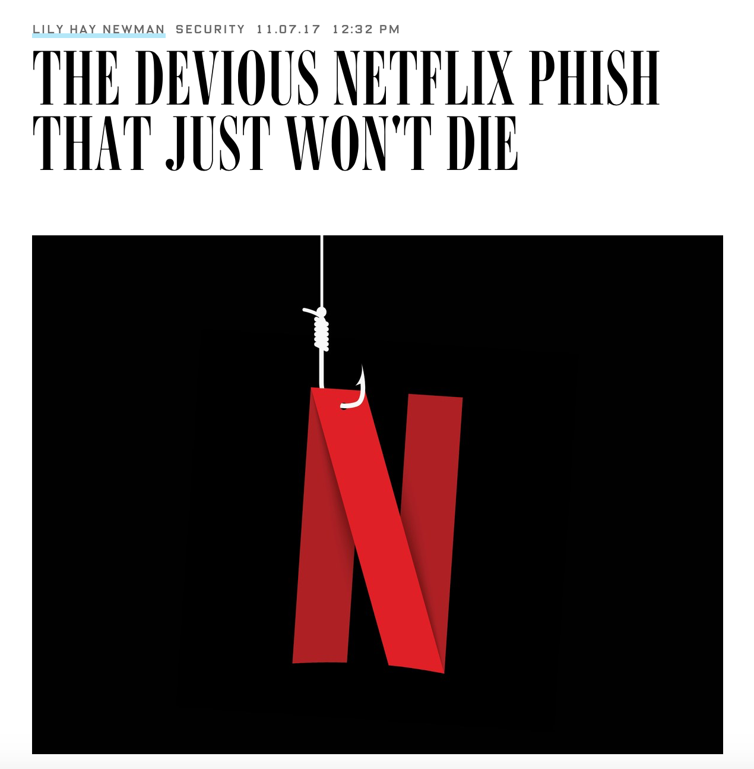
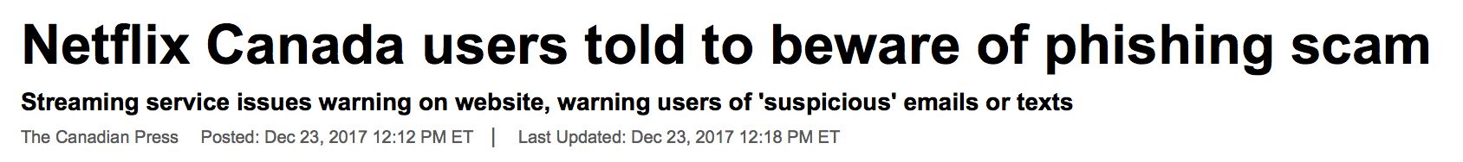

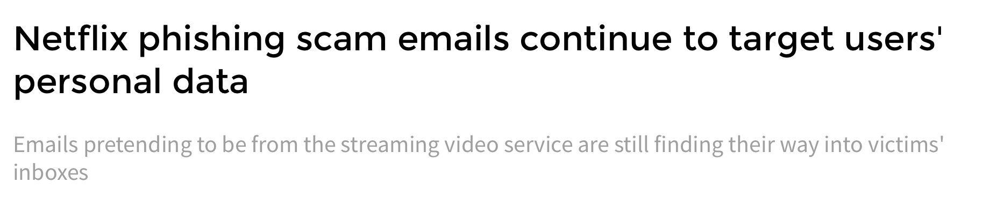
Netflix Phishing is Apparently Newsworthy

Slide 15
The Lure
<a style="text-decoration: underline;transition: all .2s;color: #41637e" href="http://gasofin.com/images/color/netflix/Login/index.php" data-emb-href-display="undefined">Click here to verify your account</a><br /><br />Failure to complete the validation process will result in a suspension of your netflix membership.

Slide 16
The Phish

Slide 17
Obfuscated Source Code

Slide 18
Stepping Through the Phish

Slide 19
Stepping Through the Phish

Slide 20
What Do We Know So Far?
Primary phishing pages:
index.php
billing.php
payment.php
complete.php
Source code obfuscation
Use of IP address to create unique URLs
Redirects to legitimate Netflix homepage at conclusion of phish

Slide 21
URL Pattern Analysis
http://divspec.com/documents/netflix/billing.php?ip=162.158.69.111
http://netfllx-unauthorize.com/95a72e66812d77999adc74971/
http://www.ncrweb.in/vqmod/logs/noreplyserviceox/372c563be28852f276cdb879b/
http://divspec.com/documents/netflix/complete.php?ip=141.101.99.17
http://adityakundli.in/netf/netflix/payment.php
http://www.calltoaction.com.br/wp-includes/css/Netflix/billing.php?ip=95.85.8.153
https://netfllix-payment.windoors.gr/8a7187c4a9f4c44786953b5f6/
http://www.steuler.nl/theme/netflix/complete.php
http://christiantellez.cl/wp-admin/netflix-000547/netflix/Login/payment.php?ip=104.34.224.88
https://www.pponlinestore.com/as/netflix/en/login/Home/
index.php
billing.php
payment.php
complete.php
This family comprises more than 25% of all Netflix phishing sites in 2017

Slide 22
Phish Kit Analysis
Access control files

Slide 23
Phish Kit Analysis
Mailing scripts
Obfuscation
Primary phishing pages
Access controls/
crawler blocking

Slide 24
Genealogical Analysis
An analysis of Netflix kits shows that ALL of them are related
Likely freely distributed and modified over time
Enhanced functionality added
Form validation
Directory generation
Additional access controls
Conclusion: Many of the Netflix phishing sites created from kits are linked to an original source kit written by a single author
WHO IS THE AUTHOR?

Slide 25
Going Down the Open Source Rabbit Hole

Slide 26
Potential Original Post

Slide 27
Finding the Download Location

Slide 28
The Original Kit

Slide 29
The Original Kit

Slide 30
Comparing Kits
Original Kit
Recovered Kit

Slide 31
Backdoor
Drop email account
“Access control file”

Slide 32
Backdoor
Legitimate hostname blocking

Slide 33
Backdoor
Backdoor email account

Slide 34
Who is Admin?

Slide 35
Who is Admin?

Slide 36
Who is Admin?

Slide 37
Who is Admin?

Slide 38

Who is Admin?

Slide 39

Wrapping Up
Original lure
Family makes up >25% of all 2017 phish
One kit to rule them all
Original distribution site
Likely original kit author

Slide 40
QUESTIONS???
Crane Hassold
Director of Threat Intelligence
chassold@phishlabs.com
@CraneHassold

