Slide 1
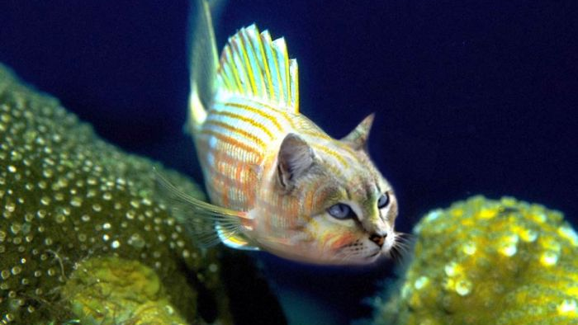
Build a better Catfish
2018 RVASec

Slide 2

Who am I?
Nat Hirsch: Red Team Director
Advanced objective based adversarial simulation
Gain access
Issue fraudulent wire transfers
Steal sensitive customer data
Exfiltration of all the things
Demonstrate impact and understand risk
Act as a sparring partner for the Blue Teams

Slide 3
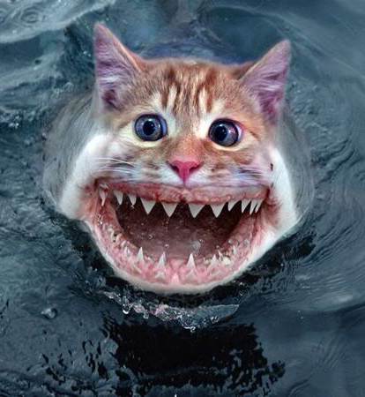
What is a Catfish?
Not phishing or MTV catfishing
Tools and technique based vs objective based
Lateral movement
Botnet beaconing traffic
Mimikatz on a box
Think MITRE ATT&CK
Focus on detection, not is it possible?
Notes:
Before we begin lets define what we are going to do.

Slide 4

Catfish: Old Way
Work with Blue Teams to identify things to test
Red Team picks something from the list at semi-random
Red Team does it
It doesn’t get caught
Red Team writes a report more or less mocking Blue’s inability to detect
Blue Team does nothing with report
Nothing gets fixed
Everyone loses
Notes:
If we are building a better one, first lets look at the old one.
Not always a failure, but not always a success.
Lets look at one of our biggest fails though.

Slide 5
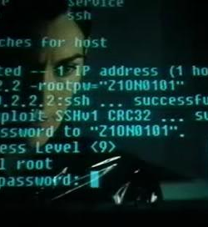
Example Fail
Aggressively vulnerability scan external web servers
Expect fireworks
No one cares
No alerts even though logs are there
Way too much noise and regularly occurring
Not enough signal
No real learning or improvement

Slide 6
Example Win
Wireless AP testing.
ADD In a bunch here about where it worked, found the dead devices, etc.

Slide 7
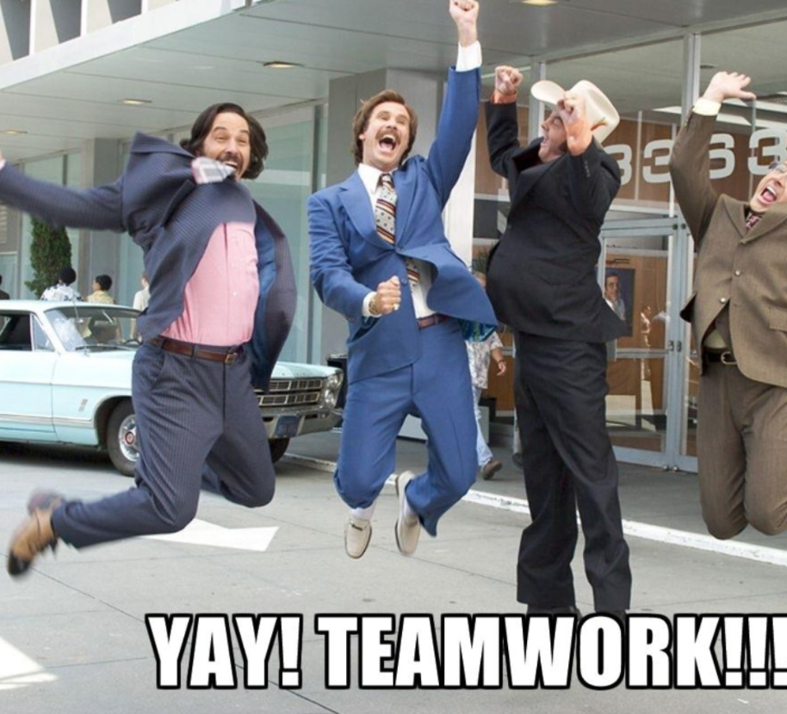
Catfish: New Way
Coordinate closely with trusted high ranking member of Blue Team
Clearly define objective
Define expected outcomes /assumptions
Bolster defenses based on Catfish expected outcomes (cheating)
Execute test
Review outcomes to identify failures
Repeat as necessary (Automate where possible)
Measure performance over time
Notes:
New way. Work with a high level D+ blue team member to identify what they want to test. Clearly define what the objectives are, what the expected outcomes should are, where we should get caught, how we should be caught, etc. Make any changes needed. Test the objective. Review the outputs, find failures, fix, retest, automate, and gather metrics. Everybody wins.
Make sense, everyone is all aboard the win train, lets take a loot at one we actually did and its outcomes.

Slide 8
Example Success
Phase 1
Generate traffic
Phase 2
Do it again
but with threat intel
Phase 3
Pivot to high value asset
Phase 4
Exfil a little
Phase 5
Exfil a lot
Phase approach: 20 Total Simulations
Steady improvement in detection over time
Revealed all kinds of gaps we thought we had filled
Improved detection, hunt ops, alert development, architecture and visibility
Notes:
Created C2 traffic.
Created threat actor associated with C2
Added to threat intel feed
Created c2 again now.
Moved to swift server
Stole some data
Stole an equifaxian amount of data.
Total Fail on first few rounds. Our visibility in these areas was not as robust as we thought ☹
Getting better. Time to identify went from never to under 7 minutes.

Slide 9
Phase 1 Generate Traffic

Slide 10
Phase 2 Again with Threat Intel

Slide 11
Phase 3 Hit that high value target

Slide 12
Phase 4 Exfil a little

Slide 13
Phase 5 Equifax that issue

Slide 14
Where new model could be further improved.

Slide 15
Problems with attribution

Slide 16
Network Diagram
ADD in network diagram how everything should look and work for this.

Slide 17
Testing of Alerts

Slide 18
Request able via internal Git hub

Slide 19
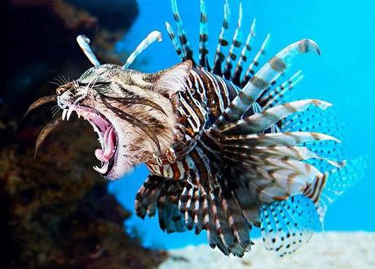
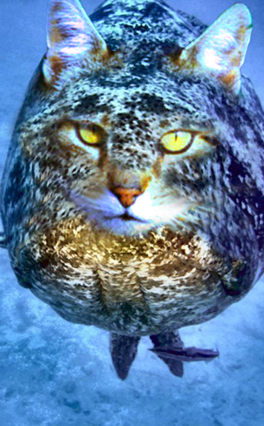
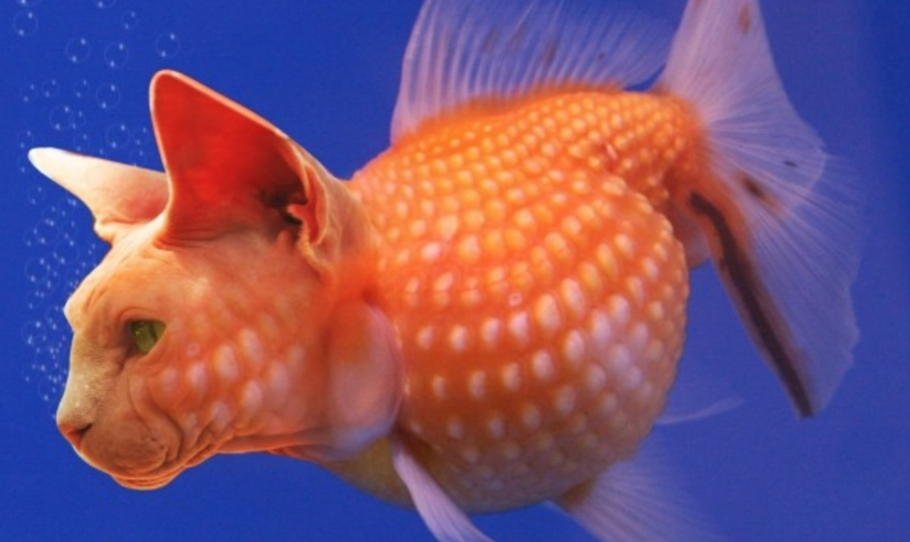
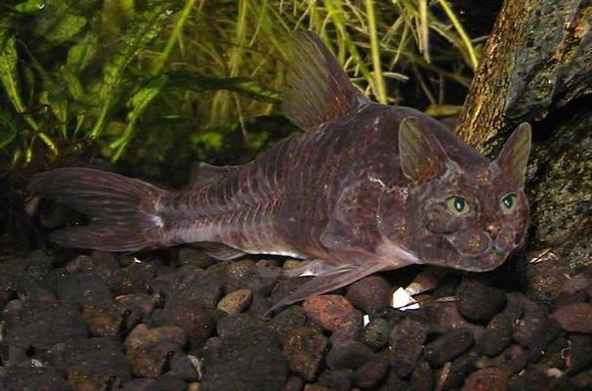
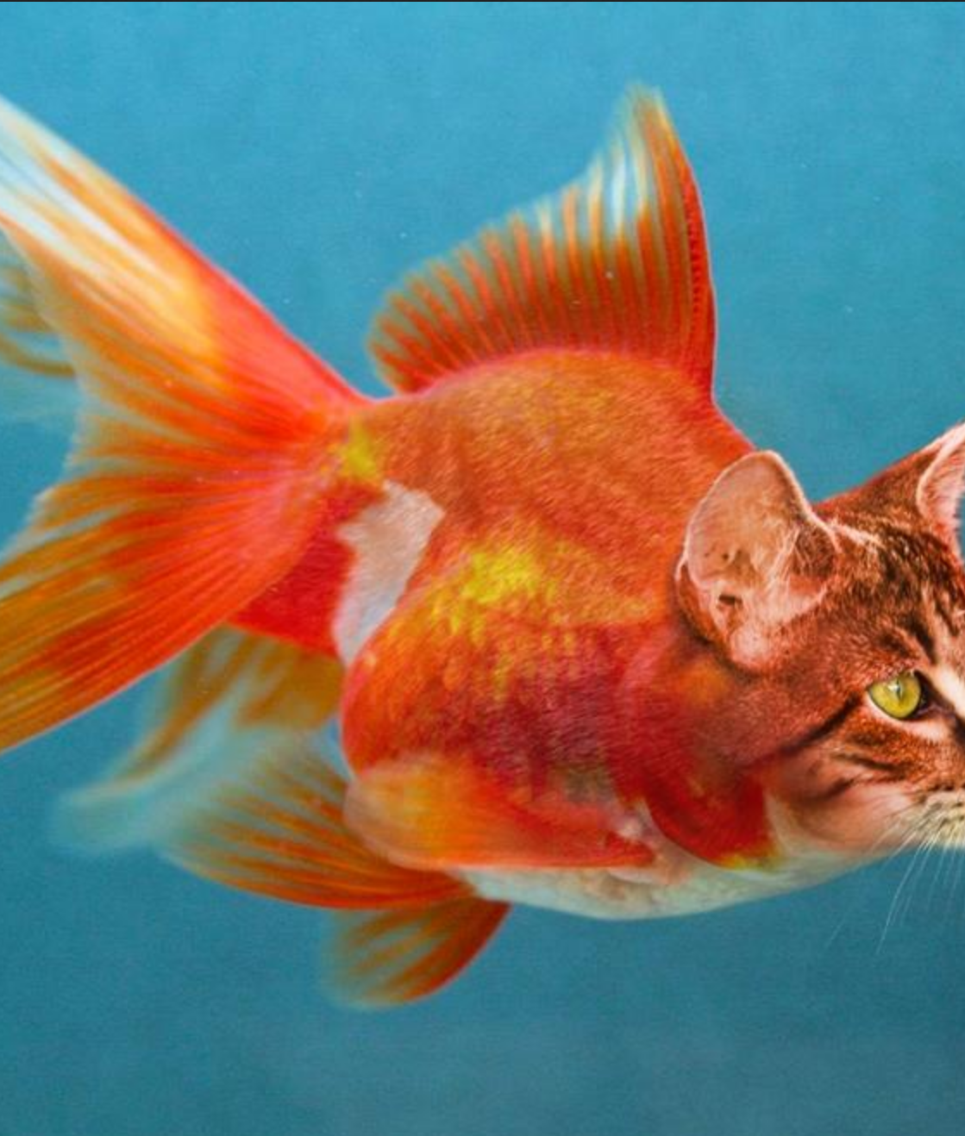
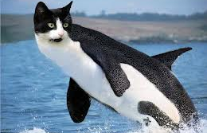
Other Catfish ideas & examples
Rogue access points
Lateral movement
Known malware drops
Insider threat profiles
Hunt for prior operations
Notes:
Anything where a blue team has a tool, process, procedure etc. that they think works, but want to verify and fine tune it.

Slide 20
Future Catfish

Slide 21
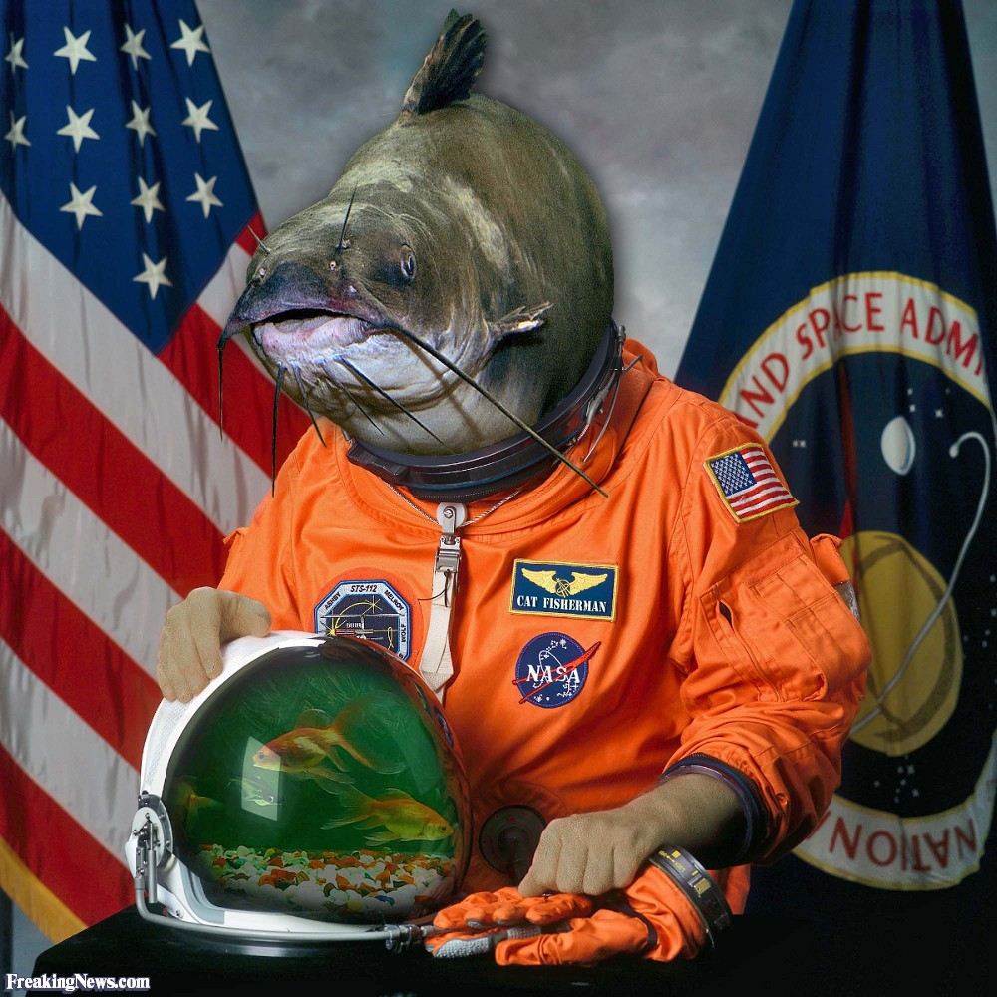
Planned Future
Everything is a Catfish
Objective based has TTPs
Define expected outcomes from a detection side at different points in the operation
Test and retest expected results
Spin up TTP based Catfishes on failed assumptions
Partnership with different Blue Teams
Automate all the things

Slide 22
Everything is a Catfish
METTA or similar framework where available.
Check whitelist for effectiveness
Verodin, etc.

Slide 23
Automation of things.
METTA or similar framework where available.
Check whitelist for effectiveness
Verodin, etc.

Slide 24
Partnerships with Others
METTA or similar framework where available.
Check whitelist for effectiveness
Verodin, etc.

Slide 25
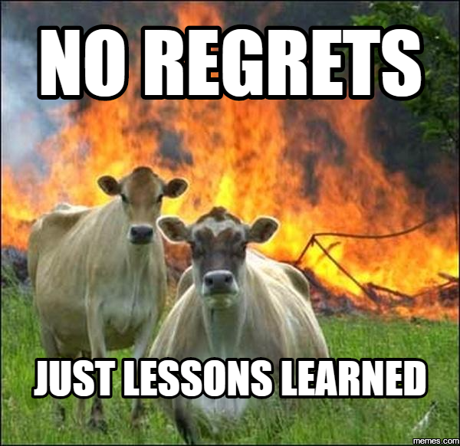
OPSEC is important
Clearly define
Objectives
Expected results
Formal and informal communication points
Your assumptions are ALWAYS WRONG
Both on the Red and Blue sides of the coin
Keep it internal, no outside reporting
Notes:
Opsec is important, Director+ is the level we found to be the best level of involvement.

Slide 26
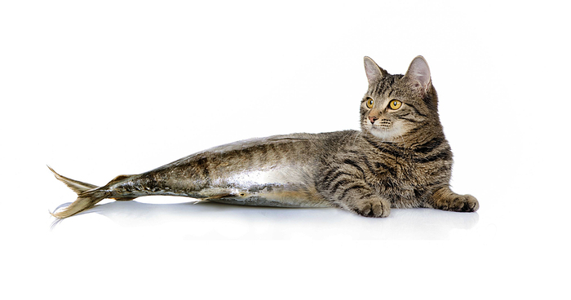
Questions?
Nathaniel.Hirsch@gmail.com

