Slide 1

Hiding in the Clouds
Leveraging Cloud Infrastructure to Evade Detection

Slide 2

Optiv Security
Attack & Pen Consultant
Full Stack Developer
OSCP | Assoc. CISSP | CEH

Slide 3

The Cloud
⇨ 1999: Salesforce delivers application to customers via the ‘cloud’
⇨ 2000’s: Amazon realizes they were only using 10% of their computing capacity
⇨ Cue revolution

Slide 4

Why Evasive Testing?
Threat
Replication
Improving
Defenses
Notes:
Evasive testing:
No infrastructure constraints
Obfuscate attack traffic
Improving Defenses:
Monitoring and detection capabilities and deficiencies
Tune existing control mechanisms

Slide 5

Web Application Attacks

Slide 6

Proxying Web Traffic
Discovery and Exploitation
Brute Force
Blocked? No problem

Slide 7

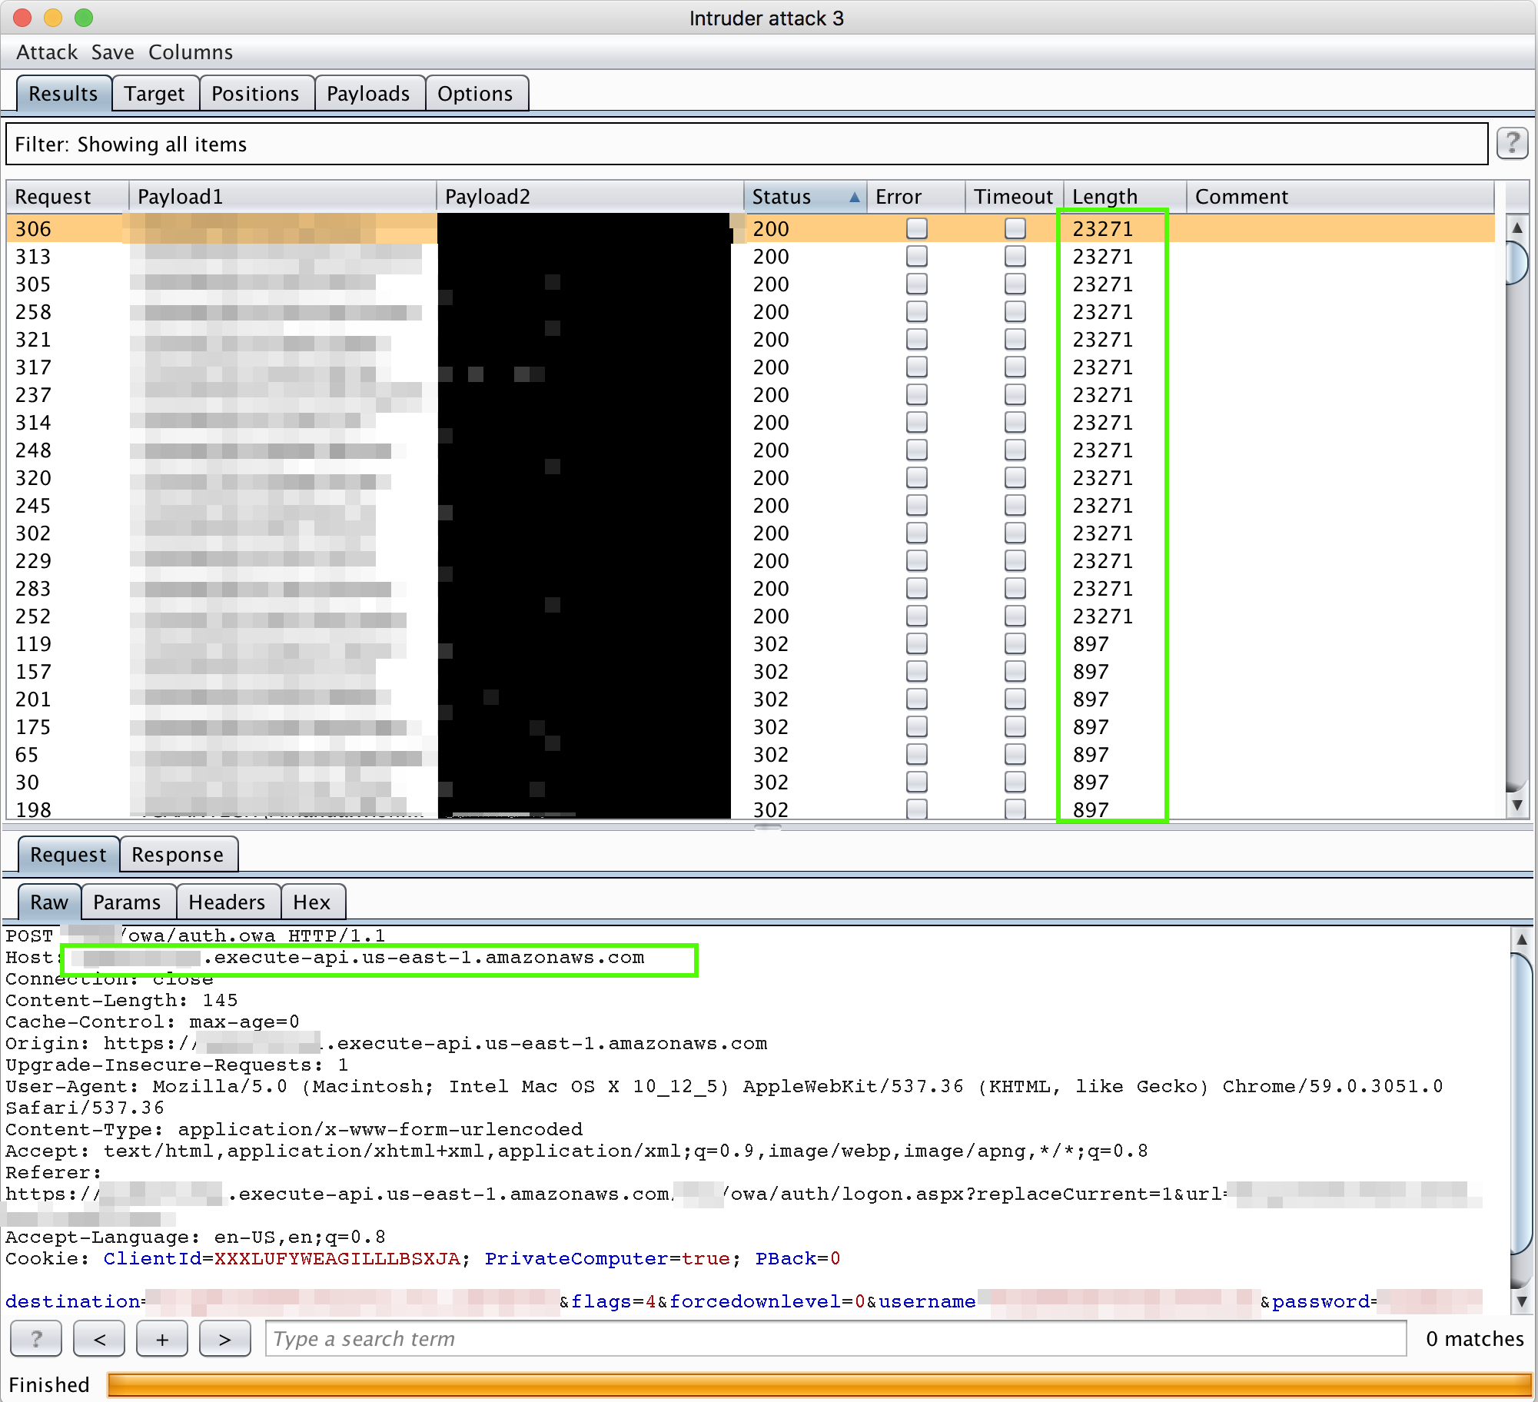
API Gateway

Slide 8

Domain
Fronting

Slide 9

What is Domain Fronting?
Originally a technique using CDNs to bypass Internet censorship
Stopping it == Breaks Stuff

Slide 10

Why care?
Bypass egress controls
Communication over SSL
Leverages very popular domains

Slide 11

Who’s Affected?
Virtually all the major cloud providers

Slide 12

Example: Google App Engine
Reverse Proxy App
TLS Negotiation
*.Google.com Domains

Slide 13

Prerequisites
C2 Server
Google Cloud Account
Redirector Program
C2 Communication Configuration with proper host header (I.e. Malleable C2 Profile)
Former two can be found here - https://github.com/rmikehodges/Google_Domain_Fronting

Slide 14

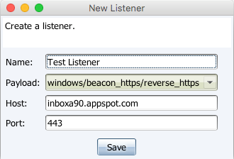
C2 Listener

Slide 15
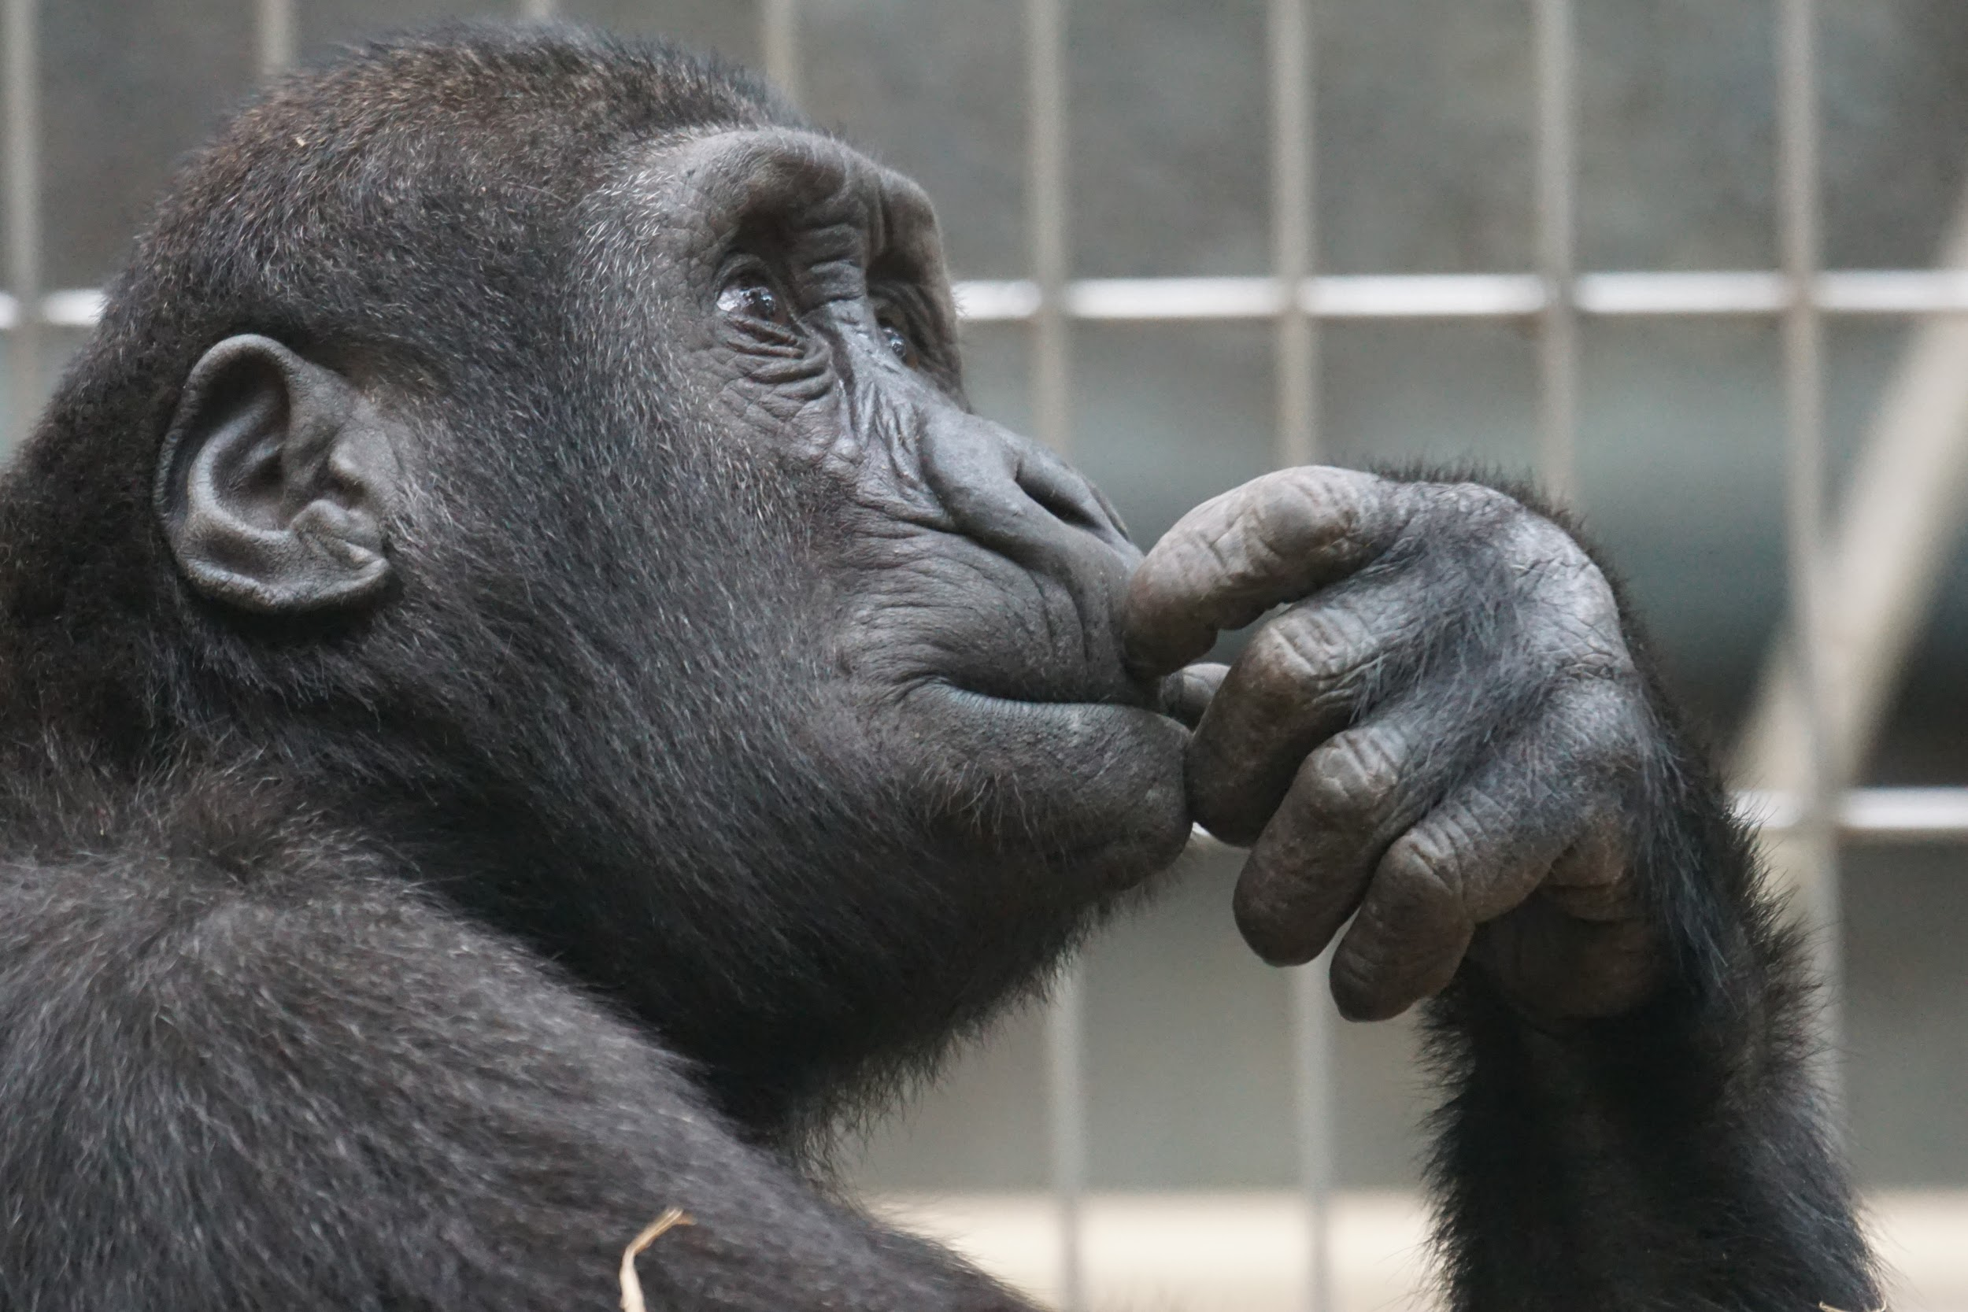
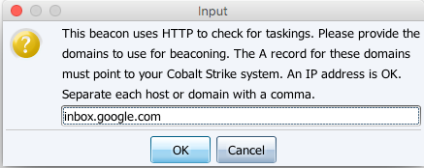
Huh??

Slide 16

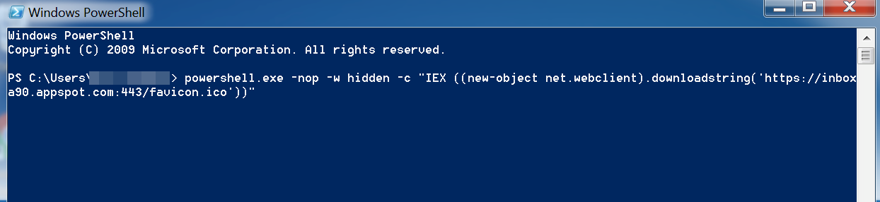
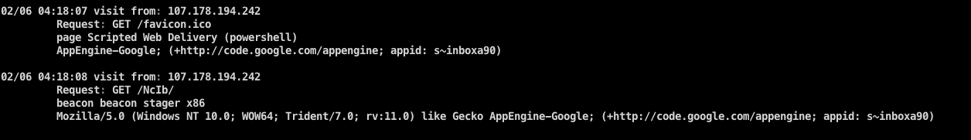
Connectivity

Slide 17

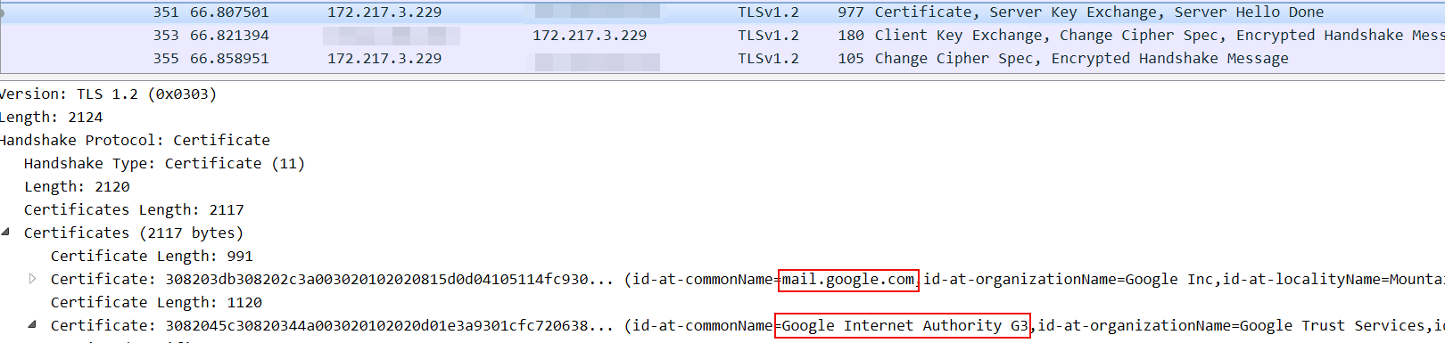
Greetings From Mountain View

Slide 18

Mitigations
SSL Stripping
RFC 2616 Compliant Proxy
SSL/TLS Handshakes
Network Baseline

Slide 19

Automation

Slide 20

Ephemeral Infrastructure
Global, Cross-Provider Infrastructure Small Footprints https://github.com/rmikehodges/hideNsneak_teaserr

Slide 21

Proxychain to Greatness
Proxychains and SOCKSd have randomization options
Send each request via a random proxy in your chain
..There Are Drawbacks..

Slide 22

Distributed Scanning
Global presence allows for efficient and evasive port scans
A single scan can cycle through multiple rounds of hosts
Sprinkle some randomization

Slide 23

Possibilities Are Growing...

Slide 24

photo credits: various artists from pexels.com && unsplash.com
design credits: my amazing wife

