Slide 1
From web app to atm: Why the basics matter
Travis McCormack

Slide 2
About Me
@Deltr0_n on Twitter
Currently Application Security Tester at Walmart
Also a competitive paintball player and gamer nerd

Slide 3
Disclaimer
All thoughts and opinions expressed in this presentation are my own and do not necessarily reflect those of any employer.

Slide 4
Overview
Just another web app pentest
Happens to manage some ATM stuff
Automation missed some major issues
No I don’t hate automation
I also blundered by becoming complacent

Slide 5
Our target
We are testing a web app used to managed ATMs. The only disclosed functionality is an operator preparing ATM for deposit and manager who can view reports of usage.
These are split between two portals.

Slide 6
Reconnaissance
Scanning
Gaining Access
Maintaining Access
Covering Tracks

Slide 7
Round 1: Fight
Creds for ”operator” in one portal and ”manager” in reporting interface.
Neither user can interact with ATMs beyond preparing ATMs owned by account to receive a deposit.

Slide 8
Lets get to spidering
The spider provided some much needed information. There is a ‘hidden’ change password function!
So lets check that out…

Slide 9
Well we could have found it manually

Slide 10
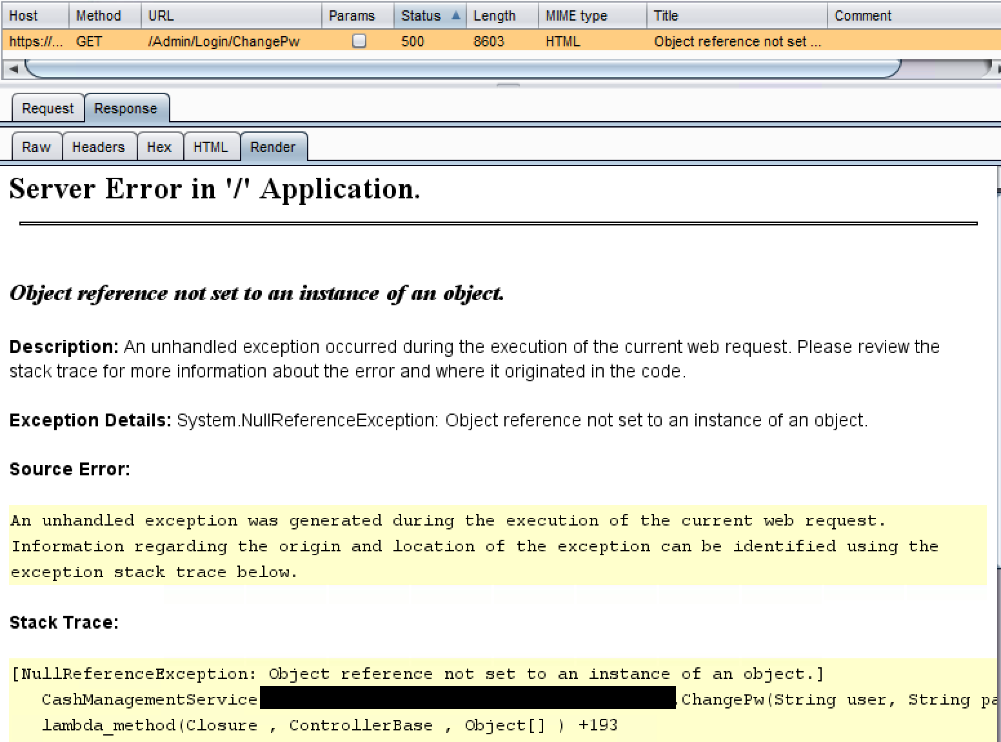
Oh a convenient stack trace
Page doesn’t take GET, must be expecting a POST.
The methods such as the login used JSON so let’s try that.

Slide 11
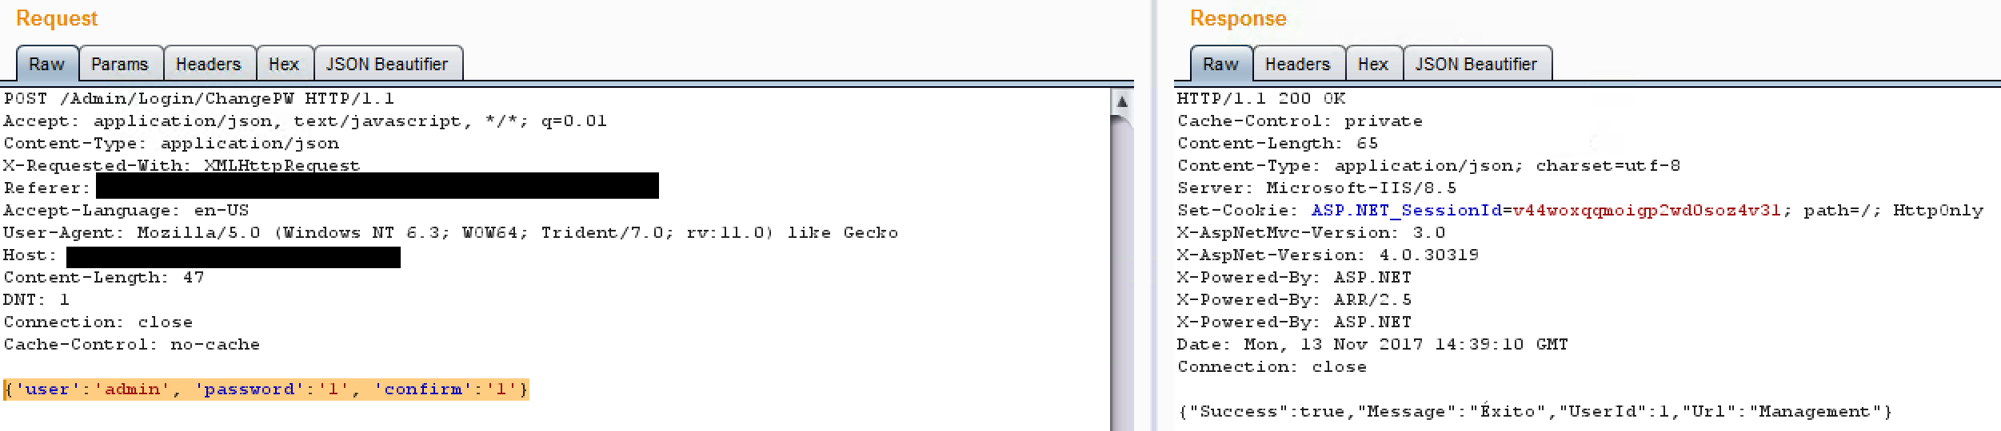
So what, its a password change?

Slide 12
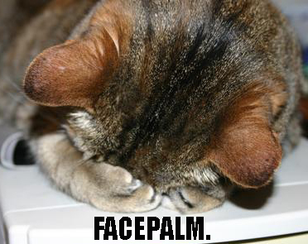

Slide 13
Yup that was unauthenticated
Okay so we can reset any user’s password with no auth.
And enumerate the users to boot based on errors!
Well that is basically a total compromise…but what was that url?

Slide 14
Account creation
So that admin account let me make accounts…but is it restricted?
Attempted unauthenticated forceful browse but failed…so I set my session ID to one of my operator users and…

Slide 15
Success!

Slide 16
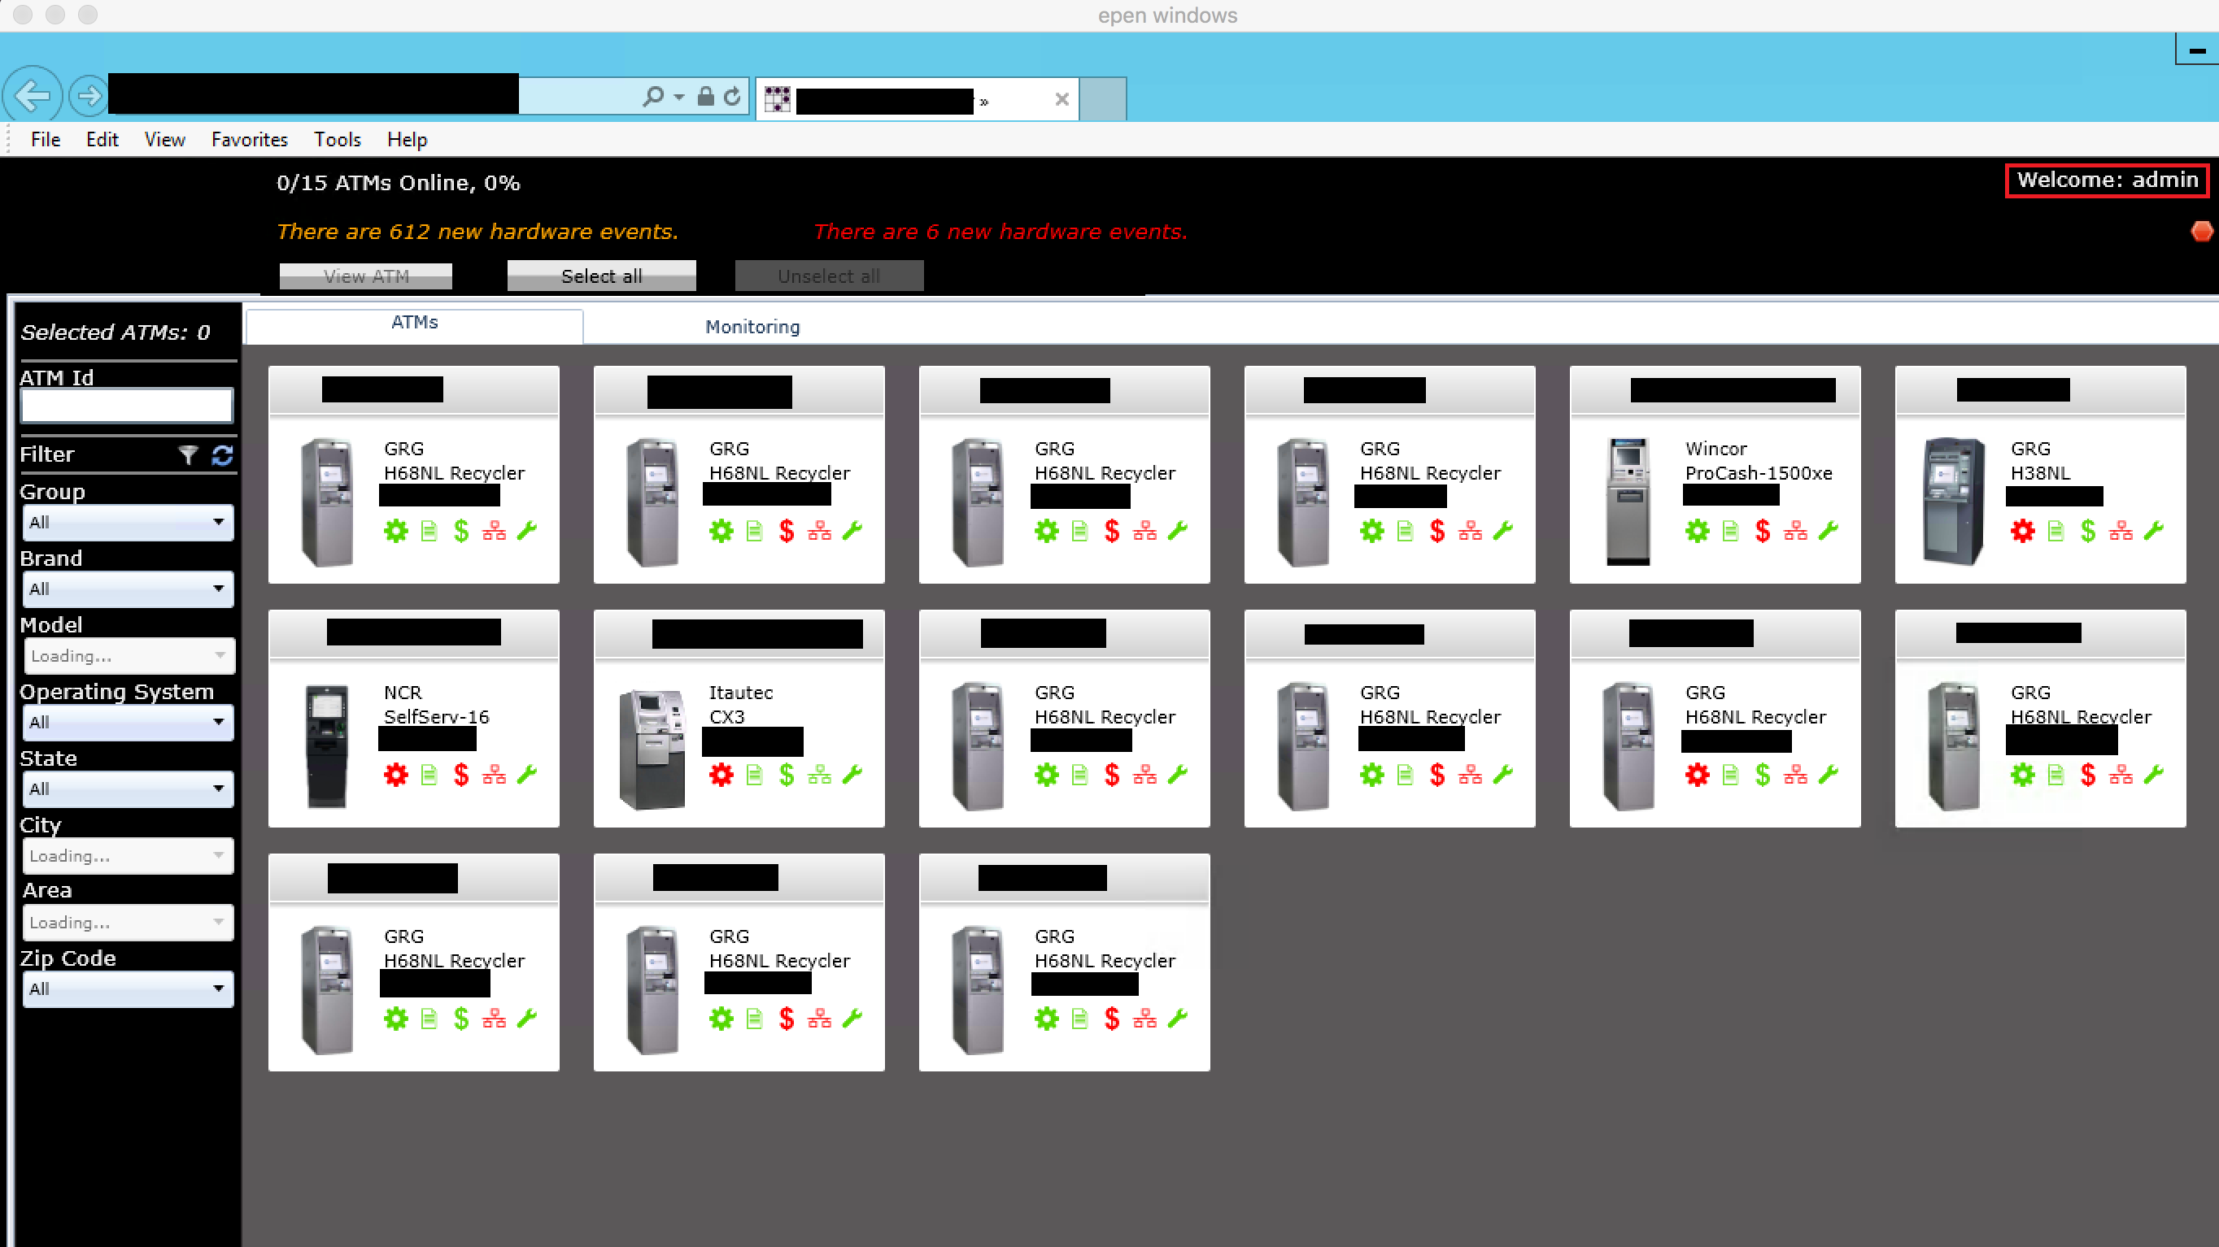
So we can make and modify accounts. Lets try one!

Slide 17
So what’s going on behind this interface?
We know this app loaded in Silverlight, and we know we had to login to access it.
Lets check the web traffic for anything interesting.

Slide 18
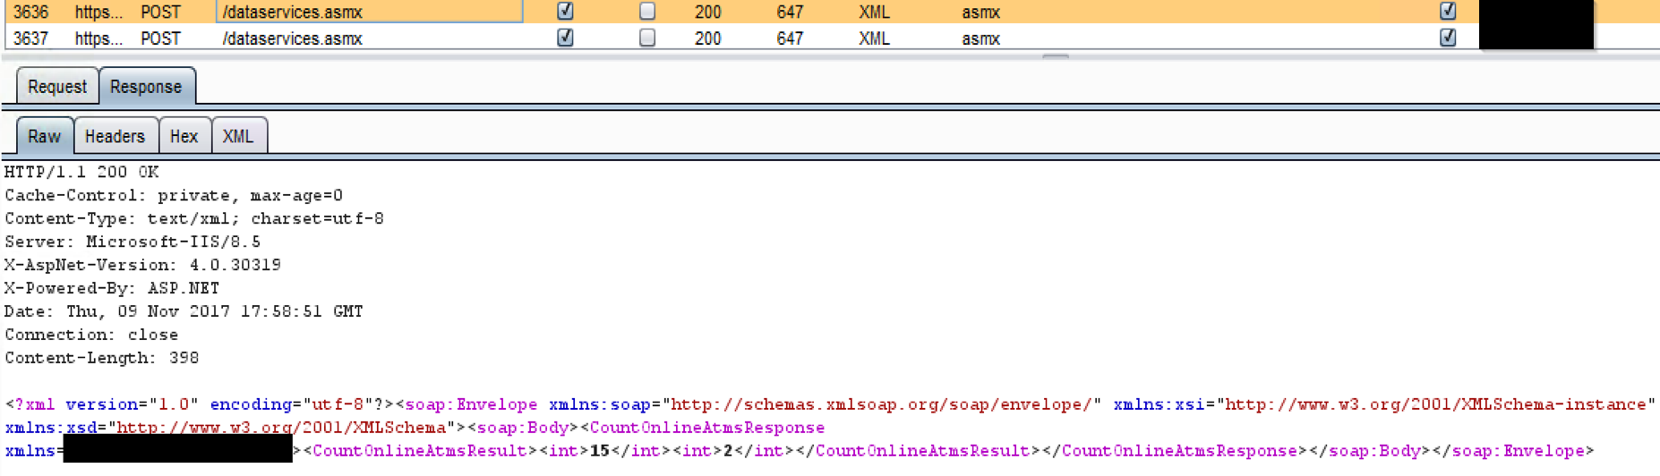
So its using a SOAP API

Slide 19
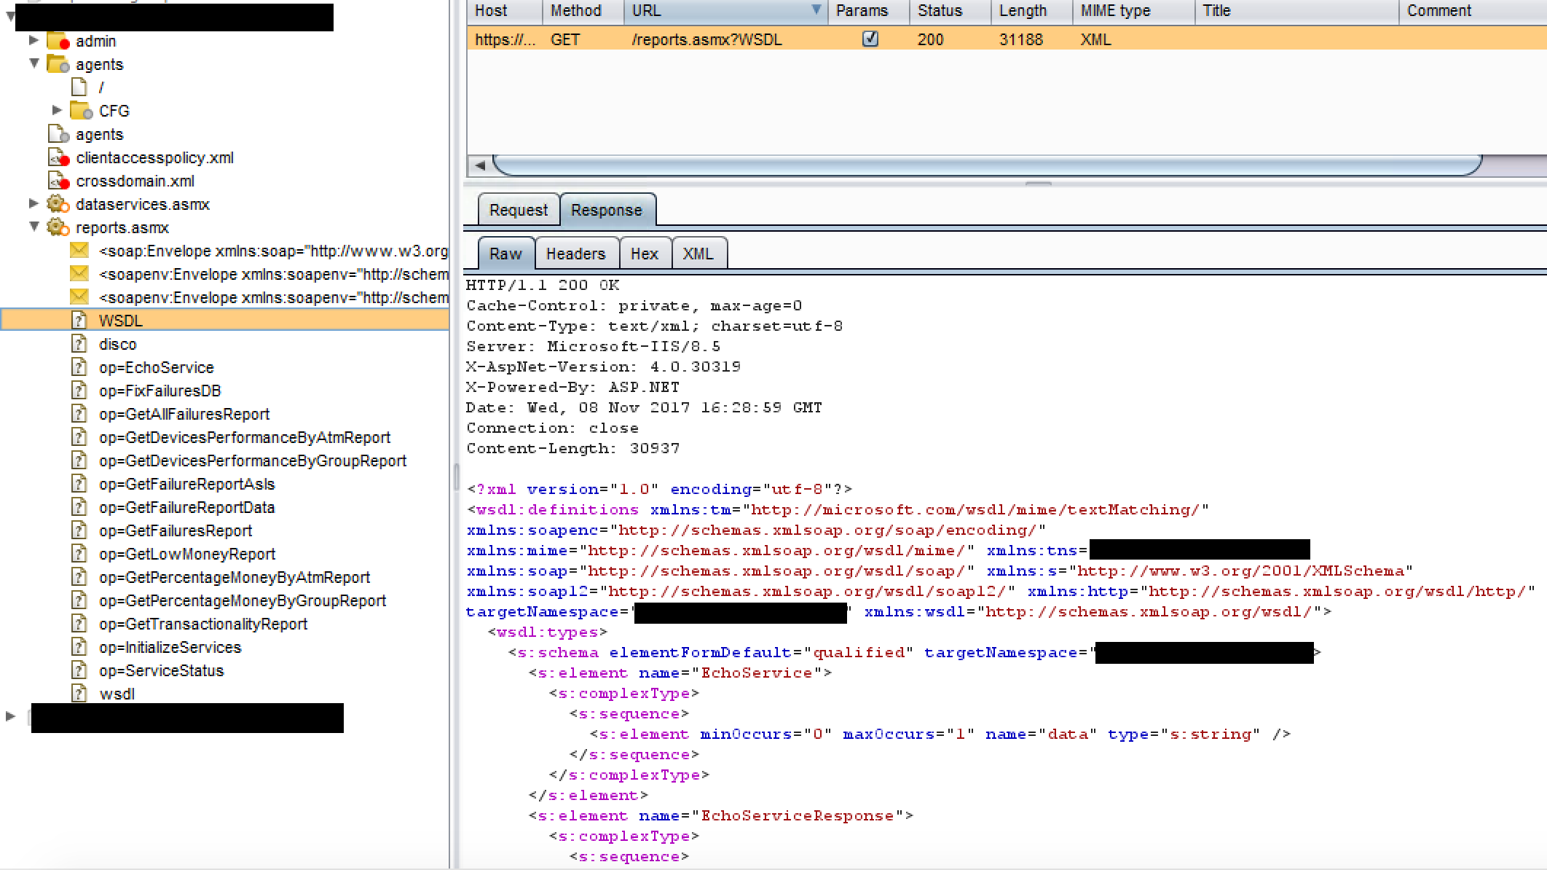
Lets see what functions we have
Grabbed the WSDL from spidering

Slide 20
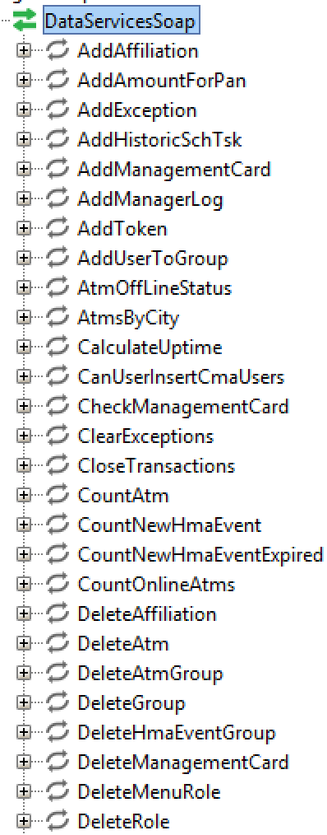
Some interesting functions
We found multiple interesting functions available in the interface
Add users to groups, get management card, remove ATMs, get all users, etc.

Slide 21
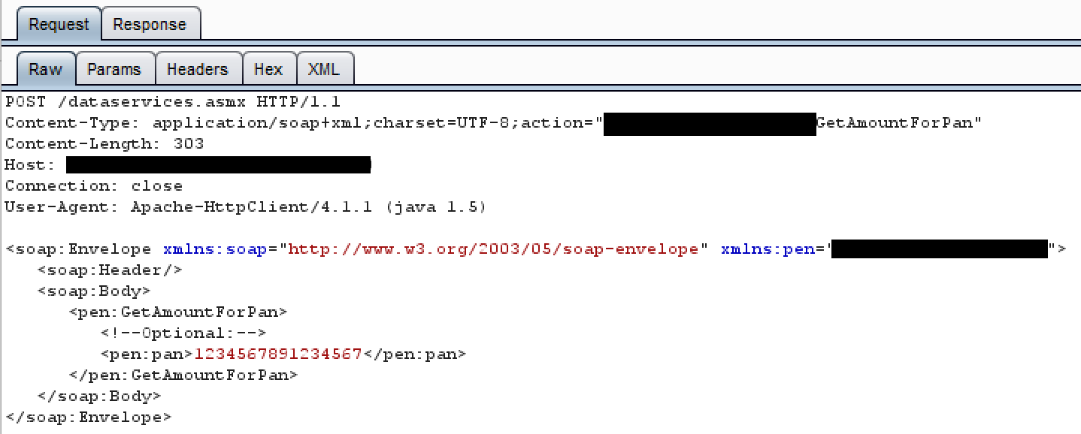
Surely it needs auth…we had to login…

Slide 23
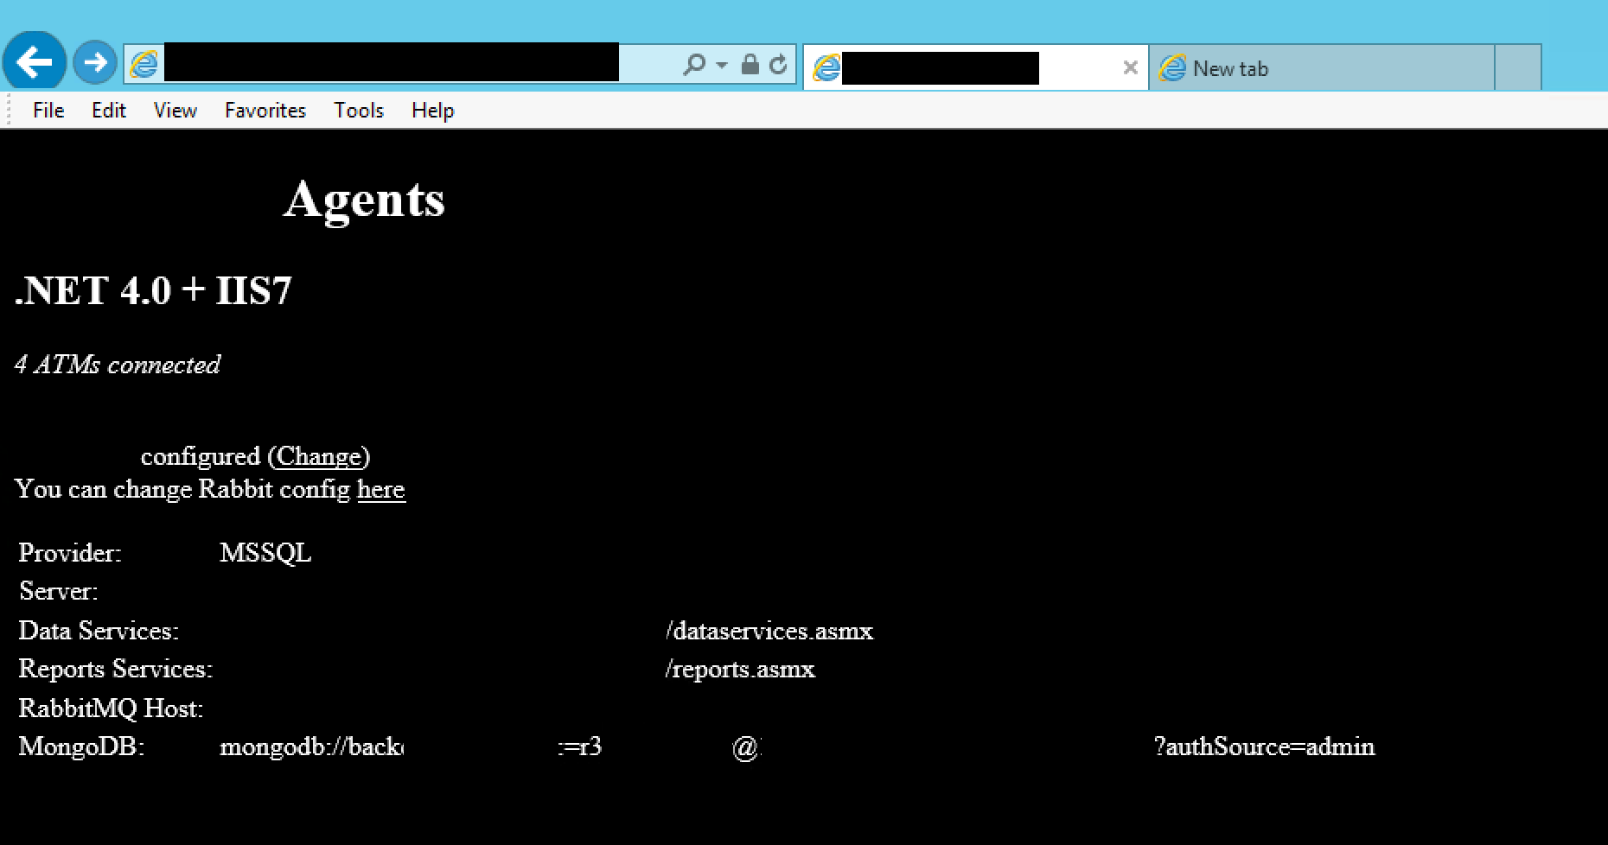
Our spider’s parting gift

Slide 24
Some things we tried but failed
Found a method that took UNC paths. Sent it to responder trying to grab hash from SMB.
XXE in in some methods which requested DISCO and WSDL files.
.NET 4.5.2+ disables DTD by default for the most part. It did so here.

Slide 25
The score so far:
Create accounts as any user
Enumerate user accounts
Reset any user’s password, including admin.
Interact with the entire SOAP interface, unauthenticated, over the internet.

Slide 26
Off with the report!
Had some great findings and a total compromise of the apps primary functionality
I was feeling great surely I’d beaten this app down as best I could!
So I sent off my report
Now this is where I messed up, More on that in a second.

Slide 27
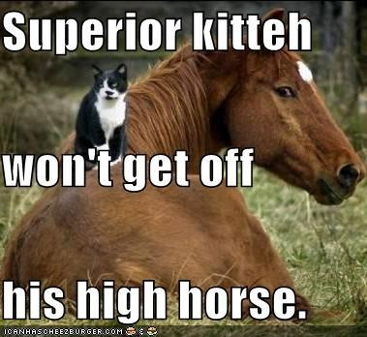
Me on my high horse

Slide 28
Then came the validation of fixes
“Fixes” went as well as expected.
Scanner still didn’t see much of anything. Ran it just for the coverage.
Hard to bolt security on. Bake it in from the ground up!
Changes forced me to look in a new way. showed me the treasure I missed

Slide 29
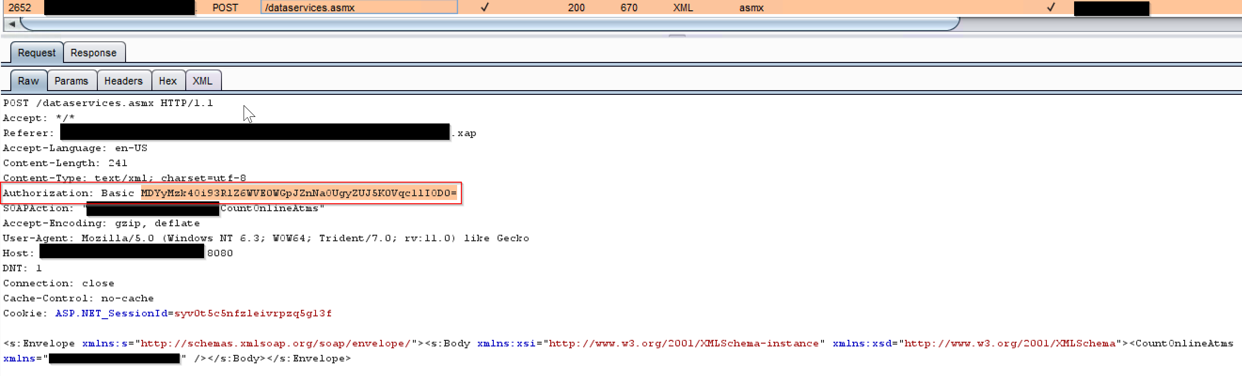
Basic Auth: With a twist
Put auth in front of API: Good!
Used basic auth: Meh!
Encrypted password in header: Clever!
But wait…

Slide 30
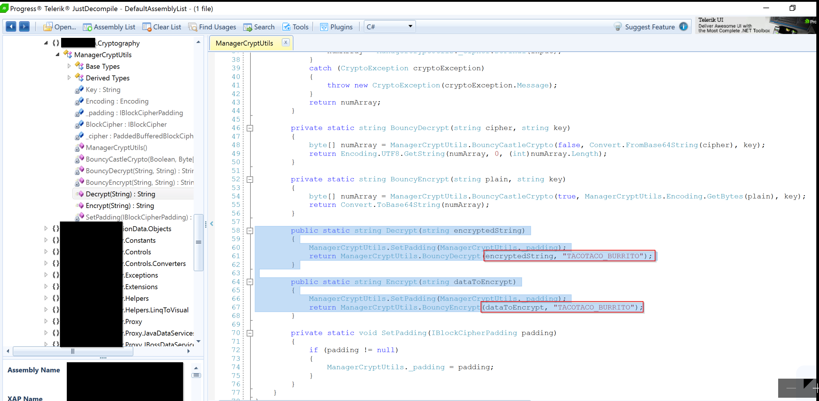
The encryption key must be known
Lets decompile that Silverlight GUI
Ah…there we go…

Slide 31
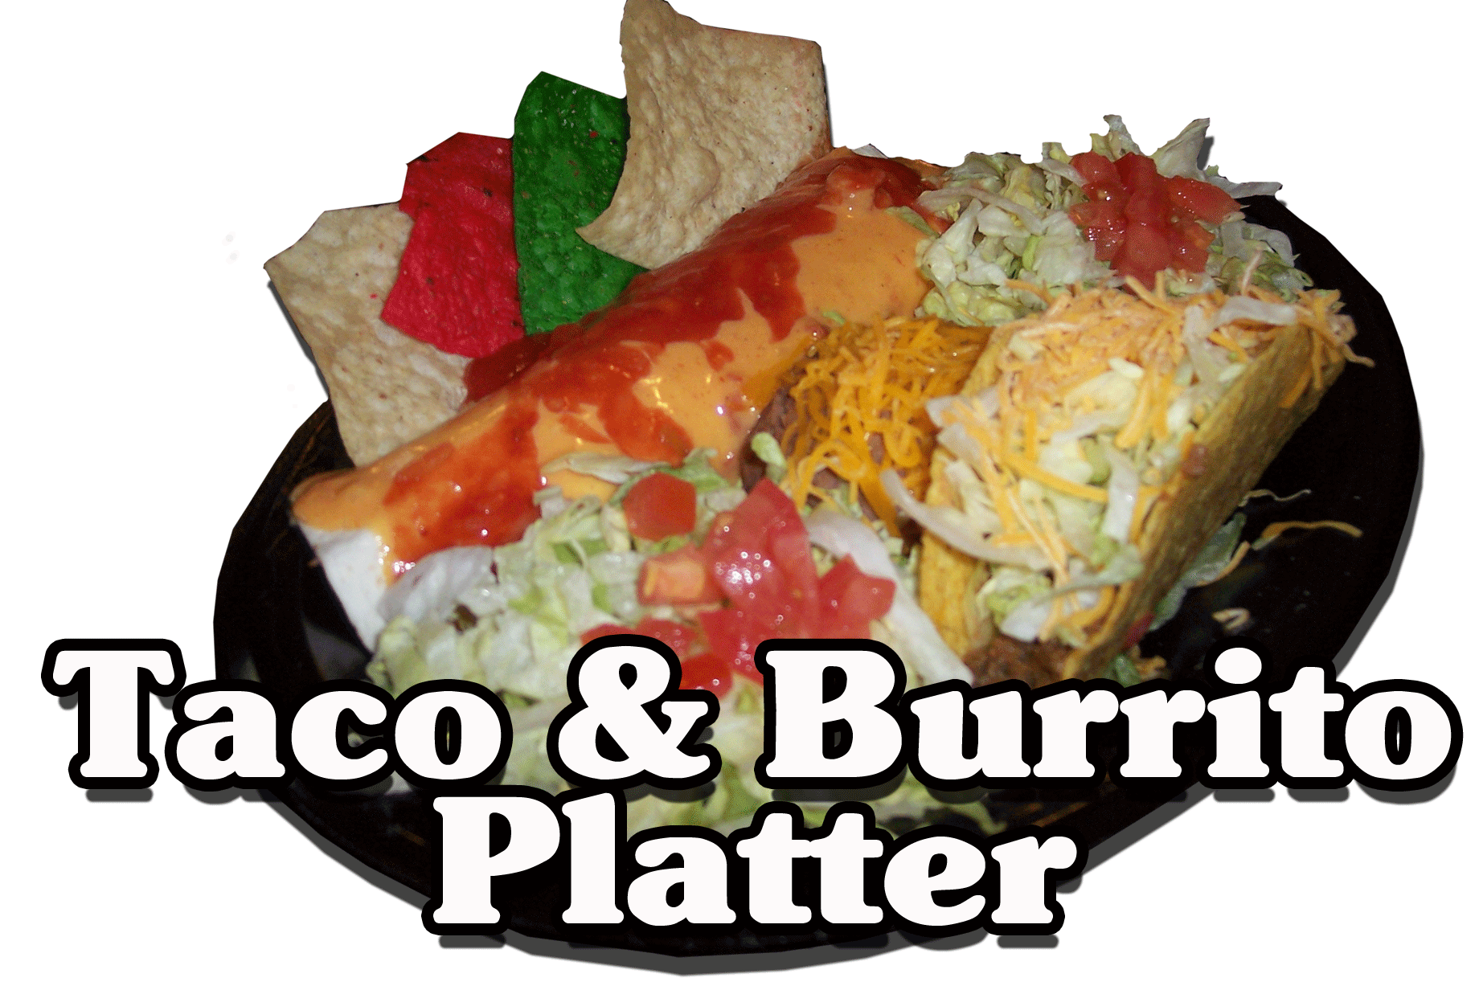
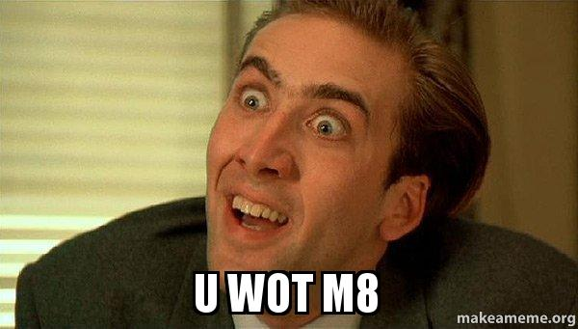

Slide 32
So I decided to peak into the interface
My mistakes in first test:
Broke own rule and stopped enumerating
Should have actually looked through GUI
Assumed entire API was documented in WSDL because tons of crit functions were
Assumed my compromise was big enough so I didn’t look further
Always remember to keep digging for attack vectors

Slide 33
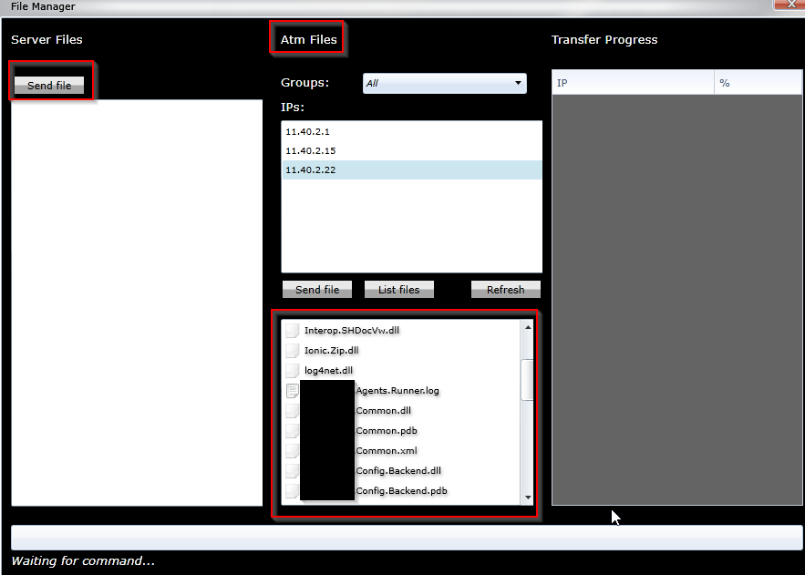
File Manager?! WAT?!

Slide 34
Upload function not found
So this was the function not in the WSDL but turns out:
This was the function to rule them all
This was the function to find my shell
And in the darkness bind...well it was a rev shell and I love Tolkien

Slide 35
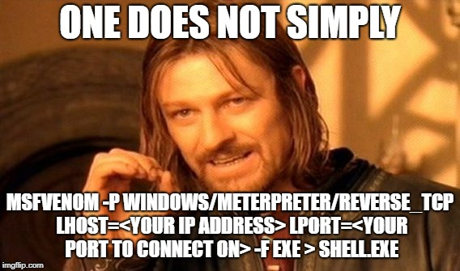
Unobfuscated shell for testing!

Slide 36
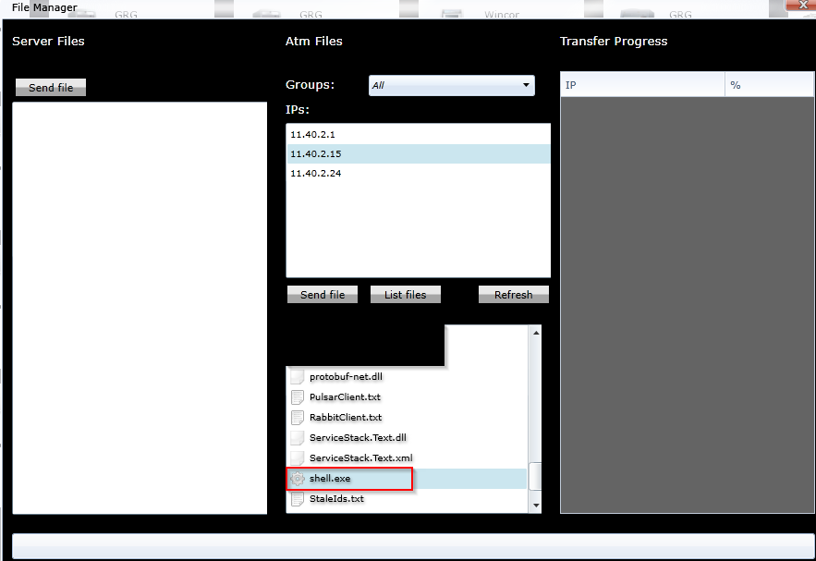
Did…that…work?!

Slide 37
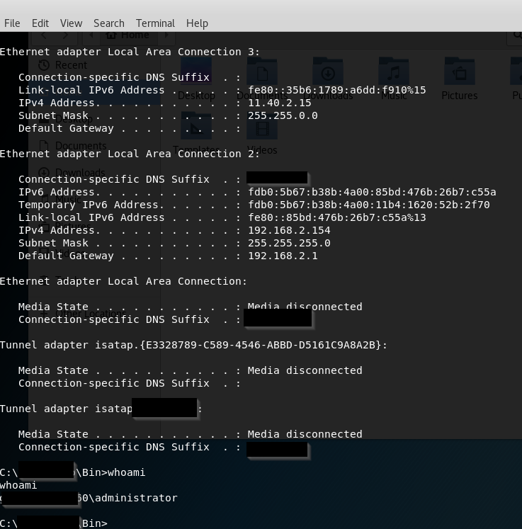
And it worked….
Yes the app is running as admin
Yes there is a complete lack of AV
At least its not on the domain?
No pivoting in this test scope was the APP

Slide 38
So what do we take from all this?
Just because scanner doesn’t find fancy vulnerabilities can still be deep flaws in the application.
Scanners didn’t know I could post any user to the changePW function.
Scanners didn’t know there was an unauthenticated SOAP interface.
Scanners didn’t know there was no concept of roles outside the GUI

Slide 39
How do we combat this?
For veteran testers: remember to always step back to the basics. Keep enumerating. Always!
For new testers: rely on learning the application over the output of your tools
Tools and automation are great, but they can miss A LOT.

Slide 40
Resources for new testers/interested parties
https://www.owasp.org/index.php/Main_Page
http://www.pentest-standard.org/index.php/Main_Page
https://www.owasp.org/index.php/OWASP_Juice_Shop_Project
https://www.offensive-security.com/information-security-certifications/oscp-offensive-security-certified-professional/

Slide 41
Questions?
Travis McCormack
@Deltr0_n on Twitter
Travis.McCormack01@gmail.com

